Slide 1
Journal Club
Mariuxi A. Viteri Malone, PGY4, Fellow Physician, Geriatric Medicine
Boston University/Boston Medical Center

Slide 2
CASE PRESENTATION:
Mrs. J is a 76 yo F, from Puerto Rico. She has a PMHx consistent with HTN, HPL, OA, prediabetes, overweight and urinary incontinence. She has 4 children, all of them vaginally delivered.
She is on Lisinopril 20 mg daily, Lipitor 20 mg qhs, Tylenol 1 g bid.
She is here for her annual exam.
MOCA: 27/30 (losing points on visual-spatial)
ADLs: 12/12
IADLs: 10/12

Slide 3
CASE PRESENTATION:
Complains of worsening urinary incontinence for the last 6 months. She is been having several frequent “leakages” through the day. She states now can not get to the bathroom on time and has limited activities out of home due to this issue.
Coughing, sneezing, and laughing leads to leakages.
What treatment options are there available to manage Mrs. J UI?
She has not receive any treatment for this yet. She states she is afraid of surgery.

Slide 4
PICO
P (Problem or Patient or Population) | Older women with urinary incontinence
I (intervention/indicator) | GBT (Group administered behavioral treatment)
C (comparison) | No GBT
O (outcome of interest) | Cost-effectiveness Quality of life/ICIQ-SF UI: Frequency, severity

Slide 5
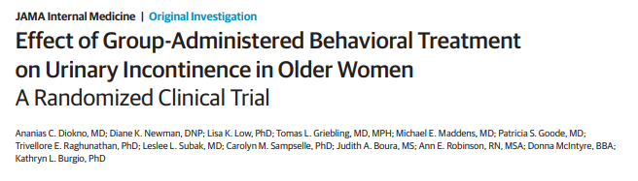
JAMA Intern Med. Published online September 4, 2018. doi:10.1001/jamainternmed.2018.3766
Multisite randomized clinical trial (the Group Learning Achieves Decreased Incidents of Lower Urinary Symptoms [GLADIOLUS] study), conducted from July 7, 2014, to December 31, 2016. The setting was outpatient practices at 3 academic medical centers. (University of Alabama at Birmingham; University of Michigan, Ann Arbor; and University of Pennsylvania, Philadelphia)
ClinicalTrials.gov identifier: NCT02001714

Slide 6
What is the effect of a one-time, group-administered behavioral treatment on urinary incontinence in older women?

Slide 7
Introduction/Rationale:
Urinary incontinence (UI) is a prevalent condition that diminishes quality of life among older women at tremendous social and economic cost.
-Behavioral interventions are recommended by most evidence-based guidelines as first-line approach for treating:
            Urgency
            Stress
            Mixed

Slide 8
Methods:
-Randomized clinical trial conducted at 3 academic medical centers:
        University of Alabama at Birmingham
        University of Michigan at Ann Arbor
        University of Pennsylvania at Philadelphia
-It was approved by the institutional review boards at the coordinating center (Beaumont Hospital, Royal Oak, Michigan) and each site.

Slide 9
Methods:
-All participants provided written informed consent.
-Eligibility, included a score of 3 or higher on the International Consultation on Incontinence Questionnaire–Short Form (ICIQ-SF).

Slide 10
Methods:
-Symptoms of at least 3 months duration, and absence of medical conditions or treatments that could affect continence status.
-Group received a one-time 2-hour bladder health class, supported by written materials and an audio CD.

Slide 11
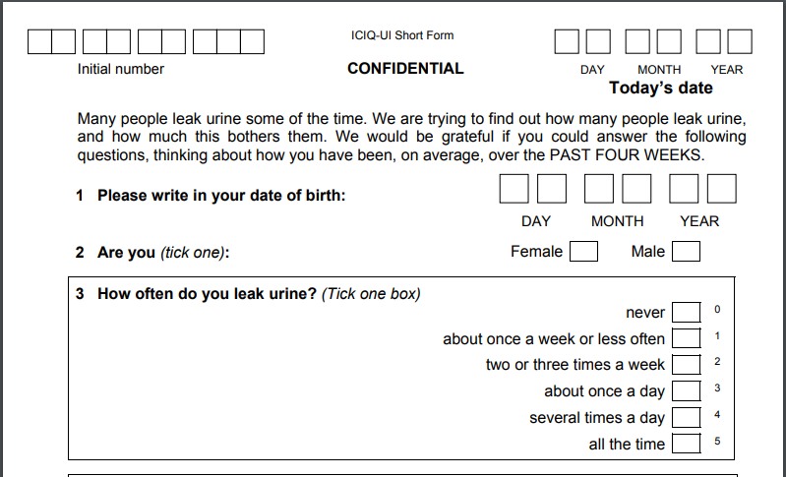

Slide 12
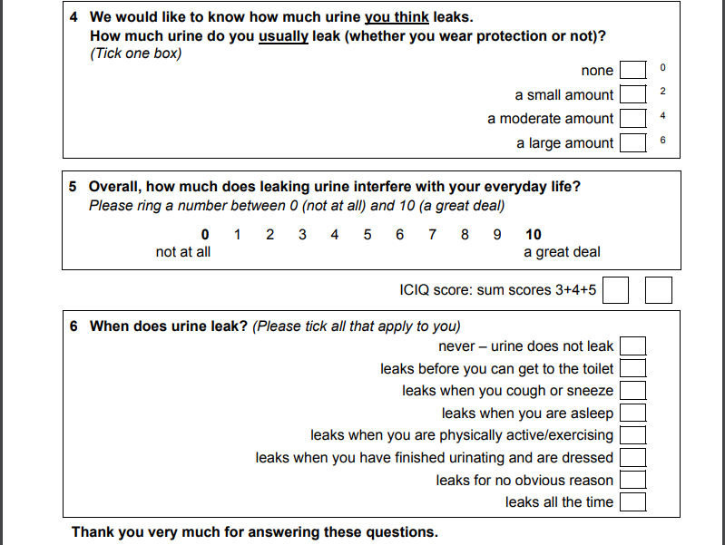

Slide 13
Recruitment:
-Potential participants (women 55 years old or older) were recruited by mailed letters of invitation to specific populations in the geographical areas surrounding the 3 sites.
-Interested individuals could mail back a return portion of the recruitment letter or call a toll-free number

Slide 14
Evaluation and Baseline Assessment:
-Women who responded to the letter of invitation were initially prescreened by telephone at the coordinating center and then referred to the appropriate research site for full screening and evaluation.
-This comprised:
Detailed medical and UI history
Baseline questionnaires: Primary outcome measure (the International Consultation on Incontinence Questionnaire–Short Form [ICIQ-SF]). Secondary outcome measures (the Medical, Epidemiologic and Social Aspects of Aging Urinary Incontinence Questionnaire [MESA] and the Incontinence Quality of Life Questionnaire [I-QOL]).

Slide 15
Evaluation and Baseline Assessment:
-Pelvic examination was conducted:
Identify pelvic organ prolapse
Test PFM strength using the digital test by Brink et al.
-Tested for cognitive impairment: Mini-Cog
-Ambulation status: Timed Up & Go test.
-A dipstick urinalysis: to detect infection and hematuria

Slide 16
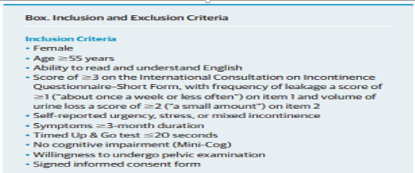
POPULATION

Slide 17
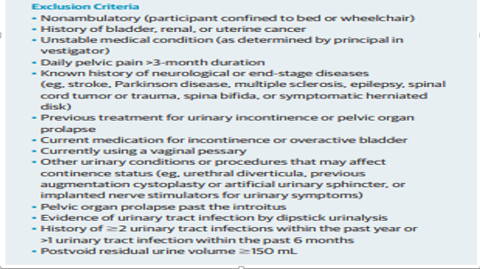

Slide 18
Randomization:
-Eligible women were randomized using a 1:1 ratio to either the GBT group or no treatment (control group).
-Randomization was carried out separately at each site using a random sequence of block sizes.
-The randomization scheme was developed by the coordinating center, and the research sites were not aware of the methods used to assign groups.

Slide 19
Intervention:
-The control group did not receive treatment.
-The GBT was modeled after previously successful randomized clinical trials on prevention of UI but focused instead on treatment of women with UI.

Slide 20
Intervention:
-This 2-hour bladder health and self-management session, with slide presentations and a booklet, anatomy of the lower urinary tract. Sessions included:
    Bladder and PFM function
    Anatomic and physiologic basis for continence
    Types, causes, and effect of UI on quality of life
    PFM identification and exercise; bladder training
    Instruction in evidence-based behavioral strategies
    Including active PFM contraction during activities that precipitate stress UI and urge suppression strategies.
    Coaching to facilitate incorporation of the strategies into their personal routines.

Slide 21
Intervention:
-After the class, participants were given materials for home use:
    Including a booklet summarizing the bladder health class
    A magnet that served as a reminder to continue adherence
    An audio CD with a PFM exercise session
    An individualized voiding interval prescription based on their baseline 3-day voiding diary.

Slide 22
Outcome Measures and Evaluation Periods:
-The primary outcome measure was the change in score on the ICIQ-SF, a fully validated 4-item questionnaire
-Secondary outcome measures included a 3-day voiding diary, the quantitative cough stress test, the 24-hour pad test.

Slide 23
Outcome Measures and Evaluation Periods:
-All participants were evaluated at in-person visits at 3 and 12 months by evaluators (D.K.N. and other non-authors) who were masked to group assignment and by mail or telephone at 6 and 9 months.
-Adverse events (AEs) were also assessed at each time point.

Slide 24
Statistical Analysis:
-Normally distributed continuous variables are reported as mean (SD) values.
-Non-normally distributed variables are reported as median values (interquartile ranges).
-The primary outcome, the ICIQ-SF score, was analyzed using a repeated-measures analysis for 3, 6, 9, and 12 months (baseline as reference).

Slide 25
Characteristics of the Sample:
-The demographic characteristics of the 2 groups were not significantly different.
-Ages ranged from 55 to 91 years (mean [SD] age, 64 [7] years), and African Americans comprised 46.2% (214 of 463).
-No significant differences were found between the 2 groups for all baseline values on primary and secondary outcome measures.

Slide 26
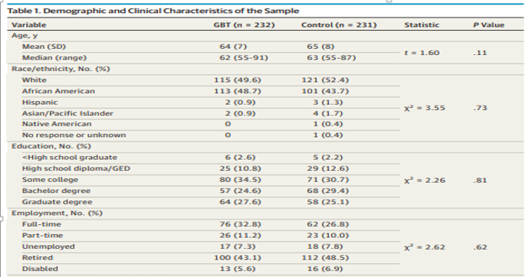

Slide 27
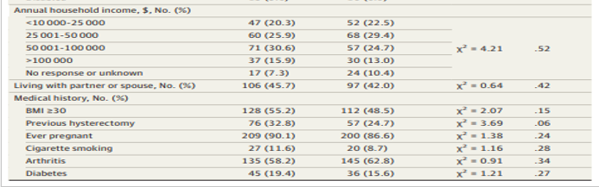

Slide 28
Results:
A total of 463 participants were enrolled from 2171 initial mail respondents; 232 were randomized to GBT and 231 to control.
Only 398 completed the 12-month study.

Slide 29
Primary Outcome:
-The ICIQ-SF scores for the GBT group were consistently lower compared with the control group across all time points.

Slide 30
Primary Outcome:
-The percentages of women who were considered successful were 35.3% (65 of 184) in the GBT group (a 70% reduction in UI episode frequency) vs 22.1% (42 of 190) in the control group (P = .005).

Slide 31
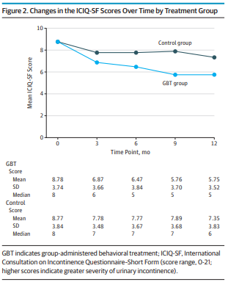

Slide 32
Secondary Outcomes:
-All secondary outcome measures, except PFM strength, showed significantly greater improvements in the GBT group than in the control group.

Slide 33

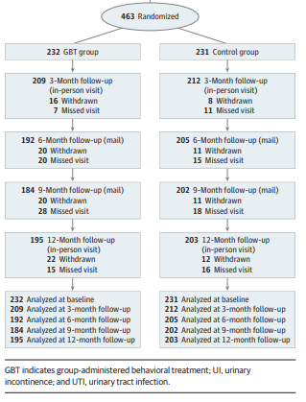

Slide 34
Costs and Cost-effectiveness:
-The GBT group accrued higher payer and societal costs per participant compared with the control group at 3 and 12 months.
-Participant costs, were lower for the GBT group than for the control group at 3 and 12 months because of the lower costs of UI management.

Slide 35
Clinical Appraisal
Were there clearly defined groups of patients, similar in all important ways other than exposure to treatment?
Yes, both groups (GBT vs control) appear to be pretty homogeneous.

Slide 36
Clinical Appraisal
  Were clinical outcomes measured in the same ways in both groups?
        Outcomes were measured by 3, 6, 9, and 12 months (baseline as reference)
        Groups were randomized
  Was the follow-up of the study patients sufficiently long enough?
        Yes, because primary and secondary outcomes were measured up to 12 months.

Slide 37
Clinical Appraisal
  Can we apply the valid, important results of this study to our patient?
        Our patient is similar in demographics to the study participants
        No harm identified by undergoing GBS, significant benefit could be obtained if we do this 2 h GBS class in order to improve the quality of life of our patient.

Slide 38

Strengths and Limitations:
-Study recruitment
-Objective measures
-Participants and interventionists were not masked to group assignment.
-Participants were a volunteer sample and thus may not represent the overall population of older women with UI.
-Primary and some secondary outcomes were based on participant self-report to assess changes in their condition

Slide 39
Conclusions:
-The GLADIOLUS study shows that a novel one-time GBT program is a safe and modestly effective first-line approach for reducing UI frequency, severity, and bother and improving quality of life for older women in the community.
-With its low cost and ease of administration, GBT is a promising first approach to enhancing access to noninvasive behavioral treatment for UI.

Slide 40

Q&A

Slide 41


