Slide 1
JOURNAL CLUB
7TH DECEMBER 2018
SOPHIA YEE

Slide 2
GOALS
Describe a clinical case
Appraise available evidence
Recognize association between tooth loss and risk of dysphagia

Slide 3
CLINICAL CASE

Slide 4
CLINICAL CASE
96-year-old, F, Caucasian
Currently living in a nursing home
Medical history:
  B cell lymphoma
  Atherosclerotic heart disease
  GERD
  COPD
  HLD
  HTN
  Type II DM
  Major depressive disorder
Medications
  Aspirin
  Omeprazole
  Ventolin
  Furosemide
  Potassium Chloride
  Robitussin

Slide 5
CLINICAL CASE
96-year-old, F, Caucasian
Currently living in a nursing home
Medical history:
  B cell lymphoma
  Atherosclerotic heart disease
  GERD
  COPD
  HLD
  HTN
  Type II DM
  Major depressive disorder
Medications
  Aspirin
  Omeprazole
  Ventolin
  Furosemide
  Potassium Chloride
  Robitussin

Slide 6
CLINICAL CASE
96-year-old, F, Caucasian
Social status:
  Has 2 daughters
  Quit smoking 4 years ago (70 pack years)
Functional status:
  Requires assistance for transfers, toileting and dressing

Slide 7
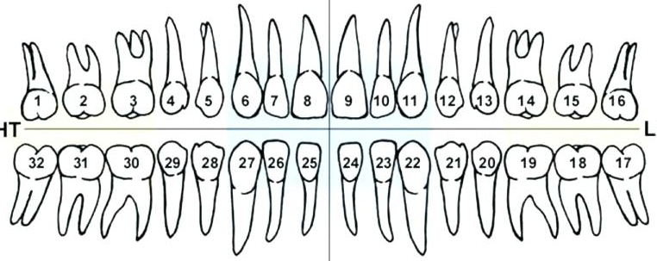
“Painful lower left gums”
June 2018
October 2018
R
R
Bridge
Nutrition Consult (September 2018):
Missing teeth
Difficulty chewing some items
Food getting stuck in throat
Coughing after drinking soup
Notes:
June 2018:
Patient first presented at the dental clinic
She had 8 fractured teeth (indicated by shadow on crowns) and 6 missing teeth
Patient opted to leave teeth alone for now
September 2018:
Patient was seen by Nutrition services and she raised 4 issues
Her symptoms seem to indicate early signs of dysphagia
October 2018:
She was seen at the dental clinic again as she was complaining of “gum pain” at the lower left side
This time, we noted that her lower right bridge was missing and there were more fractured teeth.
She had 13 fractured teeth and 8 missing teeth. She was essentially functioning only with her front teeth as she had no more support from her posterior molars after she lost her last functioning bridge.
Timing of tooth loss seem to coincide with the early signs of dysphagia. Is there an association?

Slide 8
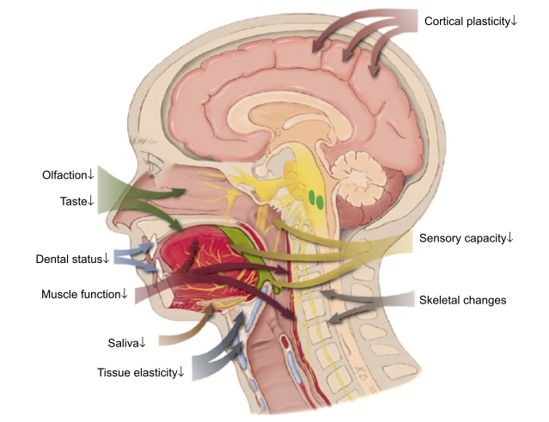
Wirth R et al. Oropharyngeal dysphagia in older persons - from pathophysiology to adequate intervention: a review and summary of an international expert meeting. Clin Interv Aging. 2016 Feb 23;11:189-208
Notes:
Dysphagia in older adults is multifactorial in nature:
Age related changes, stroke, neurodegenerative diseases are associated with dysphagia in older adults.
Teeth are part of this but no often thought of
To demonstrate the role that our teeth play in swallowing
DO SWALLOW TEST

Slide 9
PICO QUESTION
P: Older adults
I: With tooth loss
C: Without tooth loss
O: Have a higher risk for dysphagia
Notes:
Do older adults(P) with progressive tooth loss over time(I) have a higher risk for dysphagia(O)?
Independent variable: progressive tooth loss
Dependent variable (outcome): risk for dysphagia

Slide 10
JOURNAL ARTICLE

Slide 11
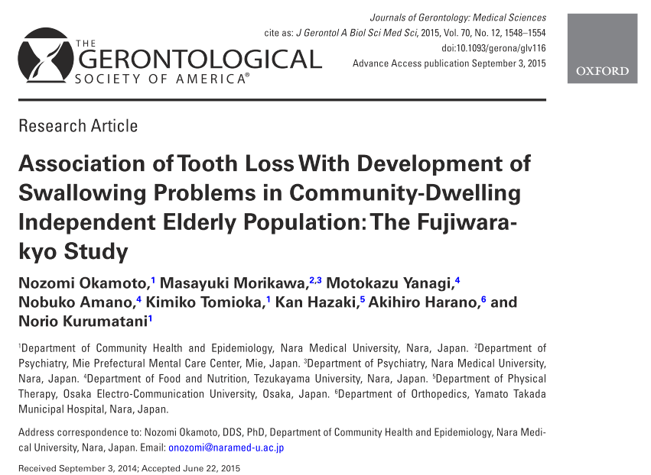
5 year prospective study
Nara Prefecture, Japan
Aim:
Investigate the effect of tooth loss on the development of swallowing problems in an independent elderly population

Slide 12
SELECTION OF SUBJECTS
4206 subjects at baseline
3109 subjects enrolled
2048 available for follow-up
1988 subjects for final analysis
2007
2012
1097 subjects excluded
1061 lost to follow-up
60 subjects excluded
Notes:
This was part of a larger population study which started in 2007
Subjects were recruited with the help of senior activity centres, clubs, public health centre
Exclusion criteria: cerebrovascular disease, PD, facial paralysis, oropharyngeal and laryngeal cancer, missing data, existing swallowing problems
The study followed them for 5 years
1061 were lost to follow-up (~34%) – most were non responders, other reasons included death and hospitalization
Among those who responded, another 60 were excluded (based on the earlier exclusion criteria)

Slide 13
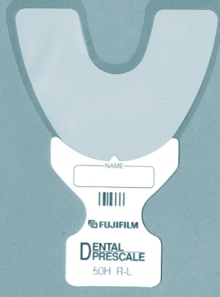
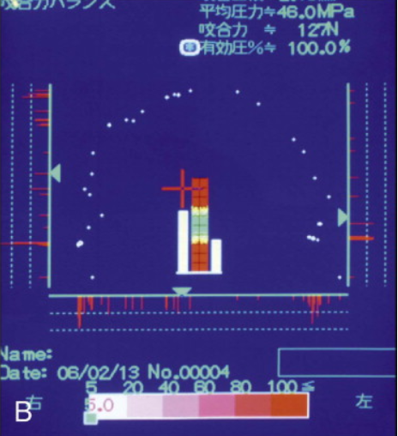
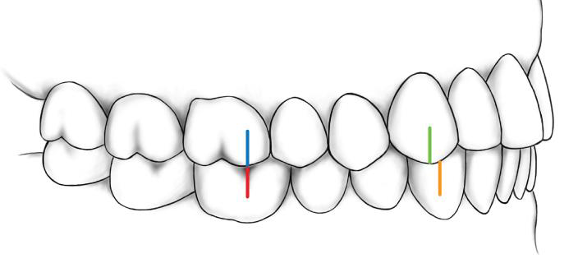
DENTAL ASSESSMENT
Number of remaining teeth
Maximum bite force
Occlusal support
Xerostomia
Notes:
Number of remaining teeth was counted by 2 dentists
Maximum bite force was measured with a pressure sensitive sheet, pressure generated from occlusion was recorded by colour image scanner
Occlusion support (Eichner Classification) was graded based on the number of zones of contacting posterior teeth
Subjects were asked if they had subjective oral dryness (Xerostomia)

Slide 14
ASSESSMENT OF SWALLOWING FUNCTION
Questionnaire:
  Do you drop food from your mouth during a meal?
  Do you feel that food remains in your mouth?
  Do you choke during a meal?
  Do you cough during and after a meal?
30ml swallow test:
  Time taken to drink water (normal: 5 secs or less)
  Presence or absence of coughing
Sensitivity: 90%
Specificity: 56%
Notes:
There were 2 parts to the assessment of swallowing function:
4- item questionnaire (Self-reported)
30ml swallow test – 6 teaspoons
Both tests were adopted based on other earlier published studies conducted among older Japanese adults.
The examiners for the swallowing test were either 2 dentists or 1 dentist with 1 hygienist

Slide 15
ASSESSMENT OF SWALLOWING FUNCTION
Answered “yes” to any of the 4 questionnaire items
Abnormal water swallow test
OR
Diagnosed with swallowing problem
Notes:
If subject answered “yes” to any questionnaire item or had an abnormal water swallow test. The subject was diagnosed to have a swallowing problem.
Confounding factors:
Chronic diseases (BP, HBA1C, cancer, MI)
Lower BMI
Lower physical function (10m walking test)

Slide 16
STATISTICAL ANALYSIS
Independent variable:
Category of number of remaining teeth at baseline
Dependent variable:
Development of swallowing problems at follow-up
Trend test:
Mantel-extension method
Logistic regression analysis:
Multivariate-adjusted odds ratios

Slide 17
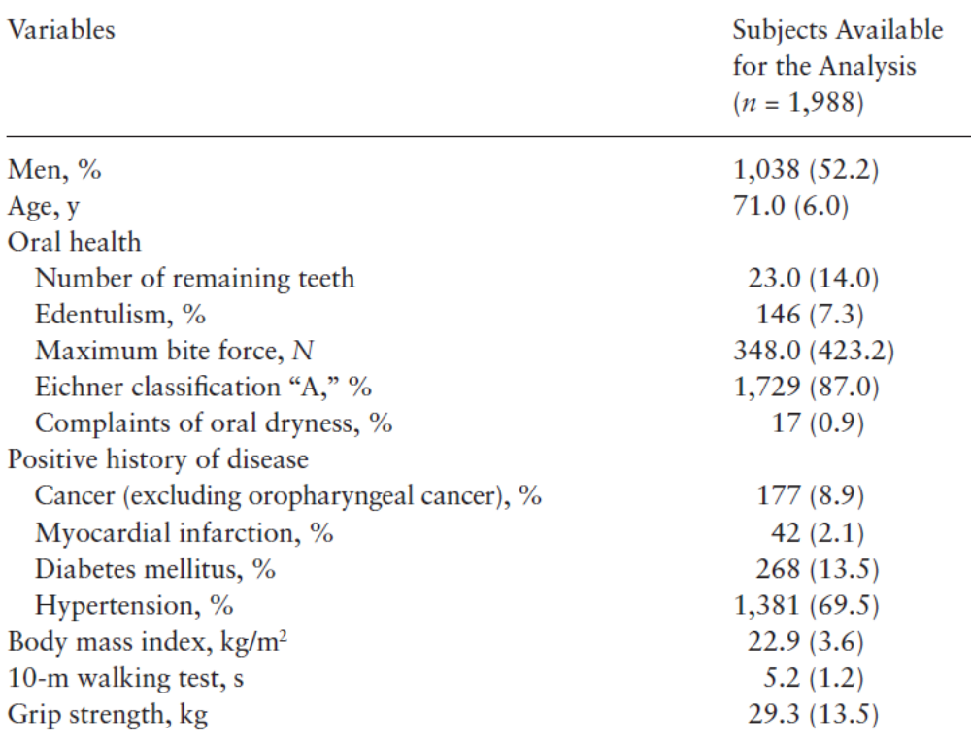
RESULTS
Notes:
Oldest subject was 89, youngest 65
Edentulism rates in japan (2016):
65 and above = 18%
65-74 = 4.1%
75 and above = 14.3%

Slide 18
RESULTS
Developed swallowing problems
15.7%
84.3%
5-year cumulative incidence (n=1988)
Notes:
312 subjects developed swallowing problems
Fewer remaining teeth was significantly associated with:
Older age
Longer time for 10m walking test
Lower grip strength
Female subjects
Diabetes mellitus
Hypertension

Slide 19
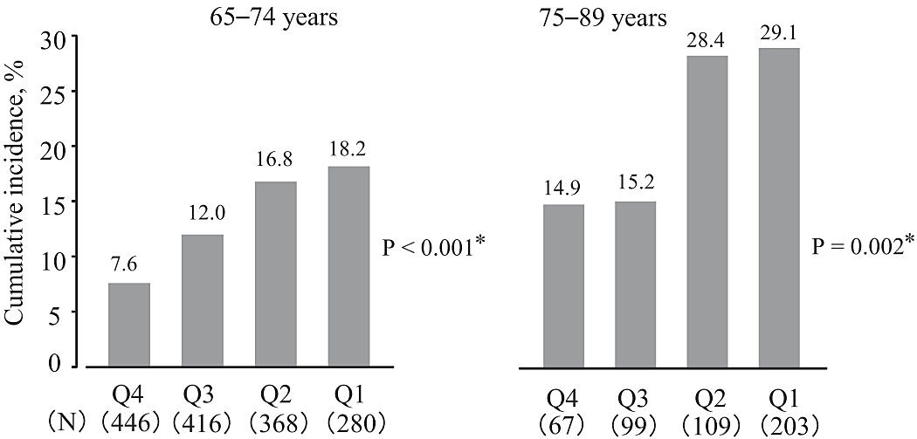
FIVE-YEAR CUMULATIVE INCIDENCE
Number of teeth at baseline
Cumulative incidence of swallowing problems
27-32 Teeth
23-26 Teeth
13-22 Teeth
00-12 Teeth
Notes:
Q4 represented 27-32 teeth, Q3 represented 23-26 teeth, Q2 represented 13-22 and Q1 represented 0-12 teeth
Results were analysed based on age group and gender.
Fewer teeth were associated with a greater cumulative incidence of swallowing problems, this trend could be observed when subjects were divided based on age group and gender.

Slide 20
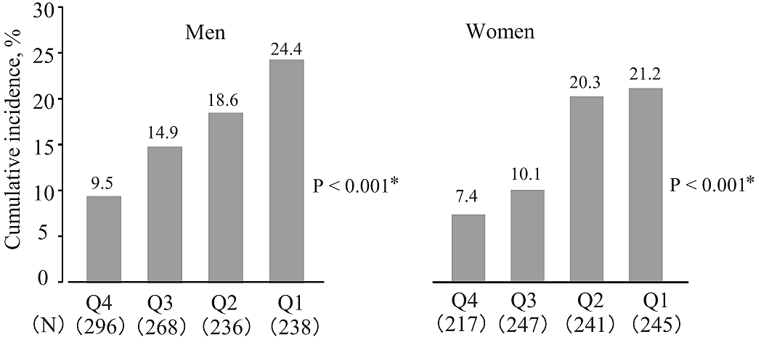
FIVE-YEAR CUMULATIVE INCIDENCE
Similar trend when results were analysed by gender
27-32 Teeth
23-26 Teeth
13-22 Teeth
00-12 Teeth
Notes:
Q4 represented 27-32 teeth, Q3 represented 23-26 teeth, Q2 represented 13-22 and Q1 represented 0-12 teeth
Results were analysed based on age group and gender.
Fewer teeth were associated with a greater cumulative incidence of swallowing problems, this trend could be observed when subjects were divided based on age group and gender
Taking a cut-off between Q1+2 and Q4, the OR was calculated (refer to next slide)

Slide 21
ODDS RATIO FOR SWALLOWING PROBLEMS
With reference to Q4 (27-32 teeth), the odds ratio for developing swallowing problems was:
2.42
Q2 (13-22 teeth)
2.49
Q1 (00-12 teeth)
Notes:
After adjusting for confounding factors (chronic diseases, lower BMI, lower physical function), the OR for developing swallowing problems in Q2 and Q1 groups was somewhat similar.
With reference to Q4 (27-32 teeth), the OR for developing swallowing problems was:
Q2(13-22 teeth): 2.42 (95% CI, 1.61-3.63)
Q1(00-12 teeth): 2.49 (95% CI, 1.68-3.69
This indicates that losing 10 or more teeth would significantly increase the risk of developing swallowing problems in older adults

Slide 22
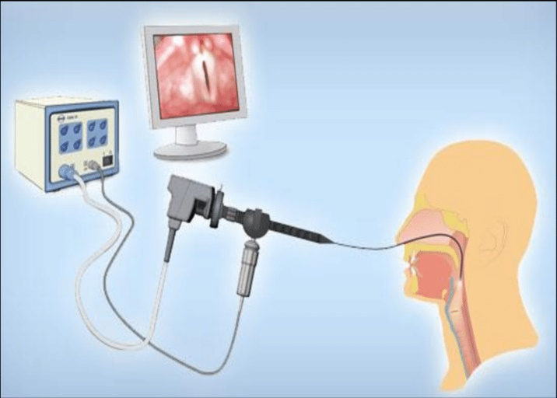
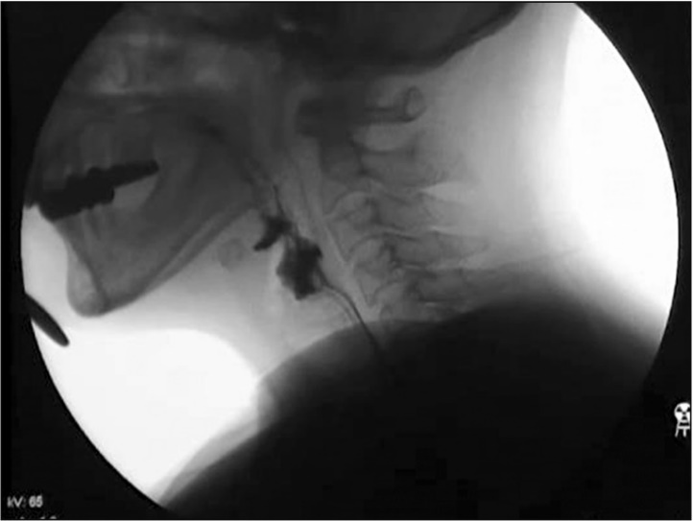
LIMITATIONS
Large proportion of subjects lost to follow-up, excluded subjects were:
  Older
  Fewer remaining teeth
  Higher frequency of edentulism
  Higher frequency of xerostomia
Assessment of swallowing disorder
Assessment of dentition
Notes:
There was a high proportion of subjects lost to follow-up
Subjects lost to follow-up were significantly different for the following factors.
This could have an impact on the results of the study – either overestimate or underestimate cases who developed swallowing problems
The assessment of swallowing disorder was 90% (sensitivity) and 56% (specificity) when compared with VFS (gold standard). Furthermore, the test-retest analysis found a kappa coefficient of 0.41. this could have an impact on the results – risk of false positive. On the other hand, the tests were easy to administer for a large group of subjects.
Sensitivity= positive reading/true disease Specificity= negative/no diseases
Study only looked at number of teeth and not the number of functional units (i.e. the number of pairs of teeth in contact with each other)

Slide 23
CRITICAL APPRASIAL
Notes:
We will now ask a few questions to appraise this article to see if it has answered our PICO question and if the evidence can be applied to our clinical situation

Slide 24
CRITICAL APPRASIAL
Were there clearly defined groups of patients, similar in all important ways?
  Independent older adults aged 65 years or older
  Clearly defined exclusion criteria
Were exposures and clinical outcomes measured in the same way?
Notes:
Q2. exposures and measurements were the same and objective (refer to next slide for summary)

Slide 25
Assessment of Swallowing Function
4-item questionnaire
30ml water swallow test
Dental Assessment
Number of remaining teeth
Maximum bite force
Occlusal support
Xerostomia

Slide 26
CRITICAL APPRASIAL
Was the follow-up of the study patients sufficiently long and complete?
  Follow-up: 5 years
  Large proportion of patients lost to follow-up
Notes:
5 years was an adequate follow-up period
34% were lost to follow-up
But the main flaw of this cohort study was that a large proportion of patients was lost to follow-up and this group was significantly older, had fewer teeth and higher frequency of xerostomia as compared with the group of subjects which was analysed
Attrition Bias. Loss to Follow Up Bias

Slide 27
CRITICAL APPRASIAL
Do the results of the study fulfil some of diagnostic tests for causation?
  Consistency with other studies:
    Loss of posterior teeth occlusion was associated with dysphagia risk in older nursing home residents
                Y.Okabe et al 2016
    Older adults with dysphagia presented with poor oral health, high prevalence of edentulism
              O. Orfega et al 2014
Notes:
The results of this study were consistent with other population studies which found associations between fewer remaining teeth and dysphagia.
From a pathophysiology point of view, VFS studies published in dental literature compared swallowing patterns of older adults with and without dentures. These studies found that the removal of dentures – which affected the stability of the mandible resulting in greater movement of the oropharyngeal structures, changed bolus transport and increased the risk of bolus penetration into the hypopharynx, significant delay in pharyngeal swallowing.

Slide 28
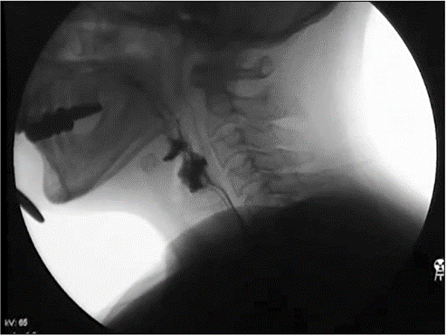
CRITICAL APPRASIAL
Do the results of the study fulfil some of diagnostic tests for causation?
  Videofluoroscopy studies:
    Significant alterations in oropharyngeal and lower jaw movements in fully edentulous patients
    Increases risk of dysphagia and aspiration
    S. Onodera et al 2016
    H. Yamamoto et al 2013
    M. Yoshikawa et al 2006
Notes:
The results of this study were consistent with other population studies which found associations between fewer remaining teeth and dysphagia.
From a pathophysiology point of view, VFS studies published in dental literature compared swallowing patterns of older adults with and without dentures. These studies found that the removal of dentures – which affected the stability of the mandible resulting in greater movement of the oropharyngeal structures, changed bolus transport and increased the risk of bolus penetration into the hypopharynx, significant delay in pharyngeal swallowing.

Slide 29
CRITICAL APPRASIAL
Is this valid evidence about etiology important?
2.5x risk of developing swallowing problems
2.5x risk of developing swallowing problems
Lost 10 or more teeth
Lost 10 or more teeth
Notes:
Clinical case: Patient has lost 21 teeth (out of 32) in total – high risk of developing dysphagia. In addition, she has also reported avoiding certain foods and distress during meal times. This could increase her risk of aspiration pneumonia, affect her nutrition status, distress/anxiety could worsen her depressive state.
Older adults who have lost 10 or more teeth have a 2.5x risk of developing swallowing problems
Risk could be greater in older adults with co-morbidities

Slide 30
CRITICAL APPRASIAL
Is this valid evidence about etiology important?
RISK of developing swallowing problems
Multiple co-morbidities
2.5x risk of developing swallowing problems
Multiple co-morbidities
Lost 10 or more teeth
Lost 10 or more teeth
Notes:
Clinical case: Patient has lost 21 teeth (out of 32) in total – high risk of developing dysphagia. In addition, she has also reported avoiding certain foods and distress during meal times. This could increase her risk of aspiration pneumonia, affect her nutrition status, distress/anxiety could worsen her depressive state.
Older adults who have lost 10 or more teeth have a 2.5x risk of developing swallowing problems
Risk could be greater in older adults with co-morbidities

Slide 31
CRITICAL APPRASIAL
Can we apply the valid, important results of this study to our patient?
  Similar age group (above 65 years old)
  Community dwelling resident vs nursing home patient
  Previous radiotherapy treatment for left parotid mass (B cell lymphoma), GERD, COPD
Notes:
Main difference between study and patient: independent community resident vs LTC resident
Out patient has more comorbidities which can predispose her to greater risk of dysphagia when compared with an independent community dwelling older adult.

Slide 32
Maintaining adequate dentition in older adults may prevent dysphagia
CONCLUSION
Notes:
Swallowing problems are more likely to develop in older adults with fewer teeth.
Prevention against tooth loss (such as regular dental visits, reducing consumption of sugary food, good oral hygiene practices) in older adults can prevent dysphagia and also maintain masticatory function and comfort for older adults.
MORE IS BETTER

Slide 33
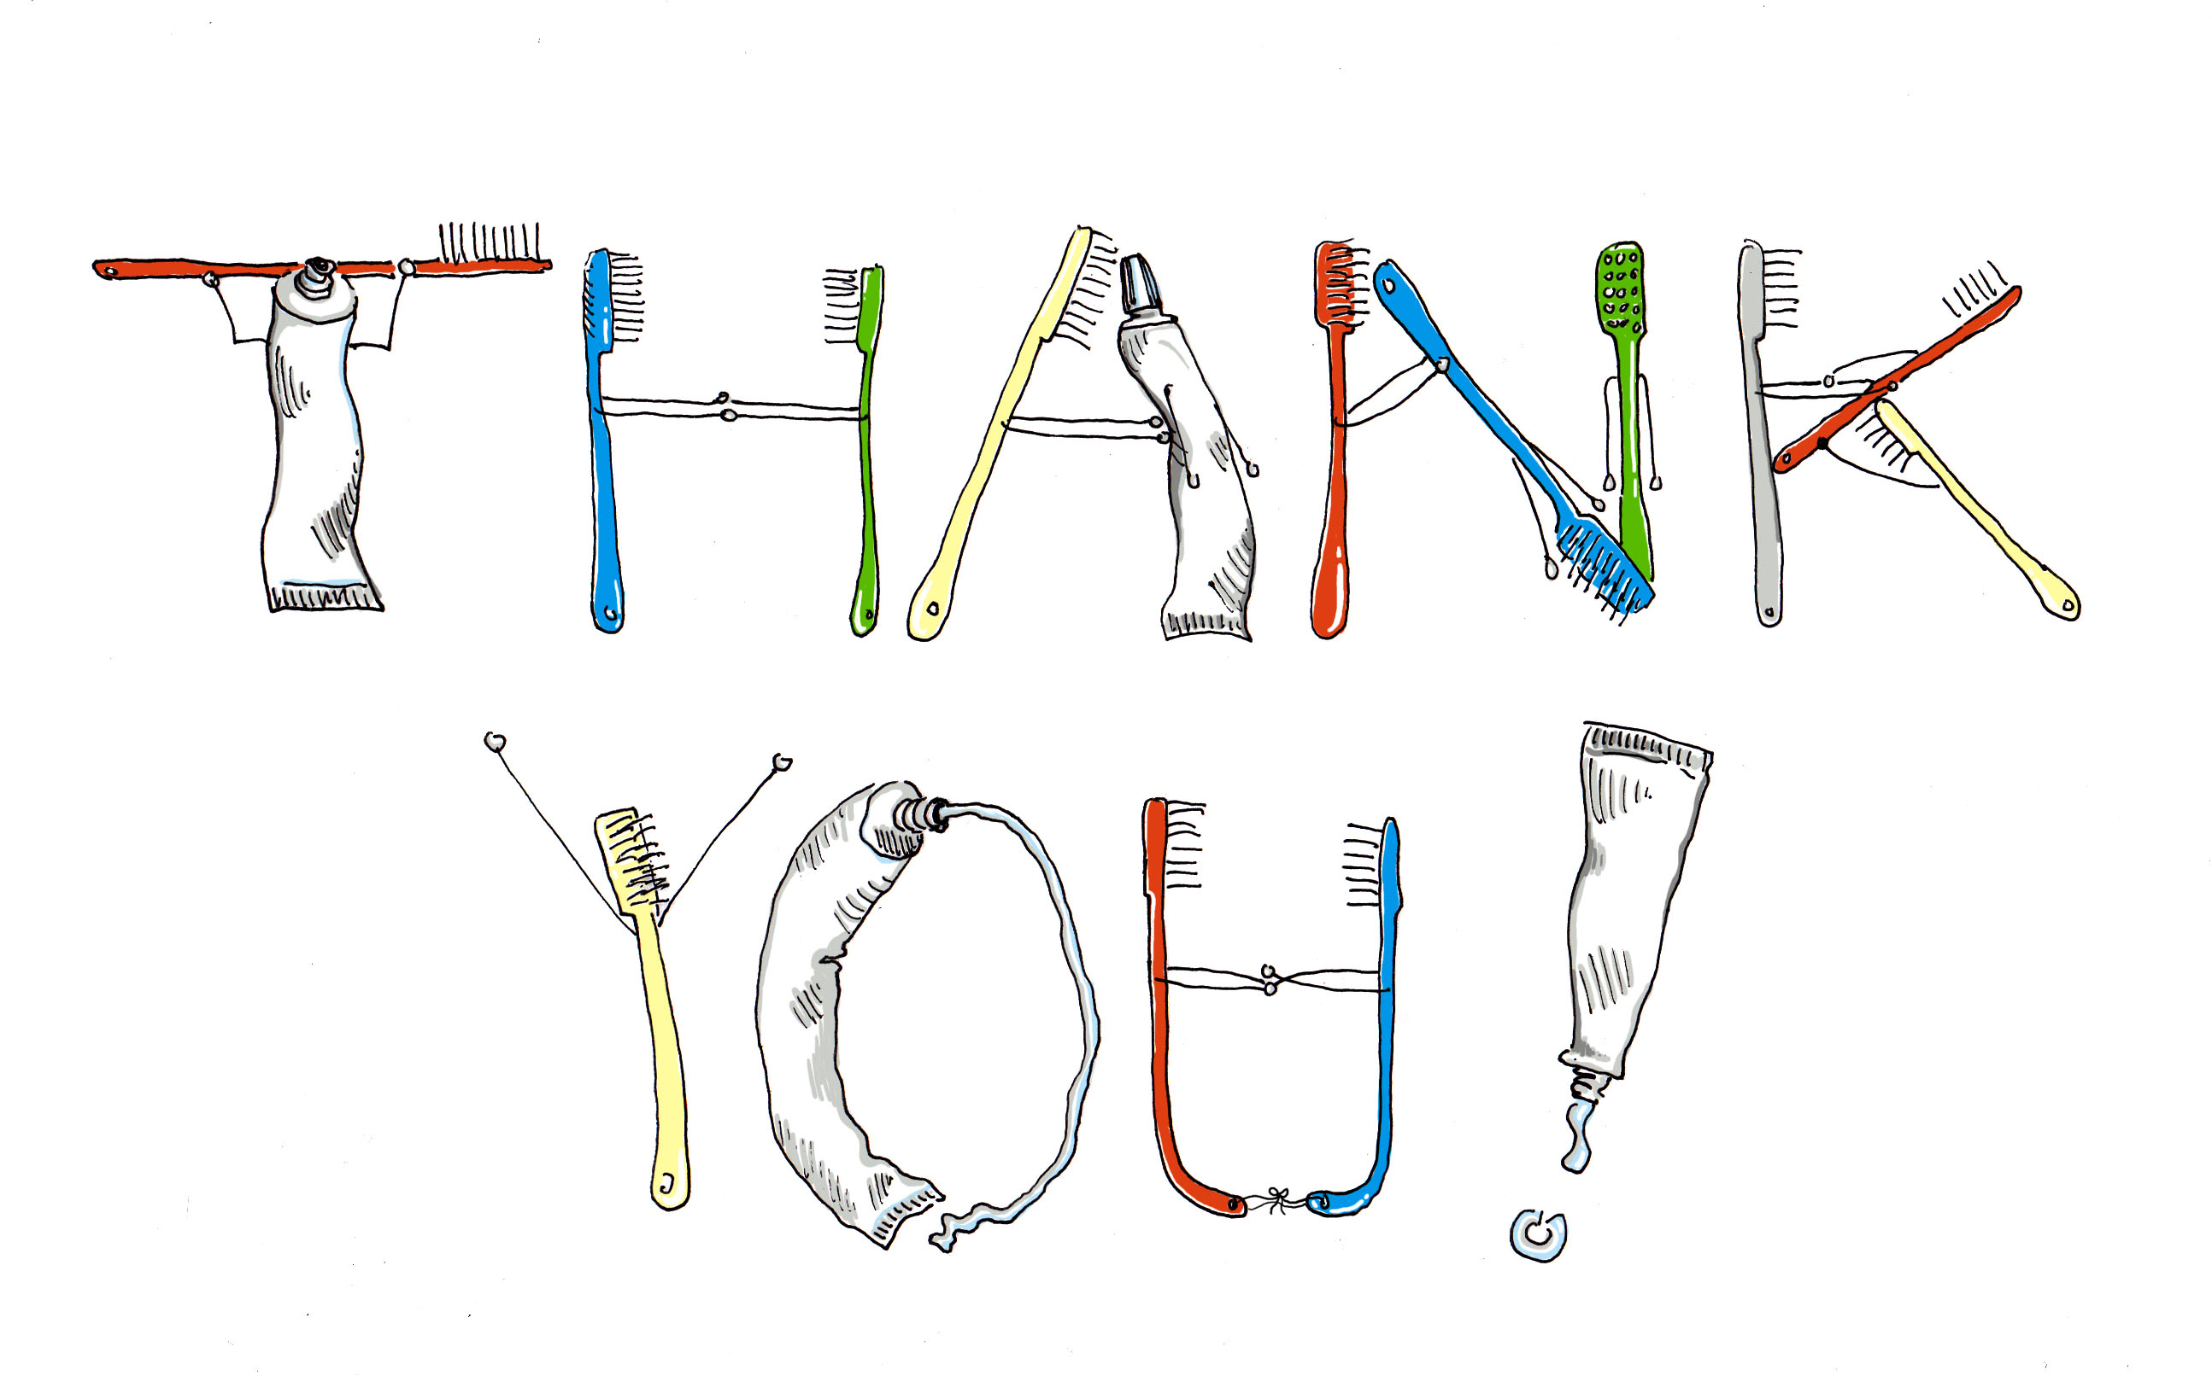

Slide 34
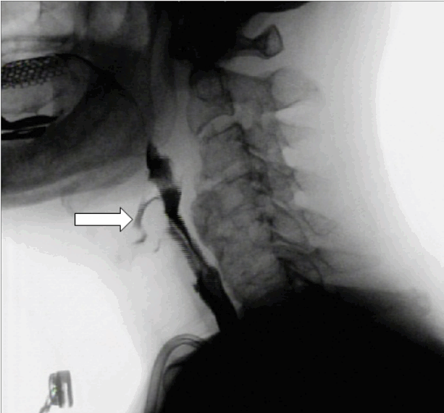
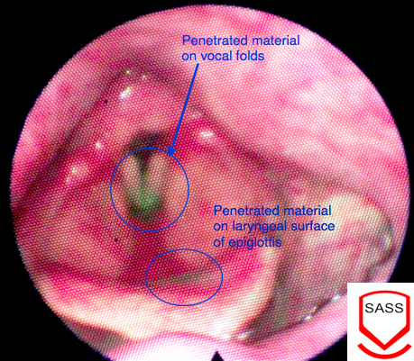
VFSS & FEES
Videofluoroscopic Swallow Study (VFSS)
Fiberoptic Endoscopic Evaluation of Swallowing (FEES)

Slide 35
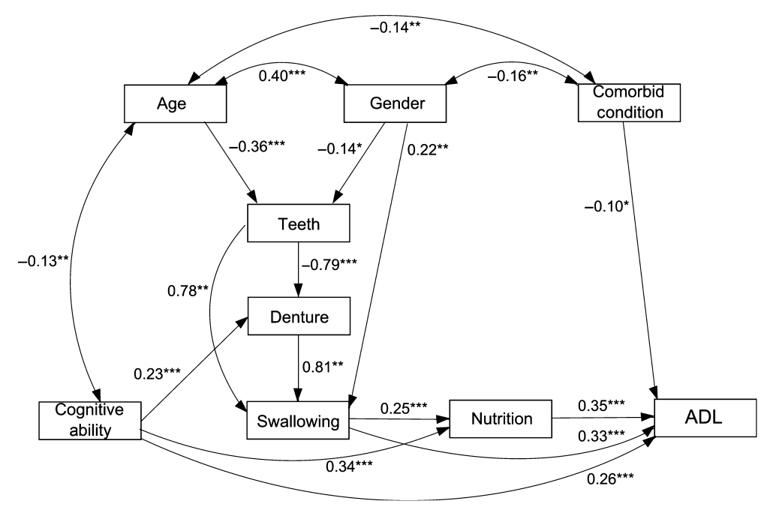
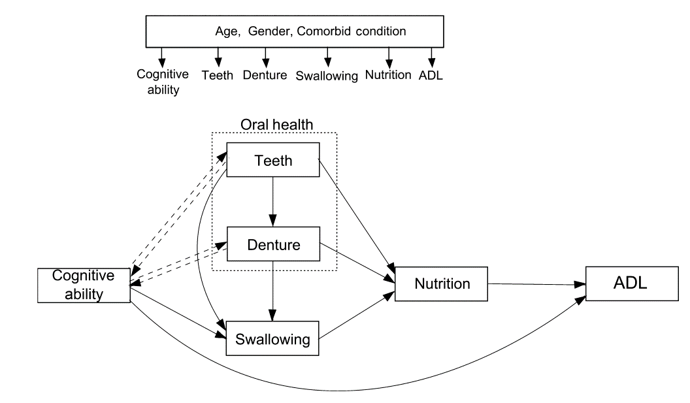
INTERRELATIONSHIP OF ORAL HEALTH STATUS & SWALLOWING FUNCTION

Slide 36
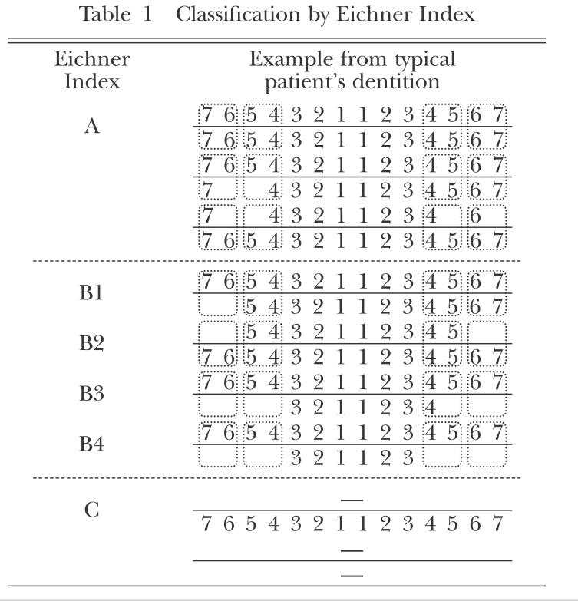
EICHNER INDEX

Slide 37
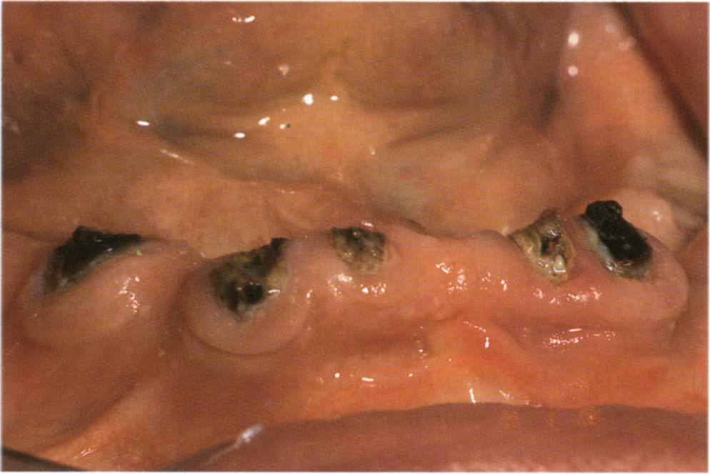

Slide 38
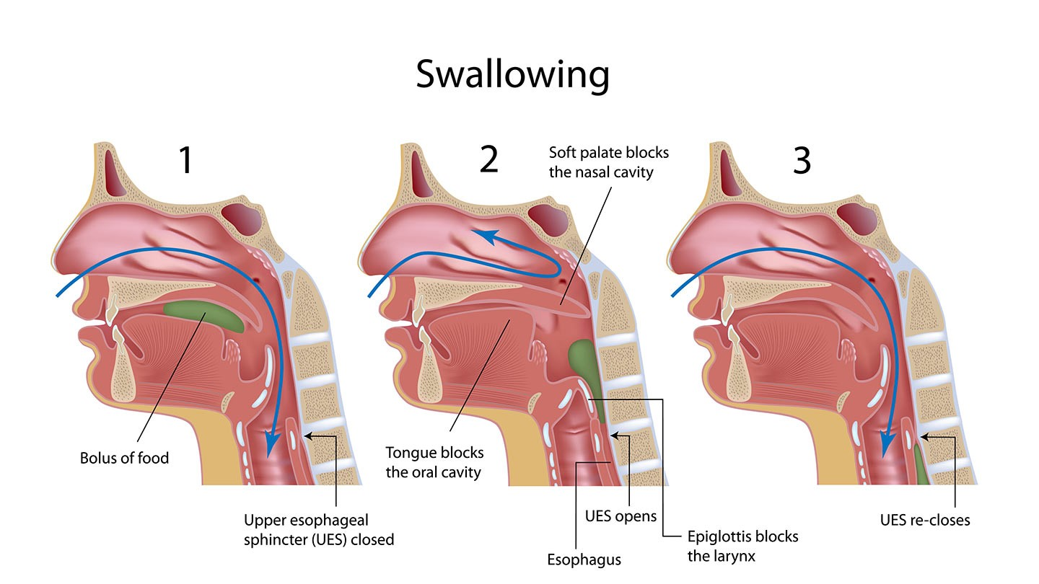
Kruger D. Assessing esophageal dysphagia. JAAPA. 2014 May;27(5):23-30
Notes:
Background on various phases of normal swallowing:
In general, there are 3 phases in normal swallowing: oral, pharyngeal and oesophageal
The phases are interdependent and must coordinate to allow for movement of the bolus down the right pathway
The teeth play an important role besides chewing as they help to stabilise the mandible during the pharyngeal phase to allow the tongue to push the bolus and for the hyoid bone to rise to bring the larynx upwards while the epiglottis closes the airway

