Slide 1
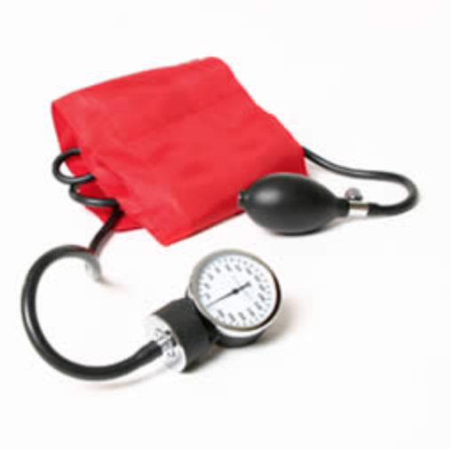
Journal Club
Meredith Rees Halpin, MD
Geriatric Oncology Fellow
Boston University Medical Center
November 17, 2017
Notes:
I very much enjoyed preparing this Journal Club and reviewing this topic that is both very relevant to clinical practice in Geriatrics and a ever moving target. I hope you enjoy, please feel free ask questions at any time.

Slide 2
Clinical Case
71 year old Haitian man presenting to geriatric clinic for follow up
PMH: HTN, Osteoarthritis, BPH, Active ½ PPD smoker
Meds: Lisinopril 40 mg daily, Tylenol 1 g BID, ASA 81 mg daily, Atorvastatin 40 mg daily, Tamsulosin 0.4 mg daily
Often hypertensive in the range of 170/90 when seen in clinic, although when followed closely by VNA for several months BP readings were consistently 145/80.

Slide 3
PICO
What is the ideal goal blood pressure for this geriatric patient to optimize his risk reduction for cardiovascular events without increasing risk of falls or syncope?
P- Geriatric Clinic Patient with HTN and cardiovascular risk factors
I- Antihypertensive treatment targeting systolic BP <150
C- Antihypertensive treatment targeting lower systolic BP
O- Cardiovascular Outcomes and Falls

Slide 4


Notes:
September 2017

Slide 5
Background- Hypertension
Most common condition seen in primary care
Prevalence in adults >65 years old as high as 60-80%
Risk factor for MI, Stroke, Renal Failure and Death
Notes:
We know this, many studies have been done in HTN and various populations, and yet a definitive Evidence Based goal blood pressure has been elusive.

Slide 6
Background
A 2000 Meta-Analysis of 8 outcome trials of patients older than 60 with systolic hypertension (15,693 Patients).
NNT for 5 years to prevent 1 Cardiovascular event was 26.
NNT for patients aged 70 years or more was 19.
Baseline BP in this analysis 160 mmHg or more.
These trials did not achieve a systolic pressure less than 140 mmHg.
Notes:
(including Systolic Hypertenstion in Elderly Program int vs placebo, Syst-Eur and Medical Research Council) All were Randomly assigned placebo controlled trials looking at CV outcomes including stroke

Slide 7
JNC 8 (2014)
Treatment goal of less than 150/90 in adults aged 60 years and older who do not have Diabetes or CKD.
Treatment goal of less than 140/90 with Diabetes or CKD.
Previously JNC 7 had recommended <140/90 and <130/80 respectively. (2003)

Slide 8

The Systolic Blood Pressure Intervention Trial (SPRINT)
Large Multicenter RCT (>9000 patients)
Intensive-treatment (120 mmHg Systolic) vs standard-intensity (140 mmHg Systolic) led to a significant decrease in cardiovascular events and death.
No significant increase in the number of falls or syncope.
These results were also found in the subgroup of patients 75 years and older.
Notes:
NEJM 2015
75 and older subgroup was also looked at for frailty and there was no significant difference in outcomes based on frailty.

Slide 9

2016 Canadian Hypertension Education Program (CHEP) Guidelines, 2016 National Heart Foundation of Australia Guidelines have incorporated SPRINT data, and suggest a systolic target of 120 mmHg for patients who meet the SPRINT inclusion criteria.

Slide 10
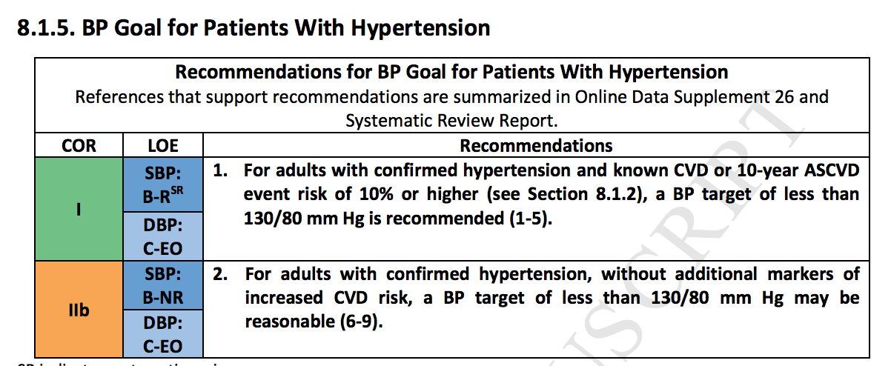
AHA/ACC Updated Guideline: Accepted Manuscript November 2017
Notes:
The ASCVD risk score for my patient was 40%

Slide 11


Slide 12
Study Design
The Irish Longitudinal Study on Ageing (TILDA): nationally representative prospective cohort study
Community dwelling adults 50 years or older living in the Republic of Ireland.
Random sampling of geographical clusters was used to select households.
Data collected by an in home interview, patient completed questionnaire and comprehensive health assessment.
Mean follow up 3.4 years
Notes:
Median follow up was 3.4 years in SPRINT

Slide 13
Study Design
This study used data from wave 1 of TILDA to retrospectively identify patients meeting full inclusion criteria for SPRINT.
All SPRINT eligibility parameters apart from degree of proteinuria were available.
Outcomes were reported at wave 2 and wave 3.
Falls and Syncope were assessed by self report or proxy at each wave.
Notes:
SPRINT had self reporting every 3 months, and also reviewed the medical records for ED visits and admissions.
SPS3 looked at <130 vs 130-149 in pts with recent lacunar strokes, showed nonsignifcant reduction in recurrent strokes.

Slide 14

Outcome being assessed
Notes:
If individuals meeting inclusion criteria for SPRINT outside the clinical trial context are similar to trial participants, especially with regard to risk for adverse outcomes.

Slide 15
SPRINT INCLUSION CRITERIA
Age at least 50 years
Subgroup Age over 75 years (2600 patients)
Systolic BP of 130 to 180 mmHg
Increased risk of cardiovascular events
  Clinical or subclinical cardiovascular disease other than stroke
  CKD (excluding PCKD) with GFR 20-60 ml/min
  10 year risk of 15% of CV disease based on Framingham risk score

Slide 16
SPRINT EXCLUSION Criteria
One minute standing SBP <110 mm Hg
Proteinuria (>1g/day, or >600mg/day albumin)
Diabetes Mellitus (ACCORD)
History of Stroke (SPS3)
Symptomatic Heart Failure within the past 6 months or EF <35%
Nursing home residents
Notes:
Accord looked at the same two intensities and did not find a significant difference but included patients with diabetes exclusively and had ½ the sample size, and younger overall population.

Slide 17
Wave 1
5751 Comprehensive Health Assessment
Wave 2
February 2012-March 2013
Injurious Falls and Syncope Outcomes assessed
Wave 3
March 2014- December 2015
Injurious Falls and Syncope Outcomes reassessed
407 Meeting Inclusion Criteria for Sprint
July 2011
8175 Self Completed Questionnaires

Slide 18
Analysis was performed using R statistical software and Stata, incorporating inverse probability weighting to account for complex survey designs.

Slide 19
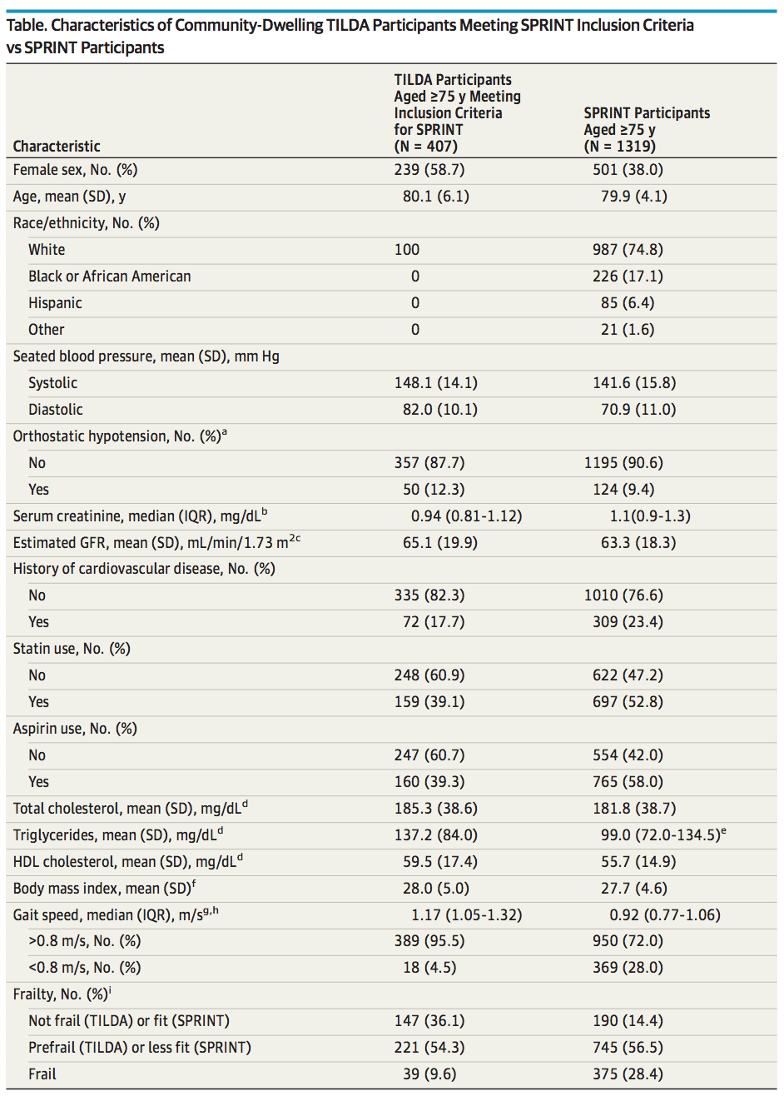
Notes:
Female, Race, BP sys/dia
Frailty

Slide 20
Characteristics
 | TILDA | SPRINT
Orthostatic Hypotension | 12.3% | 9.4%
History of Cardiovascular Disease | 17.7% | 23.4%
Aspirin Use | 39.3% | 58%
Statin Use | 39.1% | 52.8%

Slide 21
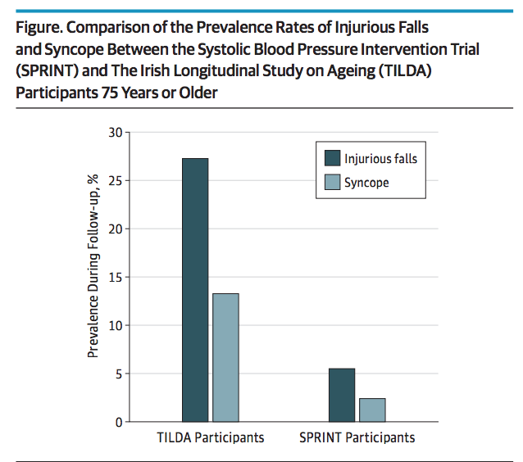

Slide 22
SPRINT Falls and Syncope for > 75 years old
Event | Intensive BP Group N with event (%) | Standard BP Group N with event (%) | HR (95% CI) | P-value
Injurious Falls | 65 (4.9) | 73 (5.5) | 0.91 (0.65-1.29) | 0.605
Syncope | 39 (3) | 32 (2.4) | 1.23 (0.76-2.00) | 0.401

Slide 23
Results: Prevalence of events
 | TILDA | SPRINT
Falls | 27.3% | 5.5%
Syncope | 13.3% | 2.4%
Notes:
5 times higher rate even though held to the same inclusion criteria

Slide 24
Questions Raised….
Is there a difference between community dwelling adults and clinical trial patients even when using the same inclusion criteria?
Was SPRINT powered to detect increase in injurious falls?
Is SPRINT generalizable to the 8-10 million US adults that meet the eligibility criteria?
Notes:
Better care in clinical trial closer observation, as opposed to ‘real-world cohort’ treated in community
Not the primary outcome

Slide 25
Critical Appraisal- Study Validity
Was there a representative and well-defined sample of patients at a similar point in the course of the disease? Yes, well defined prospective cohort of community dwelling adults over 50 years of age, and subsequently filtered by the same inclusion criteria.
Was the follow-up sufficiently long and complete? Yes, same follow time of 3.4 years as in SPRINT.
Were objective and unbiased outcome criteria used? Yes, injurious falls and syncope, same outcomes assessed in SPRINT. Both obtained by self reporting although at different intervals (3 months, yearly), possible change in recall bias, SPRINT also included chart review.
Was there an adjustment for important prognostic factors? Yes, followed same inclusion and exclusion criteria as SPRINT. Although some differences in baseline BP, ASA/Statin Use, Race, Gender and Frailty.

Slide 26
Critical Appraisal: Results
How precise are the estimates of likelihood? This paper provides us only with percentages of prevalence of characteristics and outcomes, as opposed to SPRINT which provides Hazard Ratios with Confidence Intervals.

Slide 27
Critical Appraisal: Implications for Patient Care
Were the study patients similar to my own? Somewhat, if considering those who would meet SPRINT criteria only. They are community dwelling older adults. However, all were white, all living in Ireland, unclear socioeconomic status/language barriers.
Will the results lead directly to selecting or avoiding therapy? Yes. This suggests the rate of injurious falls and syncope might in fact be much higher than seen in the SPRINT trial for average community dwelling adults.
Are the results useful for reassuring or counseling patients? Yes. Suggest that meeting inclusion criteria for SPRINT may not be enough to qualify for a lower blood pressure goal, and thoughtful individualized consideration and discussion of adverse outcomes will be necessary.

Slide 28
Conclusion for my patient
Planning for ambulatory blood pressure monitoring. Discussed risks and benefits of adding an additional medication to control blood pressure with the patient. We have decided to add add Norvasc 5 mg daily, as he is currently at best averaging a BP of 150/80. Will carefully monitor for ability to tolerate.

Slide 29

Questions?

