Slide 1
Journal Club
Mariuxi A. Viteri Malone, PGY4
Fellow Physician, Geriatric Medicine
Boston University/Boston Medical Center

Slide 2
CASE PRESENTATION:
Mrs. “S” is a 73 yo F. She has a PMHx consistent with HTN, CKD III, Afib on Coumadin, CAD s/p CABG, HPL, GERD, OSA on CPAP, HFpEF. She has excellent family support.
She is here with her daughter due to concerns about memory loss.
MMSE: 16/30 (losing points on language, short memory, visual-spatial)
ADLs: 10/12 (losing points in continence and dressing)
IADLs: 8/16 (losing points in cooking, transportation, telephone, finances)

Slide 3


DOMAINS:
MEMORY:
Started about 5 years ago
Family notices a consistent progressive decline
She now forgets thingd she just did, for example showers for 3h and after and hour takes another shower since forgot she already took it
Burned herself while cooking and left the stove on
Repeats same questions
Family believes that short term memory is affected the most

Slide 4

SLEEP:
No REM sleep abnormalities
Does not take medications for sleep
No problems with sleep. Sleeps about 8-9h per day
HALLUCINATIONS/PSYCHOSIS:
On Abilify 20 mg daily
Patient states that she hears voices which tell her “go back to sleep”. They also tell her to hurt herself and others. Patient states that she ignores those voices
Not seeing a psychiatrist

Slide 5


MOOD:
Family states “she is always in a good mood”
When asked to the patient, she states “I wish I had someone to talk to”
Denies suicidal or homicidal ideations
Patient loves and cares about her grand-children and children a lot
She says “I feel tired all the time”
APPETITE/WEIGHT:
Per family, she eats pretty well: 3 meals a day and several snacks during the day
Weight has been stable

Slide 6

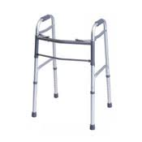
INCONTINENCE:
Has trouble getting to the bathroom in the mornings
Last month lost urine in the morning about 2-3 times
She uses colchicine and sometimes can not make it to the bathroom on time
Fecal incontinence once last month
MOBILITY:
No witnessed falls
No assistive device
Patient states she has fallen while using the stairs. There is some bruising on her knees.

Slide 7

FAMILY MAIN CONCERN:
Explained that potential diagnosis is Alzheimer’s disease
Family states that she is very active, she loves hanging out with her grand-children and she enjoys cleaning.
What should we expect regarding her quality of life and activities of daily living?

Slide 8
PICO
P (Problem or Patient or Population) | Older female with moderate dementia
I (intervention/indicator) | Non-pharmacological treatment for mobility and quality of life in dementia
C (comparison) | No treatment for mobility and quality of life
O (outcome of interest) | Change in mobility and quality of life at end of study

Slide 9
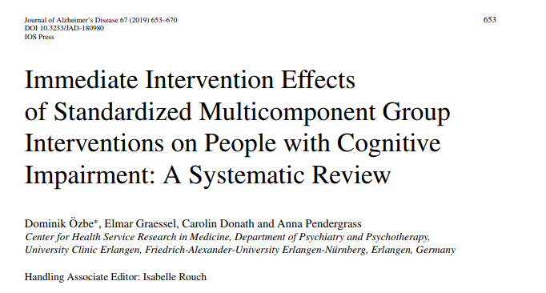

Slide 10
Methods:
Systematic literature search of randomized controlled trials of non-pharmacological multicomponent interventions for persons with any type of dementia or PwMCI.
Multicomponent interventions were defined as interventions with at least two components.
A systematic literature search was conducted using the electronic databases PubMed, PsycINFO, PSYNDEX, and CINAHL.

Slide 11
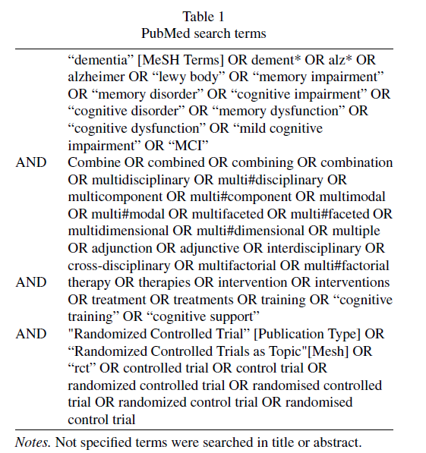

Slide 12

INCLUDED:
-Individual interventions (they are not comparable to group interventions). -Samples mixed with the healthy elderly. -Treated for another psychological disorder. -Interventions that vary significantly from group to group, (PT/OT) because they are individualized. | -Studies which reported outcomes for the PwD/PwMCI. -Every study that was published until March 27th, 2017. Only publications in peer-reviewed journals in English and German. -Standardized interventions that were held in a group.

Slide 13
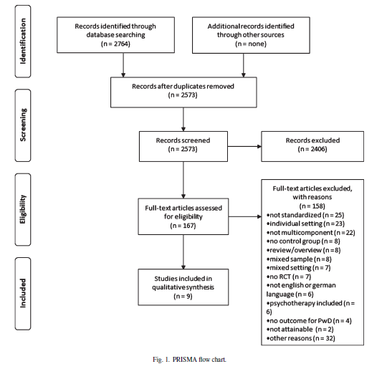

Slide 14
BASELINE CHARATERISTICS:
MEAN AGE: 70.3 (±5.8) years and 85.1(±5.1) years GENDER: 513 participants total, 312 (61%) women and 201(39%) men PLACE: 8 studies took place in community-dwelling individuals 1 in nursing home COGNITIVE IMPAIREMENT: persons with either dementia or mild cognitive impairment MMSE: moderate cognitive impairment 13.8 (±5.4) points, mild cognitive impairment 28.5 (±1.0)

Slide 15
STUDIES ADDRESSING OUR CONCERNS:
6 out of 9 of the studies included FUNCTION as part of their primary outcome (Described as quality of life, ADLs, IADLs):
Olazaran et al. Spain: FAQ, Functional Activities Questionnaire
Baglio et al. Italy: FLSA, Functional Living Skills Assessment Scale
Graessel et al. Germany: (nursing home) E-ADL, Erlangen Test of Activities of Daily Living
Buschert et al. Germany: QOL-AD, Quality of Life-Alzheimer’s disease
Maci et al.Italy: QOL-AD, Quality of Life-Alzheimer’s disease and CBS-QoLD, Cornell-Brown Scale for Quality of Life in Dementia
Troyer et al. Canada: Lifestyle Importance Questionnaire

Slide 16
National Institute on Aging
Endurance Exercises
Balance
Flexibility Exercises
PHYSICAL INTERVENTIONS:
Psychomotor interventions:
Uses both cognitive and motor
stimulation

Slide 17
INTERVENTIONS USED IN STUDIES:
Cognitive and physical components were most frequently used (seven of nine studies).
The group size ranged from 4 to 6 participants in the smallest group intervention, to 16 to 17 participants in the biggest group intervention.

Slide 18
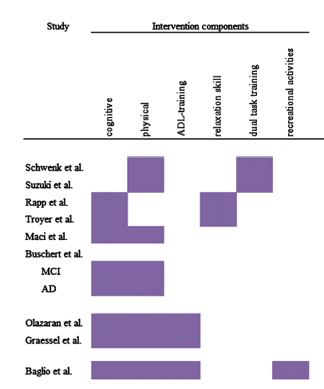

Slide 19
Maci et al. (CBS-QoLD), and QoL-AD (each QoL), significant improvement in the intervention group (IG) (all ps < 0.05) while the control group (CG) did not change. STATISTIC ANALYSIS: Wilcoxon tests | Olazaran et al. Effect after 12 months for cognition. They found no intervention effects on “others”.io STATISTIC ANALYSIS: t-test | Baglio et al. Significant effects of their intervention on NPI (p = 0.019; non-cognitive symptoms), where the intervention group (IG) showed an improvement and the control group (CG) did not change. STATISTIC ANALYSIS: ANCOVAs

Slide 20
Limitations:
-Very systematic in data search
-Appropriate inclusion and exclusion criteria
-Homogeneity of the people studied, maybe reproducible
-No study with an overall low risk of bias
-Incomplete outcome data addressing
-No real blinding of participants and personnel

Slide 21
Clinical Appraisal
Is our patient so different from those in the study that its results can not apply?
NO

Slide 22
Clinical Appraisal
  Is the treatment feasible in our setting?
  Yes
  What are our patients potential benefits and harms from the therapy?
  Not all studies reported adverse events. Potential psychological distress in the intervention group thatwas gone, without residual effects, after 3 months.

Slide 23
Clinical Appraisal
  What are our patients values and expectations for both the outcome we are trying to prevent and the adverse effects we may cause?
  Patient and family focus is quality of life. They are realistic and understand there is no curative intent but know that the patient mobility may improve with interventions suggested.

Slide 24

Q&A
Q&A

Slide 25


