Slide 1
Journal Club
Madeleine Tan
Geriatric Dental Medicine Resident

Slide 2
Mrs G
94 year old lady living in a long term care facility.
Presenting complaint:
Referred for denture evaluation due to weight loss.
Notes:
I’ll begin with a patient case- Mrs G is a 94 year old lady living in a long term care facility. She was referred to the dental clinic for evaluation of her dentures due to weight loss.

Slide 3
Mrs G
History of presenting complaint:
Soft diet due to complaints of a loose lower denture
Decreased appetite, depressed & weight loss (9Ibs in 1 month) after URI (June 2018)
Started nutritional supplements October 2018.
Notes:
Mrs G was admitted into this long term care facility in April 2017. At that time she had complained of a loose lower denture and had been placed on a soft diet.
BMI/ weight at that time:
4/17 BMI 29.1%, 2/12 later gained 12lbs (validity of records or fluid retention?)
4/18 BMI 30.8% gained 10lbs since admission 1 year ago
In June 2018, Mrs G had a major URI and was noted to have a decrease in appetite, appeared depressed and had lost 9Ibs in 1 month. This constitutes 6% of her weight. According to the ASPEN guidelines, an involuntary weight loss of 5% or more of usual body weight in 1 month is one of the risk factors of malnutrition.
Lost 9lbs in 1 month. BMI 29.5%, clinically significant.
She was started her on Glucerna an oral supplement to increase her caloric and protein.

Slide 4
Mrs G
Medical History:
Dementia
HTN
DM with neuropathy
CKD
Legally blind
Dysphagia
Pressure ulcer
Urinary incontinence
Impaired gait
Medications:
Acetaminophen
Senna
Insulin
Metoprolol
Duloxetine HCL
Prednisolone (eye drop)
Melatonin
Notes:
Acetaminophen
Senna (Senokot)- laxative
Insulin (Determir 17h, Aspart 3-4h)
Metoprolol (Beta blocker)
Duloxetine HCL(Cymbalta) (SNRI- serotonin and NE reuptake inhibitor)
Prednisolone (eye drop)
Melatonin

Slide 5
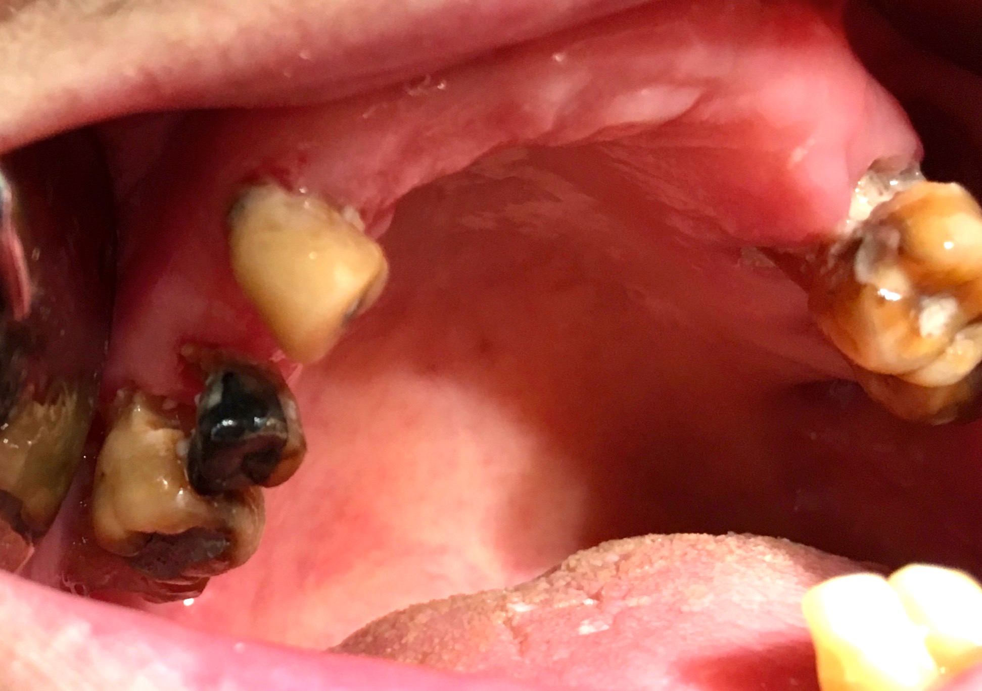
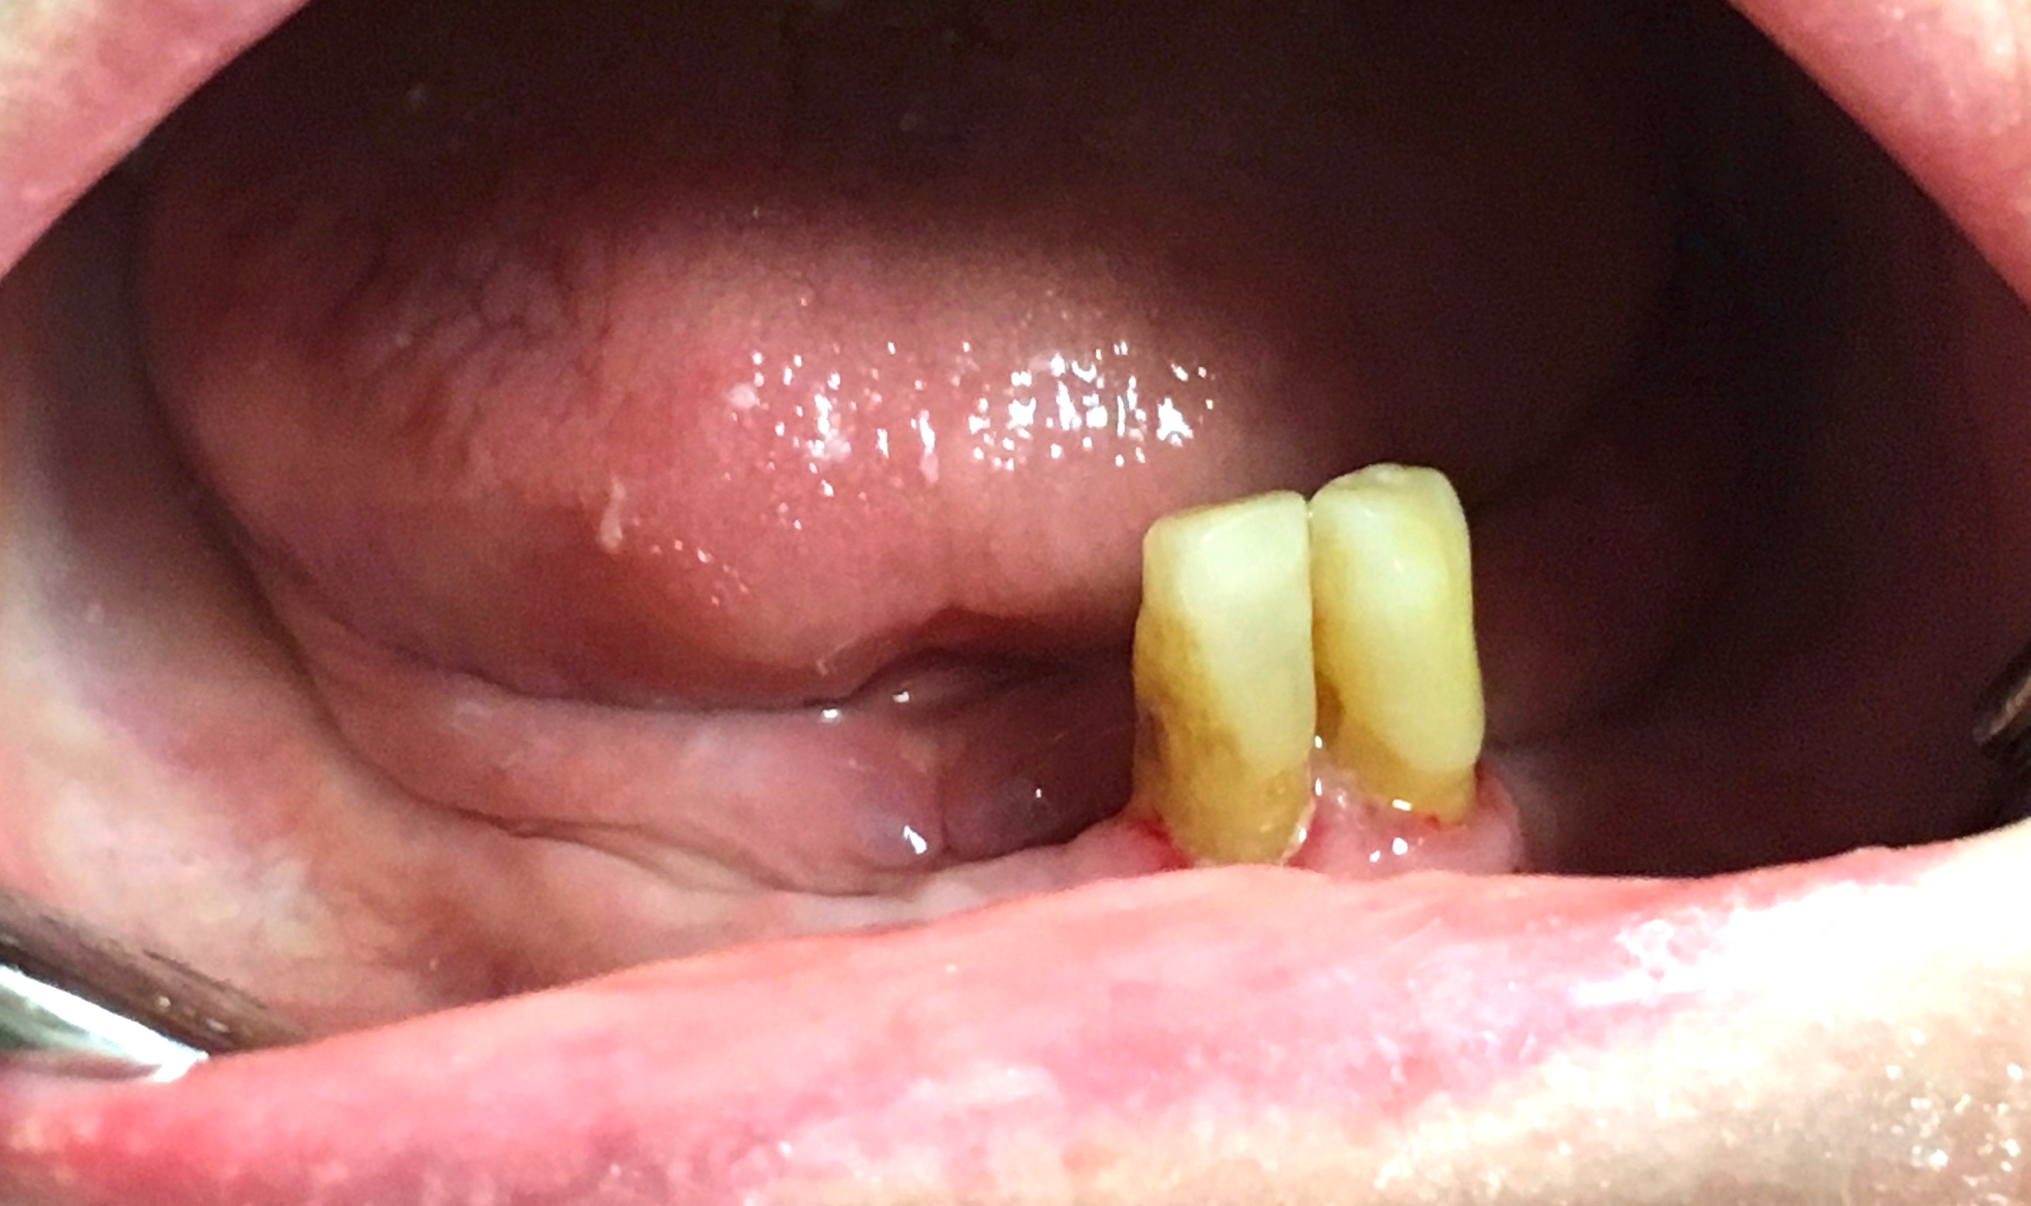
Mrs G
Dental findings (Oct 2018):
8 remaining natural teeth
Loose lower denture
Advanced decay in 4 upper teeth
Denture lost in nursing home (Nov 2018)
Notes:
She was seen for a dental examination in Oct 29 2018. Findings from the examination revealed:
8 remaining natural teeth (6 upper, 2 lower)
Wears upper and lower acrylic dentures
Upper denture is satisfactory but the lower denture is loose
Advanced decay in 4 upper teeth.
However, the nursing staff had reported loss of her dentures in the home in Nov 2018.
She was noted to have difficulties with chewing as you can imagine as none of her teeth meet when she bites down. Essentially, she was chewing on her gums.
her diet was modified to pureed diet.

Slide 6
Can dentures improve this patient’s nutritional status?
P- elderly living in LTC
I- provision of denture(s) to replace missing teeth
C- no replacement of missing teeth
O- improvement in malnutrition
Notes:
And in view of her earlier mentioned risk of malnutrition,
My clinician question derived from this case is "Can dentures improve Mrs G’s nutritional status?”
As such, the PICO question I have formulated looks at
Population- elderly population living in a LTC facility
Intervention- is to provide dentures to replace missing teeth, as opposed to the comparison which is to not replace them
(C- no replacement of missing teeth/ edentulism), and whether this would result in
O- improvement in malnutrition (in terms of weight gain)

Slide 7
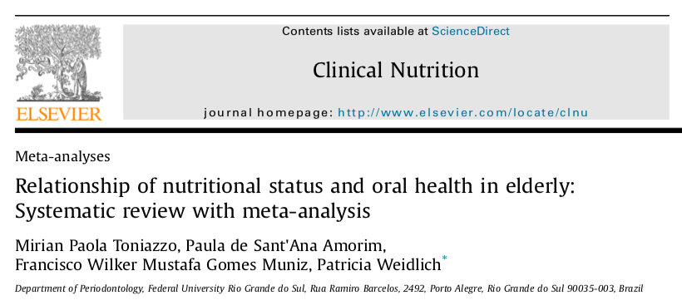
“Is malnutrition or risk of malnutrition related with oral health status in older adult subjects?”
Notes:
The AIM of the systematic review and meta-analysis was to address the focus question “Is malnutrition or risk of malnutrition related with oral health status in older adult subjects?”

Slide 8
Meta-analysis
Quantitative summary of study-specific results
  Relative Risk (RR) for dichotomized data
  Standardized mean difference (SMD) for continuous data
  Confidence Intervals describes certainty of treatment effects
Reduces bias
Accounts for heterogeneity (I²)
Notes:
A brief explanation of what a meta-analysis is, it is the quantitative summary of study-specific results
When the data is dichotomized, the analysis is presented as relative risk or odds ratio, and
Standardized mean difference (SMD) for continuous data
Confidence Intervals describes certainty of treatment effects
The advantage of a MA is it helps to reduces bias through setting an inclusion criteria for studies analysed.
It also accounts for heterogeneity and is quantified by the I² statistics, which is an inconsistency index that describes total variation across studies, presented as a percentage.
When the I2>40% there is high heterogenity between the studies and the sources of effect modification can be investigated using linear meta-regression. (only age was included in the meta-regression in this model)
The I2 can be unstable when only a few studies are included, as we can observe later
A meta regression is a tool used in meta-analyses used to determine the effect of moderator variables on effect size using regression based techniques

Slide 9
Methods

Slide 10
Potentially relevant articles identified n=3288
At least 60 years old
Nutritional evaluation performed
Oral examination by dental professional
Oral outcomes reported
Potentially relevant articles for full text analysis n=110
Articles included for methodological appraisal n=26
Observational studies
Interventional studies
Meta-analysis (edentulism) n= 8
Meta-analysis (prosthesis) n=4
Meta-analysis (number of teeth) n= 5
Notes:
We will now move on to the methodology.
The authors searched 3 data bases- MEDLINE- Pubmed, Scopus and EMBASE were used to identify potentially relevant articles.
The inclusion criteria include:
Subjects with at least 60 years old;
Studies that performed a nutritional evaluation, such as MNA or its short-form or SGA;
The studies had to perform an oral examination by a dental professional, either dentist or a dental hygienist.
The study should include any of the following oral outcomes: tooth loss, number of present teeth, of edentulous, of subjects using prosthesis, Decayed, Missing or Filled Index (DMF), functional teeth units (FTU), caries, any dental plaque index, any gingival index, probing depth or clinical attachment level.
The type of studies included are observational studies (cross sectional, cohort and case-control) and any interventional studies.
The authors excluded
Case reports, in vitro studies, experimental animal, letters to the editor, and systematic or narrative reviews;
Self-reported oral health outcomes;
An independent search was carried out by the 2 authors, and they had a kappa score of 0.87. When a consensus was not possible, a 3rd research was involved.
3288 potentially relevant articles were identified,
After excluding titles and abstracts, 110 articles were available for full text analysis.
Articles were further subjected to methodological appraisal, resulting in 26 articles for this SR (when they had inappropriate designs, dental examination performed by a non dental personnel, self reported outcomes, lack MNA or SGA analysis, or lack oral outcomes.)
For the meta analysis, there were 8 articles considered for the independent variable- edentulism, which is the complete lack of teeth. 4 articles for the use of prosthesis (which means dentures), and 5 articles for the remaining number of teeth present in the mouth.

Slide 11
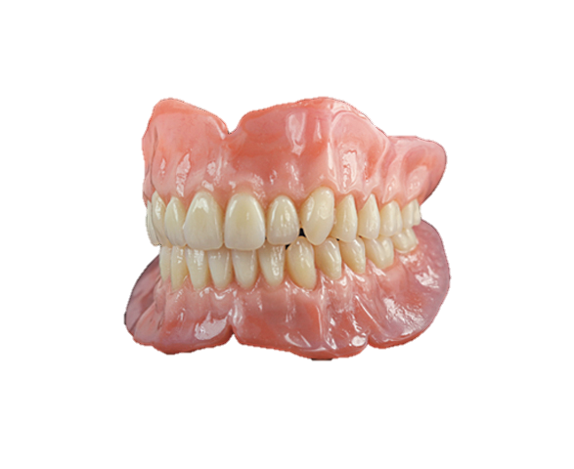
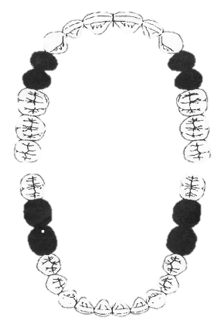
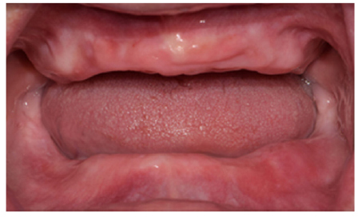
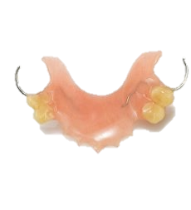
Independent Variables
Prosthesis Use
Edentulism
Number of teeth
Notes:
The independent variables investigated were
1. Prosthesis use- which refers to the use of dentures to replace teeth. This can be in the form of complete dentures or partial dentures depending on the number of natural teeth the patient has. This is the variable of interest as we wanted to know if dentures will benefit Mrs’G nutritional status.
2. The 2nd variable is Edentulism refers to the absence of teeth in the mouth.
What we see in this picture are the gums of the maxilla and mandible, on which, the complete denture will sit on.
3. The final variable examined is the number of teeth remaining in the mouth

Slide 12
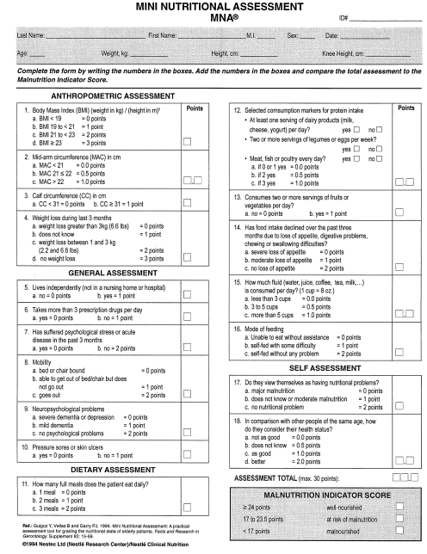
Dependent Variables
Malnourished (MNA<17)
At risk of malnutrition
(MNA 17-23.5)
Normal nutrition
≥ 24
Notes:
The dependent variables are classified into 2 groups- the malnourished groups and normal nutrition groups. The subjects are placed in either based on their mini nutritional assessment scores.

Slide 13
Dependent Variables
Anthropometric assessment
General assessment
Dietary assessment
Self assessment
Notes:
The MNA is an assessment for malnutrition designed for the elderly population. The short form serves as a screening tool.
Composed of brief questions and simple measurements that can be administered in outpatient clinics, hospitals and nursing homes, and can be completed in 10 mins, by a general person.
Has a sensitivity of 96% and specificity of 98% and predictive value of 97%
(Sensitivity is the probability that the TEST result will be positive when the disease is present,
Specificity is the probability that the TEST result will be negative when the disease is not present
PPV is the probability that the DISEASE is present when the test is positive, NPV is the probability that the DISEASE is not present when the test is negative)
The questions are categorized under 4 general categories-
Anthropometric assessment: BMI, weight loss in last 3 months
General asssessment: living independently, takes more than 3 prescription drugs, mobility, pressure sores, neuropsychological problems
Dietary assessment: food intake, appetite, mode of feeding
Self assessment: how do they perceive themselves as having nutritional problems

Slide 14
Dependent Variables
Malnourished (MNA<17)
At risk of malnutrition
(MNA 17-23.5)
Normal nutrition
≥ 24
Notes:
A score of
MNA ≥ 24 shows an adequate nutritional status and these are the normal nutrition subjects.
Risk of malnutrition if between 17- 23.5
And Protein-calorie malnutrition if <17
And they fall into this malnourished group

Slide 15
Statistical Analysis
Prosthesis use
Edentulism
Number of teeth
Relative Risk
Standardized Mean Difference
Malnourished (MNA<17)
At risk of malnutrition
(MNA 17-24)
Normal nutrition
Subgroup analysis
Institutionalized
Noninstitutionalized
Notes:
Now moving on to the statistical analysis, these are the independent variables analysed in this meta-analysis include edentulism, prosthesis use and number of teeth.
The dependent variables are malnourished and normal nutrition groups as earlier mentioned
Both prosthesis use and edentulism were represented as dichotomous data and hence calculated as RR, whereas number of teeth (0-32) lie on a continuous scale and hence is presented the standardized mean difference.
Institutionalization was the variable considered for subgroup analysis to determine if it is a risk factor for malnutrition.

Slide 16
results

Slide 17
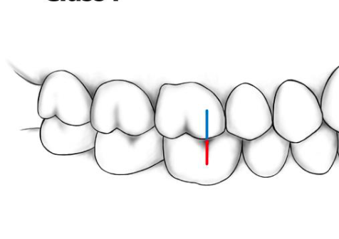
Descriptive analysis
26 studies, 13, 257 participants
  23 cross sectionals, 1 case-control, 1 cohort, 1 clinical trial
Oral health outcomes
  Number of remaining teeth
  Use of dental prosthesis
  Edentulous individuals
  Functional teeth units
  DMFT
  Dental plaque
  Periodontal disease parameters
Notes:
Moving on to results,
26 studies, 13, 257 participants
23 cross sectionals, 1 case-control, 1 cohort, 1 clinical trial
Oral health outcomes reported in the studies are:
Number of remaining teeth
Use of dental prosthesis
Edentulous individuals
Functional teeth units which we can understand as opposing pairs of teeth
DMFT
Dental plaque
Periodontal (or gum) disease parameters
Oral diseases such as dental caries and periodontal disease have a cumulative effect on oral health. It predisposes one to higher chances of tooth loss and masticatory function, imposing restrictions on diet and nutrition.
The converse should also not be neglected- tooth loss and its consequences on dietary restrictions.

Slide 18
Descriptive analysis
Nutritional assessment
  MNA (18), MNA-SF (7), SF + MNA (1)
Notes:
18 studies reported from the mini nutritional assessment, 7 used the MNA short form, and 1 study conducted the nutritional assessment in the short form but had the complete assessment performed when the SF showed a score for malnutrition or a risk of malnutrition

Slide 19
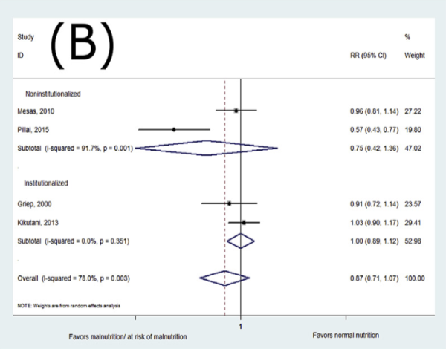
Forest plot for prosthesis use
Noninstitutionalized
Institutionalized
Favors malnutrition/ risk of malnutrition
Favors normal nutrition
Pooled RR for prosthesis use 0.87 (95% CI 0.71-1.08)
I² ⁼ 78%, p= 0.003
Notes:
The studies that assessed the nutritional status using MNA and provided sufficient data describing the oral condition were included in the meta-analysis.
We will now look at the analysis for each independent variable. This is a forest plot for the meta analysis for prosthesis use and subgroup analysis for institutionalized and nonnistitutionalized subjects. The line of no difference/ null sits at 1 as we are looking at relative risk. (null here is 1 as we are using 1 as a measure of association)
The overall pooled RR for prosthesis use was 0.87 (95% CI 0.71-1.08), demonstrating no significant difference between malnourished/at risk of malnutrition and normal nutrition individuals in relation to prosthesis use.
Subgroup analysis did not change the overall results. The 2 studies were analyzed in the noninstitutionalized subgroup, both show a trend for malnutrition even with prosthesis use but are highly heterogeneous, as evident by the lack of overlap of effect.
And in the institutionalized subgroup, the RR of each study show an equivocal association as they lie on either side of the line of no difference.
A high heterogeneity was found, (I² ⁼ 78%, p= 0.003) and the meta-regression adjusted for age did not explain heterogeneity (coefficient 0.010; p= 0.351)
Most studies did not show significant differences between malnourished and well-nourished individuals in the use of prosthesis.
But it may have an impact on food consistency

Slide 20
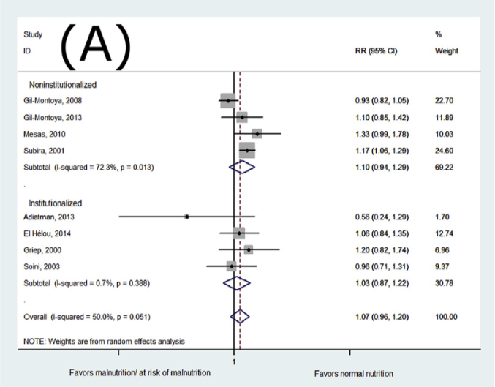
Forest plot for edentulism
Noninstitutionalized
Institutionalized
Favors malnutrition/ risk of malnutrition
Favors normal nutrition
Pooled RR for edentulism 1.07 (95% CI 0.97-1.20)
I²=50%, p-value= 0.051
Notes:
The meta-analysis for edentulism was performed with eight studies.
We can observe a trend that favours normal nutrition for edentulous subjects in the noninstitutionalized subgroup, 2 of which are statistically significant (Mesas and Subira). The other two studies by the gil-montoya et al group demonstrate an equivocal association as the CI cross the line of no difference. Similarly,
and even though the pooled RR for this subgroup also seem to favour normal nutrition, is not statistically significant as it crosses the line of no difference.
Studies analysed in the instituitionalized subgroup likewise demonstrate an equivocal association between edentulism and nutrition, with the pooled RR for institutionalized subjects lie on the line of no difference.
Therefore, the overall pooled RR for edentulism is 1.07 (95% CI 0.9657-1.200), which shows that the edentulism was not significantly different between groups.
A moderate risk of bias was detected (I=50%, p-value= 0.051). The meta-regression adjusted for age did not explain heterogeneity (coefficient 0.0072; p= 0.513).
Population- based studies found a correlation with edentulism and nutrients consumption and multiples nutritional deficiencies [11,52,53]. The edentulism reduce the chewing ability, leading to changes in the eating habits and selection of easily chewed foods. Those foods may not contain all the nutrients to a well balanced diet.

Slide 21
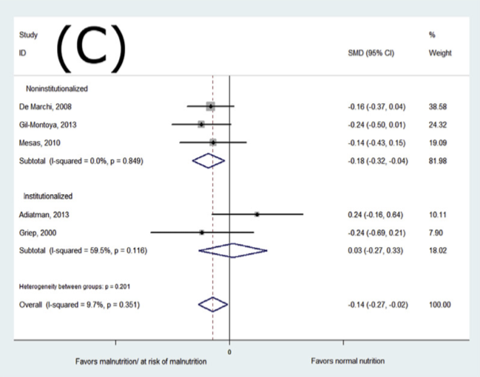
Forest plot for mean number of teeth
Noninstitutionalized
Institutionalized
Favors malnutrition/ risk of malnutrition
Favors normal nutrition
SMD -0.14 (95% CI -0.28 to -0.005)
I² =9.7%, p=0.351
Notes:
Finally, in the measure of association analyzed for the mean number of teeth:
We see that malnourished subjects had significantly fewer teeth in comparison with individuals with normal nutrition, the SMD of -0.14; 95% CI -0.28 to -0.005.
The subgroup analysis revealed that the noninstitutionalized individuals accounted for this difference (SMD 0.18; 95% CI 0.32 to 0.04).
There was no risk of bias and low heterogeneity for this analysis (I² =9.7%, p=0.351), and no meta-regression was performed.

Slide 22
Study validity
Notes:
Having looked at the results of the meta-analysis, we now move on to evaluating the validity of this MA.

Slide 23
Study validity
Addressed a focused clinical question
Individual studies were adequately assessed for validity
Meta-analyses limited to cross-sectional studies
Search criteria
No clear definition of independent variables
Notes:
The pros of this MA are highlighted by the green bullets:
1. Authors had a clear aim and addressed a focused clinical question “Is malnutrition or risk of malnutrition, related with oral health status in older adult subjects?”
2. Individual studies included were also adequately assessed for validity-
Two researchers (PSA and FWMGM) independently assessed the risk of bias within the studies, and used the Agency for Healthcare Research and Quality (AHRQ) scale for cross-sectional studies [19] and by the Newcastle-Ottawa quality assessment scale for the case-control and cohort studies.
Researchers also had a kappa agreement of 0.87 in article selection but it was unclear on the researcher agreement in terms of assessing risk of bias in selected studies.
The downside of this MA include:
1. SR of mainly cross sectional studies, only 1 cohort study and 1 clinical trial, which limits the quality of the results as cross sectional studies at best show associations but do not evalulate temporality.
2. Perhaps the search criteria could have been more comprehensive. The current search strategy was limited to only 3 databases, although authors of selected studies were contacted if additional data was required
There was no mention of hand searched articles, dissertations, conferences, and this could potentially bias results.
I also felt that independent variables could be more clearly defined.
For example, in the case of prosthesis use- are all subjects dentate, meaning they had some natural teeth remaining, and wore partial dentures? Or were edentulous subjects who wore complete dentures included in this group too?
We know that people with natural teeth have better chewing function in terms of biting force and chewing efficiency compared to complete dentures that rely entirely on their gums for support. This could affect potentially affect food choices and nutrition as people wearing complete dentures may go for softer foods generally higher in fat and sugar and lacking in certain nutrients.

Slide 24
Results appraisal
Edentulism and prosthesis use was not associated with nutritional status.
Number of teeth was associated with nutritional status.
Individuals with malnutrition/ at risk of malnutrition had fewer number of teeth present (0.14 teeth).
Notes:
Individuals with malnutrition/ at risk of malnutrition had less number of teeth present (0.14 teeth) whereas the use of prosthesis and edentulism had no association with nutritional status.

Slide 25
Results appraisal
Are the results consistent across studies?
High heterogeneity in studies
Small number of studies in meta-analysis
Risk of bias
Clinical relevance of difference in number of teeth should be interpreted with caution
Notes:
Are the results consistent across studies?
We observed high heterogeneity in studies included in the edentulous (I² 40%) and prothesis-use (I² 78%) analyses indicating large differences between trials.
The authors were not able to account for the heterogeneity even though they investigated the effect of age in the meta-regression analysis.
A possible reason could be due to the small number of studies included in meta-analyses.
Other reasons that may contribute to the heterogeneity include differences in study design, definition of patient groups not clearly specified,
For example, in the edentulous group- it was not specified if all edentulous subjects were wearing a set of upper and lower complete dentures, or if some were only wearing a single complete denture, or none in both jaws. Again, this could affect chewing efficiency, food choices and nutrition.
Only 2 studies reported the analysis of denture use in edentulous subjects-Lamy (7) and De Marchi (10). Lamy’s study was not included in the meta analysis.
All studies also had a risk of bias in their study design, one of which was the absence of blinding of examiner to nutritional status.
Case control study 4/9 stars based on the new-castle ottawa scale, evaluated according to the case definition, representativeness of cases, definitions of control, comparability of cases and controls. The cohort study had a low risk of bias (8/9 stars). Only 10/23 cross sectional studies received 6-7 “yes” out of 10 of the AHRQ evaluation criteria. All cross sectional studies had no blinding of the examiner to nutritional status.
Therefore, I would agree with the conclusion of this meta-analysis that the clinical relevance of difference in number of teeth should be interpreted with caution

Slide 26
Application To patient care
Notes:
Can we then apply this evidence about denture therapy in caring for our patient Mrs G?

Slide 27
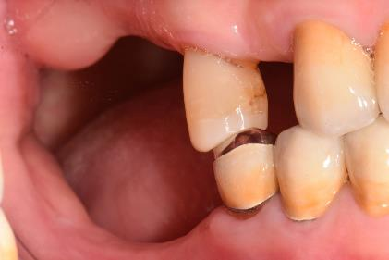
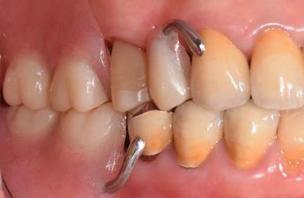
Potential benefits?
Mrs G has 8 natural teeth remaining and lack of posterior chewing teeth.
Dentures would provide more chewing units to help with masticatory function
Access to dental services available in LTC
Notes:
We then consider the potential benefits and harm:
Mrs G is an institutionalized patient with 8 natural teeth remaining but lacked posterior chewing teeth.
The benefit of providing dentures for this patient can be seen by providing more posterior teeth for chewing. She can be taken off the pureed food and switched back to a normal diet, which can give her a better quality of life.
It was reported that the number of functional tooth is a reliable indicator of chewing and determines chewing ability.
It was shown that individuals without posterior occluding pairs were twice more likely to be malnourished and had reduced nutritional intake.
Treatment was also feasible as she had ready access to dental services in the nursing home

Slide 28
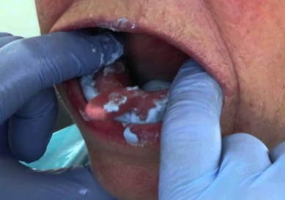
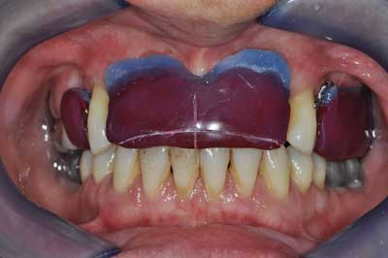
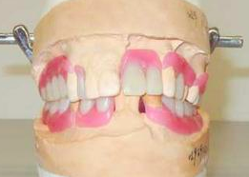
Potential harm?
Mrs G has 8 natural teeth remaining and lack of posterior chewing units.
Inability to undergo clinical procedures
Difficulties with adapting to new dentures
Inability to maintain dentition
Inability to report pain with dentures
Notes:
However, potential harm to the patient include possible inability to tolerate and understand multi-step procedures in denture fabrication,
Even if we have successfully made her a new set of dentures, she may not necessary have the motor skills and adaptive capabilities to learn to wear and control her dentures given the severity of her dementia.
Maintain health of oral soft tissues and teeth after introduction of dentures may prove to be a challenge for her. If her hygiene remains poor,she might develop more dental caries, gum disease and further loss of teeth.
Also, she may be unable to express pain or discomfort from her dentures, which could affect her eating.
It was reported that the number of functional tooth is a reliable indicator of chewing and determines chewing ability.
This systematic review included several studies that reported the data of occluding pairs and FTUs, which shows that individuals without posterior occluding pairs were twice more likely to be malnourished and had reduced nutritional intake.

Slide 29
Nutrition
Masticatory function
Medical conditions
Medication
Environmental factors
Social factors
Physical factors
Nutritional choices
Notes:
So after weighing the benefits and harm of treatment, we proceeded with making new dentures for her.
Nonetheless, we must understand that masticatory ability and efficiency provided by denture use is not the only contributor to adequate nutrition.
In Mrs G’s case, other contributing factors to her inadequate nutrition and weight loss include:
Medical conditions: dementia, respiratory infection, depression
Medications that affect appetite
Environmental factors: institutionalization, social environment at mealtimes
Social factors: institutionalization
Physical factors: loss of independence and ADLs, need for assistance with feeding, getting her out of bed to walk/ stimulate appetite
All of which can play a role in affecting her nutritional status
This patient case highlights the fact that oral health can play a small but significant part in the nutritional status our geriatric patients and our care should never be in isolation but always an interdisciplinary approach.
Thank you.

Slide 30
Thank you

Slide 31
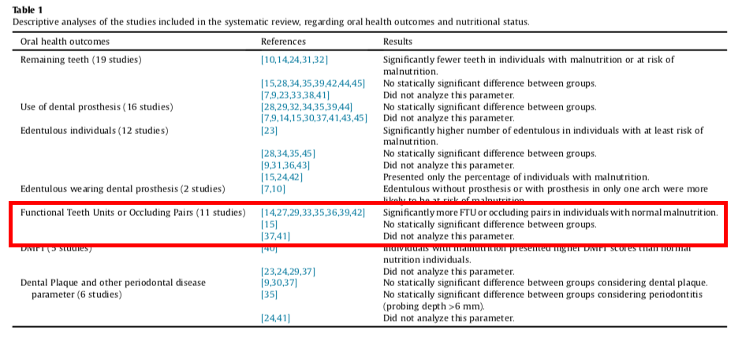
Notes:
Several studies reported in functional tooth units but a quantitative assessment was not possible for this variable.
The literature showed individuals without posterior occluding pairs were twice more likely to be malnourished.
Those with less than 4 FTU have deficient masticatory function and avoided hard to eat foods such as vegetables and meat, which explains the increased risk of malnutrition.

Slide 32
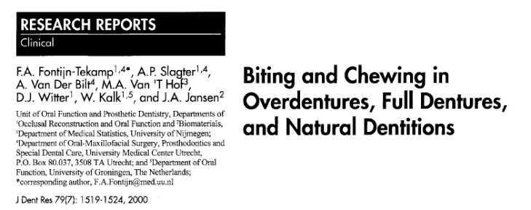
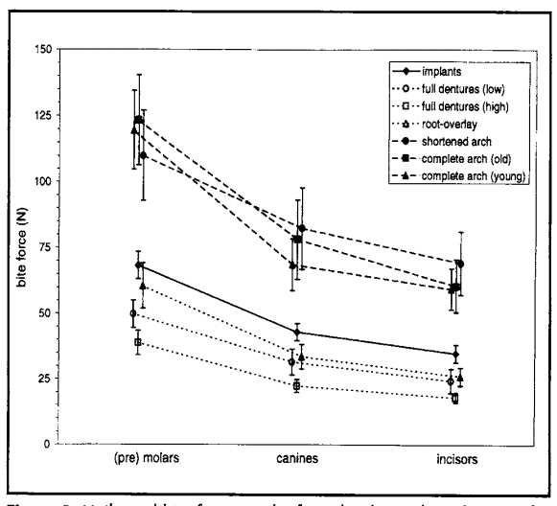

Slide 33
Mrs G
Problem list:
Missing teeth
Malnutrition (Weight loss)
Multiple comorbidities

Slide 34
Malnutrition
Acute, subacute or chronic state of nutrition, in which a combination of varying degrees of overnutrition or undernutrition with or without inflammatory activity have led to a change in body composition and diminished function
  ASPEN, the American Society for Parenteral and Enteral Nutrition

Slide 35
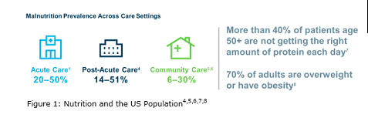
Malnutrition

Slide 36
Malnutrition
Diagnosis
1 phenotype criterion: non-volitional weight loss, low BMI/ reduced muscle mass (muscle wasting, fluid (edema), hand grip strength, energy intake
1 etiology criterion: reduced food intake/ malabsorption/ severe disease with inflammation

Slide 37
Random effect model
True effect vary from study to study
REM estimates mean distribution of true effect
Each study is estimating a different effect size
  Weights are more balanced
2 sources of error
  Each study used to estimate true effect (error depends on number of subject)
  All true effects are used to estimate mean of true effects (error depends on number of studies)

Slide 38
Random effect model
Assumptions:
  Individual specific effects not related to independent variable

Slide 39
Fixed effect model
Assumes one true effect size shared by all studies
Weights assigned based on information captured in study
Large study = more weight
Random error is the only source of error

Slide 40
Fixed effect model
Assumption:
  Indiviudal specific effect is related with independent variable

