Slide 1
Pre-operative Geriatric Evaluations
Leah Taffel, md
Journal club 1/19/18

Slide 2
CASE
  Ms. F is a 76 yo Haitian woman with HTN, HLD, obesity, diet controlled diabetes, and osteoarthritis of bilateral knees
      Knee pain causes her significant distress
      ADLs: 12/12
      IADLs: 6/12
      Has trialed acetaminophen 1000mg TID
      Minimal improvement with steroid injection
      Has not tried PT due to cost

Slide 3
CASE
  Exam consistent with severe osteoarthritis
  Prescribed:
      Acetaminophen 1000mg TID
      Capsacin BID
      Tramadol 25mg daily prn
      Gave cane
  Also discussed possibility of needing bilateral knee replacements in the future

Slide 4
PICO
  P – Older adults requiring elective surgery
  I – Preoperative intervention
  C – No intervention
  O – Improve outcomes
            Mortality
            Readmissions
            Functional status

Slide 5
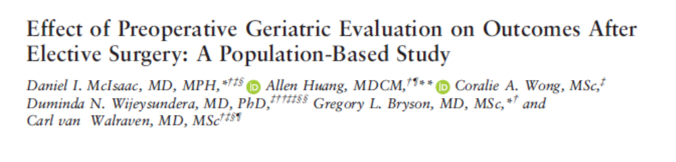
  Retrospective Cohort study
  Canadian hospital system
  Published in JAGS in 2017

Slide 6
RATIONALE
  Older people are fastest growing group of individuals undergoing surgery
  Advanced age associated with morbidity, mortality, and increase resource use after surgery
  Reason for poorer outcomes include:
      Frailty
      Cognitive impairment
      Multimorbidity

Slide 7
RATIONALE
  Single center and non randomized control studies have shown that perioperative geriatric care leads to:
      Decreased length of stay (LOS)
      Lower rates of complications
  Population level effect of geriatric evaluation has not been studied

Slide 8
METHODS
  Population based cohort study in Ontario
  9 national health administrative databases
  Created analytic data set
  Study analyst, lead author, senior author looked over data

Slide 9
STUDY POPULATION
  All individuals ≥ 65 years old in dataset
  Undergoing elective non-cardiac surgery
      Total hip and knee replacements
      Peripheral arterial bypass
      Carotid endarterectomy
      Colorectal surgery
      Nephrectomy, lobectomy, cystectomy

Slide 10
STUDY POPULATION
  Surgeries were gender neutral
  Intermediate-high risk operations
  Used codes for tracking
  Participant level cohort
      Only first surgery for each participant was included
  Enrolled from 2002-2012

Slide 11
EXPOSURE
  Outpatient geriatric evaluations 4 months prior to surgery
      Comprehensive Geriatric Assessment (CGA)
          ≥ 90 minutes
      Focused consultation
          20-75 minutes
  Used billing codes that had been previously validated to capture desired assessments

Slide 12
COMPREHENSIVE GERIATRIC ASSESSMENT
  Multidisciplinary diagnostic and treatment process that identifies medical, psychosocial, and functional limitations of older frail adults
  Goal is to create a comprehensive and coordinated treatment plan
  Lead to better health outcomes

Slide 13
COMPREHENSIVE GERIATRIC ASSESSMENT
  Who should be referred:
      Older Age
      Medical comorbidities
      Psychosocial disorders
      Dementia
      Frequent Falls
      Functional disability
      High health care utilization
      Considering changing living situation

Slide 14
COMPREHENSIVE GERIATRIC ASSESSMENT
  Core components:
      Functional capacity
      Fall risk
      Cognition
      Mood
      Polypharmacy
      Social support
      Financial concerns
      Goals of care
      Advance care preferences

Slide 15
OUTCOMES
  Primary outcome: 90 day postoperative survival
  Secondary outcomes:
      Complications
      Length of stay
      Supported discharge
      30 day readmission rate
      Total healthcare cost in 90 days post surgery

Slide 16
COVARIATES
  Demographic characteristics
  Frailty defining diagnoses
  Polypharmacy
  High risk medications in 6 months prior to surgery
  Hospitalized-patient one year mortality risk score (HOMR)
  Rural vs. urban
  Participant’s neighborhood income
  Emergency visits or hospitalizations the year before surgery

Slide 17
SAMPLE SIZE
  Population based study
  Enrolled ALL ELIGIBLE individuals in Ottawa, Onario
  With estimated 2% short term mortality in similar populations
      Powered to 80%
      5% level of significance
      Only needed 7,286 participants per arm to detect a 30% relative decrease in mortality

Slide 18
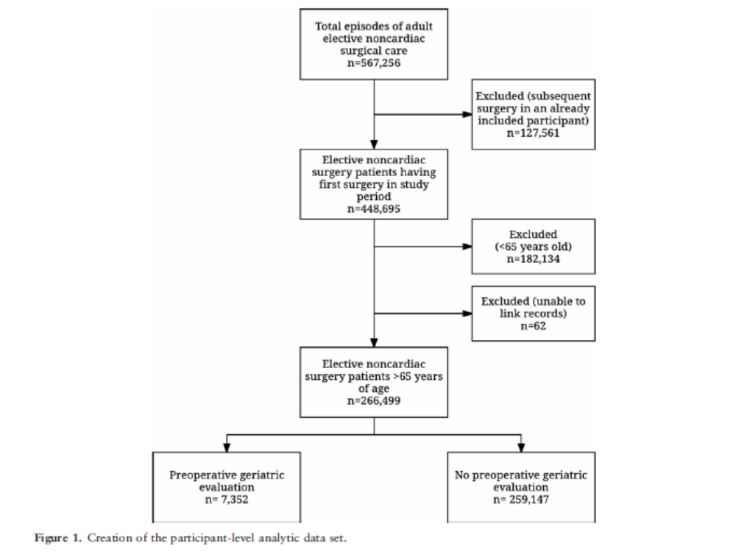

Slide 19
Geriatric Consultations
n = 6,506
Preoperative Geriatric Evaluations
n = 7,352
(2.8% patients)
Comprehensive Geriatric Assessment
n = 846

Slide 20
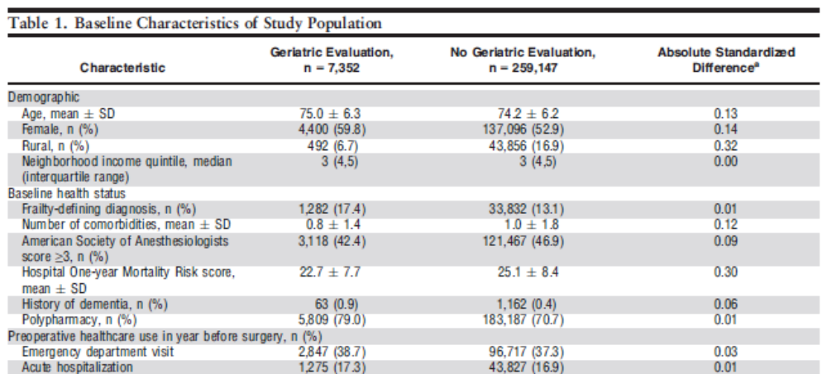

Slide 21
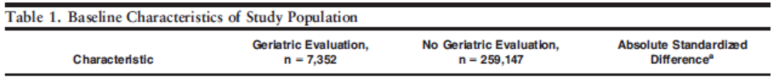
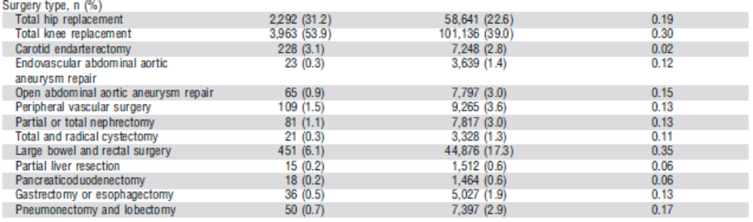

Slide 22
ANALYSIS
  Looked at proportional hazard regressions and hazard ratios
  Unadjusted and adjusted analysis on primary and secondary outcomes

Slide 23
90 DAY POST OPERATIVE MORTALITY
Exposure | Expired (n) | Expired (%)
Pre-op Geriatric Evaluations | 103 | 1.4%
No Geriatric Evaluations | 6,172 | 2.4%
 | Hazard Ratio
Unadjusted | HR = 0.59 (0.48-0.71, P<0.01)
Adjusted | aHR = 0.81 (0.68-0.95, P= 0.01)

Slide 24
SUBANALYSIS OF PRIMARY OUTCOME
  Preoperative geriatric consultations were significantly associated with longer survival
      aHR = 0.79 (0.65-0.97, P = 0.02)
  Survival was longer for CGA patients, but not statistically significant
      aHR = 0.88 (0.61-1.27, P = 0.50)
      Unclear if powered appropriately to detect subgroup analysis

Slide 25
SUBANALYSIS OF PRIMARY OUTCOME
  When comparing patients with:
        No geri evaluation
        Pre-op geri evaluation
        Pre-op and post op geri evaluation
  Increase in survival only seen in those with pre-op geriatric evaluation
        aHR = 0.77 (0.62-0.93, P = 0.008)

Slide 26
SUBANALYSIS OF PRIMARY OUTCOME
  When only looked at orthopedic surgeries, still had longer survival in those with geriatric evaluations
      aHR = 0.71, (0.52-0.98, P= 0.04)

Slide 27
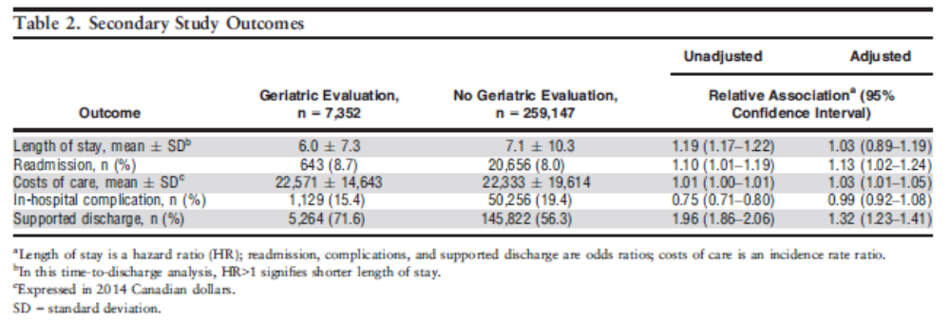

Slide 28
SECONDARY OUTCOMES
  Once results adjusted:
      Suggests no difference in complication rate or length of stay
      Those who had pre-op geriatric evaluation:
          More likely to be discharged to supportive care
          Higher rate of readmissions
          Higher cost of care

Slide 29
CLINICAL APPRAISAL
  Were there clearly defined groups of patients, similar in all important ways other than exposure to treatment?
        No, the geriatric evaluation group had significantly higher frailty, polypharmacy, and acute hospitalizations/ED visits

Slide 31
CLINICAL APPRAISAL
  Were there clearly defined groups of patients, similar in all important ways other than exposure to treatment?
        No, the geriatric assessment group had significantly higher frailty, polypharmacy, and acute hospitalizations
        Therefore, results biased against the geriatric evaluation group
        Tried to account for these biases by covariate analysis

Slide 32
CLINICAL APPRAISAL
  Were treatments and clinical outcomes measured in the same ways in both groups?
        Treatments and outcomes were measured by codes extracted from data sets
        Not randomized groups, but outcomes being measured were not known at the time of intervention
  Was the follow-up of the study patients sufficiently long enough?
        Yes, because primary outcomes being measured were 90 day mortality

Slide 33
CLINICAL APPRAISAL
  Is it clear that the exposure preceded the onset of the outcome?
        Yes, patients underwent geriatric evaluation within 4 months prior to surgery
  Does the association make biological sense?
        Yes, as geriatricians, we believe that doing geriatric assessments helps identify vulnerabilities that would otherwise be missed. By identifying syndromes, we can help prevent adverse outcomes and provide support

Slide 34
CLINICAL APPRAISAL
  Can we apply the valid, important results of this study to our patient?
        Our patient is similar in demographics to the study participants
        No harm identified by undergoing geriatric evaluation

Slide 35
CASE
  How does this affect my patient?
      Plan to do a full geriatric assessment prior to her undergoing surgery in the future

Slide 36
KEY POINTS:
  In patients undergoing elective, non-cardiac surgery, preoperative geriatric evaluations:
      Associated with greater likelihood of 90 day survival
      More likely to have supportive discharges
      Did not identify improvement in costs, LOS, complication rates, readmissions

