Slide 1
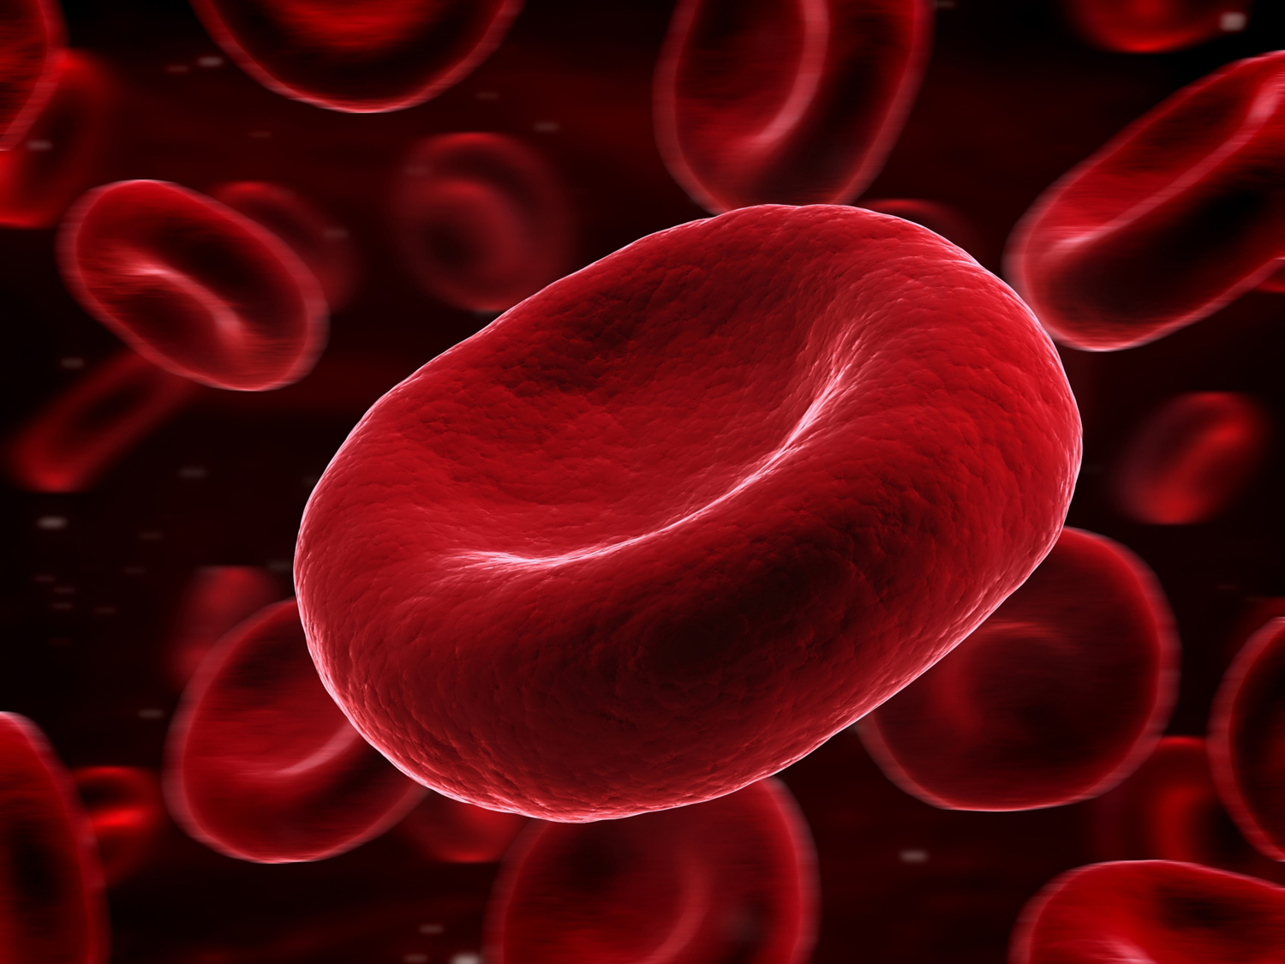
Journal Club
Meredith Rees Halpin, MD
Geriatric Oncology Fellow
Boston University Medical Center
March 23, 2018

Slide 2
Clinical Case
81 year old clinic patient with CAD s/p CABG in 1990, HTN and glaucoma presents for follow up.
He is an active man and reports feeling well. He travels to Florida each winter and regularly plays golf, and is seen in clinic to assure all is well prior to travel.
His HTN is well controlled, he follows with cardiology annually, and has had no anginal symptoms.
Routine laboratories reveal a hemoglobin of 13.1 g/dL, 1 year ago was 13.7, and 2 years prior was 14.1.
CBC normal in all parameters, FIT testing this year negative. Normal renal function and no evidence of blood loss or nutritional deficiency.

Slide 3
PICO
P: Community dwelling geriatrics clinic patients with declining hemoglobin
I: None
C: Patients without a decline in hemoglobin
O: Difference in health outcomes

Slide 4
Background
Anemia is associated with increased morbidity and mortality in the elderly.
Hemoglobin levels decrease with age, and are determined by a complex interplay of environmental and genetic factors.
What a normal hemoglobin level for older adults is not as clear, and studies question if WHO anemia criteria are sensitive enough.
Known differences exist between racial groups.
Anemia has been associated with functional, cognitive and mortality endpoints in population studies.

Slide 5

WHO CRITERIA
Suggested by committee and published in 1968
Defines anemia as
Hgb <13 g/dL in adult men
Hgb <12 g/dL in adult women

Slide 6
Background
Impact of anemia on mortality, cognition, and function in community dwelling elderly. American Journal of Medicine 2006
Prospective cohort study of 1700 men and women over age 71.
Anemia (WHO criteria) prevalence 24%
8 year mortality HR 1.7 (95% CI, 1.5-2) for anemic subjects and did not differ by sex or race
Anemia associated with poorer physical function and cognitive status (p = 0.0001)
Notes:
Hgb measured at baseline, and 4 year follow up for fucntional status with ADLs, cognition with SPMSQ, death national death index.

Slide 7
Background
A prospective cohort study looking at anemia and MRI correlation with white matter hyper-intensities showed an increased risk of worsening in patients with anemia and hypertension.
In heart failure patients, a study showed that a 1.6 g/dL decrease in hemoglobin over 1 year was associated with a 1.6-fold increased mortality over subsequent follow-up.
Notes:
WMH (consequence of small vessel disease)

Slide 8
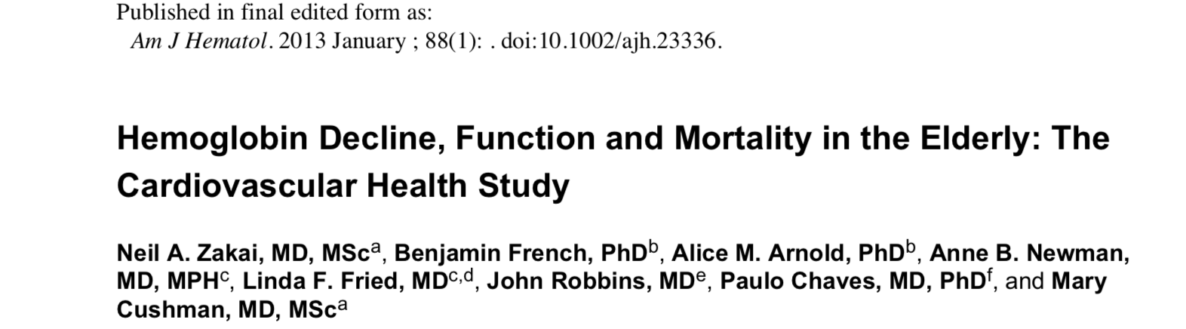


Slide 9
Study Design
Prospective observational cohort study
Conducted in 4 US communities of risk factors for and consequences of cardiovascular disease in adults >65 years.
Baseline and follow up interviews and physical exams using standardized tools
MMSE
Grip strength
Gait speed
Labs: Complete blood counts, creatinine and inflammatory markers

Slide 10
Study Design
Contacted semi-annually alternating between phone and in person interviews.
Repeat assessments
Labs drawn at baseline and 3 years

Slide 11
Exclusion Criteria
Wheelchair bound
Receiving active treatment for cancer
Institutionalized
Inability to consent

Slide 12
Objectives
To examine if decline in hemoglobin levels, would identify a group of elders at risk for subsequent physical and cognitive decline and increased mortality independent of absolute hemoglobin concentration.

Slide 13
Statistics
Baseline characteristics were compared across groups using t-tests, χ2 tests, or Wilcoxon rank-sum tests.
Linear or logistic regression models were used to evaluate the association of baseline characteristics and hemoglobin decline.
Generalized estimating equations with an exchangeable correlation structure were used to investigate the association between measures of hemoglobin change and longitudinal measures of cognitive and physical function.
We used age-, sex-, race-, hypertension-, CVD-, diabetes, CKD-, and baseline hemoglobin- adjusted Cox proportional hazard models to quantify the association between hemoglobin change and all-cause mortality
Notes:
Covariates were chosen for multivariable models based on previous data from the CHS and the association of the covariates with measures of hemoglobin change.

Slide 14
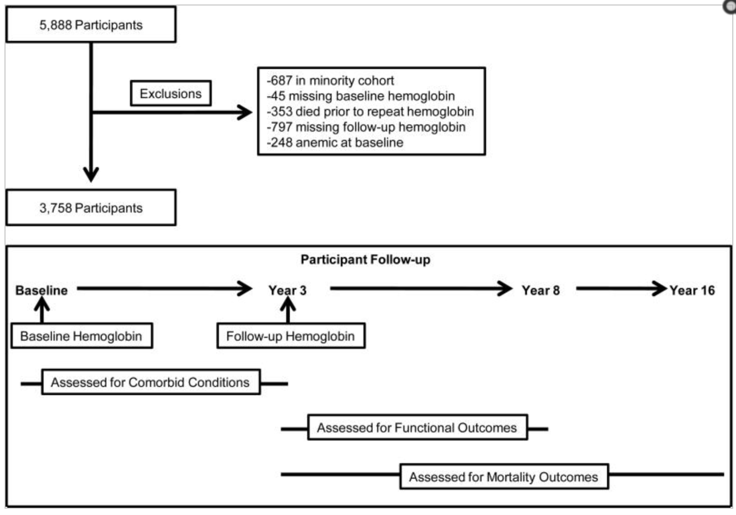

Slide 15
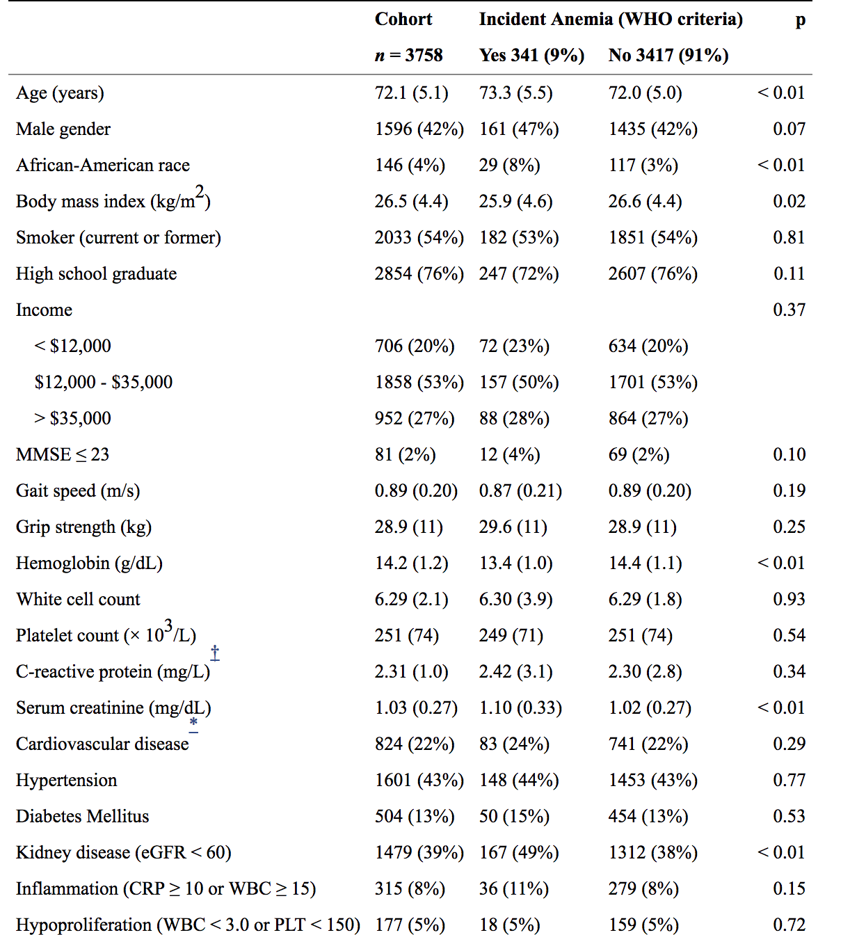
Notes:
baseline hemoglobin was 14.2 (1.2) g/dL; 15.0 (1.0) for men and 13.8 (0.9) for women
Increased Age, Black race, lower BMI, CKD, higher creatine and lower hemoglobin were more common among those with incident anemia

Slide 16
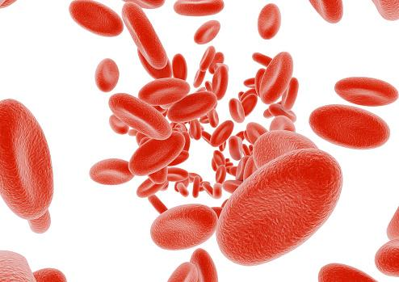
65% of patients who developed anemia had a >1 g/dL drop in hemoglobin
Only 27% of patients with a hemoglobin decline of >1g/dL developed anemia

Slide 17
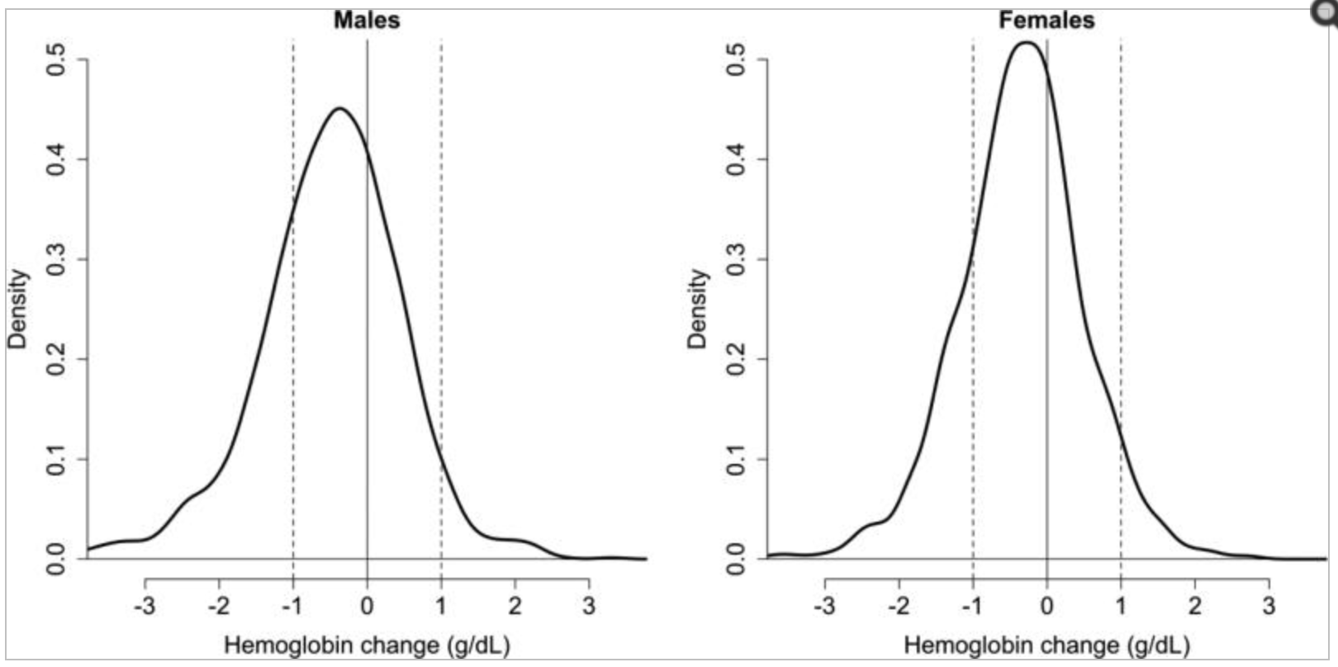
Notes:
The median 3 year change in hemoglobin was -0.4 overall, 0.5 for women and 0.3 for men.

Slide 18
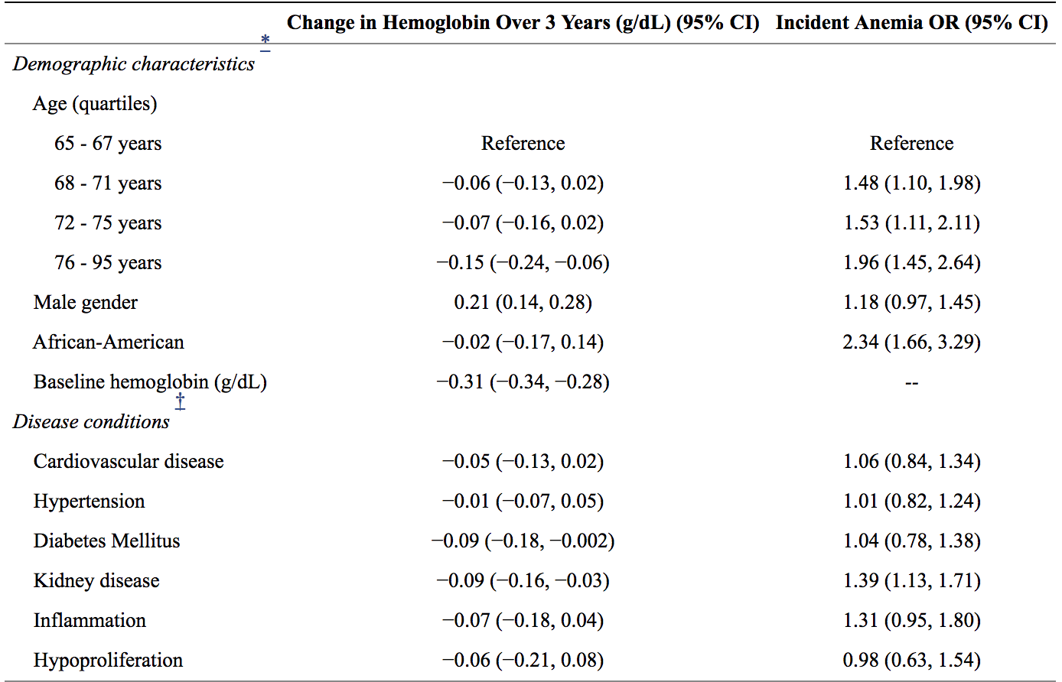
Notes:
Increasing age, male, higher baseline hgb, baseline cvd, dm, and ckd were associated with an Hgb decline over 3 years. And age, male, black, lower baseline hgb and ckd were associated with anemai development. In a multivariable linear regression models including age, gender, race, and baseline hemoglobin; increasing age, being male, higher baseline hemoglobin, baseline CVD, diabetes, and CKD were associated with a hemoglobin decline over 3 years (Table II). Older age, male sex, black race, lower baseline hemoglobin and CKD were associated with anemia development (Table II).

Slide 19
Hazard Ratio for Mortality
Category | Hazard Ratio | 95% CI
Incident Anemia | 1.39 | 1.15-1.69
Hemoglobin Decline (>1g/dL) | 1.11 | 1.04-1.18
Notes:
After adjusting for baseline age, sex, race, htn, cvd, dm, ckd and follow up hemoglobin both incident anemia and hemoglobin decline were associated with increased mortality. There was a significant interaction between Hgb change and follow up Hgb and subsequent mortality p = 0.03

Slide 20
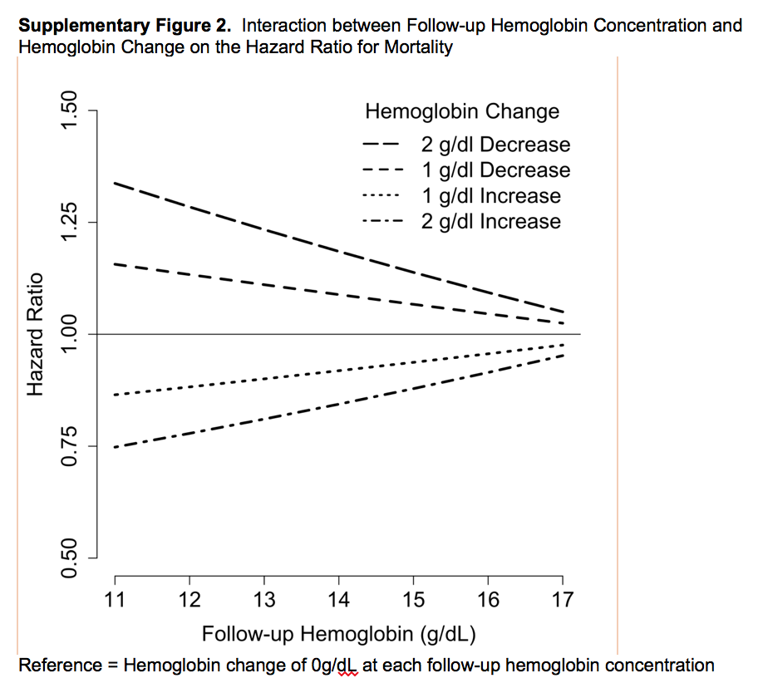
Notes:
Hemoglobin decreases at lower baseline levels were associated with a greater risk of mortality than decreases at higher baselines.

Slide 21
Median hemoglobin level declined 0.4 g/dL over 3 years.
9% of participants developed anemia.
Each 1 g/dL decrease in hemoglobin was associated with increased odds of developing CKD, inflammation, and other cytopenias.
Lower hemoglobin was associated with future lower gait speed and MMSE scores in women, and decreased future grip strength in men and women.
Notes:
Decline in all participants

Slide 22
Critical Appraisal- Validity
Was there a representative and well defined sample of patients at a similar point in the course of disease? 3758 community dwelling adults, predominantly white, representative mix of comorbidities at baseline.
Was follow up sufficiently long and complete? Yes, 16 years.
Was there adjustment for important prognostic factors? Yes, adjusted for baseline age, sex, race, hypertension, cardiovascular disease, diabetes, ckd and follow up hemoglobin. Still anemia and hemoglobin decline were associated with increased mortality.

Slide 23
Critical Appraisal- Results
How large is the likelihood of the outcome events in a specified period of time? Hazard ratio of mortality with anemia was 1.39, and for decline in hemoglobin was 1.11
How precise are the estimates of likelihood? Fair, confidence intervals are narrow, but for decline in hemoglobin is very close to 1.

Slide 24
Implications for patient care
Were the study participants similar to my own? Not as racially diverse.
Will the results lead directly to selecting or avoiding therapy? No, these results do not help guide therapy, work up and treatment of anemia should be managed as per existing guidelines.
Are the results useful for reassuring or counseling patients? Not enough information at this time, although having read this paper change in hemoglobin and development of anemia are associated with mortality. May serve as a marker, and help when thinking about goals of care.

Slide 25
Questions raised but not answered….
Is anemia causal or a marker?
Will interventions to increase hemoglobin or stop decline improve outcomes?
Should we be using change in hemoglobin over time as opposed to WHO cutoffs?
Do interventions to increase hemoglobin other than treating nutritional deficiencies, addressing blood loss, and managing chronic diseases have any role?

Slide 26
Conclusion for my patient
His decrease in hemoglobin by 1 g/dL over the last 2 years may be associated with worse functional outcomes and mortality. Will continue to monitor, although at this time does not warrant any intervention.

Slide 27
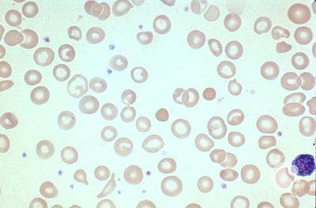
Questions?

