Slide 1
Comprehensive Geriatric Assessment in
Management of Older Adults With Advanced Non–Small-
Cell Lung Cancer:
Hossein Sadrzadeh, MD
The Section of Geriatrics
04/12/2019

Slide 2
My Patient
76 year old male
  HTN
  HLD
  Grade I diastolic dysfunction
  Gout
  ADLS :12/12
  IADLS: 16/16

Slide 3
My Patient
Newly diagnosed Stage IV NSCLC (adenocarcinoma)
Was diagnosed when admitted to hospital for post-obstructive PNA
Tumor board
Immunotherapy alone with Pembrolizumab

Slide 4
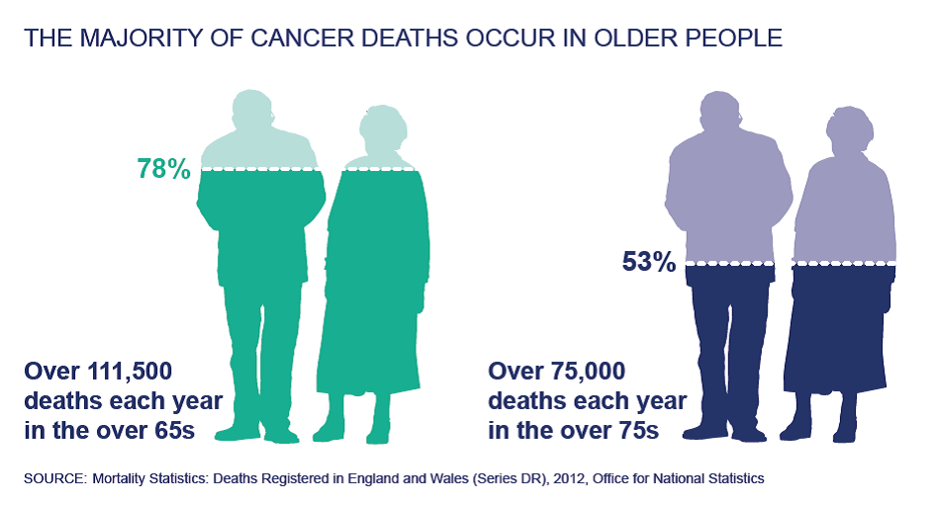
Cancer in older adults
Incidence 11-fold higher
Over 60% of newly diagnosed cancer
Heterogeneous
Medical oncologists often tend to overestimate patients fitness for chemotherapy *

Slide 5
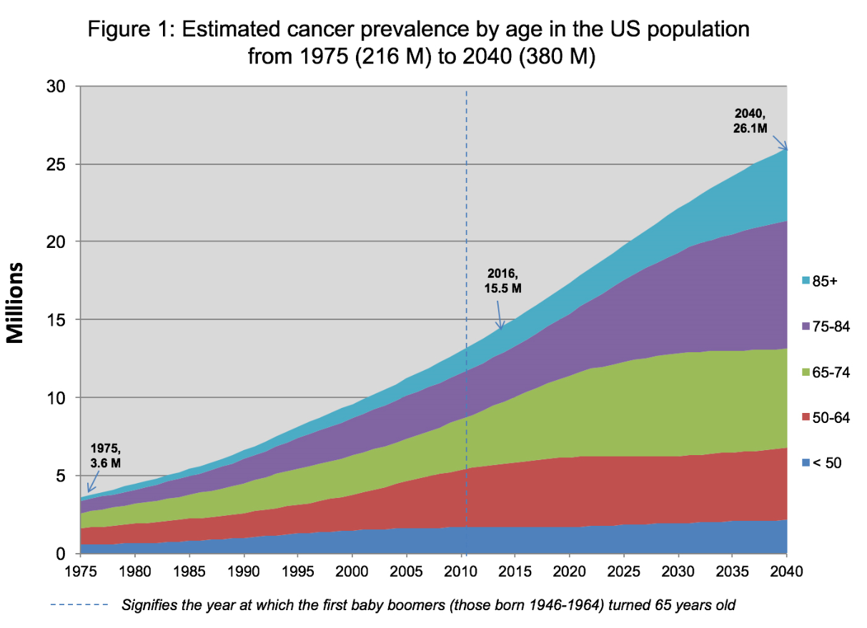
~80% ≥ 65

Slide 6
cancer acts differently in older adults
Heterogeneity of health status
Panoply of physiologic changes
Atypical presentations of common illnesses
Increased importance of social support
Increased rate of adverse events to medications or therapies
Goals of therapy
Notes:
It is also necessary to determine how unique geriatric conditions and/or comorbidities may predispose to effects of chemotherapy leading to specific toxicities
it is also critical to determine how the patient's status may be improved, to define what remedial measures might be instituted and to identify appropriate social support arrangements that may improve opportunities for better outcomes
Of even greater significance is the need to identify prognostic factors in the elderly that may be predictive of short-term mortality. Thus, it is important to distinguish between chronologic age, physiologic age and associated geriatric conditions and comorbidities to more effectively decide when and with what to treat older cancer patients.

Slide 7
Fitness
One of the most important challenges
Who if FIT?
S/He looks younger?
Level of reserve?
An individual’s level of physiological reserve becomes unmasked during cancer therapy when the need arises to rely on this reserve

Slide 8
Frailty
Frailty is a state of extreme vulnerability to stressors that leads to adverse health outcomes
Approximately 10% to 20% of ≥65 years
Incidence doubles in those ages 85 years and older

Slide 9
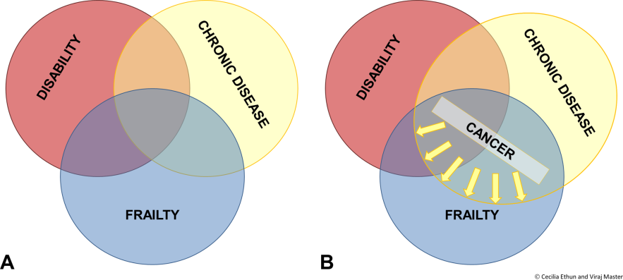
Frailty and cancer: Implications for oncology surgery, medical oncology, and radiation oncology
(A)The Overlapping Existence of Frailty With Disability and Chronic Disease.
(B)When chronic disease includes cancer, patients are at greater risk of having disability and frailty.
Frailty and cancer: Implications for oncology surgery, medical oncology, and radiation oncology, Volume: 67, Issue: 5, Pages: 362-377, First published: 21 July 2017, DOI: (10.3322/caac.21406)
Notes:
The Overlapping Existence of Frailty With Disability and Chronic Disease (A). When chronic disease includes cancer, patients are at greater risk of having disability and frailty (B).
IF THIS IMAGE HAS BEEN PROVIDED BY OR IS OWNED BY A THIRD PARTY, AS INDICATED IN THE CAPTION LINE, THEN FURTHER PERMISSION MAY BE NEEDED BEFORE ANY FURTHER USE. PLEASE CONTACT WILEY'S PERMISSIONS DEPARTMENT ON PERMISSIONS@WILEY.COM OR USE THE RIGHTSLINK SERVICE BY CLICKING ON THE 'REQUEST PERMISSIONS' LINK ACCOMPANYING THIS ARTICLE. WILEY OR AUTHOR OWNED IMAGES MAY BE USED FOR NON-COMMERCIAL PURPOSES, SUBJECT TO PROPER CITATION OF THE ARTICLE, AUTHOR, AND PUBLISHER.

Slide 10
Commonly uses tools by oncologists
Clinical Judgment
Performance Status (ECOG – Karnofsky)
CARG score Cancer and Aging Research Group
Notes:
0
Fully active, able to carry on all pre-disease performance without restriction
1
Restricted in physically strenuous activity but ambulatory and able to carry out work of a light or sedentary nature, e.g., light house work, office work
2
Ambulatory and capable of all selfcare but unable to carry out any work activities. Up and about more than 50% of waking hours
3
Capable of only limited selfcare, confined to bed or chair more than 50% of waking hours
4
Completely disabled. Cannot carry on any selfcare. Totally confined to bed or chair
5
Dead

Slide 11

Isn`t he Fit for standard therapy?
Why only Immunotherapy?
Charles Eugster, 96,
https://gephardtdaily.com/what-the/95yearold-man-breaks-200meter-sprint-record/

Slide 12
pico
P:
    Older adults with newly diagnosed advanced NSCLC
I:
    Comprehensive Geriatric assessment before treatment decision making to assess fitness for therapy
C:
    Current commonly used means of assessment tools such as
    age and ECOG PS
O:
    Better mortality and morbidity outcome

Slide 13
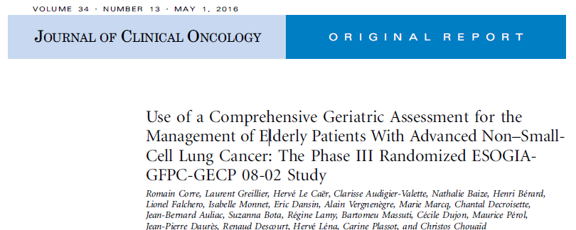

Slide 14
Study
Multicenter (45 centers in France & Spain)
Open label
Randomized
Phase III trial
≥70 years with stage IV NSCLC
A prospective cohort study
Between January 2010 and January 2013
Eligibility criteria
  age ≥ 70 years,
  histologically or cytologically proven advanced NSCLC
  ECOG PS of 0 to 2
  Adequate hematologic, renal, and hepatic function

Slide 15
Outcome Measures
Primary end point :
  Treatment Failure–Free Survival (TFFS)
Secondary end points :
  OS, PFS, OSR, tolerability, QoL, and QoL-adjusted survival
Notes:
TFFS: the time elapsing between random assignment and early treatment discontinuation as a result of any reason (including disease progression, treatment toxicity, or early death), disease progression, or death (resulting from any cause).
EuroQol EQ-5D questionnaires

Slide 16
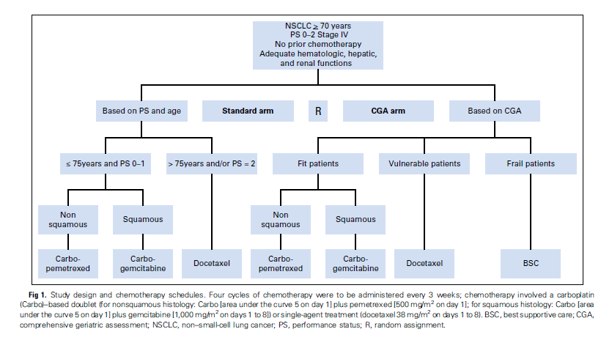
Design

Slide 17
Geriatric assessment
  Diagnostic and treatment process that identified medical, psychosocial, functional limitations of older frail adults
  Goal is to create a comprehensive and coordinated treatment plan for a frail adult
  Identifies a variety of treatable health problems and lead to better health outcomes
Notes:
GA can reveal/detect previously unknown and potentially reversible geriatric problems not found by routine oncology care
GA can predict toxicity/adverse effects from cancer treatment or decrease in QOL, enabling more targeted use of preventive measures
GA has important prognostic information that can be helpful in estimating life expectancy, which is of paramount importance when making treatment decisions
GA can influence/improve treatment decisions
GA allows targeted interventions, which can improve QOL and compliance with therapy

Slide 18
domains
  Core components:
      Physical Ability
      Cognition
      Psychosocial
      Polypharmacy
      Nutrition
      Comorbidities
      Financial concerns
      Advance care preferences

Slide 19
CGA performed by their regular cancer physician
No specific interventions to improve problems detected by the CGA
Randomly assigned at a 1:1 ratio to the two arms

Slide 20
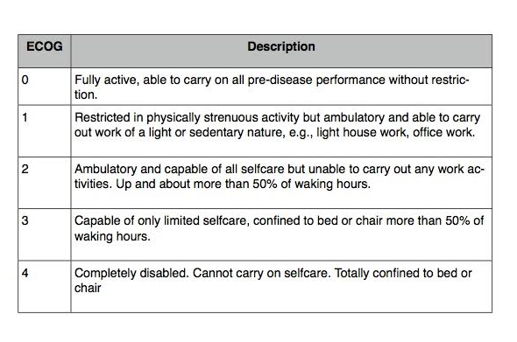

Slide 21
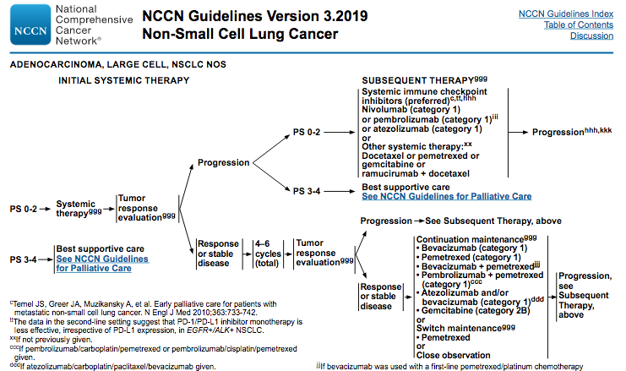

Slide 22
Domain | Scales
Functional status | Eastern Cooperative Oncology Group performance status, Katz basic Activities of Daily Living Scale, Simplified Lawton’s Instrumental Activities of Daily Living Scale
Comorbidities | Charlson comorbidity index
Medications | Number, type, indication
Cognitive function | Folstein Mini-Mental State Examination, Schultz-Larsen Mini-Mental State Examination
Geriatric syndrome | Repeated falls, fecal and/or urinary incontinence
Depression/mood | Geriatric Depression Scale 5, Emotional questionnaire
Nutrition | Body mass index
Mobility | Timed Up and Go test
Situational assessment | Accessibility of services, mobility, social environment, accessibility of home rooms

Slide 23
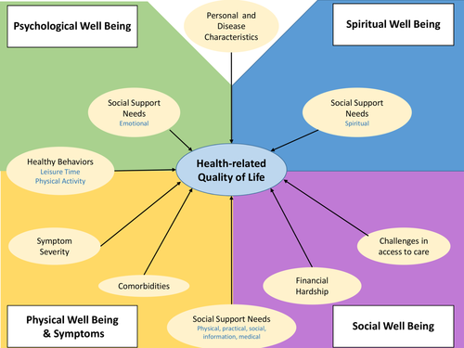
Most impactful factors on the health‐related quality of life of a geriatric population with cancer
Cancer, Volume: 124, Issue: 3, Pages: 596-605, First published: 18 December 2017, DOI: (10.1002/cncr.31048)
Notes:
Conceptual model of relevant domains affecting health‐related quality of life and factors examined.
IF THIS IMAGE HAS BEEN PROVIDED BY OR IS OWNED BY A THIRD PARTY, AS INDICATED IN THE CAPTION LINE, THEN FURTHER PERMISSION MAY BE NEEDED BEFORE ANY FURTHER USE. PLEASE CONTACT WILEY'S PERMISSIONS DEPARTMENT ON PERMISSIONS@WILEY.COM OR USE THE RIGHTSLINK SERVICE BY CLICKING ON THE 'REQUEST PERMISSIONS' LINK ACCOMPANYING THIS ARTICLE. WILEY OR AUTHOR OWNED IMAGES MAY BE USED FOR NON-COMMERCIAL PURPOSES, SUBJECT TO PROPER CITATION OF THE ARTICLE, AUTHOR, AND PUBLISHER.

Slide 24
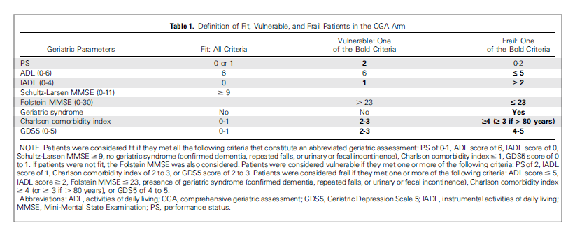

Slide 25
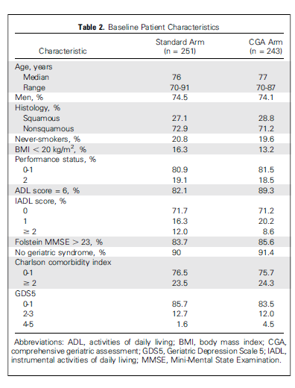

Slide 26
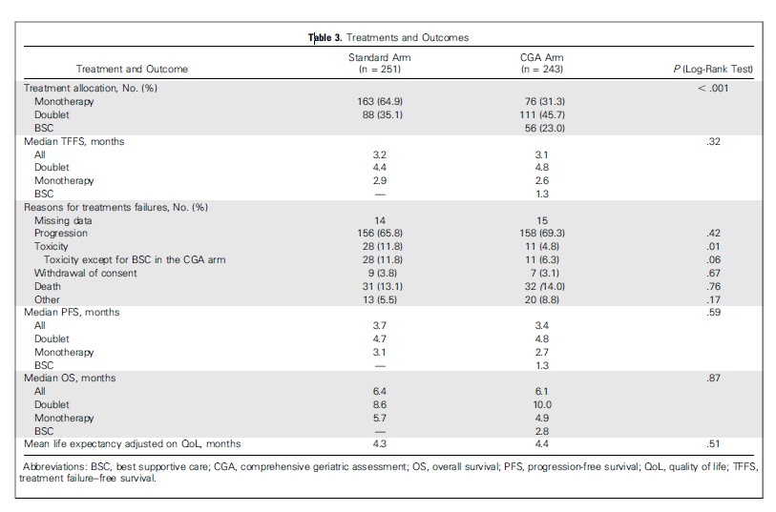

Slide 27
Median time spent on CGA administration was 35 minutes.
All grade AEs
  Standard arm 93.4%
  CGA arm 85.6 P = .015
QoL utility scores at baseline did not differ between the arms
  At each subsequent evaluation, the utility score was always higher in the CGA arm, but the difference was significant only at week 36 (P = .02)

Slide 28
Median follow-up : 4.5 months
Independent predictors of TFFS :
  Charlson comorbidity index ≥ 2
  presence of a geriatric syndrome
  BMI <20
  Being current or former smoker

Slide 29
Screening
Does the study question match your question?
Was the study design appropriate?

Slide 30
VALIDITY
Was the assignment of patients to treatments randomized?
Were all patients who entered the trial accounted for? And were they analyzed in the groups to which they were randomized?
Was follow-up long enough?

Slide 31
VALIDITY
Were the groups similar at the start of the trial?
Were patients, health workers, and study personnel “blind” to treatment?
Aside from the allocated treatment, were groups treated
equally?

Slide 32
CLINICAL IMPORTANCE
How large was the treatment effect?
How precise was the estimate of the treatment effect?

Slide 33
Implications for patient care
Were the study patients similar to my patient?
Will the results lead directly to selecting or avoiding
a treatment?
Are the results useful for reassuring or counseling my patient?

Slide 34
strengths
Multicenter
Large population
Prospective

Slide 35
Limitations
Study Design
Outcome Measures
CGA assessment
no specific interventions to improve problems detected by the CGA

Slide 36

Meet Charles Eugster

