Slide 1
Frailty in Older, Community Dwelling Adults
Leah Taffel, md
Journal club 5/18/18

Slide 2
Case
Ms. B is an 81 year old woman with PMH TIA, HTN, lumbar spinal stenosis, positive PPD who is followed in clinic
  Lives at home with her daughter
  Independent – travels to clinic via ride by herself
  ADLs: 12/12
  IADLs: 14/16
  High fall risk due to lumbar stenosis and fear of falling

Slide 3
Frailty
Frailty
Frailty

Slide 4
AGS got me thinking…
  What really is frailty?
  How do we measure frailty?
  How does it help me frame my thoughts about this relatively independent patient?
  How can I use it in clinic?
  What important outcomes can frailty tell me?

Slide 5
PICO
  P = Community dwelling, older adults
  I = Frailty assessment over time
  C = none
  O = Association with ED visits, hospitalizations, and death

Slide 6
What is Frailty?
  “State of increased vulnerability that results from age related declines in physical reserve and function across multiple organ systems”
  See effects of frailty after a stressor event
      New medication, infection, minor surgery
  Stressor results in striking and disproportionate change in health state
Chen, 2014

Slide 7
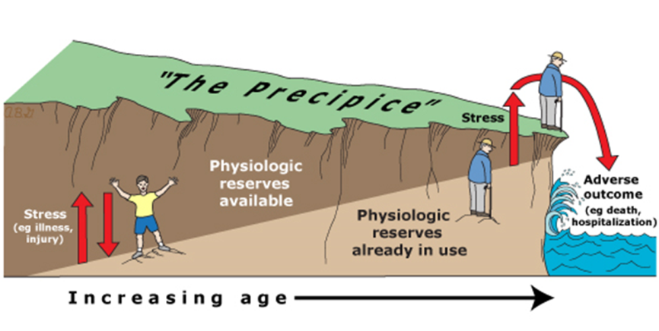
Source: UpToDate, “Normal Aging”

Slide 8
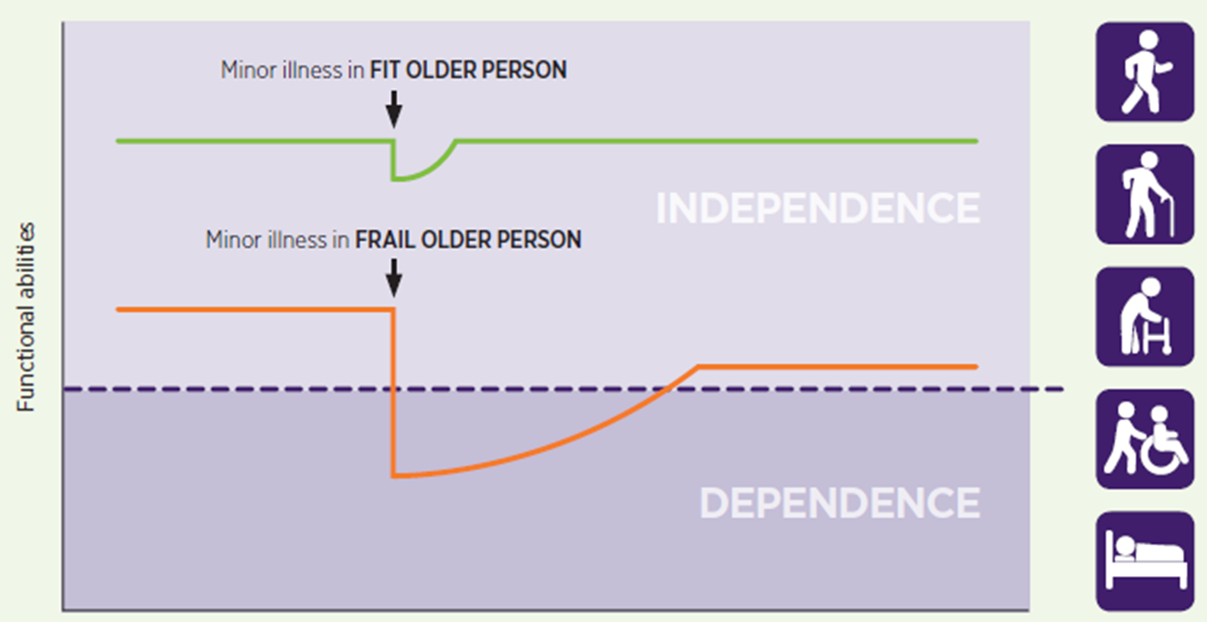
Adapted from Clegg, A et al. Lancet 2013.

Slide 9
Who is frail?
  As people age, there is an increased risk of frailty
  25-50% of oldest adults are frail
  Higher incidence in long term care facilities

Slide 10
Common presentations of frailty
Non-specific | Extreme fatigue, unexplained weight loss, frequent infections
Falls | Falls due to minor illness causing postural imbalance Falls due to decreased vision, balance, strength Falls associated with fear of falling causing development of impaired mobility
Delirium | Rapid onset of fluctuating confusion and impaired awareness
Fluctuating Disability | Some “good days” and some “bad days”

Slide 11
Why do we care?
  Frailty as a syndrome predicts many poor outcomes
Falls
Delirium
Disability
Hospitalizations
Longer length of stay
Readmissions
Rates of long term care
Progression of CKD to ESRD
Poor outcomes in perioperative period
Development of cognitive impairment
Quality of life trajectories
Death

Slide 12
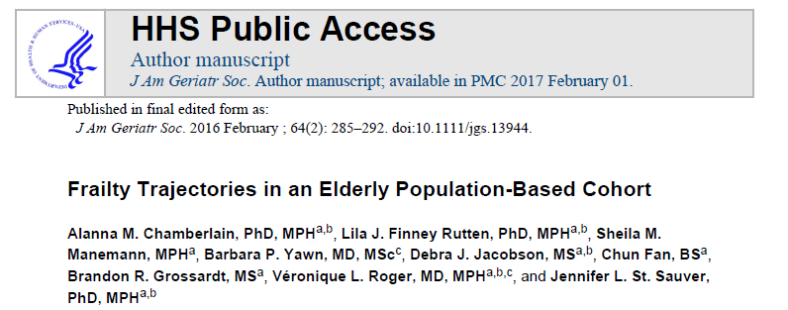

Slide 13
Design
  Population based cohort study
  Minnesota
  Data from Rochester Epidemiology Project (REP)
  Between 2005-2012
  3 independent Frailty index scores over study period
Notes:
Because in this area of Minnesota, all patients go to the same health system, they were able to collect complete data

Slide 14
Outcomes
  Hospitalizations
  ED visits
  Deaths

Slide 15
How do we measure frailty?

Slide 16
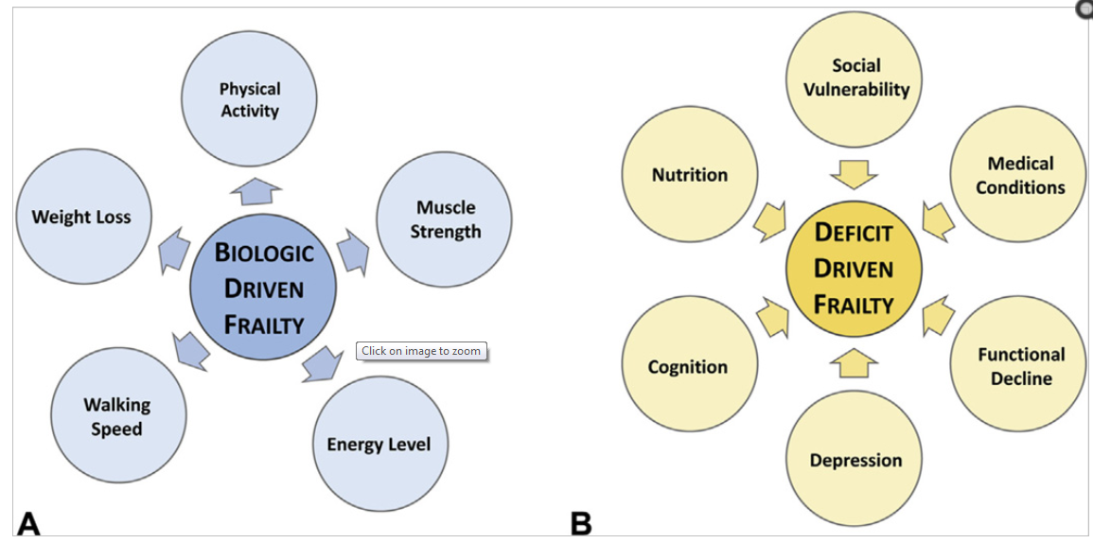
Fried’s phenotype model:
  Developed from Cardiovascular Health Study
  Looks at specific measurements to define frailty
      ≥ 3 = Frail
      1-2 = Pre-frail
      0 = Robust
  Method has been used for many studies on frailty
Robinson T, et al. J Am Coll Surg. 2015; Taken from Dr. Orkaby.

Slide 17
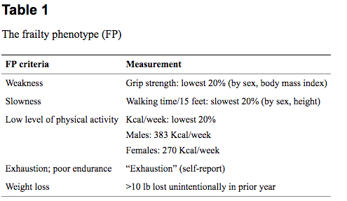
Chen et al

Slide 18
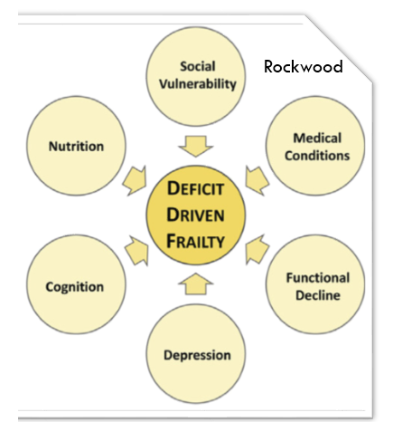
Rockwood’s Cumulative Deficit Model:
  Developed from Canadian Study of Health and Aging
  Developed an index of risk factors
  If above a cutoff, considered frail
  Performs well at predicting death
  Can use EMR to tailor an index
Robinson T, et al. J Am Coll Surg. 2015; Taken from Dr. Orkaby.

Slide 19
Study Frailty Index
  Created frailty index with 32 deficits
      BMI
      17 comorbidities
          Needed two codes, 30 days apart for a diagnosis
      14 ADLS
          Self reported by participants
  Needed to be able to create frailty scores 3 times during study period

Slide 20
Study Frailty Index
  All variables assigned a value
  Add up cumulative points and divide by 32
      If >3 items missing, then frailty index not calculated
  Repeated frailty index yearly, with the following rules:
          Comorbidities carried forward in time
          For multiple questionnaires in one year, used survey with least number of missing items
          If multiple complete questionnaires, then averaged values
          Missing BMI values were linearly interpolated

Slide 21
Statistics
  Looked at trajectory over time
  Subdivided into homogenous subgroups and created trend trajectories
  Used logistic regression to determine association of frailty trajectories with all cause mortality, ED visits, and hospitalizations

Slide 22
16,443 residents aged 60-89 years old
between 2005-2012
4,173 excluded because did not have 3 years of frailty measures
12,270 participants
included:
  Mean age: 70.2
  44.5% male
  3.7% non-white
60-69 years old
n = 6,045 (49.3 %)
70-79 years old
n= 4,313 (35.1 %)
80-89 years old
n = 1,911 (15.6 %)

Slide 23

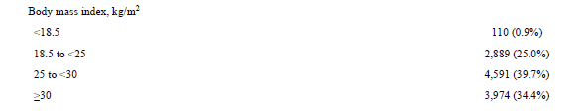

Slide 24
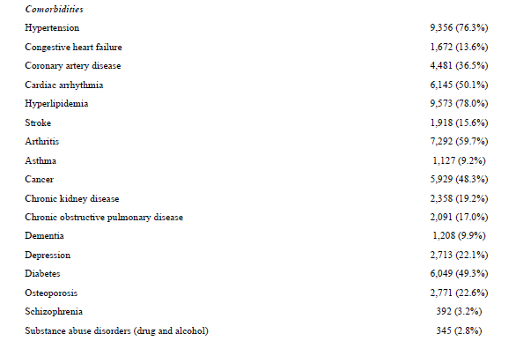
Most common diagnoses:
HLD (78%)
HTN (76%)
Arthritis (59%)
Arrhythmia (50%)
Diabetes (49%)
Cancer (48%)
CAD (36%)

Slide 25
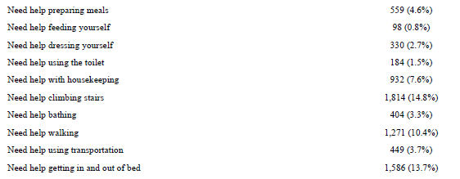
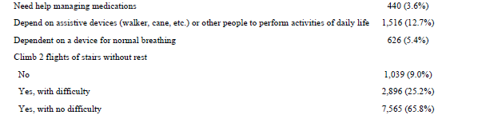
Most common ADL deficits:
Need help climbing stairs (15%)
Need help getting in an out of bed (13.7%)
Use assist device (13%)
Need help walking (10%)
Less common ADL deficits:
Need help with meals (4.6%)
Need help managing meds (3.6%)
Need help bathing (3%)

Slide 26
Trends in prevalence of comorbidities
  60-69 and 70-79 year olds:
      Increased prevalence of obesity
  80-89 year olds:
      Increased prevalence of dementia, stroke
      Experienced the largest increase in prevalence of ADL deficits over time
  For all age groups, the prevalence of every deficit increased between baseline and last follow up

Slide 27
Frailty scores
  Mean frailty scores:
  Frailty scores nearly identical between men and women
  Frailty increased in all trajectories, for all age groups
60-69 yo | 0.11
70-79 yo | 0.14
80-89 yo | 0.19

Slide 28
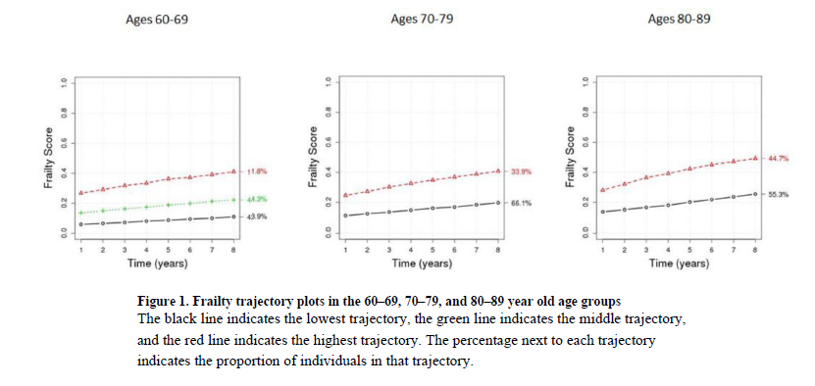
This change equates to additional 3 deficits over 8 years
This change equates to additional 7 deficits over 8 years

Slide 29
Outcomes
  Over 8 years:
      36,293 ED visits
      22,709 hospitalizations
      1,770 deaths

Slide 30
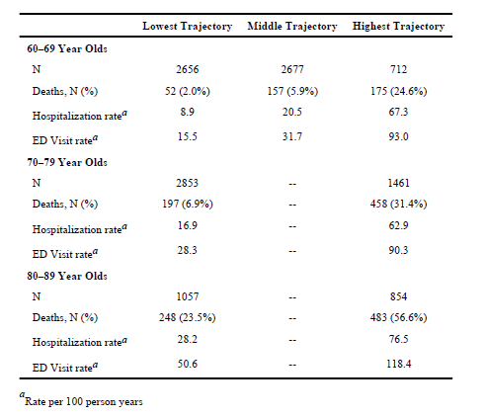
Table 2: Number of Deaths and Rates of Hospitalizations and Emergency Department Visits Occurring over the Trajectory Period by Frailty Trajectory

Slide 31
Table 2: Number of Deaths and Rates of Hospitalizations and Emergency Department Visits Occurring over the Trajectory Period by Frailty Trajectory

Slide 32
Table 2: Number of Deaths and Rates of Hospitalizations and Emergency Department Visits Occurring over the Trajectory Period by Frailty Trajectory

Slide 33
Outcomes
  In all age groups, increasing frailty trajectories were associated with increased odds of death, increased ED visits, and hospitalizations
Notes:
Even after adjusting for age, sex, and baseline frailty index

Slide 34
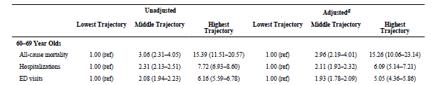
Outcomes
  In all age groups, increasing frailty trajectories were associated with increased odds of death, increased ED visits, and hospitalizations
Notes:
Even after adjusting for age, sex, and baseline frailty index

Slide 35

Outcomes
  In all age groups, increasing frailty trajectories were associated with increased odds of death, increased ED visits, and hospitalizations
Notes:
Even after adjusting for age, sex, and baseline frailty index

Slide 36

Outcomes
  In all age groups, increasing frailty trajectories were associated with increased odds of death, increased ED visits, and hospitalizations
Notes:
Even after adjusting for age, sex, and baseline frailty index

Slide 37
Study conclusions
  Those with the highest frailty trajectories in each age group experienced higher rates of ED visits, hospitalizations, and all cause mortality
  Even in the lowest frailty groups, the participant’s frailty index increased over time
  This study found differences in frailty by age, but no differences in frailty by gender

Slide 38
Evaluating the study
Was a defined, representative sample of patients assembled?
    Included all participants in health care system over the age of 60 years old
    No exclusions based on comorbidities
Was follow up of study patients sufficiently long and complete?
    Study ran for 8 years
    Because only one health system in the area, unlikely that participants were lost to other health care facilities

Slide 39
Evaluating the study
How likely are the outcomes over time?
    We know prevalence of frailty is high in older adults
    Clinically we know that as our patients age, their need for support with ADLs increases
Can we apply these results to our patients?
    Less diverse than our patient population
    We have high levels of ADL deficits and multiple comorbidities like the participant population
    Helpful in framing odds of adverse outcomes for our patients as they age

Slide 40
Limitations of the study
Used Rockwood frailty index, when most studies use Fried’s frailty phenotype, making it difficult to compare results
Clinically, not going to do a 32 index assessment on my patient

Slide 41
Case
Ms. B is an 81 year old woman with PMH TIA, HTN, lumbar spinal stenosis, positive PPD who is followed in clinic
  Lives at home with her daughter
  Independent – travels to clinic via ride by herself
  ADLs: 12/12
  IADLs: 14/16
  High fall risk due to lumbar stenosis and fear of falling

Slide 42
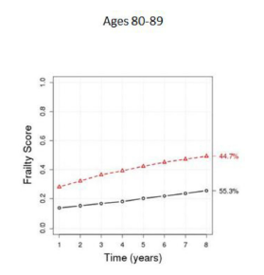
Back to our case
BMI: 25.5 = 0.5
Comorbidities:
    HTN, arrhythmia, HLD, stroke, arthritis, diabetes = 6 points
ADLS, walking: 2 points
Total: 8.5/32 = 0.26 frailty index

Slide 44
Learning points
  Frailty is a syndrome that is associated with poor outcomes, including death, ED visits, hospitalizations, delirium, and falls
  This study showed that those with the highest frailty trajectories in each age group experienced higher rates of ED visits, hospitalizations, and all cause mortality
  Even in the lowest frailty groups, the participant’s frailty index increased over time, and was associated with much higher odds of all cause mortality
  Frailty can be helpful in framing and understanding a patient’s prognosis

Slide 45
References
Chen X, Mao G, Leng SX. Frailty syndrome: an overview. Clinical Interventions in Aging. 2014;9:433-441. doi:10.2147/CIA.S45300.
Clegg et al. Frailty in elderly people. Lancet. 2013; 381:752-62.
Fried LP, Tangen CM, Walston J, Newman AB, Hirsch C, Gottdiener J, Seeman T, Tracy R, Kop WJ, Burke G, McBurnie MA; Cardiovascular Health Study Collaborative Research Group. Frailty in older adults: evidence for a phenotype. J Gerontol A Biol Sci Med Sci. 2001 Mar;56(3):M146-56.
Rockwood et al. A global clinical measure of fitness and frailty in elderly people. CMAJ. 2005;173(5): 489-95.

Slide 46
Fried et al

Slide 47
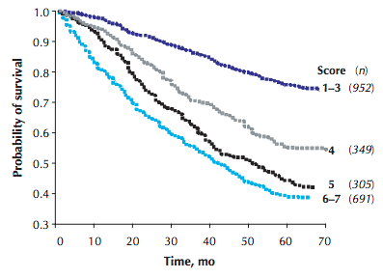
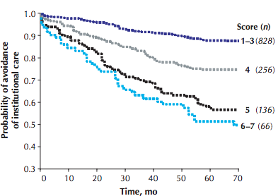
Rockwood et all.

