Slide 1
“BUT DOESN’T MOM NEED TO EAT?”
Leah Taffel, MD
Journal club march 23rd, 2018

Slide 2
CASE
Ms. R is a 95 yo woman, Italian speaking, with mixed Alzheimer’s and vascular dementia, history of severe depression, CAD s/p MI, constipation.
Lived at home with daughter, son-in law, sister with dementia
Granddaughter is primary caretaker
Had not left house in 10 years
Dependent for all IADLs, and most of ADLs

Slide 3
CASE
In May of this year:
    Became acutely confused and agitated in setting of bilateral cerumen impaction
    Required multiple hospitalizations at Carney and BMC for confusion
        Diagnosed with:
            Failure to thrive
            NSTEMI
            Acute kidney injury
    Stopped eating and performing remaining ADLs
    Seen by psychiatry and trialed on multiple antipsychotics and SSRIs

Slide 4
CASE
Final diagnosis is worsening dementia and failure to thrive
Family distraught about decline in cognition and functioning
Most upset about patient not eating
Repeatedly ask…
“But doesn’t mom need to eat? What about a feeding tube?”

Slide 5
Percutaneous Endoscopic Gastrostomy (PEG)
Initially developed by a pediatric surgeon to help provide nutrition to malnourished children
Adapted for adults with neurologic impairment
Now commonly used for adults with anatomical issues:
    Oropharyngeal cancer
    ALS
    Stroke

Slide 6
Percutaneous Endoscopic Gastrostomy (PEG)
In addition, PEG tubes are often used for people with dementia.
Natural progression of advanced dementia includes difficulty swallowing, decreased oral intake, and malnutrition.
In 2003, more than 33% of nursing home patients with cognitive impairment in US nursing homes had feeding tubes.

Slide 7
PEG Tubes and Dementia
Studies have shown that placing PEG tubes in dementia patients:
    Do NOT improve risk for aspiration pneumonia
    Do NOT improve healing of pressure ulcers
    Worsen function status
    Increase in-hospital mortality
    Higher cost of health care
90% one year mortality for advanced dementia with PEG tube

Slide 8
PEG tubes and Dementia
Studies show that PEG tubes are often placed because:
  Physicians do not know evidence
  Physician’s own personal beliefs
  Family request
  Fear of litigation

Slide 9

Choosing Wisely Campaign
Developed in 2013 by ABIM and AGS
“Don’t recommend percutaneous feeding tubes in patients with advanced dementia; instead offer oral assisted feeding.”

Slide 10
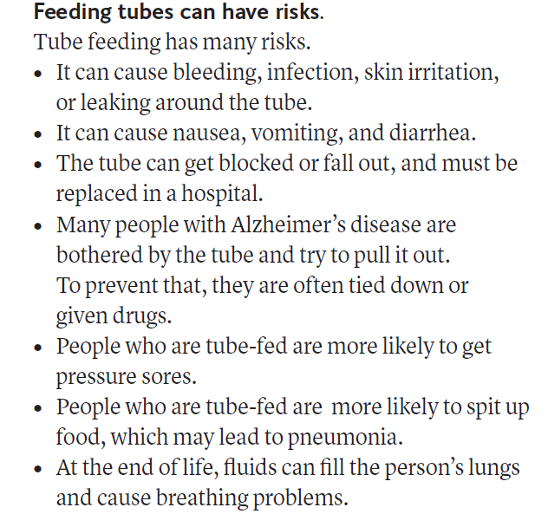
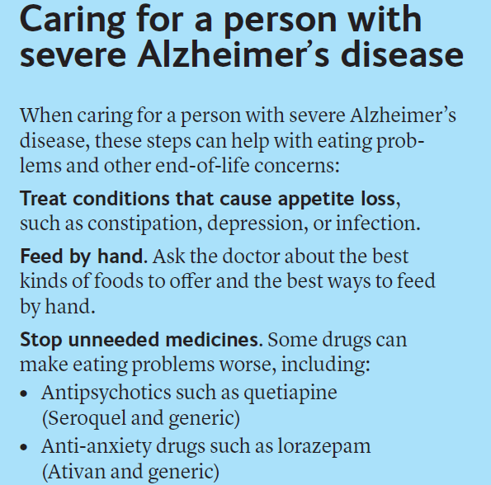
Choosing wisely- http://www.choosingwisely.org/wp-content/uploads/2017/06/ChoosingWiselyFeedingTubeAGS-ER-1.pdf

Slide 11
Choosing Wisely Campaign
Despite this initiation, PEG tubes are still being offered and placed in patients with advanced dementia

Slide 12
PICO
P = Internal medicine and subspecialty providers
I = Choosing Wisely Campaign
C = Those not taught about campaign
O = Change in knowledge about PEG tube recommendations and perceptions

Slide 13
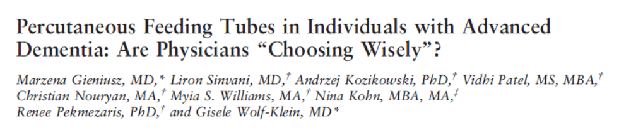

Slide 14
Objective of study
To evaluate physician knowledge and perceptions about Choosing Wisely recommendations regarding PEG tube placement in individuals with advanced dementia

Slide 15
Methods
Conducted mixed-mode survey with a tailored design method
  Paper and online surveys
  Brief and personalized questionnaires
No validated PEG questionnaires
Developed survey based on literature review and expert agreement

Slide 16
Survey
Survey consisted of 36 questions
4 main categories:
  Level of involvement of care of individuals with advanced dementia
  Perceptions about PEG tube placement in individuals with advanced dementia
  Knowledge about Choosing Wisely recommendation
  Demographic characteristics

Slide 17
Survey
Paper surveys distributed during medical grand rounds
Email surveys sent to medicine and sub-specialty providers
17% response rate for both paper and email

Slide 18
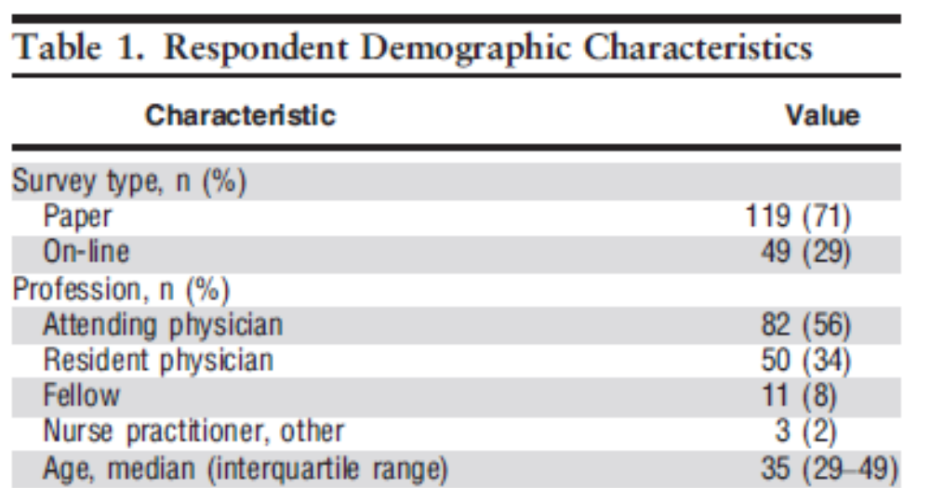
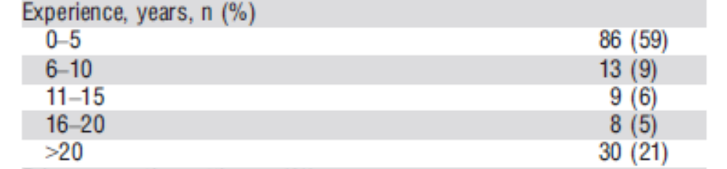
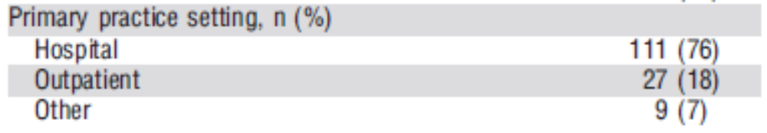
Results

Slide 19
Demographics | Percentage of physicians
Had cared for individuals with advanced dementia | 95%
Care for individuals with advanced dementia often | 76%
Been involved in PEG decision making conversations | 95%
Had experience with PEG tubes outside of work | 20%

Slide 20
General knowledge item | Percentage of physicians
Not sure whether ABIM recommends for or against PEG tubes in advanced dementia | 38%
Believe ABIM recommends placement of PEG tube in advanced dementia | 6%

Slide 21
Knowledge items about PEG tube complications | Percentage of physicians
PEG placement does not reduce risk of aspiration pneumonia | 85%
PEG tube does not increase survival | 81%
PEG tube does not improve pressure ulcer healing | 61%
PEG tube does not improve nutritional status | 49%

Slide 22
Hand feeding is at least as good as tube feeding for… | Percentage of physicians
Comfort | 71%
Functional status | 61%
Death | 60%
Aspiration pneumonia | 58%

Slide 23
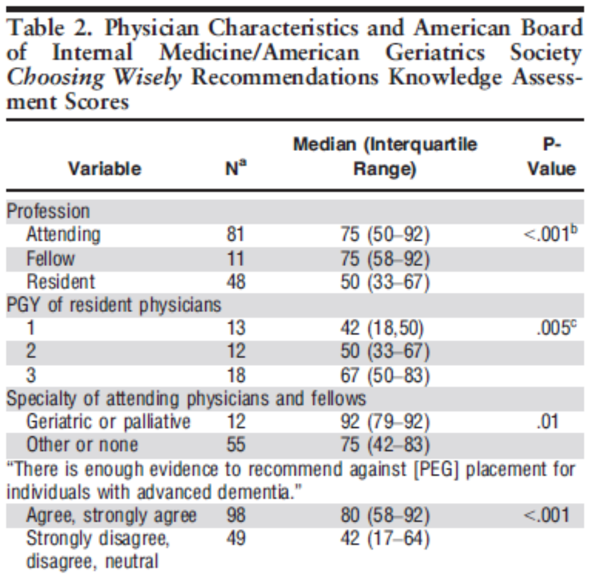
Physicians who agreed that there is enough evidence to recommend against PEG tube placement, were more likely:
To know about Choosing Wisely campaign (71% vs 28%, p <0.001)
Score higher on knowledge assessment (80% vs 42%, p <0.001)

Slide 24
71% of Attendings
55% of Fellows
33% of Residents
No difference among PGY 1-3
P <0.001

Slide 25
Physicians who were against PEG tube placement
Were significantly more likely to know that tube feeding:
    Does not reduce aspiration pneumonia
    Does not increase survival
    Does not improve pressure ulcer healing
    Does not improve nutritional status
Physicians were:
    Less like to be concerned about legal issues
    Believe hand feeding is as good as tube feeding
    Believe tube feeding decreases quality of life and comfort

Slide 26
Perceptions
52% of physicians felt in control of decision to place PEG tube
82% of physicians thought PEG tube placement should be individualized
63% of physicians stated families had requested PEG tubes even when physicians did not recommend it
Almost all of the physicians surveyed would not want PEG tubes if they were to develop advanced dementia themselves

Slide 27
Evaluating the study
Was the selection of participants explicit and appropriate?
  Targeted the desired participants:
      Residents, fellows, and Attendings in tertiary and community hospitals
      Medicine and subspecialty providers
  No medical students surveyed

Slide 28
Evaluating the study
Were the methods for data collection and analysis explicit and appropriate?
  Discussed how they distributed they survey, rate of return, demographics, statistics
  Did not provide a copy of the survey

Slide 29
Evaluating the study
Are the results of this study impressive?
  Significant number of providers knew about Choosing Wisely recommendations
  More aware of recommendations with more time practicing
  Still some gaps in knowledge in benefits of PEG tubes
  Most physicians would not want PEG tubes themselves

Slide 30
Evaluating the study
Do these same phenomena apply to my patient?
  Large portion of our patients suffer from dementia
  Providers are frequently asked about PEG tube placement and evidence for or against it
  As geriatricians, it is our job to teach other providers about recommendations

Slide 31
Limitations of the study
Small sample size
Multiple hospitals, but within geographically limited location
Bias in physicians responding to survey
Do not know prior thoughts about PEG tubes before Choosing Wisely recommendation

Slide 32
Back to our case
Given Ms. R’s advanced dementia, discussed with family recommendations against PEG tube placement
Multiple family members were upset
But in the end, agreed that comfort was the goal
Patient died a few months later

Slide 33
Learning Points
Choosing Wisely recommends against PEG tube placement in patients with advanced dementia.
Many providers unaware of recommendation
Many factors are involved when it comes to why people suffering from advanced dementia still receive PEG tubes despite research supporting that it may be harmful
Almost all physicians surveyed would not want a PEG tube if they developed advanced dementia

Slide 34
References

Slide 35
Survey statistics
Mann-Whitney test used to compare groups according to continuous dependent variables
Kruskal-Wallis test used for comparison in which the variable of interest had 3 levels
Categorical variables compared using chi square or Fisher test

Slide 36
