Slide 1
Journal Club
05-18-2018
Aruna Tokas
Geriatric Fellow

Slide 2
Case
78 year old female presenting to geriatrics clinic to establish care
Lives at home alone, independent in ADLs and most of her IADLs. No hx of smoking or drinking
Medical history-HTN,HLD, depression-anxiety, Diabetes, Right knee OA, Obesity (BMI 34)
Exam –VS and physical exam within normal limits.
Medications- metformin 500 mg BID, tylenol 500 mg TID, ativan 0.5 mg daily prn,losartan 50 mg daily, Ca+D (600 mg/400 IU) BID

Slide 3
Reports taking calcium for ‘years’. Takes it for her bones.
Had a bone density scan few years ago, thinks it was ‘okay’.
Has had no falls. Walks without assistive device.
Had right wrist fracture when she was in her 30s
Most recent labs- Calcium level 9.8
Vitamin D -41

Slide 4
P- Older adults living in community
I- calcium+ Vitamin D supplementation
C-no supplementation
O-risk of fracture

Slide 5
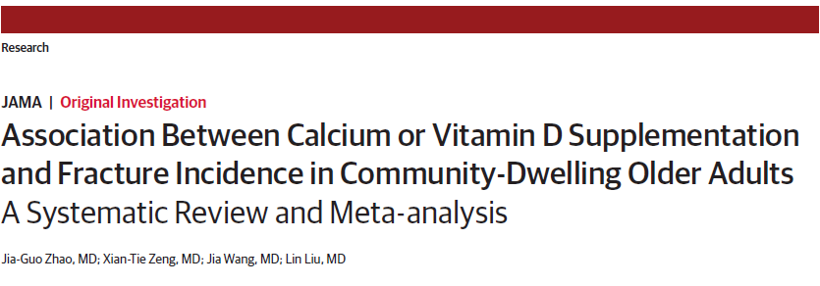

Slide 6
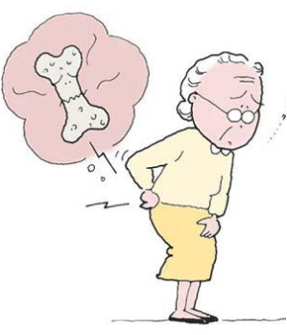
Background :
Hip fractures associated with increasing health care burden and cost
Increased morbidity and mortality
Within a year of having fracture, ~50% need assistance with ADL
About 20% mortality within a year

Slide 7


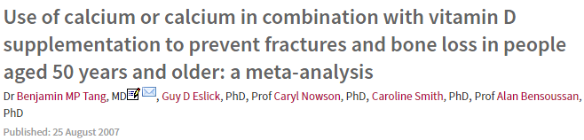
Notes:
Overlapping meta-analysis common, they chose a common topic to look at it and looked at meta-analysis in high ranking medical journals
Discordant estimates, trial selection/analytical methods different

Slide 8
Methods
Meta-analysis performed according to Cochrane Handbook of systematic reviews
Searched Pubmed, Cochrane Library and EMBASE from inception date until Dec 2016
Keywords-calcium, Vitamin D and fracture
No language restrictions
Looked at systematic reviews and RCTs in past 10 years
Additional search for recently published RCTs in past 5 years

Slide 9
INCLUSION CRITERIA
RCTs comparing calcium, Vit D or both with placebo/no treatment
Trials enrolled adults 50 or older living in community
Trials provided fracture date
EXCLUSION CRITERIA
RCT’s without placebo or no treatment group
Trials involving people with steroid induced osteoporosis
Trials in which Ca, Vit D supplementation was combined with anti-osteoporotic drug
Trials in which Vit D analogues like calcitriol was used
Trials in which dietary intake was evaluated

Slide 10
Methodological quality or included RCTs independently assessed by 2 researchers based on Risk of Bias assessments
Graded as low, high , moderate quality based on randomisation, allocation concealment
2 researchers independently extracted the data about participant characteristics, baseline 25(OH)-vitamin D levels, trial duration etc
Primary Outcome-no. of participants with Hip fracture
Secondary outcomes- no. of participants with with vertebral, non vertebral fracture and total fracture

Slide 11
Analysis
each type of supplement was separately compared with a placebo/no treatment group
Used Risk ratios, absolute risk differences and 95% CI
Random effects model was used to pool data
Subgroup analysis done to detect statistical significance- on dose (1 g calcium,800 IU Vitamin D), frequency of supplementation, fracture history, dietary intake, baseline vitamin D, gender
Mean age in trials ranged from 52-81.7 years

Slide 12
25 trials (from 884 records of trials and systematic reviews) met inclusion criteria
15 trials (from 1441 individual trials) met inclusion criteria
Out of total 40, 7 were duplicates and excluded
In the end, 33 trials were included in meta-analysis
One –low quality,6 –high quality and rest were moderate quality

Slide 13
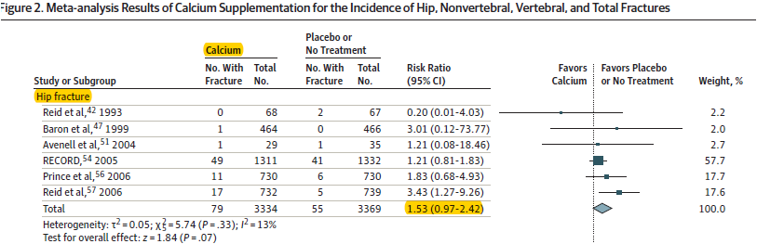
RESULTS:
Notes:
Only included hip fracture data due to time constraints . 14 trials compared CALCIUM supplements

Slide 14
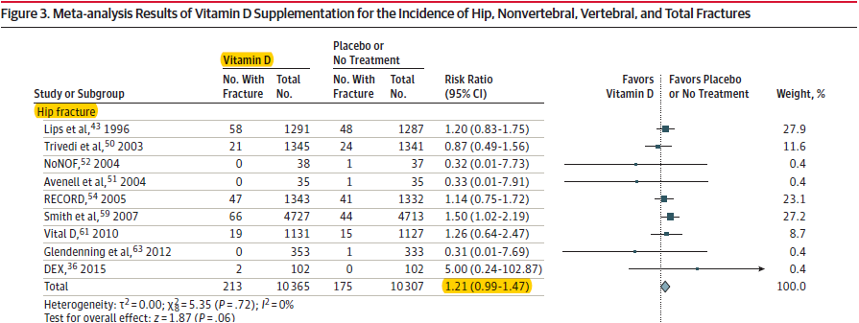
Notes:
17 Trials compared Vitamin D with placebo

Slide 15
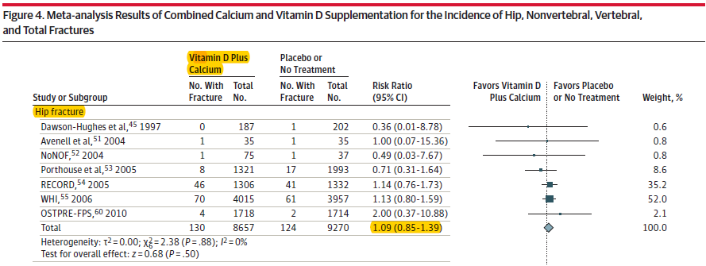
Notes:
13 trials checked Combined effect of Vitamin D and calcium

Slide 16
No statistically significant association seen with other types of fractures with calcium, Vitamin D or combined supplementation
Subgroup analysis did not show any significant differences within subgroups based on supplement dose, gender, fracture history, dietary intake and baseline Vitamin D concentration.

Slide 17
Critical Appraisal
Systematic review of randomized trials
Describes comprehensive and detailed search for relevant trials
Results consistent regardless of dose, gender, previous hx of fracture
Excluded patients on hormone therapy and other high risk population(steroid, nursing home etc)

Slide 18
Limitations
Some trials were poor quality and used unclear allocation concealment
Many trials were moderate quality
Methods used to classify studies as high quality may have been lenient.
No comment on symptoms ?
Side effects
Not everyone had baseline vitamin D level

Slide 19
Can we apply this to our patient ?
Is our patient so different from those in the study that its results cannot apply ?
What are the potential benefits and harms from the therapy ?
What are our patient’s values and expectations for both the outcome we are trying to prevent and the adverse effects it may cause?
Notes:
Benefits- to replete low level, harms- kidney stones, polypharamacy

Slide 20
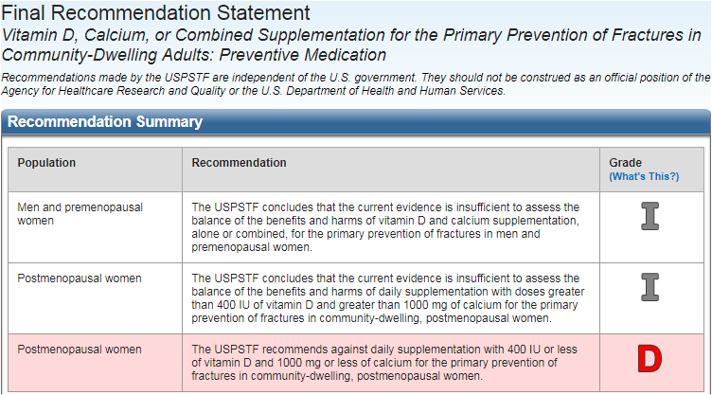
UPSTF recommendation statement

Slide 21

Questions ?

Slide 22
Thank you

