Slide 1
Journal Club
Aruna Tokas
Geriatrics fellow
01/19/2017

Slide 2
Case
94 year old Cape Verdean speaking female with increased anxiety , agitation and sleep disturbances ~ 2 years
Medical history –Dementia, HTN,DVT, Type 2 DM
-Dependent for ADL/IADL
Meds –Clonidine, atenolol and amlodipine for HTN
-Melatonin, Mirtazapine
-Xanax 0.25 mg at bedtime x40 years

Slide 3
RUDAS 15/30 –(lost points on recall, cube drawing and praxis, language relatively spared )
Increasing episodes of agitation, fluctuating mood, sleep difficulties , delusions.
Has had trial of SSRI as outpatient , not successful
Admitted to the hospital for increased confusing , yelling and screaming. Discharged on seroquel

Slide 4
Is the worsening behavior secondary to her dementia ?

Slide 5
P- Alzheimer’s disease patients with behavioral disturbances
I-Memantine
C-placebo
O-improvement in behavioral symptoms

Slide 6

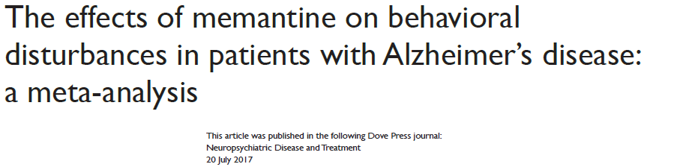

Slide 7
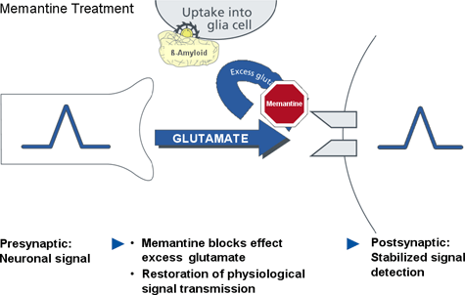
Memantine
Used in patients with moderate-severe dementia
Noncompetitive NMDA receptor antagonist.
NMDA receptors located throughout the brain
Blocks effect of pathologically elevated glutamate preventing neuronal dysfunction

Slide 8
Study Design
Meta-analysis
Included 11 studies in total
4 studies-memantine monotherapy vs placebo
7 studies- combination therapy with memantine and cholinesterase inhibitors vs cholinesterase inhibitors alone
10 double blind RCT, one was an open label study

Slide 9
Mean duration of included studies was 26.5 weeks (24-52 weeks)
Mean patient age-76.3 years
Males-34.6%
Memantine dose was 20 mg/day except for one study
Most studies excluded patients who had psychiatric disorders other than alzheimer’s disease

Slide 10
Search and data analysis
Done by 2 authors independently
MEDLINE, Cochrane library, Scopus, PsycINFO without language restrictions.
Also searched clinical trials gov and clinical trial registry, conference abstracts, unfinished trials
Terms used were Alzheimer’s, memantine, randomized
Intention to treat analysis used. Investigators contacted if any data missing. Unpublished data also obtained

Slide 11
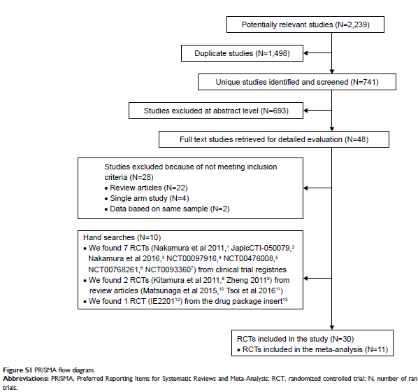
Notes:
20 studies not included because data for meta-analysis was not available

Slide 12
Primary Outcomes
Delusion
Agitation/aggression
Disinhibition
Nighttime/diurnal rhythm disturbances
Hallucinations
Irritability/lability
Anxiety/phobia
Dysphoria
Euphoria
Apathy
Aberrant motor activity
Eating disturbances
Notes:
Dysphoria- not satisfied with life
Apathy- lack of interest

Slide 13
Meta-analysis conducted using Review Manager software. Random effect model selected
Heterogeneity tested using I² (considered significant if 50% or more)
2 subgroup analysis done to detect any confounding.
Severity of disease (mild to moderate vs moderate and moderate to severe)
Therapeutic strategy (memantine monotherapy vs combination of memantine and cholinesterase inhibitors)
Notes:
Heterogeneity-proportion of total variation observed between the trials which due to differences between the trials and not sampling error

Slide 14
Results
Improvement by memantine seen in-
Agitation/aggression (P 00.01,I² 47%)
Delusion (P 0.04, I² 0%)
Disinhibition(P 0.04, I² 0%)
Nighttime disturbances(P 0.02, I² 36)
Was similar to control in aberrant motor activity, anxiety/phobia/dysphoria/eating disturbances and euphoria

Slide 15
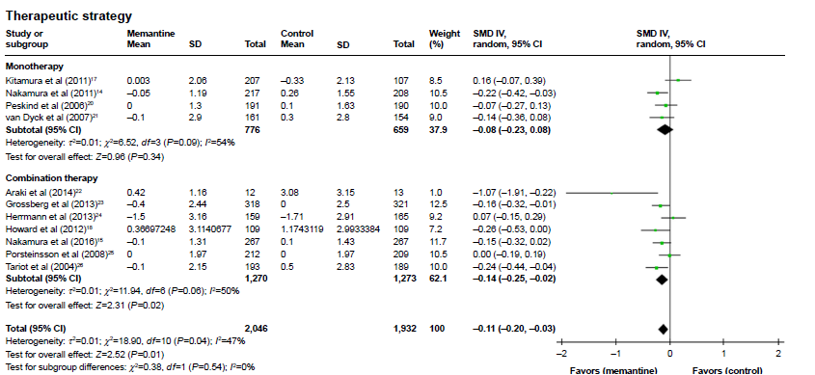
Notes:
AGITATION/AGGRESSION

Slide 16
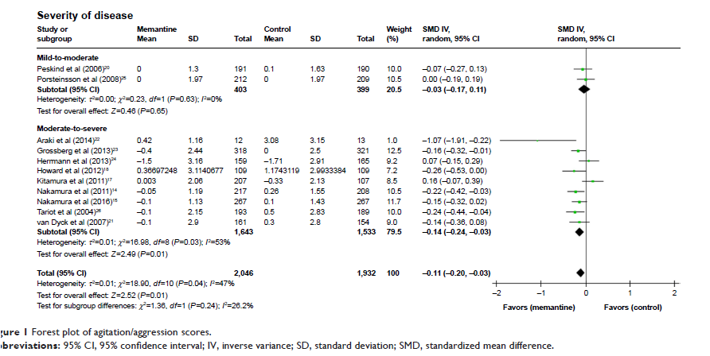
Notes:
Agitation/ aggression

Slide 17
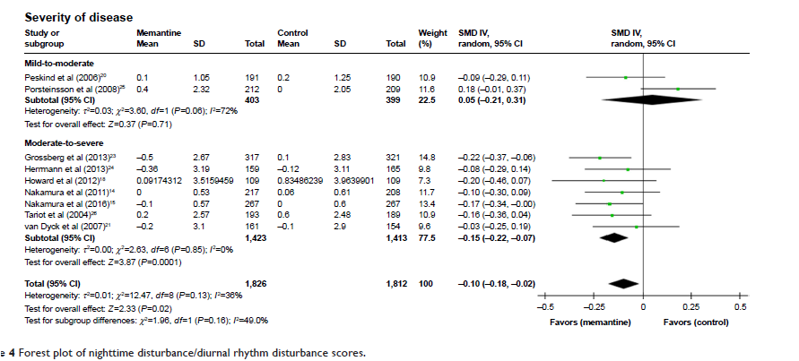
Notes:
Diurnal rhythm disturbance forrest plot –overall improvement, specially in moderate to severe

Slide 18
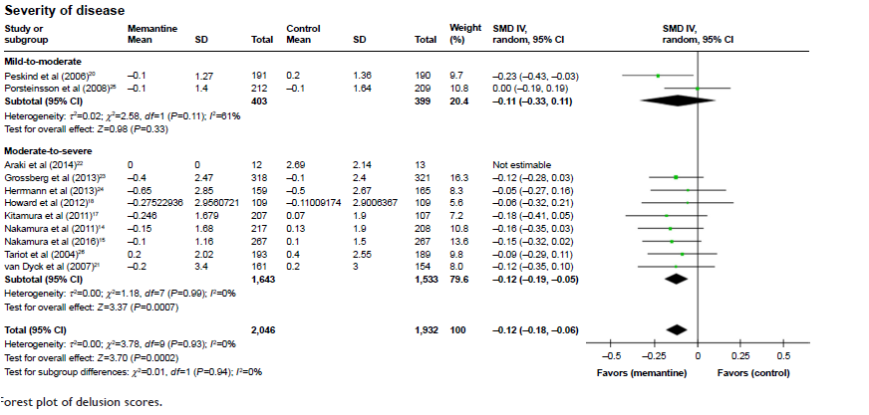
Notes:
Delusion forest plot. Improvement in moderate –severe dementia group

Slide 19
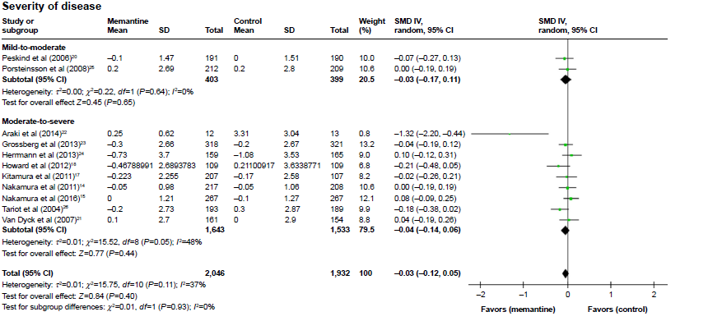
Notes:
ANXIETY/PHOBIA

Slide 20
For delusion, memantine was superior to control in monotherapy group
For agitation and disinhibition, memantine was superior to control in combination therapy group
Overall, memantine showed improvement in positive symptoms
Similar to control in negative symptoms (anxiety/phobia/apathy/eating disturbance/aberrant motor activity)

Slide 21
Critical Appraisal
Thorough search
Subgroup analysis
Low heterogeneity

Slide 22
Limitations
9 studies were industry sponsored
1 was an open label study
Varied patient characteristics across studies –symptom severity, study duration, race etc
Use of concomitant psychotropic drugs
Focused on alzheimer’s disease

Slide 23
What this means for our patient ?
Older , on chronic benzos
Mild favourable effect of memantine seen for diurnal rhythm disturbance, delusion and agitation
Notable side effects are GI intolerance, hallucinations, swelling
Notes:
Worth discussing with patients daughter.
Clarifying goals
Wouldn’t change my practice because more data and studies are needed and because several limitations of this study

Slide 24
Thank you

