Slide 1
Journal Club
Aruna Tokas
Geriatrics Fellow
11/17/17

Slide 2
Case
82 Year old female presenting to the clinic for follow up visit
PMH- DVT, OA
Medications- Flonase, Xarelto, Colace, Cholecalciferol
Independent in her ADLs and IADLs. Educated to grade 8. Born and brought up in Haiti.
RUDAS on office visit –28/30

Slide 3
Random fingerstick -113, Hba1c 5.9
‘Will I have problems with my memory in future’.

Slide 4
In this patient without a diagnosis of diabetes mellitus, should I be worried about risk of dementia?
P- Patient without known Diabetes Mellitus
I-elevated blood sugar
C-not elevated blood sugar
O- Incidence of dementia

Slide 5
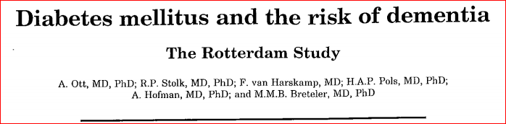
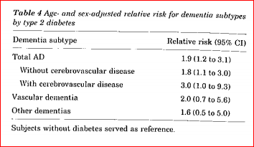
Why do we care ?
With ageing of the population, prevalence of dementia is also increasing
Prior studies have shown an association between Diabetes and dementia

Slide 6
Mechanism
Increases Advance Glycated End products (AGE)
Increased microvascular disease of CNS
Reduced degradation of beta amyloid , increased aggregation
Enhanced plaque formation

Slide 7
Unclear if elevated blood sugar levels in people without diabetes could also increase the risk of developing dementia ?
Notes:
Not many studies done looking at this

Slide 8

Original Article
Glucose Levels and Risk of Dementia
Paul K. Crane, M.D., M.P.H., Rod Walker, M.S., Rebecca A. Hubbard, Ph.D., Ge Li, M.D., Ph.D., David M. Nathan, M.D., Hui Zheng, Ph.D., Sebastien Haneuse, Ph.D., Suzanne Craft, Ph.D., Thomas J. Montine, M.D., Ph.D., Steven E. Kahn, M.B., Ch.B., Wayne McCormick, M.D., M.P.H., Susan M. McCurry, Ph.D., James D. Bowen, M.D., and Eric B. Larson, M.D., M.P.H.
N Engl J Med
Volume 369(6):540-548
August 8, 2013

Slide 9
Study Design/Methods
Prospective cohort study of community based elders
(Adult Changes in Thought)ACT study-2581 randomly selected dementia free members of Group Health in Washington State.
Longitudinal study going on in University of Washington, participants are
enrolled every two years and are followed
Participants are individuals with age >65 and do not have dementia
Included 2067 participants from ACT study

Slide 10
Inclusion criteria
Enrolled in Group Health for atleast 5 years before study entry
Had atleast 5 measurements of glucose/glycated hemoglobin over the course of 2 or more years before study entry

Slide 11
Participants to return at 2 year intervals for purpose of identifying incident cases of dementia
Assessed by using ‘Cognitive Abilities Screening Instrument’ with scores from 0-100.
Patients with score of 85 or less underwent clinical and neuropsychological tests
Reviewed in consensus conference, diagnosed with dementia
Dementia free participants continued with scheduled follow up visits

Slide 12
Glucose data obtained (glycated Hemoglobin, Hba1c )
Daily average glucose values calculated to compute a time varying estimate of average glucose level for each participant
Participants classified as having treated Diabetes based on medication data from pharmacy records (atleast two filled prescriptions)
Questionnaire at each study visit going over exercise level, smoking status , presence of CAD or HTN (pharmacy data) or Afib

Slide 13
Statistical analysis done using Cox regression Model to identify relation between glucose level and incidence of dementia , using age as time axis
Controlled for age at study entry, sex, exercise level, BP , CAD , Afib, smoking and HTN treatment
Also adjusted for APOE 4 allele presence (one or more)

Slide 14
Results
2067 Study participants (32,264 values available for random and fasting glucose levels , 10,208 values for Hba1c /total glycated haemoglobin levels)
During preceding 5 years before enrolment, Median glucose levels in people without DM was 100 (96-108) and median level for those with DM was 175 (153-198)
Median follow up 6.8 years
524/2067 (25.4%) participants developed dementia
74/343 (21.6%) participants with diabetes developed Dementia at the end of follow up
450/1724(26.1%) participants without diabetes developed Dementia

Slide 15
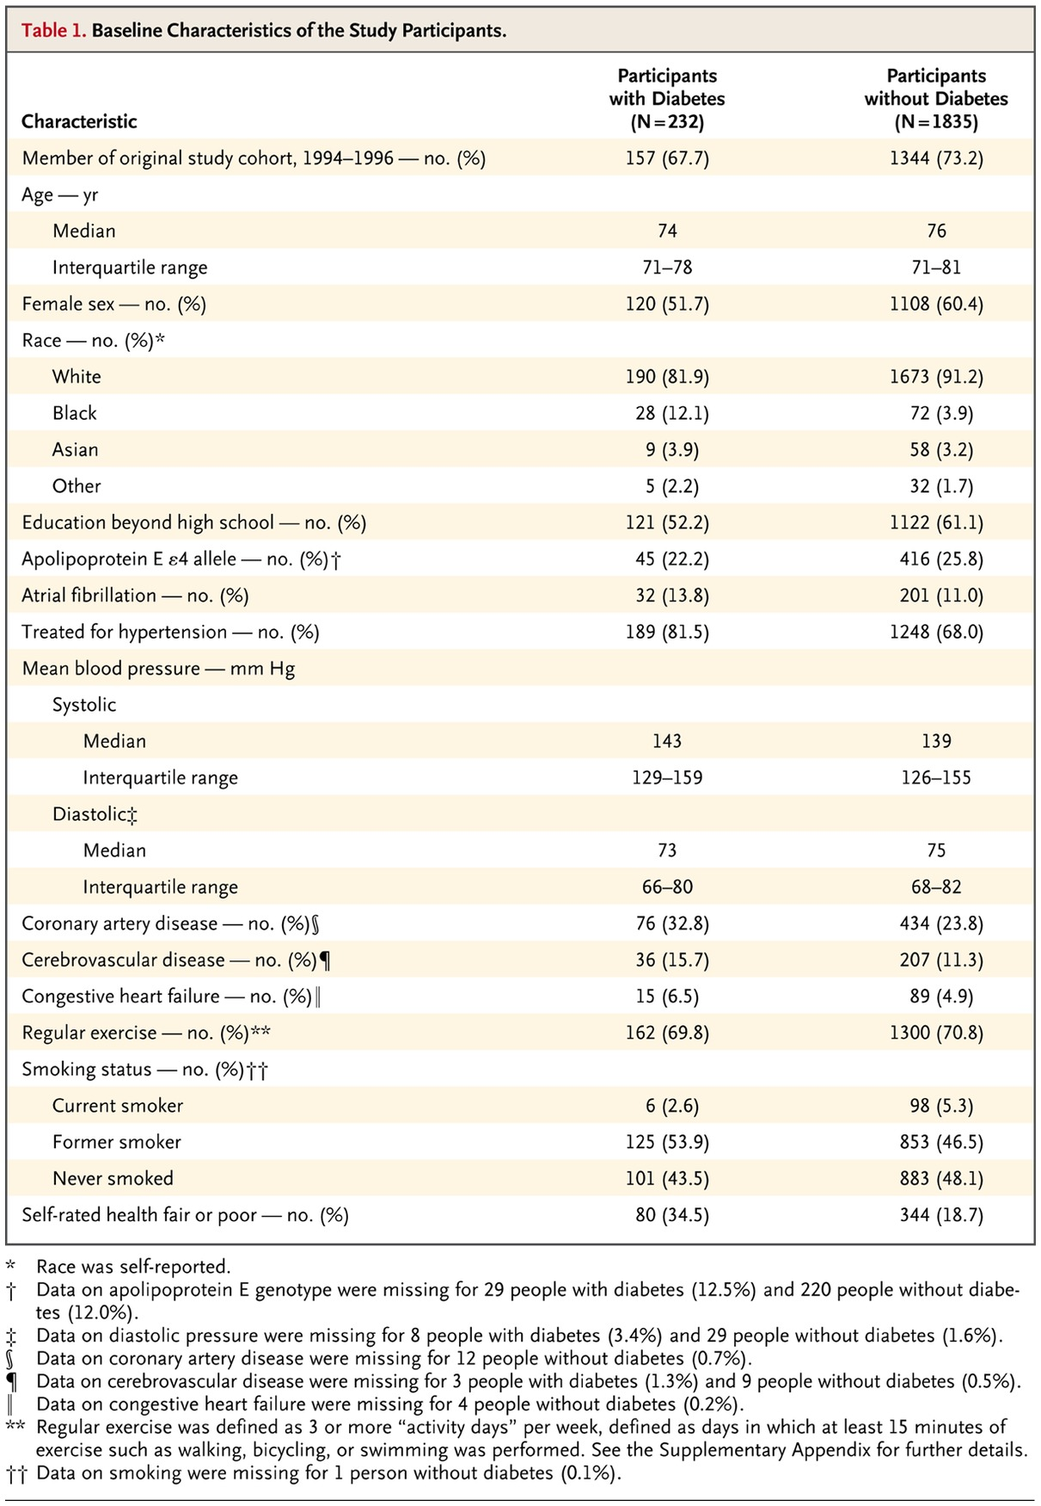
Baseline Characteristics of the Study Participants.
Crane PK et al. N Engl J Med 2013;369:540-548
Notes:
Table 1 Baseline Characteristics of the Study Participants.

Slide 16
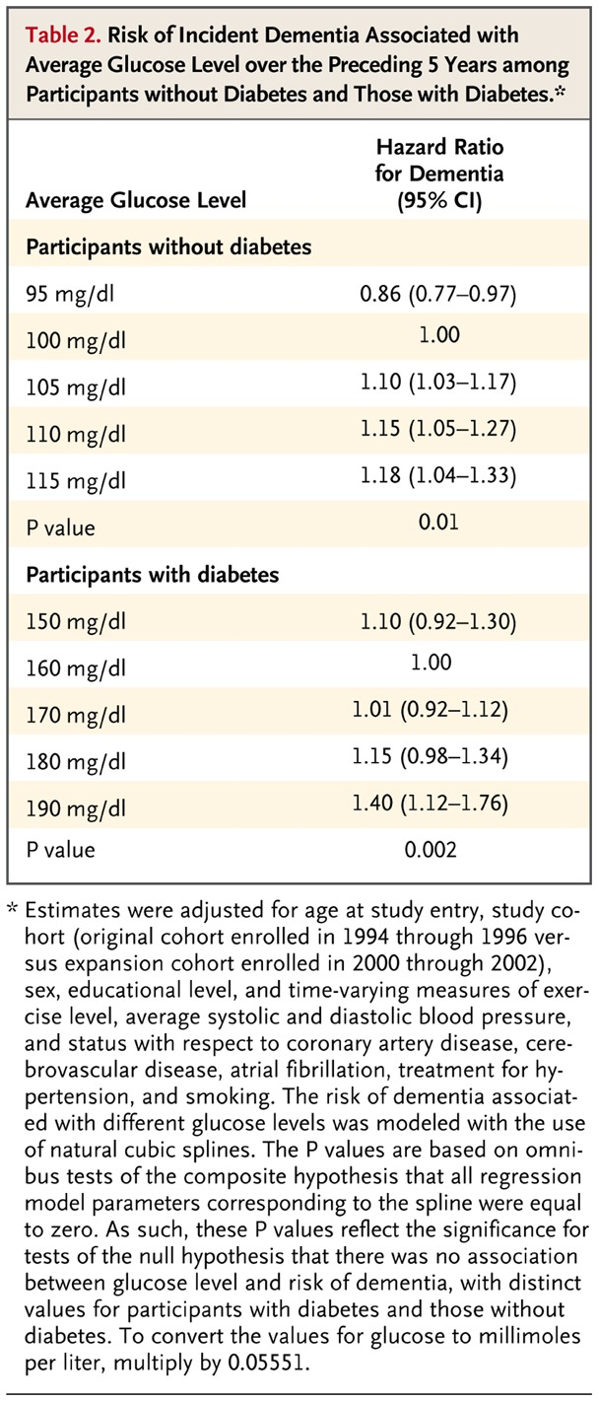
Risk of Incident Dementia Associated with Average Glucose Level over the Preceding 5 Years among Participants without Diabetes and Those with Diabetes.
Crane PK et al. N Engl J Med 2013;369:540-548
Notes:
Table 2 Risk of Incident Dementia Associated with Average Glucose Level over the Preceding 5 Years among Participants without Diabetes and Those with Diabetes.

Slide 17
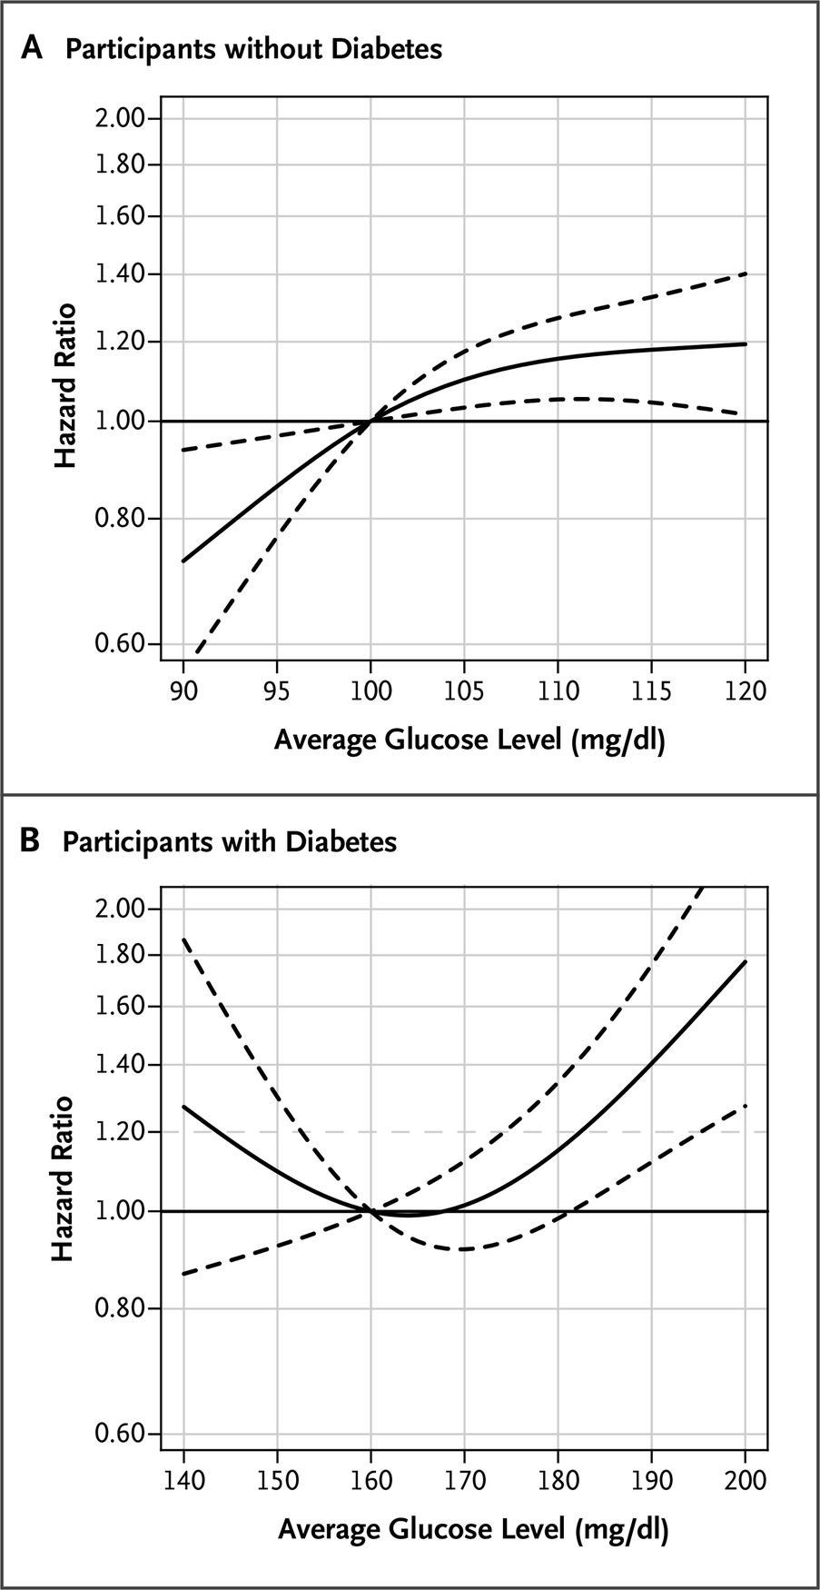
Risk of Incident Dementia Associated with the Average Glucose Level during the Preceding 5 Years, According to the Presence or Absence of Diabetes.
Crane PK et al. N Engl J Med 2013;369:540-548
Notes:
Figure 1 Risk of Incident Dementia Associated with the Average Glucose Level during the Preceding 5 Years, According to the Presence or Absence of Diabetes. Solid curves represent estimates of the hazard ratios for the risk of incident dementia across average glucose levels relative to a reference level of 100 mg per deciliter for participants without diabetes (Panel A) and 160 mg per deciliter for participants with diabetes (Panel B). The dashed lines represent pointwise 95% confidence intervals. To convert the values for glucose to millimoles per liter, multiply by 0.05551.

Slide 18
Critical Appraisal
Are the results valid ?
Large prospective community based sample
Prospective ascertainment of dementia cases
Findings consistent across many sensitivity analysis

Slide 19
Limitations
Labs obtained at irregular intervals for estimating glucose level
Significant blood sugar difference between people with and without DM
Inadequately treated diabetes ?
Covariates self reported

Slide 20
Conclusions
Results suggested that higher glucose levels may be a risk factor for dementia, even among persons without diabetes.
How does this apply to my patient ?
Increased risk with impaired blood sugar
Need for ongoing research in dementia and preventable risk factors
Tighter glucose control ? Which agent would be preferred , metformin?
Risks of hypoglycemia vs preventing dementia ?

Slide 21
Thank you !

