Slide 1
Journal Club
Leah Taffel MD
September 15TH 2017

Slide 2
Case
85 year old woman with PMH HTN, hypothyroidism, arthritis who is presenting to Geriatrics Clinic.
Lives alone. Does all ADLs. Daughters help with some shopping, cleaning, and some of the bills.
She has a friend who recently developed dementia.
She asks you if there is anything she can do to help stop her from developing dementia?

Slide 3
Why do we care about dementia?
5.5 million people have Alzheimer's Disease
14 million in 2050
  25% of people >80 yo will have dementia
5th leading cause of death in the US in people >65 yo
In 2017: $259 billion spent on payment for health care, long-term care, and hospice

Slide 4
Aspirin
Cardiovascular and cerebrovascular conditions are established risk factors for dementia and cognitive decline
Low dose Aspirin (ASA) used for prevention of cardiovascular disease
  Antithrombotic and antiinflammatory properties
ASA may decrease neuroinflammation and oxidative stress
Notes:
Because of these findings, there is growing interest in the use of drugs of a similar nature to aspirin, or NSAIDS, to prevent dementia
Now there is research

Slide 5
Previous Research
Cochrane review of 1 RCT with 70 patients
  Published in 2000
  Showed no benefit of ASA in preventing vascular dementia
Study limited by size, only vascular dementia

Slide 6
Clinical Question
Does prescribing low dose Aspirin to an 85 year old woman prevent her from developing dementia?
  Patient: 85 year old woman
  Intervention: low dose aspirin
  Comparison: placebo
  Outcome: development of dementia

Slide 7
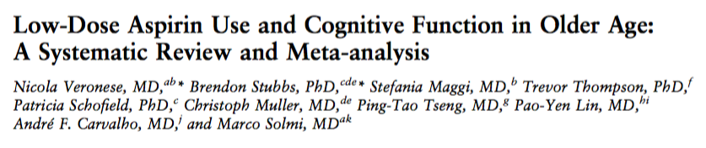
Published JAGS 2017
Systematic Review
Hypothesis: low dose ASA could have favorable effect on cognition

Slide 8
Inclusion Criteria
Observational and RCTs
Low dose ASA (<300mg/d)
Reported data on dementia diagnosed through MMSE or specific cognitive functions
Baseline participants did not have dementia or cognitive impairment

Slide 9
Exclusion Criteria:
Not in humans
Used a non-placebo control group
Used >300 mg/d ASA
Used ASA for <1 year
Standardized mean difference (SMD) or odds ratio (OR) could not be calculated based on data
Notes:
Studies were searched by 2 separate investigators and then a third cross checked them

Slide 10
Primary Outcomes
Longitudinal studies:
  Primary outcome = Incidence of dementia or cognitive impairment during follow-up
    Used MMSE ≤ 24
RCTs:
  Primary outcome = changes between baseline and follow up cognitive assessment
    Looked at global cognition, verbal memory, and fluency

Slide 11
Statistical Analysis
Compared odds ratio with 95% CIs (adjusted for covariates)
Differences between the means calculated for baseline data vs follow-up data
Looked at heterogeneity using I2 metric and Cochran Q chi-squares

Slide 12
Included Studies
2,341 articles
2,325 excluded
16 articles
accepted
8 excluded because:
3 included active controls
2 about acute effects
3 incorrect study design
8 included:
5 longitudinal
3 RCTS

Slide 13
Overall Study Participants
36,196 participants total
8,484 (23.4%) received low-dose aspirin
Mean age 66
63% female
Community dwelling
6 studies from UK; 2 studies from US

Slide 14
Study Characteristics
Longitudinal Studies
5 studies; 26,159 participants
Mean age 65
Mean follow up of 6 years
3,035 (11.6%) used aspirin
Outcomes:
  3 studies = dementia
  2 studies = cognitive impairment
Low dose ASA group statistically older
  78.1 (ASA) vs 75.9 (controls); p<0.001

Slide 15
Study Characteristics
Longitudinal Studies
RCTs
5 studies; 26,159 participants
Mean age 65
Mean follow up of 6 years
3,035 (11.6%) used aspirin
Outcomes:
  3 studies = dementia
  2 studies = cognitive impairment
Low dose ASA group statistically older
  78.1 (ASA) vs 75.9 (controls); p<0.001
3 studies; 10,037 participants
Mean age 66.8; 78% female
Mean follow up 5 years
Assessment:
  1 used MMSE alone
  2 used several tests:
    Global score, verbal memory, category fluency, auditory verbal learning, trial making etc

Slide 16
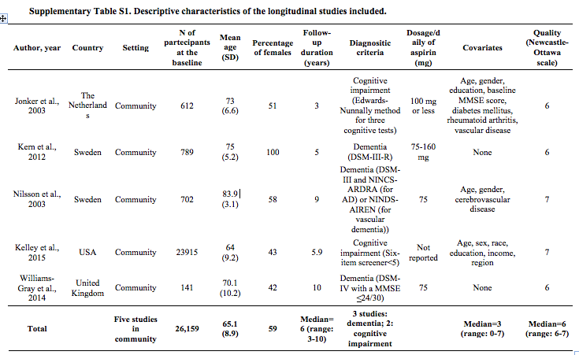

Slide 17
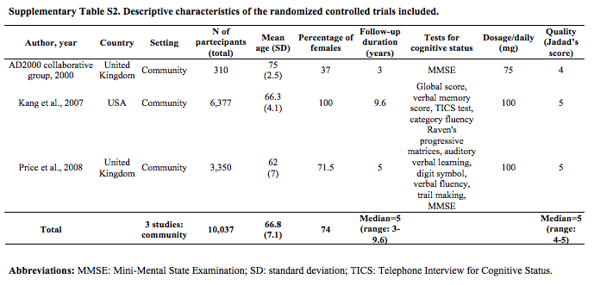

Slide 18
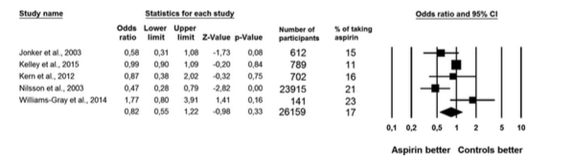
Meta Analysis from Longitudinal studies
OR = 0.82 (CI = 0.55-1.22)
Low dose aspirin was NOT significantly associated with onset of dementia or cognitive impairment

Slide 19
Meta Analysis from Longitudinal studies
OR = 0.82 (CI = 0.55-1.22)
Low dose aspirin was NOT significantly associated with onset of dementia or cognitive impairment

Slide 20
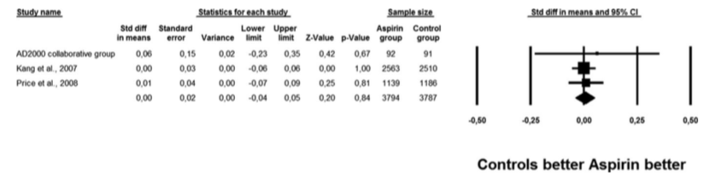
Meta Analysis from RCTs
Use of low dose aspirin was NOT associated with better global cognitive test scores
  SMD = 0.00 (CI -0.04- 0.05, P = 0.85, I2 = 0%)
Use of ASA was associated with slightly better executive function and verbal memory tests and fluency results
  But not statistically significant
Notes:
SMD= standardized mean difference
Difference was estimated to correspond to the 2.6 years younger age and 20% lower risk of cognitive decline than with placebo in single study

Slide 21
Adherence
In RCTs – lower percentage of participants using aspirin completed the RCT
  69.9% vs 75.9% (p= 0.005)

Slide 22
Adverse Events
Only 1 RCT and 1 Longitudinal study gave information on side effects
  RCT- 10x more likely to have GIB in aspirin group
    15.2% vs 1.4% (p <0.01)

Slide 23
Critical Appraisal
Did the overview address a focused clinical question?
  Yes: focused on ASA effect on preventing dementia
Were the criteria used to select articles for inclusion appropriate?
  Broad but applicable inclusion criteria:
    RCT or Longitudinal study
    ASA <300 mg/d
    Reported on dementia through accepted cognitive tests

Slide 24
Critical Appraisal
Is it unlikely that important, relevant studies were missed?
  2 investigators hand searched through:
    Multiple databases -- PUBMED, EMBASE, Cochrane etc
    No language restrictions
    Conference abstracts and reference names
    Contacted Authors

Slide 25
Critical Appraisal
Was the validity of the included studies appraised?
  Two independent investigators searched for articles and extracted data
  Third independent investigator validated data extraction
  If information was missing, authors were contacted at least two times in 1 month

Slide 26
Critical Appraisal
Were assessments of studies reproducible?
  Results corroborated with other Meta-Analysis performed
Were the results similar from study to study?
  Results were similar between different studies within the RCT analysis and longitudinal analysis
Notes:
NSAIDs and cognitive outcomes

Slide 27
Longitudinal Studies

Slide 28
RCTs

Slide 29
Critical Appraisal
What are the overall results?
  Low dose ASA not associated with lower incidence of dementia and MCI in Longitudinal studies
  Low dose ASA was not associated with improvement in cognitive test scores in RCTs
How precise were the results?
  Confidence intervals were narrow in most groups, especially in the larger studies

Slide 30
Limitations of the Study
Only 2 studies mentioned adverse events
Limited number of RCTs
In longitudinal studies:
  Selection bias?
  Some people not in ASA group were taking NSAIDs
  One study much larger than the others
No stratification by APOE

Slide 31
Critical Appraisal
Can the results be applied to my patient care?
  Participants similar to clinic patients
  Based on results, won’t be starting ASA for primary prevention of dementia
Were all clinical important outcomes considered?
  Did not have enough information about potential harms of ASA
  Only 1 study discussed risk of GI Bleed
    RCT did show 10 fold increase risk of bleeding

Slide 32
Rationale for findings
Too little, too late?
  Research suggests that pathological changes of dementia happen 20 years before clinical symptoms
Why were they taking ASA to begin with?
  May have predisposing conditions (like PVD) that put at risk for dementia
  May interfere with potential cognitive benefits of ASA

Slide 33
Rationale for findings
Genetic factors?
  Does effect of ASA depend on genetic mutations?
  One study found using NSAIDS correlated with lower risk of Alzheimer’s in people with APOE ε4 allele.

Slide 34
Next Steps
Aspirin in Reducing Events in Elderly Study
  19,000 healthy adults
  >65 years old
Are there other interventions?
  Nutritional?
  Physical activity?

Slide 35
Thank you!

