Slide 1
Journal Club
Meredith Rees Halpin, MD
Geriatric Oncology Fellow
Boston University Medical Center
September 15, 2017

Slide 2
Case
79 year old woman presenting to establish care
PMH: Osteoarthritis, HTN
Norvasc 5 mg
Recently emigrated from Nigeria to live with her daughter in Boston presented to the ED with chronic knee pain found to be hypertensive to 200/90 started on antihypertensive and referred to Geriatric Clinic
BMI: 37

Slide 3
PICO
Is there an approach to diet and exercise for weight loss in my obese clinic patient that does not put her at risk for loss of lean muscle and bone mass?
P- Obese geriatric clinic patient
I- Diet/Exercise Regimen
C- No intervention
O- Decreased BMI without increasing sarcopenia and osteopenia.

Slide 4
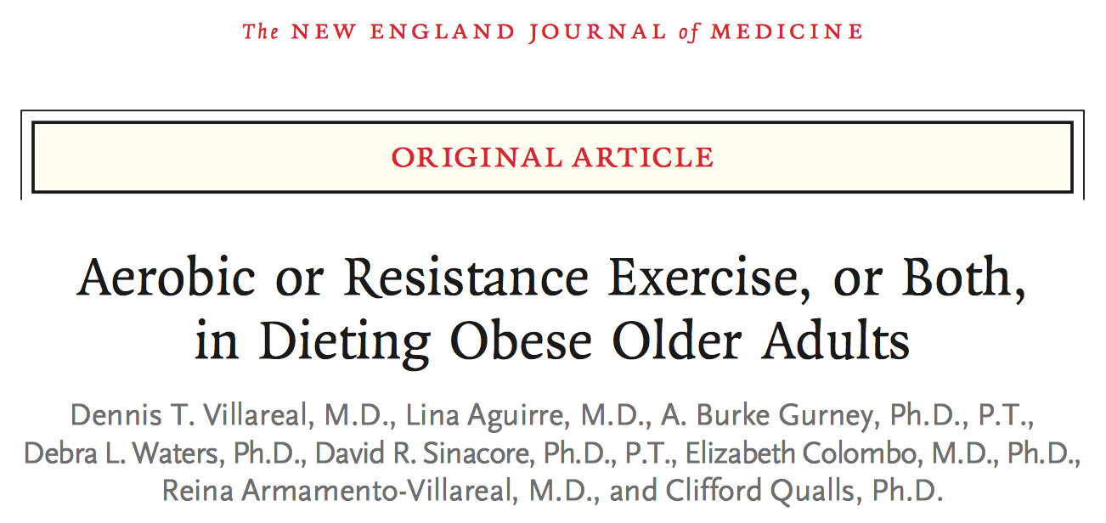

Slide 5
Background
More than 1/3 of persons older than 65 years in the United States are Obese
Obesity exacerbates age-related decline in physical function and may cause frailty
There are concerns that weight loss could worsen frailty by increasing sarcopenia and osteopenia in older adults
Exercise is known to have positive effects on physical function
Evidence based data to guide treatment of older adults with obesity are limited, mostly based on studies with younger adults

Slide 6
Aerobic Exercise
Improves cardiovascular adaptations
Increase peak oxygen consumption
Does not significantly impact strength

Slide 7
Resistance Exercise
Improves neuromuscular adaptations
Increase Strength
Do not significantly impact peak oxygen consumption

Slide 8
Study Design
Lifestyle Intervention Trial in Obese Elderly
April 2010-June 2015
University of New Mexico SOM & New Mexico VAHCS
Participants recruited through advertisements

Slide 9
Study Design
Participants randomly assigned to one of four groups:
Control Protocol (No weight management or exercise intervention)
Aerobic Exercise and weight management program
Resistance Exercise and weight management program
Combined Aerobic and Resistance Exercise and weight management program

Slide 10
Inclusion Criteria
65 years or older
BMI > 30
Sedentary at baseline (< 1 hr of regular exercise per week)
Stable body weight for 6 months (no change greater than 2 kg)
Stable Medication regimen for 6 months
Mild-Moderate Frailty (score of 18 to 31 on the Physical Performance Test)

Slide 11
Physical Performance Test
7 standardized tasks: Walking 50 feet, putting on and removing a coat, picking up a penny, standing up from a chair, lifting a book, climbing one flight of stairs, performing a progressive Romberg
2 additional tests: Up and down four flights of stairs, making a 360 degree turn
Each task score 0-4
Maximum score 36

Slide 12
Exclusion Criteria
Severe cardiopulmonary disease
Musculoskeletal or neuromuscular impairments that precluded exercise
Cognitive impairments
On medications that affect bone metabolism

Slide 13
Study Objectives
Primary Outcome: Change in score on the Physical Performance Test from baseline to 6 months
Secondary Outcomes: changes in other frailty measures, body composition, bone mineral density, specific physical functions, and quality of life

Slide 14
Weight Management Program
Same for all 3 intervention groups
Balanced Diet
Energy Deficit of 500-750 kcal per day
1 g of high quality protein per kg of body weight per day
Weekly dietitian appointments
Food diaries, weigh in sessions, and weekly goals
Goal 10% weight loss at 6 months
All received 1500 mg of Calcium and 1000 IU of Vitamin D per day

Slide 15
Aerobic Exercise Intervention
Three sessions per week
60 minute sessions: 10 minutes flexibility, 40 minutes aerobic exercises, 10 minutes balance exercises
Aerobic exercises: Walking on a treadmill, Stationary cycling, stair climbing

Slide 16
Resistance Intervention
Three sessions per week
60 minute sessions: 10 minutes flexibility, 40 minutes resistance exercises, 10 minutes balance exercises
Resistance training: nine upper body and lower body exercises using weight lifting machines

Slide 17
Combination Intervention
Three sessions per week
75-90 minutes: 10 minutes of flexibility, 30-40 minutes of aerobic exercise, 30-40 minutes of resistance exercise, 10 minutes of balance exercises

Slide 18
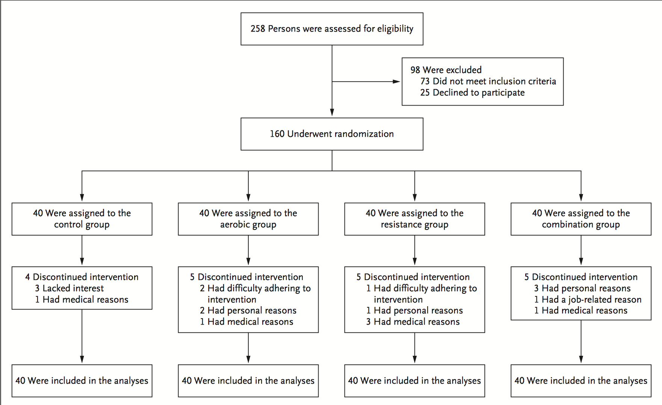

Slide 19
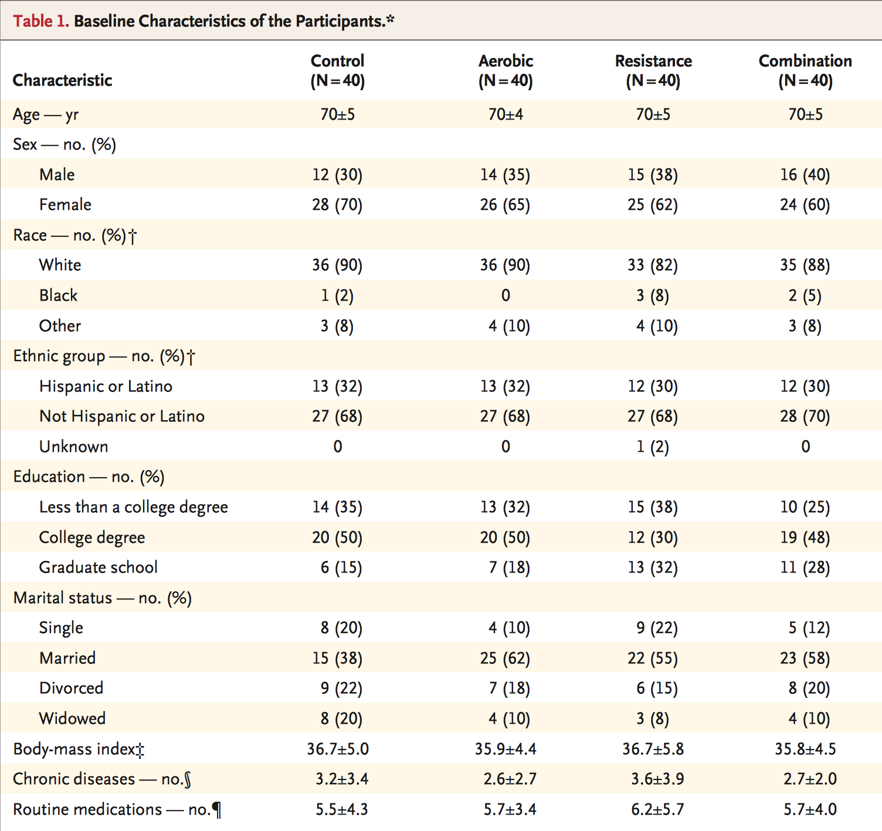

Slide 20
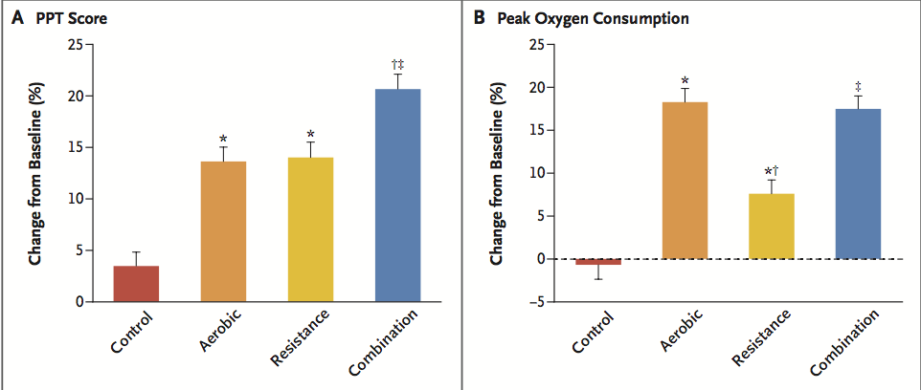

Slide 21
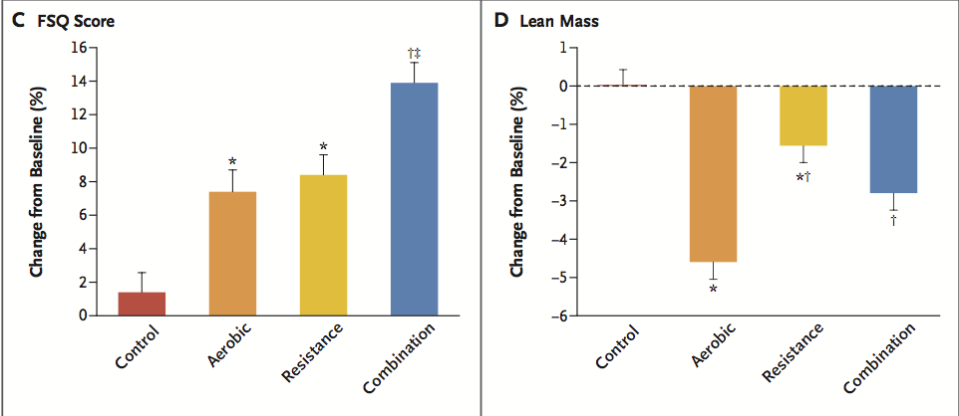

Slide 22
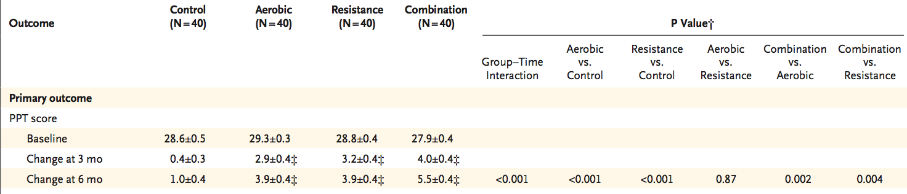
Outcomes

Slide 23
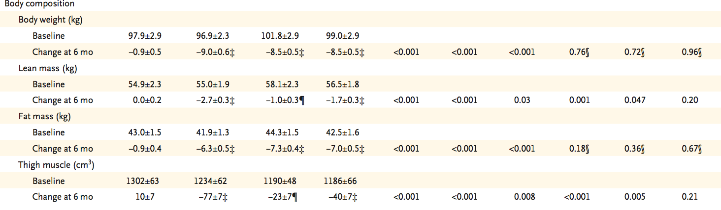
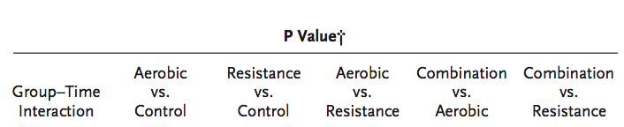

Slide 24
Bone Mineral Density of the whole body and at the lumbar spine did not change significantly in any of the study groups.
Bone Mineral Density at the hip did not change significantly in the resistance group, decreased 2.2% in the aerobic group, and 1.1% in the combination group.

Slide 25
Adverse Events
Aerobic Group: Falling, Shoulder pain, Back pain
Resistance Group: A fib, Shoulder pain, Knee pain
Combination Group: Shoulder injury, Knee pain, Back pain, Hip pain
No other differences in adverse events relative to the control group.

Slide 26
Adherence
96-100% in all groups with both exercise and weight management regimen

Slide 27
Critical Appraisal
Are the results valid?
Randomized
Intention to treat analysis
Follow up was complete
Patients were analyzed in the group they were assigned
Not blinded
Groups were similar in baseline characteristics
Similar treatment outside of interventions

Slide 28
Critical Appraisal
Results?
How large was the treatment effect? For improvement on the Physical Performance Test the score was increased 21%, 14% and 14% in the combination, aerobic and resistance group compared to control. Body weight decreased by 9% in all groups compared to control. Lean body mass decreased 3%, 5% and 2% in the combination, aerobic and resistance groups.
How precise was the estimate of treatment effect? The improvement in PPT score, and change in body composition had a p value of less than 0.005 when compared to control.

Slide 29
Critical Appraisal
Implications for patient care
Can the results be applied to patient care? Yes, although would likely require multidisciplinary approach with nutrition and PT involvement.
Were all clinically important outcomes considered? Yes. Although the risk of musculoskeletal injury and pain warrants more thought.
Are likely treatment benefits worth the potential harm and risks? Unclear risk of injury if less supervised. Cost and availability not entirely clear.

Slide 30
Conclusion for my patient
Would inform her that this study indicates that there is a benefit of combined aerobic and resistance exercise as well as balanced calorie reduced diet for weight reduction, improvement in physical fitness, and quality of life.

Slide 31
Questions?

