Slide 1
Effect of Statin Treatment vs Usual Care on Primary Cardiovascular Prevention Among Older Adults
Sarah Phillips, MD
Journal Club
June 2nd, 2017

Slide 2
The patient
72y/o Haitian female
PMHx:
  Depression
  Anxiety
  OA
  Headaches
  MCI
Medications:
  Remeron 7.5mg QHS
  APAP as needed
Notes:
Patient I recently saw in clinic

Slide 3
The patient
Weight 61kg – BMI 24.5
Labs
  A1c 9/2016 5.8%
  Lipids 1/2017
    TC 191
    TG 116
    HDL 60
    LDL 108
Per ASCVD guidelines, 10.2% 10-year risk of CVD → Moderate- to high-intensity statin recommended
Per USPSTF guidelines, consider low- to moderate-intensity statin for prevention of CVD events and mortality
Statins have risks – myalgias, impact on functional status
What do I do?
Notes:
[ascvd calculator goes up to 79 y/o]

Slide 4
The question
In elderly patients with elevated cholesterol and no other CV risk factors, is there a benefit to starting statin therapy?
P = elderly patients
I = statin therapy
C = no statin therapy (usual care)
O = primary prevention of CV events

Slide 5
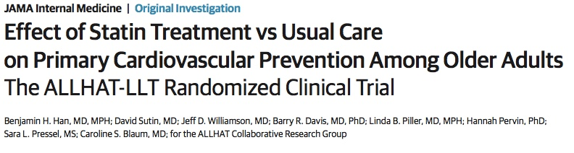

Slide 6
Study Objective
Conduct secondary analyses of several outcomes of subset of older adults without baseline ASCVD from the Antihypertensive and Lipid-Lowering Treatment to Prevent Heart Attack Trial – Lipid-Lowering Trial (ALLHAT-LLLT)
Evaluate overall benefit of statins for older adults

Slide 7
ALLHAT-LLT Sample
ALLHAT-LLT
  Sponsored by the National Heart, Lung, and Blood Institute of the NIH
  Randomized, open –label trial
  February 1994 to March 2002
  513 clinical sites
  Participants drawn from ALLHAT
Eligibility
  Adults 55 years or older
  Stage 1 or 2 HTN with at least one additional CHD risk factor
Exclusion criteria
Notes:
ALLHAT – anti-HTN trial designed to determine if tx with a CCB, ACEI, or an alpha-blocker reduces fatal CHD or nonfatal myocardial infarction compared with treatment with a thiazide-type diuretic
This paper did an analysis on a subset of patients from the ALLHAT-LLT sample – so it is important to look at the overall characteristics of this sample
Exclusion criteria:
Currently receiving lipid-lowering therapy
Known to be intolerant of statins
Manifested significant kidney or liver disease
Known secondary cause of hyperlipidemia
If known coronary heart disease – had baseline fasting LDL between 120-189 and fastng TG <350

Slide 8
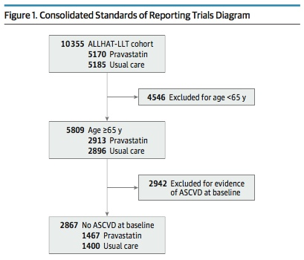
Subanalysis conducted on individuals 65 years or older and without evidence of ASCVD at baseline
Notes:
The population of interest for this study was the 2867 patients >age 65 with no ASCVD at baseline
ASCVD includes coronary heart disease, peripheral vascular disease, and cerebrovascular disease

Slide 9
Intervention and Follow-up
Open-label Pravastatin (40mg/day) versus usual care
Random assignment in 1:1 ratio
Usual care group treated for LDL-C level lowering based on the discretion of their PCP
Follow-up visits at 3, 6, 9, and 12 months after randomization and every 4 months thereafter
Notes:
Pravastatin dosing:
- Started at 20mg/day and increased to 40mg/day to achieve 25% decrease in LDL-C
- After 1st 1000 participants enrolled – just started at constant 40mg dose
Study practitioners had the option to lower to dose, discontinue tx with Pravastatin due to adverse effects, and prescribe other cholesterol-lowering drugs
UC group treated for cholesterol at the discretion of their PCP
Follow-up
- Checked fasting lipids in random preselected samples of UC (5%) and pravastatin (10%) participants
At 2, 4, and 6 year follow-up visits, a fasting lipid profile was obtained in random preselected samples of Usual Care (5%) and Pravastatin (10%) participants

Slide 10
Outcomes
Primary outcome: all-cause mortality
Secondary outcomes:
  Cause-specific mortality
  Nonfatal MI
  Fatal CHD
End points ascertained by:
  Follow-up visits
  Death certificates
  Hospital discharge summaries

Slide 11
Statistical Analysis
Intention-to-treat analysis
Kaplan-Meier method used to calculate cumulative event rates for each outcome by age range
Cox proportional hazards model used to evaluate differences between event rate curves and provide hazard ratios
Adjusted for comorbidities and cardiac risk factors
Sensitivity analyses to test the interaction between treatment group and age
Notes:
All analyses performed according to participants’ randomized treatment assignments, regardless of subsequent crossover
Adjusted for comorbidities and cardiac risk factors using a multivariable-adjusted model
Cardiac RF: baseline age, sex, ethnicity, ASA use for primary prevention, current tobacco use, present of DM2, BMI, SBP And DBP
To determine if treatment effect differed between adults >75 years and those younger than 75 years

Slide 12
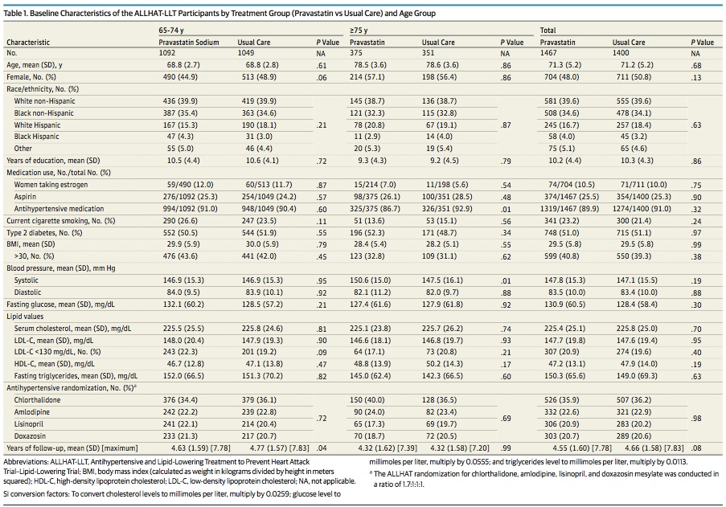
Results
Notes:
Analytical sample included 2867 ambulatory adults ages 65 and older with hypertension and without ASCVD at baseline
1467 participants in pravastatin group
1400 participants in Usual Care group
This table shows baseline characteristics of the participants – somewhat overwhelming table, but if you dig deeper, you’ll notice that groups are overall similar
Groups similar in terms of gender, race/ethnicity, years of education, total number of medications, tobacco use, percent with DM and fasting glucose, serum lipids, type of antihypertensive medication
In participants aged 65-74, mean years of f/u differed significantly for pravastatin (4.63 years) vs Usual Control (4.77 years) – losses to f/u discussed in earlier publication of ALLHAT-LLT study
Other differences between groups:
Among participants 75 years and older, significantly more participants in the pravastatin group were taking BP medications and the mean SBP values were higher compared to Usual Care participants

Slide 13
Results
Rate of unintentional crossover
  Usual Care group
    8.3% taking statin by Year 2
    29.0% taking statin by Year 6
Lower total cholesterol and LDL-C in pravastatin group
Discontinuation of Pravastatin
  Half stopped without giving a reason
  Others cited adverse effects and other medical and non-medical reasons
Notes:
Rate of unintentional crossover
Participants in the Usual Care group were allowed to be started on statin or other cholesterol-lowering medication at the discretion of they physician
More pronounced for participants aged 65 to 74 years compared to those 75 and older
Aged 65-74 years in Usual Care group
31.8% taking statin by year 6 versus only 15.2% for those 75+
Total cholesterol and LDL-C levels were lower at the 2-year, 4-year, and 6-year follow-up visits in the pravastatin group compared with the UC group across all age groups
Mean baseline LDL-C levels were 14.7.7 mg/dL in the pravastatin group versus 147.6mg/dL in the UC group
By Year 6 – mean LDL-C levels were 109.1 in the pravastatin group versus 128.8 in the UC group

Slide 14
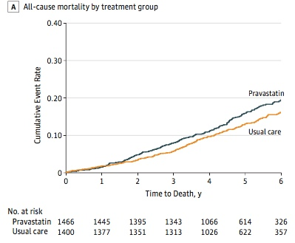
Results – All-Cause Mortality
No benefit of pravastatin for the primary and secondary outcomes
More all-cause mortality in the pravastatin group than the UC group in both age groups
Notes:
Primary outcome = all-cause mortality
This graph shows all-cause mortality for all ages

Slide 15
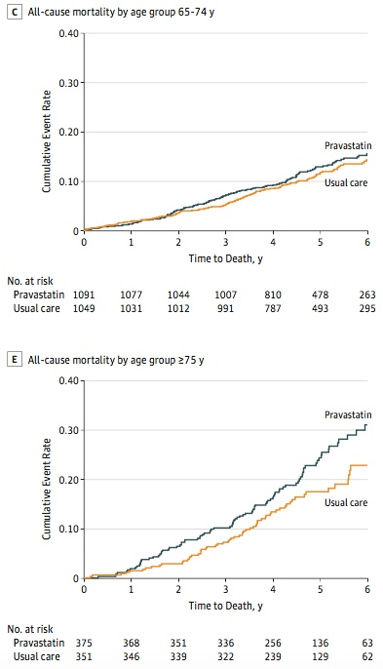
Results – All-Cause Mortality
For participants 65-74 years, there were 141 deaths in the pravastatin group and 130 deaths in the UC group (HR 1.08, 95% CI, 0.85-1.37, p=0.55)
For participants 75 years and older, there was a non-significant increase in mortality in the pravastatin group (HR 0.70, 95% CI, 0.43-1.13, p=0.07)
Notes:
Top graph shows all-cause mortality rates for ages 65-74 years
Bottom graph shows all-cause mortality rates for ages >75
- As you can see, there is an increase in mortality in the pravastatin group – but this increase is not statisfically significant
75 and older group
- 92 deaths vs 65 deaths (UC group)

Slide 16
Results – All-Cause Mortality
Multivariable Cox proportional hazards regression
  Adjusted HR (pravastatin vs UC) for all-cause mortality for all participants 65 and older was 1.15
    95% CI 0.94-1.39, p=0.17
Notes:
When they took the predetermined cardiac risk factors into account (i.e. age, gender, aspirin use, tobacco use, DM, BMI, BP) – the adjusted hazard ratio for all-cause mortality did not change much

Slide 17
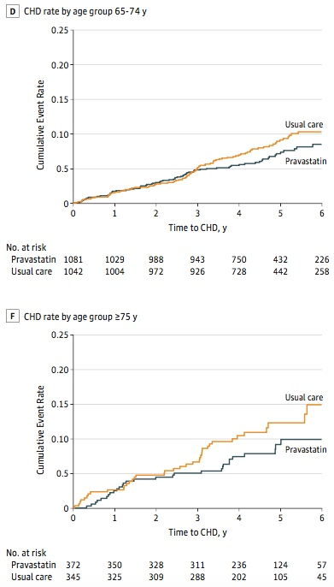
Results – Secondary Outcomes
Ages 65 to 74
  76 CHD events in Pravastatin group
  89 CHD events in UC group
  HR 0.85, 95% CI 0.62-1.15, p=0.29
Ages 75 and older
  31 CHD events in Pravastatin group
  39 CHD events in UC group
  HR 0.70, 95% CI 0.43-1.13, p=0.14
Notes:
Stroke, heart failure, and cancer rates were similar in the two treatment groups for both age groups

Slide 18
Results
Multivariable regression for CHD events adjusting for same CV risk factors did not significantly change the risk across all age groups
No significant interaction between treatment group and age
Notes:
Table 3

Slide 19
Discussion
Newly administered statin use for primary prevention had no benefit on all-cause mortality of CHD events compared with Usual Care in the subset of adults 65 years and older with hypertension and moderate hypercholesterolemia
Non-significant statistical trend toward increased all-cause mortality with use of pravastatin in age group 75+
Notes:
Noted non-significant direction toward increased all-cause mortality with use of pravastatin in the age group 75 years and older
Use of statins may be having untoward effects in the function or health of older adults
Could offset any possible CV benefit
No significant interaction between treatment group and age

Slide 20
Discussion
Why the trend toward increased mortality?
  Increased risk of statin-related muscle problems
  Negative effects on energy and fatigue with exertion
  Possible negative effects on cognition
Are there benefits of statins for primary prevention?
  PROSPER
  JUPITER
  HOPE-3
Notes:
Statins may have effect on the physical or mental functioning of older adults
Prior studies have shown that any negative effect on function places older adults at higher risk for functional decline and death
Older adults at increased risk for statin-induced muscle problems
5x higher risk of hospitalization for rhabdo compared to younger adults
Negative effect of statins on energy and fatigue with exertion → possible that statins may have negative effects on function in vulnerable older adults
Evidence suggsted that statin use may have negative effects on cognition, particularly in adults with MCI or dementia
But recent major review of statin efficacy and safety did not find any effect of statins on cognitive function – but this review was flawed and didn’t include many participants over 80 or frail older adults
Statins for primary prevention
PROSER trial (Prospective Study of Pravastatin in the Elderly at Risk) – participants without vascular disease at baseline, the use of pravastatin did not result in significant reductions in CHD or stroke events during a mean 3.2-year follow-up
JUPITER trial – secondary analysis of participants 70 years and older found all-cause mortality of 1.63 per 100 person-years in those receiving rosuvastatin and 2.04 per 100 person-years in those receive placebo (p=-.09)
HOPE-3 study concluded that there may be benefit of statin for primary-prevention of cardiovascular outcomes in yonger population of older adults, there was no benefit for all-cause mortality
But need further analysis of the subgroup of older adults

Slide 21
Discussion
Strengths
  Large population of high-risk older adults
Limitations
  Post hoc secondary analysis of a subgroup of ALLHAT-LLT
  Excluded participants already on lipid-lowering therapy
  Lack of specific adverse effects data collected during the study
  Subgroup analysis may have resulted in insufficient power
  Non-pharmacological interventions not measured
  Crossover
Notes:
Limitations
The risk-benefit ratio of statin therapy in patients who were started on tx with statins at a younger age may be different fro those 75 years and older in whom one is considering initiating treatment with statins – this study was unable to address this risk
Without specific adverse effects data → if this was available, would have a better understanding of the risks and benefits of statin therapy
With subgroup analysis → less participants in each group → power of the study might be insufficent to detect small differences in risk of infrequent events
Possible bias given the open-label design of the study
Differences in other non-pharmacological cholesterol-lowering interventions, like diet, exercise, weight loss, in the UC group compared with the pravastatin group
Frequent visits in the UC group
ALLHAT-LLT did not measure lifestyle interventions
Level of crossover between participants could affect results
More participants in UC group taking statin by year 6
More participants in statin group NOT taking statin by year 6

Slide 22
Conclusions
No benefit of primary prevention for all-cause mortality or CHD events when pravastatin was initiated for adults 65 years and older with moderate HLD and HTN
Non-significant trend toward increased all-cause mortality with pravastatin
  Observed among adults 75 and older

Slide 23
Study Validity
Was the assignment of patients to treatments randomized?
  Yes – ratio 1:1, no blinding
Were all patients accounted for and attributed at its conclusion?
  Yes – intention-to-treat analysis
Was follow-up complete?
  Yes – 6 years of follow-up!
Were groups similar at the start of the trial?
  Yes
Were groups treated equally?
  No – unintentional crossover in UC group

Slide 24
Study Applicability
Can the results be applied to my patient care?
  Yes! We see many patients 65 and older who have never seen a PCP, who have HTN and HLD
Were all clinically important outcomes considered?
  Yes
Are the likely treatment benefits worth the potential harm and costs?
  This study argues NO
Notes:
Clinically important outcomes included CHD deaths, stroke deaths, non-CVD deaths, unknown deaths, nonfatal MI, stroke (fatal and nonfatal), CHF, cancer

Slide 25
My patient
Based on this study, I am concerned that patient may not derive much benefit from statin therapy – and may suffer additional harms
Focus on eating a healthy diet, maintenance of healthy weight, regular exercise

Slide 26
Citation
Han, B.H. et al. (2016). Effect of statin treatment vs usual care on primary cardiovascular prevention among older adults: The ALLHAT-LLT randomized clinical trial. JAMA Internal Medicine, E1-E11. doi:10.1001/jamainternmed.2017.1442

