Slide 1
Cognitive Decline After Entering a Nursing Home: A 22-Year Follow-up Study of Institutionalized and Noninstitutionalized Elderly People
Sarah Phillips, MD
Journal Club
April 7th, 2017

Slide 2
My patient
94y/o African American Female
PMHx:
  CHF
  HTN, HLD
  Osteoporosis
  Gout
  Sigmoidectomy and colostomy for diverticular perforation (2005)
  Legally blind 2/2 glaucoma, cataracts, macular degeneration
  History of falls and wheelchair bound 2/2 fear of falling
Notes:
Describes herself as “independent” – “I like to go, I’m not a house person” “I like to stay active”
“Why should I ask someone to do something when I can do it myself”
Her question – are there drawbacks to moving to a NH?

Slide 3
My patient
Lives alone in senior high rise
  ADLs 9 /12 – needs help with dressing and bathing
  IADL 4/16
MMSE 23/30 in 8/2015
  12th grade education but illiterate
Wants to move to NH
  Thinks she needs help with “bodily cleaning”
Notes:
Attends ADH 2x per week during good weather; in the winter has been attending activities in her buildling
Daughter lives close by and help with shopping, cooking, finances
Describes herself as “independent” – “I like to go, I’m not a house person” “I like to stay active”
“Why should I ask someone to do something when I can do it myself”
Her question – are there drawbacks to moving to a NH?

Slide 4
My question
In elderly patients entering a NH for long-term care, is there a risk of cognitive decline?
P = elderly patients
I = entering institution (NH)
C = those living at home
O = cognitive decline
Notes:
My patient is in her 90s and with several medical problems, but no serious cognitive issues that impact her function. She is successfully living independently and thriving. I had a student with me on my most recent visit and she asked if there was a risk of cognitive decline with a move to a NH. I didn’t know the answer…hence this talk today!

Slide 5
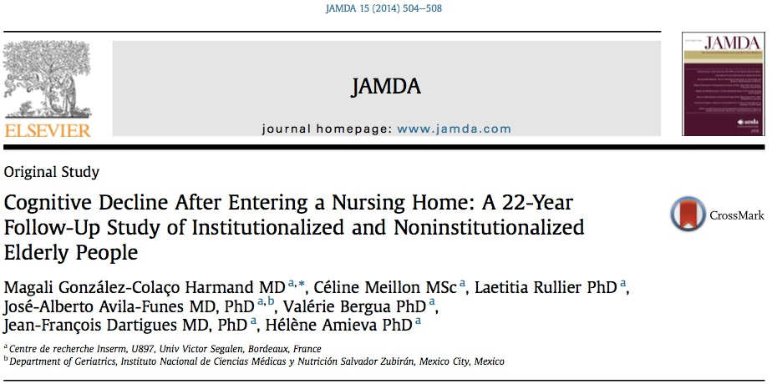
Notes:
Article published in 2014 in the Journal of the American Medical Directors Association

Slide 6
Study Objective
Compare cognitive changes of elderly people after entering an institution with that of elders living in the community
Notes:
Studies have shown that the major predictors of institutionalization are to be dependent on 3 or more ADLS or to have cognitive impairment; also lacking economic resources and supportive family environment also contribute
NH can be beneficial for dependent elderly who cannot remain at home
However – for those that do not present cognitive impairment or major functional restrictions, negative consequences on cognitivie functioning or QOL can be expected due to the drastic change in psychosocial environment experience when moving to a NH
“Transfer Trauma” or “relocation stress syndrome”
Prior studies:
Canadian study in 1990 by Winocur and Moscovitch compared normal elders living in institutions and elders living in the community on a series of cognitive tests. They found that the institutionalized people performed worse than matched noninstitutionalized counterparts
Study by Scocco et al published in 2006 that conducted a case series of 100 patients recently admitted to a NH and compared several health outcomes just after admission and 6 months later – found that the clinical condition of residents worsened after 6 months, as demonstrated by a decline in MMSE score, ADL score, and QOL. Mortality rate was 33%
A cohort study by Wilson et al published in 2007 showed that NH placement is associated with accelerated ST cognitive decline.
Little work has been done on the effect of institutionalization on cognitive change in the elderly without apparent memory impairment when entering a NH.
Purpose of this study is to compare cognitive decline in patients moving from a community to an institution with noninstitutional counterparts with comparable clinical conditions

Slide 7
Sample
PAQUID cohort
Prospective population-based study
  3777 community-dwelling people aged 65 and older
  Two areas in southwest France
For this study question, two groups compared:
  Those who entered NH during study follow-up
  Those who were living at home

Slide 8
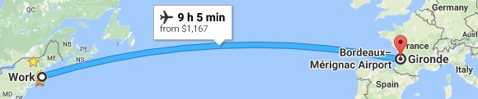
About the PAQUID Cohort
Goals of PAQUID
Paquid Study Methodology
  3777 subjects
  800 developed dementia
  2500+ died
Notes:
PAQUID refers to Personnes Agees Quid - loosely translated from French and Latin as "What about the elderly?”
Research program undertaken to study prospectively a representative random sample of 3777 people aged 65+ living independently in the community of Gironde and Dordogne, France
1992 was when first methodological article published
Goals of PAQUID:
To study normal and pathological brain ageing by repeated psychometric measures of cognitive function and to identify the prevalence, incidence, RF, and preclinical manifestations of Alzheimer disease
To describe the disability process after the age of 65 and to idenfity the main RF and consequences of disability as measured by institutionalization and mortality
PAQUID program is complemented by a study of a random sample of elderly subjects living in an institution in Gironde called “Pavin”
Authors state that Paquid and Pavin will provide a comprehensive view of the elderly population of Gironde
Will give prevalence and incidence estimates of dementia whatever the place of residence
Methodology
Subjects randomly chosen from communal electoral lists
Inclusion criteria:
At least 65 years of age by 12/31/87
To live at home at the time of the initial data collection phase
Give their written informed consent to participate
Baseline data collection
Demographics: age, sex, marital status, educational level, principal occupation during life
Social variables: number of visits received, activities, perceived social support
Subjective health measures
Health measures: weight, height, BP, dietary habits, tobacco and ETOH use, prescription drugs, age at menopause and number of children, presence of visual, dental and hearing impairments
Functional assessment – Roscow and Breslau scale, Katz ADLS, Lawton IADLs, Depressive symptoms
Personal antecedents – head injury, fractures, hospitalization, thyroid disease, depression, psych illness, major weight loss, WW2 concentration camp internment
Symptoms and pathologies – joint and back pain, dyspnea, arthritis, CV and cerebrovascular disease, diabetes
Self-perceived symptoms of cognitive deficits and neurosensory symptoms
Also took FHX – dementia in first-degree relatives
Intellectual functioning
Info re place of living – population size, geographic location, accommodations for elderly individuals (in particular, the number of beds in a NH), aluminum and fluoride level in H20

Slide 9
Methods
Psychologist visits – baseline and after 1, 3, 5, 8, 10, 13, 15, 17, 20, and 22 years
Socio-demographic data
Function: Lawton IADL scale
Depression: CES-D scale
Subjective and objective physical health
Medications and diseases
Cognitive status
Notes:
Cognitive status: (dependent variables)
MMSE for global cognitive functioning
Multiple choice recognition form of the Benton Visual Retention Test (BVRT) – assessed visual memory
Isaacs Set Test (IST) – assessed verbal fluency
Participants who entered a NH remained in the study
Visited and administered questionnaires and cognitive tests
Evaluate for dementia
F/U with neurology or geriatrics
Neurology review panel
Psychologists completed a standardized questionnaire that was designed to assign the DSM-3 criteria for dementia – if met criteria for dementia, were seen by a neurologist or geriatrician who confirmed or rejected the diagnosis.
The diagnosis then was reviewed by a panel of specialized neurologists – applied criteria for each etiological category – Alzheimer's disease, Vascular Dementia, Lewy body disease, Parkinson’s dementia

Slide 10
Methods
Independent variable = moving to a Nursing Home
  Comparison = those who remained in the community
Dependent variable = cognitive status

Slide 11
Statistical Analysis
Chi-squared and t tests used for demographic and neuropsych variables at baseline
Two-step analysis using Linear mixed-regression models
  Assess effect of institutionalization on tests scores
  Assess further cognitive decline over the 22-year follow-up period
  Effect of institutionalization
Second step of analysis excluding patients who developed dementia
Notes:
Linear mixed-regression models
Accounts for correlations that are due to the repeated measurements of cognitive scores over time within the same subject
Controlled for potentially confounding effects of the following variables:
Baseline MMSE score
Age
Sex
Educational level
Comorbidities (high BP, DM, stroke, angor, dyspnea)
Dementia
Depression
Dependency in IADLs
Effect of institutionalization on cognitive function
Second step of analysis excluding all participants who developed dementia over the study followup
Purpose of this analysis was to ensure that the results could not be explained by different rates of dementia in the NH and non-NH patients
P set at 0.05

Slide 12
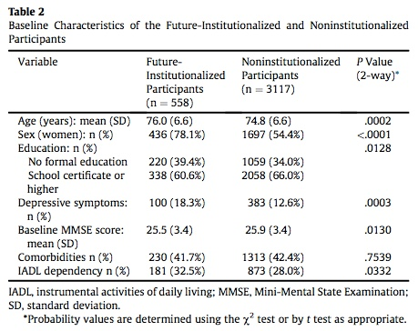
Results
Notes:
3675 participants included in study
558 entered a NH during the 22-year f/u period
102 excluded due to diagnosis of dementia at baseline
Those who entered NH were significantly older, had lower level of education
Community-dwelling participants were less depressed, less dependent for IADL, higher MMSE score
No difference in comorbidities

Slide 13
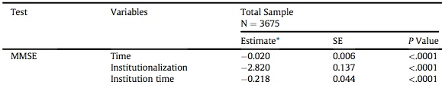
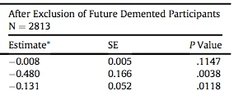
Results
Second analysis
Notes:
NH placement was significantly associated with an estimated drop in the MMSE score of 2.8 points between the last visit and the first visit after placement
Also a greater further cognitive decline after institutionalization – a difference of 0.2 point per year
Second analysis done to minimize possible reverse causality effect
Same statistical model
Excluded persons who being demented during the study followup (n = 862)
Results unchanged

Slide 14
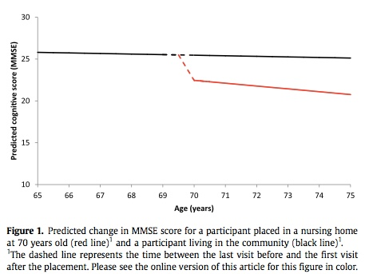
Results
Notes:
This figure shows the predicted change in MMSE score for 2 representative patients
One in NH = red line
One in community = black line
Dashed line shows the time between the last visit before and the first visit after the placement
Shows that there is a gradual decline in cognition for both patients (whether community dwelling or in a NH), but with move to NH there is a more sudden decline

Slide 15
Discussion
Elderly patients who entered NH had greater cognitive decline
Difficult to establish causal relationship
Biases
Age
Relationship between decline and move to NH
Notes:
Cognitive decline depends on several factors and cannot be attributed to a single one
Some biases could contribute to the statistically significant decline in cognitive performances evidenced in this study
Biases
Reverse causality effect – the greater cognitive decline experienced in institutionalized elderly could be explained by the fact that those who entered NH already presented cognitive impairment and therefore were more prone to decline. Attempted to minimize this with the following:
Study controlled for baseline MMSE and IADL scores, incident dementia, depressive symptoms, and chronic disease
Ran a second statistical analysis where participants who developed dementia were excluded – results were unchanged
Age – in this study, NH participants were older than community-dwelling participants. Could this influence the rate of cognitive decline?
This was controlled for in statistical analysis
Study by Ravona et al published in 2011 concluded that there was no significant association between chronological age or NH residents and the rate of cognitive decline
Difference in cognitive decline could not be explained by a sudden decline in cognitive performance immediately before or after institutionalization
- Statisical model took into account the acute effect on test scores between the last visit before and the first visit after the change point – no scores were obtained at the exact moment of institutionalization

Slide 16
Discussion – Why the cognitive decline?
Physical and psychological effects
  Relocation Stress or Transfer Trauma
Lifestyle change – more sedentary
Lack of cognitively stimulating activities
Loss of social integration
Notes:
Relocation Stress or Transfer Trauma
Heterogeneous
Depends on many factors related to the patient – his/her view of being institutionalized, personality, degree of capacity to cope with new situations; characteristics of the placement (the rush to be moved to NH, information provided to the patient, capacity to decide about placement); social and family environment
Helplessness and depressive symptoms affect 30-40% of NH residents
Study published in 1999 by Hammer showed that more than one-half o residents did not feel at home in LTC after 2 to 7 years
Sedentary Lifestyle
Often facilities don’t have space for exercise for residents
Lack of awareness for the necessity and benefits of adaptive older exercise in elderly
Often facilities will have rehab services in subacute setting but limited options for healthier LT residents
Cognitive benefits of exercise, especially combined aerobic exercise and strength training
Cognitive inactivity
Playing cards or watching TV is very common in NH, but these leisure activities are not enough to maintain cognitive health
Social integration
Participation in family engagements, social activities has a protective effect on cognition in elderly
Reducing the social and family network often happens when patient moves to NH

Slide 17
Study Conclusions
“Results suggest that institutionalized elderly people present a greater cognitive decline than individuals remaining in community”

Slide 18
Study Validity
Was the sample of patients representative?
  Random sample in specific area of France – likely representative of that area but not sure about the rest of the population
Were patient sufficiently homogenous with respect to prognostic risk?
  Yes
Was follow-up complete?
  Yes – 22-year follow-up period
Were objective and unbiased outcome criteria used?
  Objective tests of cognitive status: MMSE, IST, BVRT
  Standardized questionnaire for dementia
  Diagnosis of dementia by specialists; confirmed by consensus panel of neurologists
Notes:
Re homogeneity –
Addressed how they determined sufficient sample size in the 1992 article
In those over age 65, annual incidence rate of AD approaches 1%
Taking the aging of the cohort into account, the 5-year cumulative incidence rate was predicted to be 5%
Calculated the minimal number of subjects required to be 3,593 – anticipated needing 4000 subjects to account for those lost during f/u

Slide 19
Study Applicability
Were the study patients and their management similar to my own?
  No! This is Massachusetts, not France…
Was the follow-up sufficiently long
  Yes!
Can I use the results in managing patients in my practice?
  Yes
Notes:
This study helps provide me with data to better counsel patients. While I cannot conclude causality from this study (i.e. I can’t say that moving to NH causes dementia), I can talk with my patients that in some patients, we see cognitive decline after moving to NH, likely for a variety of reasons. Using conclusions from other studies, I can talk about protective measures patients can take – visiting with family and friends, investing in the NH community, remaining physically active

Slide 20
My patient
Active in her senior building and attends ADH
Supportive family
Very independent
Concern for decline in NH setting
My recommendations?
Notes:
Talk about risks and benefits of NH placement
Review reasons why she wants to go to NH
Talk about adjustment period and what to expect
Encourage her to visit several homes, talk with peers about their experiences
Have the whole family on board – visiting schedule?

Slide 21
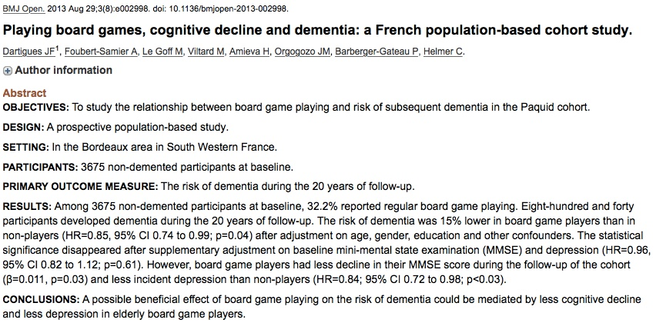
Notes:
Another study from the Paquid cohort

Slide 22
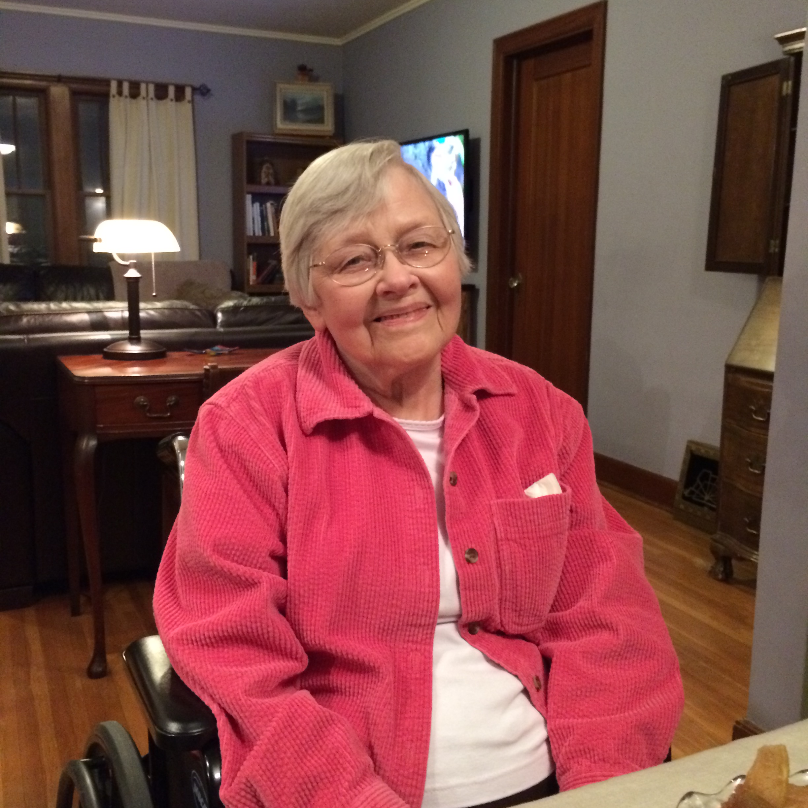
Another favorite “patient”
Currently 87 years old
Moved to ALF at age 81 after suffering a fall
Tough transition, ongoing caregiver stress
Unique retirement community
Cognitive decline

Slide 23
References
Dartigues J-F., et al. (1992). The Paquid Epidemiological Program on Brain Ageing. Neuroepidemiology, 11 (suppl 1): 14-18.
Gonzalez-Colaco Harmand, M., et al. (2014). Cognitive decline after entering a nursing home: A 22-year follow-up study of institutionalized and noninstitutionalized elderly people. Journal of the Amerian Medical Directors Association, 15: 504-508.

