Slide 1

JOURNAL CLUB
Ayesha Sheikh, MD, FACP
February 10, 2017

Slide 2
Case
83 year old man coming for a regular follow up visit
PMH: Hypertension, Hyperlipidemia, OA, COPD
Lisinopril, Lipitor, Aspirin, Advair, Spiriva, Albuterol MDI prn, Tylenol prn
Vaccinations: Influenza, PCV13, PPSV23
Zoster vaccine listed as due

Slide 3
Practicalities
Not available in Geriatrics clinic
Not routinely offered
Vaccination rate not being measured
Special storage requirements
Complicated Reimbursement
Usually referred to other pharmacies in the area

Slide 4
Is there an easily available and affordable vaccine that can reliably prevent Herpes Zoster and associated complications in my 83 year old patient in a Geriatrics clinic?
Patient – 83 yo man
Intervention – Herpes Zoster vaccine
Comparison - placebo
Outcome – risk of Herpes zoster and associated complications like post-herpetic neuralgia
Notes:
Searched PubMed – no results if I typed “reliable” or “afforadable” - but finally found an update on systemic review – digging through it I found out that they had included a “new” vaccine which is not available – it increased my curiosity and further digging lead me to this study that Im going to present toady

Slide 5
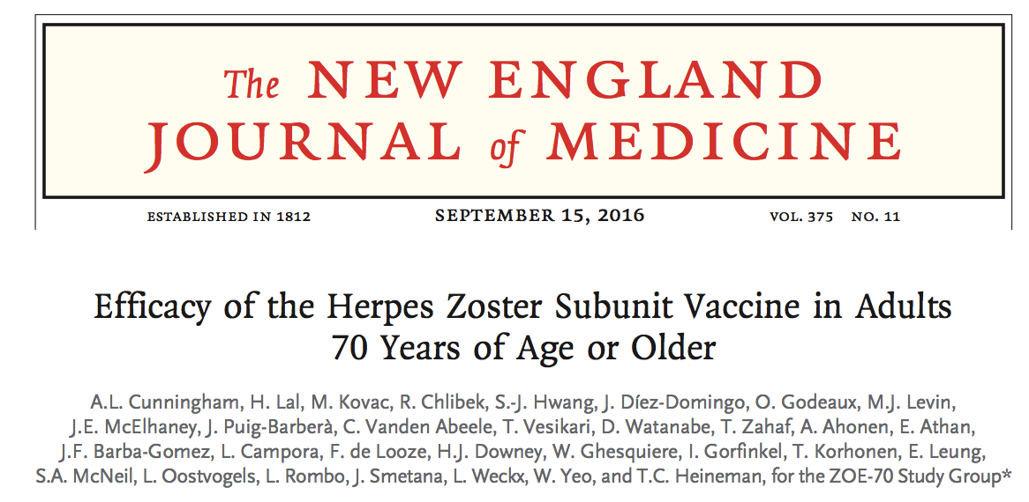

Slide 6
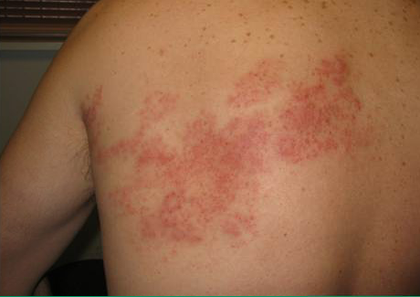
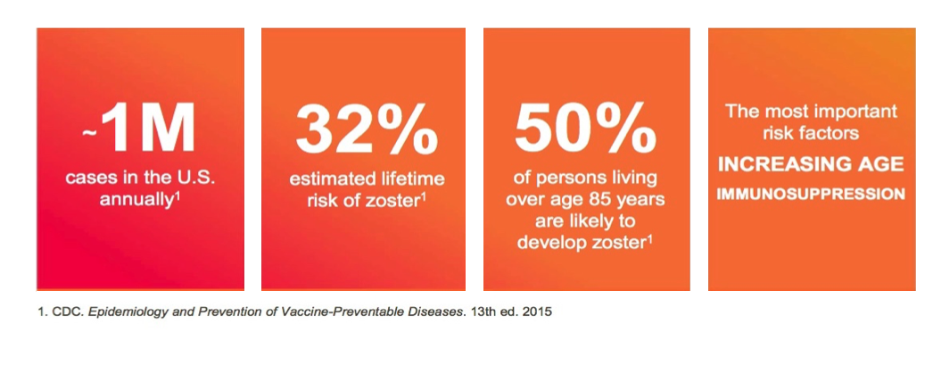
Epidemiology of Herpes Zoster
Notes:
herpes zoster,also known as shingles, is a viral disease characterized by a painful skin rash with blisters that appears in a dermatomal pattern – last about 2 – 4 weeks but may be followed by chronic nerve pain called PHN.

Slide 7
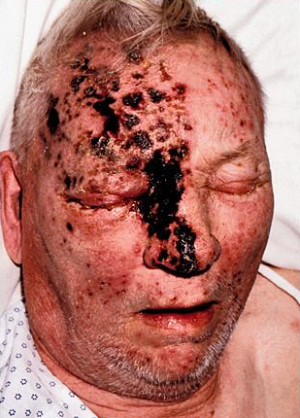
Complications of Herpes Zoster
Post Herpetic Neuralgia
Herpes Zoster Ophthalmicus
Ramsey Hunt Syndrome
Acute Retinal Necrosis
Bacterial super-infection

Slide 8
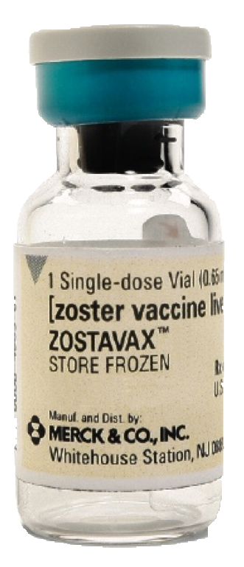
Zostavax (Merck)
Live attenuated vaccine
Recommended age > 60
Prevents zoster in 51.3%, PHN in 66.5%
Special storage requirement
Cannot be used in certain population
Complicated reimbursement
Notes:
Since 2008, the U.S. Advisory Committee on Immunization Practices has recommended that all immunocompetent persons 60 years of age or older receive a single dose of a live attenuated herpes zoster vaccine (Zostavax).1
By 2014 only 27.9% of adults 60 years of age or older reported being vaccinated.9

Slide 9
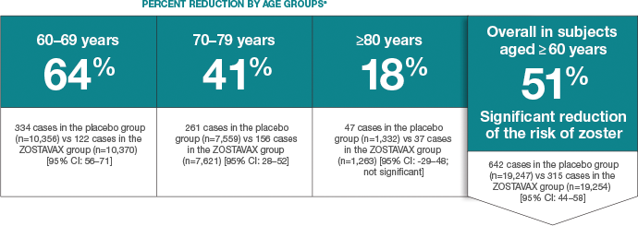
Efficacy of Zostavax declines with age
A vaccine to prevent herpes zoster and postherpetic neuralgia in older adults.
Oxman MN et. Al , N Engl J Med. 2005 Jun 2; 352(22):2271-84.
Notes:
Antiviral tx can reduce the duration of HZ rash but has not shown to dec inci of PHN

Slide 10
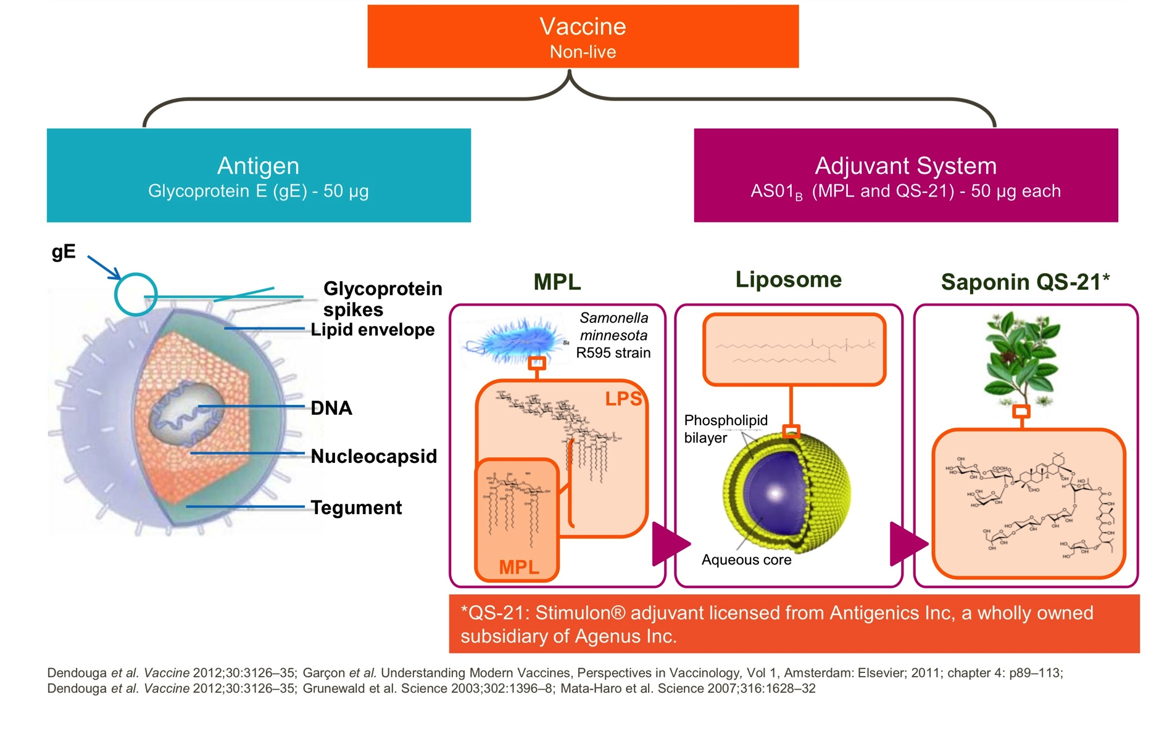
Herpes Zoster subunit vaccine (HZ/su)
Notes:
The robustness of the immune responses to glycoprotein E is attributable to the action of the liposome-based AS01 adjuvant system, which induces strong CD4+ T-cell response to glycoprotein-E, that is preserved with age.
A lower dose of this adjuvant is used in a malaria vaccine that was approved in 2015 by the European Medicines Agency for children living in areas in which malaria is endemic.

Slide 11
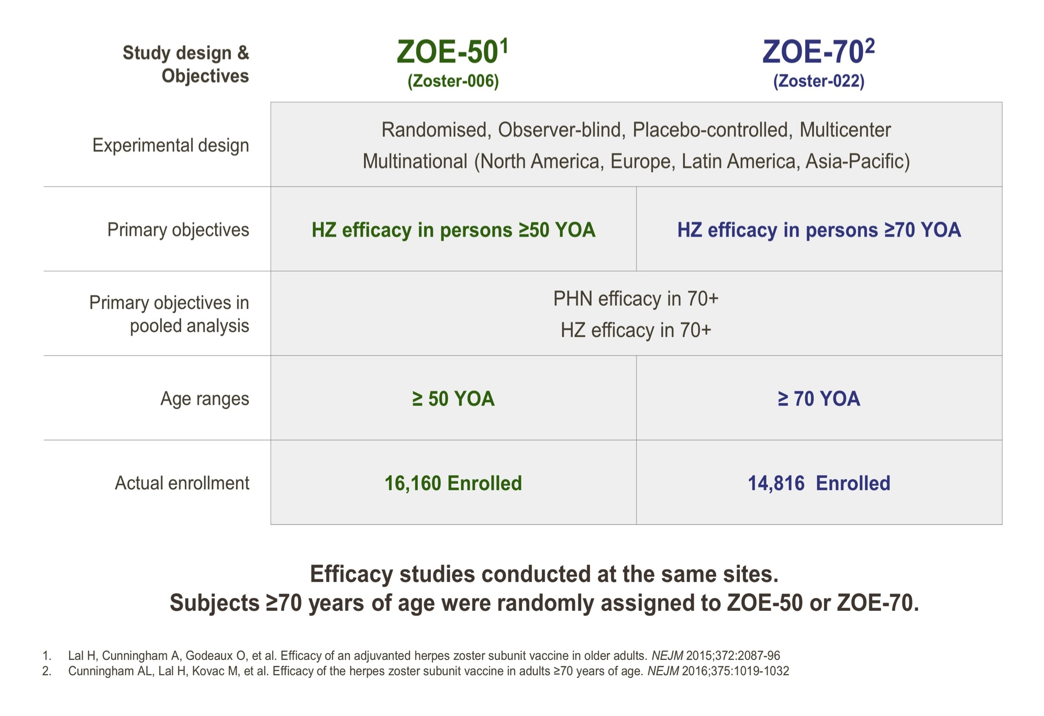
ZOE-50 and ZOE-70 overview
Notes:
A previous trial (Zoster Efficacy Study in Adults 50 Years of Age or Older [ZOE-50]) showed that HZ/su had a vaccine efficacy against herpes zoster of 97.2%, which was consistent across all age groups.26 Although 24% of the participants in ZOE-50 were 70 years of age or older, the trial was not intended to definitively assess vaccine efficacy against herpes zoster or postherpetic neuralgia in this age group. There- fore, in parallel with ZOE-50, we conducted a second trial involving only adults who were 70

Slide 12
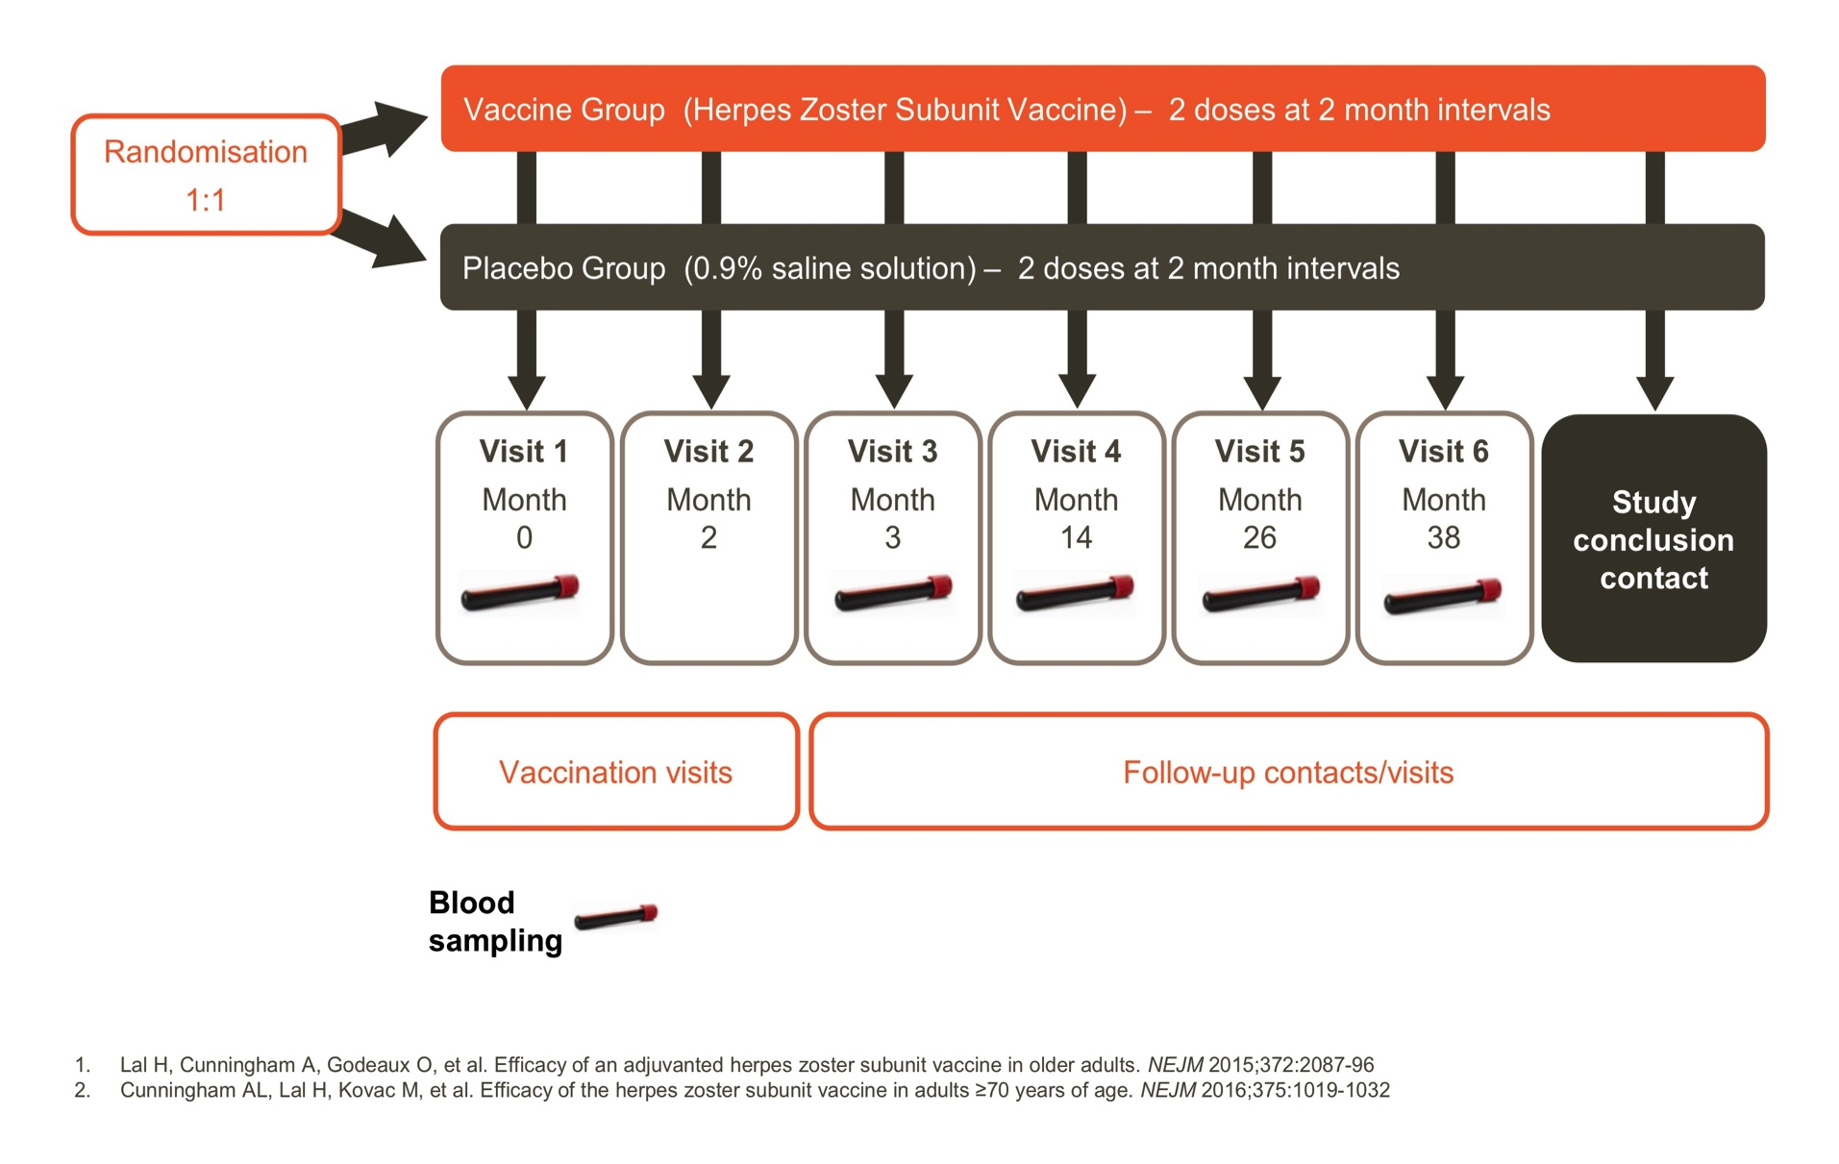
Study Design
Randomization
Notes:
participants who were 70 years of age or older were first randomly assigned to either ZOE-50 or ZOE-70 and then were randomly assigned in a 1:1 ratio to either the HZ/su group or the placebo group with the use of an online centralized randomization system.
Vaccine or placebo (0.9% saline solution) was administered (0.5 ml) into the deltoid muscle at month 0 and month 2. Participants were to be followed for at least 30 months after the second dose through monthly contacts and annual clinic visits.
Enrolled bw 8/2/2010 and 7/21/2015

Slide 13
Adults age 70 years or older were included except:
h/o Herpes Zoster
h/o varicella or Herpes Zoster vaccination
Immunosuppressed e.g. active malignancies, HIV, organ transplant, chemotherapy or immunomodulatory treatments
Comorbidities likely to limit survival to < 4 years

Slide 14
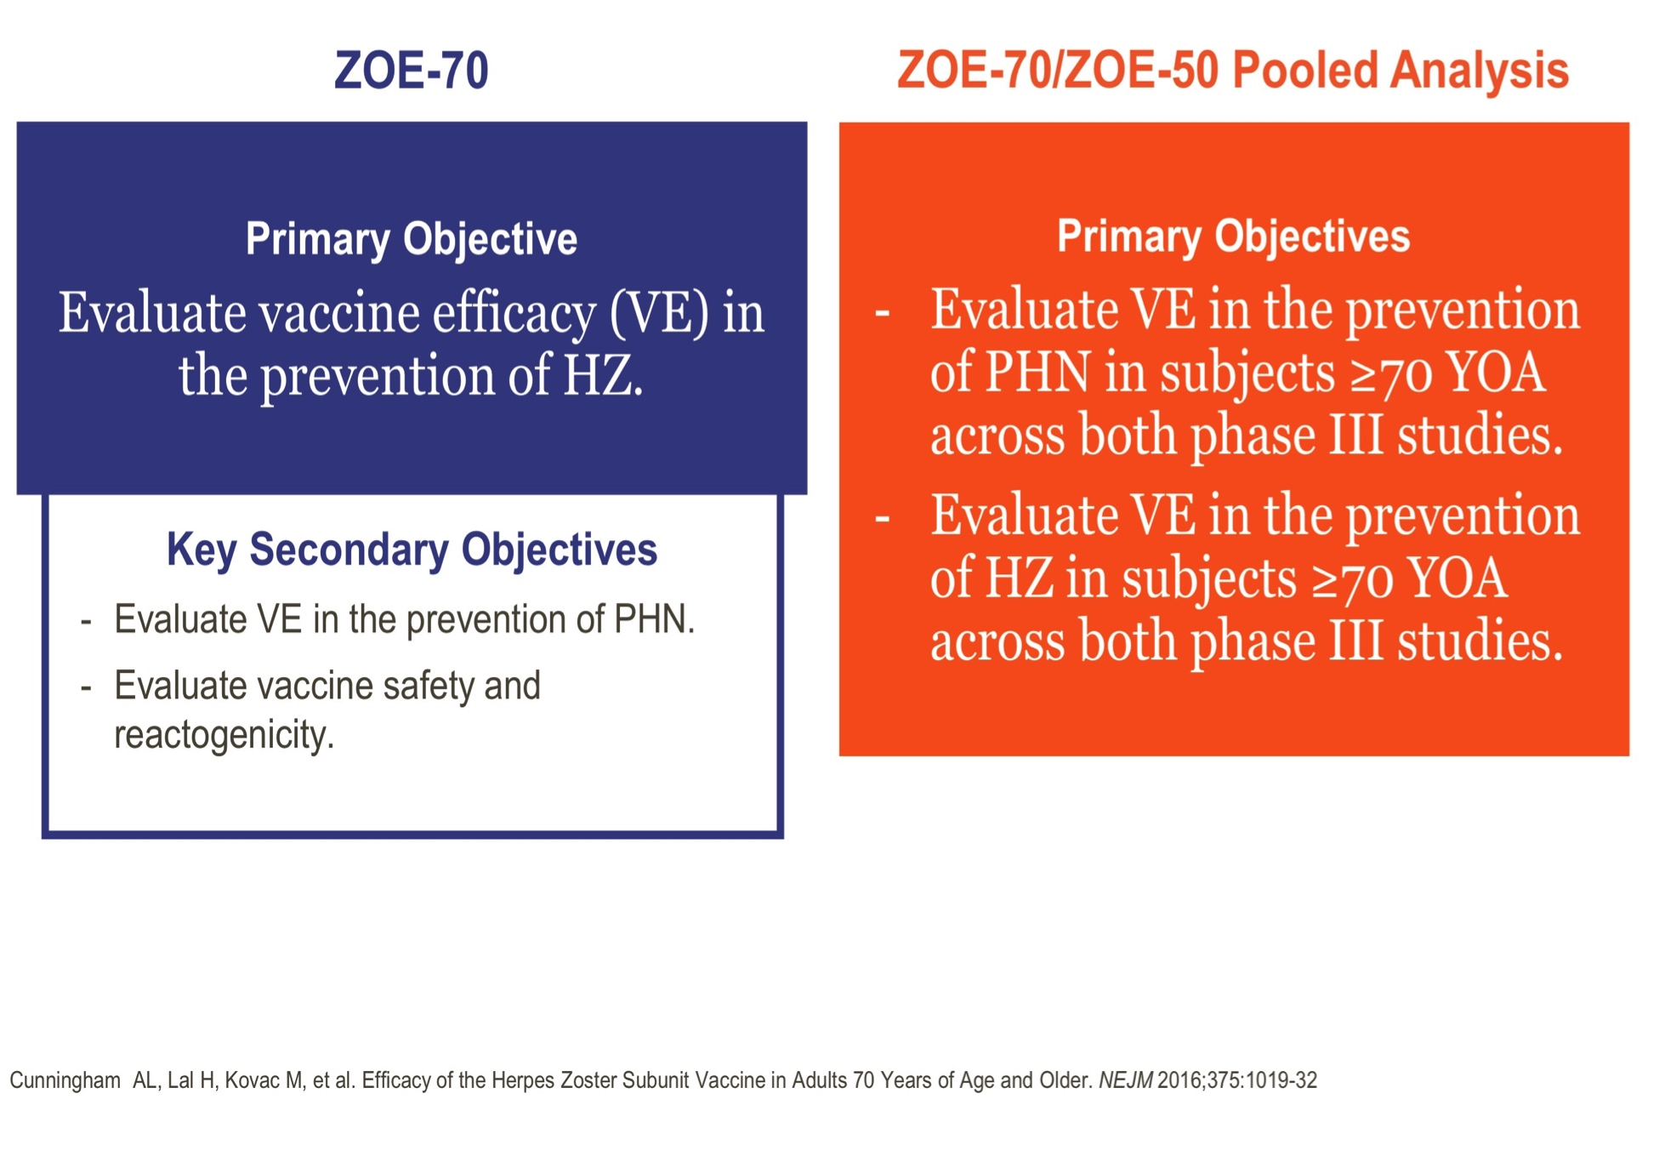
Study Objectives

Slide 15
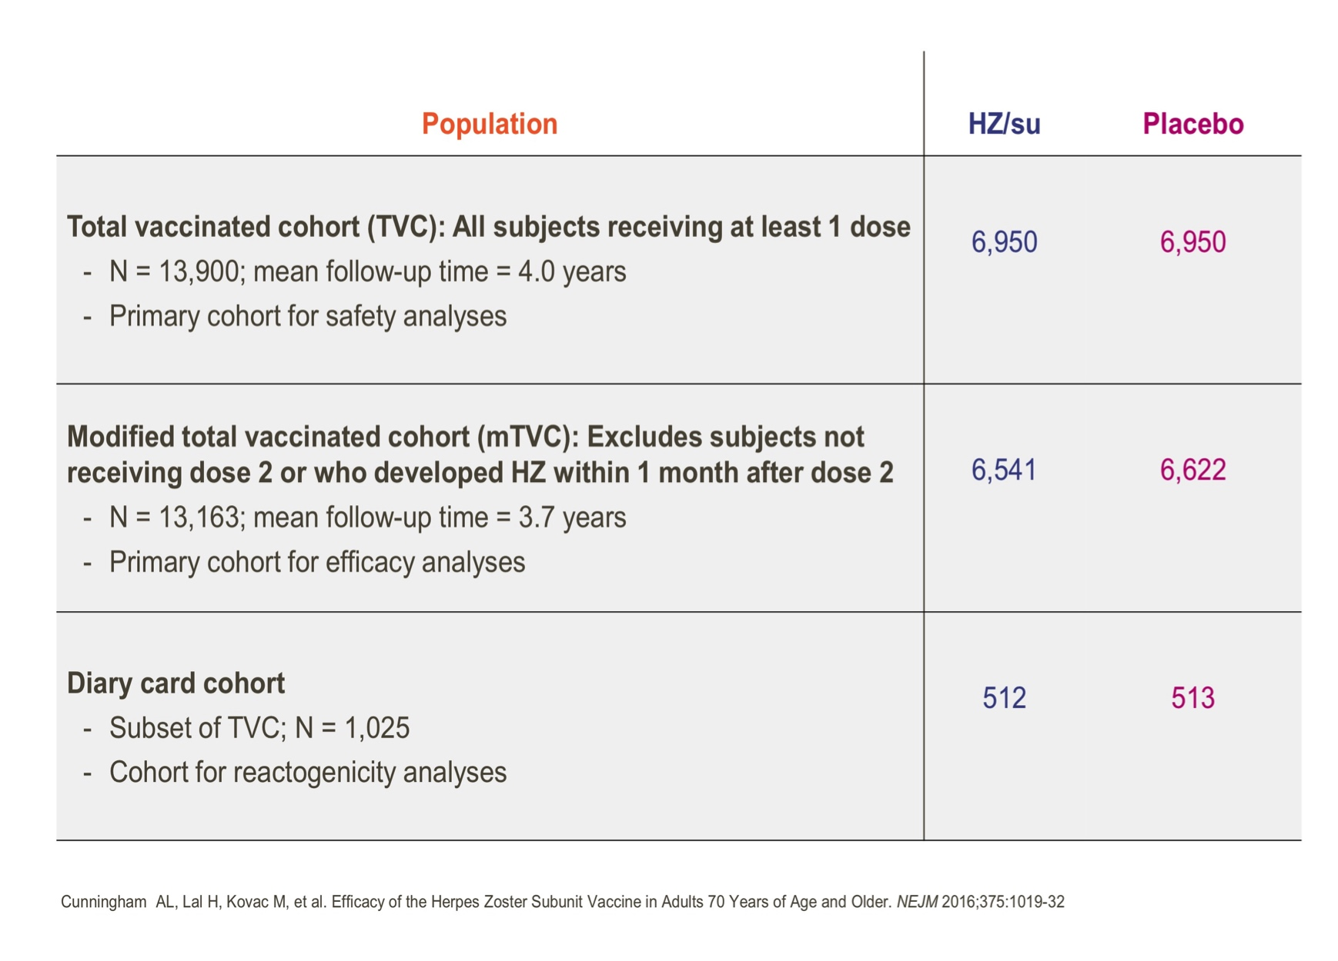
Study Cohorts

Slide 16
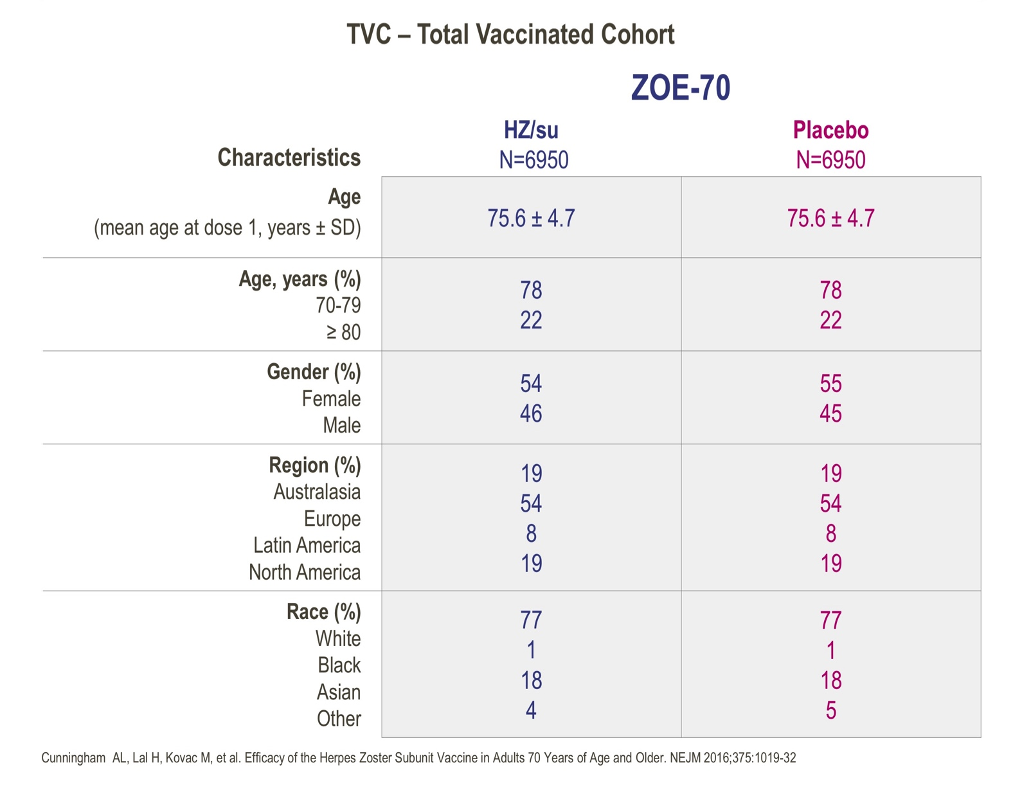
Demographics

Slide 17
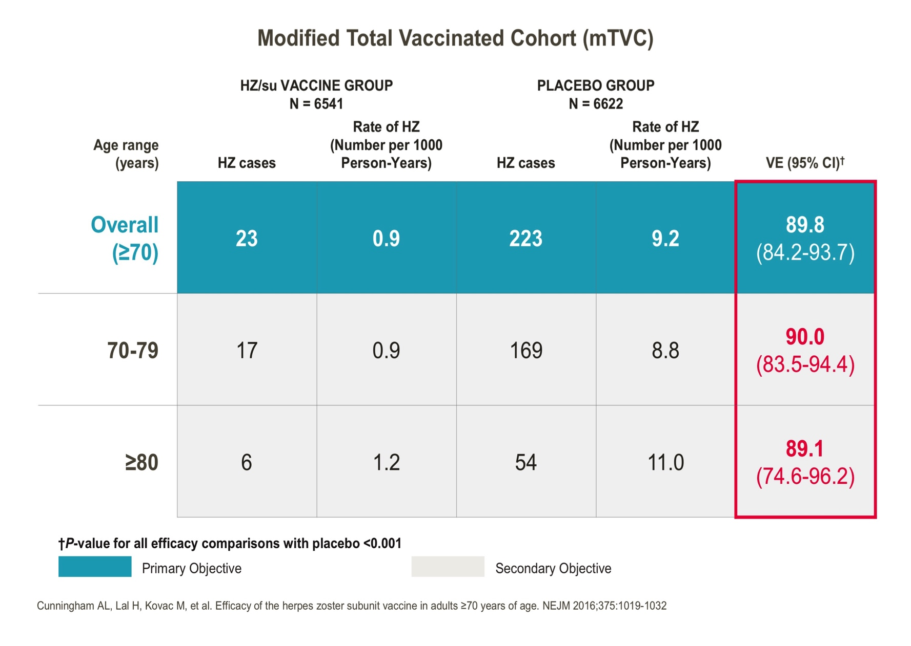
Vaccine Efficacy against HZ in ZOE-70

Slide 18
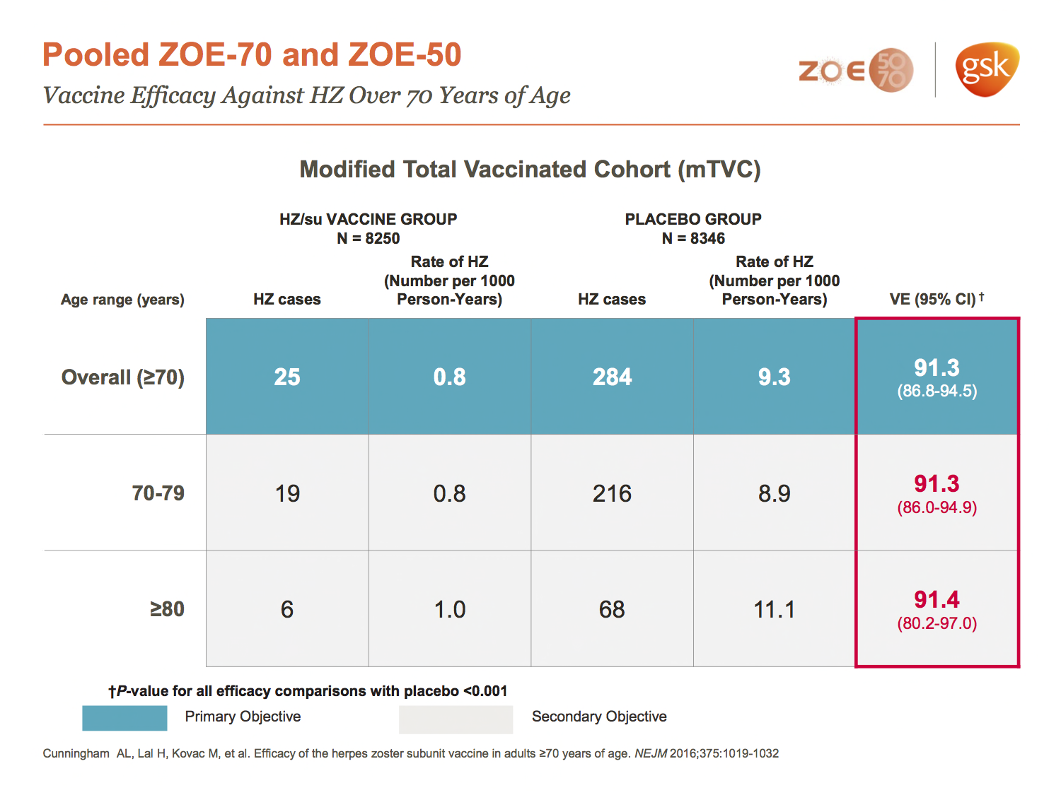
Vaccine Efficacy in pooled ZOE-50 and ZOE-70

Slide 19
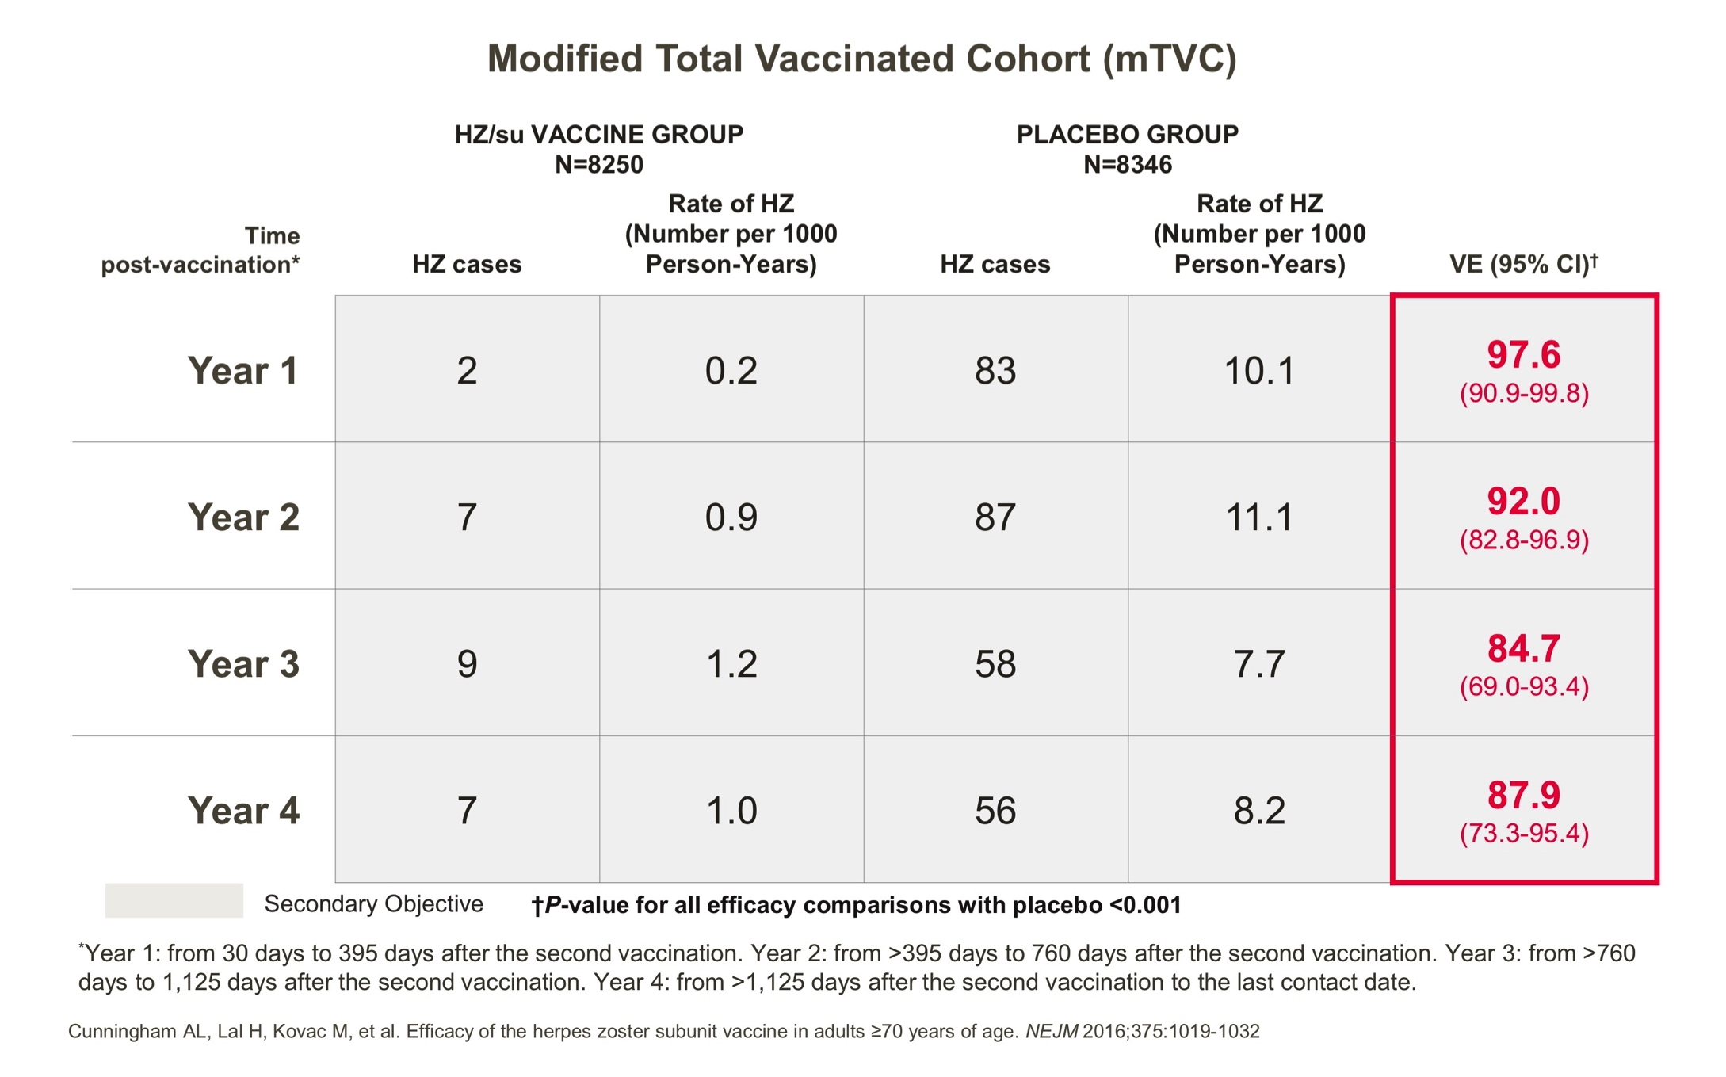
Vaccine efficacy by years since vaccination

Slide 20
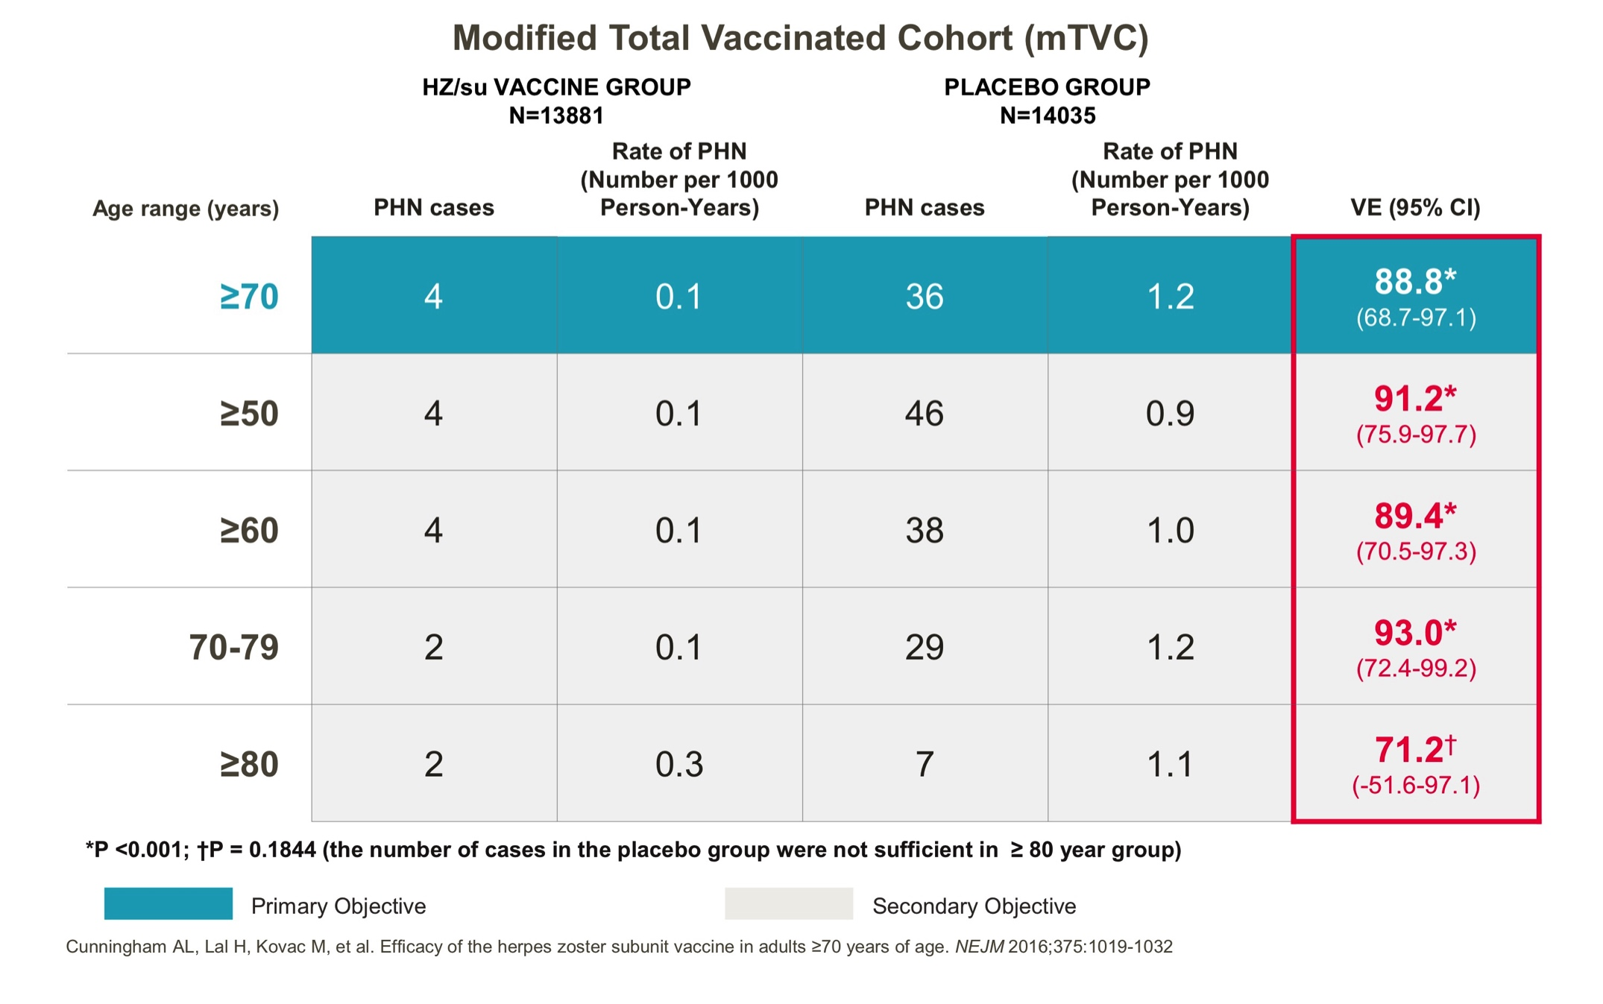
Vaccine efficacy in preventing PHN

Slide 21
Reactogenicity – Injection site reactions
 | HZ/su | Hz/su | Placebo | Placebo
Within 7 days in reactogenicity group | No. of participants (n=505) | % | No. of participants (n=505) | %
Pain | 347 | 68.7 | 43 | 8.5
Redness | 198 | 39.2 | 5 | 1.0
Swelling | 114 | 22.6 | 2 | 0.4
Grade 3 | 43 | 8.5 | 1 | 0.2
Notes:
High incidence of inj site reactions in 1st week, but mostly mild to mod in intensity and transient
Detailes in table 2

Slide 22
Reactogenicity – systemic reactions
 | HZ/su | Hz/su | Placebo | Placebo
Within 7 days in reactogenicity group | No. of participants (n=504) | % | No. of participants (n=505) | %
Fatigue | 166 | 32.9 | 77 | 15.2
Myalgia | 157 | 31.2 | 41 | 8.1
Headache | 124 | 24.6 | 55 | 10.9
Shivering | 75 | 14.9 | 22 | 4.4
Fever | 62 | 12.3 | 13 | 2.6
GI symptoms | 55 | 10.9 | 40 | 7.9
Grade 3 | 30 | 6.0 | 10 | 2.0
Notes:
Overall solicited reactions were less frequent among participants 80 yrs of age or older than among 70 -79

Slide 23
No safety concerns identified
 | HZ/su | Hz/su | Placebo | Placebo
Throughout study period in total vaccinated cohort | No. of participants (n=6950) | % | No. of participants (n=6950) | %
Serious events | 1153 | 16.6 | 1214 | 17.5
Serious events related to vaccine | 12 | 0.2 | 8 | 0.1
Potential immune-mediated disease | 92 | 1.3 | 97 | 1.4
Death | 426 | 6.1 | 459 | 6.6
Notes:
Same in 2 groups
Consistent with expectations for this age group
"Overall, 426 participants in the HZ/su group (6.1%) and 459 participants in the placebo group (6.6%) died."

Slide 24
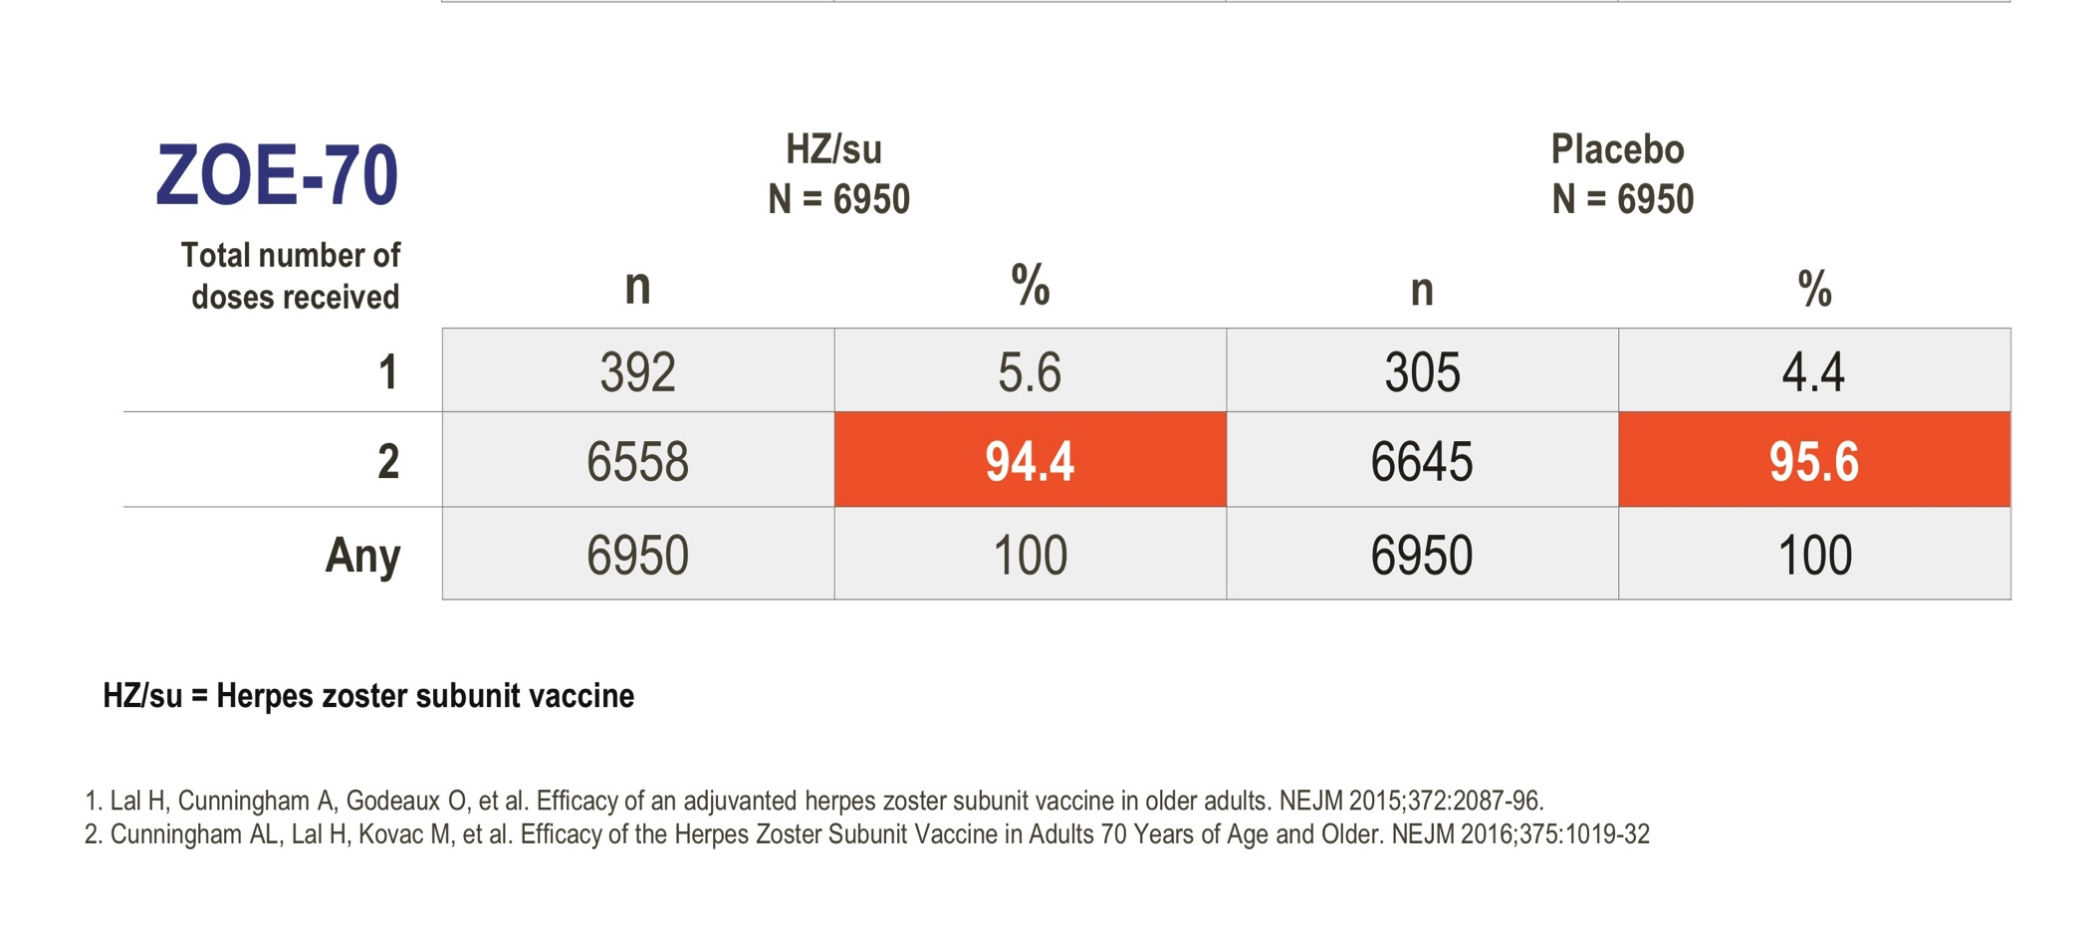
Vaccination Compliance

Slide 25
Upcoming Evidence generation
Revaccination: Immunogenicity, safety and reactogenicity in individuals with h/o Zostavax
Co-administration: Immunogenicity, safety and reactogenicity with quadrivalent influenza,PPSV23 and Tdap
Duration of protection: Efficacy, safety and immunogenicity persistence post-vaccination follow up of ZOE-50/ZOE-70 subjects
Immunocompromised population: ongoing study in the recipients of autologous HSCT

Slide 26
Critical Appraisal
Are the results valid?
Randomized
All patients accounted for and attributed at the conclusion
Double-blinded
Groups were comparable at the start of the trial
Groups were treated equally aside from experimental intervention

Slide 27
Critical Appraisal
What are the results?
How large was the treatment effect?
Efficacy in ZOE-70 - > 90% reduction in adults > 70 years
Efficacy in pooled analysis - 91% reduction in adults > 80 years
Efficacy to prevent PHN in 70 years and older - 89%
How precise was the estimate of the treatment effect?
Narrow confidence intervals = precise results

Slide 28
Critical Appraisal
Will the results help me in caring for my patient?
Can the results be applied to my patient care?
Probably yes on many patients, still need data on patients who are immunocompromised, comorbidities, h/o zoster, HZ vaccine, persistence of effect
Were all clinically important outcomes considered?
Yes - death rate was low overall but comparable
Are the likely treatment benefits worth the potential harm and costs?
Cost and availability not clear
Need 2 vaccine series
High risk of systemic reactions like fatigue

Slide 29

ShingrixTM
GlaxoSmithKline submitted a Biologics License Application (BLA) for ShingrixTM, to FDA, seeking approval for the prevention of herpes zoster in people aged 50 years or over – 10/24/2016
Regulatory submission in Canada – 11/21/2016
Regulatory submission in EU – 11/25/2016
Planned submission in Japan - 2017

Slide 30
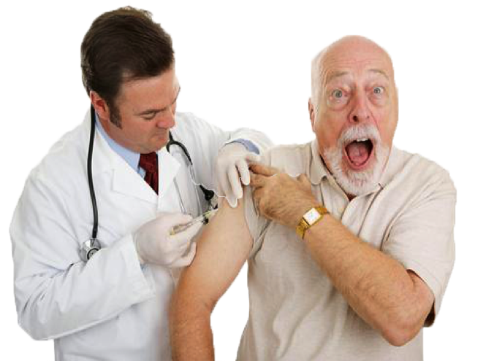
Conclusion for my patient
Would inform him about the currently available, FDA approved zoster vaccine, although efficacy is only 18%
Would likely wait for Shingrix to come on the market and ACIP recommendations before I start advising it but something to look forward to!
Notes:
FDA Standard review – 10 months
Priority review – 6 months

Slide 31
Thank you!

