Slide 1
Safety and benefit of discontinuing statin therapy in the setting of advanced, life-limiting illness: a randomized clinical trial.
JAMA Intern Med. 2015 May
Ariadne Scott MD
Geriatric Fellow

Slide 2
Clinical question
-85 year old M admitted to a NH after an ischemic stroke. --Cognitive status had deteriorated in the past year
-Multiple admissions for COPD exacerbation in the pats 12 months.
What are the benefits and risks of discontinue statin therapy in this patient who I don’t expect to live more than 6-12 months?

Slide 3
Patient: 85 yo M NH resident
Intervention: Discontinue statins
Comparison: Continue statin therapy on a similar population not expected to live longer than 12 months
Outcome: QOL

Slide 4
Study objectives
Evaluate the safety, clinical and cost impact of discontinuing statin medication for patients in the palliative care setting

Slide 5
design setting and participants
Multicenter, parallel-group, unblinded, pragmatic clinical trial
Adults with an estimated life expectancy of between 1 month and 1 year
Statin therapy for 3 months or more for primary or secondary prevention of cardiovascular disease

Slide 6
INCLUSION AND EXCLUSION CRITERIA
English-speaking adults receiving a statin for 3 months or longer for primary or secondary prevention of cardiovascular disease.
Exclusion criteria:
Treating physician’s opinion that the patient had active cardiovascular disease or sufficient risk of active cardiovascular disease to require ongoing therapy
Symptoms of myositis
Liver function test > 2.5 times the upper limit of normal,
Patient or proxy was unwilling or unable to provide informed consent

Slide 7
End Points
Primary end point of the study was the proportion of deaths within 60 days of trial enrollment
Secondary end points addressed 2 safety concerns: survival and time to first cardiovascular-related event.
Additional secondary end points addressed patient-centered outcomes important in the setting of advanced life-limiting illness: performance status, QOL, symptoms, number of nonstatin medications, statin-related adverse effects, and satisfaction with health care.

Slide 8
INTERVENTION
Statin therapy was withdrawn for eligible patients who were randomized to the discontinuation group

Slide 9
methods
Baseline assessment: Demographics, primary diagnosis, comorbid illnesses, Charlson Comorbidity Index score, laboratory studies, statin medication history, cognition and insurance status
Quality of life was measured with the McGill Quality of Life Questionnaire
Symptoms were measured using the Edmonton Symptom Assessment System
Number of nonstatin medications
Participants remained in the study until death, 1 year after enrollment, or study closure.

Slide 10
Statistical analysis
Intent-to-treat approach.
Non inferioriority trial
Repeated-measures outcomes were analyzed using a mixed-effects model performed with maximum-likelihood estimation for incomplete repeated measures.

Slide 11
Table 1
Variable | Discontinued (n= 189) | Continued (n= 192) | Total (n =381) | P value
Age | 74.8 | 73.5 | 74.1 | .29
Sex:
-Male | 98 | 112 | 210 | .20
-Female | 91 | 80 | 171 | .20
History CV disease
-Yes | 111 | 110 | 221 | .78
-No | 78 | 82 | 160 | .78

Slide 12
Table 1
Variable | Discontinued | Continued | Total | P. Value
Race:
White | 153 | 162 | 315 | .30
Black | 32 | 22 | 54 | .30
Other | 3 | 7 | 10 | .30
Multiple | 1 | 1 | 2 | .30
Cog impaired | 51 | 33 | 84 | .02
Not cog impaired | 138 | 159 | 297 | .02

Slide 13
Descriptive characteristics
48.8% had cancer as their primary diagnosis
58% had cardiovascular disease
69% had received stating for more than 5 years
36% were enrolled in hospice at study initiation

Slide 14
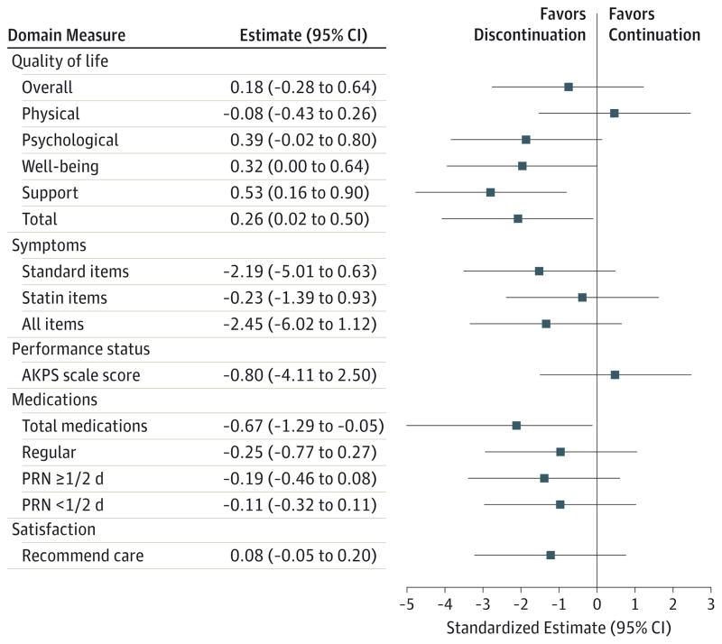

Slide 15
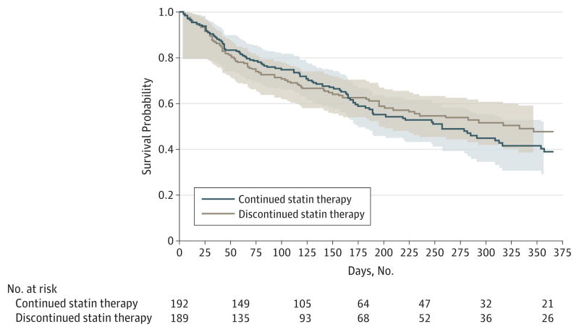

Slide 16
Back to my patient.…
85 YO NH patient
Significant deterioration over the past 12 month
What should I do based on the study findings?

Slide 17
Conclusion and relevance
Stopping statins might be safe in the appropriate setting
May be associated with benefits including improved QOL
Thoughtful discussion between provider and patient regarding uncertain benefits and potential decrement on QOL associated with stating continuation are warranted

Slide 18

Questions or comments

Slide 19
References
1. Currow DC, Stevenson JP, Abernethy AP, Plummer J, Shelby-James TM. Prescribing in palliative care as death approaches. J Am Geriatr Soc. 2007;55(4):590–595. [PubMed]
2. Stevenson J, Abernethy AP, Miller C, Currow DC. Managing comorbidities in patients at the end of life. BMJ. 2004;329(7471):909–912. [PMC free article] [PubMed]
3. Holmes HM, Hayley DC, Alexander GC, Sachs GA. Reconsidering medication appropriateness for patients late in life. Arch Intern Med. 2006;166(6):605–609. [PubMed]
4. Bain KT, Holmes HM, Beers MH, Maio V, Handler SM, Pauker SG. Discontinuing medications: a novel approach for revising the prescribing stage of the medication-use process. J Am Geriatr Soc. 2008;56(10):1946–1952. [PMC free article] [PubMed]
5. Vollrath AM, Sinclair C, Hallenbeck J. Discontinuing cardiovascular medications at the end of life: lipid-lowering agents. J Palliat Med. 2005;8(4):876–881. [PubMed]
6. Holmes HM, Min LC, Yee M, et al. Rationalizing prescribing for older patients with multimorbidity: considering time to benefit. Drugs Aging. 2013;30(9):655–666. [PMC free article] [PubMed]
7. Russell BJ, Rowett D, Abernethy AP, Currow DC. Prescribing for comorbid disease in a palliative population: focus on the use of lipid-lowering medications. Intern Med J. 2014;44(2):177–184. [PubMed]
8. Garfinkel D, Mangin D. Feasibility study of a systematic approach for discontinuation of multiple medications in older adults: addressing polypharmacy. Arch Intern Med. 2010;170(18):1648–1654. [PubMed]

