Slide 1
The effect of osteoporotic treatment on the functional outcome, re-fracture rate, quality of life and mortality in patients with hip fractures: A prospective functional and clinical outcome study on 520 patients
Makridis, Konstantinos G. et al. Injury, Volume 46, Issue 2, 378 – 383.
Sarah Phillips, MD
Journal Club
October 14th, 2016

Slide 2
My patient
91y/o Male
CC: admit to GEM s/p left femoral neck fracture, surgically repaired with intramedullary nail
PMHx: HTN, HLD, BPH s/p TURP 30 years ago, mild cognitive impairment, osteopenia
  DEXA 2010, not on any Ca+D
Lives in assisted living
  Independent with some IADLs
  Independent with some ADLs

Slide 3
My question
In older adult males who suffer an osteoporotic fracture, does treatment for osteoporosis affect functional outcome and re-fracture rate?
PubMed Search
  MESH terms: osteoporosis (therapy), hip fracture
  Limits: age, gender

Slide 4
Osteoporosis in Males
1 in 8 men >50 will sustain osteoporotic fracture during their lifetime
20-30% of hip fractures occur in men
Cause of osteoporosis and fragility fractures
  Primary osteoporosis
  Secondary osteoporosis
Management
  Primary or secondary?
  Fracture prevention – nutrition, calcium + D, exercise, lifestyle
  Medications
    Bisphosphonates
    Teriparatide
    Less evidence for Denosumab, Strontium ranelate
Notes:
Secondary osteoporosis causes
Alcoholism
Glucocorticoid excess
Hypogonadism – ex: prostate CA treatment with androgen deprivation
COPD
GI d/o
Hypercalciuria
Hyperthyroid
Hyperparathyroid
Medication-related – anti-seizure meds, chemo drugs, thyroid hormone
Neuromuscular d/o
Post-transplant
Systemic illnesses
Mgmt
Define if primary or secondary osteoporosis
Identify underlying causes and potentially modifiable risk fractures for fragility fractures
Assess absolute risk of fracture – i.e. FRAX tool
Treatment
Fracutre prevention – good nutrition, adequate calcium intake (1000-1500mg per day), exercise, avoid tobacco and alcohol.
Vitamin D supplementation with goal Vitamin D >30
Address underlying risk factors – hyperparathyroidism, hypogonadism
Consider medication – bisphosphonates; teriparatide; denosumab (monoclonal antibody that binds and neutralizes the activity of RANKL); strontium ranelate (unclear mechanism)

Slide 5
Study Objective
Evaluate impact of medical treatment of osteoporosis in postoperative period
  Functional outcome
  Quality of life
  Complications
  Re-fracture rate
  Mortality

Slide 6
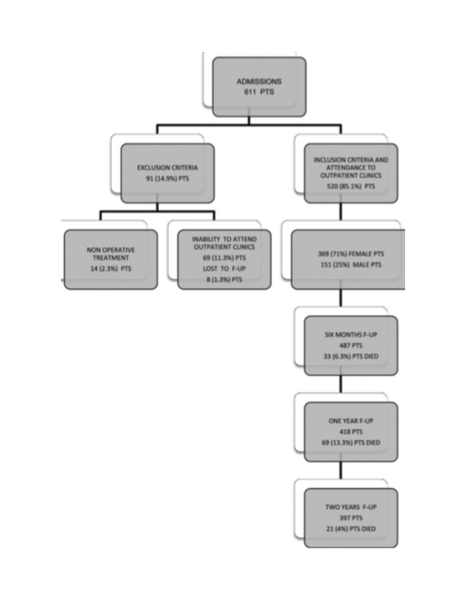
Methods
Prospective cohort study
Inclusion criteria
Exclusion criteria
  Non-operative treatment excluded!
Prospective data collection
Assessment of postoperative functional recovery
Notes:
Looking at functional and clinical outcomes
Inclusion criteria
Low energy pertrochanteric and femoral neck fractures
Age 60-90 years
Ability to respond to questionnaires – OK if they had mild to moderate dementia
Ability to attend follow-up clinics
Exclusion criteria
Subtrochanteric hip fractures
High energy hip fracutres
Pathological hip fractures
Patients less than 60 or greater than 90
Severe systemic disease – mainly cardiac, respiratory, and neurologic – affecting functional recovery
Non-operative treatment
520 patients met inclusion criteria and were able to attend f/u visits
8 patients removed due to inadequate data
For the patients that died, the last follow up recordings were used to analysis
Prospective data collected for all patients – next slide
Postoperative functional recovery was assessed using three groups of scales
Walking Scores – included Parker mobility score, walking speed test, and timed get up and go test
Hip functional scores and hip joint reconstruction scores
Quality of life questionaires
Dementia rating scale for mental status
Charlson comorbidity index used as assessment tool and predictor of clinical outcome
Took values of the scales preop, then postop at 6 months, one years, and two years
If needed, patients were need at NH or home
Recorded any postoperative complications, hip re-fracture rate and mortality – 6 months, 12 months, 2 years

Slide 7
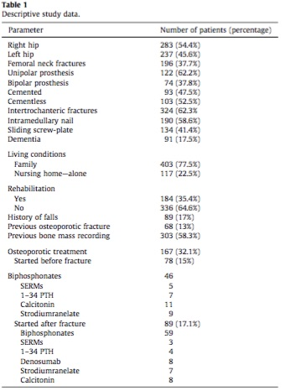
Demographics
369 females (71%) and 151 males (29%)
Mean age 80.7 (range 60-90)
Mean BMI 25.5 (range 19.5-33.5)
Mean observation period 27.5 months (range 20-36)
Notes:
Prospective data for all patients was collected:
Demographic data
Mental status
History of previous fall or fracture
Medication
Comorbidities
Fracutre type
Surgery related parameters
Living conditions
Rehabilitation
Complications
Previous history of osteoporosis and treatment of osteoporosis (at least 6 months prior to hip fracture)
Bone mass studies
Osteoporotic treatment type – and if started post-fracture
Family history of osteoporosis, treatment, and fractures in parents

Slide 8
Statistical Analysis
Quantitative data
  Student t-test for unpaired and paired samples
Qualitative data
  Pearson chi-square and Fisher’s exact test
  Non-parametric parameters analyzed using Mann-Whitney-Wilcoxon test
Logistic regression analysis model used to evaluate influence of possible risk factors and predictors of outcome
P <0.05, CI 95%

Slide 9
Results – osteoporosis treatment
 | Osteoporotic treatment versus No treatment
Get up and go test | 6.36 vs 19 seconds | p = 0.005
Lower Extremity Function Score | 59.33 versus 29.25 | P = 0.0001
SF-12 physical | 55.9 versus 22.8 | P = 0.001
SF-12 mental | 57.83 vs 47.9 | P = 0.055
Re-fracture rate | 4.2% versus 13% | P = 0.002
Mortality rate | 18.5% versus 26% | P = 0.061
Adapted from Table 3
Notes:
Osteoporosis treatment significantly improved several hip functional scores, decreased re-fracture rate, and improved all quality of life parameters.
The data presented here comes from Table 3 – I am highlighting several of the functional and quality of life measures from the study.
Get up and go test was used to assess walking score. Patients receiving treatment for osteoporosis, regardless of whether treatment was initiated before of after the fracture, had statistically significantly fasting walking speeds
Lower Extremity Function Scale was used to assess post-operative functional level. Maximum score is 80. Patients receiving treatment for osteoporosis had statistically significantly higher scores, regardless of whether treatment was initiated before of after the fracture.
SF-12 questionnaire was used to evaluate quality of life. The SF-12 has Physical and Mental Health Composite Scores; these are computed using the scores of twelve questions and range from 0 to 100, where a zero score indicates the lowest level of health measured by the scales and 100 indicates the highest level of health. Patients on osteoporotic medication had significantly higher SF-12 physical scores compared to those not receiving treatment; there was no statistical difference in the mental component of the SF-12.
Re-fracture rate was significantly lower in those receiving osteoporotic medication
Mortality rate was lower, but not statistically significant. Overall morbidity and mortality rates at different time intervals were not affected by osteoporotic treatment
Important to note that while mean values of walking, hip functional, hip reconstruction, and quality of life scores were progressively improved within two years after surgery, patients did not fully reach their preoperative functional status
Subgroup of patients who started osteoporotic treatment before fracture showed a trend (not statistically significant) towards stronger statistical correlations related to postoperative functional recovery and lower hip re-fracture rates
When comparing the treatment versus no-treatment groups, there was no dfferences in terms of demographics, mental status, living conidtions, or rehabilitiations
When comparing pertrochanteric fractures and femoral neck fractures , there were no differences found in functional and clinical outcome, re-fracture rate and mortality rate
Surgery related parameters, type of fracture, mental status, rehabilitation and living conditions were shown NOT to be independent predictors of functional recovery, re-fracture rate, QOL, and mortality rate (logistic regression analysis model)

Slide 10
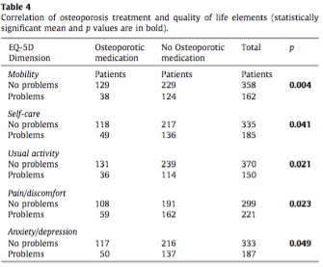
Results
23%
76%
26%
74%
Notes:
This table shows the correlation of osteoporosis treatment and quality of life elements. Based on this data, the authors concluded that osteoporosis treatment significantly improved all quality of life parameters!
On the mobility dimension, 31% of all patients had problems post-operatively. However, of those patients, the majority were not on osteoporotic medications (76%).
35% of all patients had problems will self-care postoperatively – but those on osteoporotic medications reported less problems.
Less pain and discomfort was reported among those on osteoporotic medications. 78% of patients on osteoporotic medications reported being able to return to usual activity, versus 67% of patients not on medication.

Slide 11
Discussion
Results suggest that osteoporotic treatment is potential modifier of functional recovery, re-fracture rate, and quality of life
Mechanism of benefit of medication
Predictors of outcome?
Dementia and hip fracture outcomes
Future directions
Mortality not influenced by osteoporotic treatment
Notes:
The results of this study suggest that osteoporotic treatment is a potential modifier of functional recovery, re-fracture rate, and quality of life.
In hip fracture management, orthopedic surgeons focus on quality of surgery and early mobilization. However, many patients still experience long-term disability and death (total one-year mortality rate ranging from 14-36%). Recent work has shown that post-fracture management is an important influence on outcomes.
Mechanism by which osteoporotic medication reduces fracture risk is a possible increase in muscle strength and coordination, may improve fracture healing
Literature supports the positive effect of osteoporotic treatment modalities on bone mass and reduction of fracture risk
Treatment may improve architecture and integrity of bone-implant interface of cortical and cancelous bone, leading ot a reduction in implant-related failures
No differences between patients taking and not taking osteoporotic medications in terms of demographics, mental status, living conditions, and rehabilitation – so not able to identify a specific patient profile which would lead to a better compliance with medical treatment and a better outcome
Separate analysis done of patients who initiated treatment before fracture versus after fracture showed a trend towards an improvement in functional recovery and lower re-fracture rate among those who were already on medication – authors suggest that screening for osteoporosis and treating is a more cost-effective than treatment of new hip fractures. Based on these trends, we need future studies that more clearly delineate the role of osteoporosis treatment beginning at admission for these patients.
Authors have changed their practice so that all patients admitted with hip fracture are “thoroughly investigated for metabolic bone diseases” (?DEXA) and start tx with zolendronic acid plus Ca/D
Suggest that compliance with therapy can be improved with once-a-year dosing of bisphosphonate
Predictors of outcome
Not able to show that surgery related factors, fracture type, mental status and dementia, living conditions and rehab are predictors of outcome
Dementia – can be an important predictor of poor prognosis regarding walking ability and return to IADLs
Other study demonstrated that pre-fracture motor level is a critical factor in recovery
This study did not demonstrate a significant difference when comparing outcomes – despite the fact that functional scores and QOL parameters were better in patients without dementia
Future directions
This study showed no significant improvement in patients living within a familial environment or receiving scheduled rehab program (although better QOL and functional scores seen with increased support) – however need to Better define the exact role of rehab and postoperative living conditions on outcome in hip fx patients

Slide 12
Conclusion
Osteoporotic treatment was shown to be a critical factor that can positively affect functional recovery, re-fracture rate, quality of life, and hardware-related complications
Notes:
High mortality rate was observed among the patients, with a two-year mortality rate of 23.6%. This did not seem to be influenced by osteoporotic treatment. However, authors conclude that osteoporotic treatment is still a critical factor that can positively affect functional recovery, re-fracture rate, quality of life, and orthopedic complications.

Slide 13
Validity
Were patients randomized? No
  No non-operative control group
Were all patients who entered the trial accounted for? Yes
Was follow-up complete? Yes
  Study authors comment that follow-up could have been longer
Was there blinding? No
Were groups similar? Yes

Slide 14
Applicability
Is this study valid in our population? Do our patients fit in?
    Mean age of 80.7 years
Is the treatment feasible?
    Yes – bisphosphonates are readily obtained
What are our patient’s potential benefits and harms from the therapy?
    Side effect of medication, medication compliance
What are our patient’s values and expectations for both the outcome we are trying to prevent and the treatment?

Slide 15
My patient
Patient’s goal is to return to his home at Assisted Living
  Family has the same goal
Few co-morbidities and likely 5-10 year life expectancy
Could benefit from addition of bisphosphonate

Slide 16
References
Giusti, A. and Bianchi, G. Treatment of primary osteoporosis in men. Clinical Interventions in Aging. 2015; 10, 105-115.
Makridis, Konstantinos G. et al. The effect of osteoporotic treatment on the functional outcome, re-fracture rate, quality of life and mortality in patients with hip fractures: A prospective functional and clinical outcome study on 520 patients. Injury; 46(2): 378 – 383.

Slide 17
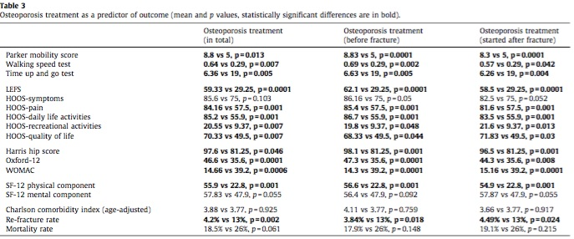
Table 3

