Slide 1
Journal Club
Ayesha R. Sheikh MD, FACP
Geriatric Oncology Fellow
PGY-4

Slide 2
CASE
69 year old Caucasian male presented with painless hematuria for 3 days, lightheadedness and unintentional weight loss of 20 lbs over 2 months
PMH: Hypertension, Hyperlipidemia
Meds: HCTZ, Lisinopril, Lipitor, multivitamin
SH: Lives with wife, runs his own business, Independent in ADLs and IADLs, smoked half a pack/day for 10 years, quit at age 40 years
FH: Colon CA in brother at age 65

Slide 3
CASE
Had colonoscopy 6 years ago → normal
Up to date on vaccinations
CBC, BMP normal 1 year ago
PSA checked in 2002 → 3.7
Does it mean anything?

Slide 4
BACKGROUND
PLCO CA screening trial: Screening detected higher incidence of CA but no difference in overall survival after 13 year follow up, suggesting overtreatment of indolent CA
ERSPC: detected higher incidence of CA, lower prostate CA specific mortality, no difference in overall mortality after 11 years
Göteborg Randomized Trial: Prostate CA mortality was reduced to almost half over 14 years; but substantial risk of over-diagnosis
Smarter screening strategies needed to improve the accuracy of diagnosing lethal Prostate CA while minimizing harms associated with over-diagnosis and over-treatment
(Ref: JNCI,2012; NEJM,2012; Lancet, 2010)

Slide 5
Baseline Prostate-Specific Antigen Levels in Midlife Predict Lethal Prostate Cancer
Journal of Clinical Oncology
Aug 10, 2016
Preston M, Batista J, Wilson K, Carlsson S, Gerke T, Feldman A, Vickers A, et al.

Slide 6
OBJECTIVE
PSA level in midlife predicted future prostate cancer mortality in an unscreened Swedish population (BMJ 2013; Cancer 2011)
The study’s purpose was to determine if a baseline PSA level during midlife predicts lethal Prostate cancer in a US population with opportunistic screening
Hypothesis: Men with PSA level above the median in midlife will be more likely to develop lethal Prostate cancer later in life

Slide 7
Selection of Participants
The Physicians’ Health Study (PHS) provided the base for current project
It was a Randomized, placebo-controlled trial of Aspirin and beta-carotene among 22,071 US male physicians initiated in 1982 and then transitioned into a prospective cohort with 30 years of follow up.
This is a nested case-control study among men age 40 to 59 years who gave blood before random assignment in PHS
Baseline PSA levels were available for 234 patients with PCa and 711 age matched controls. 71 participants who developed lethal PCa were re-matched to 213 controls.

Slide 8
Identification of Prostate CA and Deaths
Yearly questionnaire and biannual postcards
Self-reported, incident PCa cases diagnosed from 1982 to 2012 confirmed through medical records and pathology report review by the PHS Endpoints Committee
Tumor stage and metastases ascertained from medical records and by questionnaires to survivors
Deaths identified via family and National Death Index searches
Cause of death determined by death certificate, medical record review and next of kin

Slide 9
STATISTICS
Conditional logistic regression was used to estimate odds ratios and the area under the receiver operating characteristic curve, with 95% confidence intervals of the association between baseline PSA and risk of lethal Prostate Cancer (PCa)
The 15 -, 20 -, 25 -, 30 –year cumulative incidence of lethal PCa according to PSA percentile was estimated within three age groups

Slide 10
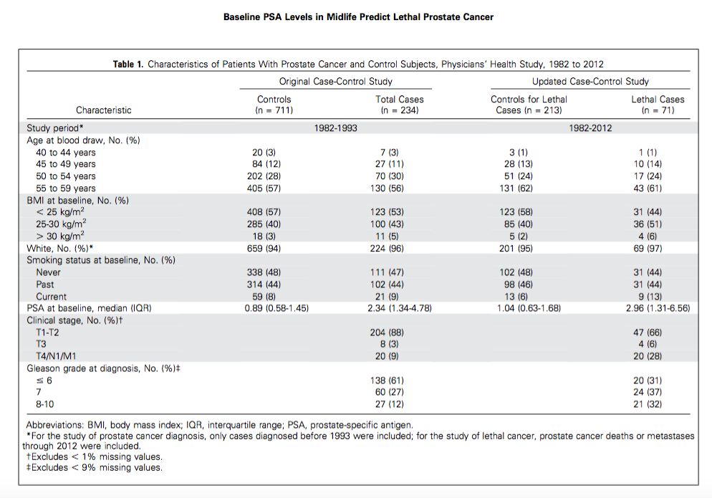

Slide 11
RESULTS
Mean age at blood draw was 55 years
Median follow up time from blood draw to cancer diagnosis was 9 years for overall cases and 8.6 years for lethal cases
Median PSA levels varied by age at baseline and were higher among older men (Graph 1)
Men with PSA above the median had consistently and significantly increased risk of total Prostate CA and lethal Prostate CA
Of the lethal PCa events, 82%, 71% and 86% occurred in men with PSA above the median at ages 40 to 49, 50 to 54 and 55 and 59 respectively (Graph 2 )

Slide 12
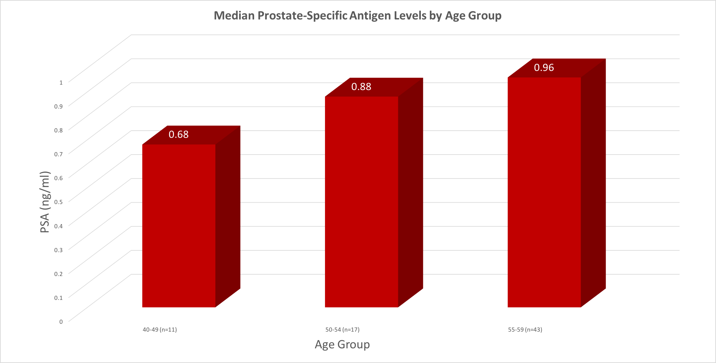

Slide 13
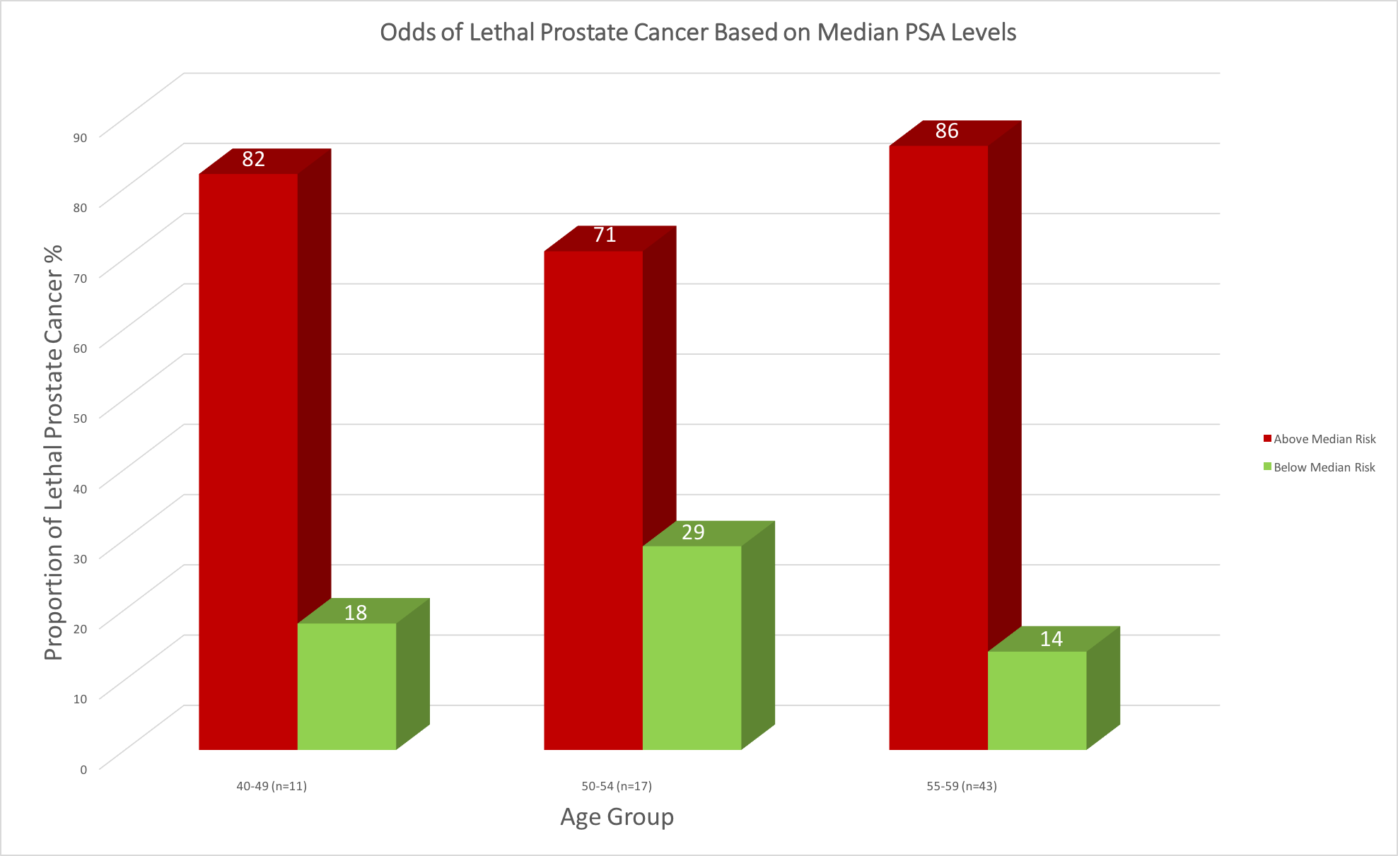

Slide 14
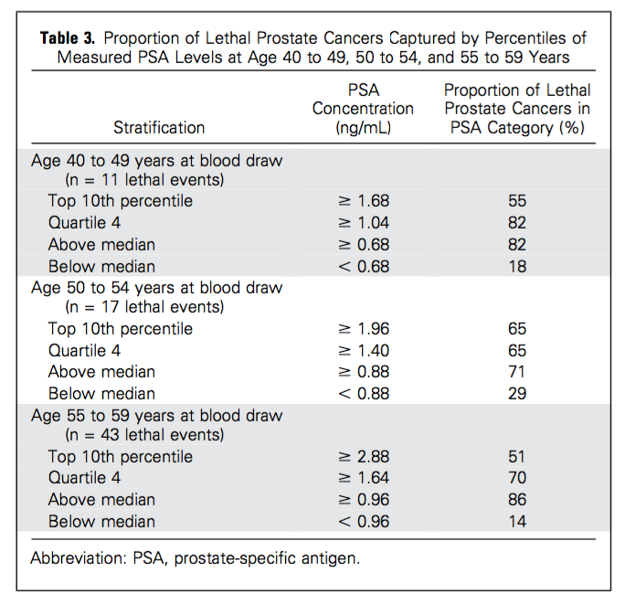

Slide 15
RESULTS
Risk of total Prostate CA was highest with PSA > 90th percentile, with ORs 32.4 (95% CI,7.1 to 149), 34.6 (95% CI , 11.5 – 103.6) and 30.3 (95% CI, 13.5 to 67.7) for ages 40 -49, 50 to 54, and 55 – 59 years, respectively.
Risk of lethal Prostate CA was similarly highest with PSA > 90th percentile range, with OR 8.7 (95% CI , 1 to 78.2) for 40 – 49 years, 12.6 (95% CI, 1.4 to 110.4) for 50 – 54 years, and 6.9 (95% CI, 2.5 – 19.1) for 55 – 59 years
Risk of lethal PCa in 30 years was low in men with PSA below median – 0.19% for 40 to 44, 0.51% for men 45 to 49, 1.62% for men 50 to 54, and 0.59% for men 55 – 59 years of age

Slide 16
CONCLUSION
PSA levels in midlife strongly predict future lethal Prostate Cancer with good accuracy over 30 years of follow up, in a US cohort subject to opportunistic screening
If PSA > 90th percentile for age, cumulative incidence for lethal PCa is 4.5%, 8.4% and 14.1% for men age 40 to 49, 50 to 54 and 55 to 59 years
Baseline PSA level is a stronger risk factor than race or family history
Use these values to tailor the screening protocol on the basis of individual’s level of risk, especially if life expectancy is 10 years or more

Slide 17
CONCLUSION (cont’d)
Ideal screening interval unknown
At age 45 years, if PSA below median, check every 5 years
Don’t stop screening as risk is low but not zero
If PSA < 1.0 ng/ml at age 60, may stop further PSA testing
If PSA > 2.0 ng/ml at age 60, rescreening results in large reduction in PCa mortality with minimal over-diagnosis

Slide 18
LIMITATIONS
Despite decades of follow up, limited lethal events especially in younger age groups, contributing to wider confidence intervals
Unknown proportion of case-control participants might have undergone PSA testing before study inclusion in 1993 – but it has limited impact as primary outcome was lethal cancer and not incidence
Cumulative incidence of PCa mortality was 4.9% which is higher than general population because of decreased cardiac mortality among this physician group
Study population consisted mainly of white men

Slide 19
STRENGTHS
Nested case control design - 3 matched controls for every case to increase power
Good follow up of 30 years
Study involved US population so it is generalizable to contemporary population
Results are consistent with studies in Swedish population

Slide 20
DISCUSSION
There has been 50% reduction in prostate cancer mortality in US and screening is estimated to account for 45% to 70%
USPSTF issued grade D recommendation against PSA screening in 2012
Mathematical models predict that abandoning screening altogether would eliminate over-diagnosis but also would result in doubling of patients presenting with metastatic disease and a 13% - 20% increase in PCa deaths by 2025
Hope USPSTF revise the guidelines!

Slide 21
CURRENT RECOMMENDATIONS
ACS: Offer PSA screening beginning at age 50 for average risk men and in 40s for African Americans and those with positive family history
NCCN and EAU: Baseline PSA testing in 40s and using those results to determine subsequent screening intervals
AUA: PSA screening to men age 55 to 69 years, with individualized decisions in men age 40 to 55 years and screening intervals of > 2 years to prevent harm

Slide 22
Cause No Harm
New biomarkers with high specificity like Prostate Health Index and 4K score to guide biopsy decision
Targeted prophylaxis based on rectal swab cultures decreases biopsy related infections
New techniques of biopsy using MRI decreases false positives
Active surveillance associated with large reduction in over-treatment of low-risk disease

Slide 23
CASE
69 years old Caucasian male presented with painless hematuria for 3 days, lightheadedness and unintentional weight loss of 20 lbs over 2 months…...
UA confirmed hematuria, CBC showed Hb of 7.0 gm/dl, BMP wnl, orthostatic hypotension
PSA - 21
Admitted for blood transfusion, Urology c/s --> CBI, CT A/P
CT shows 1.5 cm irregular mass in prostate --> biopsy confirmed Prostate adenocarcinoma, Gleason score 7, also had metastatic deposit in L3
Referred to Oncology

Slide 24
CASE
At age 55 years (14 years ago), PSA was 3.7 → >90th percentile
According to this study, incidence of lethal Prostate CA is 14.1%
WISH WE COULD AVOID IT!

Slide 25
Take Home Points
PSA levels in midlife strongly predict future lethal Prostate Cancer with good accuracy over 30 years of follow up
If PSA < 1.0 ng/ml at age 60, may stop further PSA testing
If PSA > 2.0 ng/ml at age 60, rescreening results in large reduction in Prostate cancer mortality with minimal over-diagnosis
Consider especially if life expectancy 10 years or higher

Slide 26

THANK YOU!

