Slide 1
Effect of a dementia diagnosis on survival of older patients after a diagnosis of breast, colon or prostate cancer
MUKAILA a. rAJI, MD, MSC: YOUNG-FANG KUO, Phd: Jean L greeman Phd: et al
Ariadne Scott MD
October 14, 2016

Slide 2
Background
The incidence of both dementia ad cancer increases with age.
4.5 million of Americans have Alzheimer dementia and the number is projected to triple by 2050
For those aged 60 to 79 the probability of developing invasive cancer is 1 in 3 for men and 1 in 4 for women

Slide 3
Previous studies
17 500 older patient with invasive colon cancer: Dementia associated with lower odds or undergoing tissue diagnosis
50 460 older patients with breast cancer: Dx of dementia was independently associated w late stage breast cancer

Slide 4
Clinical Case
72 year old Haitian Female admitted to BMC with worsening fatigue and confusion
Was found to have a hemoglobin of 4. Received 2 units of blood
Diagnosed with Stage IV colon cancer, no previous hospital or office visits in the past 10 years
MMSE 9/30.

Slide 5
Clinical question
Does the fact that the patient has advanced dementia affects her cancer related prognosis ?

Slide 6
methods
Retrospective cohort study of 106 061 patients aged 68 years or older diagnosed as having breast, colon or prostate cancer using data from the linked Surveillance Epidemiology and End results- Medicare database. The risk of mortality from cancer and non cancer causes, stratified by presence or absence of preeexisting dementia diagnosis
Cox proportional hazards regression was used to adjust for confounding variables.

Slide 7
Data sources
SEER- Medicare linked data was used for this study. The SEER program supports population based cancer registries covering 14% of the US population. This data base includes patient level demographic and cancer specific variables: age, ethnicity, type of cancer, month and year of diagnosis and extend of the cancer as well as socioeconomics characteristics

Slide 8
Identification of patients with cancer and dementia
SEER data included all Medicare beneficiaries diagnosed as having cancer from January 1994 through December 1999.
Population compromised 2 groups defined on the basis of comorbid dementia with claims data.
Group with comorbid dementia: Medicare beneficiaries who received a diagnosis of dementia and related disorders between January 1991 and December 1999 within the 3 years before the cancer diagnosis
The comparison group were participants with no known diagnosis of dementia

Slide 9
Measures
Patient characteristics obtained from SEER included: Age, sex, ethnicity, marital status, type of cancer and date of cancer diagnosis. Medicare data also provided information on level of comorbidity
Tumor characteristics obtained from SEER included American Joint Committee on cancer stage for breast and colon cancers and clinical stage for prostate cancer, histologic grade and in the case of breast cancer, hormone receptor status
Used a modification of the Charlson Comorbidity index

Slide 10
statistical ANALYSIS
Proportion of patient with a preexisting dementia diagnosis across strata of patient characteristics and the distribution of stage at diagnosis between patients with and without dementia for each cancer were calculated.
The Kaplan-Meier method was used to generate survival curves for patients with and without a preexisting dementia diagnosis.

Slide 11
rESULTS
Sample was composed of :
31 935 patients with breast cancer
26 891 patients with colon cancer
47 235 with prostate cancer
The prevalence of precancer diagnoses of dementia varied by cancer: 7.4% in patients with breast cancer, 10.0% for colon cancer and 5.1% fro prostate cancer.
All differences in prevalences of dementia by demographic characteristics were significant at P < .001. Preexisting diagnoses of dementia were more prevalent in patients who were older, black, female, unmarried, less educated, and living in areas with a high percentage of poverty. Preexisting diagnoses of dementia also increased with number of comorbidities.

Slide 12
Effect of a dementia diagnosis on survival
The Figure presents survival curves for patients with breast, colon, and prostate cancer, stratified by whether they carried a preexisting diagnosis of dementia. Approximately 33.3% of patients with dementia vs 8.5% of those without it died within 6 months of a cancer diagnosis. The effect of dementia on death within 6 months differed by cancer site: breast, 24.9% vs 5.1%; colon, 44.9% vs 20.2%; and prostate, 28.5% vs 4.3%.

Slide 13
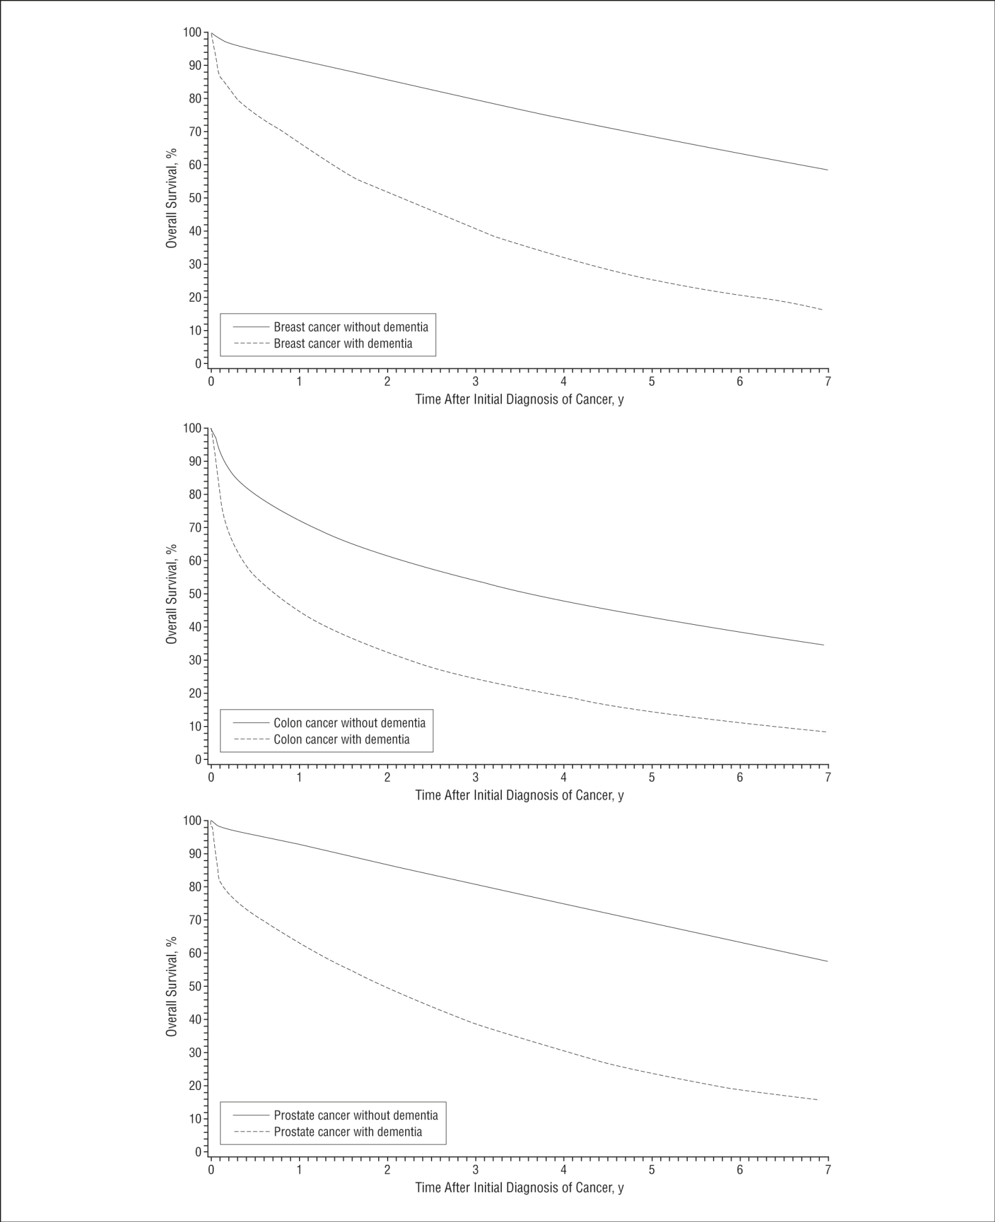

Slide 15
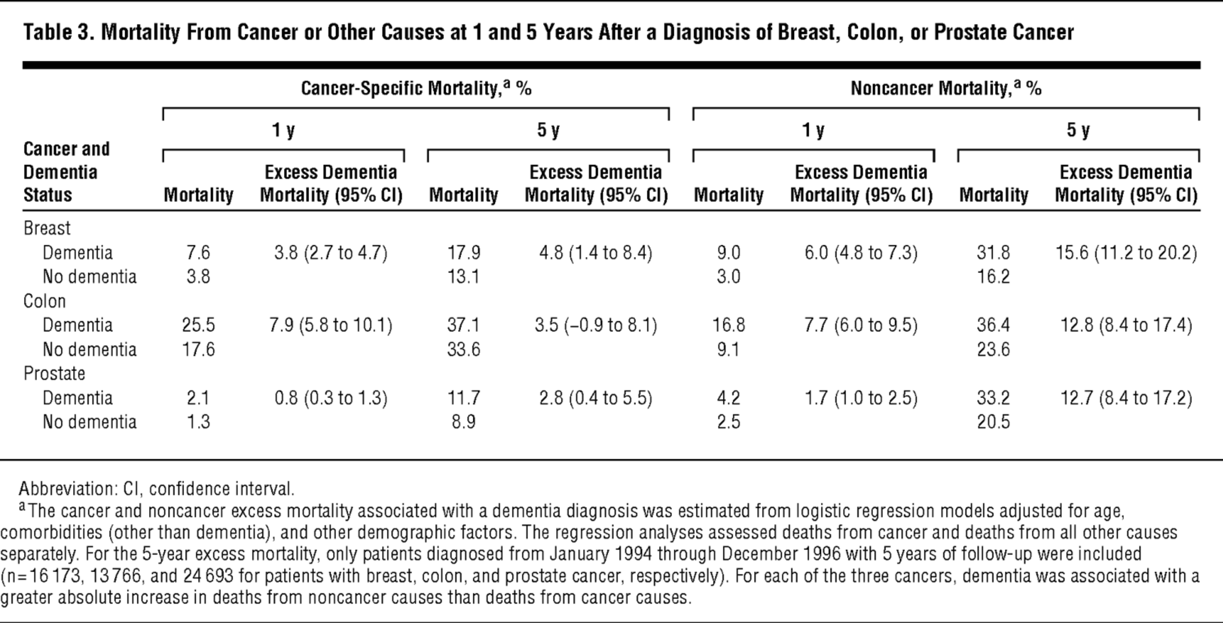

Slide 16
summarized RESULTS:
Presence of a preexisting diagnosis of dementia was associated with decreased survival after a diagnosis of breast, colon or prostate cancer.
Dementia diagnosis was associated with increased mortality from cancer and from non cancer causes
The absolute increase in deaths associated with a dementia diagnosis was considerably larger from non cancer causes of death
The effect of stage at diagnosis on cancer specific or all cause mortality after a cancer diagnosis was substantially reduced in patients with a dementia diagnosis

Slide 17
rEFERENCES
1. Evans DAFunkenstein HHAlbert MS et al. Prevalence of Alzheimer's disease in a community population of older persons: higher than previously reported. JAMA 1989;262 (18) 2551- 2556
2. Hebert LEBecket LAScherr PAEvans DA Annual incidence of Alzheimer disease in the United States projected to the years 2000 through 2050. Alzheimer Dis Assoc Disord 2001;15 (4) 169- 173
3. Jemal AMurray TWard E et al. Cancer statistics, 2005. CA Cancer J Clin 2005;55 (1) 10-30
4.Gupta SKLamont EB Patterns of presentation, diagnosis, and treatment in older patients with colon cancer and comorbid dementia. J Am Geriatr Soc 2004;52 (10) 1681- 1687

