Slide 1
The Role of Carotid Imaging in Asymptomatic Patients
Irina Vovnoboy, MD
4/22/2016

Slide 2
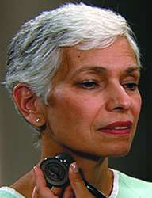
Mrs. W
88 yo woman
establishing care in geriatrics clinic
PMHx: HTN, DM, Hyperlipidemia
Lives at home, independent with ADLs
PE: Was that a carotid bruit?
Does Mrs. W need a carotid ultrasound?
Notes:
Worried about stroke – leading cause of death; 15% of strokes attributed to atherosclerosis of carotid arteries
Goal of primary stroke prevention in this patient

Slide 3
Mrs. W
88 yo woman
establishing care in geriatrics clinic
PMHx: HTN, DM, Hyperlipidemia
Lives at home, independent with ADLs
PE: Was that a carotid bruit?
Does Mrs. W need a carotid ultrasound?
What is the role of carotid imaging for primary stroke prevention in asymptomatic patients?
Notes:
Worried about stroke – leading cause of death; 15% of strokes attributed to atherosclerosis of carotid arteries
Goal of primary stroke prevention in this patient

Slide 4
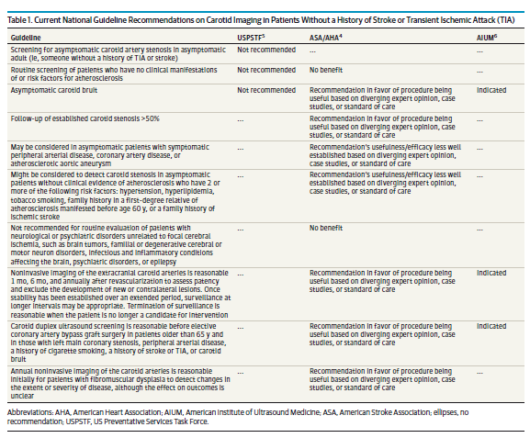
Current guidelines are confusing
Notes:
Conflicting

Slide 5

Avoid use of ultrasound for routine surveillance of carotid arteries in the asymptomatic healthy population at any time
5
The presence of a bruit alone does not warrant serial duplex ultrasounds in low-risk, asymptomatic patients, unless significant stenosis is found on the initial duplex ultrasound.
The presence of asymptomatic severe carotid artery disease in the general population yields a risk of neurologic events which is <2%. Even in patients who have a bruit, if no other risk factors exist, the incidence is only 2%. Age (over 65), coronary artery disease, need for coronary bypass, symptomatic lower extremity arterial occlusive disease, history of tobacco use and high cholesterol would be appropriate risk factors to prompt ultrasound in patients with a bruit. Otherwise, these ultrasounds may prompt unnecessary and more expensive and invasive tests, or even unnecessary surgery. In general population-based studies, the prevalence of severe carotid stenosis is not high enough to make bruit alone an indication for carotid screening. With these facts in mind, screening should be pursued only if a bruit is associated with other risk factors for stenosis and stroke, or if the primary care physician determines you are at increased risk for carotid artery occlusive disease.

Slide 6
Study Design
Retrospective cohort study of 4127 VA patients >65 who underwent carotid vascularization for asymptomatic carotid stenosis 2005-2009
  4 trained abstractors reviewed for indications:
  (1) carotid report for order listed by providers
  (2) the referring providers’ note
Notes:
ICD-9 codes then chart review to exclude patients with prior stroke
Excluded imaging other than carotid ultrasound (as other indications for ex CT-angiogram)

Slide 7
Study Design
For each study, expert multidisciplinary panel of practicing clinicians and stroke researchers [3 internists, 3 vascular neurologists, 1 vascular surgeon and 2 ophthalmologists] reviewed and rated indications through a consensus process:
  appropriate
  uncertain
  inappropriate

Slide 8
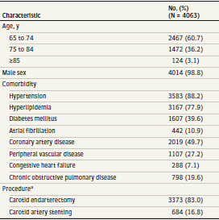
Patient Characteristics
Notes:
Mean age 73

Slide 9
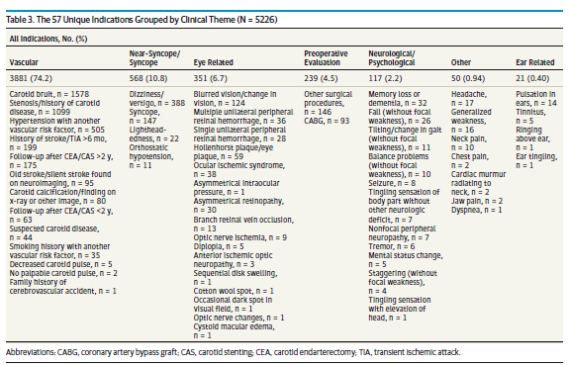
Results
Single indication 3062 (75.4%) Multiple indications 1001 (24.6%)
Notes:
3062 (75.4%) carotid
ultrasounds had a single indication while the remaining
(n = 1001) had multiple indications.

Slide 10
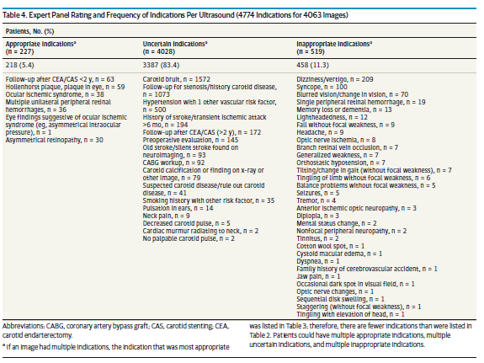
Appropriateness of Carotid Imaging
Notes:
Appropriate = 5.4%, uncertain = 83%, inappropriate = 11.3%

Slide 11
Long-term Survival
3373/4063 (83.0%) received a CEA.
663 (19.7%) procedures in patients > 80 yo.
5 year post-intervention overall survival was 71.4%
(P < .001)
Age | Patients | Percent
65-74 | 1857 | 75.3%
75-84 | 979 | 66.5%
85+ | 73 | 58.9%
Notes:
Current guidelines for CEA: revascularization only in pts expected to survive 5 years (risk/benefit)
initially, post-procedure increased risk of stroke

Slide 12
Rates of Survival by Indication
Strength of Indication
Appropriate | 66.4%
Uncertain | 72.1%
Inappropriate | 68.8%
(P = .07)
Notes:
Essentially no difference in survival – skewed by differing #’s?

Slide 13
Conclusions
The majority of patients undergo carotid revascularization for asymptomatic carotid disease for uncertain or inappropriate reasons.
Need further studies for carotid testing, especially around monitoring stenosis over long periods and evaluating carotid bruits.
Need for decision-support tools
Ongoing NIH-sponsored Carotid Revascularization and Medical Management for Asymptomatic Carotid Stenosis Trial (CREST-2) should clarify the value of revascularization in asymptomatic populations.
Notes:
Practicing in setting of uncertainty, conflicting guidelines – tendency to do more / take “conservative approach”? Financial motivation?
Role of screening or ordering tests if it will not change your management?

Slide 14
Limitations
Retrospective
Hypothesis-generating only
Uncertain applicability for BMC patient populations (98.8% male)
Indications for Imaging not always clear - k for agreement between 2 reviewers was 0.71-0.88, but only done for 20 x 2 images
Notes:
All pts in this study underwent procedure – what % screened then no change in plan?

Slide 15

Back to Mrs. W
88 yo F with PMHx HTN, HL, DM (+ RF) found to have unilateral carotid bruit on exam
Does Mrs. W need carotid imaging?

Slide 16
References
Choosing Wisely: ABIM foundation. Society of Vascular Surgery
http://www.choosingwisely.org/societies/society-for-vascular-surgery/
Keyhani S, Cheng EM, Naseri A, Halm EA, Williams LS, Johanning J, Madden E,
Rofagha S, Woodbridge A, Abraham A, Ahn R, Saba S, Eilkhani E, Hebert P,
Bravata DM. Common reasons that asymptomatic patients who are 65 years
and older receive carotid imaging. JAMA Intern Med. 2016 Apr 18.

