Slide 1
Treatment of Vitamin D Insufficiency in Postmenopausal Women: A randomized clinical trial
Journal Club
1/8/2016
Sharda Mukunda

Slide 2
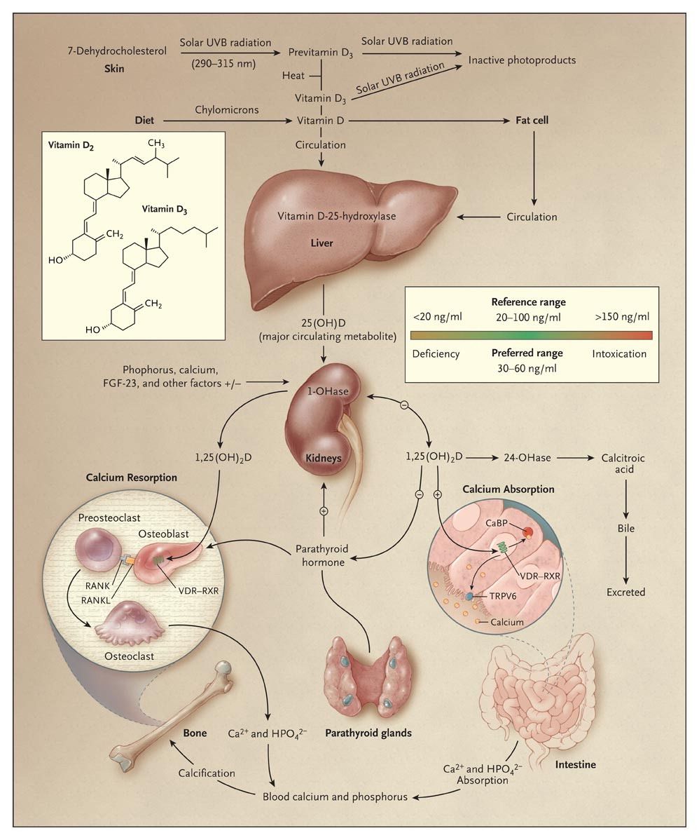

Holick MF. N Engl J Med 2007;357:266-281.
Synthesis and Metabolism of Vitamin D in the Regulation of Calcium, Phosphorus, and Bone Metabolism.
Notes:
Figure 1. Synthesis and Metabolism of Vitamin D in the Regulation of Calcium, Phosphorus, and Bone Metabolism. During exposure to solar ultraviolet B (UVB) radiation, 7-dehydrocholesterol in the skin is converted to previtamin D₃, which is immediately converted to vitamin D₃ in a heat-dependent process. Excessive exposure to sunlight degrades previtamin D₃ and vitamin D₃ into inactive photoproducts. Vitamin D₂ and vitamin D₃ from dietary sources are incorporated into chylomicrons and transported by the lymphatic system into the venous circulation. Vitamin D (hereafter “D” represents D₂ or D₃) made in the skin or ingested in the diet can be stored in and then released from fat cells. Vitamin D in the circulation is bound to the vitamin D–binding protein, which transports it to the liver, where vitamin D is converted by vitamin D-25-hydroxylase to 25-hydroxyvitamin D [25(OH)D]. This is the major circulating form of vitamin D that is used by clinicians to determine vitamin D status. (Although most laboratories report the normal range to be 20 to 100 ng per milliliter [50 to 250 nmol per liter], the preferred range is 30 to 60 ng per milliliter [75 to 150 nmol per liter].) This form of vitamin D is biologically inactive and must be converted in the kidneys by 25-hydroxyvitamin D-1α-hydroxylase (1-OHase) to the biologically active form — 1,25-dihydroxyvitamin D [1,25(OH)₂D]. Serum phosphorus, calcium, fibroblast growth factor 23 (FGF-23), and other factors can either increase (+) or decrease (–) the renal production of 1,25(OH)₂D. 1,25(OH)₂D decreases its own synthesis through negative feedback and decreases the synthesis and secretion of parathyroid hormone by the parathyroid glands. 1,25(OH)₂D increases the expression of 25-hydroxyvitamin D-24-hydroxylase (24-OHase) to catabolize 1,25(OH)₂D to the water-soluble, biologically inactive calcitroic acid, which is excreted in the bile. 1,25(OH)₂D enhances intestinal calcium absorption in the small intestine by interacting with the vitamin D receptor–retinoic acid x-receptor complex (VDR-RXR) to enhance the expression of the epithelial calcium channel (transient receptor potential cation channel, subfamily V, member 6 [TRPV6]) and calbindin 9K, a calcium-binding protein (CaBP). 1,25(OH)₂D is recognized by its receptor in osteoblasts, causing an increase in the expression of the receptor activator of nuclear factor-κB ligand (RANKL). RANK, the receptor for RANKL on preosteoclasts, binds RANKL, which induces preosteoclasts to become mature osteoclasts. Mature osteoclasts remove calcium and phosphorus from the bone, maintaining calcium and phosphorus levels in the blood. Adequate calcium (Ca²⁺) and phosphorus (HPO₄ ²⁻) levels promote the mineralization of the skeleton.

Slide 3
Background
Renal production of active vitamin D
  Parathyroid hormone
  Circulating levels of Ca/Phos
Effects on
  Renal calcium absorption
  Intestinal calcium and phosphorous absorption
  Bone
    Vitamin D deficiency → inc PTH→Osteoclasts→osteopenia/porosis

Slide 4

Patient Case
80 Haitian woman with uncontrolled hypertension. Has never had a fracture.
Does not like to take medications
25-OH D level of 20
She declines vitamin D prescription
How important is it for us to focus on her vitamin D?
http://graphics8.nytimes.com/images/2012/04/17/science/17BROD/17BROD-articleInline.jpg

Slide 5
Study Design
Randomized, double blind, placebo controlled
INCLUSION | EXCLUSION
Age less than or equal to 75, postmenopausal | Age >75- Intestinal resistance to vitamin D
Baseline 25(OH)D level 14-27 | Osteoporosis (measured BMD), fragility, fracture of the hip, spine, or wrist
5 yrs or more past menopause/ oophorectomy | Hypercalcemia
60 yrs or older if they had prior hysterectomy | Nephrolithiasis
 | Cancer within 5 yrs
 | IBD, malabsorption, sprue, diarrhea
 | CKD (GFR <45)
 | Use of bone active meds within 6 months

Slide 6

Methods
230 Women randomized to
  High dose cholecalciferol 50,000 IU q15 d (74 completed)
  Low dose cholecalciferol 800 IU qd (74 completed)
  Placebo (73 completed)
All subjects received the same pills
  Yellow capsules = 50,000 IU
  White capsules = 800 IU
  31 day prefilled boxes
Only personnel who did not have contact with participants knew assignments
http://thumbs.dreamstime.com/z/smiley-face-pills-blister-white-background-48547435.jpg

Slide 7
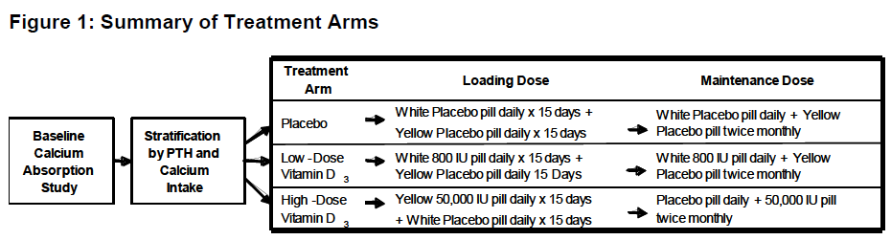

Slide 8
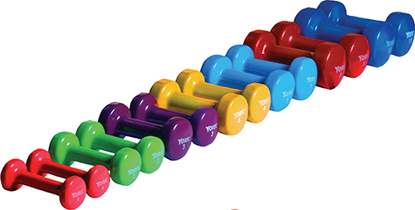
Methods
Study visits 30, 60 120, 240, 365 days
  Timed Up and Go (TUG)
  5 Sit to stand tests (STS)
  Pain reports on 10 point scale
  Functional status
  Physical Activity for the Elderly Scale
  Adverse Events
Urine calcium levels at 0, 60, 120, 240 (Total fractional calcium absorption, TFCA)
Vitamin D levels- treated if high dose <30
Repeat BMD 1 yr after entrance into study

Slide 9
Calcium absorption studies
Total Fractional Calcium Absorption (TFCA)
  Dual stable calcium isotope method
    IV isotope tracks renal reabsorption and endogenous fecal calcium excretion
  Fasted from midnight to 7AM
  Breakfast with a standardized with calcium isotope
  IV infusion of a DIFFERENT calcium isotope
  24 hr urine collection
  TFCA is the ratio of the two isotopes found in the urine
    INCREASE in TFCA means you have better intestinal absorption

Slide 10
Outcomes
Primary outcome:
  1 yr change in Total Fractional Calcium Absorption
Secondary outcome
  Change in BMD
Additional outcomes
  Effects on muscle function, muscle mass, trabecular bone score, and bone turnover
Pain, functional status, and physical activity

Slide 11
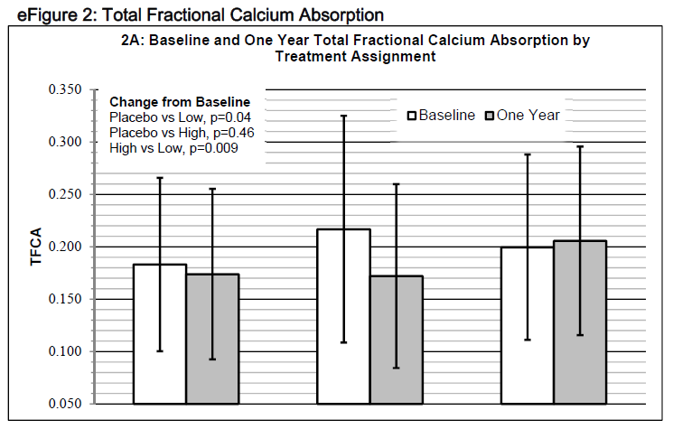
Results
25 (OH)D levels significantly different between the groups (<0.001)
Placebo Low dose High dose

Slide 12
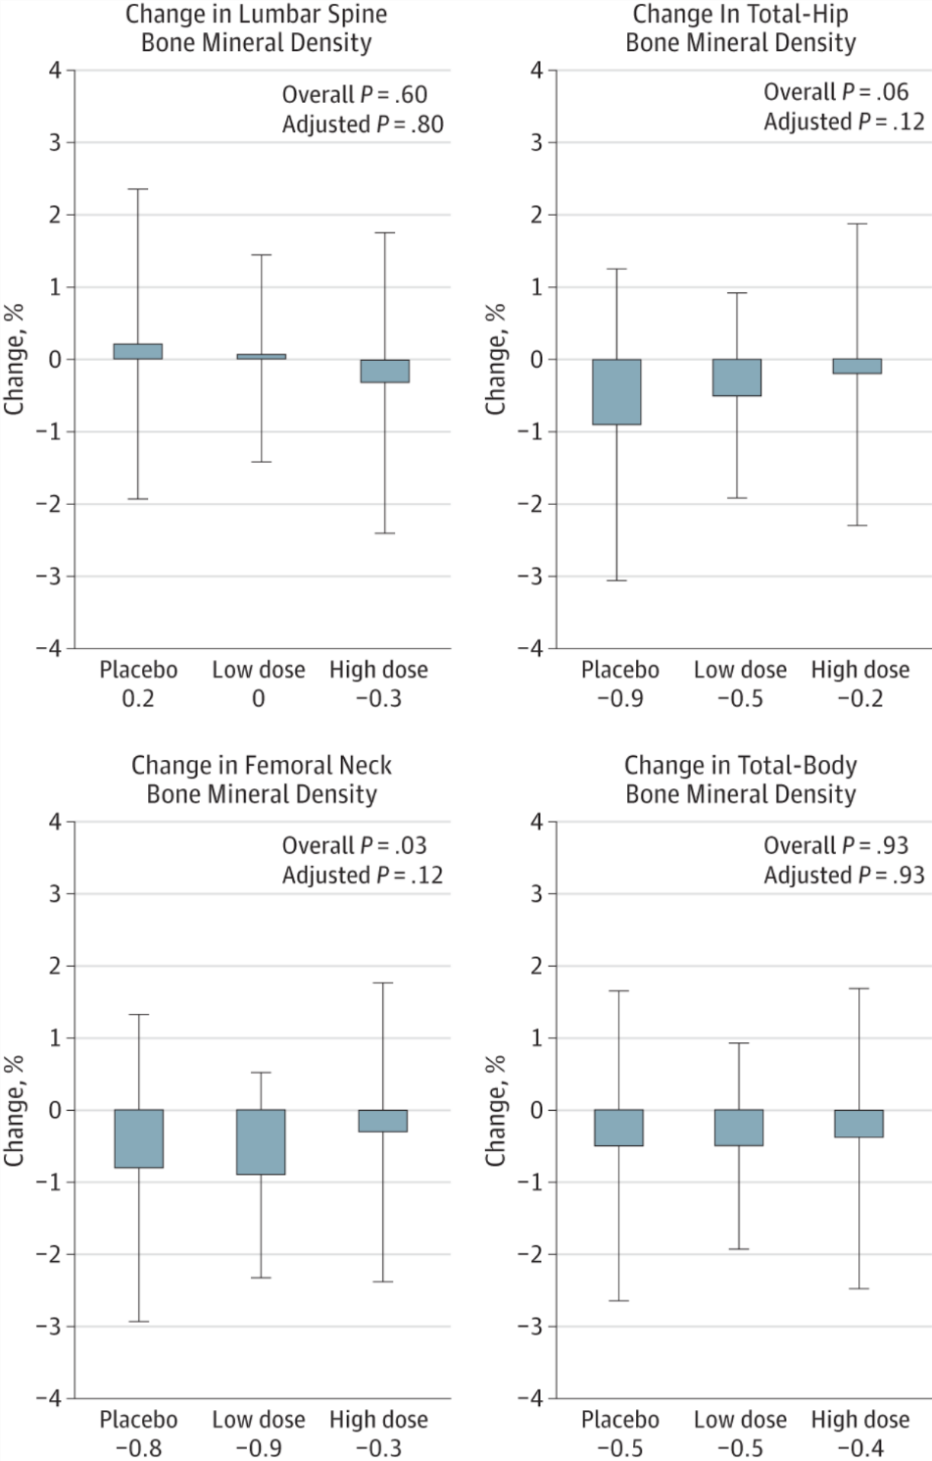

Slide 13
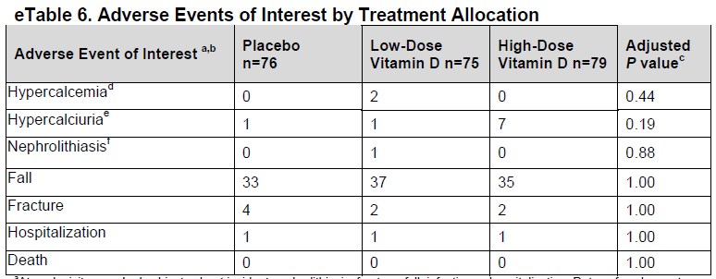
Adverse events

Slide 14
Other testing
All treatment arms had slightly faster TUG and STS testing
  No between arm differences
No between arm differences in:
  muscle mass
  number of falls
  number of fallers
No between arm differences for 1 yr change in the health assessment questionnaire or physical activity for the elderly score

Slide 15
Conclusions
High-dose cholecalciferol therapy increased calcium absorption, but the effect was small and did not translate into beneficial effects on bone mineral density, muscle function, muscle mass, or falls.

Slide 16
Validity
Was the assignment of patients to treatment randomized? –YES
  How exactly were they randomized?
Was the randomization concealed– YES
Were the groups similar at the start of the trial—YES
Was follow up sufficiently long– ONLY 1 YEAR
Were all patients analyzed in groups to which they were randomized—YES
Were patients, clinicians, and study personal kept blind to the treatment—YES
Were groups treated equally—YES… received sham pills

Slide 17
Applicability
Is this study valid in our population? Do our patients fit in?
    Mean age ~60- how does this effect how we interpret?
    89-90% White!
Is the treatment feasible?
    Negative trial- would be feasible to decrease vitamin D Rx in elderly postmenopausal women
What are our patient’s potential benefits and harms from the therapy?
    No significant harms; though recent studies differ
What are our patient’s values and expectations for both the outcome we are trying to prevent and the treatment?

Slide 18
Patient Case
Age is 80 (mean age 60 in this study)
  Though increasing age associated with resistance to vitamin D effects in intestine
She is Haitian Creole
Perhaps she would not benefit from vitamin D treatment

Slide 19
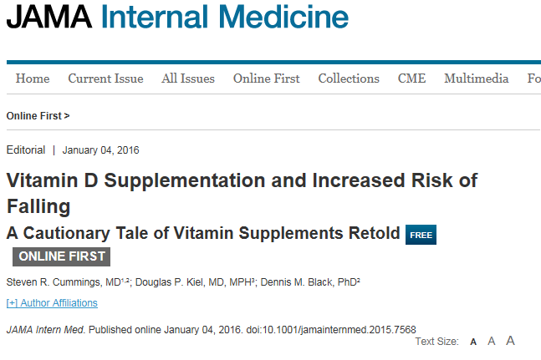
Further considerations

Slide 20
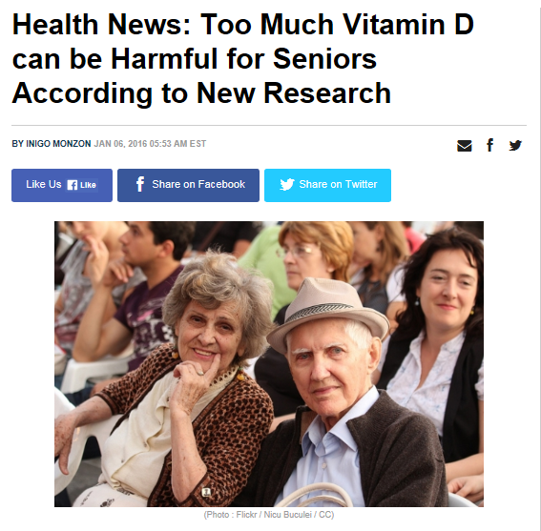

Slide 21
References
Hansen, KE et al. “Treatment of Vitamin D Insufficiency in Postmenopausal Women: A randomized clinical trial.” JAMA Internal Med. 2015; 175 (10): 1612-1621.
Holick, MF. “Vitamin D Deficiency.” N Engl J Med 2001; 357: 266-281.

