Slide 1
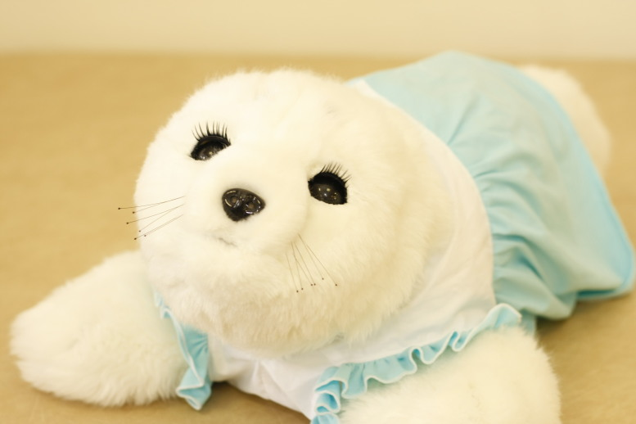
Is there a place for PARO?
Comparison of verbal and emotional responses of elderly people with mild/moderate dementia and those who have severe dementia in responses to seal robot PARO
Irina Vovnoboy, MD
Geriatrics fellow, PGY-4
January 8, 2015

Slide 2
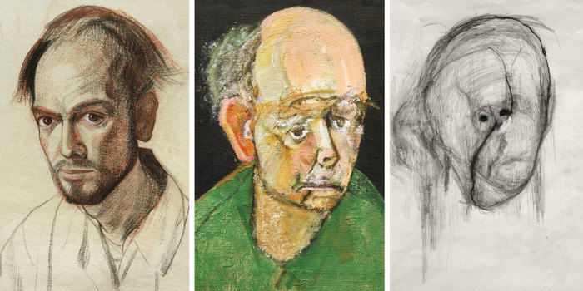
Our patient, Mrs. C
81 yo woman, nursing home resident x 5 years
PMHx: colon cancer (s/p resection) and dementia.
Spends most of the day in bed. Occasionally paranoid. Variable responses to caregivers. Enjoys art.

Slide 3

Background:
Plant therapy
Pet therapy
Rodin J, Langer EJ. Long-term effects of a control-relevant intervention with the institutionalized aged. Journal of Personality and Psychology, Dec 1977
Notes:
Study in 1970’s: NH residents, live plants in every room – 50% told that they have to water their plant, 50% had their plant watered for them; monitored pts for 1.5 years, found to have higher activity levels and even improved mortality

Slide 4

Dr. Bill Thomas:
“He came to think that the missing ingredient in this nursing home was life itself, and he decided to try an experiment to inject some…”
“He decided to try to put some life into the nursing home the way that he had done in his own home – by literally putting life into it. If he could introduce plants, animals, and children into the lives of the residents – fill the nursing home with them – what would happen?”
-- Atul Gawande, Being Mortal, p. 122
Notes:
Bill Thomas – young family medicine physician took over a nursing home in NY near Rochester, decided to “inject life into it”
2 dogs, 4 cats, 100 parakeets, NH workers encouraged to bring in their children
Residents thriving walking, talking again

Slide 5

The Green House Project
“The most important finding of Thomas’s experiment wasn’t that having a reason to live could reduce death rates for the disabled elderly. The most important finding was that it was possible to provide them with reasons to live, period. Even residents with dementia so severe that they had lost the ability to grasps much of what was going on could experience a life with greater meaning, pleasure, and satisfaction.”
-- Atul Gawande, Being Mortal, p. 125
Notes:
Currently works on Green House project small houses instead of nursing homes, makes it feel more like “a home”

Slide 6
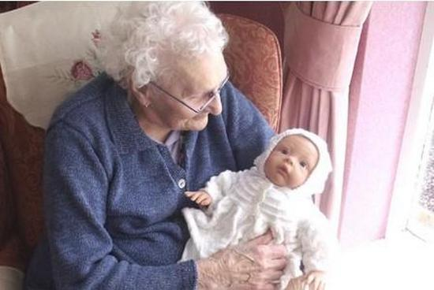
Background:
Plant therapy
Pet therapy
Doll therapy?
Notes:
Doll therapy: meta-analysis of doll therapy as intervention for pts with behavioral disturbances; 11 studies; majority of studies found that the use of dolls could be therapeutic for people iving with dementia
Controversial – infantalizing. Lots of articles especially in nursing literature.
Google “alzheimers doll” this comes up

Slide 7
Research Questions:
1. What are the broad trends that can be grasped with respect to the effects of introducing PARO?
2. Does PARO have a psychological effect on residents with severe dementia in the dementia ward compared to residents with mild/moderate dementia in the general ward?
3. Can the introduction of PARO improve willingness of care staff members to work on interventions for elderly people with dementia?

Slide 8

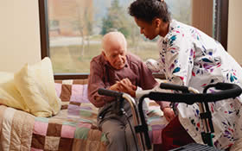
Research Questions:
Notes:
1. What are the broad trends that can be grasped with respect to the effects of introducing PARO?
2. Does PARO have a psychological effect on residents with severe dementia in the dementia ward compared to residents with mild/moderate dementia in the general ward?
3. Can the introduction of PARO improve willingness of care staff members to work on interventions for elderly people with dementia?

Slide 9
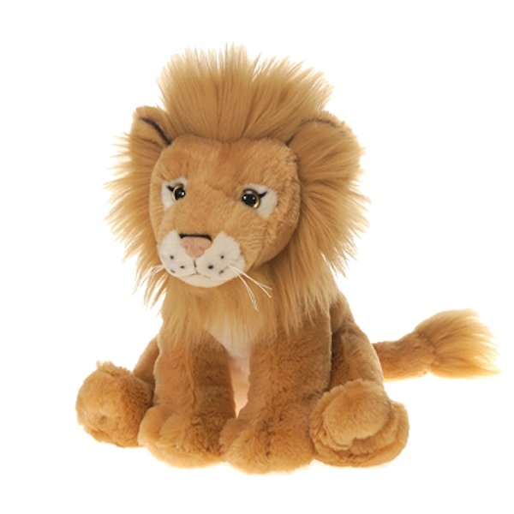
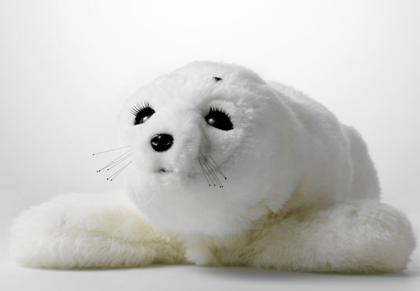
Study Design:
Mild/mod dementia
“M group”
19 residents
Severe dementia
“S group”
11 residents
Robotic seal “PARO”
Stuffed toy: “Lion”
Responses to PARO vs. Lion videotaped
Behavioral analysis of initial 6 minutes of interaction
Talking to animal
Touching/stroking
Expressing emotion
Talking to staff
Staff talking to patient
Notes:
Mean age of subjects on general ward 85, vs. 89 – living on different wards
Dementia graced using “hasegawa dementia scale – like MMSE” per the article
“because of limitations of elderly nursing care facilities some of the residents were transferred to their own homes or to specialized NH”..? Loss of subjects initially planned?
All subjects given exposure to both after 3-6 months (one time only)

Slide 10
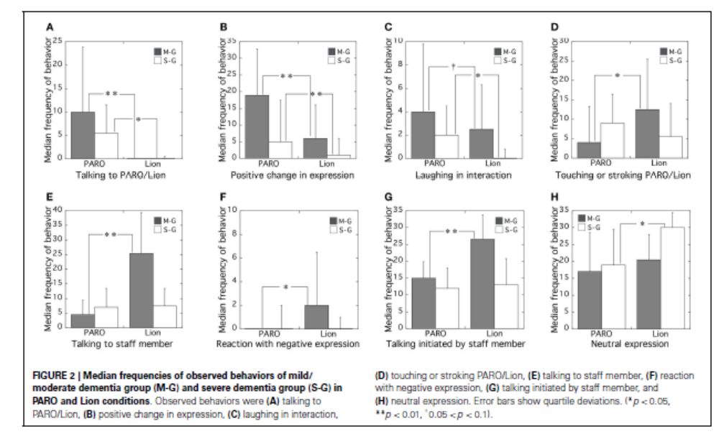
Monitoring frequencies of behaviors

Slide 11
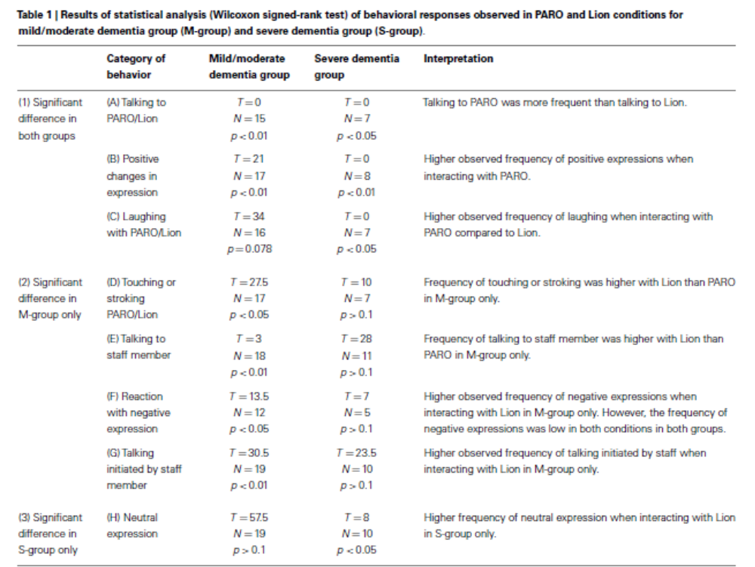

Slide 12

Problems with study:
Control group – Lion vs. non-robotized seal
Larger sample size
Firmer end-points
Industry-sponsored
Ethical concerns

Slide 13
Opposition
"If you give me a robot that helps perform mundane tasks associated with caregiving, such as vacuuming or doing the dishes, I'm all for that," says Dr. Thomas, founder of the Green House Project, a campaign to make nursing homes smaller and more like regular houses. But "if we wind up with nursing homes full of baby-seal robots, the robots will be trying to fulfill the relationship piece of caregiving, while the humans are running around changing the beds and cooking the food.”
Dr. Bill Thomas (Green House Project)
Wall Street Journal, November 6, 2015

Slide 14
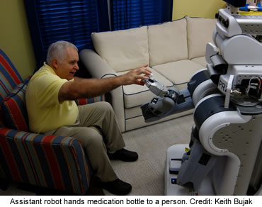
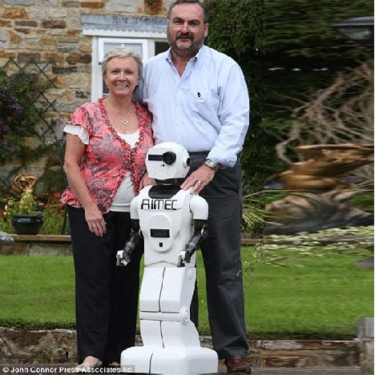
The Future?
Fall 2009 – PARO classified as a “class 2 medical device” by US regulators
VA investment
Ongoing clinical trials in Australia
Notes:
Other examples of class 2 medical device – powered wheelchairs
Clinical trial in australia – single-blind RCT – control group gets other psychosocial activities – primary endpoints - improving mood, stimulating social interaction and communication for people with dementia in the community (chilnese adults); -MMSE and depression scale as secondary outcomes

Slide 15
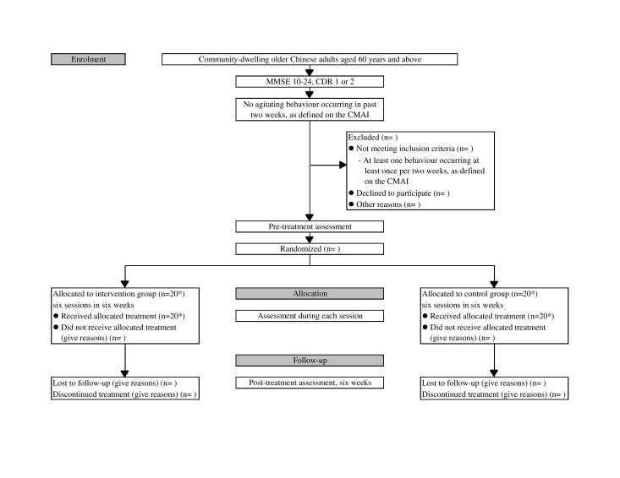

Slide 16
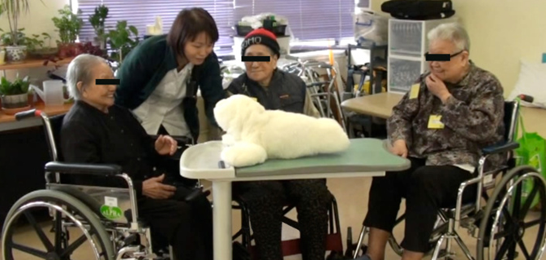
Back to our patient Mrs. C…
81 yo nursing home resident with moderate dementia
…. Should BUGS invest in PARO for nursing homes?

Slide 17
References
Gawande A. Being Mortal: Medicine and What Matters in the End. Metropolitan Books, NY. 2014.
Mitchell G et al. Therapeutic use of dolls for people living with dementia: a critical review of the literature. Dementia (London). Aug 2014.
Rodin J, Langer EJ. Long-term effects of a control-relevant intervention with the institutionalized aged. Journal of Personality and Psychology, Dec 1977. 35 (12) 897-902
Takayanagi K et al. Comparison of verbal and emotional responses of elder people with mild/moderate dementia and those with severe dementia in responses to seal robot, PARO. Frontiers in Aging Neuroscience, Sept 2014. 6 (257) 1-5.
Yu R et al. Use of a Therapeutic, socially-assistive pet robot (PARO) in improving mood and stimulating social interaction and communication for people with dementia: study protocol for a randomized controlled trial. JMIR Research Protocol. May 2015

