Slide 1

The Association Between Income and Life Expectancy in the United States, 2001-2014
Sharda Mukunda

Slide 2
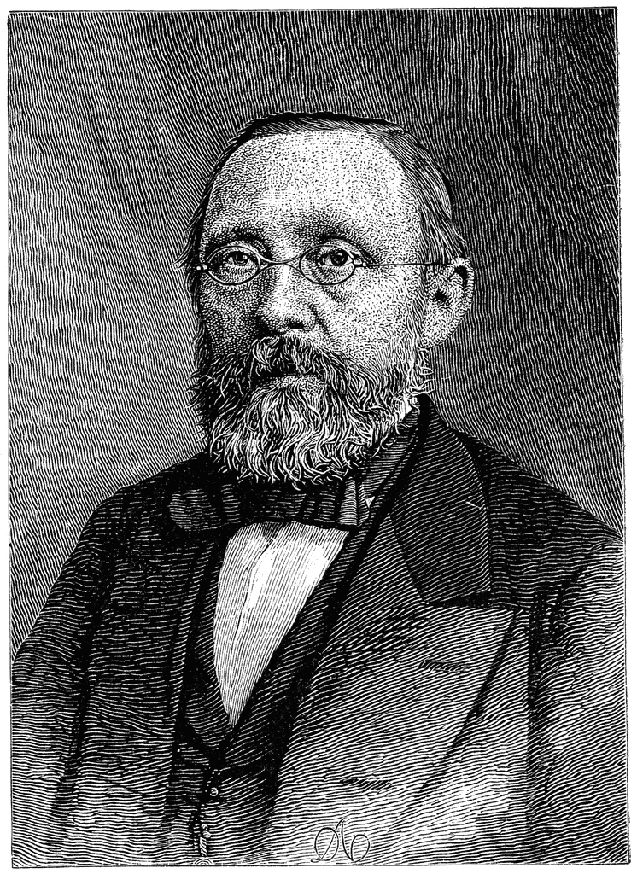
“Medicine is a social science, and politics is nothing but medicine at a larger scale”
  Virchow
http://etc.usf.edu/clipart/56000/56042/56042_r-virchow_lg.gif

Slide 3
Patient Case
79F originally from Guyana
Multiple comorbid conditions
Low financial status
  Family diverting her funds
Misses appointments, cannot have labs drawn
Takes meds incorrectly
Multiple hospital admissions

Slide 4

Background
Higher incomes are associated with longer life expectancy
  Threshold income?
  Change over time?
  Local and regional differences?
  Why? What sources?
http://religiopoliticaltalk.com/wp-content/uploads/2014/11/old-white-rich.jpg

Slide 5
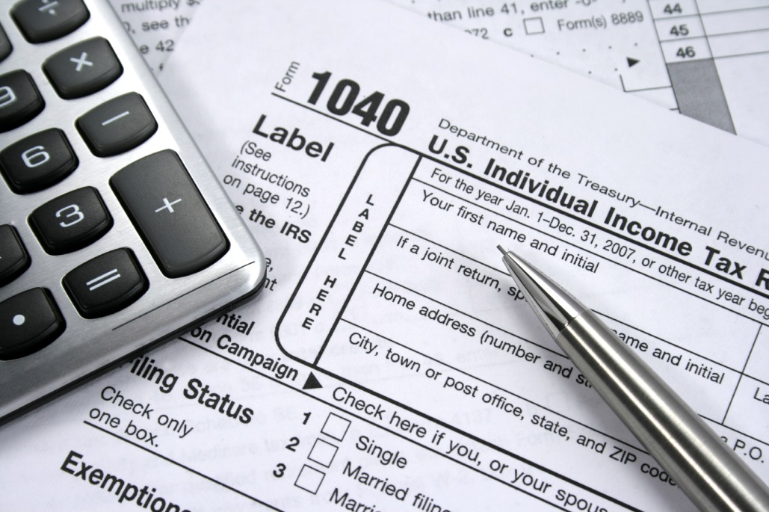
Methods
1999-2014
  Income data → tax records
  Mortality data→ Social Security
Race, ethnicity specific life expectancy at 40
  Income
  Sex
  Geographical area
http://www.myrelianttax.com/wp-content/uploads/2015/01/taxes.jpg

Slide 6
Definitions
Period life expectancy- the expected length of life for a hypothetical individual who experiences mortality rates at each subsequent age that match those in the cross-section during a given year.
If <63 → Used income from 2 yrs before
  Retirement increases sharply at 62
Incomes usually correlate ages 40-60

Slide 7
Outcome measures
Relationship between income and life expectancy
Trends in life expectancy by income
Geographic variation in life expectancy
Factors associated with differences in life expectancy

Slide 8
Results
1.4 million person years, 1999-2014
  Age 40-76; Mean age 53
  ~4million male deaths
  ~2.7 million female deaths
Ages 38-61 household
  Median income ~$61.000
  Mean income ~$98,000

Slide 9

Results: MEN
Higher income → longer life
Bottom 1% at the age of 40 years had an expected age of death of 72.7 years.
Top 1% had an expected age of death of 87.3
14.6 years longer

Slide 10
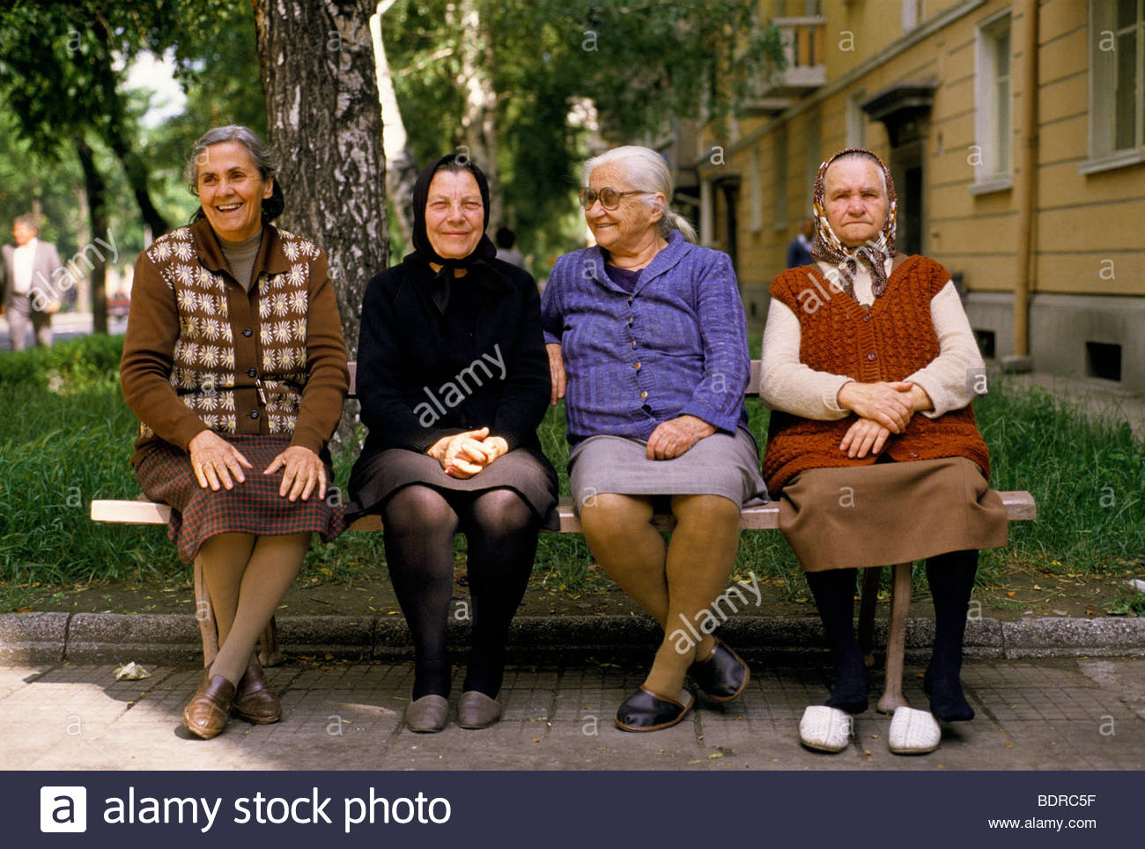
Results: WOMEN
Bottom 1% at the age of 40 years had an expected age of death of 78.8 years.
Top 1% had an expected age of death of 88.9 years
10.1 years longer
http://c8.alamy.com/comp/BDRC5F/group-portrait-of-old-women-sitting-on-a-bench-location-kazanlum-bulgaria-BDRC5F.jpg

Slide 11
Results continued
Gap in life expectancy between men and women narrower at higher income levels
  bottom 1% women lived 6.0 yr longer than men
  top 1% women lived 1.5 yr longer than men.
An increase in income of a given dollar amount was associated with smaller gains in life expectancy at higher income levels.

Slide 12
Results Continued
Life expectancy varied across states, with particularly big differences in lower income levels (not much difference in high incomes)
For low income levels:
  Nevada, Indiana, and Oklahoma = lowest life expectancies
  California, NewYork, and Vermont = highest life expectancies

Slide 13
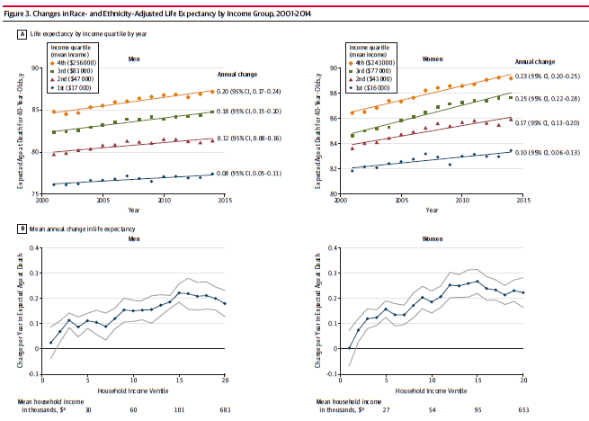

Slide 14
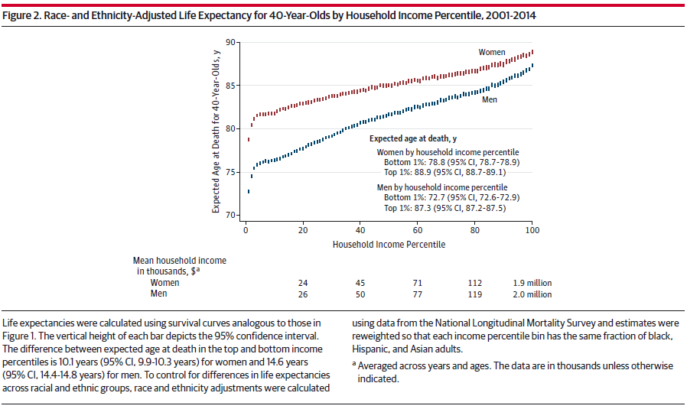

Slide 15
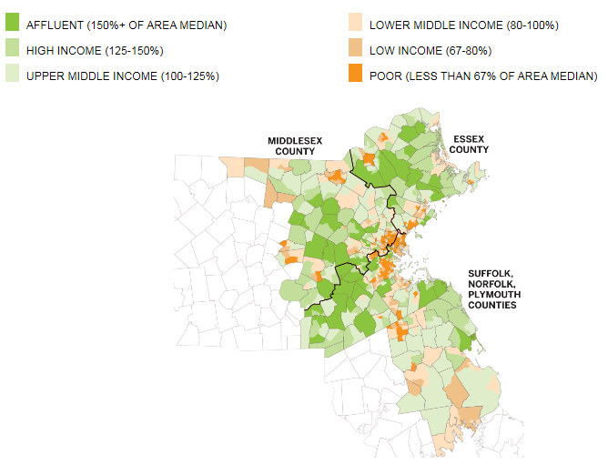
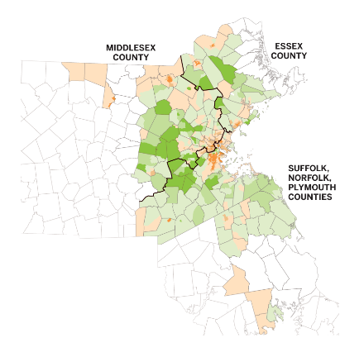
MASSACHUSETTS?
Hawaii, Maine, and Massachusetts had the largest gains in life expectancy (gaining >0.19 years annually)
https://www.bostonglobe.com/metro/2016/03/05/segregation/NiQBy000TZsGgLnAT0tHsL/story.html
Notes:
1970 vs 2014

Slide 16

Results
Measures of health insurance coverage and spending (the fraction of uninsured and risk-adjusted Medicare spending per enrollee) were not significantly associated with life expectancy for individuals in the bottom income quartile.

Slide 17
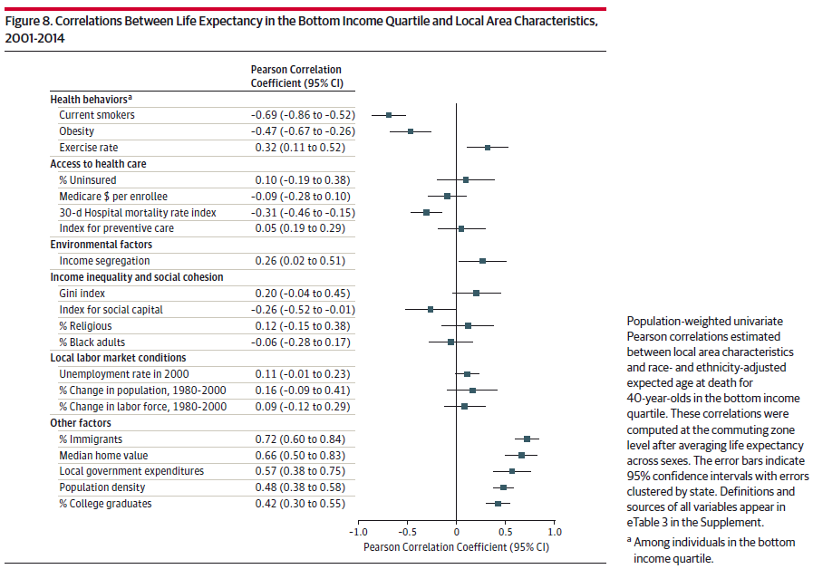
Notes:
Pearson’s correlation is a measure of the linear correlation between two variables X and Y, giving a value between +1 and −1 inclusive, where 1 is total positive correlation, 0 is no correlation, and −1 is total negative correlation.

Slide 18
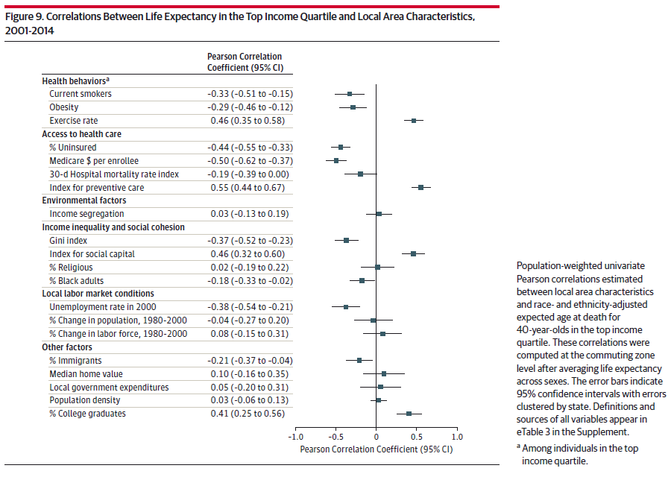
Notes:
Pearson’s correlation is a measure of the linear correlation between two variables X and Y, giving a value between +1 and −1 inclusive, where 1 is total positive correlation, 0 is no correlation, and −1 is total negative correlation.

Slide 19
Major conclusions
Life expectancy increases continuously with income
Life expectancy has increased in recent years
Life expectancy varies by region
And life expectancy did not seem to change based on our measures of quality and quantity of care (such as how many insured). MA not in the top!
  Income segregated areas? Pollution, etc

Slide 20

Conclusions
The strongest pattern in the data was that low-income individuals tend to live longest (and have more healthful behaviors) in cities with highly educated populations, high incomes, and high levels of government expenditures
  New York, New York
  San Francisco, California
  Smoking bans, public programs
http://www.safetysign.com/images/catlog/product/large/J2514.png

Slide 21
Final Background
“Race/ethnicity is inseparable from the economic consequences and stress associated with segregation, past and present marginalization in the distribution of resources, structural racism, persistent poverty, and violence”

Slide 22
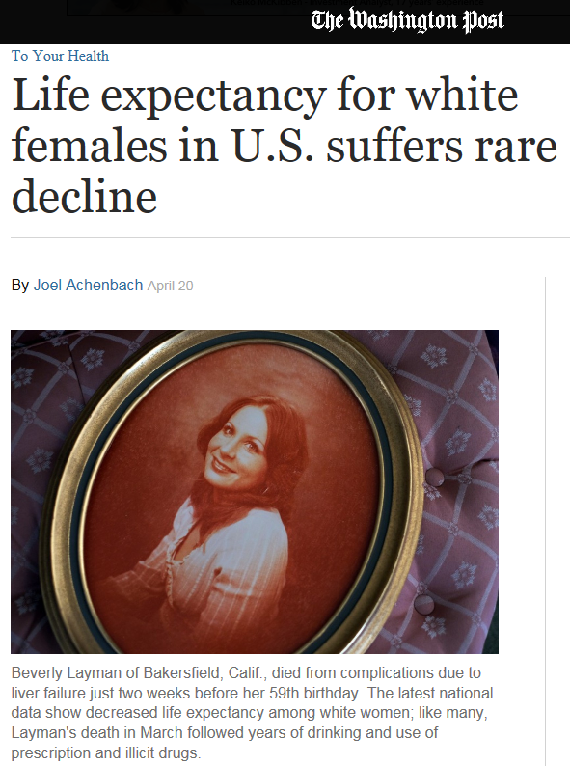
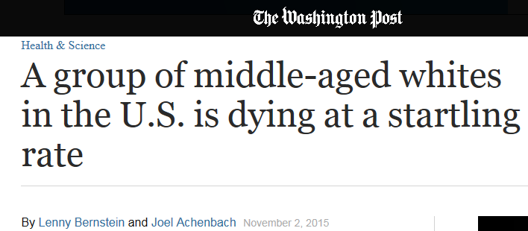

Slide 23
References
Chetty, Raj, et al. "The association between income and life expectancy in the United States, 2001-2014." JAMA.
Deaton, Angus. "On Death and Money: History, Facts, and Explanations." JAMA (2016).
Woolf, Steven H., and Jason Q. Purnell. "The Good Life: Working Together to Promote Opportunity and Improve Population Health and Well-being." JAMA (2016).

