Slide 1
sprint
Sharda Mukunda
11/13/2015

Slide 2
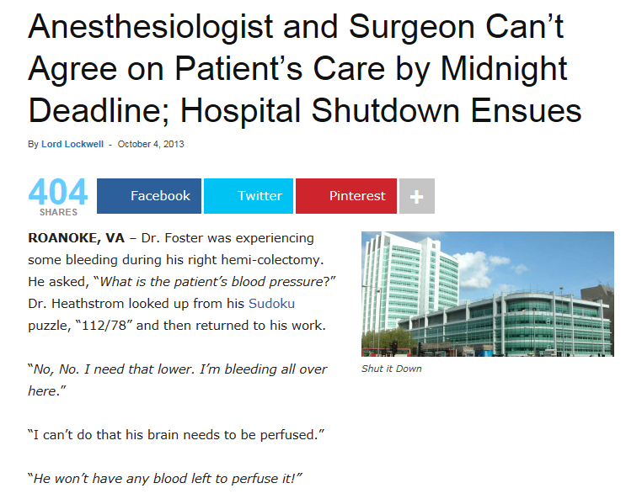
http://gomerblog.com/2013/10/anesthesiologist-surgeon-cant-agree-patients-care-midnight-deadline-hospital-shutdown-ensues/

Slide 3
Background
Optimal BP goals for frail elderly is controversial
Treatment of HTN reduces CV outcomes
Hypothesis- goal SBP <120 as compared with <140 would reduce several cardiovascular outcomes and death

Slide 4
Relevant studies
HYVET (NEJM 2008):
    Tx in patients over 80 for SBP >160 reduced mortality, stroke, CHF
SHEP (JAMA 2011):
    Treatment with chlorthalidone for 4.5 yrs inc life expectancy
ACCORD-BP (NEJM 2010)
    No significant difference in pts with DM assigned to BP <120 vs <140
Beckett NS, Peters R, Fletcher AE et al. Treatment of hypertension in patients 80 years of age or older. N Engl J Med 2008; 358: 1887–98.
Kostis JB, Cabrera J, Cheng JQ et al. Association between chlorthalidone treatment of systolic hypertension and longterm survival. JAMA 2011; 306: 2588–93.
ACCORD Study Group. "Effects of intensive blood-pressure control in type 2 diabetes mellitus." The New England journal of medicine 362.17 (2010): 1575.
Notes:
Top two studies and others showed benefits of lowering SBP <150 in elderly population
ACCORD- mortality benefits were not statistically significant

Slide 5
Relevant Recent Studies
Milan Geriatrics study
  J Am Geriatr Soc (2015)
    In populations of
      The oldest old
      Impaired functional status
    Higher BP is leads to better cognitive function
      Classified by tertiles of BP
  Age and Aging (2015)
    Higher BP was better for those with poor cognitive function and impaired ADLs
Ogliari, Giulia, et al. "Age‐and Functional Status–Dependent Association Between Blood Pressure and Cognition: The Milan Geriatrics 75+ Cohort Study." Journal of the American Geriatrics Society 63.9 (2015): 1741-1748.
Ogliari, Giulia, et al. "Blood pressure and 10-year mortality risk in the Milan Geriatrics 75+ Cohort Study: role of functional and cognitive status." Age and ageing 44.6 (2015): 932-937.
Notes:
Jan 3 2000- March 25 2004: 1,861 consecutive new patients >75yrs
Assessed BP, MMSE, ADLs, IADLs
Geriatrics unit through referral by physician
Demographic data, medical history, medications
BP measured at first visit, seated position, 5 mins rest

Slide 6
Methods
Randomized, controlled, open-label
Age >50, SBP >130
Subjects needed to have a high cardiovascular risk:
INCLUDED | EXCLUDED
CV disease other than stroke | Prior stroke
CKD | Diabetes mellitus
10 yr risk >15% per Framingham score | Nursing home and assisted living
Age >75 | Polycystic kidney disease
 | Difficult or unable to control BP

Slide 7
Methods
Planned 2 year recruitment, follow up of 6 yrs
Target of 9250 for powering the study
  9631 participants Nov 2010- March 2013
    ~28.4% >75yrs in each group
    Females 35-36%
    ~58% in each group non Hispanic white
    Same avg number of anti-HTN meds prior to study
Aug 20,2015- CV outcomes concer
  Study ended; follow up was 3.26 yrs/5yrs

Slide 8
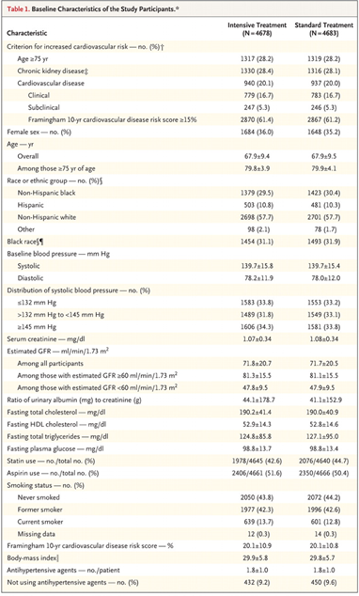
 | Intensive treatment | Standard treatment
Age >75 | 28.2 | 28.2
Female | 36 | 35.2
Black race | 31.1 | 31.9
Non Hispanic White | 57.7 | 57.7
BMI | 29.9+/- 5.8 | 29.8+/-5.7

Slide 9
Primary Hypothesis
Treatment to reach a systolic blood pressure target of less than 120mmHg, as compared with a target of less than 140mmHg, would result in a lower rate of the composite outcome of MI, ACS not resulting in MI, stroke, acute decompensated heart failure, or death from CV causes”

Slide 10
Secondary outcomes
Death from any cause
Renal outcomes
  Decrease in eGFR of 50% or more
  Development of ESRD
  Incident albuminuria
Effects of SBP targets on
  Incident dementia
  Changes in cognitive function
  Cerebral small vessel ischemic disease

Slide 11
Secondary Outcomes
SPRINT MIND
  “ To determine the incidence of all-cause dementia in SPRINT and its relation to the treatment assignment”
  Classification of dementia, MCI, or no impairment
    Neurologists, geriatricians, psychiatrists, and neuropsych
  No published data on this yet

Slide 12
Randomization
Blood pressure target of
  <120 (intensive treatment group)
  <140 (standard treatment group)
Participants and personnel aware of groups
Visits: Monthly x3; then every 3 months
Self report of CV outcomes
  Standardized interviews; interviewer knew which group patient was in

Slide 13
Antihypertensive choices
Thiazide (1st line)
Loop diuretics (CKD)
Beta Blockers (CAD)
If Thiazide- Chlorthalidone
If CCB- Amlodipine
If ACE- Azilsartan OR Azilsartan- chlorthalidone
Standardized dose titrations

Slide 14
Outcomes
Serious adverse events
  Fatal or life threatening
If presented to the ED:
  Hypotension
  Syncope
  Injurious falls
  Electrolyte abnormalities
  Bradycardia
Acute kidney injury or renal failure on admission or d/c from a hospitalization

Slide 15
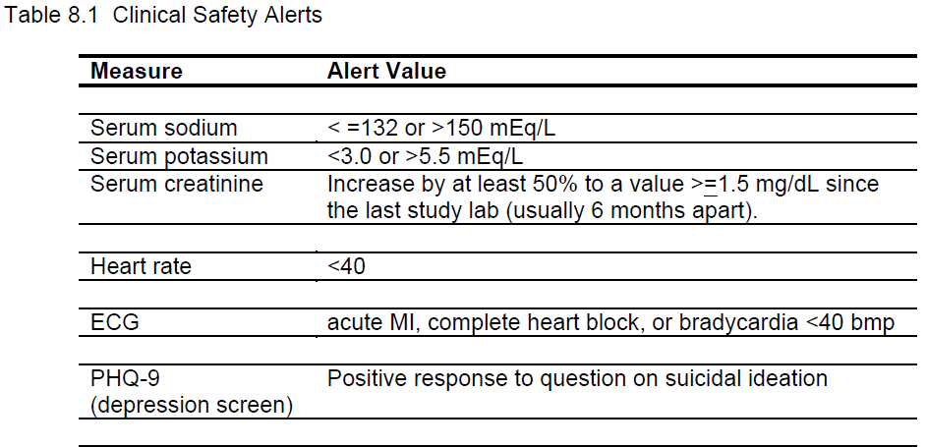

Slide 16
Outcomes for the Intensive group
Primary outcome:
  25% lower relative risk of the primary outcome
Secondary outcomes
  38% lower relative risk of heart failure
  43% lower relative risk of death from CV cause
  27% lower relative risk of death from any cause

Slide 17
Other significant outcomes
Intensive vs Standard
  30% reduction in GFR (3.8% vs 1.1%)
    More AKI and renal failure in intensive group
  Syncope (3.5% vs 2.4%)
  Hypotension (3.4% vs 2.0%)
  Intensive group with significantly more
    Hyponatremia; Hypernatremia
    Hypokalemia

Slide 18
Unexpected outcomes
Intensive vs Standard
  Orthostatic hypotension (16.6% vs 18.3%)
No significant difference in the number of injurious falls

Slide 19
Results summarized
Intensive treatment group | Control group | No difference
25% lower RR of primary outcome | Less risk of 30% decrease in GFR | Serious adverse events
38% lower RR of CHF | Less AKI or renal failure | Decrease in GFR overall
43% lower RR of death from CV cause | Less Hypotension Less Syncope MORE orthostasis?? | **INJURIOUS FALLS!**
27% lower RR of death overall | Less electrolyte abnormalities (hypoK, hypoNa)

Slide 20
Validity
Was the assignment of patients to treatment randomized? –YES
Was the randomization concealed– NO
Were the groups similar at the start of the trial—YES
Was follow up sufficiently long– ended early; ~3.2 yrs
Were all patients analyzed in groups to which they were randomized—YES
Were patients, clinicians, and study personal kept blind to the treatment—NO
Were groups treated equally—YES

Slide 21
Importance
Are the valid results of this study important?
  What is the magnitude of effect?
    NNT to prevent one CV event = 61
    NNT to prevent one death = 90
    NNT to prevent one death from CV cause = 172
Notes:
For beta blockers, for example

Slide 22
Applicability
Is this study valid in our population? Do our patients fit in?
    Age (~28% in each group >75)
    NO nursing home patients! NO diabetes!
    How frequently can we see patients?
Is the treatment feasible?
    Can we reliably get to an SBP of 120? Resistant patients
What are our patient’s potential benefits and harms from the therapy?
    Hypotension (67% inc), Syncope (33% inc)
What are our patient’s values and expectations for both the outcome we are trying to prevent and the treatment?

Slide 23
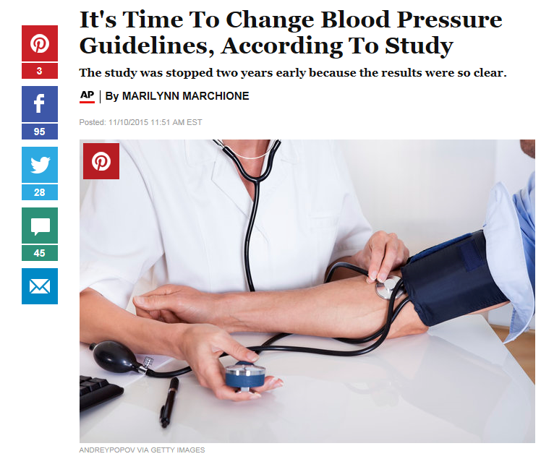
http://www.huffingtonpost.com/entry/its-time-to-change-blood-pressure-guidelines-according-to-study_56421e55e4b0411d30729b54

