Slide 1
Nursing home placement in the Donepezil and Memantine in Moderate to Severe Alzheimer’s Disease (DOMINO-AD) trial: secondary and post-hoc analyses
Howard R., et al. Lancet Neurol 2015; 14: 1171–81
Geriatrics Grand Rounds - Journal Club
Michael Voisine, DO
March 11, 2016

Slide 2
Clinical question -
In an 83 yo veteran with moderate Alzheimer’s dementia (MMSE 11), on donepezil, who’s caregiver is questioning the utility of continuing pharmacotherapy on the basis of suspected limited clinical benefit, what evidence is available to aid in shared medical decision making regarding donepezil discontinuation vs. continuation?

Slide 3
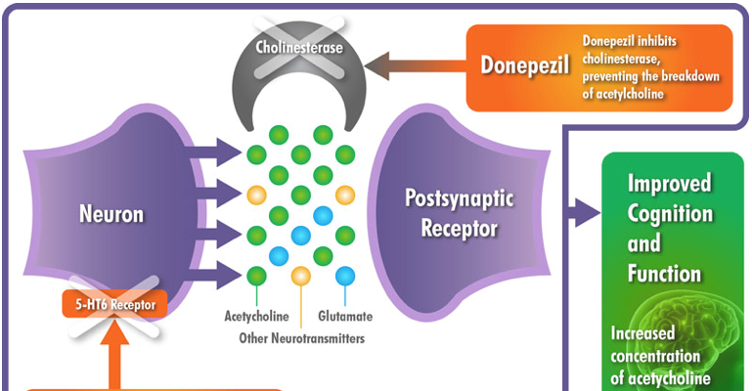
Donepezil (Aricept)
Symptomatic tx,
NOT disease modifying
Binds and inactivates cholinesterases → inhibiting hydrolysis of acetylcholine = increased [acetylcholine] at cholinergic synapses.

Slide 4
Data supporting clinical benefit -
Previously in DOMINO-AD trial it was shown that continued donepezil in mod-severe AD is associated with slight cognitive and functional benefits during 12 mos compared with tapering and discontinuing. (MMSE 1.9 pts higher, BADLS 3.0 difference)
Whether cholinesterase inhibitors can delay the point at which patients with Alzheimer’s disease make the transition to permanent residential care is controversial.
Howard R, et al. NEJM 2012; 366: 893-903.

Slide 5
Controversy
AD2000 - randomized, controlled, double-blind trial addressing the effect of donepezil on SNF placement was negative (mild-mod dementia)
Observational studies (11) have yielded positive results - criticized d/t lack of randomization, placebo control, or blinding of treatment allocation.
Courtney C., et al. Lancet 2004; 363: 2105–15.

Slide 6
Why are people with dementia placed in nursing homes?
(Patient + caregiver characteristics) + (cultural + social environment)
race (Caucasian)
impairments in cognition and ADLs
behavioral problems
age of caregivers
burden on caregivers
ALL individually predict nursing home placement in Alzheimer’s disease.
Yaffe K., et al., JAMA 2002; 287: 2090–97.

Slide 7
Background
Cost of Boston Nursing Homes:
  Semi-Private Rooms: $250-$365/day ($293/day average)
  Private Rooms: $275-$415/day ($327/day average)
Nationally: $70,000 to $178,000 per year
    Assisted Living Costs: average $36,000 per year
Home Health Costs
  In-home RN assistance: $50 to $100 per hour
  home health aid assistance: $10 to $20 per hour
  adult day care: average $64 per day
www.guidetonursinghomes.com
Notes:
The socioeconomic implications of resolution of this controversy are clear.
Models based on assumptions that the drugs can delay placement show large societal and health-care cost savings.
Surveys show it is rated as a MAJOR negative determinant of quality of life.

Slide 8
Study Objective
To investigate the effects of continuation or discontinuation of donepezil and starting of memantine on subsequent nursing home placement in patients with moderate-to-severe Alzheimer’s disease.
Secondary outcome: reported in this study, was nursing home placement: an irreversible move from independent accommodation to a residential caring facility
Primary outcome: scores on the MMSE and Bristol Activities of Daily Living Scale (BADLS)

Slide 9
Study Design
15 secondary care memory services in England and Scotland, n=295. 2/11/08 – 3/5/10.
Inclusion
  met standardized criteria for moderate or severe AD
  community-dwelling
  been prescribed donepezil continuously for at least 3 mos at a dose of 10 mg for at least the previous 6 wks
  had a score of between 5-13 on the MMSE
Exclusion
  had severe or unstable medical disorders
  were receiving memantine
  were deemed unlikely to adhere to the study regimens

Slide 10
Study Design
randomized, pragmatic, double-blind, placebo-controlled trial, with a two-by-two factorial design.
Discontinue Donepezil + Memantine
Continue Donepezil +
Memantine
Discontinue Donepezil +
placebo
Continue Donepezil + placebo

Slide 11
Randomization
computer-generated to maintain allocation concealment
Groups were stratified according to
- center
- duration of donepezil treatment before entry (3–6 mos vs > 6 mos)
- baseline MMSE score (5–9 vs 10–13)
- age (<60 years, 60–74 years, >74 years)
Patients, caregivers, clinicians, outcome assessors, and investigators were all masked to treatment assignment.

Slide 12
Methods
  Depending on study arm -
  Donepezil 10 mg/d
  If discontinued, treated with donepezil 5mg x 4 wks
  Memantine 20 mg/d
First 52 wks - Client Service Receipt Inventory (gathers retrospective information on service utilization) captured the patient’s usual place of residence since the last assessment together.
Following 3 years - the caregiver was contacted by telephone every 26 weeks and asked whether the participant was still living at home or had moved to live permanently in a residential or nursing home, and what the date of transition was.

Slide 13
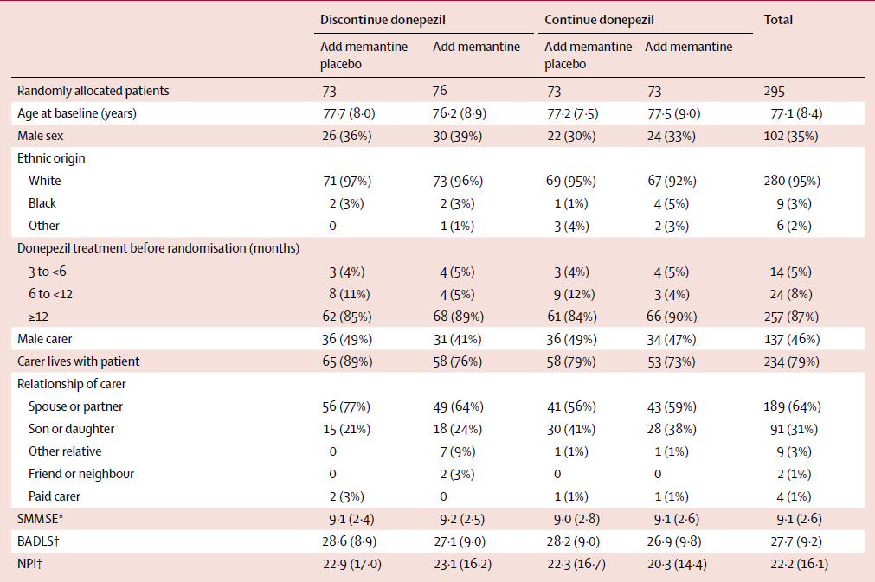
Table 1: Baseline demographics
0-30
0-60
0-144

Slide 14
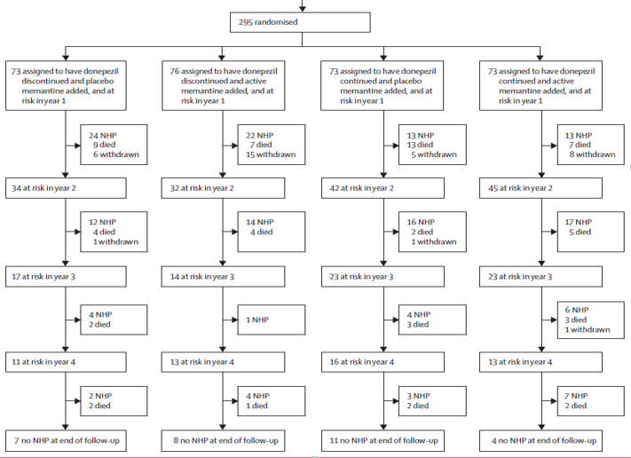
Notes:
Trial profile

Slide 15
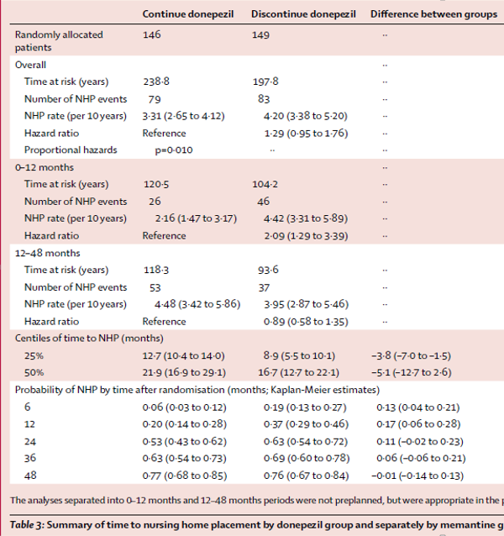

Slide 16
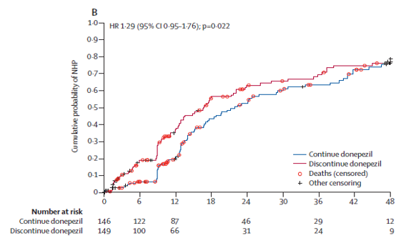
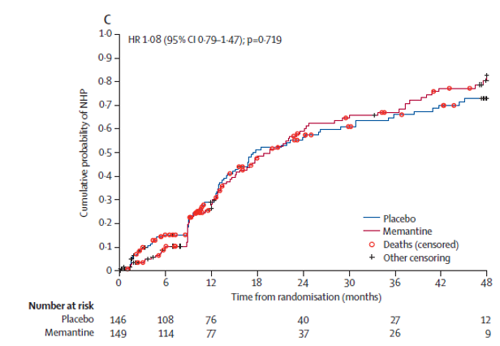
Difference was non-significant in the un-stratified analysis (p=0.100)

Slide 17
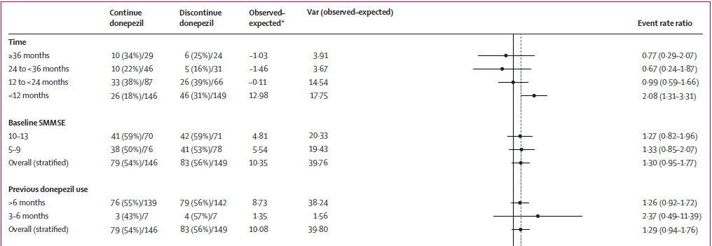
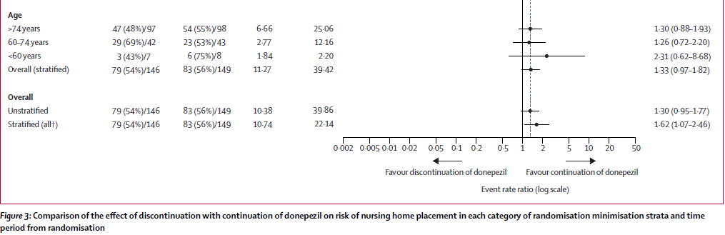

Slide 18
Outcome
162 (55%) patients underwent NHP within 4 yrs of randomization, with similar numbers for all groups
  36 [49%] in patients who continued donepezil without memantine
  42 [58%] who discontinued donepezil without memantine
  41 [54%] who discontinued donepezil and started memantine
  43 [59%] who continued donepezil and started memantine

Slide 19
Outcome
Significant (p=0·010) heterogeneity of treatment effect over time
  significantly more NHP in the combined donepezil discontinuation groups during the first year (HR 2·09 [95% CI 1·29–3·39]) vs. the combined donepezil continuation groups
  no difference during the next 3 years (0·89 [0·58–1·35])
  Patients who live with their carers at baseline had a lower instantaneous risk of nursing home placement throughout f/u compared with those who did not (HR 0.63 [95% CI 0.44–0.89]; p=0.013)

Slide 20
How does symptom worsening, associated with withdrawal of donepezil, increase risk of NHP in the first year?
although baseline ADL score affects risk of and time to NHP, decline in ADL most strongly predicts placement.
withdrawal from donepezil treatment in the DOMINO-AD trial was associated with a mean 3 point BADLS disadvantage during year 1
Hatoum HT, et al . J Med Econ 2009; 12: 98–103.

Slide 21
Impairment in ADLs vs. cognitive impairment
MMSE | Rates for NH placement during 1 year
15-20 | 24%
< 15 | 26%
ADLs | Rates for NH placement during 1 year
Independent | 15%
Dependent for 1 or more ADL | 25%
Yaffe K., et al., JAMA 2002; 287: 2090–97.

Slide 22
Discussion
time to NHP was a secondary objective of the DOMINO-AD trial for which the study was not designed to have statistical power for
the analysis restricted to the first 12 months was not pre-specified in the statistical analysis plan.
no dementia drug use data collected after 52 weeks
decisions about their subsequent treatment were made by their responsible clinician.
results are exploratory and would ideally need to be substantiated in future studies --- ? ethics of further RCTs

Slide 23
Back to the veteran
Along with slight cognitive and functional benefits, continuation of donepezil is associated with potential advantages in maintenance of home living (reduced risk of nursing home placement during 12 months).
Since the symptomatic benefits associated with donepezil in AD are slight, physicians/caregivers might consider stopping treatment because of perceived absence of effectiveness once patients have become moderately to severely affected.
The evidence suggests that withdrawal of cholinesterase inhibitor treatment is associated with worse cognitive and functional outcomes and, from this study, earlier transfer to a nursing home than without withdrawal.

Slide 24

Thank you!
Thank you!

