Slide 1



Journal Club: Does Zoledronic Acid Benefit Men with Osteoporosis?
Matthew T. Corey, MD
PGY-4, Geriatric Medicine
19 December 2014
Your Logo

Slide 2
Learning Objectives
1
Share a case from the BMC Geriatrics Clinic
2
Pose an appropriate clinical question to be answered in the literature
Critique a double-blinded randomized controlled trial of zoledronic acid use in men.
3
4
Identify a surprising adverse effect that may emerge among men on bisphosphonates.

Slide 3
Learning Objectives
1
Share a case from the BMC Geriatrics Clinic.
2
Pose an appropriate clinical question to be answered in the literature.
Critique a double-blinded randomized controlled trial of zoledronic acid use in men.
3
4
Identify a surprising adverse effect that may emerge among men on bisphosphonates.

Slide 4
An Ethiopian Male, aged 75
Pt is a 75yo Ethiopian male w/PMH of HTN, PUD, GERD, recently arrived in the United States complaining of 20 years of progressive right-sided weakness.
Gait is dependent on a “walking stick”– secondary to weakness not antalgia.
Admits to remote history of heavy drinking.

Slide 5
Physical Exam
Atrophy R deltoid, biceps, triceps; atrophy of intrinsic hand muscles bilaterally
Spine kyphotic, lumbar flexion limited to 45 degrees by pain, stiffness

Slide 6
Imaging
MRI of brain: no history of stroke

Slide 7
Imaging
MRI of brain: no history of stroke
Lateral chest x-ray: compression deformity with greater than 50 percent loss of vertebral body height of a mid-to-lower thoracic vertebral body

Slide 8
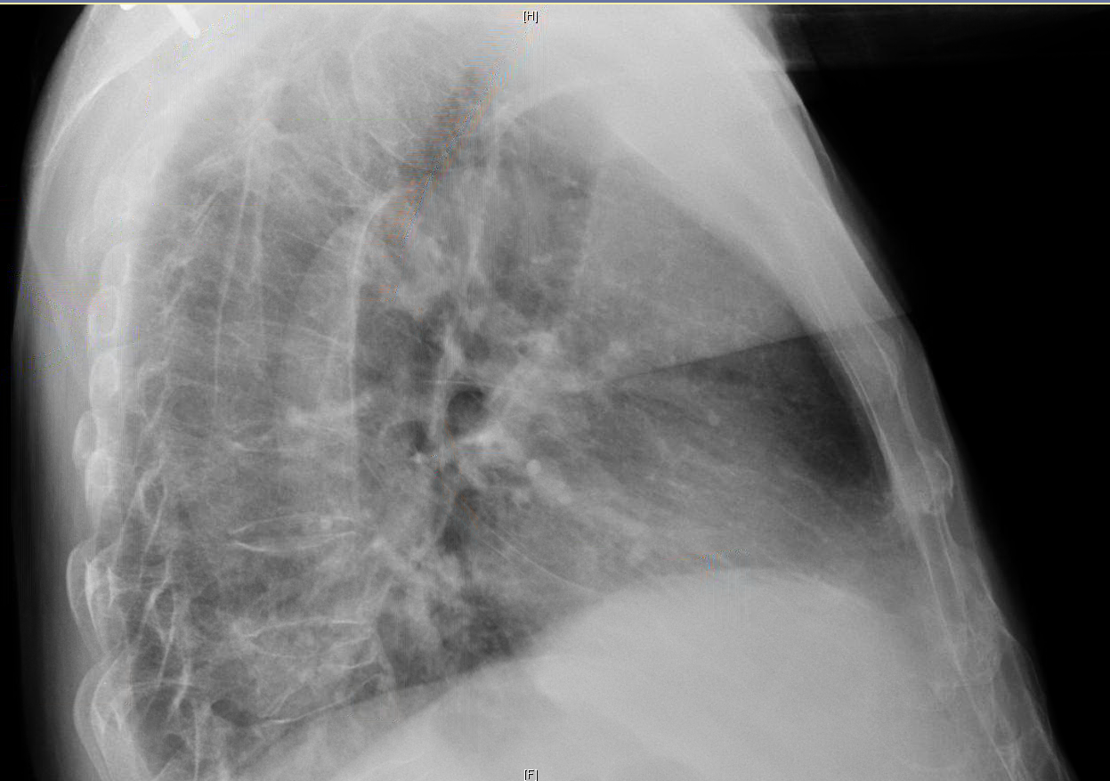
Lateral view of the chest

Slide 9
An osteoporosis-defining lesion …
Notes:
DEXA scan measured bone density at less than -2.5 in both the lumbar spine and femoral neck.
If osteoporosis is his disease state, what is the medication class that comes to mind?

Slide 10
Is there evidence for bisphosphonates in men?

Slide 11




Is there evidence for bisphosphonates in men?
The drug companies seem uninterested.
Notes:
Risendronate, ibandronate, alendronate, zoledronate

Slide 12
Learning Objectives
1
Share a case from the BMC Geriatrics Clinic.
2
Pose an appropriate clinical question to be answered in the literature.
Critique a double-blinded randomized controlled trial of zoledronic acid use in men.
3
4
Identify a surprising adverse effect that may emerge among men on bisphosphonates.

Slide 13
Posing the Clinical Question
P: African male in his 70s with osteoporosis and pathologic fracture
Notes:
Vertebral morphometry is a quantitative method to identify osteoporotic vertebral fractures based on the measurement of vertebral heights. Vertebral morphometry may be performed on conventional spinal radiographs (MRX: morphometric x-ray radiography) or on images obtained from dual x-ray absorptiometry (DXA) scans (MXA: morphometric x-ray absorptiometry)

Slide 14
Posing the Clinical Question
P: African male in his 70s with osteoporosis and pathologic fracture
I: Bisphosphonate therapy plus Vit D and calcium repletion
Notes:
Vertebral morphometry is a quantitative method to identify osteoporotic vertebral fractures based on the measurement of vertebral heights. Vertebral morphometry may be performed on conventional spinal radiographs (MRX: morphometric x-ray radiography) or on images obtained from dual x-ray absorptiometry (DXA) scans (MXA: morphometric x-ray absorptiometry)

Slide 15
Posing the Clinical Question
P: African male in his 70s with osteoporosis and pathologic fracture
I: Bisphosphonate therapy plus Vit D and calcium repletion
C: Vitamin D and calcium repletion alone
Notes:
Vertebral morphometry is a quantitative method to identify osteoporotic vertebral fractures based on the measurement of vertebral heights. Vertebral morphometry may be performed on conventional spinal radiographs (MRX: morphometric x-ray radiography) or on images obtained from dual x-ray absorptiometry (DXA) scans (MXA: morphometric x-ray absorptiometry)

Slide 16
Posing the Clinical Question
P: African male in his 70s with osteoporosis and pathologic fracture
I: Bisphosphonate therapy plus Vit D and calcium repletion
C: Vitamin D and calcium repletion alone
O: Prevention of a new morphometric fracture
Notes:
Vertebral morphometry is a quantitative method to identify osteoporotic vertebral fractures based on the measurement of vertebral heights. Vertebral morphometry may be performed on conventional spinal radiographs (MRX: morphometric x-ray radiography) or on images obtained from dual x-ray absorptiometry (DXA) scans (MXA: morphometric x-ray absorptiometry)

Slide 17
Learning Objectives
1
Share a case from the BMC Geriatrics Clinic
2
Pose an appropriate clinical question to be answered in the literature
3
Critique a double-blinded randomized controlled trial of zoledronic acid use in men.
4
Identify a surprising adverse effect that may emerge among men on bisphosphonates.

Slide 18
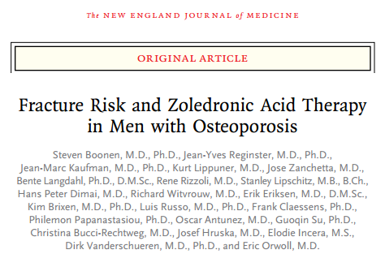
A Randomized Controlled Trial – Nov. 2012
Notes:
Steven Boonen, MD, PhD, was Professor of Clinical Gerontology and Geriatric Medicine at the Leuven University Faculty of Medicine; Head of the Gerontology and Geriatrics Section of the Leuven University Department of Experimental Medicine; Head of the Leuven University Hospital Division of Geriatric Medicine; Director of the Leuven University Hospital Center for Metabolic Bone Diseases and Senior Clinical Investigator of the National Fund for Scientific Research. Died at age 50 suddenly

Slide 19
Participants
Men 50 – 85 in Europe, South America, Africa, and Australia with:
  T score of -1.5 or less at hip or femoral neck AND 1 – 3 vertebral fractures of mild-to-moderate grade
  ** OR **
  T score of -2.5 or less w/no fracture

Slide 20
Exclusion Criteria
Very low 25-OH Vit D level or calcium derangement
Renal, hepatic failure

Slide 21
Exclusion Criteria
Previous treatment with bisphosphonates or other osteoporosis treatment, T, GC, GH, required washout period
30 days study drug-free!

Slide 22
Study Design
Computer randomized to treatment and placebo arms
Both given calcium and Vit D
Double-blinded
Duration: 24 months

Slide 23
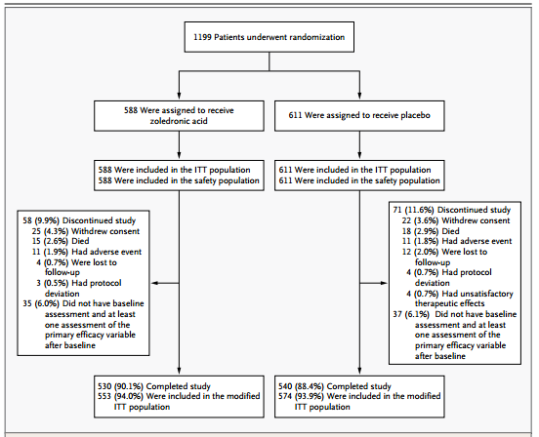
Notes:
Enrollment, randomization and outcomes

Slide 24
Notes:
Participants found the zoledronate more tolerable than the placebo.

Slide 25
Modified Intention
to Treat
Notes:
Per-protocol, intention to treat, and then mITT. Often it means “subjects who got a certain amount of the study drug or placebo”
In this case: “participants who underwent baseline and one or more post-baseline assessments of the primary efficacy variable”
Postrandomization exclusion criteria are thought to lead to biased estimates of the treatment effect.
MITT is demonstrably more common in studies with industry sponsorship (like Novartis) and in cases of authorial conflict of interest.

Slide 26
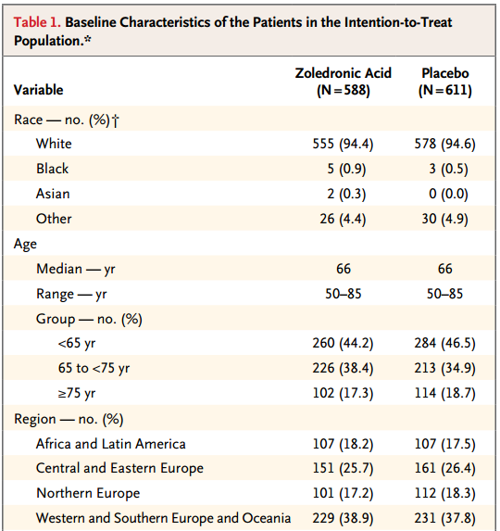
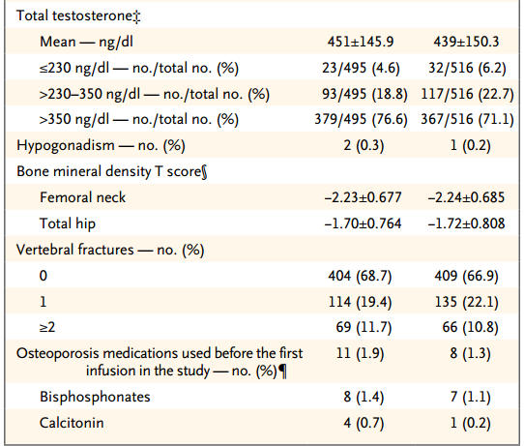
Baseline characteristics
Notes:
No statistically significant differences

Slide 27
Baseline characteristics
Notes:
A relatively young population

Slide 28
Baseline characteristics
Notes:
The median patient did not have an osteoporosis-defining T score!

Slide 29
Study Measurements
Primary End-Point: Incidence of new morphometric vertebral fractures (24 mos.)

Slide 30
Study Measurements
Secondary End-Points:
  Incidence of new (12 mos.) or worsening (12, 24 mos.) morphometric vertebral fractures
  Change in height
  Time to first clinical fracture
  Changes in bone mineral density
  Overall safety

Slide 31
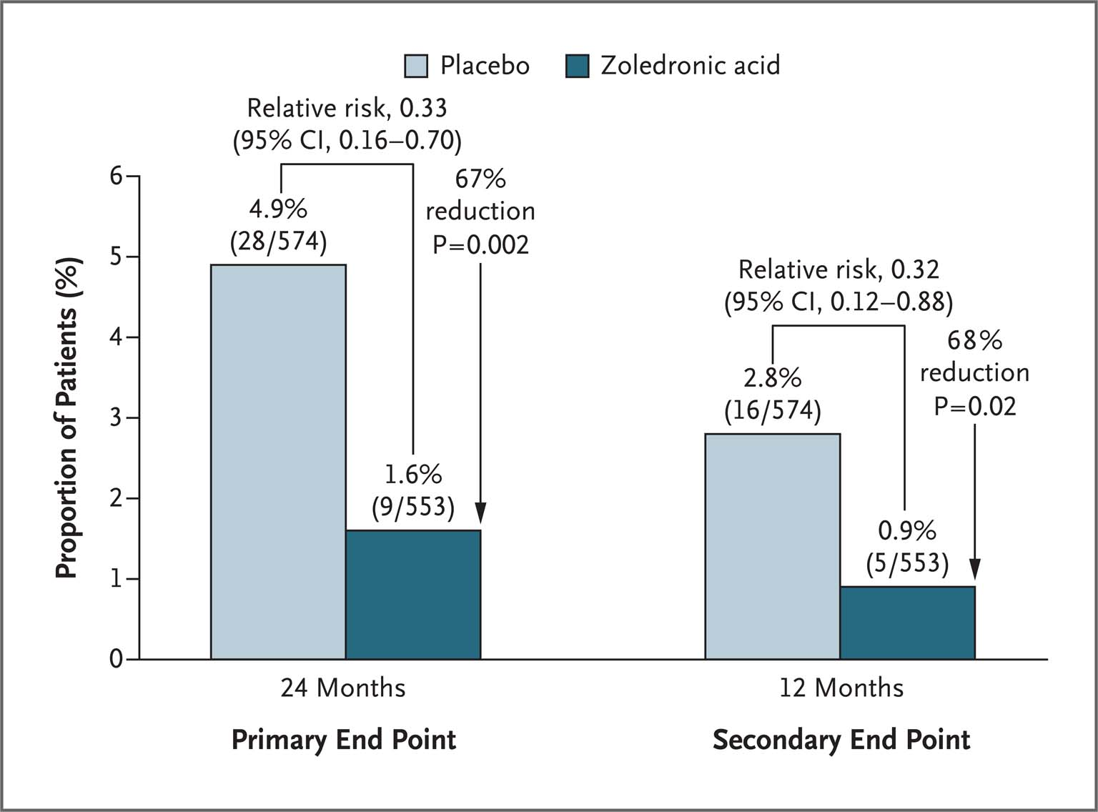
Results

Slide 32
Results
Notes:
Shows the incidence of one or more new morphometric vertebral fractures at 24 and 12 months. Relative risk reductions: both of them have 95% CI which excludes 0

Slide 33
What is the magnitude of the treatment effect?

Slide 34
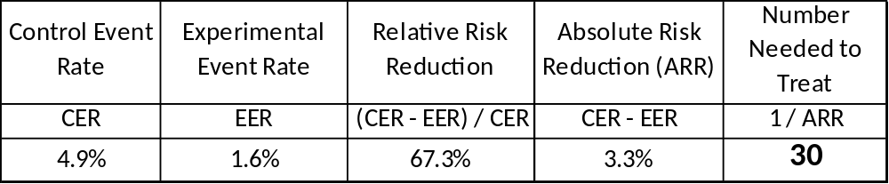
What is the magnitude of the treatment effect?
Number Needed to Treat (Primary End-Point)

Slide 35
Significant Improvements in Most Secondary Outcomes
New moderate-to-severe vertebral fractures at 12 and 24 mos.
New or worsening fractures (24 mos. only)
Changes in height
BMD: lumbar spine, total hip and femoral neck
Biochemical markers of bone turnover

Slide 36
Learning Objectives
1
Share a case from the BMC Geriatrics Clinic
2
Pose an appropriate clinical question to be answered in the literature
3
Critique a double-blinded randomized controlled trial of zoledronic acid use in men.
Identify a surprising adverse effect that may emerge among men on bisphosphonates.
4

Slide 37
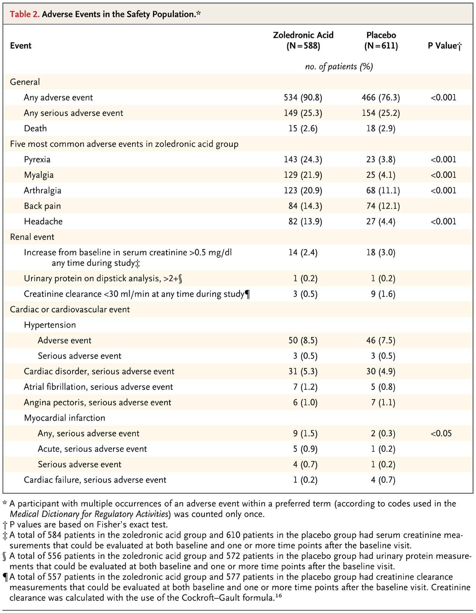
Safety

Slide 38
Safety

Slide 39
Safety:
No significant differences observed, with exception:
Any myocardial infarction
  9 men [1.5%] in zoledronic acid group
  2 men [0.3%] in the placebo group, [P=0.03]
“None of the events were considered by the investigator to be related to the study drug.”

Slide 40
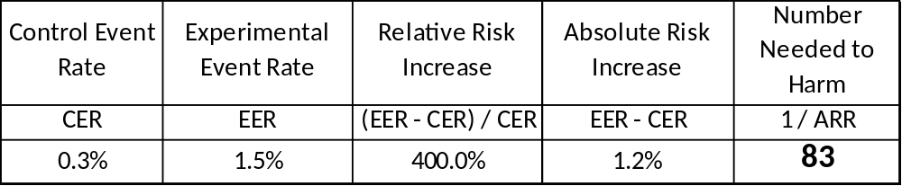
What is the magnitude of the added MI risk?

Slide 41
Is MI a valid concern?
Notes:
After all, the number of people affected was still a mere handful. Was it just noise?

Slide 42
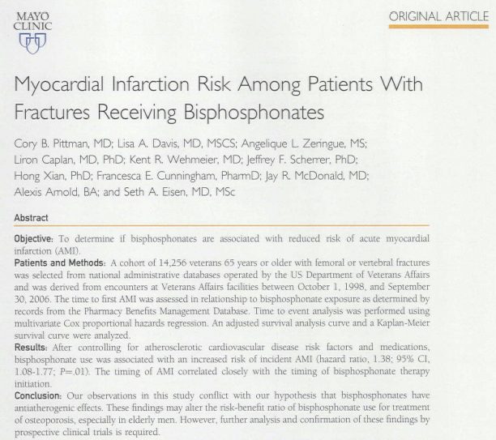
Is MI a valid concern?
Cohort study published in Mayo Proceedings, Jan. 2014
Notes:
The interesting thing is that the authors hypothesized that bisphosphonates would be cardioprotective and found the opposite.

Slide 43
Cohort study of myocardial infarction risk
Study Design
Database cohort of 14,256 veterans 65 years or older with femoral or vertebral fractures
Time to first AMI was assessed in relationship to bisphosphonate exposure

Slide 44
Cohort study of myocardial infarction risk
Results
Bisphosphonate use associated with an increased risk of incident AMI (hazard ratio, 1.38; 95% CI, 1.08-1.77; P=.01).
Timing of AMI correlated closely with the timing of bisphosphonate therapy initiation.

Slide 45
Conclusions: Effectiveness
Zoledronic acid appeared protective against new fracture when compared to placebo in osteoporotic men, 50-90, reducing risk by approx. one third.

Slide 46
Conclusions: Effectiveness
Zoledronic acid appeared protective against new fracture when compared to placebo in osteoporotic men, 50-90, reducing risk by approx. one third.
Problematic populations may be men over 80 and men with greater bone density defect (T-score < -2.5)

Slide 47
Conclusions: Methodological
Modified Intention-to-Treat is not a term with a single meaning, reader should always be evaluated individually

Slide 48
Conclusions: Methodological
Modified Intention-to-Treat is not a term with a single meaning, reader should always be evaluated individually
Number needed to treat should be calculated from results that only show relative risk reductions, in order to show a clinically significant magnitude of benefit.

Slide 49
Conclusions: Safety
At this writing, male patients at risk of coronary artery disease may accrue additional risk of an MI from the use of bisphosphonates.
Further study is needed.

Slide 50
THANK YOU!
Your Logo

Slide 51
References
Diacinti D, Guglielmi G. Vertebral morphometry. Radiol Clin North Am. 2010 May;48(3):561-75.
Montedori A, Bonacini MI, Casazza G, et al. Modified versus standard intention-to-treat reporting: Are there differences in methodological quality, sponsorship, and findings in randomized trials? A cross-sectional study. Trials. 2011 Feb 28;12:58.
Pittman CB, Davis LA, Zeringue AL, et al. Myocardial infarction risk among patients with fractures receiving bisphosphonates. Mayo Clin Proc. 2014 Jan;89(1):43-51.

