Slide 1

Perioperative bridging anticoagulation in patients with atrial fibrillation
The BRIDGE trial
Irina Vovnoboy, MD
Sept 11, 2015

Slide 2

Learning objectives
Review CHADS2Vasc risk stratification
for patients with atrial fibrillation
Discuss risks/benefits of bridging therapy
Analyze the BRIDGE trial

Slide 3
The patient…
66 yo F with PMHx non-ischemic CMY (EF 30%) s/p ICD, DM2, HTN, hx TIA (2 years ago)
Admission 4 months ago with new-onset afib w/RVR, occasional aflutter on EKG
  DCCV attempted x2, unsuccessful
  On Toprol XL, amiodarone, digoxin
  Started on Coumadin during this admission
Has scheduled follow-up colonoscopy for polyps in 2 weeks

Slide 4
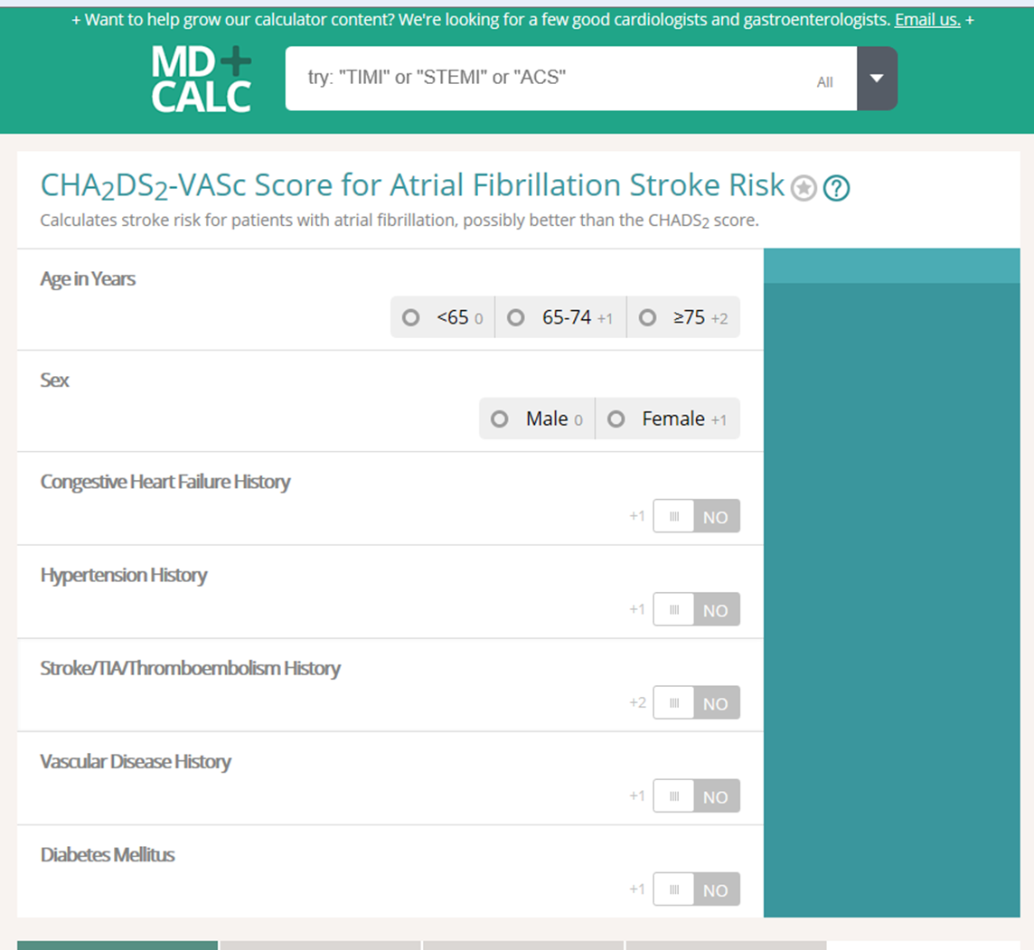
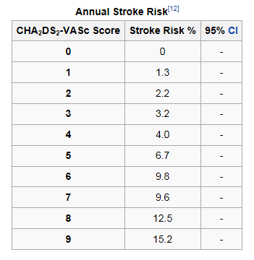

Slide 5
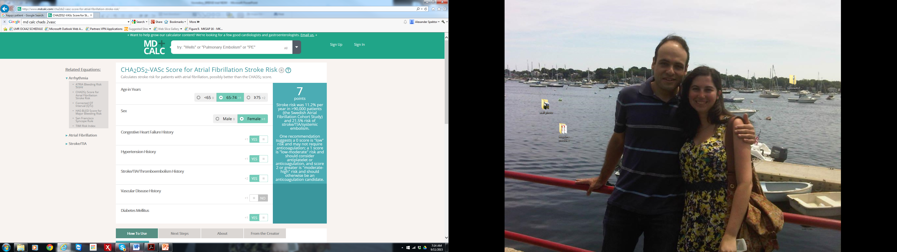

Slide 6
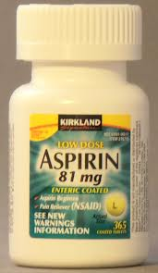
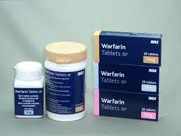
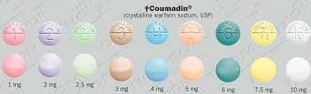
How do we reduce risk of ischemic stroke?
20% decrease→ 60% decrease
→No change in risk major bleeding (BAFTA trial)

Slide 7




Slide 8
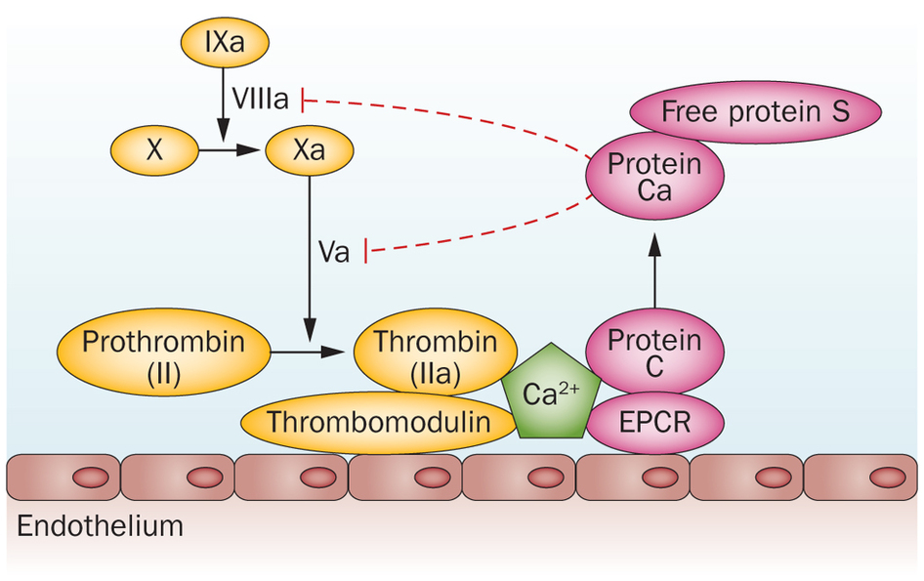
Prothrombotic state?
Warfarin interruption leading to hypercoagulability?

Slide 9

Does this patient need bridging before undergoing her procedure?
… BRIDGE Trial

Slide 10
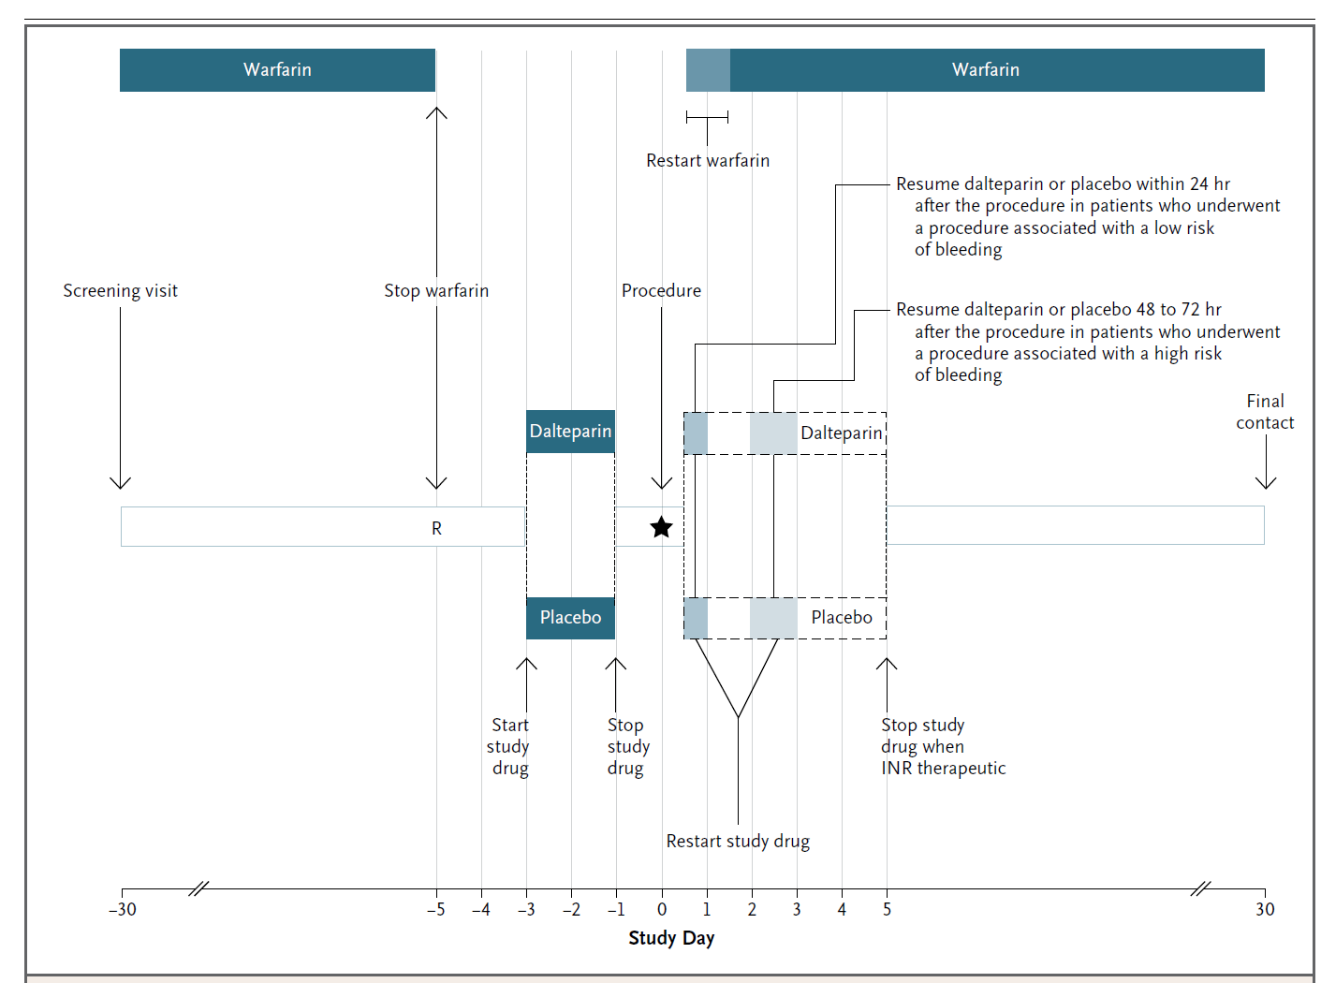
Figure 1. BRIDGE study design

Slide 11
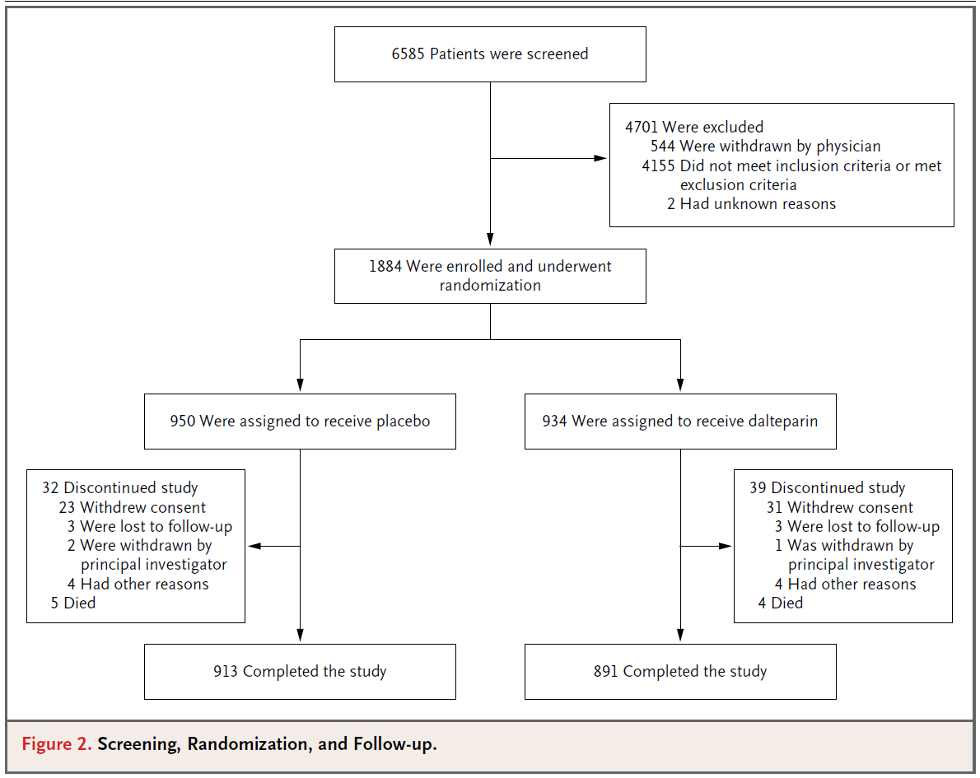
The BRIDGE Trial:
Double Blind
Randomized
Placebo-Controlled

Slide 12
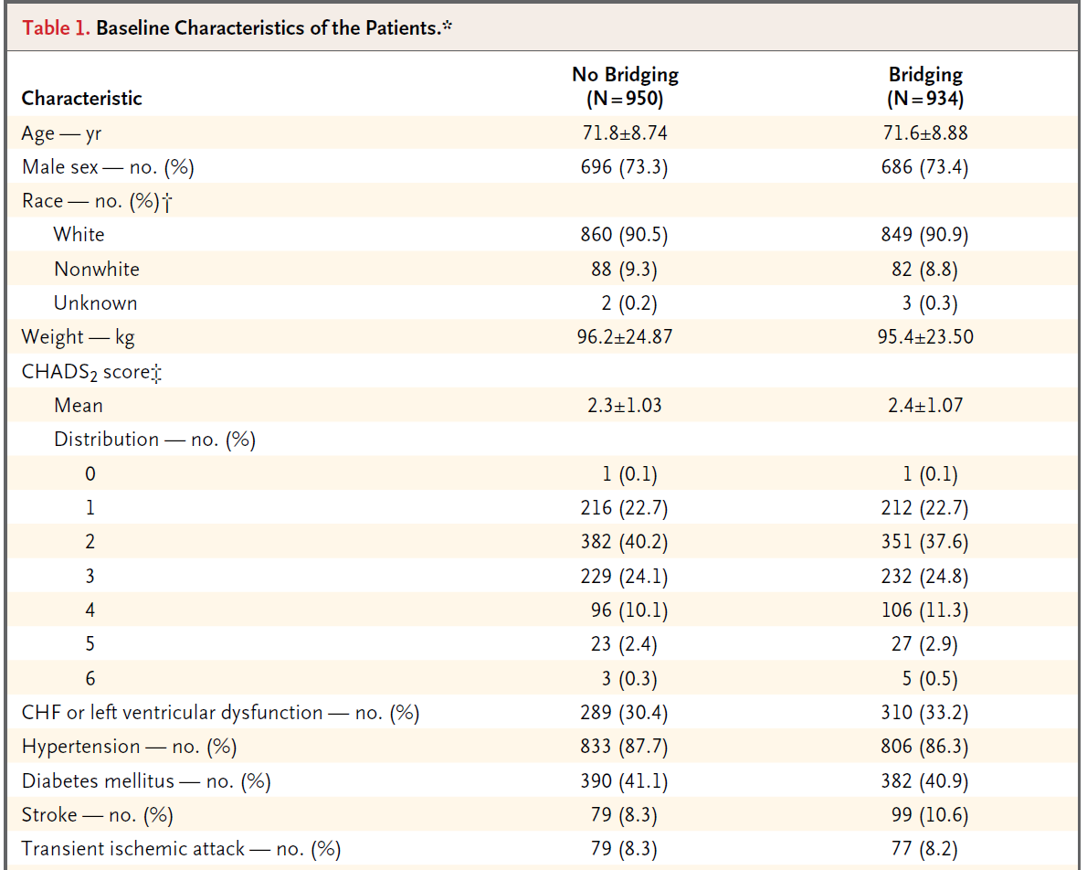
Notes:
Exclusion criteria:

Slide 13
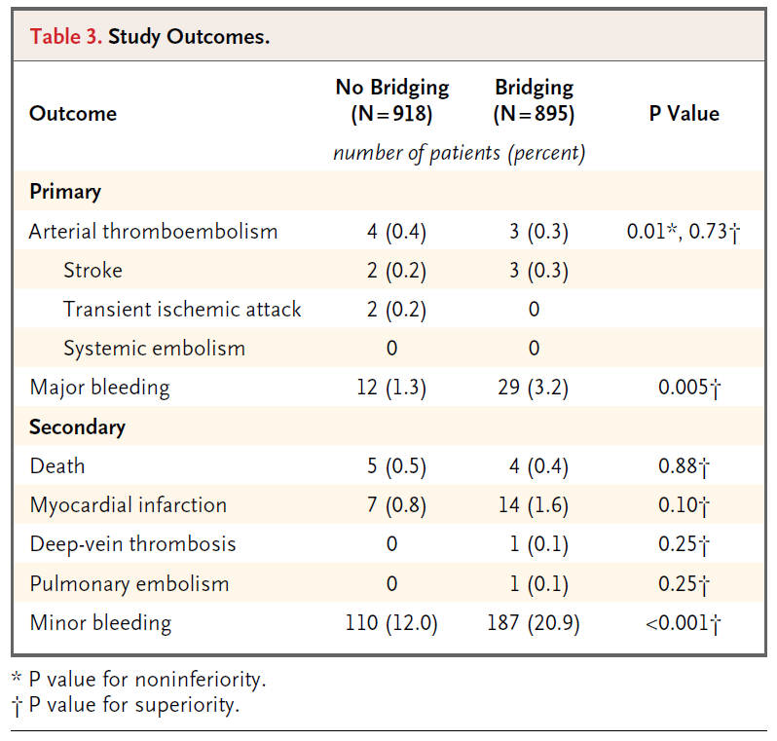

Slide 15

In conclusion:
“For patients with atrial fibrillation who require temporary interruption of warfarin treatment for an elective operation…, a strategy of forgoing bridging anticoagulation was noninferior to perioperative bridging with LMWH for the prevention of arterial thromboembolism. The strategy of forgoing bridging treatment also decreased risk of major bleeding.”

Slide 16

Study Limitations
Few patients with CHADS2 >5
Study design: no patients undergoing major surgical procedure (CEA, cancer, cardiac, neurosurgery)
Rate of arterial thromboembolism lower than expected
Decreasing coumadin, increasing NOAC’s?
Notes:
RELY trial sub-study: pts treated with dabigatran who had treatment interruption for elective procedure had mojre major bleeding with bridging than without, and no effect on arterial thromboembolism

Slide 17
References
Connolly et al. Dabigatran versus Warfarin in Patients with Atrial Fibrillation. NEJM 361: 1139-1151. Sept 2009. [RE-LY trial]
Douketis et al. Perioperative Bridging Anticoagulation in Patients with Atrial Fibrillation. NEJM 373:9. 8/27/2015. [BRIDGE trial]
Olesen JB et al. Validation of risk stratification schemes for predicting stroke and thromboembolism in patients with atrial fibrillation: nationwide cohort study. BMJ. Jan 2011.

Slide 18


Slide 19
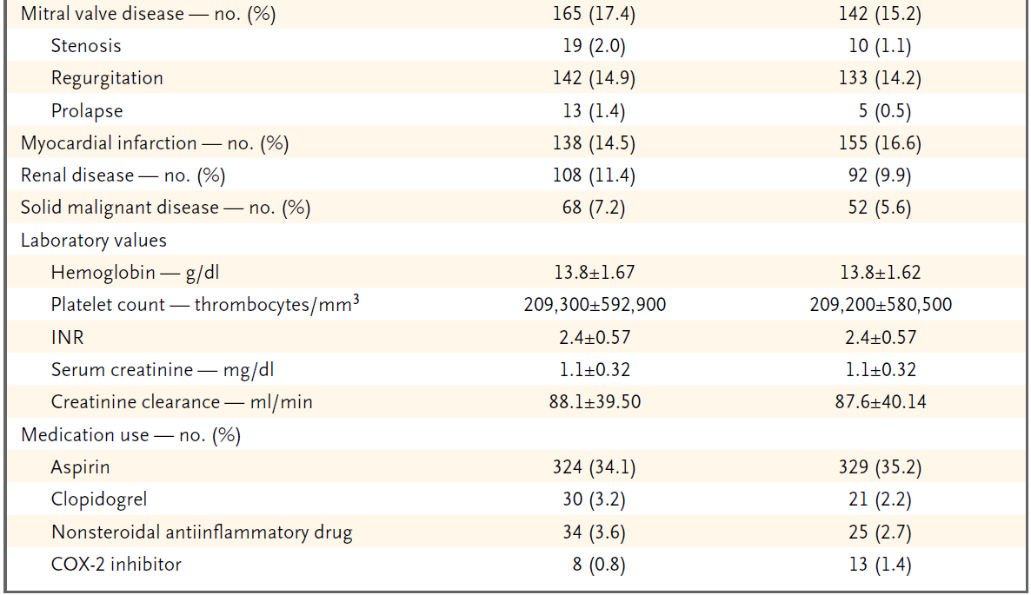
Table 1. Baseline characteristics, cont

