Slide 1
Safety and Benefit of Discontinuing Statin Therapy in the Setting of Advanced, Life-Limiting Illness
Jean S. Kutner; Patrick J. Blatchford; Don H. Taylor; Christine S. Ritchie; Janet H. Bull; Diane L. Fairclough; Laura C. Hanson; Thomas W. LeBlanc; Greg P. Samsa; Steven Wolf; Noreen M. Aziz; David C. Currow; Betty Ferrell; Nina Wagner-Johnston; S. Yousuf Zafar; James F. Cleary; Sandesh Dev; Patricia S. Goode; Arif H. Kamal Cordt Kassner; Elizabeth A. Kvale; Janelle G. McCallum; Adeboye B. Ogunseitan; Steven Z. Pantilat; Russell K. Portenoy; Maryjo Prince-Paul; Jeff A. Sloan; Keith M. Swetz; Charles F. Von Gunten; Amy P. Abernethy
Shereen Mohiuddin
Geriatrics Fellow
Journal Club
April 10, 2015

Slide 2
Case
89 y/o F
Pmhx: HTN, HLD, dementia, 2013 BMC admission for hypothermia and syncope with subsequent PEA arrest, s/p CPR and pacer for complete heart block, with multiple subsequent admissions for recurrent syncope, hypotension, hypothermia, and AMS, dx with likely multiple system atrophy, on home hospice
Meds: acetaminophen, ASA, vitamin D, pyridostigmine, miralax, simvastatin
2/10/15 home care note: “#HLD: On simvastatin. Can consider d/c to decrease number of medications”

Slide 3
Clinical Question
In an older adult, on statin, with limited life expectancy, does discontinuation of statin, in comparison with continued statin therapy, affect mortality and/or morbidity

Slide 4
Background
Number of medications increases in the last year of life.
Advanced disease may affect how medications are metabolized
  Therefore, May increase adverse effects of meds
Taking multiple pills can be difficult due to symptoms like dysphagia and anorexia
Notes:
INCREASE MEDS TO TX MEDICAL CONDITIONS AND ALSO EFFECTS OF THOSE ILLNESSES
ADVERSE EFFECTS
GI symptoms
Myopathy and musculoskeletal pain
Rhabdomyolysis

Slide 5
Background
Significant evidence to support statin use for primary or secondary prevention of cardiovascular (CV) disease
2013 ACC/AHA guidelines increase the number of people for whom statin therapy recommended
No prior evidence regarding discontinuing statin therapy in patients with advanced disease and limited life expectancy
Notes:
IN NEJM 4/2014 ARTICLE, INCREASE THE NUMBER OF PEOPLE ELIGIBLE FOR STATIN BY 12.8 MILLION (MOST WITHOUT CV DISEASE)

Slide 6
Objectives
Of the article: “to evaluate the safety, clinical, and cost impact of discontinuing statin medications for patients in the palliative care setting.”
Of this journal club: to review the article with a focus on better understanding whether there are any safety/morbidity/mortality effects of stopping statins in patients at end of life
Notes:
Basically, the bottom line is I wanted to know, am I going to harm this patient in any way by stopping the statin

Slide 7
Methods
Multicenter, unblinded, randomized, pragmatic clinic trial.
  Randomized to discontinue or continue statin therapy at the time of enrollment
Eligibility criteria:
  >18
  On statin for 3+ months for primary or secondary prevention
  Documented diagnosis of advanced life-limiting illness
  Life expectancy >1 month
  “Cognitively intact”
  Recent decline in functional status
Notes:
Multicenter: 15 palliative care sites
Pragmatic clinical trial does not have the strict inclusion/exclusion criteria, PCT seeks to have a study population that reflects the patient population in clinical practice.
TRIED TO KEEP ELIGIBILITY CRITERIA BROAD TO MAKE RESULTS GENERALIZABLE
“DOCUMENTED DIAGNOSIS OF ADVANCED LIFE LIMITING ILLNESS”=AT LEAST 1 DOCTOR SAID “WOULDN’T BE SURPRISED” IF DIED IN THE NEXT YEAR
SHORT PORTABLE MENTAL STATUS QUESTIONNAIRE <4 /10 OR REPRESENTED BY PROXY: ORIENTATION, PRESIDENT, MOTHERS MAIDEN NAME, SUBTRACT BY 3S
PATIENTS EXCLUDED:
PHYSICIAN’S OPINION THAT THEY HAD ACTIVE CV DZ REQUIRING ONGOING STATIN
SYMPTOMS OF MYOSITIS
LFTs OR CK >2.5X ULN
ENROLLED UNTIL:
DEATH, 1 YEAR, END OF STUDY

Slide 8
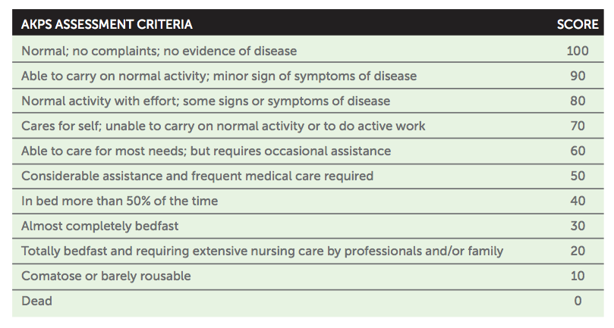
Methods
Functional status assessment: Australia-Modified Karnofsky Performance Status Scale
Notes:
DECLINE IN FUNCTIONAL STATUS= REDUCTION IN AUSTRALIA-MODIFIED KARNOFSKY PERFORMANCE STATUS SCALE SCORE TO <80% IN PREVIOUS 3 MONTHS
EXLUSION******
PHYSICIAN’S OPINION THAT THEY HAD ACTIVE CV DZ REQUIRING ONGOING STATIN
SYMPTOMS OF MYOSITIS
LFTs OR CK >2.5X ULN
ENROLLED UNTIL:
DEATH, 1 YEAR, END OF STUDY

Slide 9
Methods
Primary end point: proportion of deaths within 60 days of enrollment
Secondary end points:
  Survival
  Time to first CV-related event
Notes:
INITIALLY WANTED PRIMARY END POINT TO BE SURVIVAL IN THOSE CONTINUING VS. D/C STATINS. EXPECTED SURVIVAL OF 3-4 MONTHS WHEN IT ACTUALLY WAS MORE LIKE 9 MONTHS. REALIZED THEY WOULD NEED 30,000 PATIENTS. (AIMED TO ENROLL 1200). PRIMARY ENDPOINT WAS CHANGED TO PROPORTION OF DEATHS WITHIN 60 DAYS OF ENROLLMENT. STILL WERE ABLE TO CAPTURE OTHER DATA.
1ST CV EVENT MEANT:
NEW CV EVENT OR INVASIVE CV PROCEDURE WITH HOSPITAL OR ED ADMISSION

Slide 10
Methods
Secondary end points, cont’d:
  “Patient-centered” outcomes
    Performance status: Australia-Modified Karnofsky Performance Status Scale
    QOL: McGill QOL Questionnaire
    Symptoms: Edmonton Symptom Assessment System Scale
    # of non-statin medications
    Statin-related adverse effects
    Satisfaction with health care
Notes:
MEASURED AT MULTIPLE TIME POINTS
QOL: MCGILL QOL QUESTIONNAIRE (HIGHER SCORES INDICATE BETTER QOL)
SYMPTOMS WERE MEASURED USING THE EDMONTON SYMPTOM ASSESSMENT SYSTEM SCALE (PAIN, FATIGUE, NAUSEA, DEPRESSION, ANXIOUSNESS, DROWSINESS, APPETITE, WELLBEING, BREATHING.) ADDED A STATIN-SPECIFIC SUPPLEMENT: MUSCLE-RELATED PAIN, WEAKNESS, HEADACHE, FEVER.
NON STATIN MEDS: EITHER SCHEDULED OR PRN, NEEDED <½ OR >1/2 OF DAYS IN PRIOR WEEK. GROUPED ALL THESE AND COMBINED THEM TO QUANTIFY THE # OF NON-STATIN MEDS.
SATISFACTION: 5-point LIKERT SCALE WITH LIKELIHOOD OF RECOMMENDING THEIR CURRENT HEALTH CARE.

Slide 11
Methods
Secondary end points, cont’d:
  “Patient-centered” outcomes
    Performance status: Australia-Modified Karnofsky Performance Status Scale
    QOL: McGill QOL Questionnaire
    Symptoms: Edmonton Symptom Assessment System Scale
    # of non-statin medications
    Statin-related adverse effects
    Satisfaction with health care
Notes:
MEASURED AT MULTIPLE TIME POINTS
QOL: MCGILL QOL QUESTIONNAIRE (HIGHER SCORES INDICATE BETTER QOL)
SYMPTOMS WERE MEASURED USING THE EDMONTON SYMPTOM ASSESSMENT SYSTEM SCALE (PAIN, FATIGUE, NAUSEA, DEPRESSION, ANXIOUSNESS, DROWSINESS, APPETITE, WELLBEING, BREATHING.) ADDED A STATIN-SPECIFIC SUPPLEMENT: MUSCLE-RELATED PAIN, WEAKNESS, HEADACHE, FEVER.
NON STATIN MEDS: EITHER SCHEDULED OR PRN, NEEDED <½ OR >1/2 OF DAYS IN PRIOR WEEK. GROUPED ALL THESE AND COMBINED THEM TO QUANTIFY THE # OF NON-STATIN MEDS.
SATISFACTION: 5-point LIKERT SCALE WITH LIKELIHOOD OF RECOMMENDING THEIR CURRENT HEALTH CARE.

Slide 12
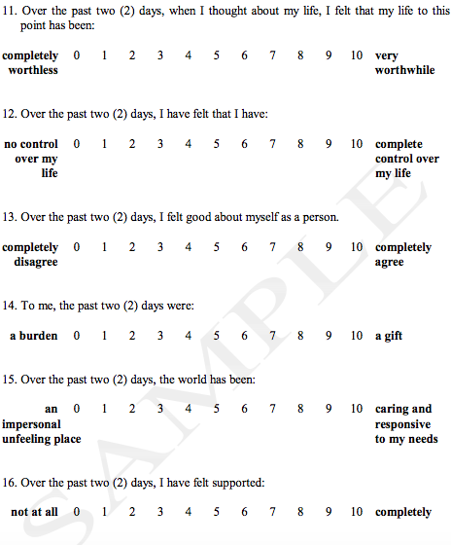
(excerpt from) McGill QOL questionnaire
http://www.promotingexcellence.org/tools/pe1199.html
Notes:
MCGILL QOL QUESTIONNAIRE: OVERALL, PHYSICAL PSYCH, AND “EXISTENTIAL QUESTIONS”
A SAMPLE OF THE “EXISTENTIAL” QUESTIONS

Slide 13
Methods
Secondary end points, cont’d:
  “Patient-centered” outcomes
    Performance status: Australia-Modified Karnofsky Performance Status Scale
    QOL: McGill QOL Questionnaire
    Symptoms: Edmonton Symptom Assessment System Scale:
      PAIN, FATIGUE, NAUSEA, DEPRESSION, ANXIOUSNESS, DROWSINESS, APPETITE, WELLBEING, BREATHING
      MUSCLE-RELATED PAIN, WEAKNESS, HEADACHE, FEVER
    # of non-statin medications
    Satisfaction with health care
Notes:
MEASURED AT MULTIPLE TIME POINTS
QOL: MCGILL QOL QUESTIONNAIRE (HIGHER SCORES INDICATE BETTER QOL)
SYMPTOMS WERE MEASURED USING THE EDMONTON SYMPTOM ASSESSMENT SYSTEM SCALE (PAIN, FATIGUE, NAUSEA, DEPRESSION, ANXIOUSNESS, DROWSINESS, APPETITE, WELLBEING, BREATHING.) ADDED A STATIN-SPECIFIC SUPPLEMENT: MUSCLE-RELATED PAIN, WEAKNESS, HEADACHE, FEVER.
NON STATIN MEDS: EITHER SCHEDULED OR PRN, NEEDED <½ OR >1/2 OF DAYS IN PRIOR WEEK. GROUPED ALL THESE AND COMBINED THEM TO QUANTIFY THE # OF NON-STATIN MEDS.
SATISFACTION: 5-point LIKERT SCALE WITH LIKELIHOOD OF RECOMMENDING THEIR CURRENT HEALTH CARE.
ALL END POINTS TESTED USING NONINFERIOY HYPOTHESIS

Slide 14
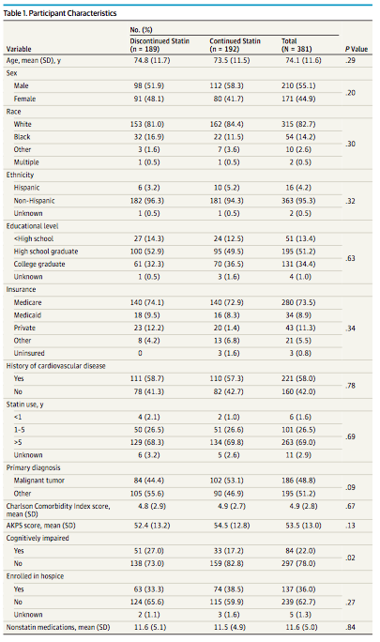
Notes:
381 PATIENTS ENROLLED:
189 TO D/C STATIN
192 TO CONTINUE
PPTS WERE mean mid 70s WHITE (LIMITATION OF THE STUDY), MAJORITY RECEIVING MEDICARE, AND HAD MAJORITY OF PTS HAD BEEN ON STATINS FOR >5 YRS
ALMOST ½ HAD CANCER AS PRIMARY DIAGNOSIS
50% IN BOTH GROUPS HAD CV DZ
STATISTICALLY GROUPS WERE SIMILAR, EXCEPT FOR COGNITIVE IMPAIRMENT—larger proportion randomized to d/c statin cog impaired
MEAN SURVIVAL TIME 30 WEEKS

Slide 15
Results
No statistical difference between the 2 groups for the following:
  Percentage of people who died within 60 days (p=0.36)
    23.8% in discontinuation group versus 20.3% in continuation group (p=0.36)
  Survival time
    229 days in discontinuation group versus 190 days in continuation group (p=0.60)
  Time to first cardiovascular event
    Time to CV events not reported (p=0.64) 13 CV-related events in discontinuation group versus 11 in continuation group
Notes:
STATINS MAY HAVE ALREADY DONE THEIR JOB IN REDUCING PLAQUE EARLIER ON.
MAJORITY OF PEOPLE ON STATINS FOR 5+ YEARS
PTS W ADVANCED DISEASE MAY HAVE ORGAN FAILURE—MAY COUNTERACT THE BENEFITS OF STATINS—WHY CONTINUED STATIN GROUP DID NOT HAVE MORE BENEFIT
Non-inferiority was not achieved: upper confidence limit for primary end point exceeded the non-inferiority margin

Slide 16
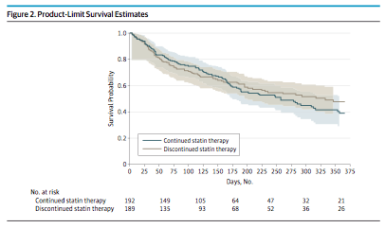
Notes:
LIGHT GRAY—90%CI FOR CONTINUATION ARM
LIGHT BROWN—90%CI FOR DISCONTINUATION ARM
WHILE PRIMARY ENDPOINT WAS SURVIVAL AT 60 DAYS, OBTAINED MORE LONG TERM DATA, FOLLOWING THEM OUT TO A YEAR
OVERLAPPING CONFIDENCE INTERVALS. EVEN WHEN FOLLOW OUT OVER TIME, NOT STATISTICALLY SIG DIFFERENCE

Slide 17
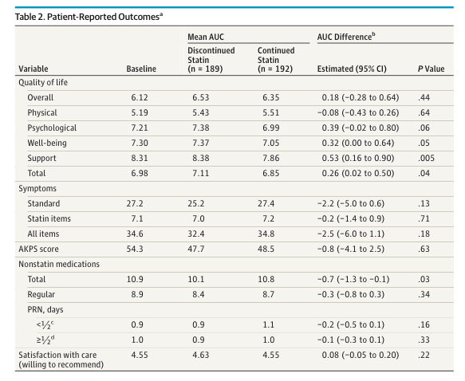
Notes:
NO DIFFERENCE BETWEEN THE 2 GROUPS IN TERMS OF:
PHYSICAL SYMPTOMS, PERFORMANCE STATUS, STATIN-RELATED SYMPTOMS
THEY SAY THOSE WHOSE STATINS WERE D/C’ED “TRENDED TOWARD” A LOWER SYMPTOM SCORE BUT SKEPTICAL
QOL:: ONLY SIGNIFICANT DOMAIN IS WELL-BEING, “SUPPORT”: “OVER THE PAST 2 DAYS I HAVE FELT SUPPORTED…
# OF NON-STATIN MEDS WAS LOWERIN D/C GROUP: potentially less side effects

Slide 18
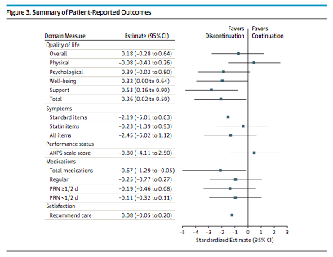

Slide 19
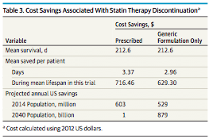
Notes:
COST SAVINGS ~$3/DAY ($629.30 PER PATIENT AT MEAN F/U TIME) – POTENTIAL SAVINGS OF IN THE US OF $603M IN 2014—CLEARLY THEY ASSUMED ABOUT A MILLION PEOPLE WOULD BE ABLE TO D/C STATINS EACH YEAR AS A RESULT OF THESE FINDINGS—NOT CLEAR WHERE THEY GOT THAT NUMBER FROM. ARE THERE A MILLION PEOPLE ON STATINS WITH A PROGNOSIS OF ONE YEAR OR LEFT TO LIVE?
Argue that significant cost savings, dow not explain what # they are using for estimate

Slide 20
Limitations
No blinding
Potential bias towards providers/patients comfortable discontinuing statins—may have captured lower-risk patient population.
Discontinue statins group significantly more likely to be cognitively impaired
Study population
QOL conclusions
Notes:
NO BLINDING: COULD BIAS TOWARDS REOIRTING OF MORE UNFAVORABLE CONSEQUENCES OF D/C—NOT NOTED
COGNITIVE IMPAIRMENT: MAY HAVE “LOST” SOME DATA RE: POSITIVE EFFECTS OF STOPPING STATINS THAT PATIENTS WERE UNABLE TO REPORT
STUDY POPULATION NARROW IN RELATION TO RACE: they don’t identify that as a limitation but it is one.
QOL IMPROVEMENT IN D/C GROUP—THINK THIS MAY BE A STRETCH

Slide 21
Conclusions
Discontinuation of statin at the end of life does not seem to result in increased mortality or morbidity from CV events
QOL may potentially be improved in those who discontinue statins, although this conclusion is based on limited assessment
Notes:
Non-inferiority was not achieved: upper confidence limit for primary end point exceeded the non-inferiority margin
CASE: died before chance to make a decision, but in retrospect, I think she would have been an appropriate candidate for d/c statin and in future would likely choose to d/c statin for patient in similar context
WOULD NOT GENERALIZE TO OTHERS WITH LESS POOR PROGNOSIS

Slide 22
References
Cohen SR, Mount BM, Bruera E, Rowe J & Tong K, Validity of the McGill Quality of Life Questionnaire in the palliative care setting. A multi-center Canadian study demonstrating the importance of the existential domain. Palliative Medicine. 11 (1997) 3-20.
Pencina MJ et al. Application of new cholesterol guidelines to a population-based sample. N Engl J Med 2014; 370;15:1422-1431.

