Slide 1
New Oral Anticoagulants in Elderly Adults: Evidence from a Meta-Analysis of Randomized Trials
Partha Sardar, MD, Saurav Chatterjee,MD, Shobhana Chaudhari, MD, and
Gregory Y. H. Lip, MD
J Am Geriatr Soc 62:857–864, 2014.
Shereen Mohiuddin, MD
Geriatrics Fellow
Journal Club
January 9, 2015
Notes:
Came to decide on this article due to a case for which I was doing background reading

Slide 2
Case
73 y/o F
PMHx: DM, HLD, morbid obesity, dHF (EF 50%), chronic pain 2/2 knee OA, stg III endometrial cancer, s/p TAH in 2013
Admitted to BMC 3/14-4/14 in the setting of shock 2/2 massive PE.
No evidence of recurrence or metastasis on 9/14 CT A/P.
She has been on long-term anticoagulation with enoxaparin since hospital discharge and has diffuse injection site reactions characterized by palpable tender nodules.
Due to enoxaparin intolerance, oral anticoagulation is being considered.
Notes:
She did complete 5/6 cycles of chemo. Chemo was terminated at the time of her PE. Radiation therapy has been recommended, but the patient has declined.
CAME UPON THIS ARTICLE WHILE WADING THROUGH THE LITERATURE
ALTHOUGH MY PATIENT IS SLIGHTLY YOUNGER THAN THE 75+ GROUP THAT IS LOOKED AT IN THIS STUDY AND HER SITUATION SPEFICALLY CONCERNS VTE, CHOSE THIS ARTICLE BECAUSE IT
--AS A META-ANALYSIS, PROVIDE OVERALL PICTURE
--FOCUSES ON OLDER ADULTS
--LOOKS AT NOACs FOR BOTH STROKE/SYSTEMIC EMBOLISM AND VTE

Slide 3
Clinical Question
In an older adult considering oral anticoagulation, do the new oral anticoagulants, in comparison with warfarin or conventional injectable anticoagulants, have a similar—or improved—efficacy and safety profile?

Slide 4
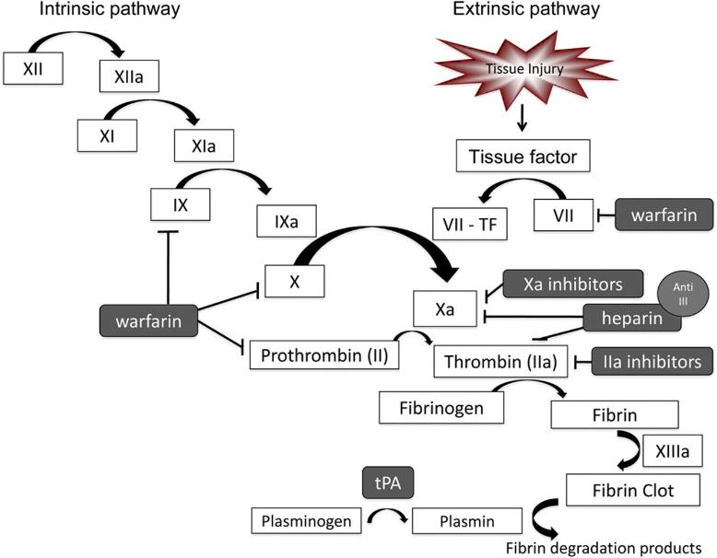
NOACs and anticoagulation
Rivaroxaban
Apixaban
(Edoxaban)
dabigatran
Image adapted from Neurology (www.neurology.org).
Notes:
New/Novel Oral Anticoagulants (NOACs)
Direct Thrombin Inhibitors
Dabigatran (Pradaxa®)
Xa inhibitors
Rivaroxaban (Xarelto®)
Apixaban (Eliquis®)
Endoxaban (Lixiana®; Savaysa®)

Slide 5
Background
In some clinical contexts, NOACs have begun to be used as first-line anticoagulants due to:
  Studies indicating their favorable safety and efficacy profiles—in general population, less major bleeds
  Ease of administration
  Inhibit only single factor—leads to shorter onset and offset
  [Marketed as] No need for lab monitoring and no “therapeutic window”
  No dietary restrictions (Rivaroxaban with meal for maximal absorption)
  Fewer drug-drug interactions

Slide 6
Background
Existing studies of NOACs have looked at efficacy and safety profiles but no RCTs have focused on older adults

Slide 7
Objectives
Of the article: To evaluate safety and efficacy of NOACs in older adults by reviewing existing RCTs
Of this journal club: To better understand what the existing data are regarding NOACs in older adults
Notes:
WITH THIS, HOPE TO ALSO PROVIDE SOME INFORMATION ABOUT WHAT THE NOACs ARE
AND OFFER SOME FOOD FOR THOUGHT ABOUT THE THINGS THAT ARE GOOD…AND NOT SO GOOD
ABOUT DRUGS THAT ARE BECOMING MORE COMMON AND THAT WE WILL LIKELY BE SEEING MORE OF

Slide 8
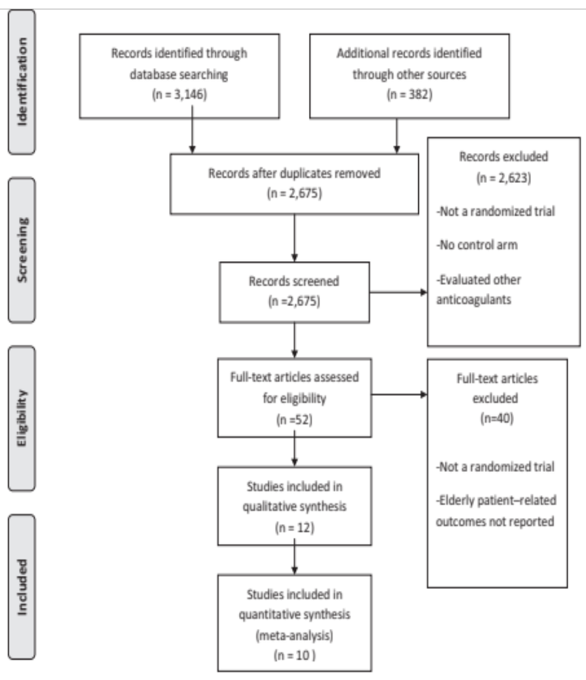
Methods
Systematic search of major databases (PubMed, Cochrane Library, EMBASE, Web of Science, and CINAHL) for relevant articles published through 3/30/13
Included RCTs which compared NOACs with conventional therapy (vitamin K antagonists, LMWH, aspirin, placebo) AND included specific data for older adults
Safety outcome: major or clinically relevant bleeding
Efficacy outcome:
  stroke or systemic embolism
  VTE/VTE-related death
Notes:
TRIALS DID NOT HAVE TO REPORT ON BLEEDING TO BE INCLUDED—NOT PART OF INCLUSION CRITERIA
If trial only reported major bleeding (not separating clinically significant), then same data was used for both
Major Bleeding: ISTH (Int’l Society on Thrombosis and Haemostasis:
Decrease in Hg by >/= 2g/dL
require transfusion of 2+ units PRBC, occur in critical site (intracranial, retroperitoneal), contributed to death
Clinically relevant, nonmajor bleeding:
Does not meet definition for major bleeding but associated with
Medical intervention, unscheduled MD interaction, interruption/discontinuation of drug, impairment/discomfort in activties of daily living

Slide 9
Statistical Analysis
Odds ratios and 95% confidence intervals were calculated for each trial and were pooled
Publication bias was evaluated
  (By using Egger regression test and funnel plots, findings not reported in study)
Accounted for variable length of follow-up
  (By using rate of bleeding as person years to calculate log rate ratio and by using random effects regression model)
Degree of heterogeneity between trials determined using I²
Notes:
Odds ratio: Quantify how likely that bleeding occurred as a result of the drug versus odds of occurring with control, how likely reduction in stroke/embolism related to NOAC
Funnel plots: look for asymmetry that may indicate that studies with smaller sample size having disproportionately large effect (represented by asymmetry in the plots)
Did comment that reporting bias was common. Most dabigatran trials did not report bleeding outcomes in subgroup of older adults

Slide 10
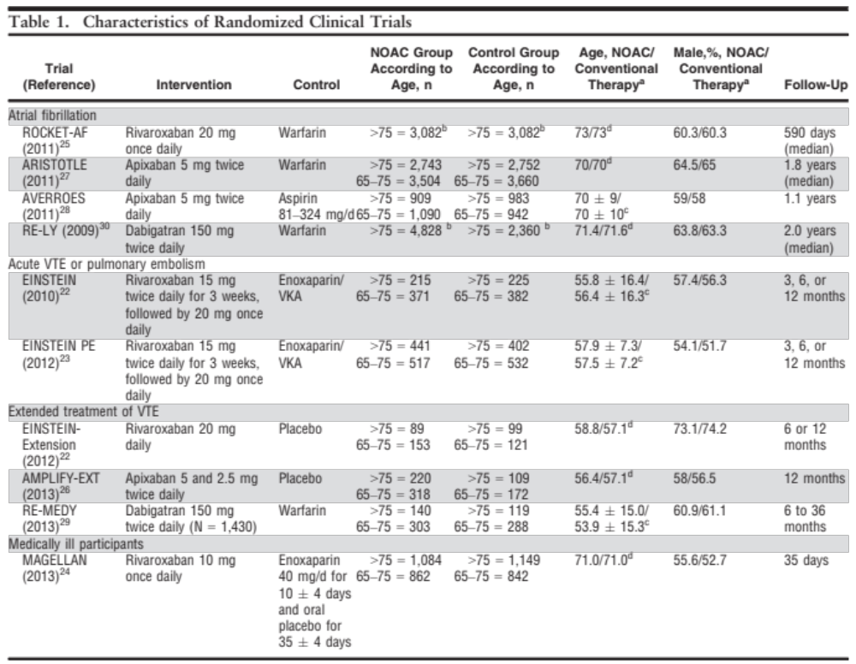
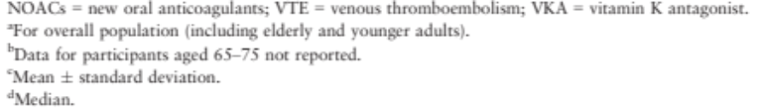
Notes:
10 RCTs fit criteria, included 25,031 older adults
Useful reference
Table organized by indication for anticoagulation, allows you to see how many studies were evaluated for each indication and what the controls are
>50% of subjects in all studies were males (54—73% male in NOAC groups), shouldn’t matter in terms of skewing the data since groups were matched, but does indicate underepresention of women
This may be particularly important when consider risk of stroke in AF as female sex is risk factor
(no diff in VTE risk and sex)
Acute VTE/PE just looked at rivaroxaban. Dabigartan not licensed for use in acute VTE tx
Extended tx of VTE: Just looked at rivaroxaban vs placebo

Slide 11
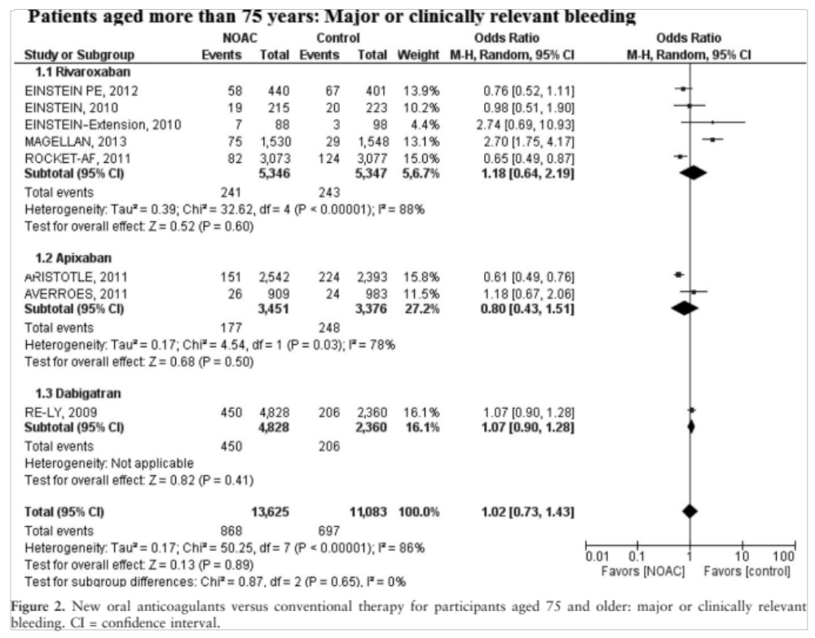
Notes:
#Intro:
--1st in series of 3 figures which are at Heart of the article which is the series of figures which look at the outcomes
--Not by bleeding for indication, organized by drug—use table 1 as a reference for what the indications for use and controls were
--I am including modified version of figure 2 in online version because removes RCTs with placebo and includes only active agents
Placebo as expected would favor control

Slide 12
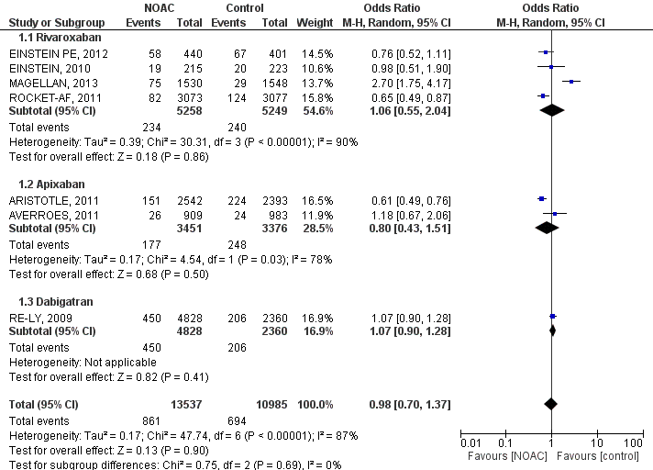
Appendix Figure 1: NOAC versus pharmacologically active comparator for patients aged more than 75 years: Major or clinically relevant bleeding
Notes:
#Conclusion:
--ODDS RATIONS FOR ALL 3 DRUGS, AND POOLED TOGETHER, CLOSE TO ONE.
OVERALL, SEEMED TO INDICATE THAT BLEEDING WAS NOT WORSE IN NOACS (with exception of Magellan)
#Issues:
--STATS: High heterogeneity (defined in study by >75%)—indicating that may have been significant differences between the studies that were conducted,
Some have wide CIs
--BLEEDING: Only 1 RCT which looked at bleeding for dabigatran, although relatively large number of participants.
The other study that met inclusion criteria did not look at bleeding outcomes (not included in inclusion criteria). –Article states as a limitation that “safety data for dabigatran limited”. Doesn’t specify what this means
--THIS MAY BE A IMPORTANT CONSIDERATION GIVEN THAT THERE WERE SOME SAFETY CONCERNS RE: DABIGATRAN AFTER TRIAL PUBLISHEFD AND DRUG APPROVED

Slide 13

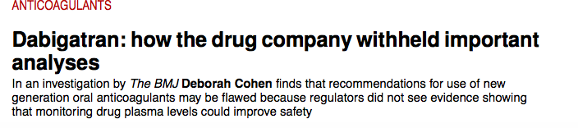
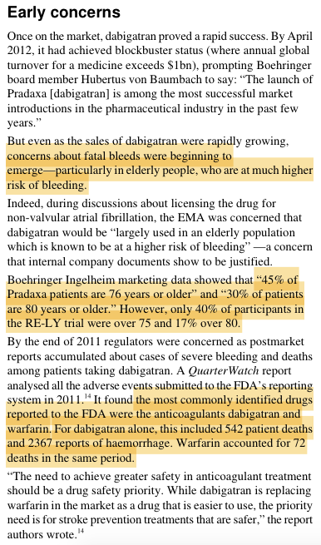
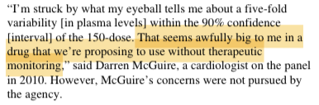
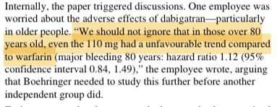
Dabigatran and monitoring
BMJ 2014;349:g4670
Notes:
-MANY REPORTS OF BLEEDING AND DEATH>>audits, litigation
--More bleeds over plasma level 200 without benefit
--THERAPEUTIC WINDOW? MONITORING?
--The pharmaceutical company does appear to be aware of this but wanted to downplay it so as to be able to market themselves as not requiring drug level monitoring
--OLDER ADULTS>>INCREASED RISK OF BLEEDING renally cleared. Older adults, higher incidence of renal disease, more comorbidities, higher risk of bleeding
--This study states that despite these case reports, this study did not find more bleeding with NOACs
--Only trial that was looked at associated with controversy, caution given bleeding risks in older adults

Slide 14
Study conclusion #1
“NOACs did NOT lead to greater major or clinically relevant bleeding than conventional therapy and pharmacologically active agents in elderly adults”
Issues to consider:
  Dabigatran—only one RCT included that looked at bleeding, although similar sample size. RE-MEDY RCT not included
  Older age associated with increased renal disease, more comorbidities, which may increase risk for bleeding
Notes:
While this study not showing more bleeding, need to weigh the risks

Slide 15
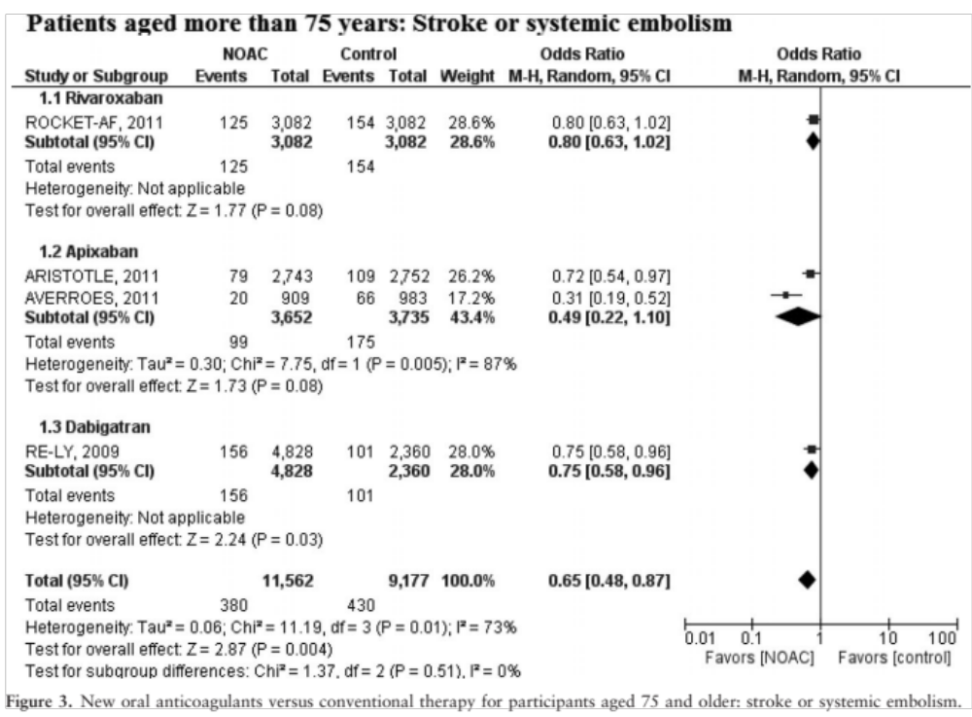
Notes:
4 STUDIES THAT ARE THE AF (non-valvular) STUDIES
--FOR RIVAROXABAN AND APIXABAN, CI DOES JUST CROSS 1.
--HOWEVER ALL THE ODDS RATIONS ARE <1, INDICATING THAT NOACS ARE OVERALL FAVORED
----------------------------------------------
All seem to slightly favor NOACs
rIVAROXABAN: equal if not slightly better (odds ratio is 0.8, favoring NOAC, but the CI does cross 1)
aPIXABAN: similarly equal if not better, Dabigatran (MORE effective than warfarin)
ARISTOTLE: WARFARIN; AVERROES ASA
Analysis of RIVAROXABAN, Apixaban, and dabigartran studies indicated that each agent, and collectively, NOACs were favored

Slide 16
Study conclusion #2
“NOACs significantly reduced the risk of stroke or systemic embolism in elderly adults with AF”
Notes:
May be true, certainly didn’t seem to be worse
WHEN YOU LOOK AT OVERALL ODDS RATIO, THIS IS TRUE, BUT SEEMS TO BE SOME VARIABILITY DEPENDING ON THE DRUG,
WITH SOME OF THE ORS closer to 1 with CI crossing 1

Slide 17
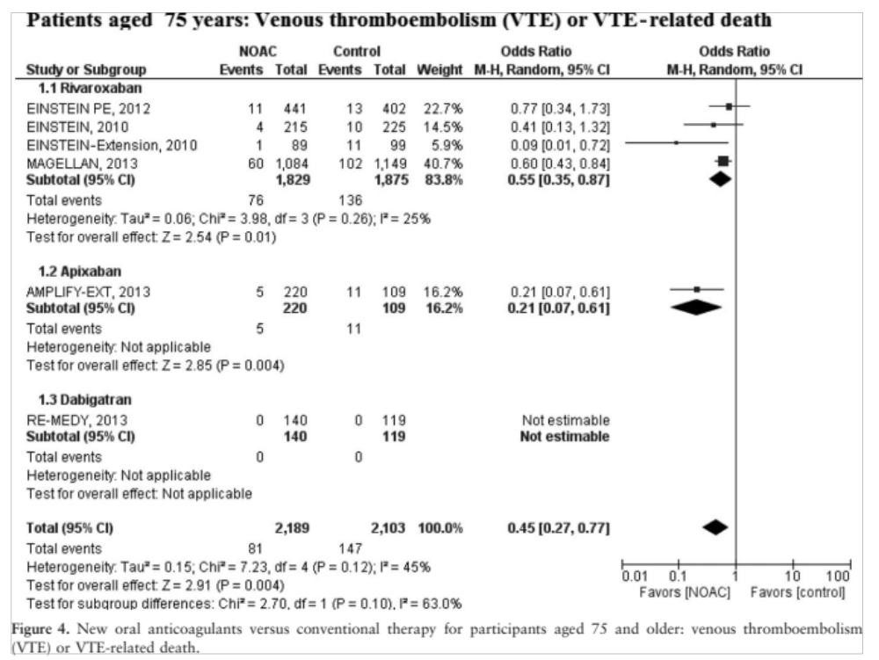
Notes:
---The 6 STUDIES (6/10) included in this trial are those that looked at VTE/VTE-related death as outcome.
--Again, Einstein-extension is study of medication vs. placebo, so we would expect NOAC to be favored over placebo in VTE prevention
FOR APIXABAN, NO RCT EVALUATED THAT COMPARED IT WITH ANOTHER ACTIVE AGENT.
AMPLIFY STUDY WAS APIXABAN VERSUS PLACEBO, so would expect VTE rate to be lower.
--DABIGATRAN: 1 small study, VERSUS WARFARIN. No EVENTS SO CANNOT ASSESS WHETHER FAVORABLE

Slide 18
Study conclusion #3
“NOACs were also more effective than conventional therapy for the reduction of the risk of VTE or VTE-associated death”
Issues to consider:
  The evidence presented supports that this may be true for rivaroxaban, but, based on RCTs reviewed in this meta-analysis, questionable whether sufficient evidence to make general statement about NOACs
Notes:
--Given that apixaban RCT compared with placebo (not comparing it to another active agent) and no events for dabigatran

Slide 19
Limitations
Study population overall healthier, less comorbidities
Pharmacologic differences between classes of NOACs but grouped together
Wide CIs and high heterogeneity
Safety data for dabigatran were inconsistently reported

Slide 20
Other limitations/considerations
One of the authors has been consultant/speaker’s bureau for pharmaceutical companies responsible for these drugs
Grouping all NOACs together but when look at each individual drug, some were evaluated by only 1 RCT
Does not consider other factors influencing other issues of safety and tolerability in older adults (GI side effects, more MIs with dabigatran)
(lack of) Reversibility
Variable degree of renal clearance
Cost
Notes:
Renal clearance: Dabigatran 80%, Rivaroxaban 33%, apixaban 27%
All have some degree hepatic clearance
Use with caution if crCL <30, not IF <15
Weren’t enough studies to do metanalysis on each NOAC
Have to lump together
Is one study enough?
May be differences depending on which medication is the control
--Only 2 trials that looked at dabigatran; much smaller number of patients looked at with use of dabigatran and apixaban in comparison to rivaroxaban in analysis of VTE risk

Slide 21
Summary
Safety: The NOACs seem to be a reasonable alternative to conventional therapy in older adults
  They do not seem to cause more major/clinically significant bleeding.
  However, must consider comorbidities.
  Maybe these drugs do need to be monitored??
Efficacy:
  The NOACs in general do seem to decrease risk of stroke/ systemic embolism/VTE in older adults in comparison to conventional therapy, however, strength of the findings may be limited
Notes:
May cause less major bleeding
As discussed earlier, limits in the number of RCTs and by their study design
DRUGS NEED TO BE LOOKED AT INDIVIDUALLY

Slide 22
Case
Case for a NOAC (if continue anticoagulation):
  Not tolerating enoxaparin
  Evidence supports that not greater risk of major bleeding (May be less risk of major bleeding than with warfarin)
Which One?
  The results regarding VTE/VTE-related death outcomes in this analysis have most supporting evidence for rivaroxaban
  Better side effect profile than other NOACs and once daily dosing
But, patient has to be comfortable with the risks/benefits and fact that there is not yet a therapy for reversal…
Notes:
No head-to-head trials of the NOACs—need to look at existing RCTs
(Less GI side effects than with dabigatran, and once daily dosing vs BID with apixaban)
hEME Onc, Same rate of bleeding but less major bleeding than conventional therapy
The data in this study was pooled for major and clinically significant bleeding so cant decipher from the figure
(RIVAROXABAN) IN ADDITION TO SIDE EFFECT PROFILE MAKE IT A 1ST CHOICE
Still consider what plan is for continued anticoagulation

Slide 23
References
Cohen D. Dabigatran: how the drug company withheld important analyses. BMJ 2014;349:g4670.
EINSTEIN-PE Investigators. Oral rivaroxaban for the treatment of symptomatic pulmonary embolism. N Engl J Med 2012;366:1287-97.
Connolly SJ et al. Dabigatran versus warfarin in patients with atrial fibrillation. N Engl J Med 2009; 361:1139-51.
Halperin JL, Malhotra JK. Implications of new oral anticoagulants for stroke prophylaxis in elderly patients with atrial fibrillation. Annals of Long Term Care 2014;22. www.annalsoflongtermcare.com/article/implications-new-oral-anticoagulants-stroke-prophylaxis-atrial-fibrillation
Sardar P et al. New oral anticoagulants in elderly adults: evidence from a meta-analysis of randomized trials. J Am Geriatr Soc 2014;62:857-864.
Yeh C et al. Evolving use of new oral anticoagulants for treatment of venous thromboembolism. Blood 2014;124:1020-1028.

