Slide 1
Journal Club
Anitha Bhat
October 10, 2014

Slide 2
Case
88 yo man with hx of CAD, CHF (EF 60%, but with hypokinesis), afib, dementia, COPD seen as new patient in clinic with daughter.
Recently hospitalized for dyspnea.
  incidentally, was observed to have episodes of agitation and was started on haldol in the hospital.
Spoke to wife on the phone. She requested medication for his mood – says that at times he can be “snappy, rude, irritable.” Not physically aggressive. Does not have weight loss, changes in appetite, sleep problems, anhedonia. Haldol has not improved these symptoms.

Slide 3
Case
Meds: ASA, lisinopril, digoxin, metoprolol, lasix, duonebs, advair, prednisone (10 mg)
Social Hx: Worked in construction, lives with wife, who still works. Has 3rd grade education – cannot read
MMSE in hospital 16/30
GDS: pending
Able to do most ADLS independently (needs help with bathing and dressing). Needs assistance with medications, travel, finances, housekeeping.

Slide 4
Background
Agitation
  emotional distress, excessive psychomotor activity, aggressive behavior, irritability, disinhibition
  Can result in:
- impaired quality of life
- caregiver burden
- dangerous behaviors
- institutionalization
- restraint use
- psychiatric admission

Slide 5
Background
Non pharmacologic
Pharmacologic
  Antipsychotics (not recommended)
  Other Psychotropics?

Slide 6
Background
systematic review of 29 English-language meta-analyses and double-blind, placebo-controlled randomized trials of any drug (in clinical use in United States) used in treatment of neuropsychiatric symptoms of dementia (other than depression)
  cholinesterase inhibitors had small benefit in 2 meta-analyses and 6 randomized trials; benefit mainly shown with metrifonate which was not FDA approved due to toxicities
  valproate had no efficacy in 3 randomized trials
  carbamazepine had conflicting results in 2 small randomized trials
  Memantine had conflicting results in 2 small randomized trials
  **antidepressants which were included had no efficacy for symptoms other than depression in 5 randomized trials, except for 1 trial of citalopram finding reduction in agitation and lability
JAMA. 2005 Feb 2;293(5):596-608.
Notes:
Pharmacological treatment of neuropsychiatric symptoms of dementia: a review of the evidence.
Sink KM¹, Holden KF, Yaffe K.
JAMA. 2005 Feb 2;293(5):596-608.
sertraline and possibly citalopram appear to reduce agitation in patients with dementia (level 2 [mid-level] evidence)
based on Cochrane review of trials with methodologic limitations
systematic review of 9 randomized trials comparing antidepressants vs. placebo, other antidepressants or other active treatments for treatment of agitation and psychosis in 692 patients with dementia
methodologic limitations included
unclear allocation concealment
unclear blinding
lack of intention-to-treat analysis
comparing sertraline 200 mg daily to placebo in 1 trial with 244 patients
sertraline associated with significant improvement in agitation (Cohen-Mansfield Agitation Inventory scores) (p < 0.05)
no significant difference in total Neuropsychiatric Inventory scores (including agitation, delusion, and hallucination subscales)
citalopram associated with significant improvement in Neurobehavioral Rating Scale total score after adjustment for baseline scores compared to placebo in one 3-arm trial with 52 patients analyzed (p < 0.05)
no significant differences in measurements of behavioral disturbance or in trial withdrawals in comparisons of
citalopram vs. risperidone
selective serotonin reuptake inhibitors vs. typical antipsychotics
trazodone vs. placebo
trazodone vs. haloperidol
Reference - Cochrane Database Syst Rev 2011 Feb 16;(2):CD008191

Slide 7
Question
In older patients with Alzheimer’s Disease, is citalopram an effective medication for reducing symptoms of agitation?

Slide 8
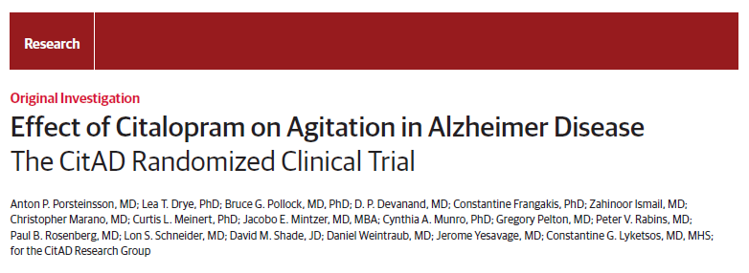
JAMA, 2014; 311(7): 682-691

Slide 9
Aims of Study
Primary
  Efficacy of citalopram for managing agitation in patients with Alzheimer’s disease
Secondary
  Effect of citalopram on patient’s function and caregiver distress
  Safety of citalopram
Notes:
Safety was assessed in terms of effects on vital signs, weight, gait stability, cognitive effects, electrolyte panels, adverse event reports, electocardiogram results

Slide 10
Study Design
Randomized Controlled Trial
Multicenter Study
  8 US and Canadian Academic Centers
Double Blind
Placebo Controlled
Funded by National Institute of Aging and National Institute of Mental Health
Notes:
Details outlined in: Drye LT, Ismail Z, Porsteinsson AP, et al; CitAD
Research Group. Citalopram for agitation in Alzheimer’s disease. Alzheimers Dement. 2012;8(2):121-130.
Randomization was stratified by clinical center
- Generic citalopram was purchased and over encapsulated for use in study

Slide 11
Study Population
Inclusion Criteria:
  Probable Alzheimer’s disease, MMSE score of 5–28 (based on criteria from National Institute of Neurological and Communicative Disorders and Stroke and the Alzheimer’s Disease and Related Disorders Association)
  Medication for agitation is appropriate, in the opinion of the study physician (based on assessment on the Neuropsychiatric Inventory)
  Primary Caregiver willing to participate in study
  No prior change to AD medications in month prior to study
Notes:
Inclusion criteria
Alzheimers dz as defined by criteria from National Institute of Neurological and Communication Disorders and Stroke-Alzheimer Disease and Related Disorders Association
NINCDS-ADRDA criteria for probable dementia - Dementia established by clinical examination and standardized brief mental status examination and confirmed by neuropsychological tests; Deficits in two or more areas of cognition;Progressive worsening of memory and
other cognitive function; No disturbance of consciousness; Onset between 40 and 90 years; Absence of other systemic or neurologic
disorder sufficient to account for the progressive cognitive defects
*Clinically significant agitation defined as
(1) the frequency of agitation as assessed by the NPI is “Very
frequently” or
(2) the frequency of agitation as assessed by the NPI is “Frequently”
AND the severity of the agitation as assessed by the NPI is “Moderate” or “Marked”
*Provision of informed consent for participation in the study by patient
or surrogate (if necessary) and caregiver
*Availability of primary caregiver, who spends several hours
a week with the patient and supervises his or her care, to
accompany the patient to study visits and to participate in
the study
*No change to AD medications within the month preceding randomization, including starting, stopping, or dosage modifications

Slide 12
Study Population
Exclusion Criteria
  Have a diagnosis of depression (DSM IV)
  Psychosis requiring antipsychotic therapy
  Failure of past treatment with citalopram or contraindication to treatment with citalopram
  Current treatment with psychotropic medications (with exception of lorazepam and trazodone)
  Prolonged QTC (added later on)
Notes:
Exclusion criteria
*Meets criteria for Major Depressive Episode by DSM-IV (TR) criteria
*Presence of a brain disease that might otherwise explain the presence of dementia, such as extensive brain vascular disease, Parkinson’s disease, dementia with Lewy bodies, traumatic brain injury, or multiple sclerosis
*Psychosis (delusions or hallucinations requiring antipsychotic
treatment in the opinion of the study physician)
*Treatment with citalopram is contraindicated in the opinion of the
study physician
*Failure of past treatment with citalopram for agitation after adequate
trial at a minimally accepted dose (_20 mg/d)
*Treatment with a medication that would prohibit the safe concurrent
use of citalopram, such as monoamine oxidase inhibitors
*Need for psychiatric hospitalization, or is suicidal
*Current participation in a clinical trial or in any study that may add
a significant burden or affect neuropsychological or other study
outcomes
*Current treatment with antipsychotics, anticonvulsants (other than
dilantin), other antidepressants (other than trazodone, _50 mg per
day at bedtime), benzodiazepines (other than lorazepam), or
psychostimulants
*Any condition that, in the opinion of the study physician, makes it
medically inappropriate for the patient to enroll in the trial

Slide 13
Study Methods
Between August 2009 and January 2013
Citalopram group – started on 10 mg/day, uptitrated to 30 mg/day as tolerated over 3 weeks.
Scheduled in-person visits (weeks 3, 6, and 9 after randomization)
Trial conducted over 9 weeks
Rescue medication (lorazepam and/or trazodone) were permitted
Notes:
Citalopram, target dose 30 mg/d (range: 10–30 mg/d),
given orally + standardized psychosocial intervention
Placebo + standardized psychosocial intervention
**Both groups received standardized psychosocial intervention
-a 20 to 30-minute counseling session at each of the scheduled study visits, provision of educational materials, and 24-hour availability for crisis management assistance.
Rescue medication:
Lorazepam (0.5 mg daily) is permitted as a rescue medication for clinically significant agitation. Trazodone (50 mg nightly) is also allowed to treat sleep disturbance for patients with clinically significant sleep disturbance
In person assessments
-Assess med adherence, reported side effects
Perform cognitive, behavioral, functional assessments
- Perform psychosocial therapy

Slide 14
Outcomes
Agitation over 9 weeks as measured by different scales
  NBRS -A – Neurobehavioral Rating Scale with focus on agitation
  mADCS-CGIC - modified Alzheimer’s Dz Cooperative Study – Clinical Global Impression of Change
  CMAI – Cohen Mansfield Agitation Inventory
  NPI agitation sub category – Neuropsychiatric Inventory
Cumulative lorazepam dose
Functional performance as assessed by ADCS-ADL
Cognition as assessed by MMSE
Caregiver distress (assessed by caregiver distress ratings on NPI)
Adverse events and side effects
Notes:
NBRS, NeuroBehavioral Rating Scale – The NBRS is a 28-item observer-rated instrument derived from the Brief Psychiatric Rating Scale. The agitation subscale includes the NBRS items regarding
disinhibition, agitation, and hostility/uncooperativeness. The NBRS will be assessed at baseline and weeks 3, 6, and 9. Longitudinal analyses of NBRS scores are assessed with linear mixed effects model
ADCS-CGI, Alzheimer’s Disease Cooperative Study—Clinical Global Impression - focuses on change since baseline. Ratings on the ADCS-CGIC at week 9 will be compared between treatments.
CMAI, Cohen-Mansfield Agitation Inventory - CMAI, which was developed for use in nursing homes to observe agitated behaviors in the older population
NPI, Neuropsychiatric Inventory (only parts of this) – the NPI domain ratings (overall and agitation specific ratings) from baseline to 9 weeks will be compared between the treatment groups; and (3) the NPI caregiver distress ratings from baseline to 9weekswill be compared
by treatment group.
ADCS-ADL, Alzheimer’s Disease Cooperative Study—activities of daily
living; MMSE, Mini-Mental State Examination; DSM-IV, Diagnostic and
Statistical Manual of Mental Disorders-IV.

Slide 15
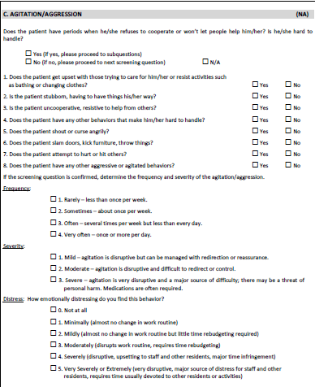
NPI

Slide 16
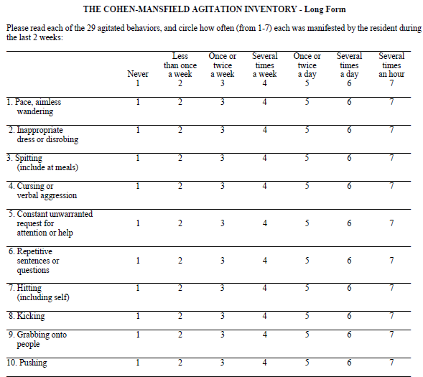
Notes:
29 items
Developed for nursing home residents, although there is a version for community dwellers

Slide 17
Statistical Analysis
Intention to treat Principle
Linear mixed effects regression model for NBRS rating
Proportional odds regression for ADCS-CGIC
Notes:
Study group determined that a 3 to 5 -point difference on the NBRS was felt to be clinically meaningful
Study group were trying to detect a difference of 20% between the proportion of participants who improve (or worsen) in the citalopram group as compared with the placebo group.
For the NBRS-A, the study was designed to have 85% power to detect a standardized difference at week
9 of 40% for citalopram compared with placebo. For the mADCS-CGIC proportional odds analysis, the study was designed
to have power greater than 80% to detect a difference of 20% between citalopram and placebo in the proportions of
patients who improved (or worsened).

Slide 18
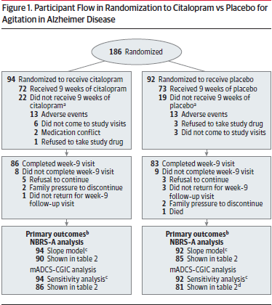
Results
Notes:
Main Talking Points
Randomization was successful
That a large proportion of groups completed week 9 visit
A fair number of people did take 9 weeks of medication:: At week 9, 78%of the sample were receiving 30 mg citalopram daily and 15% were receiving 20 mg citalopram daily.

Slide 19
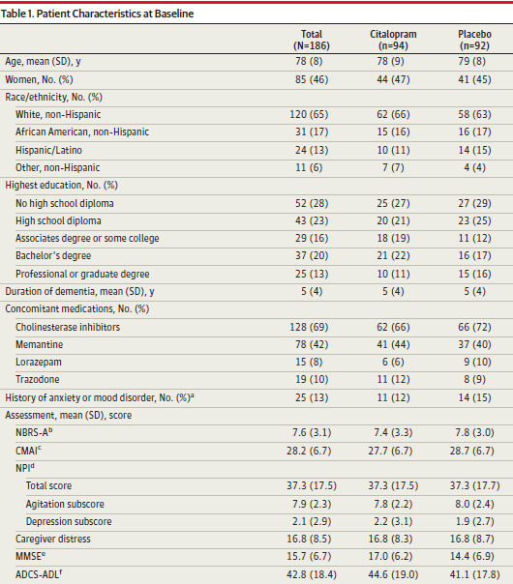
Results: Baseline Characteristics
Range 0-18
Range 14-70
Range 0-144
Range 0-12
Range 0-60
Range 0-78
Notes:
-NBRS-A range, 0 to 18 (higher scores indicate more severe symptoms).
-CMAI range, 14 to 70 (higher scores indicate more severe symptoms).
-NPI total frequency by severity range, 0 to 144 (higher scores indicate more severe symptoms; 2 of the 12 NPI domains are shown [0-12 range for each]).
-ADCS-ADL range, 0 to 78 (higher scores indicate better functioning).
-Caregiver distress – scale of 0-60, higher scores indicate more distress
89% of study members were community dwelling

Slide 20
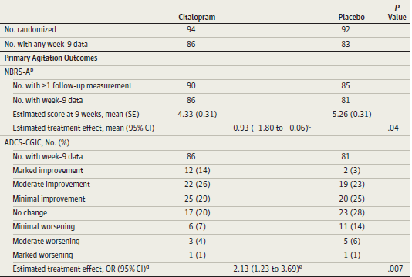
Notes:
Primary Outcome:
NBRS-A: difference in week-9 scores between citalopram and placebo on the Neurobehavioral Rating
Scale-agitation subscale (NBRS-A) calculated using mixed-effects regression
ADCS-CGIC: The treatment effect estimate is the OR (calculated using proportional odds logistic regression) of being at
or better than a given ADCS-CGIC category for citalopram vs placebo.
A little unusual that there was similar % for both groups in terms of moderate improvement, minimal improvement and no change between the groups.

Slide 21
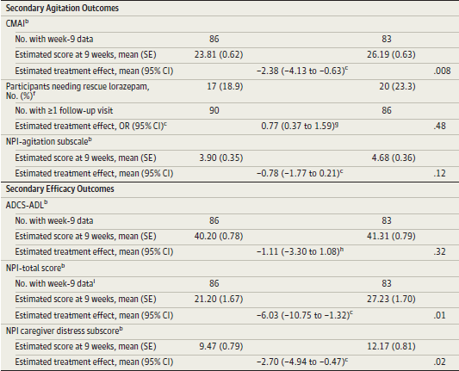
Results
citalopram
placebo
Notes:
There was no significant difference between groups on the ADCS-ADL scale.
There was no difference between the 2 treatment groups in the use of rescue lorazepam.

Slide 22
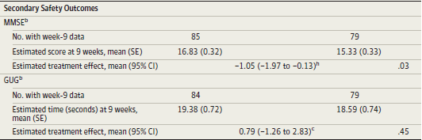
Results
citalopram
placebo
Notes:
Greater cognitive worsening in patients taking citalopram. (b) The treatment effect is the
difference in scores at week 9, controlling for baseline score and MMSE. (h) A positive treatment effect value
favors citalopram for MMSE and ADCS-ADL.
Decrease in MMSE is below minimum clinically significant change of 1.4 points, considered
by many experts.

Slide 23
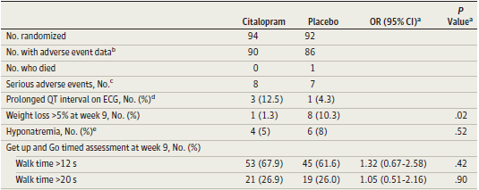
Results
Notes:
ECG data was available for 48 patients (24 citalopram and 24 placebo).
Citalopram was associated with greater increase in QTc interval than placebo (18.1 ms; 95%CI,
6.1-30.1; P = .004), and more participants in the citalopram group showed a QTc increase of greater than 30 ms from enrollment
to week 3 than participants in the placebo group (7 vs 1; Fisher exact P = .05).
Four participants (3 citalopram and 1 placebo) showed QTc prolongation (>450 ms for men and>475 ms for women).

Slide 24
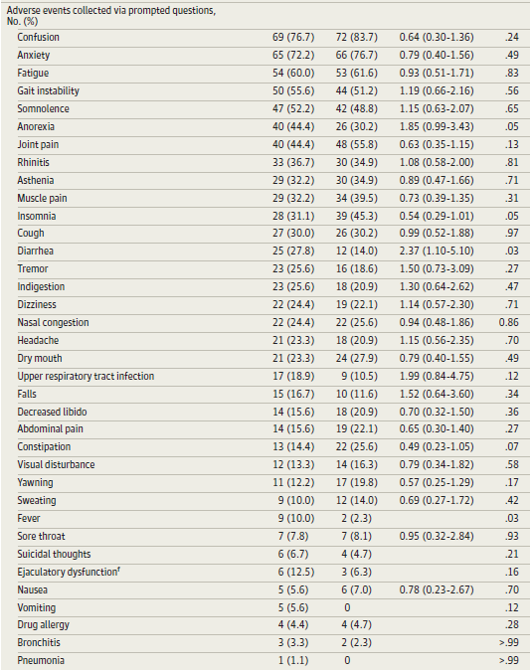
Results
Notes:
Falls were more frequent in the citalopram group and remained so even after controlling for baseline differences.

Slide 25
Study Conclusions
30 mg citalopram daily was associated with
decreased agitation in patients with Alzheimer Disease over the course of 9 weeks
This particular regimen was also associated with mild cognitive decline and QTC prolongation

Slide 26
Strengths
Randomized, double blind, placebo controlled study
Large proportion of participants completed the study
Relatively few medical/medication exclusions for both participants
psychosocial intervention administered to both groups
Notes:
resulting in a study population that is broadly representative of Alzheimer disease patients

Slide 27
Limitations
Majority of participants were community dwelling
Study conducted in academic medical centers
Duration of treatment was only 9 weeks
Patients were on high dose of citalopram
Only included patients with probable Alzheimer’s disease
MMSE was used to measure cognition

Slide 28
Discussion

Slide 29
Thank You!

Slide 30
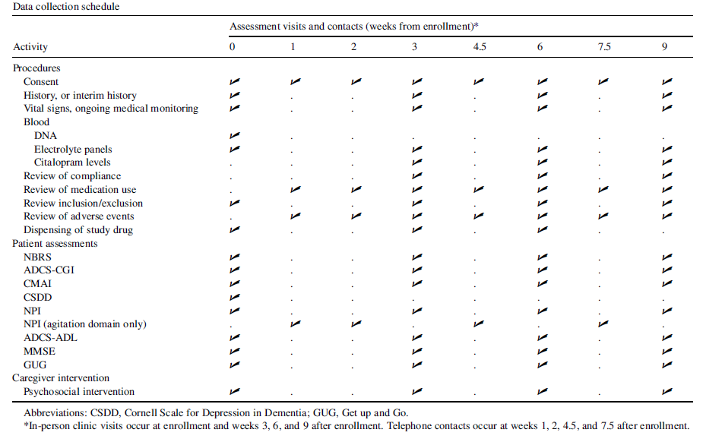

Slide 31
Is this study valid?
Was the assignment of patients to treatment randomized?
Was randomization concealed?
Were the groups similar at the start of the trial?
Was follow-up of patients sufficiently long and complete?
Were all patients analyzed in the groups to which they were randomized?
Were patients, clinicians, study personnel blinded?
Were groups treated equally, apart from experimental therapy?
Notes:
All patients are followed up via in-person study visits and
telephone contacts even if no longer adherent to the assigned
study treatment
Yes to all questions! This is a valid study!

