Slide 1
Predicting Chemotherapy Toxicity in Older Adults With Cancer:
A Prospective Multicenter Study
Hurria, A., et al. J Clin Oncol 29:3457-3465.
Geriatrics Grand Rounds - Journal Club
Michael Voisine, DO
September 11, 2015

Slide 2
Background
> 1/2 of patients with newly diagnosed cancer are > 65
11-fold increase in cancer incidence
16-fold increase in cancer mortality
Concerns specific to geriatric oncology -
Elders are underrepresented in oncology clinical trials
older age is a risk factor for chemotherapy toxicity
older adults are less likely to be offered chemotherapy because of concerns regarding their ability to tolerate the treatment.
chronologic age does not equate to physiologic age
Notes:
Cancer is a disease associated with aging. As well as Alzheimer’s dementia and atherosclerosis. This population of older adults is growing rapidly. By 2030, 20% of the population in the United States will be older than age 65 years.
Cancer in the elderly is a huge healthcare issue.
- The available data suggest that older adults derive benefit from chemotherapy similar to that derived by younger adults

Slide 3
Clinical question
In frail elders with multiple medical comorbidities and new cancer diagnoses, are there useful prognostic tools clinicians can use to help guide shared decision making with patients’ regarding their cancer management plan?
Notes:
Case – VR
Case - JB

Slide 4
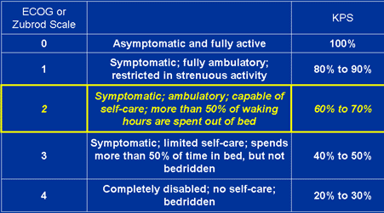
Typical practice
Oncology performance status measures –
Karnofsky performance status [KPS]
Eastern Cooperative Oncology Group [ECOG]
Use in all adults regardless of age to estimate functional status, assess eligibility for clinical
trials, and predict treatment toxicity and
survival.
Geriatric assessments measure independent clinical predictors of morbidity and mortality in older
adults.
- Not typically used in daily oncology practice to assist in decision making
A predictive model that incorporates geriatric + oncologic correlates of vulnerability to chemo toxicity in older adults to help the clinician and patient weigh the benefits/risks of chemotherapy
Notes:
Currently, there is no consensus within the geriatric or oncology communities regarding a standard assessment that can identify those older adults at risk for chemotherapy toxicity. These tools were validated in younger patients and do not address the heterogeneity in the aging process.
Reflects the limitations using one global assessment measure of functional status in the geriatric population.

Slide 5
Study Objective
Develop a predictive model for grade 3 to 5 toxicity in older adults with cancer that uses age, sociodemographic factors, tumor and treatment characteristics, laboratory data, and geriatric assessment variables
Assess the predictive capability of the model for chemo toxicity in comparison to KPS
Notes:
Describe grades of chemotherapy toxicity

Slide 6
Study Design
Enrollment November 2006 to November 2009
500 patients were recruited from the outpatient oncology practices of 7 participating institutions.
Inclusion Criteria –
> age 65
diagnosis of cancer
scheduled to receive a new chemotherapy regimen
fluent in English

Slide 7
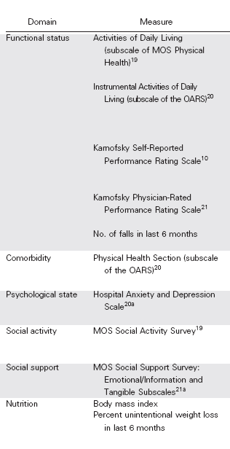
Methods:
Pretreatment Data
Geriatric Assessment
Oncology
Sociodemographic factors
Tumor characteristics (tumor type and stage)
pretreatment laboratory data (WBC, hemoglobin, BUN, creatinine, albumin, and LFTs)
chemotherapy regimen
line of chemotherapy (first line or greater)
use of WBC or RBC growth factors
Standard vs reduced dose chemo
Timed get up & go measure
Blessed Orientation Memory Concentration test
Notes:
GA done before initiation of the chemo regimen. Provider portion – KPS, timed get up and go, Blessed orientation memory concentration test.
Assuming a prevalence rate of 30% for grade 3 to 5 toxicity, 500 patients would provide 80% power to detect a prevalence difference of 11% for a dichotomous predictor in logistic regression.

Slide 8
Demographics
73 y retired, college-educated, white married female with HTN and arthritis with iADL score of 13 and KPS of 80% now with metastatic lung cancer treated with 1st line, standard doses of polychemotherapy .
Notes:
Patient followed from beginning to end of chemo course. Toxicities evaluated at each clinical encounter by two physicians

Slide 9
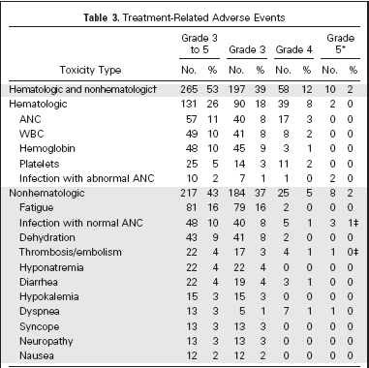
Results
National Cancer Institute Common Terminology Criteria for Adverse Events (NCI CTCAE)
Grade 3 – severe
Grade 4 – life threatening
Grade 5 - cardiac ischemia/infarction,
liver failure, pneumonitis/pulmonary infiltrate, and sudden death.
31% required dose reduction
31% had a dose delay
23% were hospitalized during treatment

Slide 10
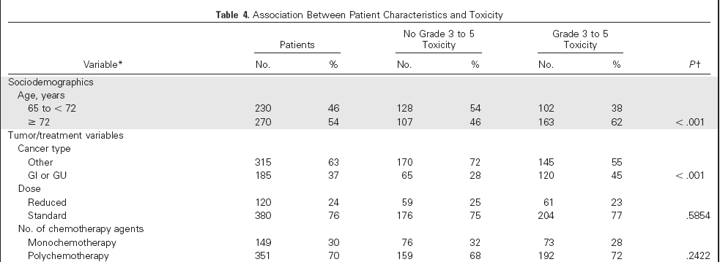
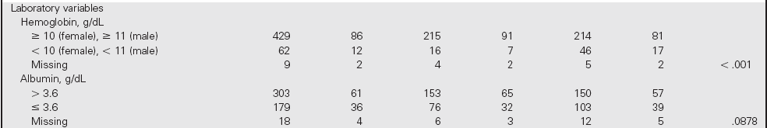
Notes:
Chi squared - Does the number of individuals or objects that fall in each category differ significantly from the number you would expect? Is this difference between the expected and observed due to sampling variation, or is it a real difference?
null hypothesis usually refers to a general statement or default position that there is no relationship between two measured phenomena, or no difference among groups.[

Slide 11

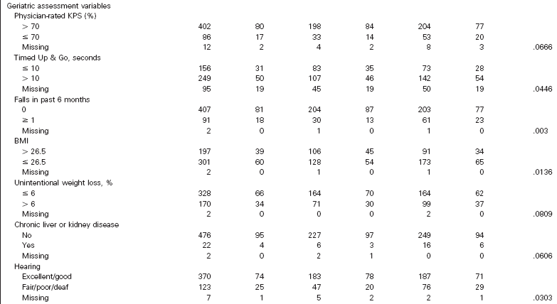

Slide 12
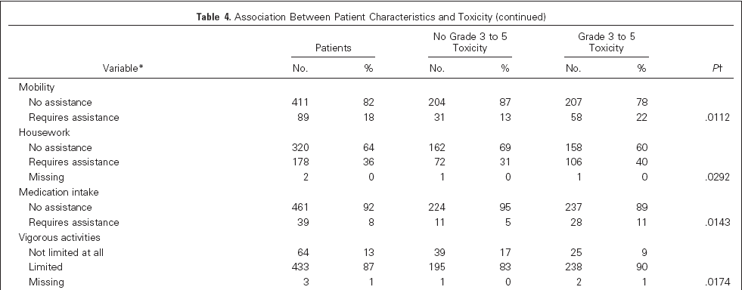
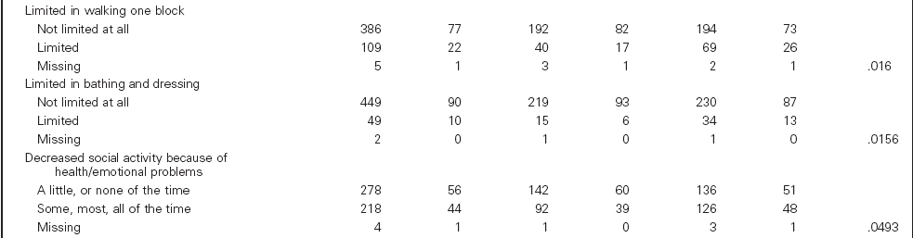

Slide 13
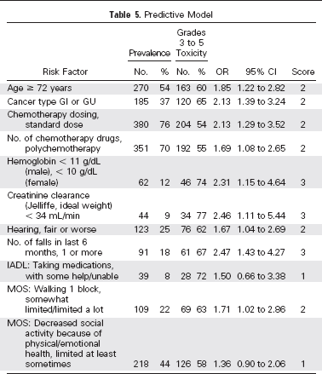
The median risk score was 7, range (0 to 19)
The sample was divided into 3 risk strata:
low 0-5
medium 6-9
high 10-19

Slide 14
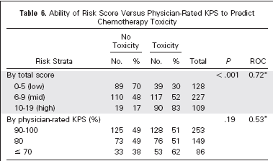
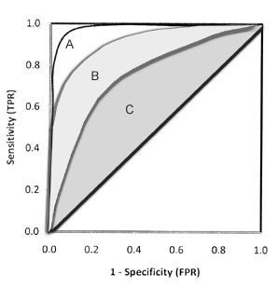
Results
Example ROC Curve
Notes:
Exploratory analyses were performed to calculate the ROC of
the model by using the total risk score for each tumor type: GI
(0.72),GU(0.76), breast (0.66), lung (0.68),GYN(0.66), and other
(0.81) cancers.
low risk (0 to 5 points, 30%),
intermediate risk (6 to 9 points, 52%), and high risk (10 to 19 points,
83%). There was a significant difference in toxicity among the risk
groups (P.001; Fig 1 and Table 6).

Slide 15
Discussion
53% w/ grade 3 to 5 chemotoxicity
2% w/ treatment related mortality in 2%
Patient age (> 72), tumor type (GI/GU), treatment, labs (Hgb, CrCl), fall hx, hearing, TUG, and all geriatric assessment variables are risk factors for chemotherapy toxicity.

Slide 16
Limitations
Toxicities < grade 3
External validity
Heterogeneous tumor types and/or treatment regimens

Slide 17
Conclusion
Predictive model had a greater ability to discriminate risk of chemotherapy toxicity than the KPS.
Geriatric assessment has not been routinely incorporated into oncology care because of the time and resource requirements.

Slide 18
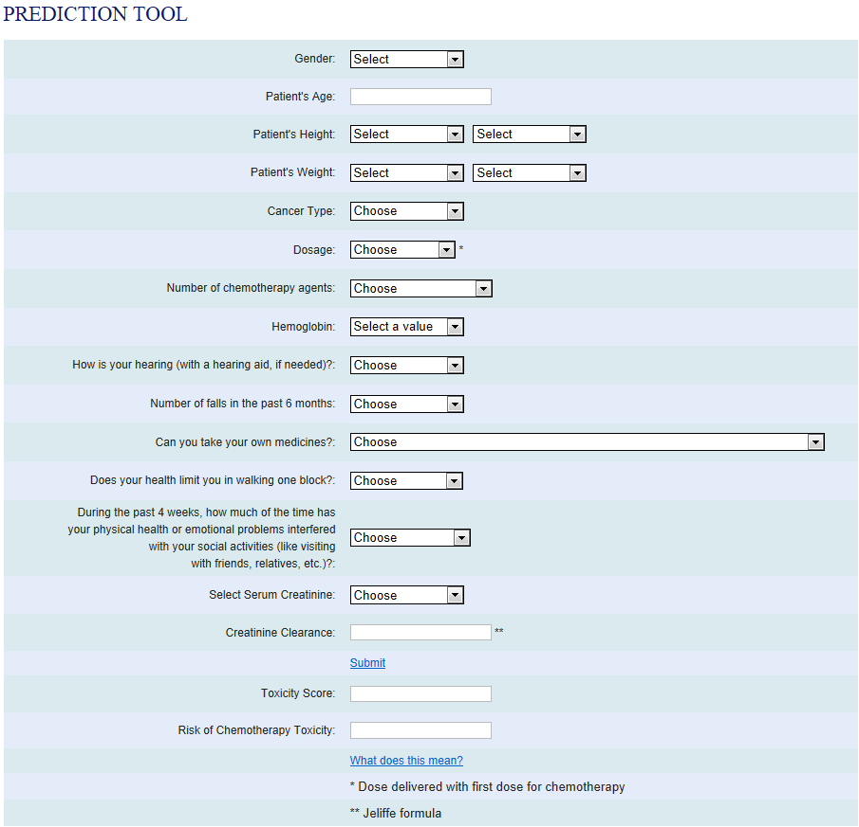
http://www.mycarg.org/Chemo_Toxicity_Calculator

Slide 19


Slide 20

Questions? Thank you!

