Slide 1
Risk of Thiazides in Older Adults
Matthew t. Corey, mD
Pgy-4
Geriatrics section
department of medicine
Boston medical center
12 june 2015

Slide 2
Objectives
Present a case of thiazide use in an older adult with refractory hypertension
Evaluate a recent observational cohort study on the safety of thiazide diuretics in older adults
Explore a protocol for safer thiazide use in the geriatric population

Slide 3
Objectives
Present a case of thiazide use in an older adult with refractory hypertension
Evaluate a recent observational cohort study on the safety of thiazide diuretics in older adults
Explore a protocol for safer thiazide use in the geriatric population

Slide 4
A Case of Sepsis
An 83-year-old African-American woman, retired Harvard administrator, lives at home in Cambridge.
Notes:
Elephantiasis verrucosa nostra

Slide 5
A Case of Sepsis
Comorbidities
  Obesity
Notes:
Elephantiasis verrucosa nostra

Slide 6
A Case of Sepsis
Comorbidities
  Obesity
  Difficult-to-manage hypertension
Notes:
Elephantiasis verrucosa nostra

Slide 7
A Case of Sepsis
Comorbidities
  Obesity
  Difficult-to-manage hypertension
  Dyslipidemia
Notes:
Elephantiasis verrucosa nostra

Slide 8



A Case of Sepsis
On the phone with the patient, granddaughter became concerned:
Notes:
Elephantiasis verrucosa nostra

Slide 9
A Case of Sepsis
On the phone with the patient, granddaughter became concerned:
Pt was confused, speaking nonsense.
Notes:
Elephantiasis verrucosa nostra

Slide 10
A Case of Sepsis
In the ED: pt febrile to 102°F / 38.9°C, hypotensive to 84/52, with a new 2L oxygen requirement.

Slide 11
A Case of Sepsis
In the ED: pt febrile to 102°F / 38.9°C, hypotensive to 84/52, with a new 2L oxygen requirement.
CXR: Left lower lobe consolidation.

Slide 12
A Case of Sepsis
In the ED: pt febrile to 102°F / 38.9°C, hypotensive to 84/52, with a new 2L oxygen requirement.
CXR: Left lower lobe consolidation.
Admitted to MICU for CAP sepsis, IV antibiotics and fluid support.

Slide 13
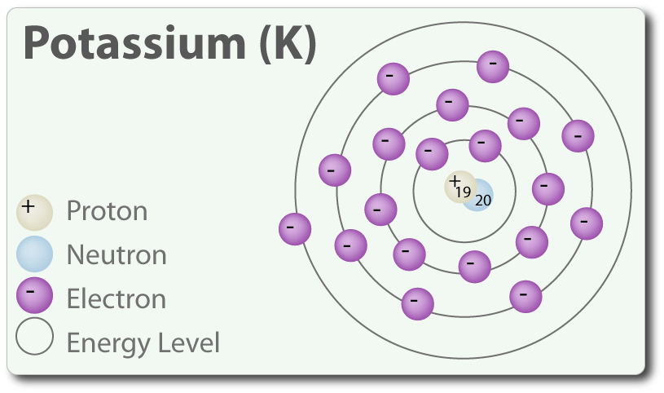
A Case of Sepsis
Notable Labs
  WBC 19, PMN 90%
  K 3.1

Slide 14
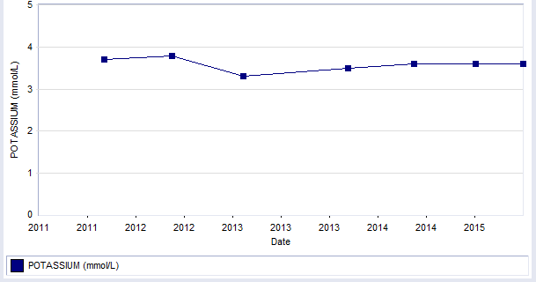
Chronic Mild Hypokalemia … Requiring Oral Repletion in Outpatient

Slide 15
The Rule of Geriatrics: Drugs, Drugs, Drugs
Patient’s home meds:
  HYDROCHLOROTHIAZIDE 25mg PO daily
  LABETALOL 400mg PO BID
  CALCIUM 600 + D 600-200 mg-IU PO daily
  LOVASTATIN 40mg PO daily
  ASA 81mg PO daily
  NIFEDIPINE CR 90mg PO daily
  KCl crystals 20 MEq PO daily
  CHLORHEXIDINE GLUCONATE 4 % LIQD wash daily
Allergies:
  LISINOPRIL (cough)

Slide 16
Solution: Discontinue Hydrochlorothiazide?
What is the evidence?

Slide 17
Objectives
Present a case of thiazide use in an older adult with refractory hypertension
Evaluate a recent observational cohort study on the safety of thiazide diuretics in older adults
Explore a protocol for safer thiazide use in the geriatric population

Slide 18

AGS Geriatrics Literature Update 2015, courtesy Dr William J. Hall, University of Rochester
Parekh TM et al. Hypoglycemia After Antimicrobial Drug Prescription for Older Patients Using Sulfonylureas. JAMA Intern Med. 2014 Oct;174(10):1605-12.
Kesselheim AS et al. Burden of changes in pill appearance for patients receiving generic cardiovascular medications after myocardial infarction: cohort and nested case-control studies. Ann Intern Med. 2014 Jul 15;161(2):96-103.
Makam AN et al. Risk of thiazide-induced metabolic adverse events in older adults. J Am Geriatr Soc. 2014 Jun;62(6):1039-45.
Porsteinsson AP et al. Effect of citalopram on agitation in Alzheimer disease: the CitAD randomized clinical trial. JAMA. 2014 Feb 19;311(7):682-91.
Valls-Pedret C et al. Mediterranean Diet and Age-Related Cognitive Decline: A Randomized Clinical Trial. JAMA Intern Med. 2015 May 11.
Lipska KJ et al. Potential overtreatment of diabetes mellitus in older adults with tight glycemic control. JAMA Intern Med. 2015 Mar;175(3):356-62.

Slide 19
AGS Geriatrics Literature Update 2015, courtesy Dr William J. Hall, University of Rochester
Makam AN et al. Risk of thiazide-induced metabolic adverse events in older adults. J Am Geriatr Soc. 2014 Jun;62(6):1039-45.

Slide 20
Makam AN et al. Risk of thiazide-induced metabolic adverse events in older adults.
Research Question
What added risk of adverse events is conferred by the use of thiazide diuretics in older adults?

Slide 21
Makam AN et al. Risk of thiazide-induced metabolic adverse events in older adults.
Research Question
What added risk of adverse events is conferred by the use of thiazide diuretics in older adults?
P: Veterans aged 65 and older, anti-hypertensive naïve.

Slide 22
Makam AN et al. Risk of thiazide-induced metabolic adverse events in older adults.
Research Question
What added risk of adverse events is conferred by the use of thiazide diuretics in older adults?
P: Veterans aged 65 and older, anti-hypertensive naïve.
I: Treatment with a thiazide diuretic.

Slide 23
Makam AN et al. Risk of thiazide-induced metabolic adverse events in older adults.
Research Question
What added risk of adverse events is conferred by the use of thiazide diuretics in older adults?
P: Veterans aged 65 and older, anti-hypertensive naïve.
I: Treatment with a thiazide diuretic.
C: “Nonusers” of a first-line antihypertensive medication.

Slide 24
Makam AN et al. Risk of thiazide-induced metabolic adverse events in older adults.
Research Question
What added risk of adverse events is conferred by the use of thiazide diuretics in older adults?
P: Veterans aged 65 and older, anti-hypertensive naïve.
I: Treatment with a thiazide diuretic.
C: “Nonusers” of a first-line antihypertensive medication.
O: Known adverse events of thiazides.

Slide 25
Clinical Importance of Research Question
JNC 8:
  Recommendation 6: In the general nonblack population, including those with diabetes, initial antihypertensive treatment should include a thiazide-type diuretic, calcium channel blocker (CCB), angiotensin-converting enzyme inhibitor (ACEI), or angiotensin receptor blocker (ARB). (Moderate Recommendation – Grade B)
  Recommendation 7: In the general black population, including those with diabetes, initial antihypertensive treatment should include a thiazide-type diuretic or CCB. (For general black population: Moderate Recommendation – Grade B; for black patients with diabetes: Weak Recommendation – Grade C)
Notes:
Thiazides are still first line in both black and nonblack patients.
The desirability of thiazides are not part of the new age stratification guidelines

Slide 26
Clinical Importance of Research Question
Multiple smaller studies (2000-2012) have shown associations between thiazides and morbidity
Hypokalemia
Hyponatremia
AKI
THIAZIDES
Morbidity
Costs
Mortality

Slide 27
Clinical Importance of Research Question
Multiple smaller studies (2000-2012) have shown associations between thiazides and morbidity
But are these associations even more dangerous in older adults?
Hypokalemia
Hyponatremia
AKI
THIAZIDES
Morbidity
Costs
Mortality

Slide 28
Methods: The New-User Design
A type of observational cohort study:
Notes:
Why? No one would do a randomized control trial on these old, off-patent drugs.

Slide 29
Methods: The New-User Design
A type of observational cohort study:
  Identify cohort of clinically similar patients, who don’t have intervention at t₀

Slide 30
Methods: The New-User Design
A type of observational cohort study:
  Identify cohort of clinically similar patients, who don’t have intervention at t₀
  Disaggregate cohort into…
    New users of intervention
    Matched group of non-users of intervention

Slide 31
Methods: The New-User Design
A type of observational cohort study:
  Identify cohort of clinically similar patients, who don’t have intervention at t₀
  Disaggregate cohort into…
    New users of intervention
    Matched group of non-users of intervention
  Track outcomes from t₀ to end of study period

Slide 32
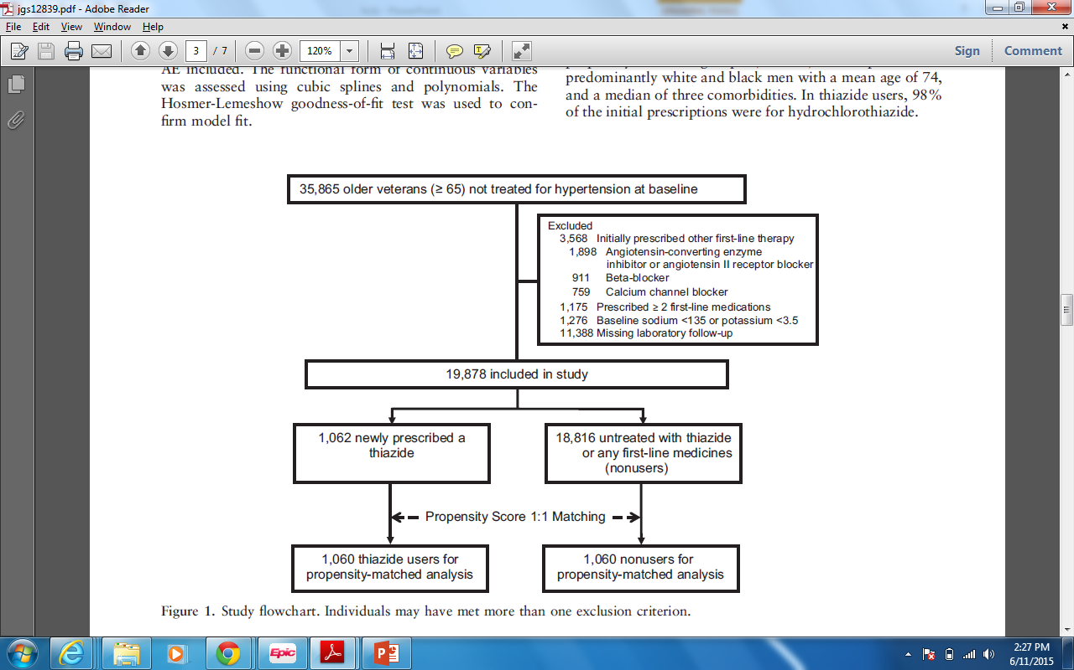
Methods: Study Population
Veterans aged 65 and older with “essential hypertension” without a first-line anti-hypertensive
Notes:
The control group are men who bear a diagnosis of “essential hypertension” but are on no treatment whatsoever.

Slide 33
Methods: Study Population
Veterans aged 65 and older with “essential hypertension” without a first-line anti-hypertensive
Notes:
The control group are men who bear a diagnosis of “essential hypertension” but are on no treatment whatsoever.

Slide 34
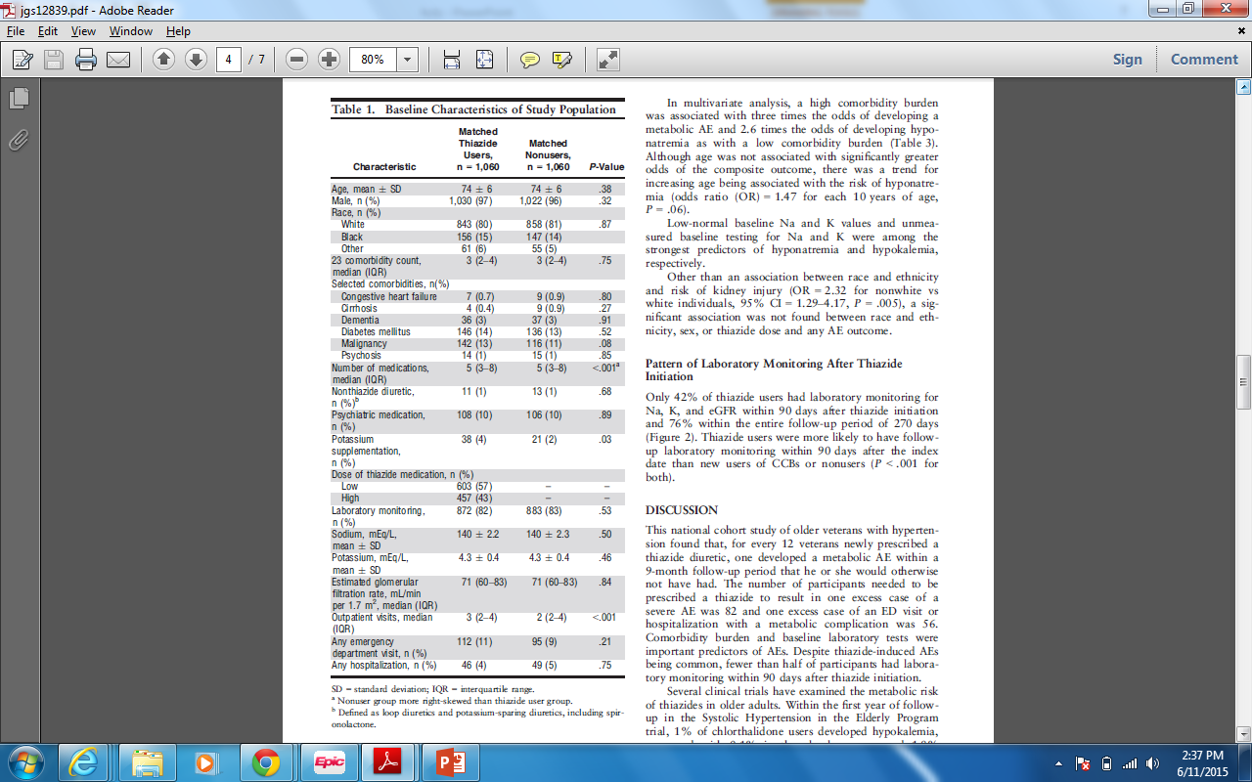
Methods: Matching Baseline Characteristics
Notes:
Ideally I would like to see Mexican American and American Indian guys included in significant numbers and disaggregated, both because they are significant subgroups of the veteran population out west and because we all know that their BP profiles and responses to medications are quite distinct.

Slide 35
Methods: Matching Baseline Characteristics
Notes:
Roughly two-thirds fall in the middle 2 SD: 68 – 80, only a handful of women
Did experimental and control groups start out with similar prognosis?
Unknown. How advanced was their hypertensive disease?
Arrhythmias?
Potassium supplementation?

Slide 36
Methods: Measuring Outcomes
Na, K, and eGFR measured over 9-month follow-up period.

Slide 37
Methods: Measuring Outcomes
Na, K, and eGFR measured over 9-month follow-up period.
Primary outcome: composite of thiazide-related metabolic AEs
  Hyponatremia (Na <135 mEq/L)
  Hypokalemia (K <3.5 mEq/L)
  Risk of kidney injury (decrease in eGFR of >25%)

Slide 38
Methods: Measuring Outcomes
Secondary outcomes
  Each individual AE
  Composite of severe metabolic AEs (Na <130 mEq/L, K <3.0 mEq/L, decrease in eGFR of >50%)
  Composite of ED visits, hospitalizations with hyponatremia, hypokalemia, electrolyte imbalance, and AKI

Slide 39
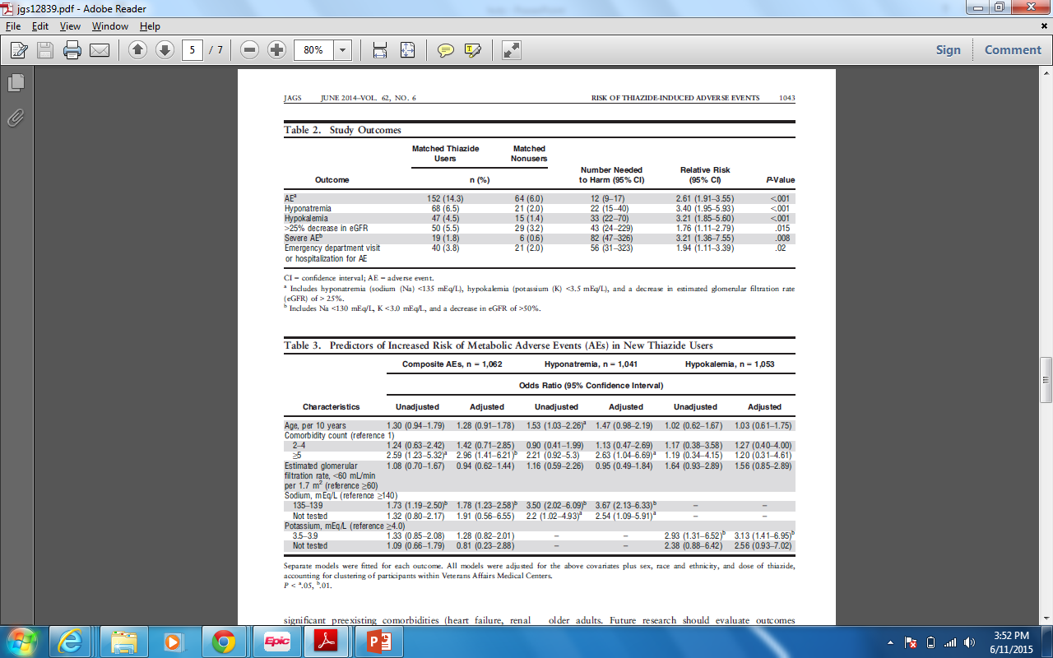
Results: Outcomes
Notes:
Across the board, grossly increased risks of hyponatremia, hypokalemia, AKI, severe metabolic events and hospitalizations.
The number needed to harm for the composite variable primary outcome was 12, which is a pretty serious burden of risk.

Slide 40
Results: Predictors of Increased Risk of Metabolic AEs in New Thiazide Users

Slide 41
Results: Predictors of Increased Risk of Metabolic AEs in New Thiazide Users
Notes:
Multiple comorbidities confer a lot of added risk from thiazides

Slide 42
Results: Predictors of Increased Risk of Metabolic AEs in New Thiazide Users
Notes:
Having low NORMAL sodium (not just hyponatremia) at baseline confers a lot of added risk

Slide 43
Results: Predictors of Increased Risk of Metabolic AEs in New Thiazide Users
Notes:
Having low NORMAL potassium (not just hypokalemia) at baseline confers a lot of added risk

Slide 44
Objectives
Present a case of thiazide use in an older adult with refractory hypertension
Evaluate a recent observational cohort study on the safety of thiazide diuretics in older adults
Explore a protocol for safer thiazide use in the geriatric population

Slide 45
When should we use thiazides with care in older adults?

Slide 46
When should we use thiazides with care in older adults?
Multimorbidity (>5 diagnoses)

Slide 47
When should we use thiazides with care in older adults?
Multimorbidity (>5 diagnoses)
“Low normal” baseline electrolytes and renal function

Slide 48
When should we use thiazides with care in older adults?
Multimorbidity (>5 diagnoses)
“Low normal” baseline electrolytes and renal function
When ACEi or ARB confer a morbidity and mortality benefit

Slide 49
When should we use thiazides with care in older adults?
Multimorbidity (>5 diagnoses)
“Low normal” baseline electrolytes and renal function
When ACEi or ARB confer a morbidity and mortality benefit
Past crises?
  Gout
  Hypovolemia / Prerenal azotemia
  Orthostatic hypotension
  Atrial or ventricular tachyarrhythmias
Notes:
And then a category I call past crises, especially those requiring hospitalizations

Slide 50

Case Conclusion: Discontinued Hydrochlorothiazide and Labetalol
On day of discharge:
  BP: (147-152)/(69-71)
  On nifedipine CR 90mg PO daily ONLY
  Potassium = 3.9 for final two days of admission, requiring no repletion

Slide 51

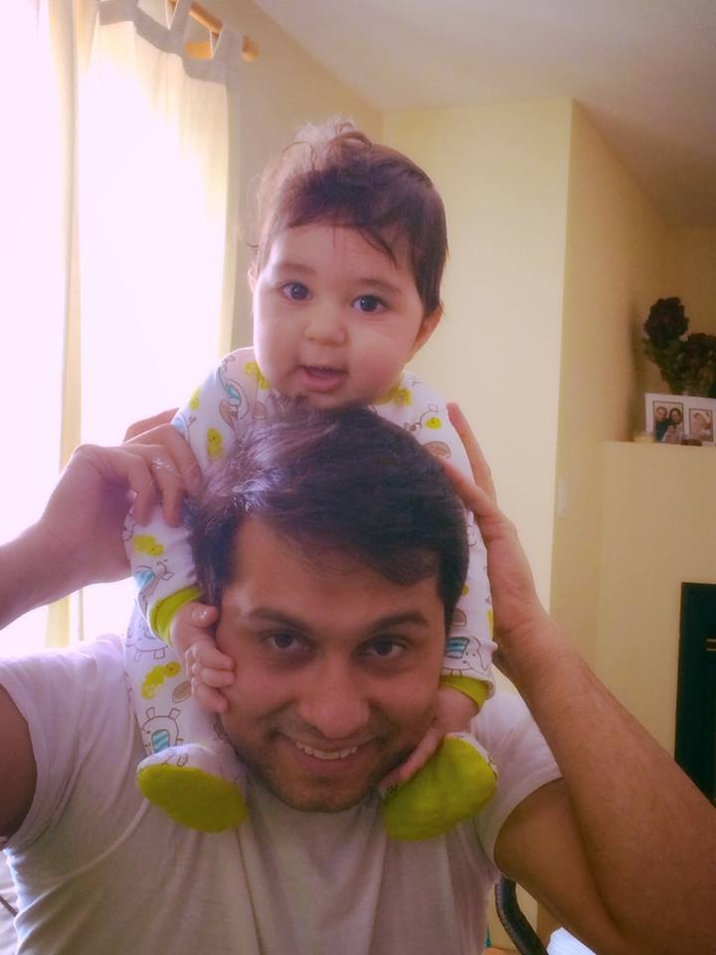
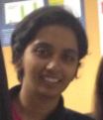

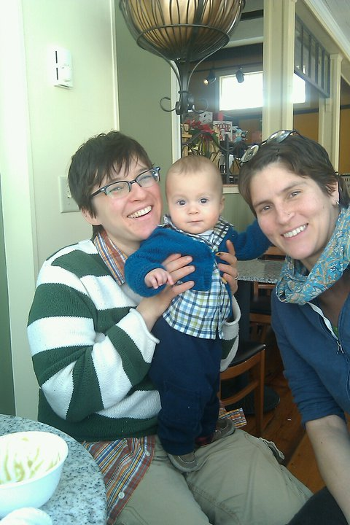
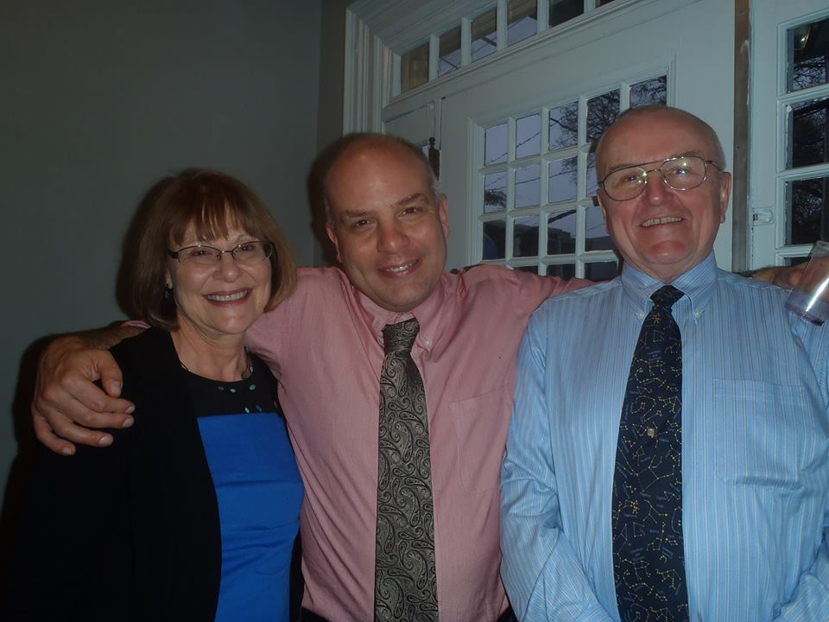
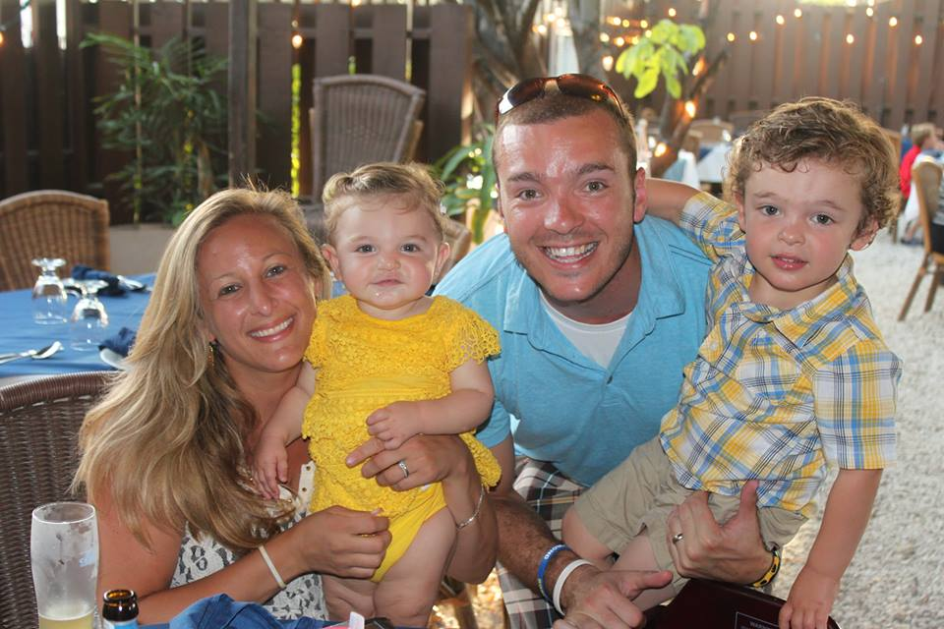
Happy Graduation Day!

