Slide 1
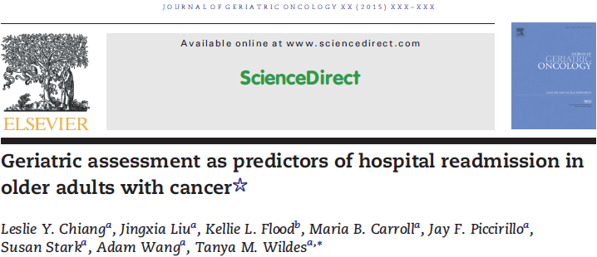
Journal club 6/12/2015
Rawad Elias, M.D.
PGY4, Geriatrics & Hematology-Oncology

Slide 2
Hospital readmissions
Frequent Medicare readmission 19.5% in 2003-2004
Expensive $17.4 billion in 2003-2004
Penalized
Associate with functional decline
Notes:
Hospital readmissions are frequent, the rate was 19.% in 2003-2004
They are also expensive with a cost of about 17.4 billion
Since 2012 CMS started penalizing hospitals with excessive readmission rates by reducing payments
Very important: Associated with a higher risk of functional decline and risk of institutionalization

Slide 3
Readmissions risk factors
General Medical Literature
Malnutrition
Age
Comorbidities
Depression
African-American race
Notes:
Previous studies identified risk factors for readmissions including

Slide 4
Readmissions in older adults with cancer
?

Slide 5


Readmissions in older adults with cancer
 | Readmitted | Non-Readmitted | p-Value
Age (years ) | 58 | 62 | 0.07
Type of Cancer | GI | Non-GI | 0.0118
Nausea < 24 hours | 73% | 46% | 0.01
Living situation | Alone | Not-Alone | 0.047
Caregiver difficulty | Yes | No | 0.0455
Financial issues | Yes | No | 0.0455
Day of the week | Friday | Other | 0.0485

Slide 6
Study Design
Retrospective cohort
Study period: 2000-2008
Population: Patients > 65 years admitted to
OACE unit at Barnes-Jewish Hospital
Index admission: Earliest hospitalization during which
patient completed geriatric assessment

Slide 7
Study Design
Inclusion: Patient with cancer or within 1 year
of receiving treatment for cancer.
Exclusion: - Patients who died during index hospital stay
- Patients who died within 30 days of discharge
from index hospital stay.

Slide 8
Measures
Katz Index of IADL
Lawton Instrumental ADL Scale
Clock Completion Test
Short Blessed Test of Orientation, Memory, and Concentration
Inappropriate medications
Notes:
- Brief geriatric assessment battery which is part of routine clinical care on the OACE unit
- It was done within 72 hours of admissions, by patients or their caregivers if patient were not able to participate

Slide 9
Data Collection
Medical record review
Reasons for admissions were consolidated into categories
Primary Endpoint: 30-day unplanned readmission
Notes:
Reasons for admission were consolidated into broader system-based categories. For example, vomiting, dehydration, dysphagia, and diarrhea were classified as gastrointestinal reasons for admission.
Elective or scheduled readmissions such as planned procedure were excluded

Slide 10
Results

Slide 11
Results / Patient Characteristics
696 Index Hospitalization
Median Age: 72.7 years
Most Common Caner Types: Solid Thoracic
Hematologic
Most Common Cancer Stage: Stage IV
Treatment intent: Palliative in 74%
Notes:
Reasons for admission were consolidated into broader system-based categories. For example, vomiting, dehydration, dysphagia, and diarrhea were classified as gastrointestinal reasons for admission.
Elective or scheduled readmissions such as planned procedure were excluded

Slide 12
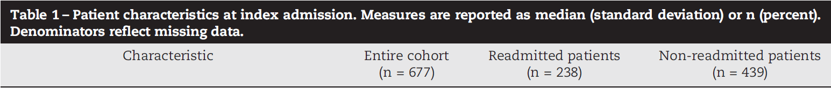
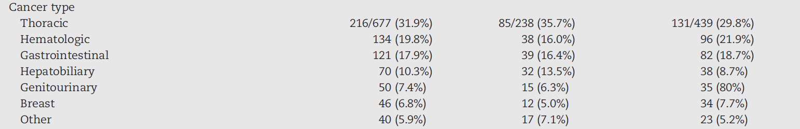
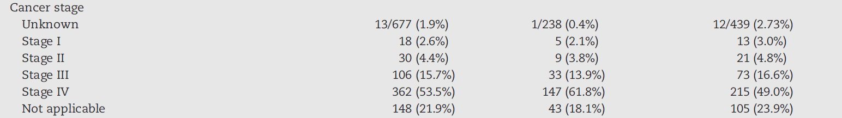
Results / Patient Characteristics

Slide 13
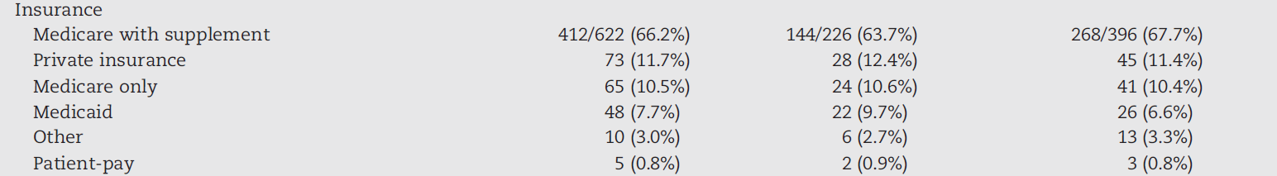
Results / Patient Characteristics

Slide 14
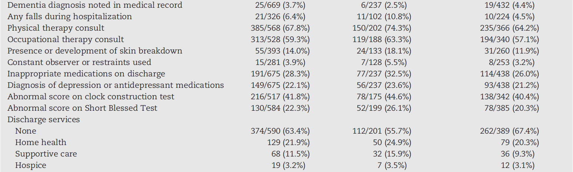
Results / Patient Characteristics

Slide 15
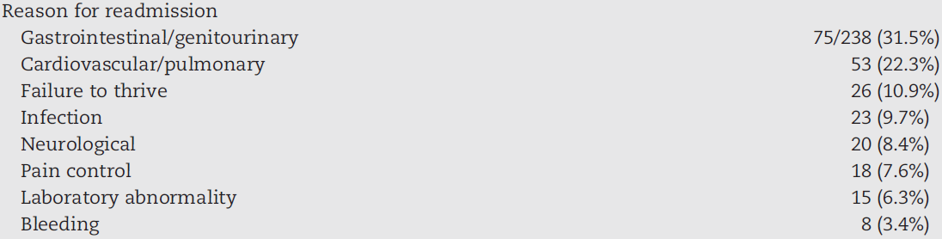
Results / Readmission Rates
Notes:
There was also 3 inpatient psych and 24 ER visits that were not included in this study

Slide 16
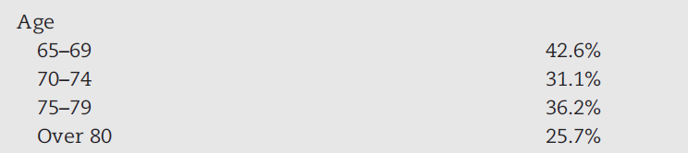



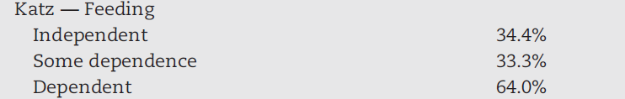
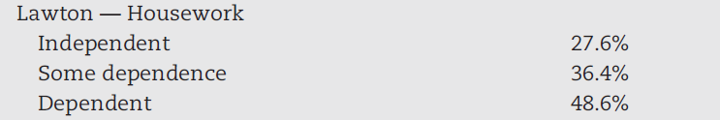


Results / Univariate Analysis
Notes:
There was also 3 inpatient psych and 24 ER visits that were not included in this study

Slide 17





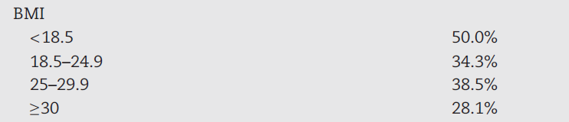


Results / Univariate Analysis
Notes:
There was also 3 inpatient psych and 24 ER visits that were not included in this study

Slide 18
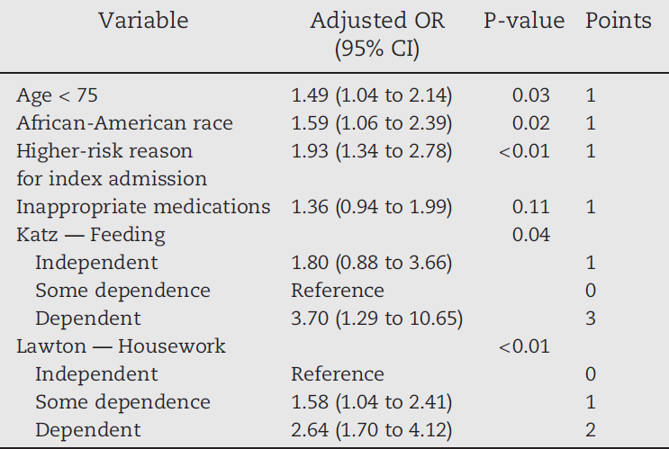
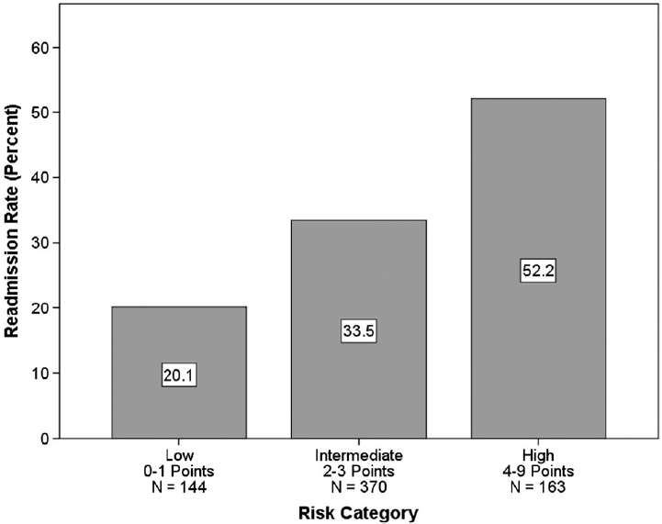
Results / Prognostic Index

Slide 19
Discussion / Questions
…

Slide 20
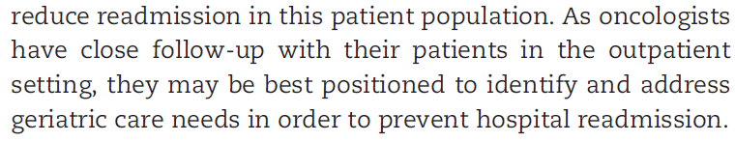
Conclusion

Slide 21


