Slide 1
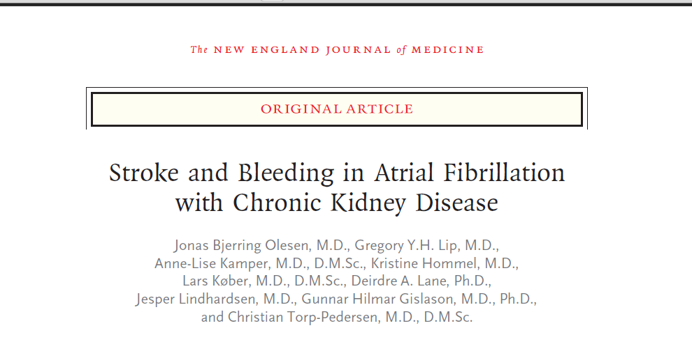

Slide 2
Case
66 year old male with PMH of HTN, DM, ESRD on renal replacement TIW, stroke in 2011 with right side residual weakness, atrial fibrillation, currently on warfarin has been in the VA nursing home when found down on the floor by the RN.
Patient back to baseline
Vitals stable.
Sent to OSH where CT head shows old stroke.
Work up at outside including cardiac echo, carotid US negative.
PMH: as above plus two previous episodes of falling

Slide 3
Question
Is Aspirin beneficial in stroke prevention in this patient?

Slide 4
Background
Atrial fibrillation increases the risk of stroke by a factor of 5
The U.S.-based Renal Data System has reported that chronic kidney disease (CKD) increases the risk of stroke by a factor of 3.7
End stage renal disease (ESRD) requiring renal replacement therapy increases the risk by a factor of 5.8

Slide 5
Background
Wizemann et al, 2010
Use of warfarin may increase the risk of ischemic stroke among patients undergoing dialysis.
Reinecke et al, 2009
Risk of bleeding associated with warfarin treatment is increased among patients with atrial fibrillation who also have CKD.
Large randomized trials of antithrombotic therapy in patients with atrial fibrillation have typically excluded patients with moderate-to-severe CKD

Slide 6
Study Objective
Determine the risk of stroke or systemic thromboembolism and bleeding associated with chronic kidney disease among patients with atrial fibrillation and to determine whether the effect of warfarin and aspirin differed between patients with and those without chronic kidney disease

Slide 7
Study Design
Observational cohort study
Data obtained from Danish national registries and linked to individuals
Sponsored by the Lundbeck Foundation
No role in the conduct of the study.
Approved by the Danish Data Protection
agency.

Slide 8
Study Population
All patients discharged from the hospital with a diagnosis of non valvular atrial fibrillation during 1997 through 2008
Baseline pharmacologic treatment with drugs
other than warfarin and aspirin was determined
on the basis of prescriptions filled from 180 days
before discharge to 7 days after discharge.

Slide 9
Study Population
Patients with chronic kidney disease not requiring renal replacement therapy were identified from the national patient registry.
Patient requiring renal replacement therapy or had a renal transplant were identified through the national registry on regular dialysis and transplantation.
Renal status was determined at baseline and could be modified during follow up.

Slide 10
Exclusion criteria
Patients were excluded if they died, had a thromboembolic event, or had major bleeding during the 7 days before the baseline assessment.
Patient on Plavix or Dipyridamole

Slide 11
Stage and type of CKD
Different stages of renal disease patients were stratified according to dose of loop diuretics
Influence of renal disease was identified by comparing the following diagnostic groups
Autosomal dominant polycystic kidney disease
Chronic tubulointerstitial nephropathy
Chronic glomerulonephritis
Diabetic nephropathy
Hypertensive nephropathy and other causes

Slide 12
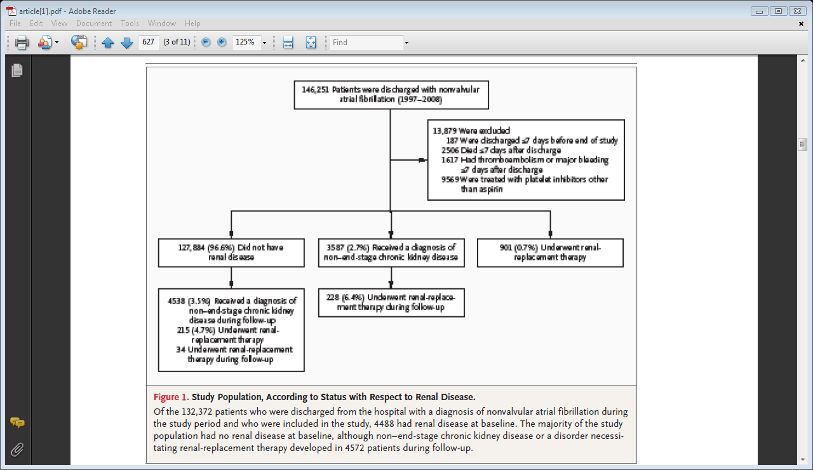
Study population with respect to renal status

Slide 13
Stroke assessment
The predicted risk of stroke or systemic thromboembolism for all patients was assessed with the use of the CHA₂DS₂-VASc score, which reflects the risk of stroke among patients with atrial fibrillation who are not receiving anticoagulant therapy, with values ranging from 0 to 9 and with higher scores indicating greater risk

Slide 14
CHA₂DS₂-VASc
Congestive heart failure
Hypertension,
Age >75 years
Age 65-74 years
Diabetes mellitus,
History of stroke or thromboembolism,
Vascular disease,
Female sex

Slide 15
Bleeding risk assessment
The predicted risk of bleeding was assessed with the use of the HAS-BLED score, which reflects the risk of major bleeding among patients with atrial fibrillation who are receiving anticoagulant therapy, with values ranging from 0 to 9 and with higher scores indicating greater risk

Slide 16
Bleeding risk assesment
Hypertension
Abnormal liver function or renal function*
Stroke or thromboembolism
Bleeding
Labile INRs*
Elderly (age ≥65 years)
Drugs (NSAIDS or Alcohol)
*abnormal renal function was not included (since chronic kidney disease was the subject of the study) and labile international normalized ratios (because these data were not available

Slide 17
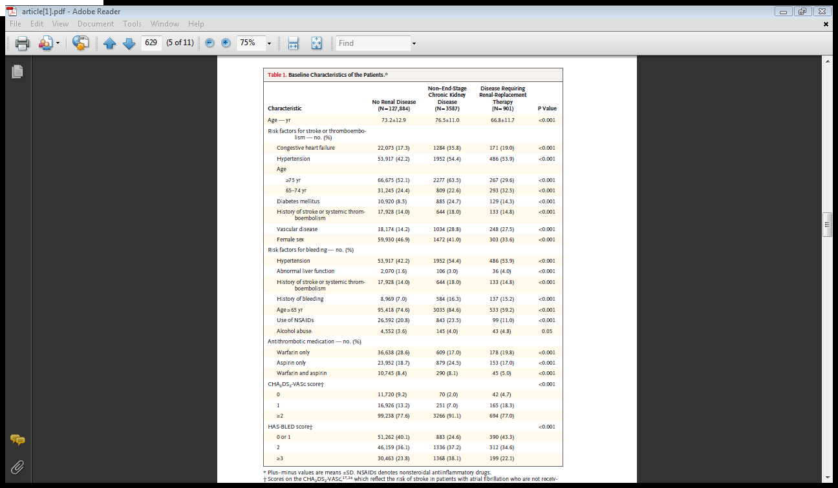
Baseline characteristics

Slide 18
Study Outcomes
Hospitalization or death from stroke or systemic thromboembolism (peripheral-artery embolism, ischemic stroke, and transient ischemic attack),
Bleeding (gastrointestinal, intracranial, urinary tract, and airway bleeding),
myocardial infarction, and
death from any cause.
A secondary analysis of the risk of stroke or systemic thromboembolism excluded transient ischemic attack.

Slide 19
Statistical Analysis
Comparisons of characteristics among patients with different renal status at baseline were performed with the use of the chi-square test for categorical covariates.
Risk of stroke or systemic thromboembolism bleeding, myocardial infarction, and death from any cause were estimated by means of time-dependent Cox proportional-hazards models with adjustment for all baseline characteristics.

Slide 20
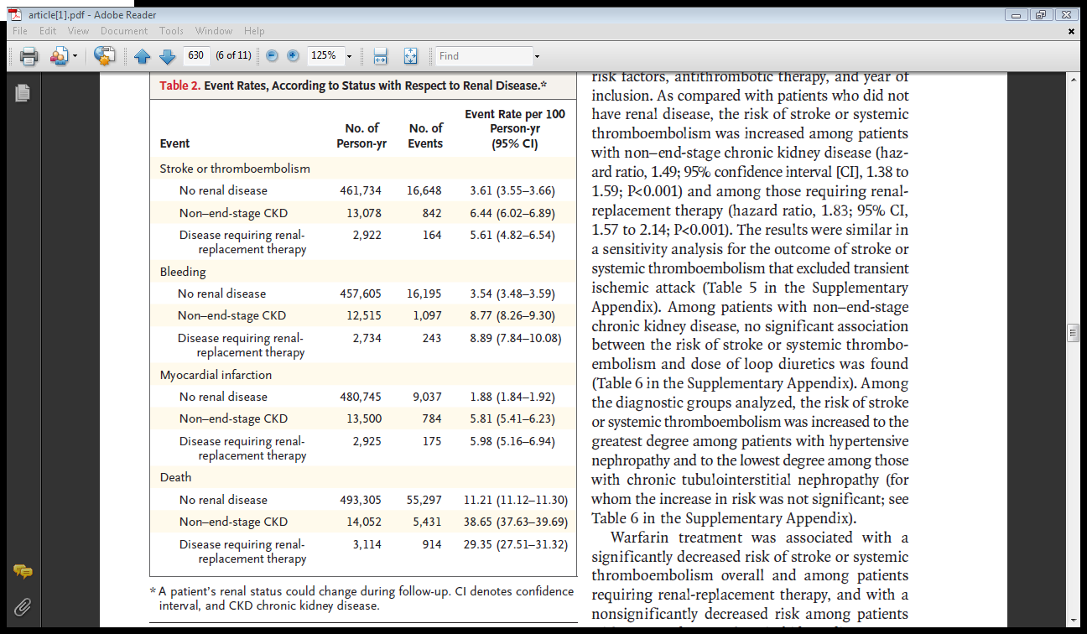
Rates of stroke or systemic thromboembolism, bleeding, myocardial infarction, and death

Slide 21
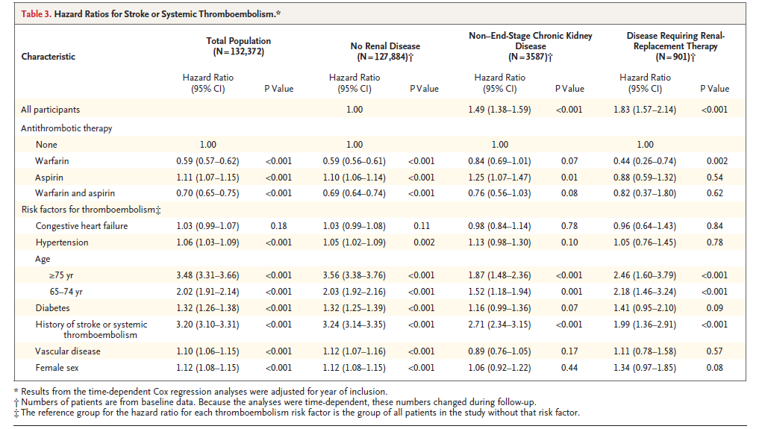
Hazard ratio for Stroke/Thromboembolism

Slide 22
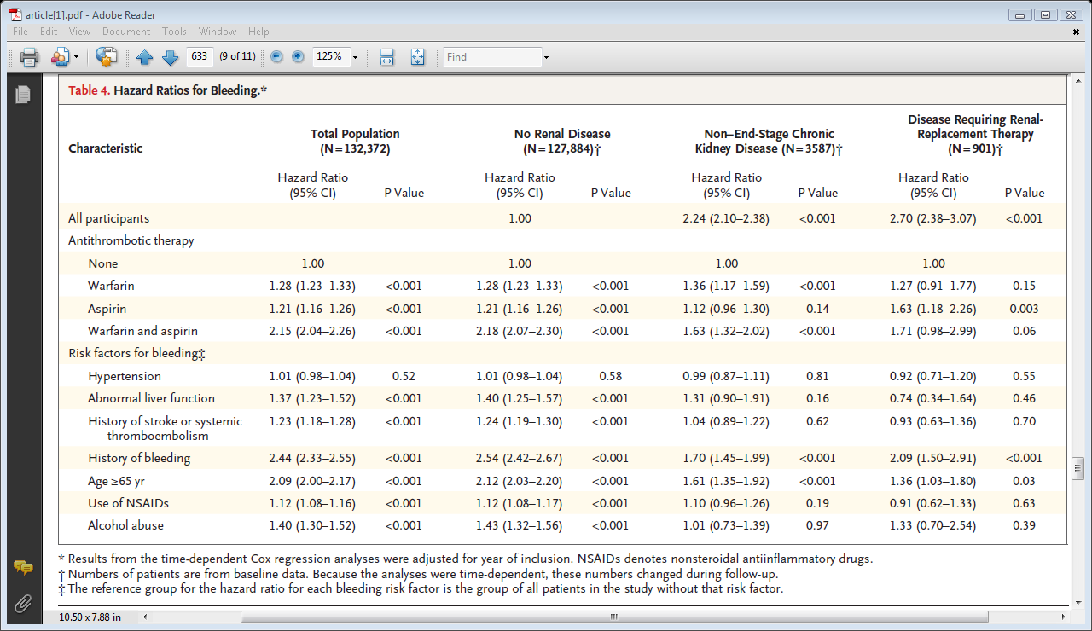
Hazard ratio for bleeding

Slide 23
Risk of Myocardial Infarction and Death
 | No renal disease | Chronic kidney disease | Renal disease requiring renal replacement therapy
Risk of Myocardial infarction | 1 | 2.00; 95%CI, (1.86 to 2.16); P<0.001 | 3.00;95% CI,( 2.58 to 3.5);P<0.001
Risk of Death | 1 | 2.37;95% CI,(2.30 to 2.44);P<0.001 | 3.35;95%CI,(3.13 to 3.58); P<0.001

Slide 24
Limitations
Observational study
Patients with heart failure, DM, HTN were identified on basis of filled prescriptions so patients treated with life style modifications not identified.
Bleeding outcomes restricted to hospitalization or death related to gastrointestinal bleeding, intracranial bleeding, bleeding from the urinary tract, and airway bleeding, and the results
cannot be applied to the risk of other types of bleeding

Slide 25
Back to the case

Slide 26
Thank You

