Slide 1
A Pooled Analysis of Vitamin D Requirements for Fracture Prevention
Yasser Rehman, MD
Journal Club
August 10, 2012

Slide 2
CASE
82 YR old female living in NH with PMH of HTN, DM, mild dementia brought in with left hip fracture after suffering a mechanical fall

Slide 3
Past Medical History
HTN
DM
HYPERLIPIDEMIA
DEMENTIA likely Alzheimer’s

Slide 4
Medications
Atenolol 50mg daily
Glyburide 10mg daily
Zocor 20mg at night time daily
Aricept 10mg daily
Calcium 500mg daily
Vitamin D 400IU daily

Slide 5
ADLs and IADLs
Uses a cane for walking,
Needs assistance with dressing and bathing,
Able to eat and toilet.
Uses prefilled meds
Home maker for laundry and cleaning
Daughter helps with shopping and finances

Slide 6
CASE
Patient is admitted to the orthopedics service
Medicine service is consulted and pt. cleared to undergo surgery
Undergoes ORIF. Tolerates procedure well
Post op patient evaluated by PT and recommended to undergo physical rehab

Slide 7
CLINICAL QUESTION
Can we reduce fractures in the elderly ?

Slide 8
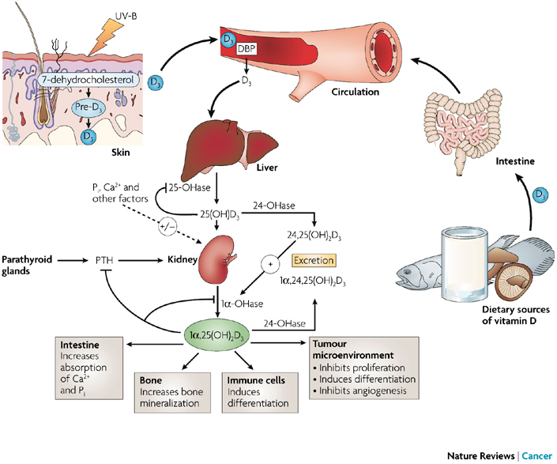
Vitamin D Metabolism

Slide 9
Background
75% fractures in people > 65 years.
Numbers expected to rise as geriatric population rises.
Study results examining vitamin D supplementation and fracture reduction have been inconsistent.

Slide 10
Prior Studies
Bischoff-Ferrari et al. , 2009
Daily vitamin D of 482 IU reduced hip fracture by 18% and non vertebral fractures by 20%
Boonen S et al. , 2007
Vitamin D reduces the risk of hip fractures only when given along calcium supplements
Cochrane review 2009
Similar findings

Slide 11
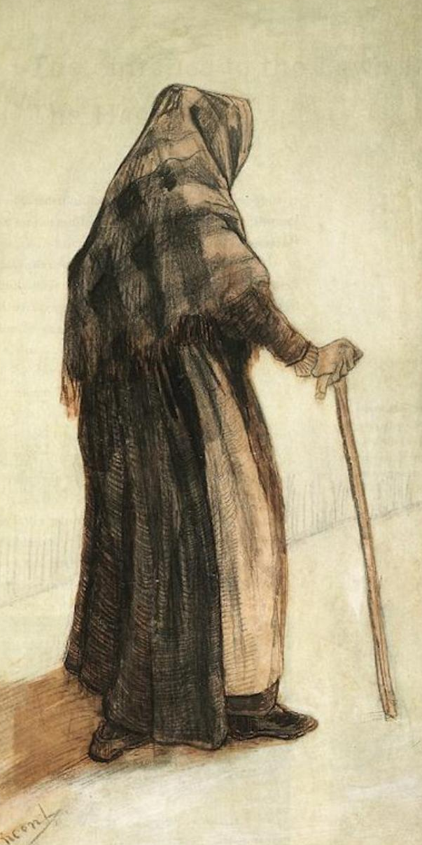
Study Objective
The effect of oral vitamin D supplementation according to the actual intake of each participant on the incidence of hip or non vertebral fractures in patients 65 years or older

Slide 12
Study Design
Data from 12 double blind randomized controlled data of vitamin D supplementation with or w/o calcium vs. placebo or calcium alone in patients 65 years or older was pooled
Primary end point was to measure the risk of hip fracture and non vertebral fractures

Slide 13
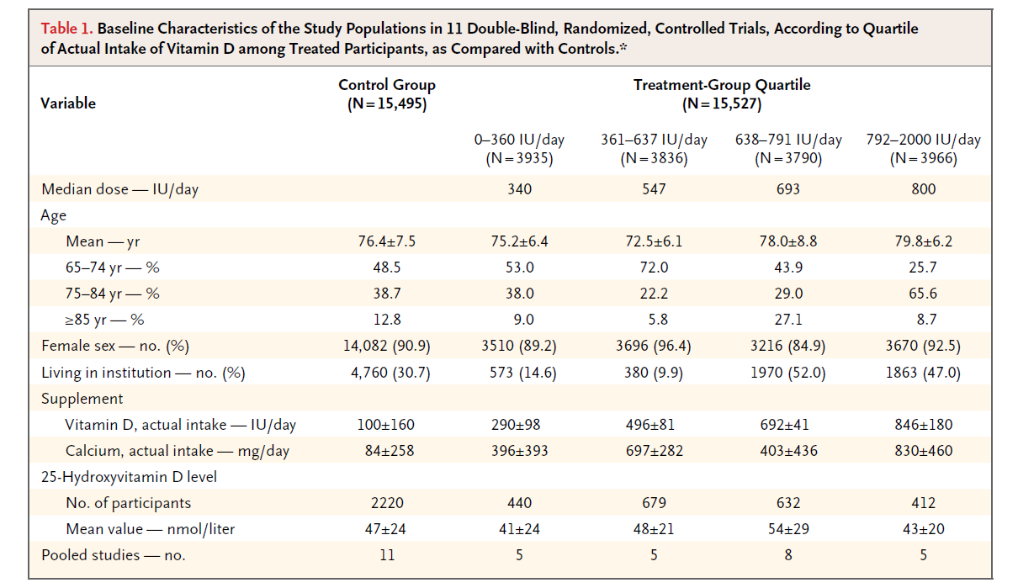
Baseline Characteristics

Slide 14
Inclusion Criteria
All double blind, randomized controlled trials involving persons 65 yr or older that evaluated oral vitamin D with or without calcium as compared with a control (placebo or calcium) and had information on low trauma fractures

Slide 15
Meta Analysis
14 studies screened
Two not used due to lost files
Twelve studies reviewed with source data for 30,011 participants received

Slide 16
Primary Analyses
Primary end points - risk of hip fracture and any non vertebral fracture
The primary analyses compared the actual intake of vitamin D supplementation, in quartiles, between treated participants and controls

Slide 17
Analyses
Internal validation study
Sensitivity analyses
Subgroup analyses
Statistical Analysis

Slide 18
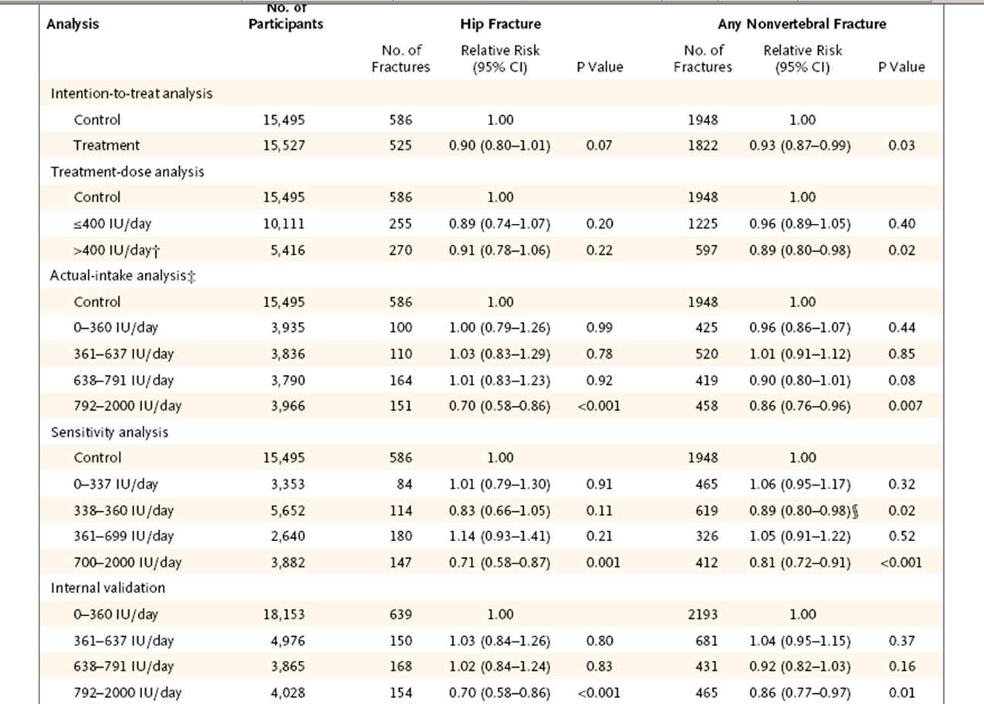
Incidence of Fracture

Slide 19
Results
Intention to treat analysis - 10%reduction in risk of hip fracture
Actual intake - 30% reduction in the incidence of hip fracture at the highest actual-intake level (792 to 2000IU daily.
Similar pattern noted for the non vertebral group as well

Slide 20
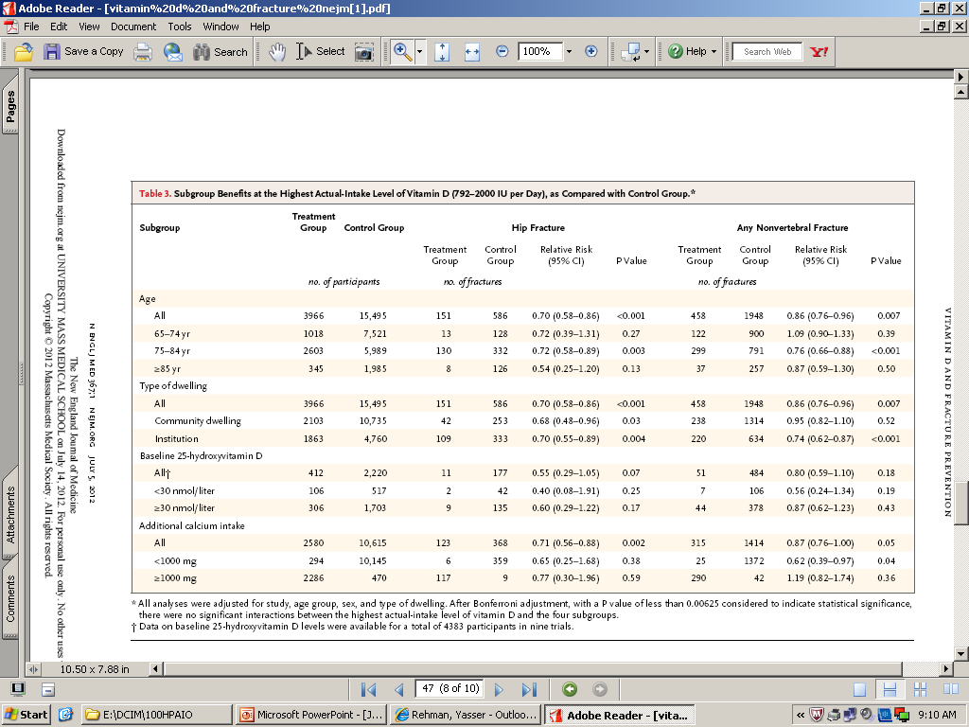

Slide 21
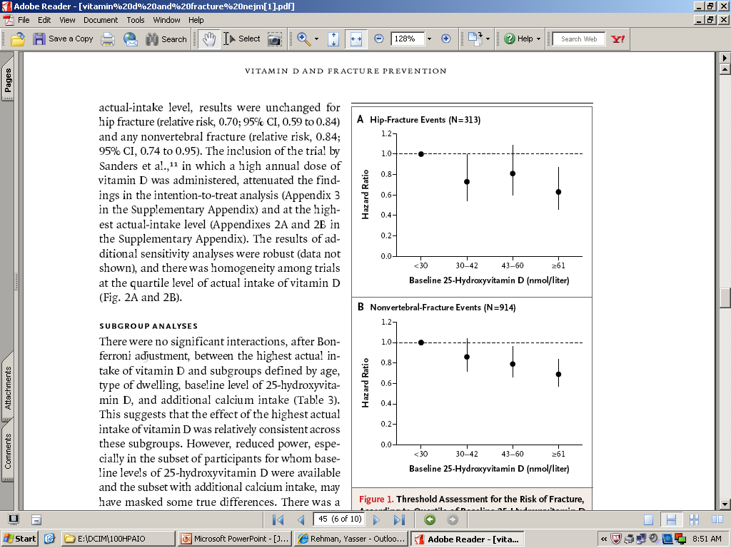
25(OH) vitamin D level and fractures

Slide 22
Discussion
Previous meta-analyses – vitamin D benefits older persons living in institutions only.
Subgroup analyses - all people aged 65 years or older benefited in terms of hip fracture reduction at the highest actual intake of vitamin D whether in both community and institution setting

Slide 23
STRENGTHS
Large sample size
Assessment of fracture risk by actual intake of vitamin D
Consistency of the primary findings and the internal validation study

Slide 24
Limitations
Effect of vitamin D alone could not be assessed as calcium given concurrently in studies.
Unavailability of the source data for the 2 of the 14 qualifying studies.
Baseline level of hydroxy vitamin D were available for only a subset of participants and the assays used to measure it also varied.

Slide 25
This study supports the recommendation by the institute of medicine (IOM) that people aged 65 years or older receive 800 IU of vitamin D per day.
However it also suggest that a hydroxy vitamin D level greater than 60nmol per liter might be more beneficial in reducing the risk of fracture

Slide 26
Back to Case
What recommendations would you make for our patient

Slide 27
Thank You

