Slide 1
Relapse Risk after Discontinuation of Risperidone in Alzheimer’s Disease
Devanand et al
NEMJ 2012; 367:1497-1508
.
By Hila Hoch, MD

Slide 2
Background
Agitation or psychosis is common in AD
Caregiver burden, NH placement
Non-pharmacologic strategies recommended,
Among psychotropic medications, only anti-psychotics have shown benefit over placebo, with still conflicting evidence….

Slide 3
Behavioral symptoms in Dementia
Neuropsychiatric symptoms are common in dementia: agitation, delusions, hallucinations, and wandering, sexually inappropriate behavior
61-92% of patients with advanced dementia
Abusive behavior toward caregiver for unprovoked events
Pharmacotherapy not necessary if neither patient nor family disturbed by them.
Non-pharmacological interventions should be 1st attempted

Slide 4
Case Study
86 year old veteran with medical history of CAD, HTN, carcinoma of prostate, atrial fibrillation, advanced dementia. Veteran is a long-term care patient.
Medications:
Trazodone 75mg QHS, aspirin 81mg, docusate 100mg BID, pravastatin 20mg QHS, pantoprazole 40mg Qam, digoxin 0.125mg Q am, metoprolol succinate SA 75mg Qpm.
‘Physically aggressive, showing teeth, making fists, for unprovoked events. Becoming threatening to staff, especially female staff’. Requesting psych consult!

Slide 5
Non-Pharmacologic Management
Onset, duration, course of symptoms
Concomitant medical illness, side effects of medications, and pain should be ruled out as trigger to aggressive behavior.
Avoiding environmental changes
Avoiding sudden changes in the surroundings
Improved personal patient centered care
Structured Exercise Training
Music Therapy, pet therapy

Slide 6
Antipsychotics
Typical and Atypical
Risks of sedation, anti-cholinergic side effects, parkinsonism, metabolic syndrome, atrial fibrillation
Mortality as high as 1.6 times placebo
Increased risk of stroke, myocardial infarction and death

Slide 7
More complications
Movement disorders
Falls (hip fractures)
Cerebrovascular events and TIA’s
Risk of death
Therefore: Antipsychotic medications must be prescribed at the lowest possible dosage for the shortest period of time and are subject to gradual dose reduction and re-review

Slide 8
Inadequate Indications
Poor self-care
Restlessness
Impaired memory
Mild anxiety
Wandering
Insomnia
Inattention
Uncooperativeness

Slide 9
Criteria for use of psychotropics
The behavioral symptoms present a danger to self or others
AND one or both of the following:
The symptoms are identified as being due to mania or psychosis (auditory/visual or other hallucinations; delusions, paranoia or grandiosity); OR
Behavioral interventions have been attempted but were not helpful

Slide 10
Tapering down of psychotropics
An end to prolonged un-necessary use
During first year of use, gradual dose reduction must be tried in two separate quarters
Attempts should be made one month apart
After one year of use, need to attempt tapering down at least once a year
Risks/Benefits
Unless symptoms worsen after reduction

Slide 11
Goal of study
Establish risk of recurrence of symptoms in patients with AD who have a good response to risperidone for treatment of psychosis or agitation, after discontinuation of tx
Hypothesis: Relapse rate will be lower in patients who continue risperidone than in patients who switch to placebo

Slide 12
Methods of Study
Phase A: Patients with AD received risperidone for 16 weeks.
Phase B: Those patients having a response to risperidone randomized blindly to 3 groups
Group 1. Risperidone for 32 wks
Group 2. Risperidone for 16 wks, then placebo for 16 wks
Group 3. Placebo for all 32 wks of study

Slide 13
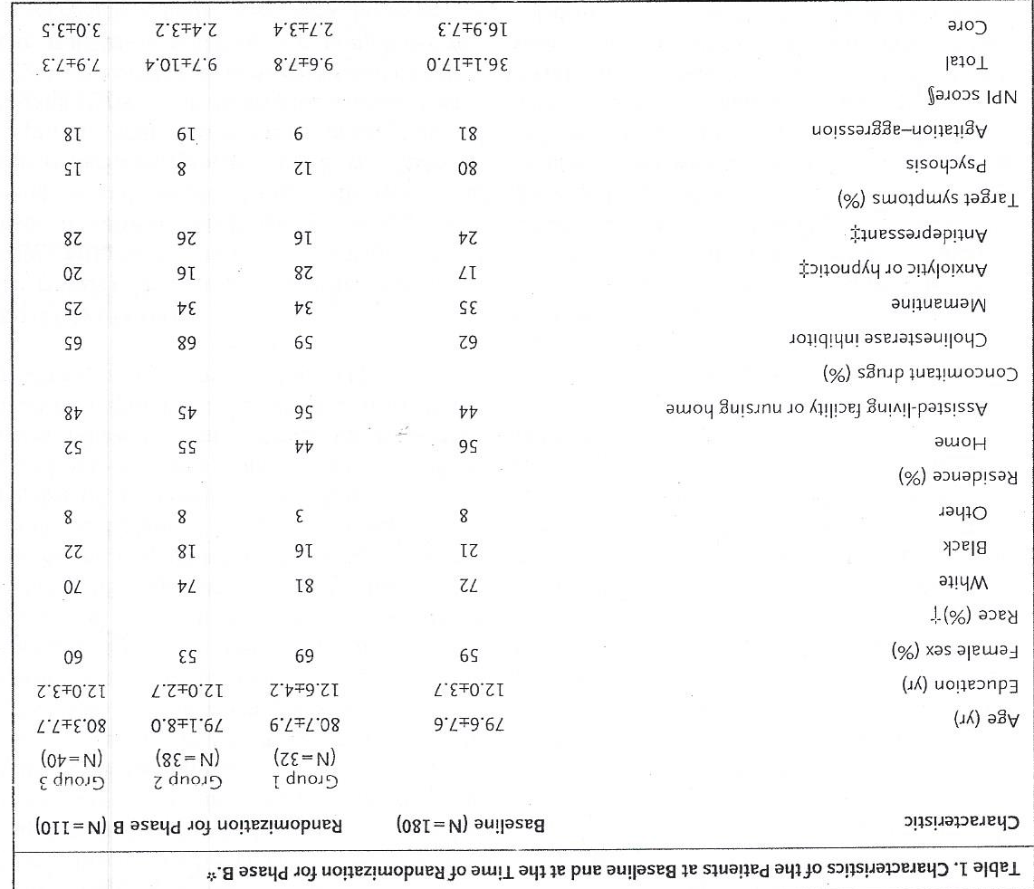

Slide 14
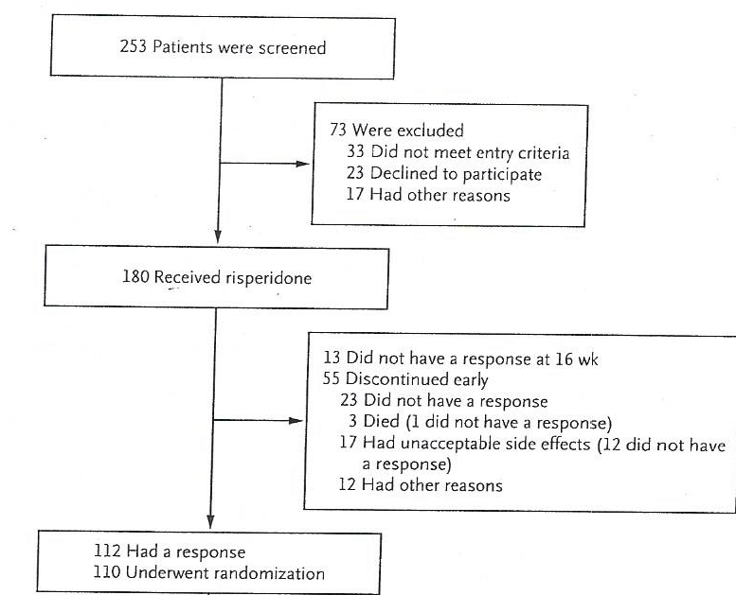

Slide 15
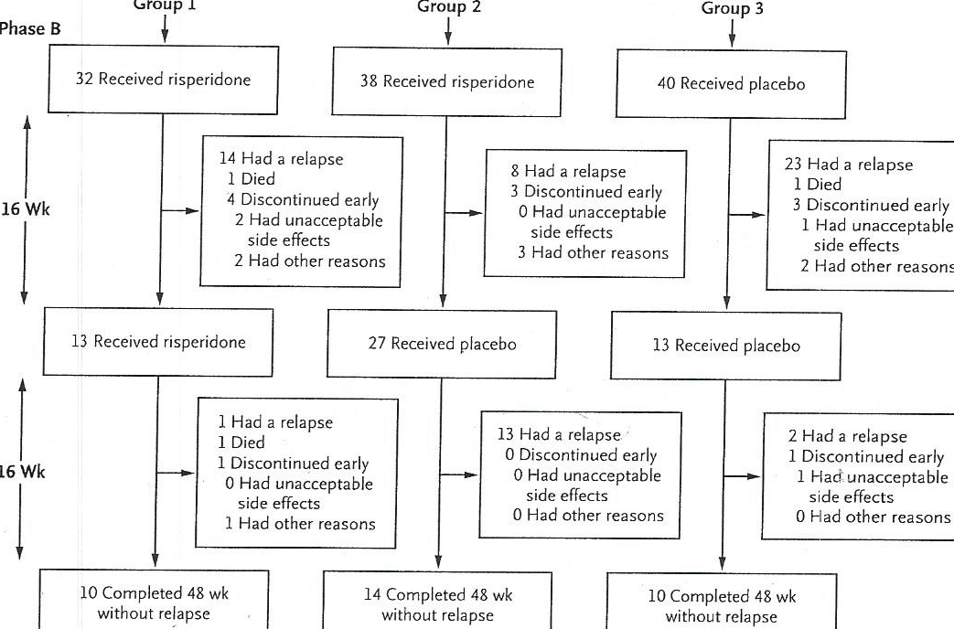

Slide 16
Inclusion Criteria
AD in outpatient setting
Living at home, assisted-living or nursing home
Age 50-95, mean age 80+/-8 years
NPI>4 on psychosis or agitation scale
MMSE 5-26 (community) or MMSE 2-26 (NH)
NPI scale: subscales for delusions, hallucinations, and agitation/aggression (0-36)

Slide 17
Exclusion Criteria
History of psychiatric disorder
History of substance abuse
History of stroke
History of seizures
Atrial Fibrillation
At risk for suicide or homicide
Allergy/Intolerance to risperidone

Slide 18
Outcome measures
Phase A: Positive response to risperidone if 30% reduction in baseline score on NPI and socre of 1 or 2 on CGI-C
Phase B: Relapse if NPI increase of 30% or 5 point increase on CGI-C

Slide 19
Secondary Outcome Measures
Adverse effects of treatment
EPS severity (Simpson Angus Scale):0-40
Tardive Dyskinesia (AIMS)-’Abnormal involuntary Movement Scale 0-35
Cognition (MMSE and ADAS-COG)
Physical function (Physical Self-Maintenance Scale)-0-30

Slide 20
Results
Phase A: 112/180 (62%) had positive response (responded to risperidone), 110 randomized
Phase B: First 16 wks: 60% (24/40)on placebo (Group 3) relapsed vs. 33% (23/70) on risperidone (Groups 1 & 2), p=0.004
NNT of 28.5 patients/week to prevent 1 relapse)
Second 16 wks: 48% (13/27)on placebo relapsed vs. 15% (2/13)on risperidone, p=0.02

Slide 21
Results-Cont.
No significant differences in rates of adverse events amongst the different treatment groups.
No significant differences in extrapyrimidal signs, tardive dyskinesia or cognitive status per scales used.
3 deaths during Phase A (2 in risperidone, 1 in placebo group), and 3 deaths in phase B with no pattern observed with respect to cause

Slide 22
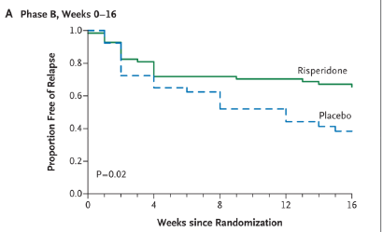

Slide 23
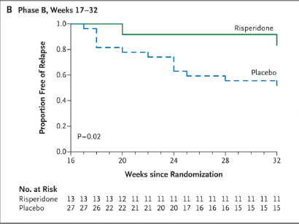

Slide 24
Discussion
In patients who initially responded to risperidone, discontinuation was associated with an increased risk of relapse for at least 4 months.
Risperidone is not highly effective in achieving or sustaining a reduction in psychosis or agitation in AD
Rates of discontinuation for any reason:
38% in Phase A
68% in Group 1 during 32 wks, 29% in Group 2 during first 16 wks

Slide 25
Discussion –Cont.
Little harms of treatment in this population over short period study time of 32 weeks
Will continue to need a multifactorial approach to management of these challenging patients

Slide 26
Type of study: Therapy/Prevention
Was the assignment of patients randomized?
YES
Was the randomization blind?
Yes
Were the groups similar demographically at the beginning of the study?
Yes
Multi-center study

Slide 27
Limitations
Short study: 32 weeks
Small sample
Comparison to placebo
Solely based on outpatient setting
Homogeneous population
Abrupt withdrawal instead of Gradual Dose Reduction: Phase B tapered over 1 week only if risperidone dose> 2mg to avoid withdrawal

Slide 28
Cochrane Database Syst Rev 2013
‘Our findings suggest that many older people with Alzheimer's dementia and NPS can be withdrawn from chronic antipsychotic medication without detrimental effects on their behaviour. It remains uncertain whether withdrawal is beneficial for cognition or psychomotor status, but the results of this review suggest that discontinuation programs could be incorporated into routine practice.
However, two studies of people whose agitation or psychosis had previously responded well to antipsychotic treatment found an increased risk of relapse or shorter time to relapse after discontinuation. Two other studies suggest that people with more severe NPS at baseline could benefit from continuing their antipsychotic medication. In these people, withdrawal might not be recommended’.

Slide 29
Back to our case…
Can we apply the study to our patient?
Thank you!

