Slide 1
Osteoarthitis
&
Cartilage
By Hila Hoch, MD
NASHA Hyaluronic Acid Vs. Methylprednisolone for Knee Osteoarthritis
A prospective multi-center randomized non inferiority trial, Leighton et al (10/22/13)

Slide 2
Case Study
A 76 year old female from Cape Verde
Medical HX significant for HTN, DM with neuropathy on insulin, hyperlipidemia, diastolic HF with pEF, bilateral knee osteoarthritis, COPD.
Complaint: Recurrent knee pain. Is taking standing acetaminophen and prn tramadol.
Has just received intra-articular steroids 3 months ago. What next?

Slide 3
Background: Osteoarthritis
Knee osteoarthritis is common
Progressive joint disease
One of the 5 leading causes of disability among non-institutionalized adults
40% report their health as poor or fair
Major socioeconomic burden, job related losses between 3.4 and 13.2$ billion/year

Slide 4
Background
Mild cases->Simple analgesia, lifestyle modifications
Advanced cases->Knee replacement
Moderate cases->Intra-articular injections
Steroids-> powerful anti-inflammatory effect
In recent years, HA! Restore viscoelasticity of synovial HA and its natural protective functions in the joint

Slide 5
Background
Intra-articular hyaluronic acid (IA HA) is an established treatment for knee osteoarthritis.
Options for analgesics for osteoarthritis include simple analgesics, NSAIDS, and COX2 Inhibitors, but all associated with safety concerns especially for the elderly population
Intra-articular steroids short-lived and with side effects

Slide 6
Hyaluronic Acid
A physiologic component of the synovial fluid
Is reduced in OA joints
Viscoelastic properties and protective effect on articular cartilage
Restore normal articular homeostasis
3-5 dose regiment with 1 week interval between injections

Slide 7
NASHA
Hyaluronic Acid
High Molecular Mass
Prolonged time of effect
Half life around 4 weeks
Previous studies demonstrated benefit for six months
Previous studies showed it to be similar in benefit to steroid in 12 week trial

Slide 8
Hypothesis
NASHA is at least as effective as MPA which is today’s standard treatment.
Non-Inferiority Trial

Slide 9
Study Design
Prospective
Multi-center (Canada, UK, Sweden)
Double Blinded (participants+ investigators)
26 week study+ Un-blinded Extension Phase
Study protocol reviewed and approved by Independent Ethics Committees/Institutional Review Boards

Slide 10
Study Objectives
Primary objective: Determine whether NASHA is non-inferior to MPA in Western Ontario and McMaster Universities Osteoarthritis Index (WOMAC) pain responder rate defined as improvement from baseline of >40% and an absolute improvement of 5 points at 12 week post treatment
Secondary Objective: Assess safety of NASHA compared with MPA

Slide 11
Study Design
442 Participants-baseline with no significant demographic differences (Table I)
221 treated with NASHA
221 treated with MPA
Analysis done 0-26 weeks blinded
At 26 weeks, 342 patients elected to receive open label NASHA, 163 from NASHA group, and 179 from MPA group
(Figure I)

Slide 12
Study: Where? When?
Multiple Study Sites:
Canada (15 sites, 284 participants)
UK (4 sites, 36 participants)
Sweden (5 sites, 122 participants)
March 27, 2007-November 12, 2008
Data published 10/2013 Osteoarthritis & Cartilage Journal

Slide 13
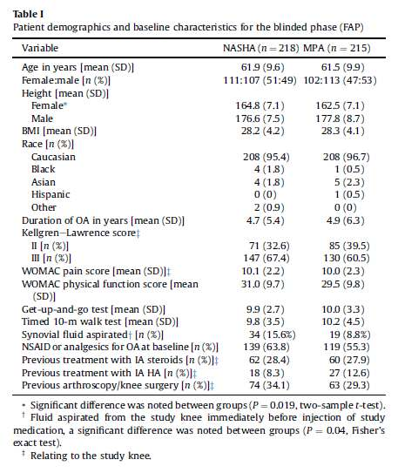
Table I

Slide 14
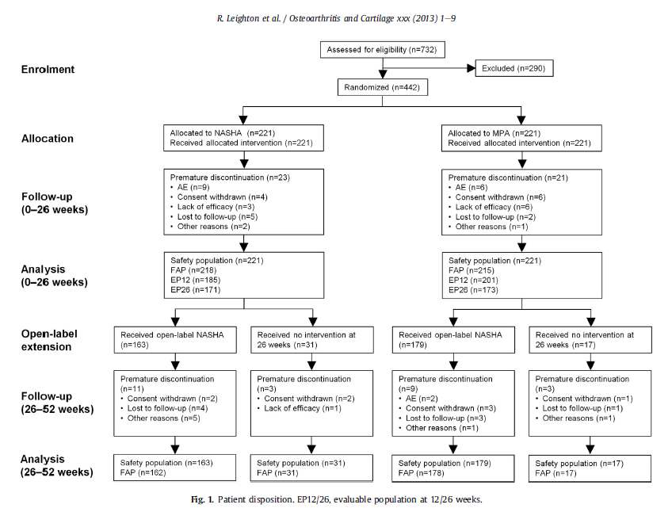
Figure I

Slide 15
Participants-Inclusion Criteria
442 participants (M+F)
Ages 35-80
BMI of <40
Ability to walk 50 meter unaided
Unilateral knee pain
Meeting American College of Rheumatology criteria for osteoarthritis
WOMAC pain score 7-17

Slide 16
Exclusion Criteria
Clinically detectable knee effusion
Clinical significant contralateral knee OA
Clinically significant pain in joints other than the knee
IA steroidal injection into the study knee within the past 3 months
IA HA injection into study knee within 9 mo. of study
Use of systemic steroids within preceding 3 mo.
Arthroscopy in the study knee within preceding 12 mo.

Slide 17
Study Treatments
Eligible patients randomized 1:1 to receive single IA injection of either NASHA or MPA
Randomization computer generated
Investigators Blinded. Identities of both the study and reference product concealed by identical packaging labeled with subject number
The treating investigator was the only one aware of the identity of package. Concealed to other assessing investigators.
Subjects also blinded to treatment, by using drapes to prevent them from seeing procedure

Slide 18
Schedule
Screening visit (Visit 1)
Baseline visit, IA injection (Visit 2)
Telephone calls at 2 & 4 weeks post-injection to evaluate safety and concomitant medication use
Clinic visits at 6,12,18, 26 weeks post injection (Visits 3-6) to conduct effectiveness and safety assessments
Rescue acetaminophen up to 3g/day allowed

Slide 19
Open Label Extension Phase
Can one injection cause sensitivity to 2nd injection? And what are the benefits?
Subjects attending visit of week 26 offered a single un-blinded IA injection of NASHA.
Clinic visits scheduled for week 28, 39, 52 weeks after initial injection.
The patient, treating investigator and assessing investigator unaware of which treatment was administered at first injection
Patients not wanting NASHA were also followed to 52 weeks.

Slide 20
WOMAC INDEX
Pain: five items, score 0-20
Stiffness: two items, score0-8
Physical function: 17 items, score 0-68
Patient global status: 5point scale
Get up and go test
WOMAC pain responder rate defined as improvement in WOMAC pain score of at least 40% vs. baseline and an absolute improvement of at least 5 points

Slide 21
WOMAC INDEX-Pain
Instructions: Please rate the activities in each category according to the following
scale of difficulty: 0 = None, 1 = Slight, 2 = Moderate, 3 = Very, 4 = Extremely
Circle one number for each activity
Pain
1. Walking 0 1 2 3 4
2. Stair Climbing 0 1 2 3 4
3. Nocturnal 0 1 2 3 4
4. Rest 0 1 2 3 4
5. Weight bearing 0 1 2 3 4

Slide 22
WOMAC INDEX-Stiffness
Stiffness
1. Morning stiffness (0-4)
2. Stiffness occurring later in the day (0-4)

Slide 23
WOMAC INDEX –Physical FX
Physical Function
1. Descending stairs 0 1 2 3 4
2. Ascending stairs 0 1 2 3 4
3. Rising from sitting 0 1 2 3 4
4. Standing 0 1 2 3 4
5. Bending to floor 0 1 2 3 4
6. Walking on flat surface 0 1 2 3 4
7. Getting in / out of car 0 1 2 3 4
8. Going shopping 0 1 2 3 4
9. Putting on socks 0 1 2 3 4
10. Lying in bed 0 1 2 3 4
11. Taking off socks 0 1 2 3 4
12. Rising from bed 0 1 2 3 4
13. Getting in/out of bath 0 1 2 3 4
14. Sitting 0 1 2 3 4
15. Getting on/off toilet 0 1 2 3 4
16. Heavy domestic duties 0 1 2 3 4
17. Light domestic duties 0 1 2 3 4

Slide 24
Safety Analysis
Adverse Effects noted as # and %
Classified as ‘mild’, ‘moderate’, ‘severe’
Relationship to study treatment

Slide 25
Statistical Methods
Using SAS software
Two sided statistical tests
Significance level of 5%
Primary effectiveness endpoint was WOMAC pain responder rate, non inferiority of NASHA to MPA
Secondary effectiveness outcomes included:
WOMAC pain responder rate, WOMAC pain score, WOMAC physical function score, WOMAC stiffness score, patient assessment of global status, physical activity assessment, Functional mobility assessment (Get up and go)

Slide 26
Results: Blinded Phase (0-26 wks)
At 12 Weeks NASHA non-inferior to MPA
NASHA: 44.6%, MPA: 46.2%; 95% CI of difference -11.2%-+7.9%
WOMAC pain responder rates at weeks 6,12, 18 remained comparable between NASHA and MPA
Between weeks 18-26, the WOMAC pain responder rate remained stable in NASHA group, while there was a decrease in MPA. NASHA non-inferior, superiority not seen

Slide 27
Results –Continued
MPA provided early improvement in pain, with the improvement reaching maximum at 6 weeks and declining until 26 weeks.
NASHA with lower initial reduction, but no substantial decline between weeks 6-26, higher response rate to NASHA at 26 weeks
Improvement from baseline larger for NASHA than MPA at week 26
NASHA eliciting greater improvement than MPA at weeks 12,18,26 in WOMAC physical function, stiffness

Slide 28
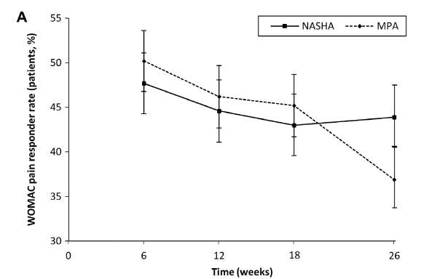
Figure 2A

Slide 29
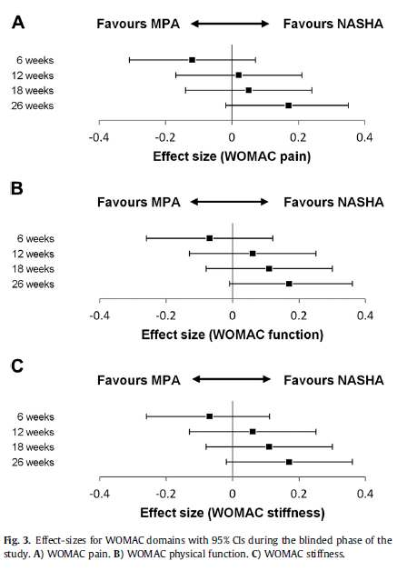
Figure 3

Slide 30
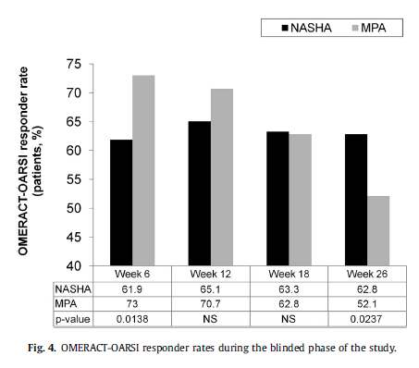
Figure 4

Slide 31
Open-label extension (26-52 weeks)
Patients who received NASHA at 26 weeks showed higher WOMAC pain responder rate at 39 & 52 weeks than at 26 weeks
The extent of improvement was similar whether patients initially received NASHA or MPA
The responder rate was lower in the MPA group than the NASHA group at 26 weeks and this difference was maintained at 39 &52 weeks, with statistical sig at 39 weeks

Slide 32
WOMAC pain score among recipients of NASHA at 26 weeks decreased by approximately one point between 26 & 39 weeks in both NASHA->NASHA and
MPA-> NASHA groups
Small additional decrease between 39 & 52 weeks.

Slide 33
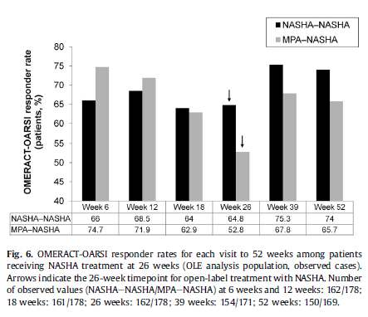
Figure 6

Slide 34
Safety results
The number of treatment related adverse effects was 64 in NASHA group (48/221) and 15 in MPA group (15/221).
Most common side effect, arthralgia
Most commonly within 3 days of injection and resolved within 2-3 weeks (NASHA 17.5 days, MPA 15.5 days)

Slide 35
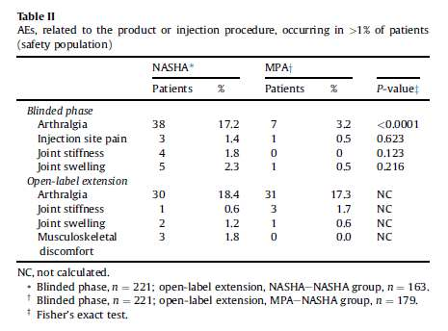
Table II

Slide 36
Discussion
NASHA non-inferior to MPA
Little deterioration in WOMAC responder rate observed between 12 and 26 weeks in NASHA group
Significant deterioration observed in MPA group between 18 and 26 weeks
Open label treatment with NASHA at 26 weeks provided improvement lasting to 52 weeks and showed NASHA provided benefit in patients previously treated with MPA

Slide 37
Discussion
MPA demonstrated earlier effectiveness with short duration
NASHA showed slower time to onset but longer lasting pain relief
Further injections of NASHA may be administered after NASHA or MPA
NASHA works also in non end-stage knee osteoarthritis

Slide 38
Strengths of study
MPA as control (MPA standard of care)
Big sample, big study arms
Long study period
Similarity of patients at baseline
1: 1 randomization
Prospective study
Blinded (participants+ investigators)
Multi-center trial
Low drop out rate, 90% completion at 26 wks
WOMAC pain responder rate scale

Slide 39
Limitations of study
No placebo control group (unethical?)
Primarily Caucasian population
More patients in NASHA group than in MPA group had synovial fluid aspirated at time of injection (NASHA 15.6%, MPA 8.8% P=0.04). More fluid aspirated, better results
Statistically significant 2.3cm difference in height of female subjects (NASHA: 164.8cm, MPA:162.5cm; P=0.019)

Slide 40
Practice Guidelines-ACR
AFP, 4/13
Non-pharmacologic: Aquatic/aerobic exercise program, proper BMI, thermal agents, walking aids if needed, tai chi
Pharmacologic:
Recommendations for initial management with acetaminophen, intra-articular steroids, oral or topical NSAIDs, and tramadol.
Avoid chondroitin, glucosamine, or topical capsaicin
Avoid cymbalta, intra-articular HA, or opioids

Slide 41
Back to our case!
Is this article relevant to our patient population, and specifically to my patient?
Which therapy should we offer our patient?
We can say NASHA is valuable treatment for knee osteoarthritis.
We can say NASHA is non-inferior to MPA
We can tell her that NASHA is longer acting than MPA.
We can use NASHA as primary/secondary injec.
Minimal side effects

Slide 42

Thank you for your attention!

