Slide 1
Journal Club
Anitha Bhat
December 20, 2013

Slide 2
Case
70 yo woman from Barbados with hx of HTN , DM , hyperlipidemia, new to clinic. Had been followed at one of the community health centers in the past.
Meds: amlodipine, glipizide, pravastatin
ROS: + forgetfulness
Lipids: Chol 238, HDL 56, LDL 149
Notes:
Obtained records from prior PCP, which indicated that patient had been non-adherent to statin therapy

Slide 3
Case
At next visit…….
she admitted that she wasn’t taking her statin, but not clear why.
further investigation of memory complaints
  Mini Cog: Had 2/3 recall, and normal clock
  ADLS/IADLS: independent with adls; needs assistance with transportation and finances.
Notes:
Asked her about myalgias specifically

Slide 4
Question
In patients with normal cognition or mild cognitive impairment, will statin therapy decrease cognitive decline over time?

Slide 5
Statins and Cognition
This topic has been studied in the past
Results have ranged across the spectrum from protective effect to harmful effect
However, there are limitations to these prior studies
Notes:
- Some of these studies were done as secondary analyses, or looked at cognition as a secondary endpoint
- In some studies, statins were used intermittently

Slide 6
FDA in 2012 approved label changes to statins.
rare post-marketing reports of cognitive impairment
Note that it is reversible
“FDA continues to believe that the CV benefits of statins outweigh these small increased risks.”
Notes:
FDA reviewed the AERS database, the published medical literature (case reports and observational studies),⁴⁻¹³ and randomized clinical trials to evaluate the effect of statins on cognition.¹⁴⁻¹⁷
The post-marketing adverse event reports generally described individuals over the age of 50 years who experienced notable, but ill-defined memory loss or impairment that was reversible upon discontinuation of statin therapy.
Time to onset of the event was highly variable, ranging from one day to years after statin exposure. The cases did not appear to be associated with fixed or progressive dementia, such as Alzheimer’s disease. The review did not reveal an association between the adverse event and the specific statin, the age of the individual, the statin dose, or concomitant medication use.
Data from the observational studies and clinical trials did not suggest that cognitive changes associated with statin use are common or lead to clinically significant cognitive decline.

Slide 7
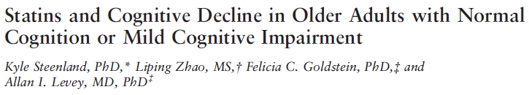
JAGS 61:1149-1455

Slide 8
Purpose
To assess the effect of statins on cognitive performance in patients with normal cognition or mild cognitive impairment over time.

Slide 9
Study Design
Longitudinal observational study
Multicenter Study
  31 NIH and National Institute of Aging supported Alzheimer’s Disease Centers

Slide 10
Study Population
Volunteers
Inclusion criteria
  Participants must have a diagnosis of normal cognition or MCI from
clinicians at each center.
Criteria for MCI
  person is not cognitively normal
- does not meet diagnostic criteria for dementia
- has preserved or only minimally impaired functional abilities
- has evidence of cognitive impairment or decline
based on self- or informant report and objective cognitive
tests.
A diagnosis of normal cognition is made when a person
does not meet criteria for MCI or dementia.
Notes:
MCI – person is not cognitively normal.
Does not meet diagnostic criteria for dementia.
Has preserved or only minimally impaired functional abilities
Evidence of cognitive impairment or decline based on self- or informant report and objective cognitive tests
Normal Cognition – patient does not meet criteria for MCI/dementia

Slide 11
Study Design
Participants had annual follow up
  Underwent evaluations of cognitive performance via the Uniform Data Set
  Inquiry about statin use
The minimum requirement of at least three annual visits, resulting in an average follow-up of 3 years
Notes:
These participants had repeated evaluations of cognitive performance and information about statin use at each annual follow-up as part of the Uniform Data Set (UDS), a standardized assessment and data protocol that the National Alzheimer’s
Coordinating Center maintains.
Uniform Data Set – developed by the national alzheimers coordinating center (NACC). The data are intended to standardize clinical and cognitive data on all ADC participants with uniform clinical assessments and diagnoses. Data is collected prospectively, and longitudinally. Some data elements included in the UDS are: Sociodemographics on subject and informant, family history, dementia history, neurological exam findings, functional status, neuropsych-ological test results, clinical diagnosis, whether imaging testing done, ApoE genotype.
Self reported statin use was also obtained from the uds database

Slide 12
Outcomes
Cognitive Performance
  Measured by Clinical Dementia Rating Score
  A standardized battery of neuropsychological tests
    - Included MMSE

Slide 13
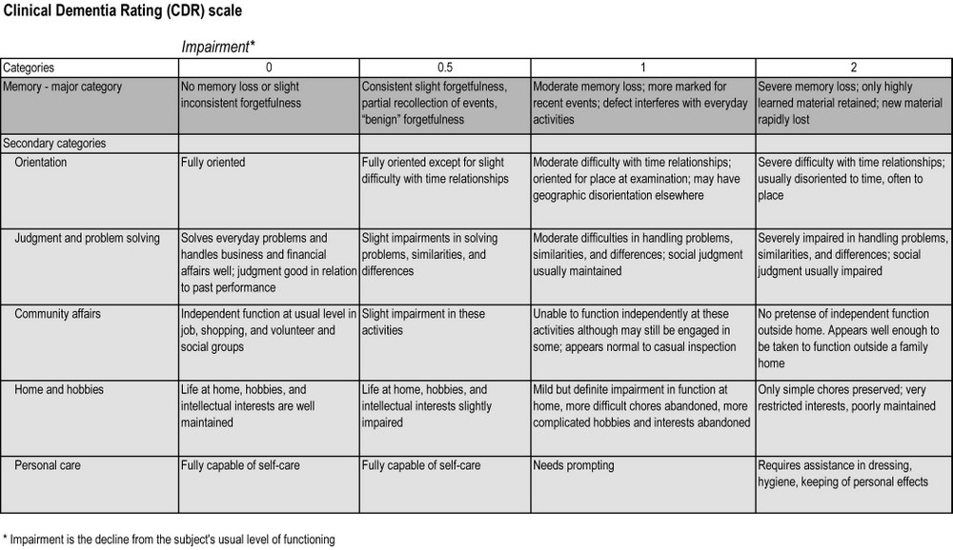
Notes:
Clincal Dementia Rating Score – memory, orientation,
judgment and problem solving, community affairs,
home and hobbies, and personal care are each rated for
their level of impairment

Slide 14
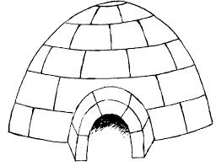
Attention
Digits Forward
Trails A
6
3
1
4
2 5
Language
30 item Boston Naming Test
Notes:
Attention - maximum number of correct trials for Digits Forward; and the number of seconds needed to sequence numbers
using a pencil (Trails A).
Language - 30-item version of the Boston Naming Test

Slide 15
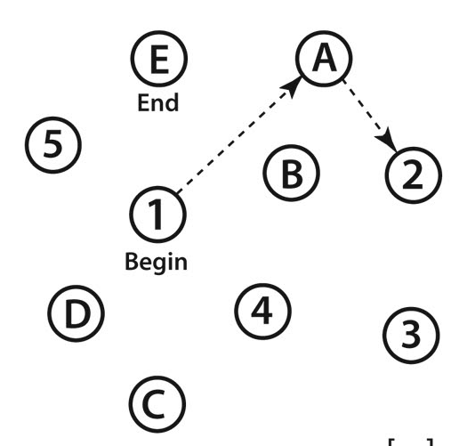
Executive Function
Wechsler Intelligence Test
Trails B
Memory
Immediate and delayed story recall
Time recall of animal names
Notes:
Memory - immediate and delayed story recall, and timed generation of animal names
Executive functioning - set shifting tasks involving mental manipulation of digits and rapid alternation of numbers or letters
and symbols (Trails B and Wechsler Adult Intelligence
Scale Digit Symbol)

Slide 16
Statistical Analysis
Longitudinal linear regression analyses
Notes:
Variables that could confound the relationship
between statin use and cognitive function were entered a
priori in all the statistical models. These covariates were
age (continuous); race (white, non-white); sex; education
(no high school degree, high school degree, >high school);
and presence vs absence of self-reported history of baseline
diabetes mellitus, hypertension, heart disease (e.g., myocardial
infarction, atrial fibrillation, congestive heart failure),
stroke or transient ischemic attack, or depression within
the last 2 years. A variable for hypertension was also
included and was divided into three levels: no history of
hypertension (reference), history of hypertension but not
current high blood pressure (>80 diastolic or >120 systolic
blood pressure), current high blood pressure.

Slide 17
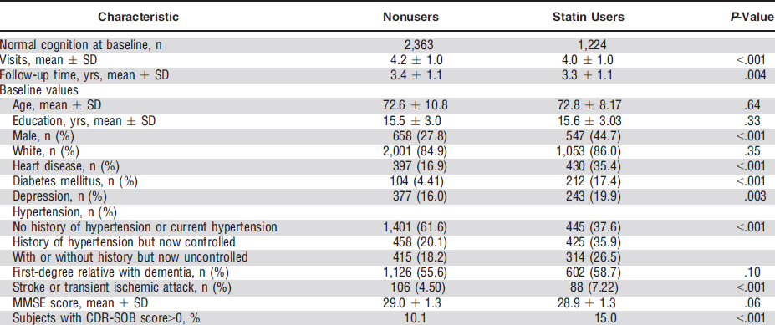
Results

Slide 18
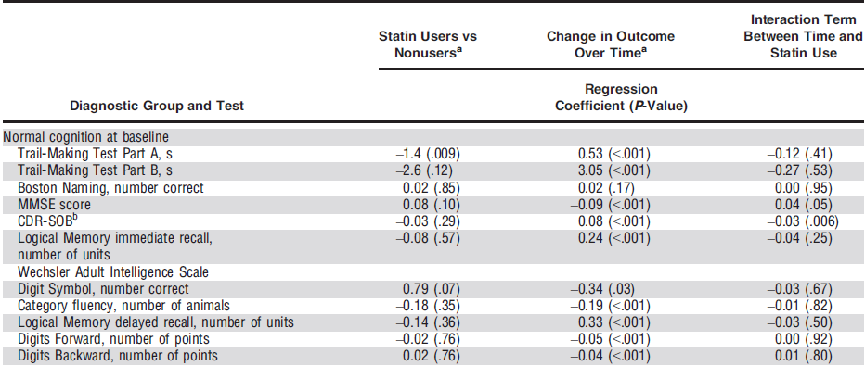
Results
Notes:
-Statin users had significantly better scores on Trails A and
better scores on Digit Symbol
-Change in cognition over time (combines both statin users and nonusers) - most tests, as expected, showed significant deterioration over time.
Interaction – when an independent variable has a different
effect on the outcome depending on the values of another independent variable.
The last column indicates whether change over time differs in statin users and nonusers.
there was significantly less deterioration over visits (over time) for statin users on the CDR-SOB and less decline on the MMSE, although the latter fell short of statistical significance after
adjusting for multiple comparisons
P value is associated with the null hypothesis that the true correlation between the 2 measures is 0. Thus, the P value represents the probability that, if the true correlation were 0, an apparently linear relationship as strong as or stronger than the one we actually observed would have occurred as a result of chance
Adjusted for age (continuous), sex, race, education (<high school, high school, >high school), family history (first-degree relative) with dementia, depression
in last 2 years (yes/no), and history of heart disease at baseline (yes/no) and diabetes mellitus (yes/no), uncontrolled or controlled hypertension (yes/
no), and stroke or transient ischemic attack (yes/no) at baseline. Coefficients for Columns 2 to 3 come from a main effects model; coefficient in Column 4
is from a separate model with an interaction term.

Slide 19
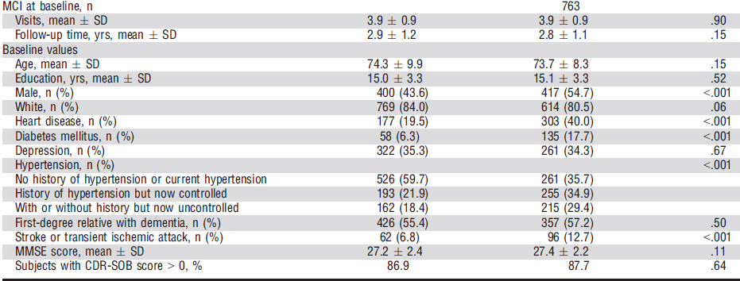
Results

Slide 20
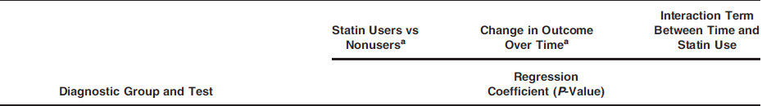
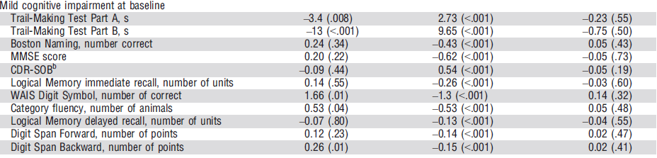
Results
Notes:
Change in cognition over time, - most tests, as expected, showed significant deterioration over time. Slightly larger incremental change in people with MCI.
Of those with
- MCI at baseline, statin users had significantly better scores
across all visits for Trails A, Trails B, Digit Symbol, category
fluency, and Digits Backward.
There were no significant differences in change over time
for those diagnosed with MCI at baseline.

Slide 21
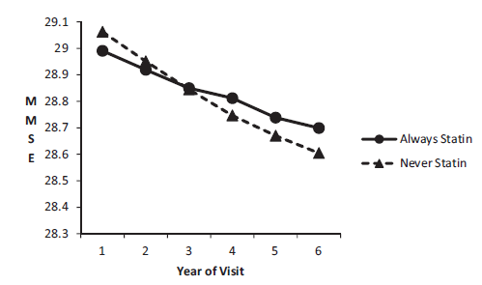
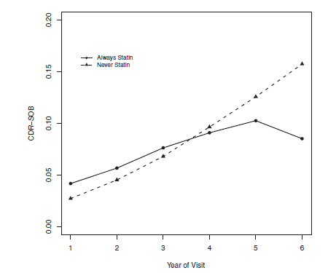
Result
Notes:
Fig 1: Decline in MMSE score in statin users vs. non users for people with normal cognition over time
Fig 2: Increase in mean predicted CDR score over annual visits for people with normal cognition at baseline.

Slide 22
Study Conclusions
statin users performed better than nonusers on certain cognitive tests.
overall cognitive decline over time was significantly less pronounced in statin users with (normal cognition )than nonusers
Statin users with MCI did not demonstrate any protective effect

Slide 23
Strengths
large sample size
standardized cognitive testing
reasonably long follow-up
ability to distinguish between normal cognition and MCI
Notes:
Were Patients Similar for Prognostic Factors That Are Known to Be Associated With the Outcome (or Did Statistical Adjustment Level the Playing Field)? Authors reported adjusting for specific confounders.
Were the Circumstances and Methods for Detecting the Outcome Similar? – I think so.
Was the Follow-up Sufficiently Complete? The duration was aqdequate, but the article did not sufficiently discuss whether people were lost to follow-up.

Slide 24
Limitations
Observational Study
  Potential unidentified confounding factors
  No information regarding the strength of this relationship or whether these changes are clinically meaningful
Notes:
-possible indication bias – patients on statins were somehow less susceptible to cognitive decline
Observer bias – because the study population was voluntary
- both groups fairly well educated; tests likely administered in english

Slide 25
What do I tell my patient?

Slide 26
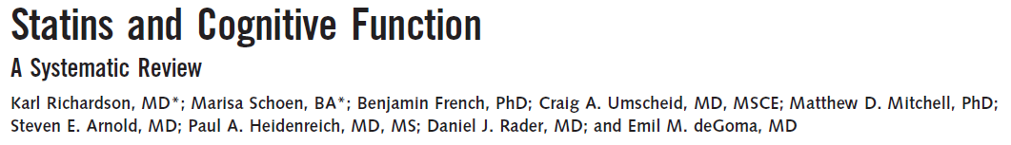
Notes:
Included total of 57 studies (19 RCTs, 16 cohort, 4 case-control and 4 cross-sectional studies).
Among statin users, low-quality evidence suggested no increased incidence of Alzheimer disease and no difference in cognitive performance in procedural memory, attention, or motor speed. Moderate-quality evidence suggested no increased incidence of dementia or mild cognitive impairment, nor any change in cognitive performance related to global cognitive performance scores, executive function, declarative memory, processing speed, or visuoperception.

Slide 27
New lipid guidelines
Identified 4 major groups for whom statins were felt to benefit
1) with clinical ASCVD,
2) primary elevations of LDL >190 mg/dL
3) diabetics 40 - 75 years old w/o clinical ASCVD, but with LDL 70 - 189 mg/dL
4) LDL 70 - 189 mg/dL with an estimated 10-year ASCVD risk >7.5%.
Notes:
Clinical ASCVD refers to people with (acute coronary syndromes, or a history of MI, stable or unstable angina, coronary or other arterial revascularization, stroke, TIA, or peripheral arterial disease presumed to be of atherosclerotic origin).
- The 10-year ASCVD risk should be estimated using the Pooled Cohort Equations

Slide 28
2013 Lipid Guidelines
What about people over 75 years?
No clear recommendations due to a paucity of data
“Therefore, initiation of statins for primary prevention of ASCVD in individuals >75 years of age requires consideration of additional factors, including increasing comorbidities, safety considerations, and priorities of care.”
Notes:
-RCT evidence does support the continuing statins in persons already on these drugs.
-Some data also support using moderate-intensity statin therapy for secondary prevention in individuals with clinical ASCVD >75 years of age.
-Few data did not clearly support initiation of high-intensity statin therapy for secondary prevention in individuals >75 years.
Few data were available to indicate an ASCVD event reduction benefit in primary prevention among individuals >75 years of age who do not have clinical ASCVD. Therefore, initiation of statins for primary prevention of ASCVD in individuals >75 years of age requires consideration of additional factors, including increasing comorbidities, safety considerations, and priorities of care. The Pooled Cohort Equations can also provide information on expected 10-year ASCVD risk for those 76 to 79 years of aged that may inform the treatment decision. These factors may influence decisions about cholesterol-lowering drug therapy, especially in the primary prevention setting. Accordingly, a discussion of the potential ASCVD risk reduction benefits, risk of adverse effects, drug-drug interaction, and patient preferences precede the initiation of statin therapy for primary prevention in older individuals.

Slide 29
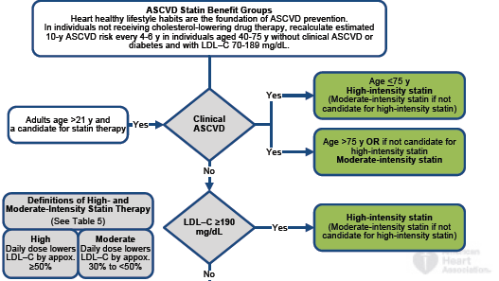
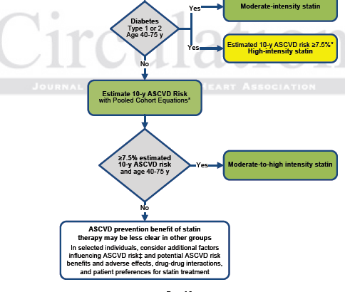
Notes:
Pooled Cohort Equations for estimating ASCVD were developed from sex- and race-specific proportional hazards models that included the covariates of age, treated or untreated systolic BP level, total cholesterol and high-density lipoprotein cholesterol levels, current smoking status (Y/N), and history of diabetes (Y/N).

Slide 30
As you get older, three things happen. The first is your memory goes… and I can’t remember the other two.
Norman Wisdom

