Slide 1
Journal Club
Anitha Bhat
August 9th, 2013

Slide 2
Case
85 yo African American female who presented for a new patient visit.
  She reported having knee pain – present in both knees, but left was more bothersome than right.
  She had been using tylenol as well as tramadol TID without adequate benefit.
  Had tried cox-2 inhibitors and nabumetone in the past
  Wanted to know more about steroid injections, but did not feel that she was quite “ready” for them
Notes:
X-ray of L knee in 2009 showed mild to moderate lateral compartment joint space narrowing is identified.

Slide 3
Case
ANTIPHOSPHOLIPID SYNDROME with history of pulmonary embolism
(secondary) PULMONARY HYPERTENSION
HYPERTENSION
GERD
GRAVES DISEASE, in remission after treatment with PTU
OSTEOARTHRITIS in multiple sites
- Lower back
- Knees
PLANTAR FASCIITIS
WARFARIN (since 2006)
LISINOPRIL
DILTIAZEM
HYDROCHLOROTHIAZIDE
PRILOSEC
VITAMIN D 2000 UNIT TABS
CALCIUM +D
ACETAMINOPHEN
ULTRAM
CLARITIN

Slide 4
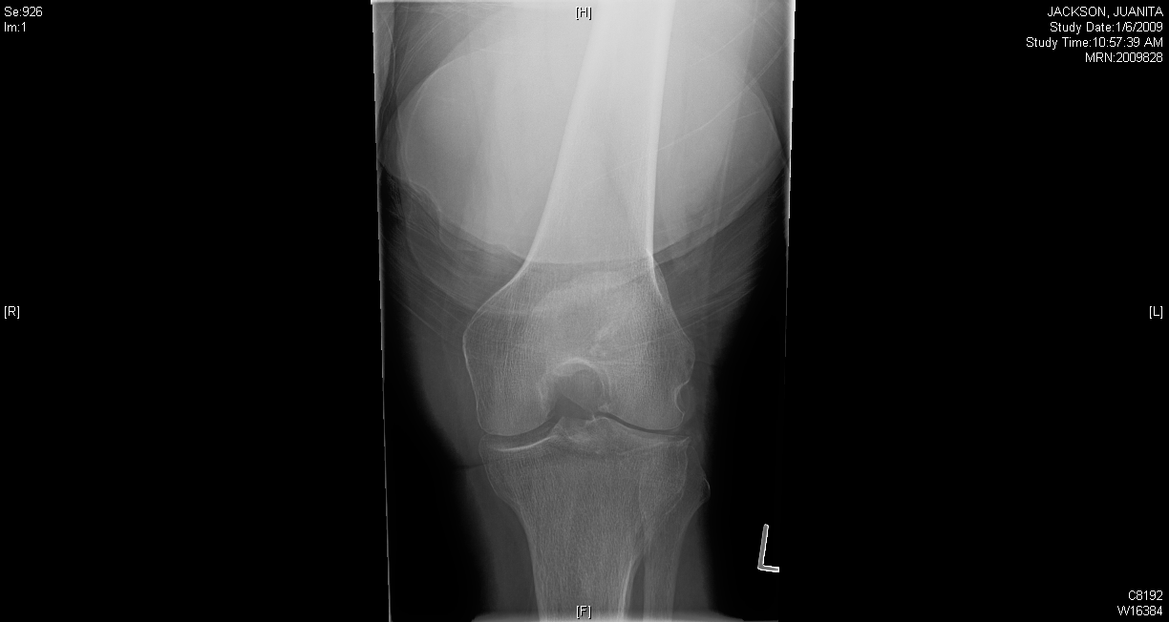

Slide 5
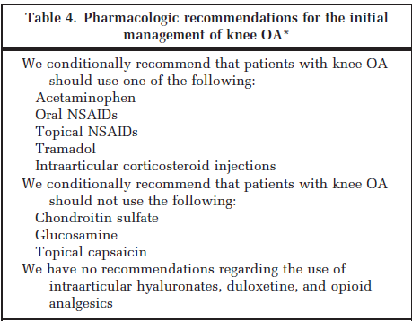
ACR 2012 recommendations for management of osteoarthritis of knee
Notes:
Of note, the body of this document stated that for patients with symptomatic knee OA who have had and inadequate response to both pharmacologic and nonpharmacologic modalities and are either unwilling or are not candidates for TKR, ACR recommends the use of opioid analgesics (and weakly) the use of duloxetine.

Slide 6
Duloxetine (Cymbalta)
Seratonin-Norepinehprine Re-uptake Inhibitor
Indications for treatment:
  of major depressive disorder (MDD)
  generalized anxiety disorder (GAD)
  diabetic peripheral neuropathic pain and fibromyalgia
  chronic musculoskeletal pain due to chronic osteoarthritis pain and chronic low back pain

Slide 7
Clinical Question
Would my patient benefit from a trial of duloxetine (Cymbalta) for her knee osteoarthritis?

Slide 8
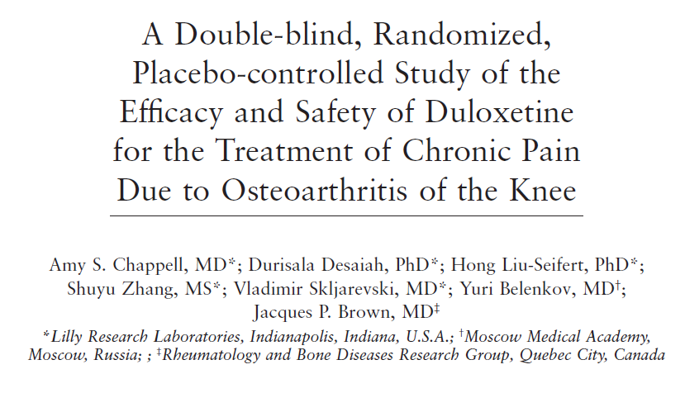

Slide 9
Study Aim
To determine if daily duloxetine (60 to 120 mg) can reduce knee pain in patients with osteoarthritis (compared to placebo)

Slide 10
Study Design
Multicenter, double blind, randomized controlled trial
  21 clinical sites in Canada, Greece, Russia, Sweden, and US.
February 27, 2007 and May 4, 2008
Community dwelling subjects

Slide 11
Study Population
Inclusion Criteria:
  Men and women > 40 years of age
  Met ACR diagnostic criteria for osteoarthritis of the knee
  Had pain for > 14 days per month for 3 month prior to study.
  have pain severity of > 4 on the Brief Pain Inventory 24-hour average scale
  agree to maintain their usual level of activity for the duration of study period
  People who used NSAIDs or acetaminophen were allowed to participate in study provided that the dose remained stable for the duration of the study

Slide 12
ACR criteria for knee osteoarthritis
Clinical and laboratory | Clinical and radiographic | Clinical †
Knee pain | Knee pain | Knee pain
+ at least 5 of 9: | + at least 1 of 3: | + at least 3 of 6:
- Age > 50 years | - Age > 50 years | - Age > 50 years
- Stiffness < 30 minutes | - Stiffness < 30 minutes | - Stiffness < 30 minutes
- Crepitus | - Crepitus | - Crepitus
- Bony Tenderness | + Osteophytes | - Bony Tenderness
- Bony enlargement |  | - Bony enlargement
- No palpable warmth |  | - No palpable warmth
- ESR <40 mm/hour
- RF <1:40
- SF OA
92% sensitive | 91% sensitive | 95% sensitive
75% specific | 86% specific | 69% specific

Slide 13
Study Population
Exclusion Criteria
BMI > 40 kg/m²
diagnosis of inflammatory arthritis or an autoimmune disorder
Hx of invasive therapies to the knee during the past 3 months
Hx of joint replacement of the knee
nonambulatory or crutch- or walker-dependant
psychiatric disorders, including major depressive disorder
history of substance abuse or dependence
presence of serious medical condition
Prior exposure to duloxetine, or known hypersensitivity to duloxetine/active ingredients

Slide 14
Study Design
Week -1
Week 0
Week 13
Week 7
Week -1: Screening period
Week 0: Start treatment (either duloxetine 60 mg or placebo)
Week 7: Assess effect of medication; increase dose to 120 mg if < 30% reduction of (24 hour average) pain from baseline
Week 13: Taper down dose of medication over 2 weeks
Notes:
Patients kept a daily diary noting 24 hour average pain scores

Slide 15
Outcomes
  Primary
    Change in pain severity
      measured by BPI (brief pain inventory) 24 hour average score
Secondary
  Weekly mean of the 24 hour average pain score
  Safety and tolerability of duloxetine
  - Other
Notes:
Other assessments that looked at patient’s perception of improvement; change in physical function
BPI average pain score, the total score of the Beck Depression Inventory-II (BDI-II) and Hospital Anxiety and Depression Scale anxiety subscale
(HADS-A)

Slide 16
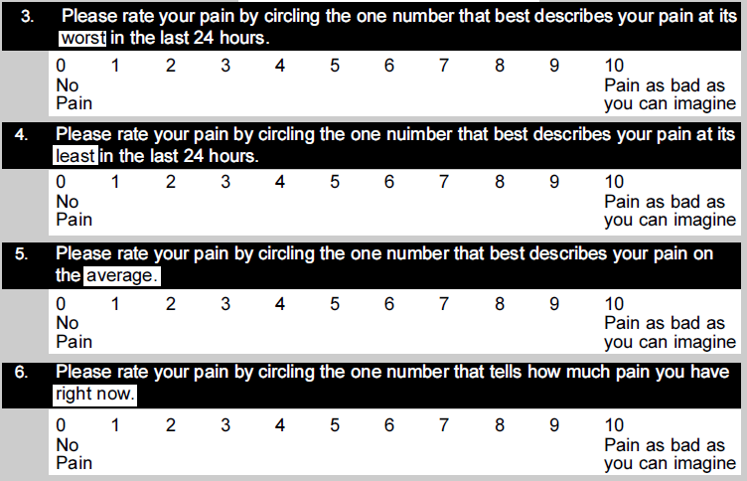
Brief Pain Inventory

Slide 17
Statistical Analysis
Used an intention to treat principle
A likelihood-based, mixed-effects model repeated measures (MMRM) was used to assess the primary endpoint.
analysis of variance (ANOVA) and analysis of covariance
Notes:
Advantage of mixed models:
One of the nice things about mixed models is that we can use all of the data we have. If a score is missing, it is just missing. It has no effect on other scores from that same patient. Also, allows rhat patients don’t have to be tested at the same intervals:
We don't have to worry that they couldn't be tested at the same intervals.

Slide 18
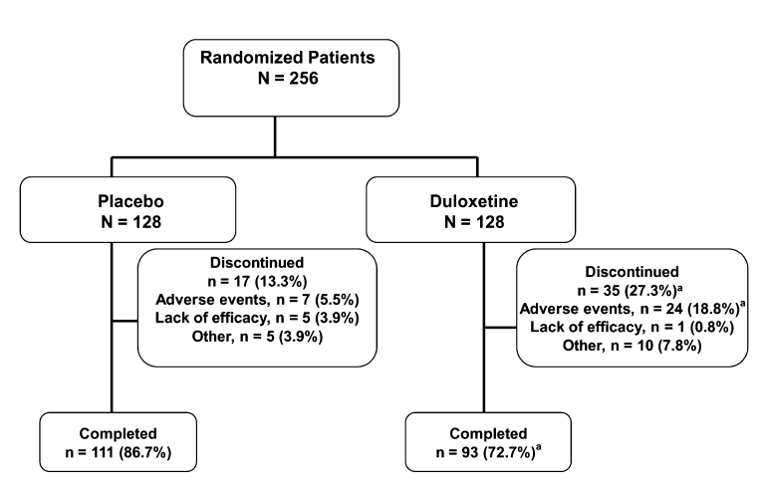
Results
Notes:
More people in the duloxetine group discontinued medication (was noted to be a statistically significant difference)
More people in the duloxetine group reported adverse events

Slide 19
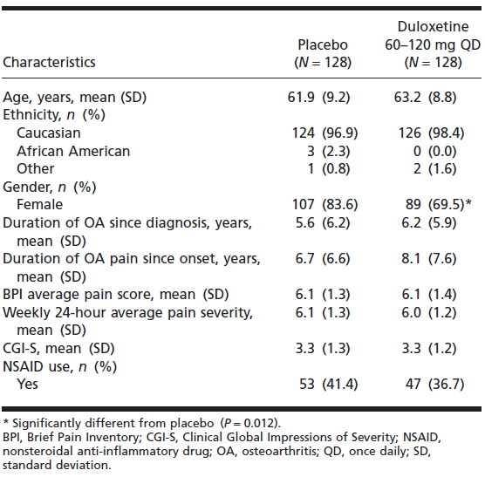
Results

Slide 20
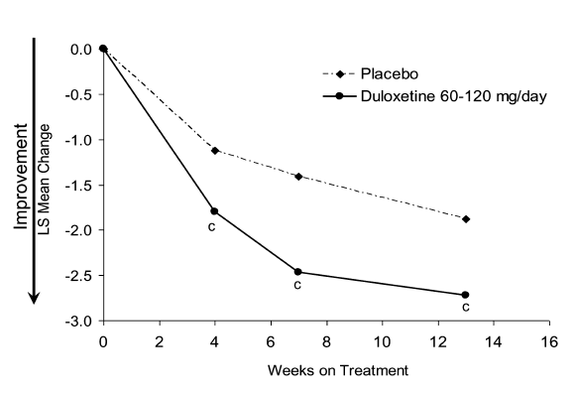
Results
Changes in Brief Pain Inventory 24 hr average pain
P <0.001
Notes:
A statistically significant (P 2 0.001) reduction in the average pain rating was observed in the duloxetine group compared
with the placebo group at all time points (4, 7, and 13 weeks after treatment)
Figure 2. Changes in the Brief Pain Inventory 24-hour average pain (primary efficacy measure) in patients with chronic pain
due to osteoarthritis of the knee treated with duloxetine 60 mg to 120 mg once daily or placebo for 13 weeks (mixed-effects
model repeated measures). LS, least squares. cP 2 0.001 duloxetine vs. placebo.

Slide 21
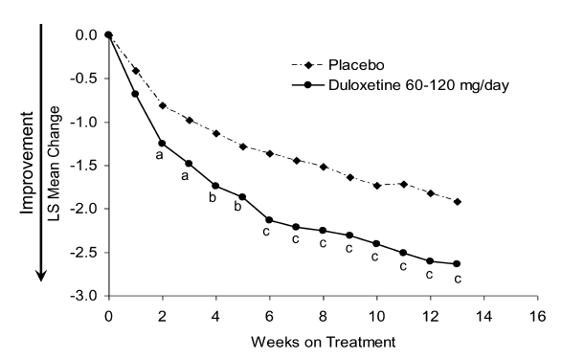
Results
Weekly mean changes in 24 hour average pain score
A P < 0.05
B P < 0.01
C P < 0.001
Notes:
A statistically significant reduction in the average pain rating was observed in the duloxetine group compared
with the placebo group as early as at week 2 and remained statistically significant at all time points

Slide 22
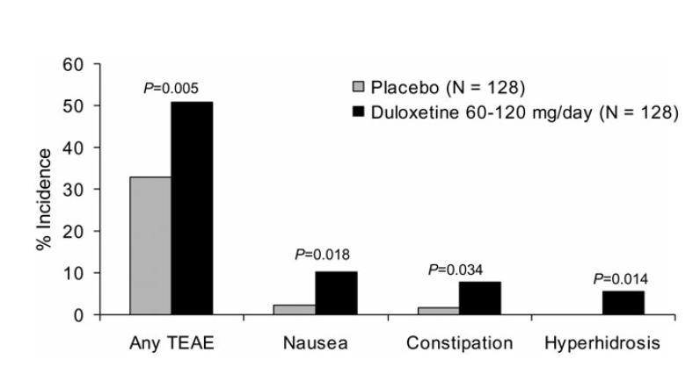
Results
TEAE – Treatment emergent adverse event
Notes:
No deaths occurred during the study
Total of 5 serious adverse events (2% study population): two patients in the placebo group (atrial fibrillation and acute pyelonephritis)
and three patients in the duloxetine group (drug intolerance, memory impairment, and supraventricular tachycardia).

Slide 23
Conclusion
Patients treated with duloxetine, showed statistically significant greater pain reduction compared to placebo.
The safety profile for duloxetine is favorable ( compared to other pain studies).

Slide 24
Limitations
This study was sponsored by Eli Lilly and Company and statistical support was provided by Lilly research laboratories
The majority of the study population was performed in Caucasian females
Short treatment duration
Clinical significance?

Slide 25
Applicability?
………..Not Really
  Average age was younger
  Excluded people with significant comorbidity
  Excluded people who relied on assistive devices

Slide 26
Duloxetine for the management of pain in older adults with knee osteoarthritis: randomized placebo-controlled trial
  -Suzan Abou-Raya, Anna Abou-Raya, Madihah Helmii
  - Age Ageing (2012) 41 (5): 646-652
Notes:
288 patients aged 65 years and above with primary knee OA were enrolled in this study (mean age 68). Patients were randomised 1:1. Totally, 144 received 60 mg/day of duloxetine HCL and 144 received placebo for 16 weeks. Outcome measures included pain reduction and improvement in physical functioning scores. Pain was assessed using the visual analogue pain scale (VAS; 0–100 mm). The Western Ontario and McMaster Universities Osteoarthritis Index (WOMAC) scores were used to assess function.
The responder rates at 16 weeks were 48% and 9% in the duloxetine group and placebo group, respectively
Significant Improvement in pain scores and WOMAC pain and function scores.
There were no deaths or severe life-threatening events. Main treatment-related adverse events recorded significantly more frequently in the duloxetine group were constipation, nausea, hyperhidrosis, cough, myalgia, arthralgia and palpitations.

Slide 27
So, duloxetine may be a possible therapy that I could recommend to my patient.
Has anyone ever prescribed Cymbalta for chronic pain?

Slide 28
Beers List
Moderate evidence that SNRIs can cause or worsen SIADH, resulting in hyponatremia
Strongly recommend careful monitoring when initiating therapy or with dose changes
Notes:
The Beers List is a list of medications that are potentially inappropriate for use in the elderly

Slide 29
Accessibility
Out of pocket cost for 1 month supply of Cymbalta 60 mg: $230-240

Slide 30
Accessibility
Mass Health patients need PA to get coverage.
Cymbalta for chronic musculoskeletal pain due to osteoarthritis
Documentation (including medical records) of the following is required:
  an appropriate diagnosis; and
  an adverse reaction, inadequate response (to at least two weeks of therapy) or contraindication to acetaminophen and two different NSAIDS.

Slide 31
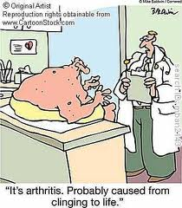
Thanks for coming!

