Slide 1
Mobile Instant Messaging and the Future of Citizenship
Sebastián Valenzuela*
Catholic University of Chile
Boston University | Emerging Media Studies | Symposium on Perpetual Contact | April 10, 2019
* A big thank you to my co-authors, Ingrid Bachmann, Matías Bargsted, Daniel Halpern, Jim Katz, and Juan Pablo Miranda.

Slide 2
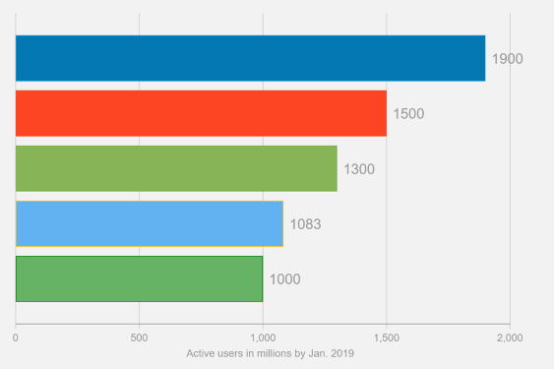
Use of MIMS Around the World
Popularity of WA vs. SMS
Active users of SNS vs. MIMS
SOURCE: Google Trends (worldwide)
SOURCE: Statista

Slide 3
What’s with MIMS?
Developed and conceived for smartphones.
Perpetual contact in relatively more intimate, closed, and controlled environments.
Less likely to suffer from “context collapse” (boyd, 2011), i.e., narrowcasting is more likely.
Notes:
Facebook is like a giant mall: you can do everything, but because of of that, less intimate.
Twitter is for news junkies, interest-based networks.
Instagram is like a fashion show: image is everything.
WhatsApp is like a coffeeshop, more intimate.

Slide 4
Data + Methods
2016-2017 elections in Chile.
Penetration rate of WhatsApp in 18+ population: 84%.
Study 1: Two-wave panel survey of a probability-based sample living in Greater Santiago, interviewed face-to-face (n = 505)
Study 2: Two-wave panel survey of an opt-in internet sample living in Chile (n = 451)

Slide 5
What’s the relationship between MIMS and individuals’ political information, attitudes, and behavior?
Notes:
Who uses mobile instant messaging services (MIMs)?
What do they use MIMs for?
How does this usage of MIMs influences users’ political engagement during an election campaign (e.g., knowledge of public affairs news, attitudes towards contentious issues in the news, and participation in various political activities)?
What is the contribution of MIMs to contemporary repertoires of digital media use and news consumption?

Slide 6
Use of MIMS
“In phatic media culture, content is not king, but ‘keeping in touch’ is”
-Miller (2008)

Slide 7
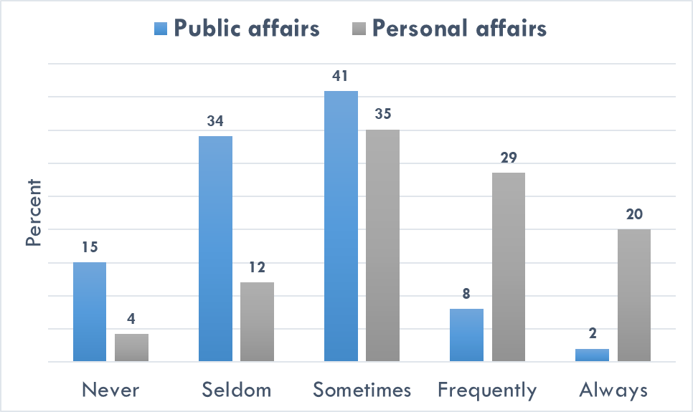
WhatsApp Use
“With what frequency do you share information about: (a) your personal and/or family life, (b) your work and/or studies, (c) news and general current affairs, (d) political issues?”
SOURCE: Study 1, wave 2.

Slide 8
Great news
WhatsApp use is rather egalitarian: not tied to the typical inequalities found for other digital media.
SOURCE: Study 1. NOTE: Results of autoregressive panel models. Bars represent point estimates, whereas lines represent 90% confidence intervals. Values above zero display positive effects on changes in the DV; values below zero display negatives effect on changes in the DV.

Slide 9
Different story with Facebook
Facebook use, especially sharing public affairs, is stratified along both resources and motivations.
SOURCE: Study 1. NOTE: Results of autoregressive panel models. Bars represent point estimates, whereas lines represent 90% confidence intervals. Values above zero display positive effects on changes in the DV; values below zero display negatives effect on changes in the DV.

Slide 10
Good news
Using WhatsApp has a positive influence on changes in political information and political participation (e.g., petitioning, protesting, etc.)
SOURCE: Study 1. NOTE: Results of autoregressive panel models, controlling for gender, age, education, income, political interest, ideology, news exposure and attention. Bars represent point estimates, whereas lines represent 90% confidence intervals. Values above zero display positive effects on changes in the DV; values below zero display negatives effect on changes in the DV.

Slide 11
So-so news
WhatsApp has no effect on political efficacy.
While using WhatsApp for public affairs increases the intention to vote, this effect is offset by the negative impact of personal uses of WhatsApp on turnout.
SOURCE: Study 1. NOTE: Results of autoregressive panel models, controlling for gender, age, education, income, political interest, ideology, news exposure and attention. Bars represent point estimates, whereas lines represent 90% confidence intervals. Values above zero display positive effects on changes in the DV; values below zero display negatives effect on changes in the DV.

Slide 12
Bad news
Using WhatsApp for personal affairs increases polarization and decreases trust in political institutions.
Again, these effects are partially canceled by positive effects of using WhatsApp for pubic affairs.
SOURCE: Study 1. NOTE: Results of autoregressive panel models, controlling for gender, age, education, income, political interest, ideology, news exposure and attention. Bars represent point estimates, whereas lines represent 90% confidence intervals. Values above zero display positive effects on changes in the DV; values below zero display negatives effect on changes in the DV.

Slide 13
Really bad news
Using WhatsApp can increase both exposure and sharing of rumors, conspiracies, and misinformation.
SOURCE: Study 2. NOTE: Results of autoregressive panel models, controlling for gender, age, education, income, ideology, news media use (exposure and attention). Bars represent point estimates, whereas lines represent 90% confidence intervals. Values above zero display positive effects on changes in the DV; values below zero display negatives effect on changes in the DV.

Slide 14
Silver lining?
Replicating the models with Facebook yields no significant results for pro-democratic outcomes.

Slide 16
Conclusions
“Perpetual contact” through MIMS can have significant effects on democratic citizenship.
Not all positive, not all negative, but complex set of effects: MIMS are neither a panacea, nor a calamity, for democracy.
Specific uses of MIMS relate in unique—if not opposite—ways to political variables, and these relationships are relatively constant across groups.
The power of intimate social conversations on political activity: Same as it ever was?

Slide 17
Gracias
savalenz@uc.cl
@SebaValenz

