Slide 1
Acceptance and Gender Perceptions of Robots in a U.S. Context
Kate k. mays & james E. Katz
Division of emerging media studies, boston university
April 11, 2019

Slide 2
Research collaboration
China – Taiwan – United States
→ Are there cultural differences between the East and West in terms of robot perceptions and attitudes?

Slide 3
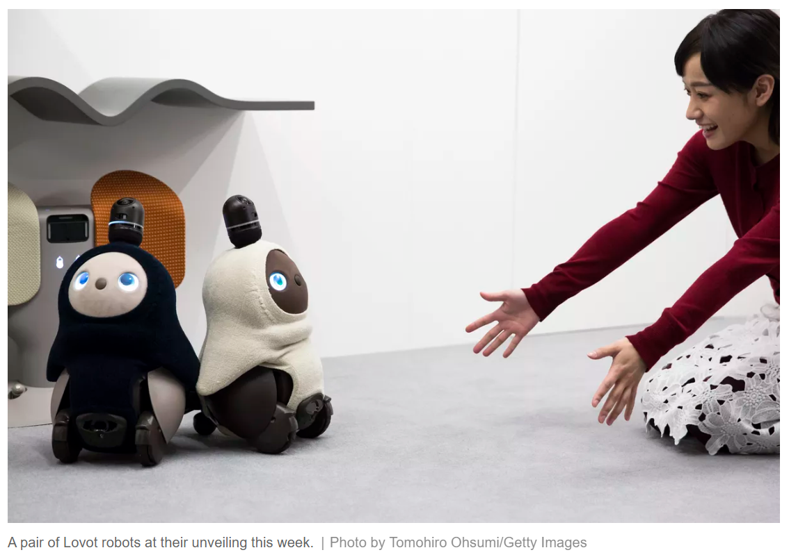
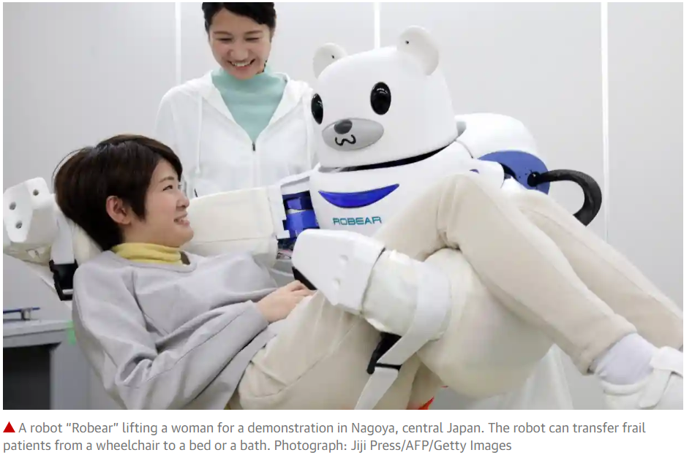
The BBC, 2018
The Guardian, 2018
The Verge, 2018
Notes:
While not China or Taiwan, Japan has been at the forefront of robotic technology, as I’m sure we’ll hear about in a lot more detail in one of the later panels. From news reports what we are seeing is a real embrace of the technology, for both pragmatic reasons – employing robots in conjunction with human reasoning, as with the case of this café; trying to close the gap in older care workers;
- And also socio-emotional reasons. There are robots designed primarily as a comfort object – Paro the seal has been used particularly to help alleviate loneliness in older people, and these new Lovot robots

Slide 4
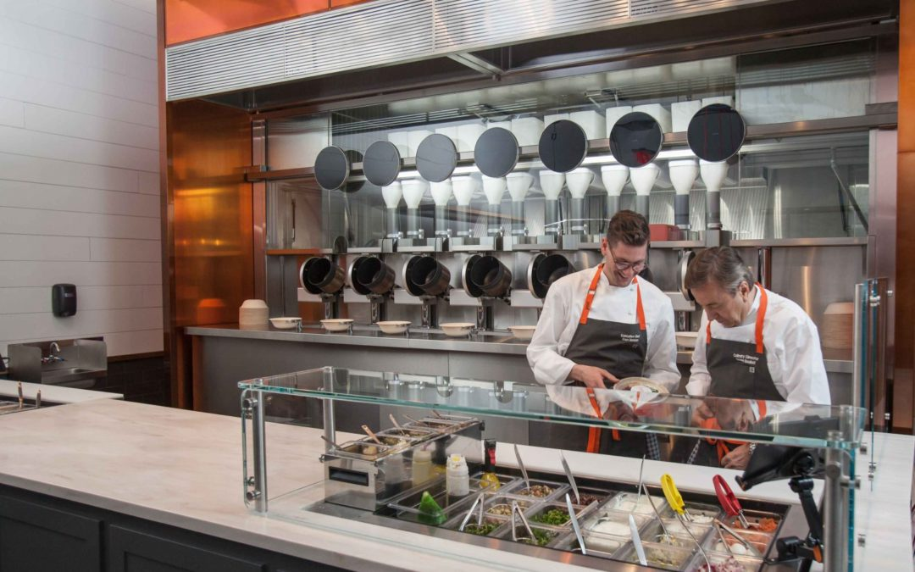
Robots in the United States?
Notes:
We haven’t seen the same kind of embrace of embodied robots in the U.S. yet. But we have seen in the last few years, the
Development and proliferation of AI forebears – interactive, autonomous voice systems like Alexa and Google Home, increasingly automated systems, self-driving cars. This new fast-casual restaurant claims to have eliminated chefs – all of the food is prepared and comes out those tubes without human intervention. Important to note that the restaurant is not fully automated – there are still humans to put the finishing touches, sauces, garnish, etc on the dish
Inklings on potential concerns re: robot socialization, shifting norms, etc

Slide 5
Theoretical framework
Theory of Apparatgeist (Katz & Aakhus, 2002)
Spiritual and individualized meanings imbued in communication technology, beyond functional affordances
Computers as Social Actors (CASA) Paradigm and Media Equation
Rely on assumptions about human behavior (e.g., gender stereotypes) to demonstrate that humans treat machines as social actors
→ Perceptions of robots may reveal underlying truths about social perceptions and behavior
Notes:
There are several possible theoretical frameworks by which to study robot attitudes. The Technology Acceptance Model, which Dr. Liu touched on, is one example.
We chose to use the Theory of Apparatgeist, which considers both the functional affordance but beyond that they ways a communication technology embodies a spirit that can take on individualized meanings
We also considered the Computers as Social Actors paradigm, and Media Equation Theory within that. The reality that human treat machines as social actors seems increasingly pertinent as these machines are created to appear and behave more and more socially.

Slide 6
Topics
General attitudes about robots (phobia and liking)
Perceptions of robot rights
Gendered perceptions of robots
Notes:
As Dr. Liu covered, research has shown that men and women have different attitudes about robots. There has also been some work on how the gender of the robot makes a difference. Even small design tweaks like the length of hair (short vs. long) and chest-waist-hip ratios has been found the influence people’s perceptions of the robot, their suitability for certain tasks, and so on. So we also want to look at gender perceptions as they relate also to the robot’s gender.

Slide 7
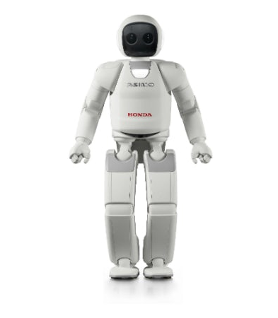
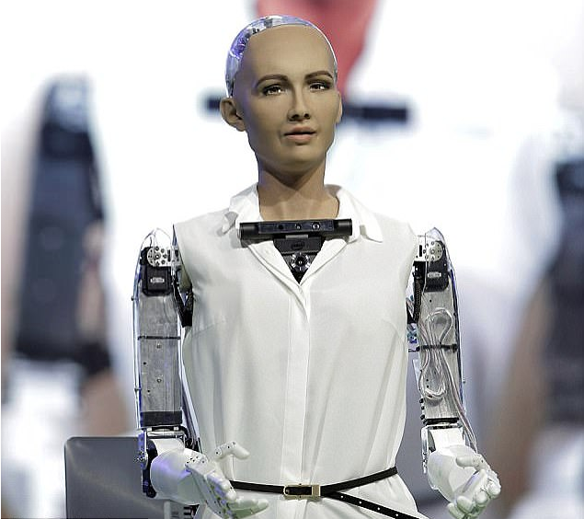
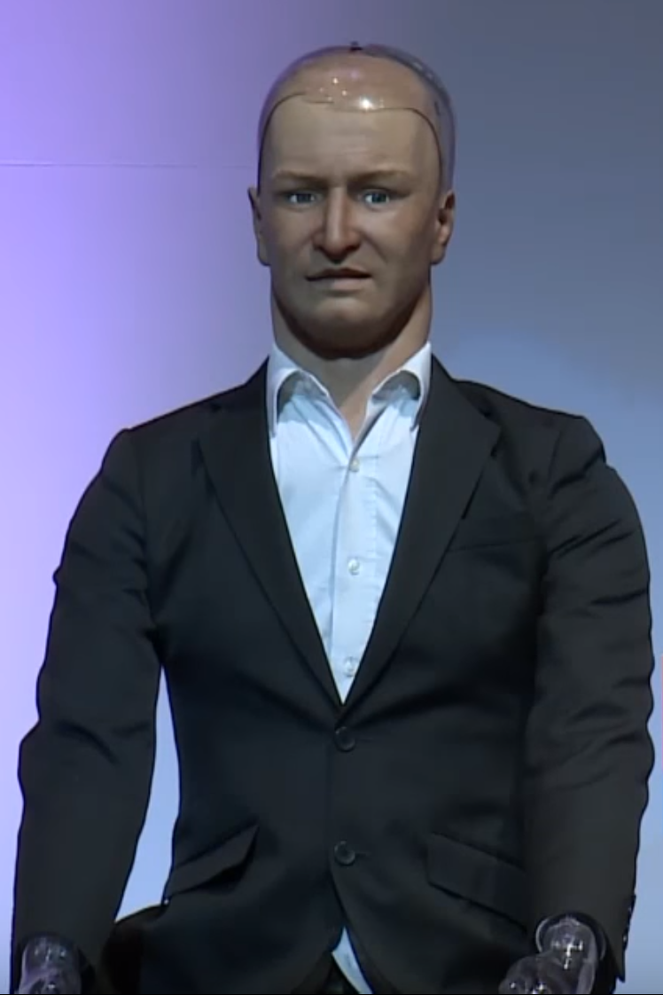
Method
Online survey questionnaire (N = 1158)
Quotas specified for: gender, age, race, income, education
Manipulation:
Agender
(n=317)
Female
(n=416)
Male
(n=425)

Slide 8
Method
Independent Variables
Dependent variables
Type of robot (agender, female, male)
Robot traits
Robot-human likeness (α = .911)
Perceived enjoyment (α = .855)
Perceived usefulness (α = .911)
Demographics (gender, age, race, education, income)
Individual traits
Perceived technology competence (α = .869)
Religious affiliation & religiosity (α = .977)
Extraversion (α = .922) & neuroticism (α = .938)
Robot Phobia (α = .830)
“I would feel nervous just being around a robot”
“Robots would be a bad influence on children”
“If I depend on robots too much, something bad might happen”
Robot Liking (α = .904)
“I would feel relaxed talking to robots”
“I would like to live with robots”
“Robots can contribute to my personal happiness”
Robot Rights
Comfort killing/destroying robots

Slide 9
Results
→ Across the board, men have more positive views of robots than women
→ Compared to China and Taiwan, U.S. appears to have less positive views of robots

Slide 10
Preference for robot type
Perceived usefulness
Perceived enjoyment
Robot-human likeness
Robot liking
Robot phobia

Slide 11
Results
Contributors to robot phobia
(Total adjusted R² = 27.3%)
Contributors to robot liking
(Total adjusted R² = 75.3%)
Robot-human likeness (β = 0.122, SE = .029)
Perceived enjoyment (β = -0.436, SE = .043)
Gender (β = -0.123, SE = .045)
Income (β = 0.035, SE = .029)
Religiosity (β = 0.144, SE = .021)
Neuroticism (β = 0.261, SE = .026)
Robot-human likeness (β = 0.312, SE = .019)
Perceived enjoyment (β = 0.311, SE = .027)
Perceived usefulness (β = 0.279, SE = .023)
Gender (β = -0.096, SE = .029)
Religiosity (β = -0.028, SE = .013)
Religion (β = -0.074, SE = .034)
Neuroticism (β = 0.076, SE = .017)
Technology competence (β = 0.054, SE = .020)

Slide 12
I'm fascinated with the idea of having a robot helper, and I can envision having one in my home, however, I would expect that my relationship with such a device would not ever become personal … It is not a conscious, living "spirit," as a human being is ... It’s a "man-made," machine, capable only of what man programs it to do, and emotions are a "human thing," … I am a child of God, I don't believe God will be adopting robots any time soon. AMEN?
It really is hard to give good honest answers to some of these questions because I feel you would have to spend some time with the robot & learn more about how it thinks before you can form an opinion.
Well, I do look forward to welcoming a new and special entity into my family. How nice it will be to carry on a normally intelligent conversation at last with some"body" who is not self absorbed and judgmental. I only hope that these new friends will be affordable.

Slide 13
I'm fascinated with the idea of having a robot helper, and I can envision having one in my home, however, I would expect that my relationship with such a device would not ever become personal … It is not a conscious, living "spirit," as a human being is ... It’s a "man-made," machine, capable only of what man programs it to do, and emotions are a "human thing," … I am a child of God, I don't believe God will be adopting robots any time soon. AMEN?
It really is hard to give good honest answers to some of these questions because I feel you would have to spend some time with the robot & learn more about how it thinks before you can form an opinion.
Well, I do look forward to welcoming a new and special entity into my family. How nice it will be to carry on a normally intelligent conversation at last with some"body" who is not self absorbed and judgmental. I only hope that these new friends will be affordable.

Slide 14
I'm fascinated with the idea of having a robot helper, and I can envision having one in my home, however, I would expect that my relationship with such a device would not ever become personal … It is not a conscious, living "spirit," as a human being is ... It’s a "man-made," machine, capable only of what man programs it to do, and emotions are a "human thing," … I am a child of God, I don't believe God will be adopting robots any time soon. AMEN?
It really is hard to give good honest answers to some of these questions because I feel you would have to spend some time with the robot & learn more about how it thinks before you can form an opinion.
Well, I do look forward to welcoming a new and special entity into my family. How nice it will be to carry on a normally intelligent conversation at last with some"body" who is not self absorbed and judgmental. I only hope that these new friends will be affordable.

Slide 15
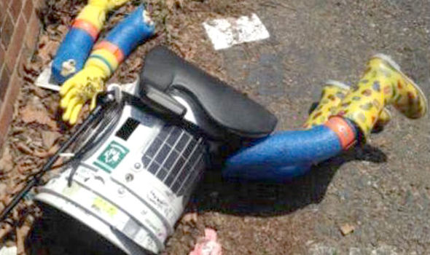
Robot Rights
Normative (should robots have rights?) vs. descriptive (can robots have rights?) aspects (Gunkel, 2017)
Different criteria proposed for “thresholds” in giving moral consideration – some grounding in animal rights debates
“relational turn” in discussion of robot rights – context-dependent (Coeckelbergh, 2010)
How robots appear to humans, how humans respond to robots is important (Darling, 2012)
Primarily interested in the sociological view, of how individuals conceive of and perceive robot rights
Notes:
robot properties (characteristics)
robot relational accounts (interactions with humans)

Slide 16
Robot Rights – scale items (α = .905)
“Human rights should be extended to robots”
“Robots and people should be allowed to marry”
“Robots should be allowed to adopt children”
“Robots should be allowed to say whatever they want”
“Robots should be allowed to vote”
“Robots should be allowed to become citizens of a country”
“Robots should be allowed to kill people in certain contexts, such as in war”
“Robots should be allowed to shoot at someone invading a home”
“Robots should be allowed to serve on juries”
“It should be possible to charge robots with a crime”
“Robots should be programmed to do whatever their owners want, provided it isn’t illegal or immoral”
“Human owners should have the right to destroy/kill their robots if they wish”

Slide 17
Robot Rights
Contributors to favoring robot rights:
Robot-human likeness (β = 0.464, SE = .023)
Perceived usefulness (β = 0.061, SE = .029)
Gender (β = -0.237, SE = .036)
Age (β = -0.007, SE = .001)
Religion (β = -0.091, SE = .043)
Extraversion (β = 0.071, SE = .026)
Neuroticism (β = 0.144, SE = .021)
Technological competence (β = -0.049, SE = .025)
→ Total adjusted R² = 53.5%
Total sample M(SD) | Male M(SD) | Female M(SD)
2.28 (0.85) | 2.47 (0.87) | 2.09 (0.78)
Agender robot | Female robot | Male robot
2.36 (0.86) | 2.34 (0.85) | 2.17 (0.79)

Slide 18
Robots are not people and WILL NEVER BE PEOPLE!!!! There is more consciousness, sentience, and life in an amoeba than there will ever be in a robot.
Robots are machines. They could be very helpful for everyday tasks. But, they are not human and should not be considered human. Some of the questions in this survey were kind of creepy.
The questions were really weird. A lot of the questions depend on how evolved the robots become emotionally. If they can feel emotions like humans then they deserve to be treated as equals not like objects.
I believe that robots are the future, and deserve the rights we treat beings of intelligence with.

Slide 19
Robots are not people and WILL NEVER BE PEOPLE!!!! There is more consciousness, sentience, and life in an amoeba than there will ever be in a robot.
Robots are machines. They could be very helpful for everyday tasks. But, they are not human and should not be considered human. Some of the questions in this survey were kind of creepy.
The questions were really weird. A lot of the questions depend on how evolved the robots become emotionally. If they can feel emotions like humans then they deserve to be treated as equals not like objects.
I believe that robots are the future, and deserve the rights we treat beings of intelligence with.

Slide 20
Robots are not people and WILL NEVER BE PEOPLE!!!! There is more consciousness, sentience, and life in an amoeba than there will ever be in a robot.
Robots are machines. They could be very helpful for everyday tasks. But, they are not human and should not be considered human. Some of the questions in this survey were kind of creepy.
The questions were really weird. A lot of the questions depend on how evolved the robots become emotionally. If they can feel emotions like humans then they deserve to be treated as equals not like objects.
I believe that robots are the future, and deserve the rights we treat beings of intelligence with.

Slide 21
Robots are not people and WILL NEVER BE PEOPLE!!!! There is more consciousness, sentience, and life in an amoeba than there will ever be in a robot.
Robots are machines. They could be very helpful for everyday tasks. But, they are not human and should not be considered human. Some of the questions in this survey were kind of creepy.
The questions were really weird. A lot of the questions depend on how evolved the robots become emotionally. If they can feel emotions like humans then they deserve to be treated as equals not like objects.
I believe that robots are the future, and deserve the rights we treat beings of intelligence with.

Slide 22
Killing/Destroying robots
Question: Considering the robot pictured, please answer how comfortable you would feel with: Its owner killing or destroying it.
Doggy robot
Agender robot
Female robot
Male robot

Slide 23
Killing/Destroying robots
Female – most to least comfortable
Agender – Doggy (41%)
Female (39%)
Male (36%)
Male – most to least comfortable
Agender (65%)
Female – Male (64%)
Doggy (59%)

Slide 24
I just want to say, let's be realistic here, robots are not human, so you can not kill them. They are programmed by humans.
The first robot was SO CREEPY. The dog one reminded me of a toy from childhood. I don't like the use of kill/destroy when discussing the robots. Can't we just unplug/unhook, remove wiring? :)
I thought some of the questions were a bit strange like should it be a citizen or should it be allowed to kill or should you be allowed to kill it. I don't want robots that are so human-like to me that would be creepy. I prefer a robot you would be least likely to confuse with an actual human being.

Slide 25
I just want to say, let's be realistic here, robots are not human, so you can not kill them. They are programmed by humans.
The first robot was SO CREEPY. The dog one reminded me of a toy from childhood. I don't like the use of kill/destroy when discussing the robots. Can't we just unplug/unhook, remove wiring? :)
I thought some of the questions were a bit strange like should it be a citizen or should it be allowed to kill or should you be allowed to kill it. I don't want robots that are so human-like to me that would be creepy. I prefer a robot you would be least likely to confuse with an actual human being.

Slide 26
I just want to say, let's be realistic here, robots are not human, so you can not kill them. They are programmed by humans.
The first robot was SO CREEPY. The dog one reminded me of a toy from childhood. I don't like the use of kill/destroy when discussing the robots. Can't we just unplug/unhook, remove wiring? :)
I thought some of the questions were a bit strange like should it be a citizen or should it be allowed to kill or should you be allowed to kill it. I don't want robots that are so human-like to me that would be creepy. I prefer a robot you would be least likely to confuse with an actual human being.

Slide 27
Conclusions and limitations
How a robot is perceived – as human-like, enjoyable, useful – are the strongest factors in positive attitudes about robots and their rights
Gender is the strongest demographic factor in attitudes about robots and their rights
Personal traits like religiousness, neuroticism, and technology competence contributed to attitudes about robots and their rights
Validity of manipulation
Internet sample

Slide 28
Thank you!

