Slide 1
Chagas Disease in the US:
An approach to screening and treatment of this neglected tropical disease
David Hamer, MD
Dept. of Global Health, BU School of Public Health
Section of Infectious Diseases, BMC

Slide 2
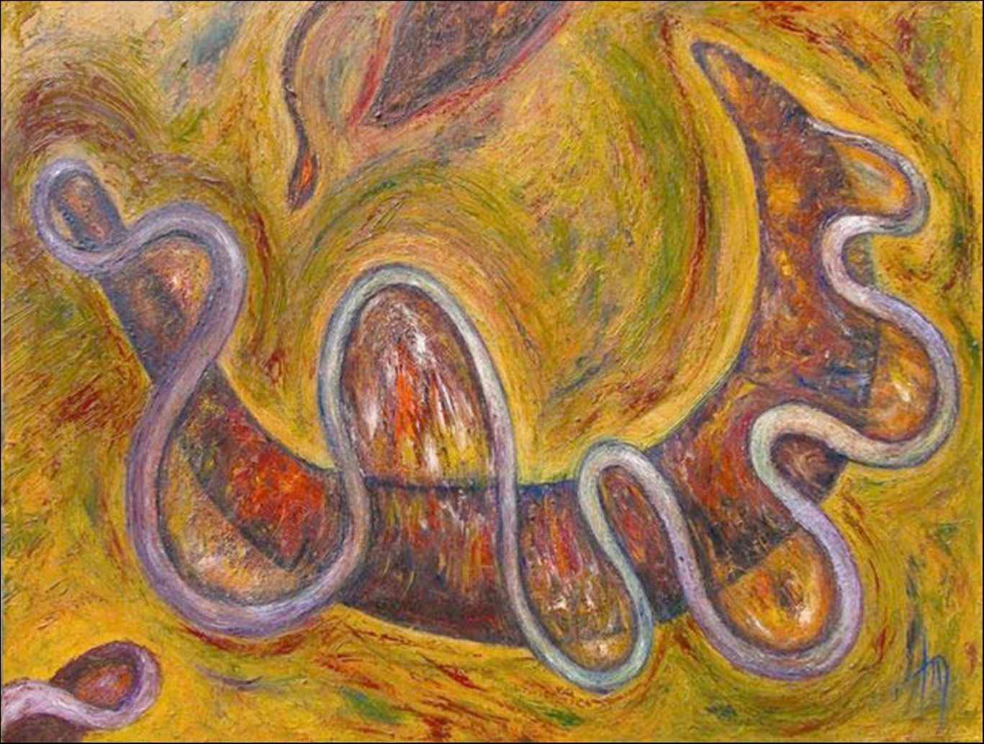
Learning Objectives:
Review the rationale for routine screening for Chagas disease in at-risk individuals
Provide an approach to screening for Chagas disease
Review the rationale and published evidence supporting treatment of adults living with Chagas disease

Slide 3
Disclosures:
NIH grant funding in collaboration with Kephera Diagnostics
Off-label use of benznidazole and nifurtimox will be discussed

Slide 4
46 year old male presents to his primary care physician with left sided chest pain.
Originally from Guatemala, arrived 15 years ago.
ECG: q waves II, III, v1-v3, LAD, multiple PVCs, TWI.
In the Emergency Department, troponins negative and ECG stable.
Telemetry shows a 7-beat run of NSVT.
Echocardiogram: global LV dysfunction (LEVF 30%) with akinesis of the inferior wall
Cardiac catheterization - normal coronary anatomy
Serology confirms Chagas disease

Slide 5
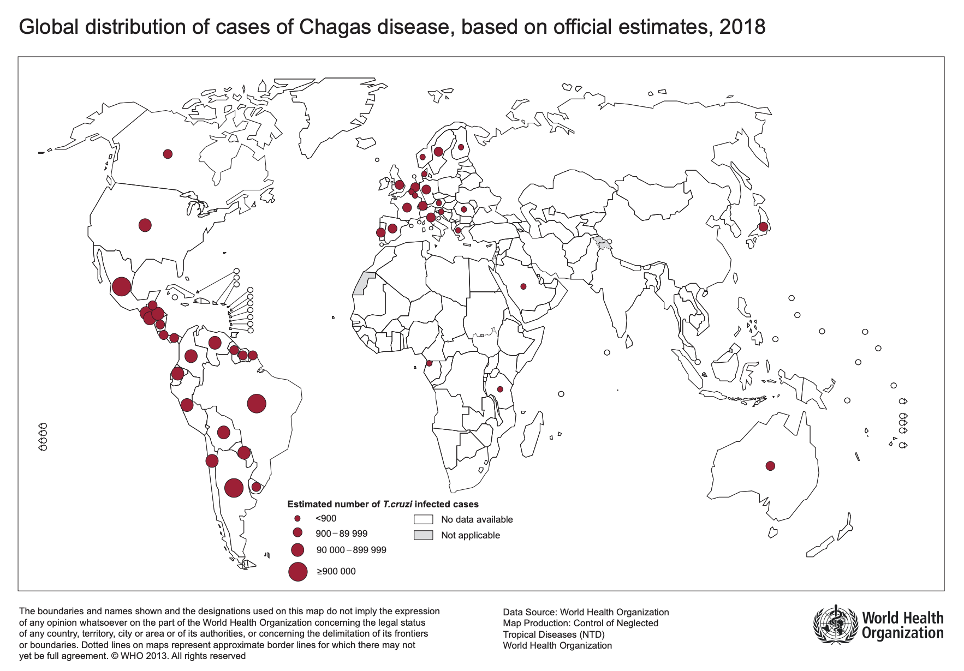
Chagas: Global Epidemiology
6-7 million worldwide living with Chagas disease
Bolivia, Argentina, Paraguay with highest prevalence
Source: https://www.who.int/health-topics/chagas-disease#tab=tab_1

Slide 6
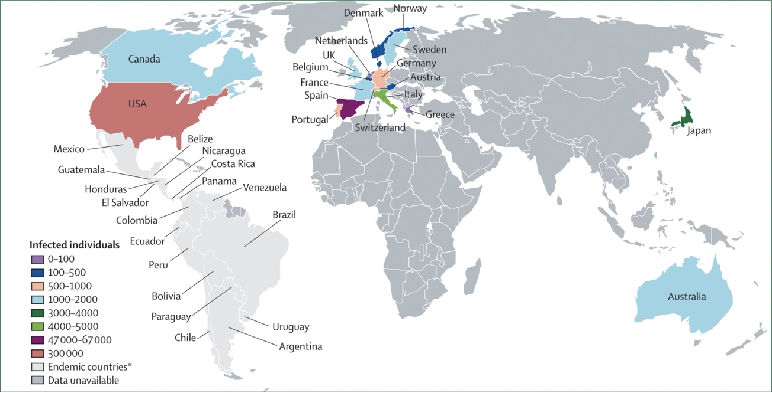
Epidemiology in Non-Endemic Countries
Source: www.thelancet.com Vol 375 April 17, 2010

Slide 7
Changing Population in Massachusetts

Slide 8
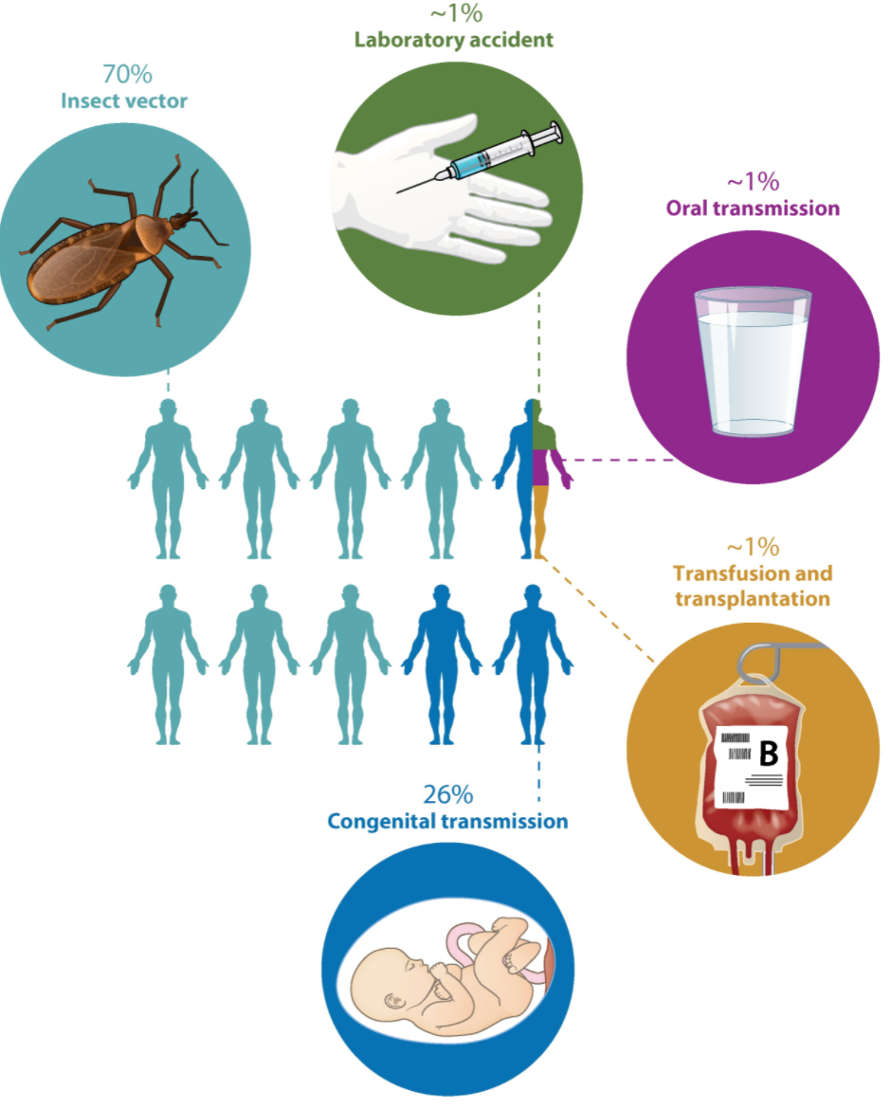
Modes of Transmission
Vector
Triatomine bug
Contaminated food
Non-vector
Vertical transmission Transfusions
Organ transplants
Bonney KM et al, Ann Rev Pathol Mech Dis 2019

Slide 9
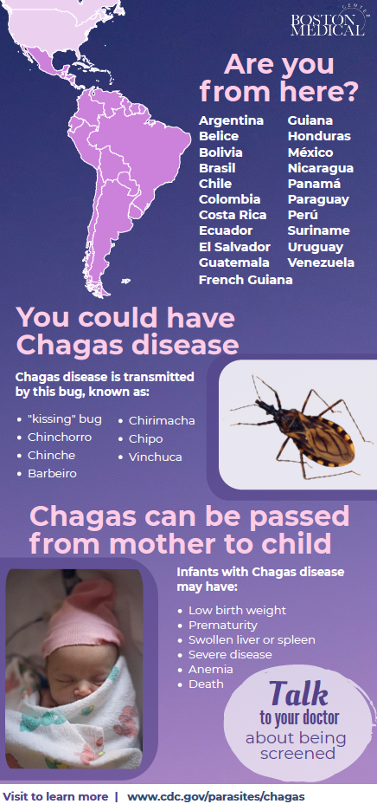
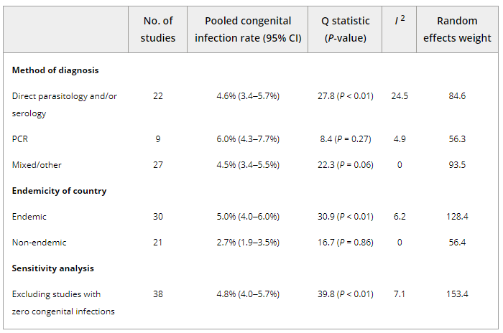
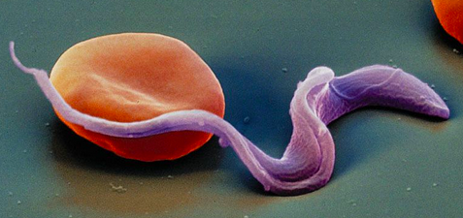
Congenital Chagas Disease
Estimated 40,000 women of childbearing age are infected with Trypanosoma cruzi in the US
Risk of transmission from mother-to-child is 2-5% (63 to 315 infected infants born yearly in the US)
Howard et al. BJOG 2013

Slide 10
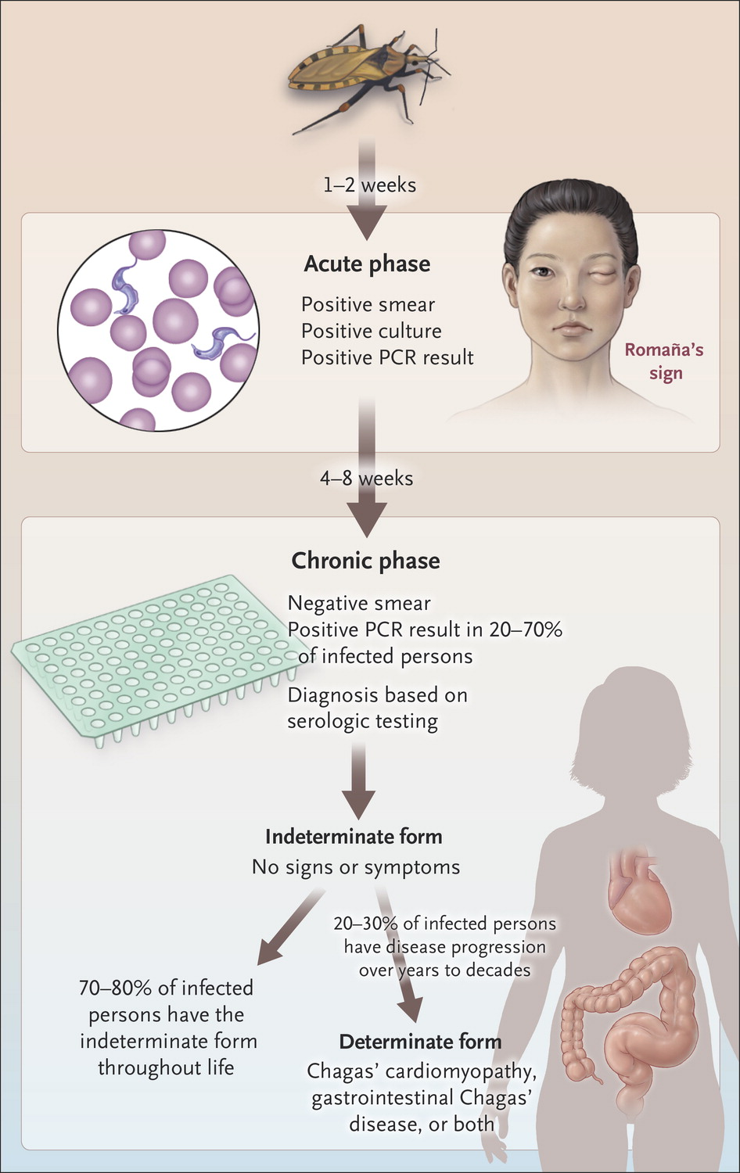
Exposure
Acute phase
Chronic phase
Bern C, NEJM 2015.

Slide 11
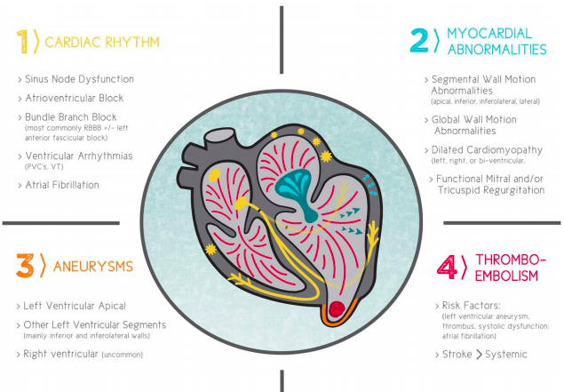
Arrhythmias
Cardiomyopathy
Aneurysms
Thromboembolism
Carmo, Circulation 2018
Notes:
Chagas cardiomyopathy is the most important clinical manifestation of Chagas disease, resulting in the majority of Chagas morbidity and mortality.
Occurs over several decades with indeterminate form. Fibrosis of the posterior and apical regions of the LV, Involvement of the SA node, AV node, and bundle of His
Arrhythmias overall cause of death (55%–60%), followed by heart failure (25%– 30%) and embolic events (10%–15%), but the proportions vary depending on the population studied

Slide 12
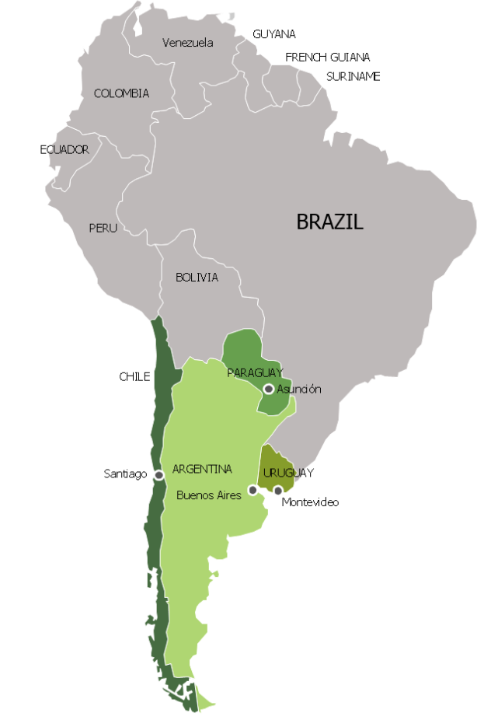
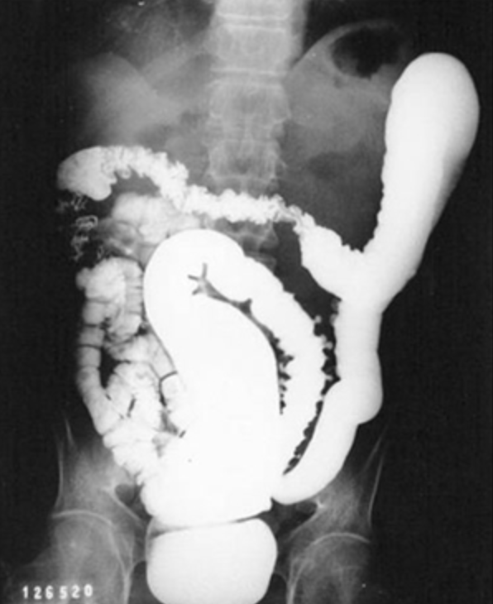
Chagas Gastrointestinal Disease
More common in Southern Cone of South America
Any part of the GI tract may be affected
Esophagus and colon most common
20% may be asymptomatic
Esophageal disease often manifests as dysphagia
Colon involvement most commonly presents as progressive constipation

Slide 13
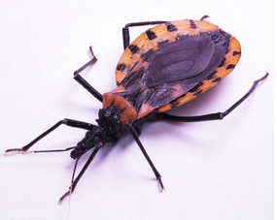
22 yo previously healthy male born in El Salvador who came to the US to reunite with his mother and sister
Asymptomatic at time of refugee assessment
Reported having lived in a small town in El Salvador with his grandmother, adobe walls on housing noted
Screened for Chagas disease at Boston Medical Center

Slide 14
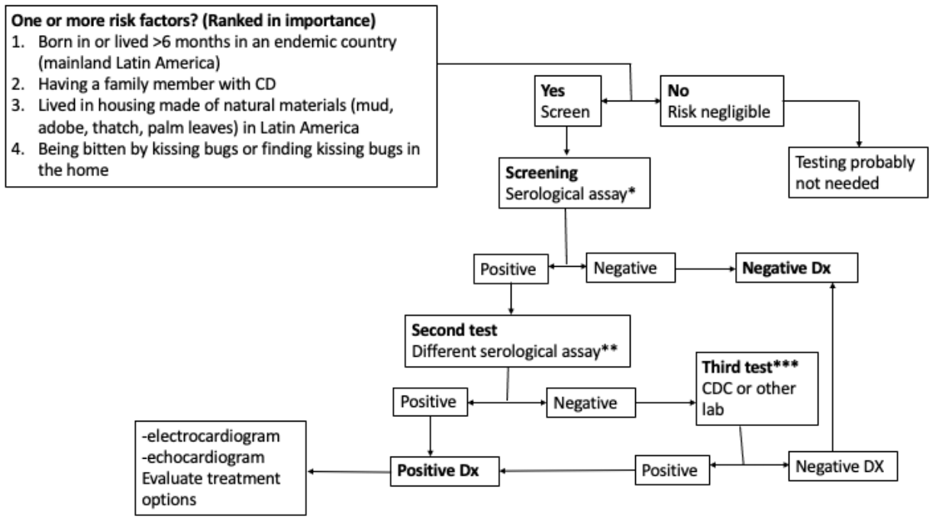
Making a Diagnosis of T. cruzi infection
Serologic testing Single positive result does NOT confirm the diagnosis
Need at least two tests (different techniques/ antigens)
Forsyth CJ et al. JID 2021
Notes:
The sensitivity of PCR in the chronic phase of Chagas’ disease is highly variable and depends on specimen volume and processing, population characteristics, and PCR primers and methods.
Diagnosis of chronic Chagas infection requires serologic methods to detect immunoglobulin (Ig)G antibodies to T. cruzi, most commonly enzyme-linked immunosorbent assay (ELISA) and immunofluorescent antibody assay (IFA). No available assay has sufficient sensitivity and specificity to be used alone; a positive result by a single assay does not constitute a confirmed diagnosis. Two serologic tests based on different antigens (eg, whole-parasite lysate and recombinant antigens) and/or techniques (eg, ELISA and IFA) are used in parallel to increase the accuracy of the diagnosis. Prefer different formats (not 2 ELISAs)
Data suggest that the sensitivity of serologic assays varies by geographic location, possibly due to T. cruzi strain differences and resulting antibody responses
radioimmune precipitation assay and IgG trypomastigote excreted-secreted antigen immunoblot are promoted as reference tests, but even these do not have optimal sensitivity and specificity and may not be capable of resolving the diagnosis
InBios - multiepitope fusion protein

Slide 15
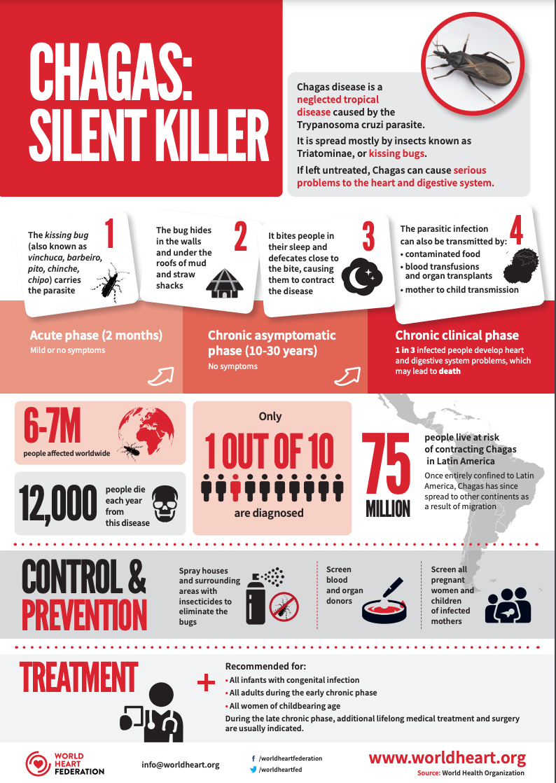
Why Screen for Chagas disease?
Prevent vertical transmission
Prevent disease progression with treatment
Appropriate cardiac monitoring and treatment
Modify risk for stroke, sudden cardiac death

Slide 16
Who should be screened for Chagas disease in the US?
Forsyth C, JID 2022

Slide 17
Barriers to Screening
Lack of physician awareness/ knowledge
Limited guidelines about who to screen and how
Confusion about which tests to use
Patient barriers/fears
Notes:
No gold standard for screening

Slide 18
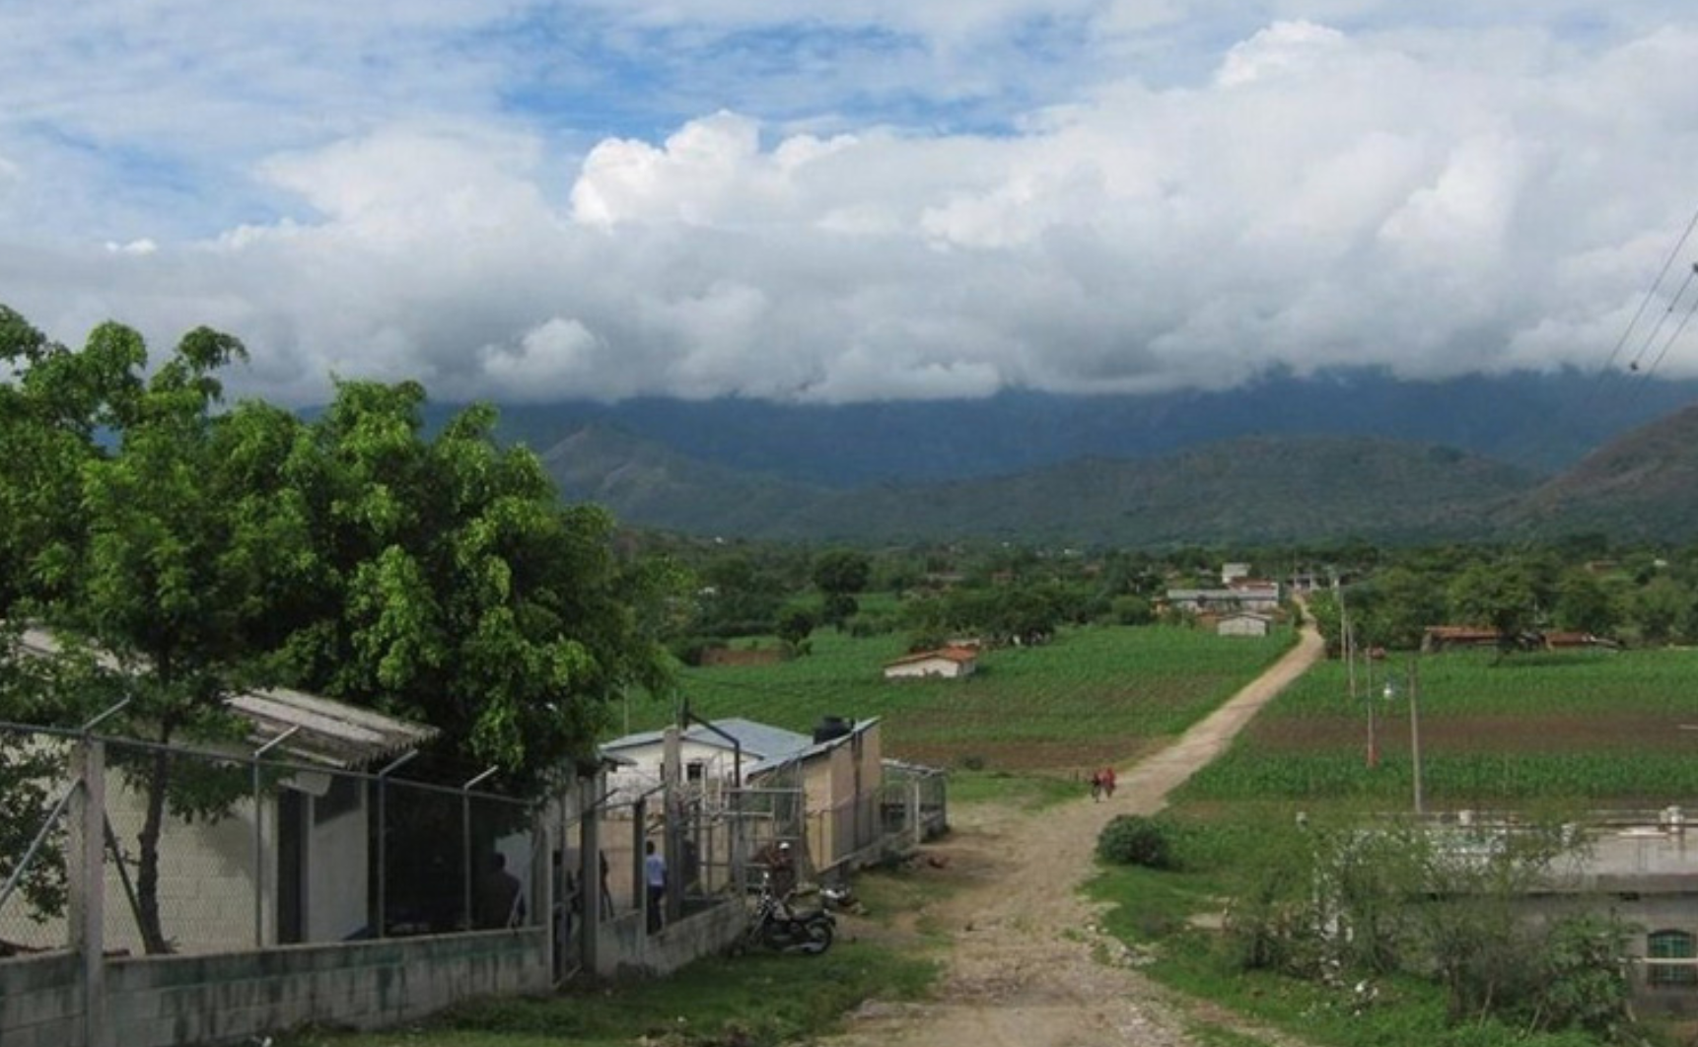
What do we know about treating Chagas disease?

Slide 19
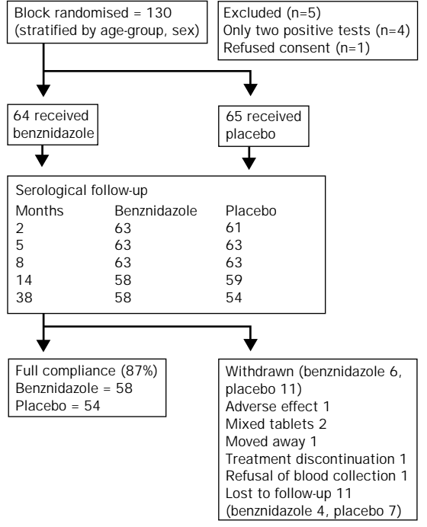
Double-blind RCT in children in rural Brazil (1991-1995)
Benznidazole 7.5mg/kg daily for 60 days vs. placebo
Primary endpoint: negative seroconversion at 3 years
Secondary endpoint: reduction in Ab titers
Sgambatti de Andrade, et al. Lancet 1996; 348: 1407–13
Notes:
Double-blind RCT in children in rural Brazil in the 1990s
Included children age 7-12 years old
Primary end-point was negative seroconversion, using this as a surrogate for parasite clearance
64 children received BNZ and 65 received placebo and they were followed for over 3 years with serial titers

Slide 20
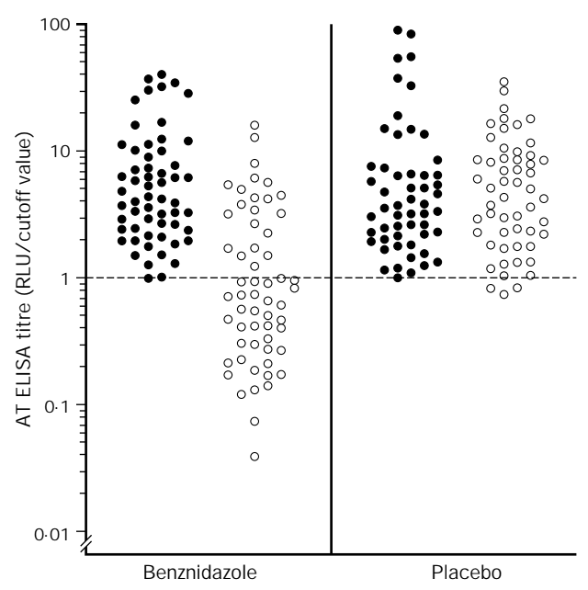
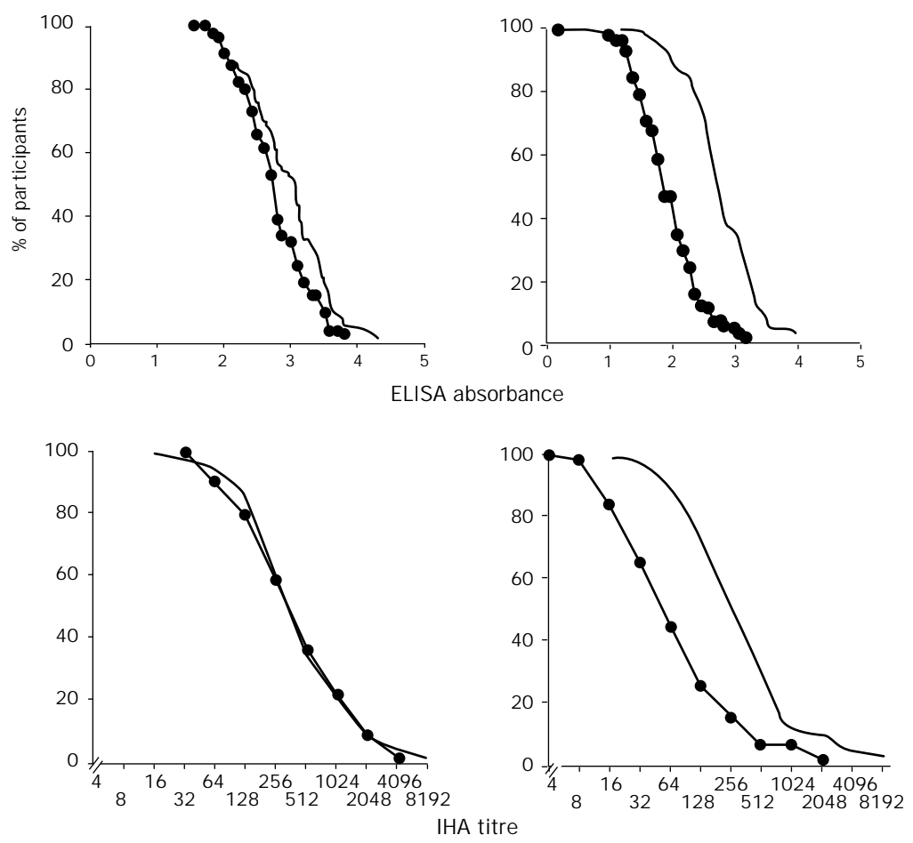
Benznidazole effective in leading to negative seroconversion in children
Sgambatti de Andrade, et al. Lancet 1996; 348: 1407–13
Notes:
Left figure: ELISA results at the start of treatment and at the end of follow-up
Right figure: Shows cumulative distribution curves for placebo (left) and BNZ (right) at baseline and at 3 years - indicating that titers in BNZ group declined over time while placebo group were stable.
A 60-day course of benznidazole treatment was 55·8% effective in leading to disappearance of specific antibodies.
The 21 subjects in the benznidazole group who did not show negative seroconversion did have significant reductions in antibody concentrations compared with their baseline values.
Only mild adverse effects noted and no treatment discontinuations in BNZ group

Slide 21
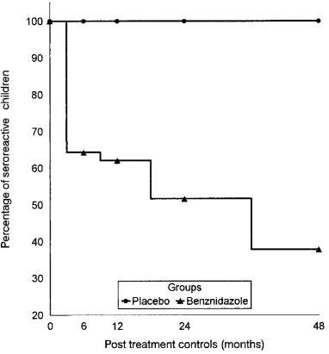
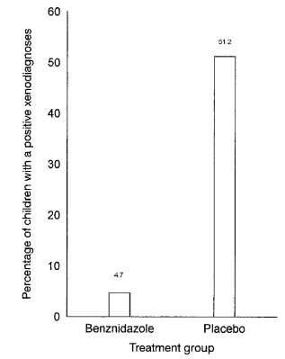
Double-blind RCT in Salta, Argentina
Children age 6-12 years
Benznidazole 60 days vs placebo
Follow period = 48 months
Serial serologic and xenodiagnosis at 48 months
Sosa Estani et al. AJTMH 1998
Notes:
Double-blind RCT in Argentina which included children age 6-12 years and followed for 4 years with serial serology and xenodiagnosis.
Salta region of Argentina chosen due to heavy triatomine surveillance and insecticidal use starting in 1982 (study occurred 1991-1995); authors assumed duration of infection in children was at least 6 years.
Benznidazole group = 51
Placebo = 55
>After treatment, BNZ group seropositivity decreased to 38% while placebo was unchanged
>Xenodiagnosis was positive in 51% of placebo group and only 4.7% of BNZ group (though pre-treatment testing not done)
So both of these studies suggest a relatively high treatment success rate in young children (though using serology as a surrogate for parasite clearance).

Slide 22
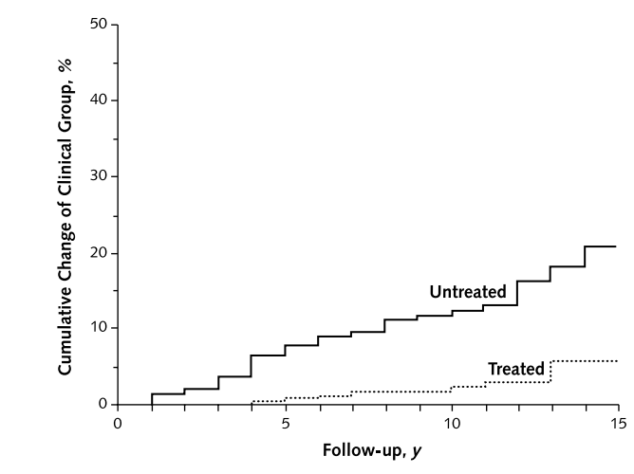
Decreased progression of cardiac disease in treated adults
Argentina, n= 566 (age 30-50)
Serology+, no heart failure
Benz (n=283) vs no treatment (n=283)
4% vs 14% progressed to heart disease
Viotti, Annals of Internal Medicine 2006
Notes:
Prospective trial in Argentina that enrolled patients 30-50 years old with no evidence of cardiomyopathy and compared BNZ 5mg/kg/day for 30 days vs. no treatment.
Excluded patients with heart failure and other co-morbidities (cancer, COPD, DM2, CAD, valvular heart disease, etc)
Patients had baseline: ECG, CXR and echo
Serial ECGs, annual CXR
Echo done if cardiomegaly on CXR
Mean age 39.5 years.
Median time to follow up was 9.8 years (range 5-14 years).
>Fewer treated patients had progression of disease or developed abnormalities on ECG (5% vs.16%; adjusted hazard ratio, 0.27) compared with untreated patients.
>Conversion to negative results on serologic testing was more frequent in treated patients than in untreated patients
> Also, there was no progression or development of cardiac disease in patients who had seroreversion and those who did not were more likely to have progression of cardiac disease.
> Another key finding: low LVEF and higher left ventricular end diastolic diameter were associated with disease progression (suggesting that treatment is not effective in patients with pre-existing cardiomyopathy)
This study suggested that benznidazole treatment significantly decreased the progression of Chagas cardiomyopathy in adults.
Since progression only occurs in 20 to 30% of those with infection and takes decades to become clinically evident, the ideal trial would require large study populations followed for 20 years or more, a virtually impossible clinical trial design

Slide 23
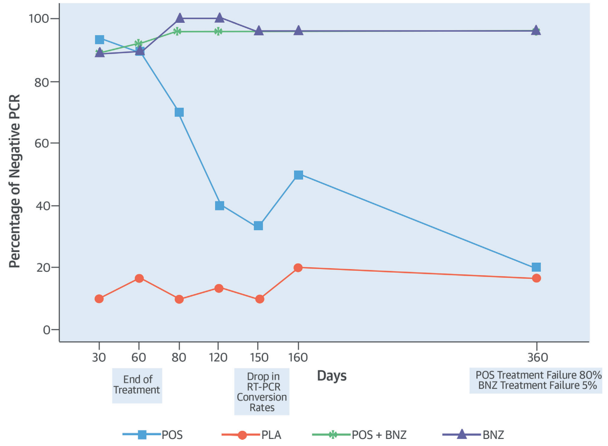
Benznidazole associated with parasite clearance
STOP-CHAGAS Trial: Spain and Latin America
4 groups (n=30 in each group):
Posaconazole
Benznidazole
Posaconazole + Benznidazole
Placebo
Morillo, JACC 2017
Notes:
STOP-CHAGAS trial was a multi-center trial in Spain and Latin America
Enrolled patients age 18-50 with no evidence of cardiac disease
Included patients with: +Serology and +RT-PCR
Patients were randomized to one of 4 groups: 1. Posaconazole
2. Benznidazole 200mg BID
3. Posaconazole + Benznidazole 200 BID
4. Placebo
Primary outcome: proportion of patients with negative RT-PCR at day 180
Defined ‘successful treatment response” as negative RT-PCR at day 180 and at least 2 preceding time points.
Treatment response rates were high in all treatment groups at day 30 and 60 but at day 180:
Only BNZ and BNZ+POS showed sustained negative RT-PCR
>32% stopped BNZ permanently due to adverse events (rash, neuropathy, GI side effects most common)

Slide 24
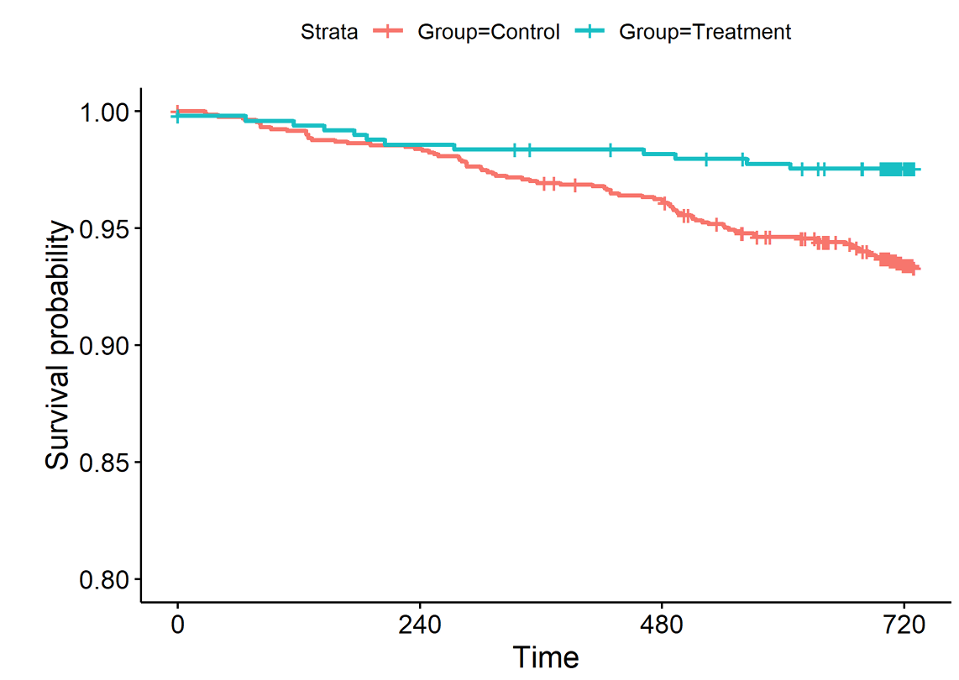
Treatment Lowers Mortality
SaMi-Trop
Prospective study, Brazil
N= 1813 (493 treated, 1320 not treated)
Benz group had decreased mortality (2.8% vs 7.6%)
Cardoso, PLoS NTD 2018
Notes:
SaMi-Trop observational prospective cohort study: enrolled chagas patients a high prevalence region of Brazil.
A total of 1,813 patients were evaluated at baseline and after two years of follow-up. Those who received at least one course of benznidazole were classified as treated group (n= 493) and control group (n= 1,320).
64% were treated within 30 days of Chagas diagnosis (20% in 1-12 months); 83% treated before age 40.
The primary outcome: death after two-year follow-up.
Secondary outcomes: presence at the baseline of major Chagas-associated ECG abnormalities, BNP levels suggestive of heart failure, and PCR positivity.
Results: Mortality after two years was 6.3% (treated 2.8% vs controls 7.6%); adjusted OR: 0.37 (95%CI: 0.21;0.63).
ECG abnormalities typical for Chagas and high BNP levels suggestive of heart failure were lower in the TrG than the CG.
TrG had significantly lower rates of PCR positivity, OR: 0.35 [CI: 0.27;0.45].
Conclusion:
Patients treated with benznidazole had reduced parasitemia, a lower prevalence of markers of cardiomyopathy, and lower mortality after two years of follow-up.

Slide 25
Patients age 18-75 with confirmed Chagas disease and cardiac involvement
n=1431 benznidazole n=1423 placebo
Mean age 55 years old
97% had NYHA class I or II heart failure (mean LVEF 55%)
93.3% in BNZ group and 94.7% in placebo group had abnormal ECG
52% had RBBB and 45 - 48% had LAFB on ECG
59.5% in BNZ group had +PCR
61.7% in Placebo group had +PCR
NEJM 373;14. 2015
Notes:
BENEFIT trial: Prospective, multicenter, randomized study involving 2854 patients with Chagas’ cardiomyopathy who received benznidazole or placebo for up to 80 days and were followed for a mean of 5.4 years.
Eligible patients were required to have cardiac findings consistent with established Chagas cardiomyopathy.
Primary outcome: death or major cardiac event (cardiac arrest, pacemaker placement, sustained VT, new heart failure, stroke, thromboembolic event)
Secondary outcome: negative PCR
97% were NYHA class I or II
Mean LVEF 55%
17.8% in BNZ group and 16.9% in Placebo group had LVEF<40%
Most had abnormal ECGs
Of note, the BENEFIT trial population had a mean age of 55, >93% had cardiac damage based on ECG abnormalities, and nearly half had decreased ejection fraction at baseline, indicating ventricular dysfunction.

Slide 26
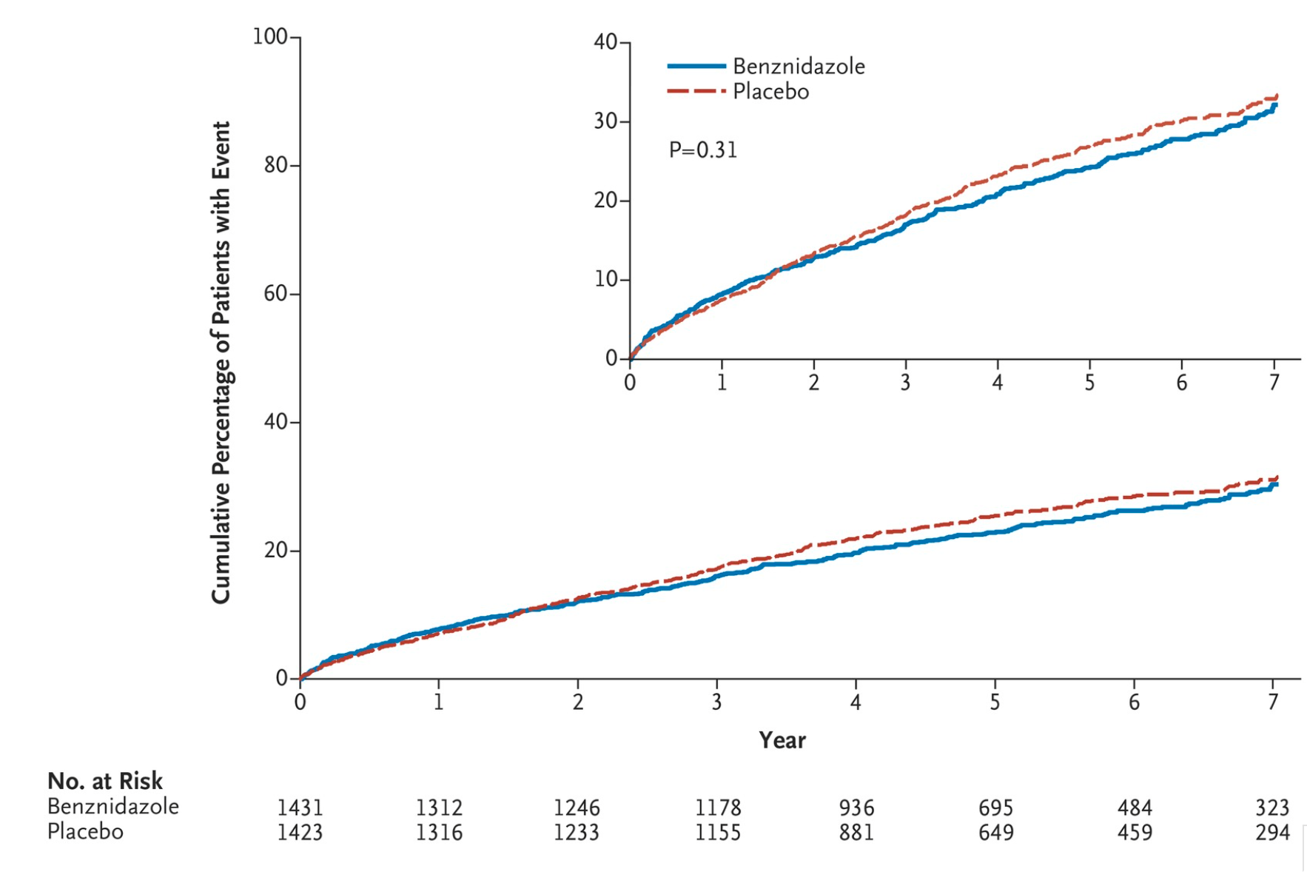
BENEFIT Trial: Trypanocidal Therapy for Chagas Cardiomyopathy Did Not Improve Outcomes
Morillo et al. NEJM 2015
Notes:
No difference between benznidazole and placebo in more advanced Chagas cardiomyopathy
No significant effect of benznidazole on preventing the progression of established Chagas cardiomyopathy
This study involving only patients with established Chagas’ cardiomyopathy, the efficacy of treatment as assessed by conversion to negative PCR results was more modest, with rates of 66% at the end of treatment and 46.7% after 5 years or more, which suggests that the standard regimen of benznidazole may be less effective in patients with established cardiomyopathy.

Slide 27
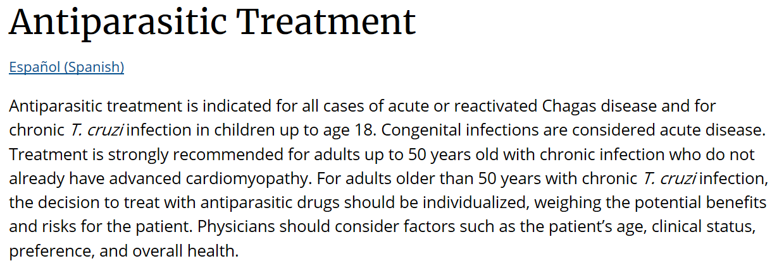
CDC Recommendations:

Slide 28
Pre-treatment evaluation of a patient with Chagas:
Baseline ECG and Echocardiogram (with contrast) in all patients
Consider ambulatory cardiac monitoring
Consider Cardiac MRI
Baseline laboratory testing:
CBC/diff, CMP
Pregnancy test (if applicable)
Troponin, BNP
HIV Ag/Ab
Strongyloides IgG
IGRA
Consider H. pylori testing
Notes:
Role of cardiac MRI:
Comprehensive assessment of anatomy, biventricular function, perfusion
Overcomes echo limitations (acoustic window)
Late gadolinium enhancement (LGE) to identify fibrosis/necrosis
Predictor for mortality, sustained VT

Slide 29
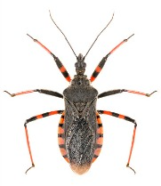
Take Home Points
Screen all individuals from endemic regions
Many uncertainties exist in the management of Chagas disease
Treatment not recommended for patients with advanced cardiomyopathy
More studies needed to determine if treatment improves outcomes in adults with mild cardiac disease
Adverse reactions to benznidazole and nifurtimox are common
Multidisciplinary approach and close monitoring may improve treatment completion rates
Notes:
Lack of test of cure

Slide 30
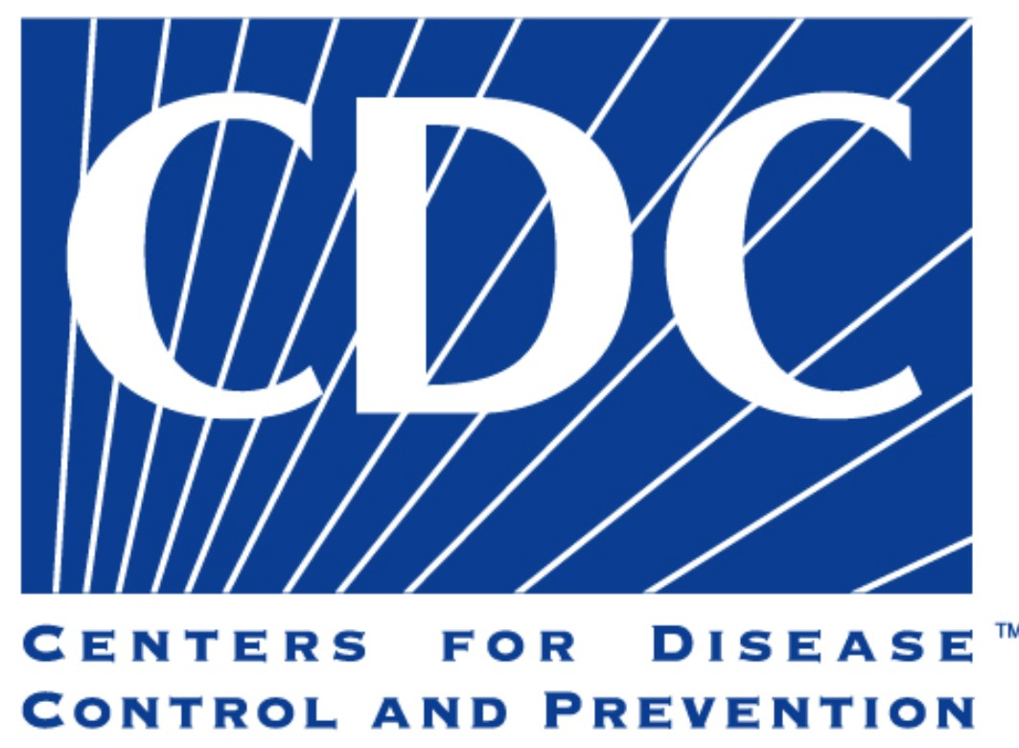
Acknowledgments
Boston University:
Dan Bourque, MD
Elizabeth Barnett, MD
Natasha Hochberg, MD MPH
Maja Carrion, MPH
Madolyn Dauphinais, MPH
Alyse Wheelock, MD
Katherine Reifler, MD
Deepa Gopal, MD
Claudia Gelinas Michael Mailluri, RPH
Strong Hearts Program:
Julia Koehler, MD
Juan Huanuco, MD
Jaime Gallegos, MD
Jillian Davis, RN
Jen Mann-Goehler, MD
Ashley Maldonado
CDC:
Susan Montgomery, DVM MPH
Emily Dodd
Funding: CoAg CDC and BUSPH NU2GGH002463-03-00

Slide 31
Resources
Handbook for guidance to providers & clinics who wish to begin screening
Posters to hang in clinic spaces
Postcards
Our website with these materials: https://sites.bu.edu/chagas/

Slide 32
Questions?

