Slide 1


NICHD Contraceptive Research Units Annual Meeting
6 – 8 APRIL 2022
Hotel Commonwealth, Boston, MA
Project 3 CLINICAL PCT STUDY OF HCA FILM
Annie Thurman MD
Professor of OBGYN, Director of Eastern Virginia Medical School/CONRAD Clinical Research Center

Slide 2
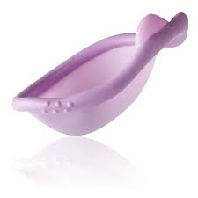
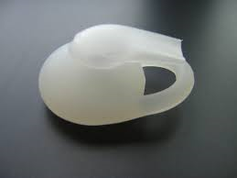
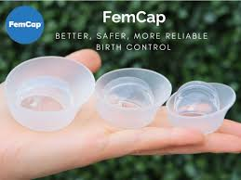
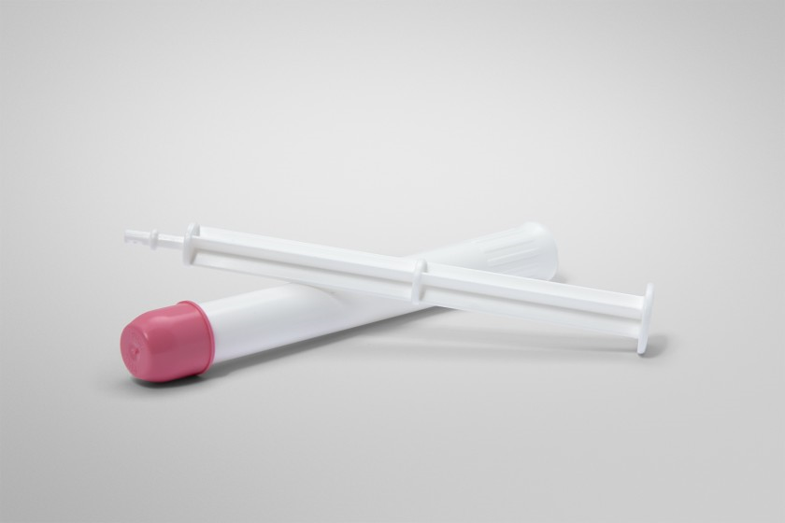
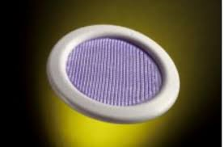


PCTs in Previous and Current Non Hormonal Contraceptives
SILCS/CAYA Diaphragm
  Schwartz et al. Contraception 2008;78(3):237-44.
  Mauck et al. Contraception 2017;96:124-130.
Lea’s Shield
  Archer et al. Contraception 1995;52(3):167-73.
Fem Cap
  Mauck et al. Contraception 1997;56(2):111-5.
Acidform (Amphora) and N9
  Amaral, Mauck et al. Contraception 2004;70:492-7.
Ovaprene IVR (Dare Biosciences)
  ClinicalTrials.gov #NCT03598088

Slide 3
PCT Correlates with Contraceptive Efficacy
SILCS/CAYA Diaphragm (with Buffergel versus N9)
  Schwartz et al. Obstet Gynecol 2015;125(4):895-903
Lea’s Shield (w and w/o spermicide)
  Mauck et al. Contraception 1995;52(3):167-73.
Fem Cap (vs Ortho All Flex Diaphragm)
  Mauck et al. Contraception 1999;60(2):71-80.
Acidform and N9 Gels alone
  Barnhart et al. Obstet Gynecol 2016;127:118S-125S
  Burke et al Obstet Gynecol 2010;116(6):1265-1273
Amphora Clinical Efficacy Trials
  Evofem Phase 3 Contraceptive Efficacy Trials

Slide 4
Recent PCT Studies
CONRAD 126 (NCT02309554, 9 visits): Phase I PCT study of CAYA Used with 2% N9 gel, Contragel or No gel (12/2014 – 10/2015)
27 enrolled (EVMS 11, Profamilia 16) → 18 Discontinued (Poor Baseline CMC, anovulation) → 9 completers (EVMS 4, Profamilia 5)
  Mauck CK, Brache V, Kimble T, Thurman A, et al. Contraception. 2017;96(2):124-30.
Dare Ovaprene Safety/PCT (NCT03598088, 21 visits): 6 US Sites (5 are CCTN sites), 5/2018 – 11/2020 (2.5 years)
135 screenings, 38 enrolled, 26 completed at 6 sites
EVMS: Screen 55 (~ 1 – 2 per month), 10 successful Baseline PCTs, 8 completers at EVMS
  Mauck C, Thurman AT, Baker J, Jensen J, Schreiber C, et al. Successful PCT Results of Ovaprene, a Monthly Hormone-Free Vaginal Contraceptive. ACOG Annual clinical Meeting Abstract.

Slide 5
Recap of Clinical Trial Design
Description: Phase 1a, single center (EVMS), open-label, crossover, mechanism of action and proof of concept study
Population: Healthy, ovulatory, sterilized women 18 – 50 years of age in a monogamous heterosexual relationship. No exogenous hormones
Primary/Surrogate Efficacy Endpoint: To assess the potential contraceptive activity of the ZB-06 film using a surrogate assessment for contraceptive efficacy (PCT): the degree to which progressively motile sperm (PMS) can be excluded from the endocervical mucus after intercourse preceded by a single administration of the ZB-06 film (benchmark is < 5 PMS/hpf (400X) averaged over 9 hpfs), compared to the same evaluation performed after intercourse without film (5+ PMS/hpf).
    Mauck CK, Vincent KL. The postcoital test in the development of new vaginal contraceptivesdagger. Biol Reprod. 2020;103(2):437-44. Epub 2020/07/14. doi: 10.1093/biolre/ioaa099. PubMed PMID: 32657328; PubMed Central PMCID: PMCPMC7401356.

Slide 6
Recap of Clinical Trial Design
2° Objective/Endpoints: To assess the safety of a single dose of ZB-06 film used with a single act of vaginal intercourse among female participants and their male partners. (Incidence of Grade 2 or greater adverse events in the participant and/or her male partner, during baseline cycle without product, compared to product use cycle).
Exploratory Objectives/Endpoints:
To determine anti-sperm antibody concentrations and agglutination potency in vaginal fluids, endocervical mucus, and serum at baseline, and at 2-3 and 24 hours after intercourse with and without product use, and 1 month after product use (additional “safety” cycle)
To assess the effect of the film on cervicovaginal immune mediators
To assess acceptability of the film with intercourse among female and male participants

Slide 7
PCT Study Visits
V1 |  | V2 | V3 | V4 | V5 |  | V6 | V7 | V8 |  | V9 Phone Call | V10
 |  | ENROLL | BASELINE NO PRODUCT CMC/PCT (5+ PMS/HPF) |  |  |  | PRODUCT CMC/PCT (1°ENDPOINT) (<5 PMS/HPF) |  |  |  | 1M POST PRODUCT SAFETY CYCLE (Exploratory Endpoint) (5+ PMS/HPF)
Screen |  | Enroll – Give LH Kit, start ovulation testing on day 10 | Baseline Cervical Mucus Check (CMC) | Baseline PCT No Product | 24 hours post PCT |  | Pre HCA Film Use CMC | HCA Film Use PCT | 24 hours post PCT |  | 1M Post Product Use CMC | 1M Post Product Use PCT

Slide 8
Status Update NCT04731818
1/26/2021 Site Activation, 2/8/2021 First Screen, LPLV 2/24/2022
Recruitment Initiatives:
Contacted previous BTL participants
Referral from faculty practice
EVMS CRC Facebook Page
Craigslist
Telephone screens from other studies
53 Screenings Scheduled
30 No Shows, Unsuccessful attempts at re-scheduling
23 SCREENINGS
(1 – 2 per month)
3 Screen Fails:
Menses > 35 d prior to BL (1)
Abnormal Pap (2) HGSIL, WNL +HRHPV
20 ENROLLMENTS
11 Discontinuations:
Failed baseline PCT < 5 PMS/hpf (3)
Male Health Issue (1)
Couple Discord/Social (4)
LTFU (1)
Anovulation (2)
8 COMPLETERS

Slide 9
Mean PMS/hpf
No Product = 25.93
Active Film = 0.04
Post Film Safety = 47.39

Slide 10
Safety and Acceptability Assessments
No Product or Procedure Related Adverse Events
  Amendment for 2 Film insertions for one participant
Female and Male Acceptability Assessed
  Female – Fairly easy insertion (some stickiness to finger), no change in lubrication, no change in sexual pleasure. Some didn’t like that insertion 30 minutes pre-intercourse
  Male – Did not feel film, did not change pleasure, some noted more or less lubrication with film

Slide 11
CONCLUSIONS
HCA Film met PCT benchmark for excluding PMS from ovulatory cervical mucus
Single dose (one participant 2 exposures) was safe and well tolerated among women and their male partners

Slide 12
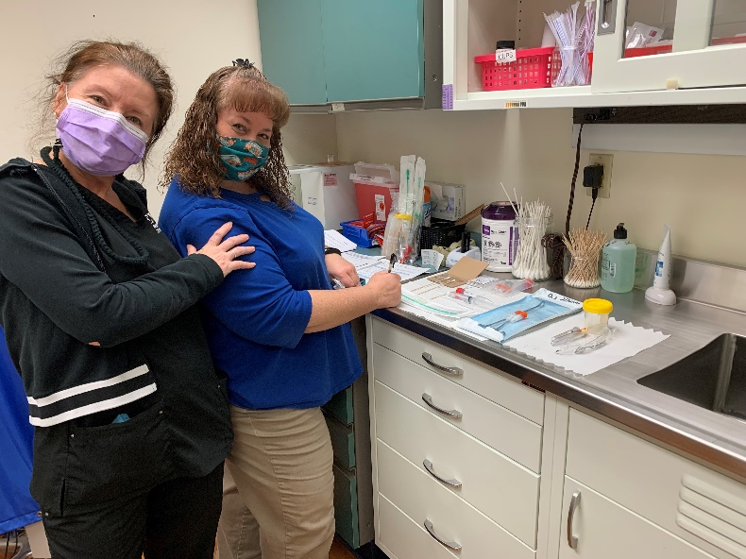
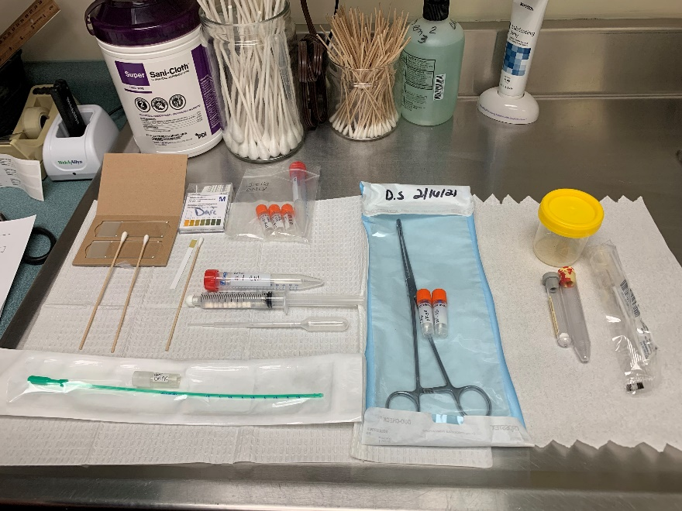
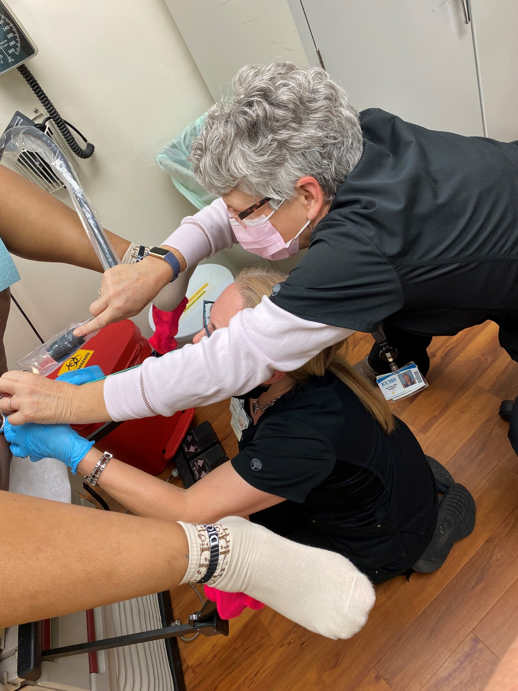
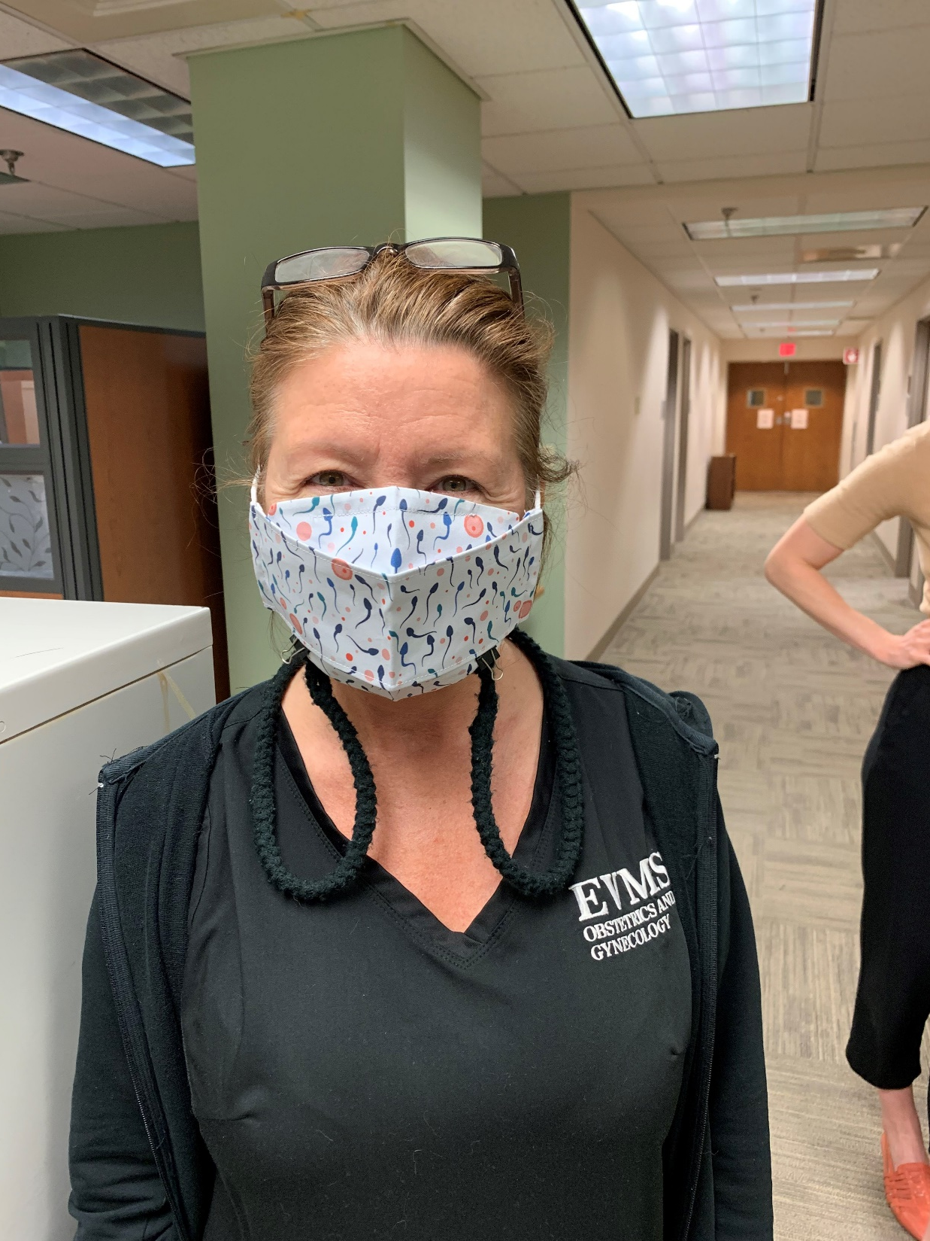
EVMS Team
Annie Thurman, MD PI
DeDe Raney, CNM Sub-I
Jamie Evans RN, Study Coordinator
Estella Jones, PhD Andrologist, Back Up Coordinator

Slide 13


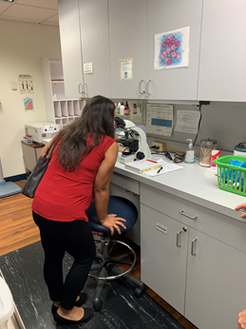



Acknowledgements

