Slide 1

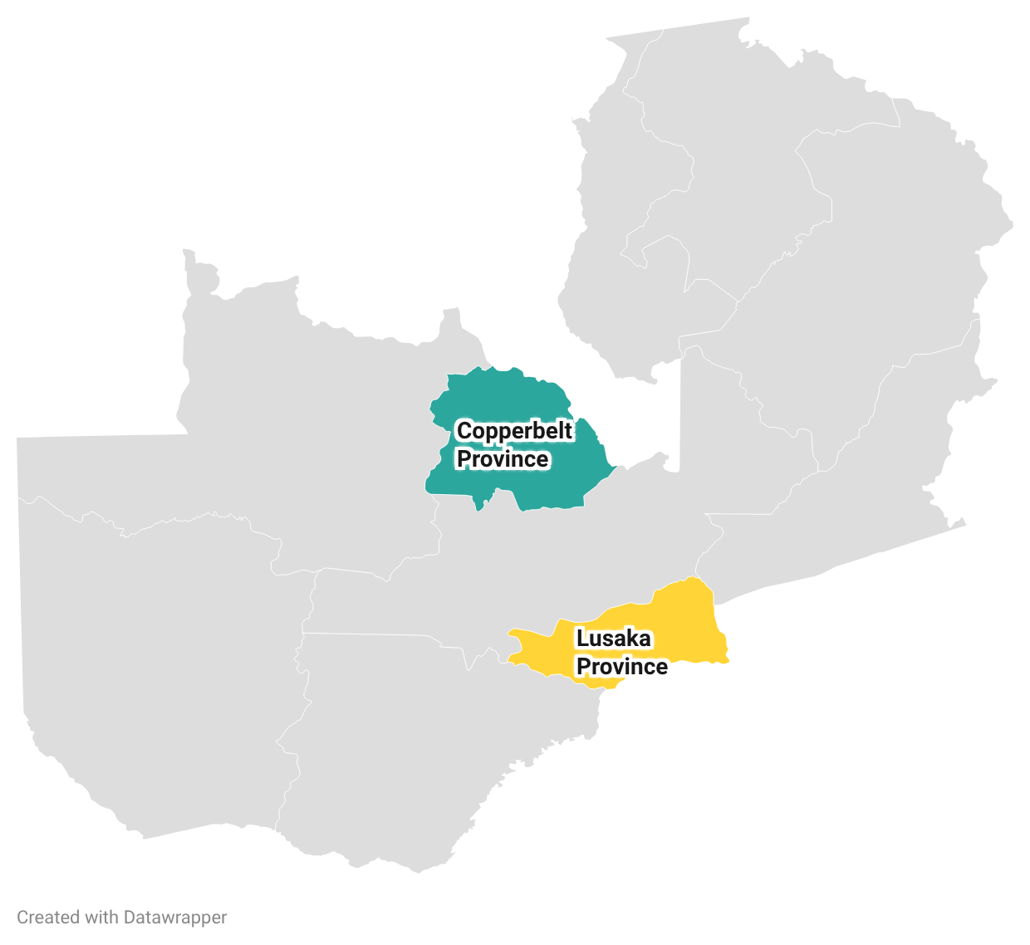
Experiences and perspectives of HIV treatment clients on the 2025 funding cuts to HIV service delivery in Zambia
BACKGROUND
METHODS
Zambia has reported exceeding the UNAIDS 95-95-95 targets for testing, treatment, and viral suppression.
PEPFAR funded approximately 84% of Zambia’s HIV program at the start of 2025, supporting service delivery through USAID, CDC, the Ministry of Health and implementing partners (Mulenga et al., 2025).
The January 2025 Stop Work Order (SWO) for USG-funded programs disrupted HIV service delivery across Zambia, affecting staffing, health commodities, outreach, and client communication for several weeks or longer.
Understanding the experiences and perspectives of clients on these disruptions is essential for designing effective mitigation strategies.
We conducted 90 in-depth interviews and 15 focus group discussions with adults (≥18 years old) living with HIV and on treatment for ≥6 months before the SWO. Interviews were conducted from 30 Nov to 13 Dec 2025.
Interview guides explored client experiences, perceptions of funding changes, and impact on HIV care.
Transcripts were analyzed using thematic analysis to identify key themes in client responses.
Findings are described with verbatim illustrative quotations drawn from the transcripts.
STUDY SITES
5 facilities in Copperbelt Province with implementation support and technical assistance from USAID IPs.
5 facilities in Lusaka Province with CDC technical assistance from IPs and implementation by province.
RESULTS
Information about SWO from social media, not from Health facilities
Clients reported receiving no official explanation from their health facility about the funding cuts or the implications on client care.
Information came from social media, radio, and community rumors, generating widespread fear before any actual drug shortage occurred at most health facilities.
“I didn’t hear anything from the clinic here, they didn’t explain anything about what we were hearing. But I just heard the messages from the community and social media. No, no one explained.” – Female IDI participant, Copperbelt province
Reduction in dispensing intervals from six months to as little as two weeks at at time was the most universally experienced and most disruptive concrete service change across all facilities.
Reductions directly disrupted clients' livelihoods, farming cycles, business travel, and family activities, with impacts felt disproportionately by clients living far from health facilities and those who traveled regularly for work.
Despite widespread fear of stockouts, most clients reported that ART was never actually unavailable at their facilities during the SWO.
“They gave me for 1-month, how can I go to the farm? My work at the farm will be ruined. I can’t go there; I don’t know how many days I will take there and I don’t have enough medicine.” – Female IDI participant, Copperbelt province “They were giving us few medications. For example, when you come, we're not receiving six months. They will just count for you. If you are lucky, they give you one month. Again, you come back.“ – FGD participant, Kitwe, Copperbelt "I've never seen a month where we go to the hospital, and we find that we don't have medication. Every time we have medication and that's how I'm satisfied with." — Female IDI participant, Lusaka province
Disruptions in drug dispensation and supply
Healthcare workforce reductions and lapse of community-based services
Following the SWO, clients noticed fewer staff at facilities and reported that community health workers, outreach vehicles, peer support groups, and home visits had largely stopped.
The loss of these community services removed a critical protective layer for clients who had depended on outreach for appointment reminders, adherence support, and medication delivery.
"There is no one to counsel us anymore, no one to check on our health or guide us on how to live well with our medication, the workers are too few now." — Female participant, Copperbelt
”Those community services to visit people and give them medicine in the community are no longer available. From the time donors withheld the funding, most programs have changed and others have gone just like that.“ – FGD participant, Lusaka province
SHIFT Policy Brief: Experiences and perspectives of HIV treatment clients on the 2025 funding cuts to HIV service delivery in Zambia
June 2026
Notes:
I found the original figure 1 hard to follow and have no idea what it is supposed to say. Can we try again? Maybe a version of the timeline figure as shown? It is at Dropbox/RETAIN6/PHASE 2/South Africa/Activity 1-Guideline implementation fidelity/SA Guidelines/South Africa first year guidelines comparison.pptx.
The placeholder I pasted in will need better formatting.

Slide 2




Viral load testing and laboratory service disruptions
Clients in some facilities reported delays in receiving viral load results.
At facilities reporting no significant disruption to lab services, clients expressed appreciation.
“I have re-drawn my blood twice and they have not told me anything. I want to know whether the virus is suppressed or not suppressed. I would like the workers to be informing us how we are adhering to the medication and how our health is.” – FGD participant, Copperbelt Province
“When I asked for my blood results, they wouldn’t tell me. Even yesterday, I was here asking – my blood results from last time – they are not telling me” FGD participant, Lusaka Province
“From the time I have been here three years the doctors take care of us very well.” FGD participant, Copperbelt Province
Psychological and economic consequences
Economic impact and out-of-pocket costs
"In a year, I now come here four times. When I used to come here twice. That is another burden which is on me now, and that is all because of the cutting of funding." — Male IDI participant, Lusaka Province
“Sometimes when you come, they hand you a paper — this medication is out of stock, go and buy it. After walking from home to come here, they tell you to go and buy. Now how are you going to buy when you don't have money?"– Female IDI participant, Lusaka Province
More frequent clinic visits significantly increased transport costs.
Non-ART medications previously provided free became unavailable, generating new out-of-pocket costs.
Fear, distress, and loss of hope
“What was going through my mind was saying, now this is a journey to death. If they stop that, it means I personally cannot afford to buy the medicine.” – Female IDI participant, Copperbelt
“In the community they had started saying, you who are HIV clients this is when you are going to die because they saying one bottle will cost ZMW2,000.” – FGD participant, Copperbelt
“We were economizing the drugs to say, this one bottle I have for six months which was given, I will be skipping some days so that this drug goes on and on for some time.” – FGD participant, Copperbelt
Fear of death was reported by clients across all the facilities.
Rumors in communities that medication would be sold at expensive prices.
Fear of running out of medication led some clients to ration their doses during the SWO.
Trust and satisfaction with HIV services
“I’m happy with how I received medication because I was worried to say they won't have medication but now I'm happy to say I always find medication and that's the joy I have.” – Male IDI participant, Lusaka
“What makes me happy is the care that the healthcare workers give us, as patients. They interact with us so that we become free with them and if there is anything, we tell them everything.”— Female IDI participant, Copperbelt
Clients reported overall satisfaction with HIV services provided in 2025, anchored by continued ART availability and caring providers.
Despite reduced staff, health providers continued delivering professional, compassionate care, ensuring clients felt welcomed and supported throughout.
What clients want funders and government to know
“They should not stop supporting HIV programs here in Zambia. Many lives depend on ARVs — and even those who are HIV negative are worried, because they have family members living with HIV."—Female IDI participant, Copperbelt Province
Clients appealed to donors and the Zambian government to continue funding ART and associated HIV services, emphasizing that sustained treatment access is essential for their survival, health, ability to work, and responsibility to care for their families.
CONCLUSIONS
Clients reported intense fear and distress following news of the SWO, which most heard about first through social media and community rumors rather than from their health facilities.
Clients reported overlapping disruptions to community support services, health worker availability, counselling, and clinic communication during the SWO period.
Shorter dispensing periods forced clients to make more frequent and costly clinic visits, while the simultaneous loss of community health workers, home visits, and outreach vehicles removed the primary support system that had kept the most vulnerable in care.
Despite widespread disruptions, most clients never went home without medication and consistently credited caring, dedicated providers as the reason they stayed in care throughout the Stop Work Order period.
Cite as: Mwale M, Mutanda N, Morgan A, Scott N, Rosen S, Haimbe P, Shakwelele H, Sivile S, Mokhele I, Ngoma T. Experiences and perspectives of HIV treatment clients on the 2025 funding cuts to HIV service delivery in Zambia. SHIFT Policy Brief. June 15, 2026.

