Slide 1
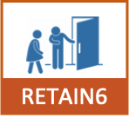
Clients starting ART with advanced HIV disease in South Africa: characteristics and six-month outcomes
BACKGROUND
METHODS
In South Africa and neighboring countries, 20-30% of individuals who come to clinics to start or re-start HIV treatment present with advanced HIV disease (AHD), defined by CD4 counts <200cells/μL or WHO stage 3/4 conditions.
AHD is associated with higher mortality and more opportunistic infections, and AHD patients require more clinical care.
Clinical guidelines do not adequately address the unique needs of AHD clients, particularly early in treatment.
From September 2022 to June 2023, we surveyed a sequential sample of clients starting or re-starting ART or on ART for ≤6 months at 18 primary healthcare facilities in three provinces in South Africa (Gauteng, Mpumalanga, and KwaZulu-Natal; mix of rural/urban).
We collected demographic and social characteristics, HIV care history, and service delivery preferences and expectations and linked survey responses to routine medical record data from Tier.Net.
Participants were classified as having AHD if they had a CD4 count ≤200 cells/mm or were in WHO Stage 3 or 4 at ART initiation.
Primary outcomes were 6-month retention and viral load (VL) suppression, categorized as suppressed (<50 copies/mL), low-level viremia (50–1,000 copies/mL), or unsuppressed (≥1,000 copies/mL) at the routine 6-month VL test.
RESULTS
We enrolled 1,098 survey participants (Figure 1).
Of these, 938 (85%) had a baseline CD4 count and/or WHO stage recorded at initiation.
275/938 (29%) had AHD, with a median CD4 count of 108.
TABLE 1. DEMOGRAPHIC AND CLINICAL CHARACTERISTICS OF ANALYTIC SAMPLE
Characteristic | Response | Non-AHD (N=663) | AHD (N=275)
Age | Median age (IQR) | 31 (25-38) | 38 (31-44)
Sex | Female | 523 (79) | 154 (56)
Marital status | Married-living with partner | 199 (30) | 90 (33)
 | Married-not living with partner | 337 (51) | 104 (38)
 | Single | 127 (19) | 81 (29)
Education | Primary or less | 238 (36) | 109 (40)
 | Secondary | 324 (49) | 129 (47)
 | Post-secondary | 101 (15) | 37 (13)
Employment | Formal employment | 132 (20) | 72 (26)
 | Informal employment | 126 (19) | 61 (22)
 | Unemployed | 347 (52) | 130 (47)
 | Student/trainee | 58 (9) | 12 (4)
Food scarcity | Sometimes/often | 157 (24) | 64 (23)
Access to R100 ($6) for healthcare if needed | Difficult/very difficult | 374 (56) | 145 (53)
Tested HIV positive before most recent ART initiation | Yes | 226 (34) | 90 (33)
Previously on treatment | Yes | 73 (11) | 30 (11)
Reason for testing most recently | Recommended by provider | 162 (24) | 43 (16)
 | Known exposure or risk | 88 (13) | 22 (8)
 | Ill health | 249 (38) | 172 (63)
 | Pregnancy/antenatal | 41 (6) | 10 (4)
 | Self-initiated/voluntary | 103 (16) | 26 (9)
 | Other | 20 (3) | 2 (1)
Time before treatment initiation after HIV-positive test | Same day | 541 (82) | 176 (64)
 | Within a week | 78 (12) | 73 (27)
 | Month plus | 40 (6) | 22 (8)
 | Unsure | 4 (1) | 4 (1)
Tested for TB at ART initiation | Yes | 442 (67) | 208 (76)
Ever diagnosed with TB | Yes | 26 (4) | 39 (14)
FIGURE 1. SCREENING OUTCOMES FOR ENROLLED SAMPLE
There were no differences between the two groups in education, employment, or access to food or money (Table 1).
Participants with AHD were more likely to be male (44% vs.21%) and older.
Clients with AHD were more likely to seek care due to illness than non-AHD clients (63% vs. 33%) (Table 1).
Participants with AHD were less likely to have started ART on the same day as HIV diagnosis.
Participants with AHD had higher rates of TB testing (76% vs. 67%).
RETAIN6 Policy Brief: Clients starting ART with advanced HIV disease in South Africa: characteristics and six-month outcomes
https://sites.bu.edu/ambit/the-retain6-project
Version of May 20, 2025

Slide 2
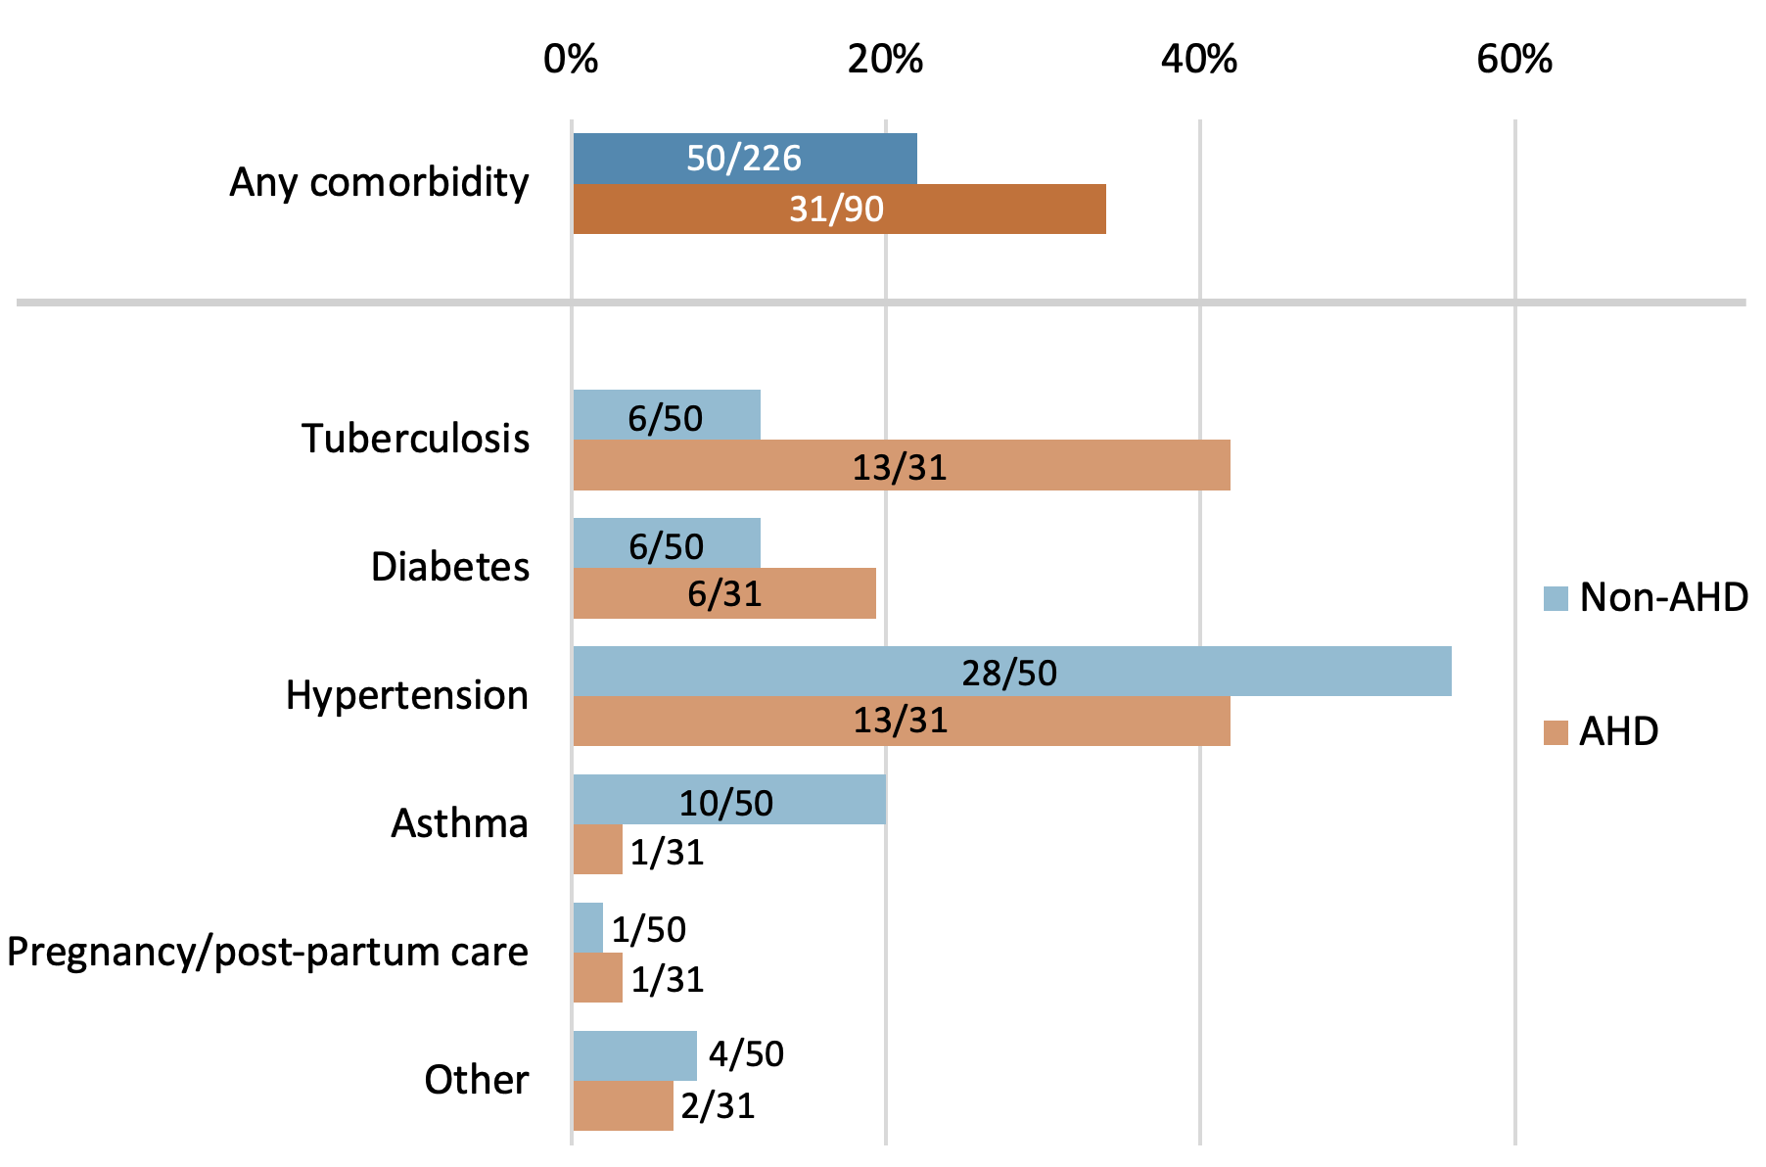


FIGURE 2. HIV CARE HISTORY
FIGURE 3. PHYSICAL CONDITION AT THE TIME OF HIV TESTING
34% of clients with AHD self-reported having any comorbidity, compared to 22% of those without AHD (Figure 2).
Clients with AHD more often reported that they felt sick than those without AHD (Figure 3.)
Participants with AHD had higher rates of TB disease (42% vs.12%)
TABLE 3. TREATMENT OUTCOMES
Characteristic | Non-AHD (n=663) | AHD (n=275) | Risk difference (95% CI) | Relative risk (95% CI)
Retention in care by 6 months on ART
Continuously in care | 466 (70%) | 208 (75%) | 5% (-1 to 12%) | 1.08 (0.99-1.17)
Transferred to another facility | 31 (5%) | 11 (5%) | 0% (-3 to 2%) | 0.86 (0.44-1.68)
Interrupted treatment and returned to care (cyclical) | 89 (13%) | 33 (12%) | -1% (-6 to 3%) | 0.89 (0.62-1.30)
Disengaged from care | 148 (22%) | 53 (19%) | -3% (-9 to 3%) | 0.86 (0.65-1.14)
Disengaged immediately after initiation | 21 (3%) | 3 (1%) | -2% (-4 to 0%) | 0.34 (0.10-1.15)
Disengaged from care 1-6 months after initiation | 37 (6%) | 14 (5%) | 0% (-4 to 3%) | 0.91 (0.50-1.66)
Deceased | 1 (0.2%) | 3 (1%) | - | -
Outcome unknown | 18 (3%) | 3 (1%) | -2% (-3 to 0%) | 0.40 (0.12-1.35)
VL suppression by 6 months on ART (copies/ML)
If VL result observed at 6 months: | 64% | 72%
Suppressed (<50 copies/mL) | 314 (47%) | 121 (43%) | -4% (-10 to 4%) | 0.93 (0.80-1.09)
Low-level viraemia (50-999) | 70 (11%) | 66 (24%) | 13% (8 to 19%) | 2.27 (1.67-3.09)
Unsuppressed (≥1000 copies/mL) | 43 (6%) | 11 (4%) | -2% (-5 to 0%) | 0.62 (0.32-1.18)
VL result not observed at 6 months | 236 (36%) | 77 (28%) | -8% (-14 to -2%) | 0.78 (0.63-0.96)
At 6 months post-initiation, clients with AHD had similar or slightly better rates of retention in care than did those without AHD (75% v 70%) (Table 3).
There were no differences in the proportions interrupting treatment and returning to care.
Few deaths were observed in either group, though AHD clients had slightly higher mortality.
AHD clients were more likely to have a 6-month VL test result recorded (72% v 64%).
Among those who did have VL results recorded, clients with AHD were more than twice as likely to experience low-level viremia (24% vs. 11%) and slightly less likely to achieve viral suppression (43% vs. 47%).
CONCLUSIONS
Advanced HIV disease at treatment initiation or re-initiation is not associated with disengagement from care but was associated with less viral suppression and more low-level viremia at 6 months.
Clients presenting with AHD had a median CD4 count of just 108 cells/m³ and were much more likely to seek care due to current illness than were those without AHD.
Cite as: Kachingwe E, Mutanda N, Ntijikelane V, Benade M, Manganya M, Malala L, Rosen S, Maskew M. Clients starting ART with advanced HIV disease in South Africa: characteristics and six-month outcomes. Retain6 policy brief, May 20, 2025.

