Slide 1
Digital Policy
A Whole Greater Than Its Parts?
Brian Kahin
Technology and Policy Research Initiative
Boston University School of Law
November 18, 2020

Slide 2
Digital Policy
United States
NSF and other agency support for computer science, networking, Internet commercialization; HPCA of 1991 (Gore)
1993-1997 Information Infrastructure initiative under Clinton-Gore
1997 Framework for Global Electronic Commerce
European Union
Area of focus since the 1994 Bangemann Report as seen in organization of the Commission (DG Information Society)
Many themes: market integration, competitiveness, competition policy, privacy, research funding, intellectual property….
GDPR and the “Brussels Effect”
OECD
Intangibles >> Going Digital
Notes:
3 dimensions of the HPCA: computing, communications, and databases
After a broad focus under Clinton/Gore – heavy on cheerleading, quickly goes Continuing efforts to measure “digital economy” until 2003.
Framework message: Let the private sector lead.

Slide 3
Why now?
Concerns about digital giants are driving a new look at competition policy and economics.
Divergence in policy among major powers, especially U.S. and China, with digital enterprise on the front lines
Platforms as institutions that embody markets and transcend national borders.
Unsettled international tax treatment of digital services
Conflicts between policy domains arising from the growing importance of data

Slide 4
Corrado-Hulten-Sichel (CHS) framework for investment in intangible assets (2004-05), modified by OECD (2013), Haskel and Westlake (2017)
Computerized Information
software
data
Innovative Property
mineral exploration
R&D
creative property
design
Economic Competencies
brand equity (and market research?)
(firm-specific?) training
organizational structure (“business process re-engineering”?)
Notes:
Parallel effort on intangibles beginning in 1990s – hinged on software and data as emerging well-defined linchpin . An accounting and econometric perspective (Brookings, Baruch Lev, early OECD work….
Conceptual, definitional, and measurement problems (choice of proxies) with “Economic Competencies”. Especially organization structure (4 different definitions in as many chapters in 2013 OECD report.
Firmly anchored by “computerized information” Software and data are (were) reasonably well-bounded.

Slide 5
Vectors of Digital Transformation OECD Digital Economy Paper, January 2019
Scale, Scope and Speed
scale without mass
panoramic scope
speed: dynamics
Ownership, Assets and Economic Value
intangible assets and new sources of value
Relationships, Markets and Ecosystems
transformation of space
empowerment of the edges
platforms and ecosystems
Notes:
abstracted but graspable concepts -- not specific to technologies, products/services, companies, national laws, Illustrative policies and programs
building awareness, no new recommendations but many soft suggestions for awareness (checklists)
3 Ss, paralleling the 3 Vs of big data.

Slide 6
Vectors of Digital Transformation OECD Digital Economy Paper, January 2019
Scale, Scope and Speed
scale without mass
panoramic scope
speed: dynamics
Ownership, Assets and Economic Value
intangible assets and new sources of value
[mobility of value]
Relationships, Markets and Ecosystems
transformation of space
empowerment of the edges
platforms and ecosystems
Notes:
Intangibility allows for mobility and that transforms space. We went back and forth on whether to put mobility of value under “Ownership, Assets and Economic Value” or under “Relationships…” It ended up as “transformation of space”
“mobility of value” enlarges market, especially since intangibles are nonrival – a big problem in international tax

Slide 7
(intangible) assets
relationships
dimensions
scale
scope
speed
data networks
structural developments
platforms/markets
ecosystems/XaaS
Notes:
The mobility link makes it possible to a broader shift from investment in resources (assets being the prime example because they endure beyond the current year to relationships, markets, and complex systems and services that have an openended temporal dimension.

Slide 8
intangible assets
assets measured by scale of investment
relationships
scale
scope
speed
data networks
platforms/markets
ecosystems/XaaS
Notes:
Assets linked to scale by virtue of aggregation and measurement.

Slide 9
Asset-centered Accounting
units add up
present
future
current expense
depreciation/amortization
asset
Notes:
The scale/asset link corresponds to asset-centered accounting, In other words,, double entry bookkeeping and the convention of distinguishing assets from current expenses, last value vs fleeting value

Slide 10
supply chain
competition in markets
distribution
retail
consumption
distribution
Notes:
Which is also reflected in the vertical and horizontal dimension of markets .

Slide 11
extremes of scale
global
regional
national
market
firm
service
transaction
unpriced transaction
data
incentives to scale
Notes:
Moving up this stylized stack… Incentives to scale services up to take advantage of increasing returns lead to competition for the market and expansion into global markets.

Slide 12
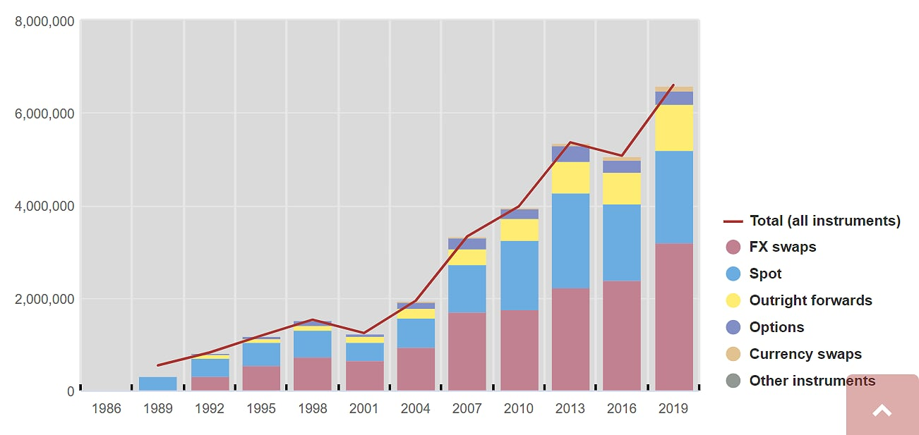
Foreign Exchange Daily Volume in millions of dollars
Notes:
The incentives to scale from the transactional level as reflected in the dramatic grown in FX transactions to $6 trillion per day! Enabled by the fact that currencies are the ultimate intangible commodity..

Slide 13
global
regional
national
market
firm
service
transaction
unpriced transaction
data
Notes:
What kind of vertical mobility exists across levels in this stylized stack?
Internet and web standards move freely
Mobility of certain policy domains because of institutional limitations. There are no treaties or strong international institutions for antitrust.

Slide 14
global
regional
national
market
firm
service
transaction
unpriced transaction
data
global
regional (trade agreements)
nation
provinces/states
(firms)
individuals
(rights)
Notes:
Two partly different stacks….
From a legal or jurisdictional perspective, the stack looks different from the technological/economic stack. Individuals are at the bottom, and they have legal rights. So personal data is protected by as a legal right cannot be aggregated for economic value. Patents are designed to operate uniquely as individual rights; they work differently at a portfolio level – and at a national level, where lowering standards to create thickets or weight royalty calculations may create advantages for domestic industries. Most but by no means all policy for digital is set at the national or regional level.
Question: Where are the legal rights/institutions/barriers that might slow the scaling of digital/intangible activities?? Where do policy domains originate and how are they extended – or reflected – across the stack.

Slide 15
government controls private sector
government activities
private sector activities
government supports private sector
Notes:
Turning to policy domains. (Not organized in Vectors, but many examples tied to particular vectors)
Here’s a stylized diagram of how policy domains might be organized according to the role that governments play.

Slide 16
Regulation
Spectrum
Antitrust
Public Utilities
Banking
Transportation
Delivery Services
Unfair Competition
Privacy
Government
Military
Administration
Adjudication
Infrastructure
Education
Procurement
Ground Rules
Contracts
Consumer Protection
Copyright
Trademarks
Patents
Trade Secrets
Leverage
Research Funding
R&D Credits
State Aid
Import/Export Controls
Small Business Loans
Government Labs
Trade
Notes:
Here’s how it looks with key examples of policy domains. In most, digital issues are the leading edge.
These are not boxes. The location of particular policies may lie between the poles, move over time, and even overlap.
For example, antitrust law can be privately enforced (ground rules)
Security and measurement are meta because they are splintered
innovation/technology/industrial policy
Digital impact felt first in Leverage, then Government and Ground Rules, then Regulation and Leverage

Slide 17
Regulation
Spectrum
Antitrust
Public Utilities
Banking
Transportation
Meta-issues
inequality
trust
learning
human capital
spillovers
efficiency
productivity
security
measurement
Delivery Services
Unfair Competition
Privacy
Government
Military
Administration
Adjudication
Infrastructure
Education
Procurement
Ground Rules
Contracts
Consumer Protection
Copyright
Trademarks
Patents
Trade Secrets
Leverage
Research Funding
R&D Credits
State Aid
Import/Export Controls
Small Business Loans
Government Labs
Trade
Notes:
Then you have to consider “meta-issues” that are not institutionalized within an established domain…’ Meta-issues tend to be more academic in orientation and audience (more political interest in Europe than the U.S.)
Security and measurement are meta because they are splintered
innovation/technology/industrial policy
Impact felt first in Leverage, then Government and Ground Rules, then Regulation and Leverage

Slide 18
Regulation
Spectrum
Antitrust
Public Utilities
Banking
Transportation
Meta-issues
inequality
trust
learning
human capital
spillovers
efficiency
productivity
security
measurement
Delivery Services
Unfair Competition
Privacy
Government
Military
Administration
Adjudication
Infrastructure
Education
Procurement
Ground Rules
Contracts
Consumer Protection
Copyright
Trademarks
Patents
Trade Secrets
digital hot zones
Leverage
Research Funding
R&D Credits
State Aid
Import/Export Controls
Small Business Loans
Government Labs
Trade
Notes:
Current hot zones are located in the two public/private zones.
Some hot issues (harmful content, misinformation) are more political/social than economic – so not included in the diagram.

Slide 19
intangible assets
relationships
scale
scope
speed
data networks
platforms/markets
ecosystems/XaaS
Notes:
Looking again at the dimensions that digital opens up

Slide 20
Digital capacity/capability
Scale
based on identity/similarity
Scope
based on difference and variety
Speed
bound by fixity of days, years, generations, lifetimes.
Notes:
Fundatmental enabling characteristics….
Scale and scope are opposites, but scale enables scope, and scope drives/demands scale.
Speed is actually about shrinking time, which operate in
Scale and scope are static. “Speed” makes them dynamic

Slide 21
Digital capacity/capability
Scale dematerializes
diminishes marginal costs
miniaturization, virtualization, XaaS
Scope complicates but manages
capability: coding, structure, functionality, variety
management: modularity, integration, design, hidden complexity
Speed shrinks time
acceleration, recording/playback, learning
Notes:
From a business perspective, all work together. Digitization of text has enormous historical but unrecognized impact. Images, sound, video came later as storage capacity, bandwidth, and processing power improved.
Note two-fold nature of scope. Management, strategy, analysis play a large role here at several levels (product, firm, etc.). This is where the action is.

Slide 22
Digitization of Alphanumeric Text
Limited analog precedents: telegraph, teletypewriter; newspapers with advertising; fax, photocopy; postal services….
Three orders of magnitude more efficient than voice for conveying information.
Efficiency of text enabled scale and speed in storage, bandwidth, and processing.
Early digital services and Internet exploited last-mile infrastructure built for voice.
“Data” as commonly used refers to structured alphanumeric text – not streamed video or audio.
Versatility of text: expressive, communicative, instructive, linking
Expands to become functional, interactive
Notes:
Digitization of text has played an unacknowledged role in digital transformation – for all three dimentsions: scale, scope, and speed.
as an element of enables scope. Digital text was far more revolutionaty than people realize. Carriers by contrast were focused on video – which required new wiring to get to the home (until xDSL was sufficiently advanced)

Slide 23
Scope at different levels
Elemental:
combination, complements, hybrids, variety
hardware and software, client-server, on and off, 1s and 0s,
structured data
Business:
business processes
complex products
Regional/national --
self-sustainability
agglomeration economies
gains from trade
Notes:
The idea of a university, the encyclopedia, Internet search….

Slide 24
Dimensions of digital scope
Capacity for scope from scale effects on cost of storage, bandwidth, and processing power
Indicators of functional and marketing scope
50 million lines of code in Windows 10
251 standards in a laptop (Biddle 2010)
250,000 possible patents in a smartphone (RPX S-1 2010)
3 million apps in Google Play Store
350 million products listed on Amazon (including Marketplace)
Notes:
Scope (“Variety” in the big data lexicon) operates at different levels, but not in a readily comprehensible way’’. There are some numbers that can convey the scope of digital scope. Reuse (e.g., standards) is common. The vortex of the digital economy?
Ultimately, should this be understood as agglomeration rather than classic scope?
Smartphone is the classic example of scale-enabled scope reducing the number of products on the market.

Slide 25
Notes:
Scope in transacting. Rich web pages with many kinds of data.

Slide 26
Notes:
The next screen down.

Slide 27
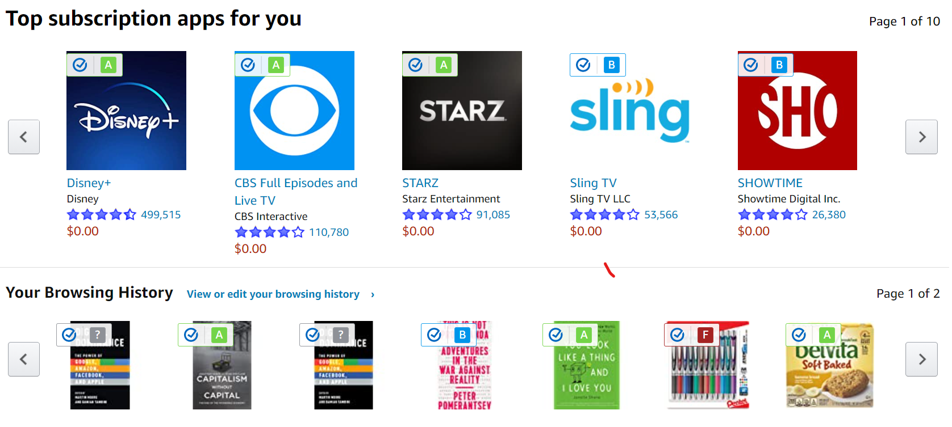
Notes:
Finally, 11 screens down (not counting a stretch of user reviews)

Slide 28
Scope as Multisidedness
1
1
4
2
3
2
3
2-sided market has 1 2-way relationship
3-sided market has 4 2-way relationships
4-sided market has 6 2-way relationships
Notes:
This shows scope as complementary for multisided platforms/markets, including the possible challenges of maintaining productive, even-handed relationships as the market becomes more complex.

Slide 29
(intangible) assets
relationships
dimensions
scale
scope
speed
data networks
structural developments
platforms/markets
scope reflected in managed ecosystems
ecosystems/XaaS
Notes:
Ecosystems, such as Google’s, represent the far end of the relationship spectrum. Of course, everything in the spectrum is enabled by and located within the global Internet.

Slide 30
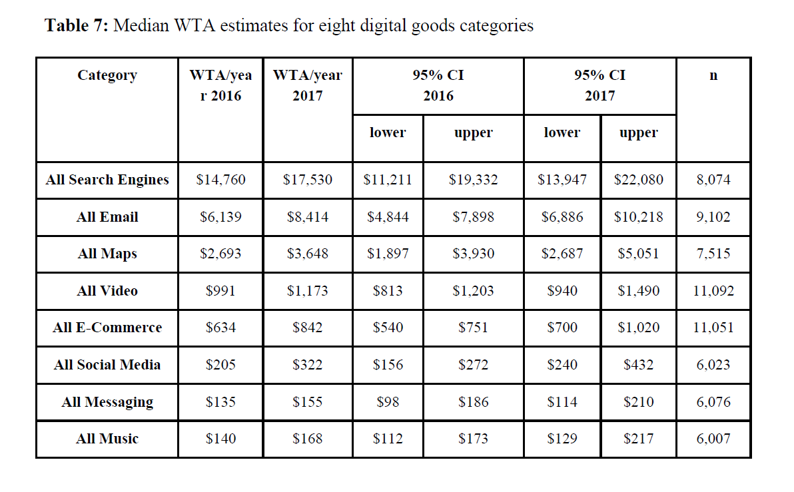
Search Manages Scope
*
Brynjolfsson, et al., 2018;
WTA = Willingness To Accept (to forego the service for one year)
Notes:
This study suggests that search is more valuable to consumers than all other major categories of digital goods put together. It is 50 times the value of social media. In the case of search: $17.5K X 200 million U.S. Internet users = $3.5trn = one-fifth of GDP! And it is more than 20 times the ad revenue for Google’s entire ecosystem.

Slide 31
Usage-based value as an alternative to investment/market value
In addition
Assets that can increase in value with use – similar to network effects
Open standards (Internet, web)
Open source software
Audiences for ad-supported media
Similarity to royalty streams
Free goods/services to offer experience, create demand, and develop market
Internet started us in this direction, small incremental cost amortized over extreme efficiencies of digital alphanumeric text.
Non-exclusive licensing to extract value repeatedly
The firm as a commons for endlessly reusing intangible property.
Brand equity from advertising and market research (recognized as economic competency)
Current problem: Apportioning royalties for standard essential patents
Emerging problem: Accounting for sharing industrial and transactional data
Notes:
Consumer surplus. Combining zero marginal cost + zero transaction cost
FRAND royalties for SEPs: Reconciling patent value (problematic in itself) with the value of standards and public domain technology in complex products.

Slide 32
Transaction cost analysis
Increasingly important as production costs diminish
Transaction benefits -- data, experience, and learning
No authoritative definition or measurement
Costs of delivery? Search formulation? Risk assessment?
Range of unpriced or avoided transactions: click-through, barter, spillovers
Costs of regulatory and legal compliance
Transaction cost reduction within relationships
Transaction costs and benefits as determinants of institutional and enterprise design >>>
Notes:
Traditional fixation on “make or buy”: lengthy contracts between large suppliers and customers
impact of “free shipping”

Slide 33
Policy process reengineering?
What could digital transaction cost analysis tell us?
“Notice and takedown” reengineered copyright, offering monetization for long-tail content.
Ex ante (regulation) vs ex post (adjudication) debate.
What about real-time? Emphasis on transparency, accountability, and mediated participation
Would EU-style observatories and expert groups work in the U.S.?
An ever expanding digital economy generating too much information?
Notes:
Experience under Trump does not bode well for disinterested expertise and knowledge gathering.

Slide 34
There is nothing a government hates more than to be well-informed; for it makes the process of arriving at decisions much more complicated and difficult.
John Maynard Keynes (1937)
Notes:
, The Times (March 11, 1937); Collected Writings, vol. 21, p. 409

