Slide 1
Declining Industrial Disruption
James Bessen, Erich Denk, Joowon Kim, Cesare Righi
TPRI, “Technology & Declining Economic Dynamism”, 2020

Slide 2
Is competition declining?
Markups rising?
Industry concentration rising?
Markups measure price competition
  Not dynamism

Slide 3

Price competition $≠$ Schumpeterian competition
Innovative firms earn rents on technology ➔ markups
Why competition matters
  Price competition ➔ static deadweight loss
  Schumpeterian competition ➔ productivity growth
Measuring industry dynamism
  Entry rates
  Growth rates of innovative firms
  Displacement of market leaders

Slide 4
This paper
What are trends in hazard of displacing top firms?
What investments by dominant firms affect displacement?
Is displacement hazard related to markups and industry concentration?

Slide 5
This paper
Hazard of displacing leading firm rose since 1970 but fell sharply after 2000
Displacement hazard negatively related to investment in intangibles, software
  Accounts for much of decline
Displacement hazard associated with higher markups, lower industry concentration

Slide 6
Data
Compustat, 1976-2017, global, publicly listed
  Peters and Taylor (2016) intangibles
  Advertising
  Patents
  Lobbying
  Software
  Acquisitions
NETS, 1990-2014, US, private & public
ACES, 2002-2012, US, private & public [not disclosed]

Slide 7
I. Dominant firm displacement

Slide 12
II. Displacement & Investments

Slide 13
IO models: investments ➔ market share
Cournot: investments in capacity
Sutton, endogenous sunk costs: investments in quality, differentiation
Investments by acquisition
Regulation: investments in lobbying

Slide 14
IO models: investments ➔ market share
Cournot: investments in capacity
Sutton, endogenous sunk costs: investments in quality, differentiation
Investments by acquisition
Regulation: investments in lobbying
Q: Which investments associated with change in displacement?

Slide 15
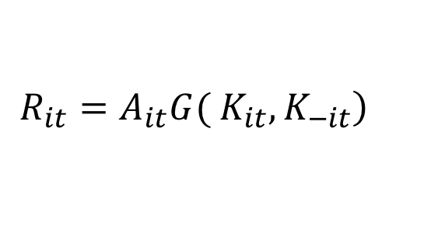
Basic model: Duopoly
Revenue Production function (reduced form)
  A = productivity; stochastic, dynamic
  K = Beginning of year capital
    variable inputs adjust
  K_{-i} = other firm capital; externality
$$\left.R_{it}=A_{it}G( K_{it}, K_{−it}\right)$$

Slide 16
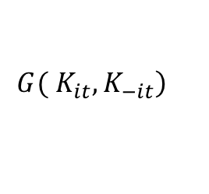
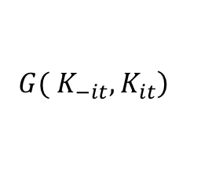
Leapfrog
$$\left.G( K_{it}, K_{−it}\right)$$
$$\left.G( K_{−it}, K_{it}\right)$$

Slide 17
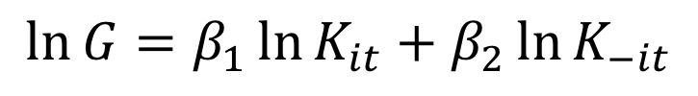
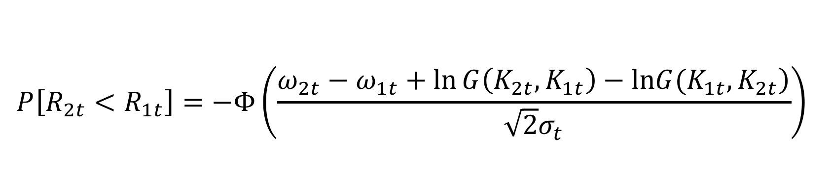
Assume
Shocks independent (Sutton 2007) and normal; Markov process
Cobb Douglas,
$$\ln{A_{it}=ω_{it}+ε_{it}}\sim N\left(ω_{it},σ_{t}\right), i=1,2$$
$$\ln{G}=β_{1}\ln{K_{it}}+β_{2}\ln{K_{−it}}$$
$$P\left[R_{2t}<R_{1t}\right]=−Φ\left(\frac{ω_{2t}−ω_{1t}+\ln{G\left(K_{2t},K_{1t}\right)−\ln\left.G(K_{1t},K_{2t}\right)}}{\sqrt{2}σ_{t}}\right)$$

Slide 18

Probability of leapfrog / dropout
    Linear approximation
    $α_{j}$ industry FE
    $δ_{t}$ captures changes in volatility, $σ_{t}$
    $ω_{−it}$ absorbed into $ε_{it}$
Multiple firms
  Top 4
  Second 4 (ranked 5-8)
Multiple capital stocks
$$P_{it}=α_{j}+δ_{t}+γω_{it}+β_{1}\ln{K_{it}}+β_{2}\ln{K_{−it}}+ε_{it}.$$

Slide 19

Identification
$ω_{it}$ unobserved & possibly correlated with $ε_{it}$
Obtain ${\hat{ω}}_{it}$ from productivity function estimation (ACF)
Robustness: bootstrap errors
$$P_{it}=α_{j}+δ_{t}+γω_{it}+β_{1}\ln{K_{it}}+β_{2}\ln{K_{−it}}+ε_{it}.$$
$$P_{it}=α_{j}+δ_{t}+γ{\hat{ω}}_{it}+β_{1}\ln{K_{it}}+β_{2}\ln{K_{−it}}+ε_{it}.$$

Slide 20
Displacement Hazard of Top 4 firm

Slide 21
Displacement Hazard of Top 4 firm

Slide 22
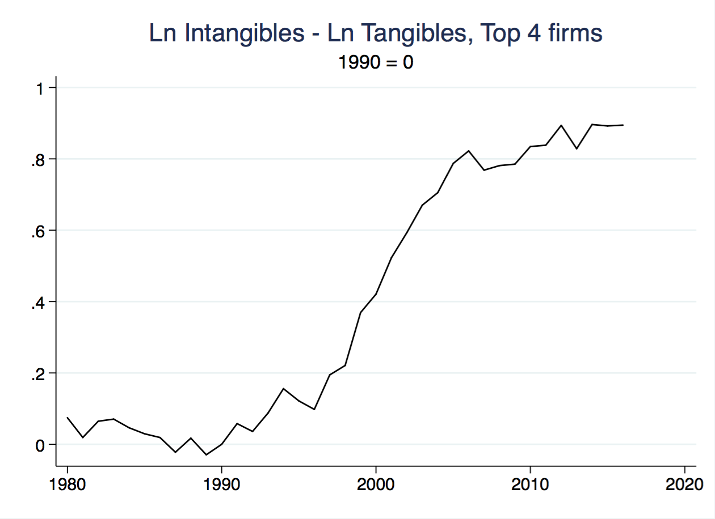

Slide 23
Firm interactions

Slide 24
Firm interactions

Slide 25
Two sides of investment
Boosts firm output
  Diminishes displacement for firms #3 and #4
Externality
  Dominant firm investments suppress leapfrogging
    Sutton endogenous sunk cost model

Slide 26
Decomposing Intangibles

Slide 27
Decomposing Intangibles

Slide 28
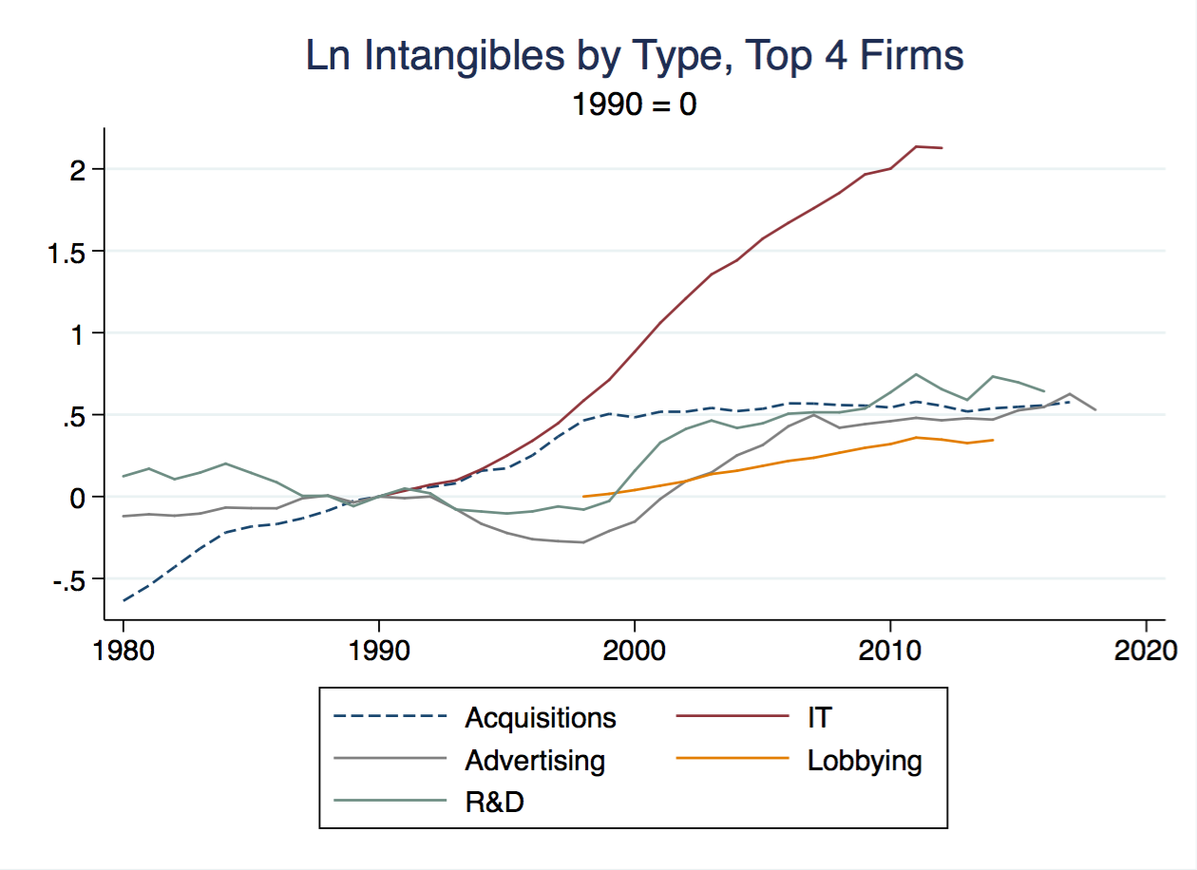

Slide 29
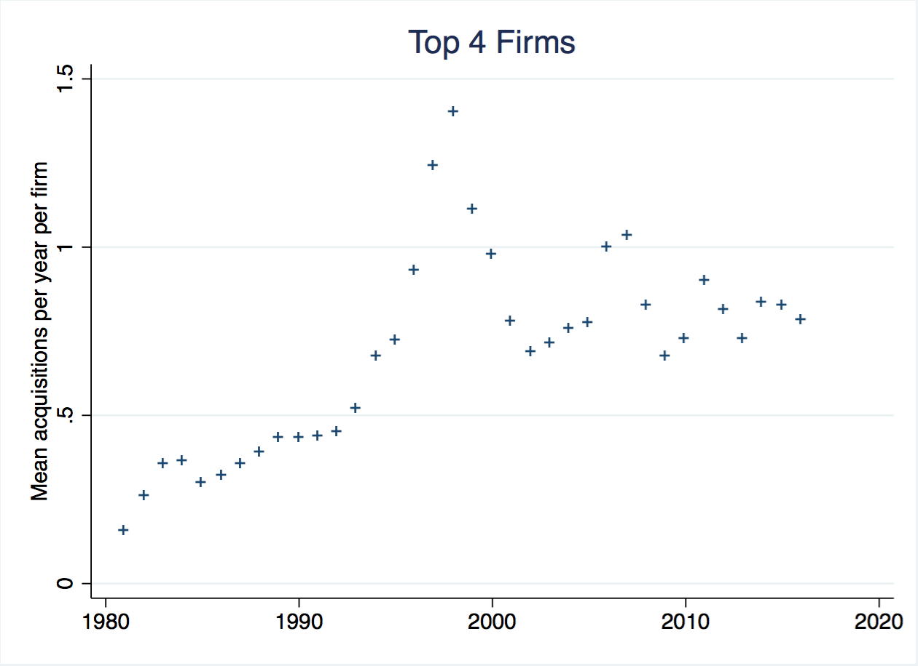

Slide 30
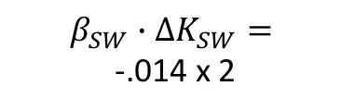
Magnitude of effect
$$β_{SW}∙ΔK_{SW}=$$
-.014 x 2

Slide 31
Industry level analysis
Own account software vs pre-packaged, contracted
  BEA data
  ➔ own account software
Instrumental variable estimates
  EU KLEMS software for EU nations

Slide 32
III. Markups & Concentration

Slide 33
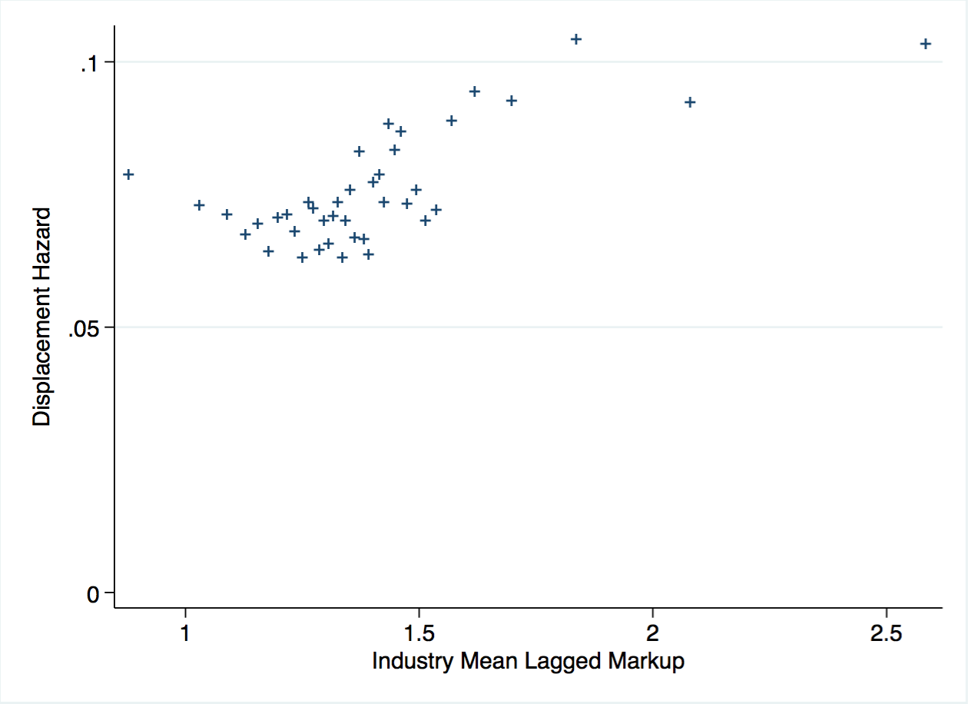
De Loecker & Warzynski (2012), De Loecker & Eeckhout (2017)

Slide 34
Markups
High markup industries ➔ high displacement
Leading firms temporarily earn rents,
but are more likely to be displaced

Slide 35
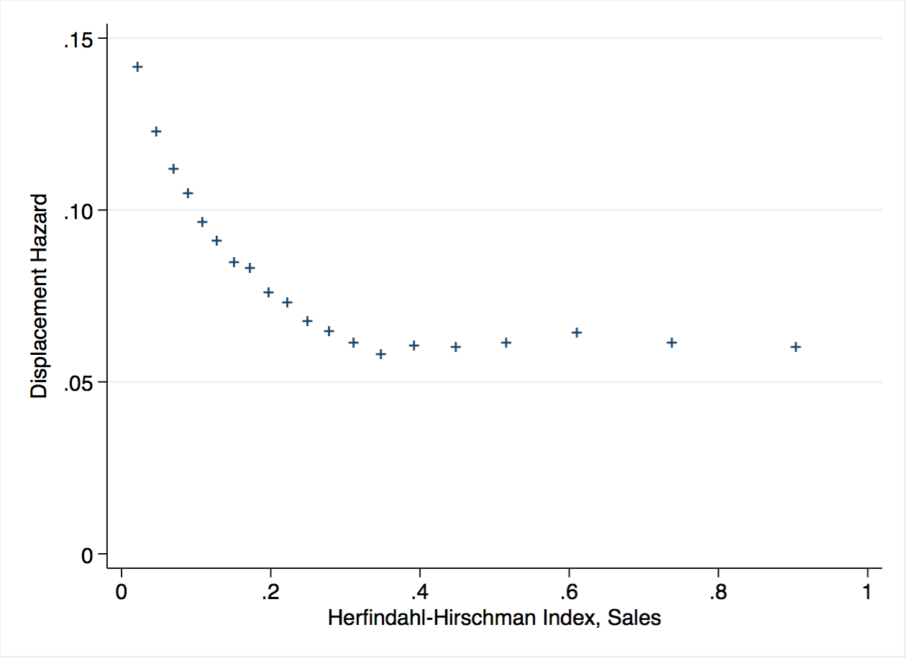

Slide 36
Conclusion
Schumpeterian competition declined since ~2000
Associated with shift to intangibles / proprietary software
  Relationship strengthened after 2000
  Investment shifted after 2000
  Especially own-account software
Markups associated with higher dynamism
  Industry concentration with less

Slide 37
Conclusion: main idea
Technology playing a new role
  Tech ➔ disruption

Slide 38
Conclusion: main idea
Technology playing a new role
  Tech ➔ disruption
  Tech ➔ suppresses disruption

